Slide 1


NSRP
AMP
SUBMITTER GUIDE
nsrp.org

Slide 2

THE PURPOSE OF
THIS GUIDE
is to assist Offerors in completing their submissions within the ATI application AMP.
AMP Site
https://identity.ati.org/

Slide 3
REQUEST
AMP ACCESS
Step 1
Step 2
Step 3
Click the link below:
Access Request Form
Complete the form and, when prompted, select the programs your organization belongs to.
Your form will be processed by each program in accordance with its requirements.

Slide 4
AMP ACCESS
Account Already Created
Step 1
Step 2
Step 3
Login to the Portal:
http://identity.ati.org/ or directly go to NSRP at https://nsrp-amp.ati.org
Select your desired program.
Click on the Submission Portal in the menu of the page.

Slide 5
ATI ACQUISITION MANAGEMENT PLATFORM (AMP)
NAVIGATING THE SITE

Slide 6
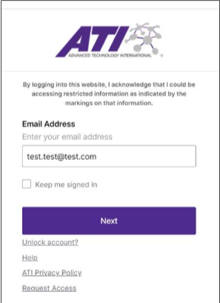
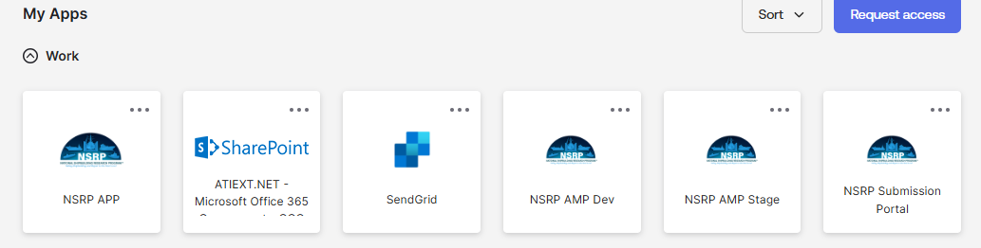
Accessing the Site
Go to http://identity.ati.org/
Log in
Select the NSRP Submission Portal

Slide 7
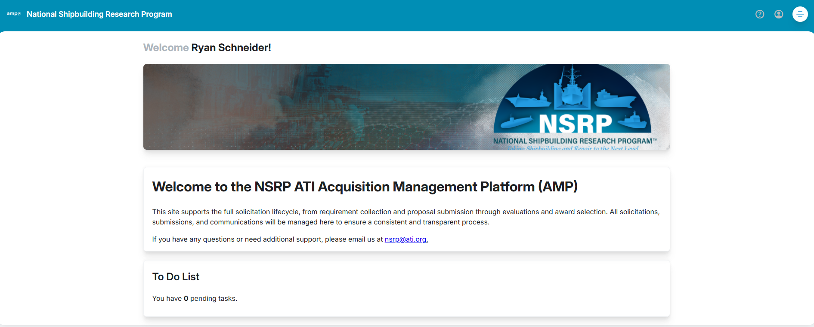
AMP Navigation
AMP Home Page |
Provides quick access to open solicitations, your submitted proposals, the Solicitation Explorer, and a list of pending actions.

Slide 8
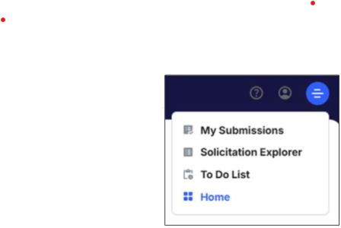

AMP Navigation
AMP Navigation |
There are several ways to navigate the site. This guide will show you different methods.
Click the hamburger icon in the top-right corner to navigate using the Menu.
Menu Key:
My Submissions – Displays all submissions created by you
Solicitation Explorer – View all Solicitations past and present
To Do List – List of outstanding actions
Home – Returns to Home Page

Slide 9
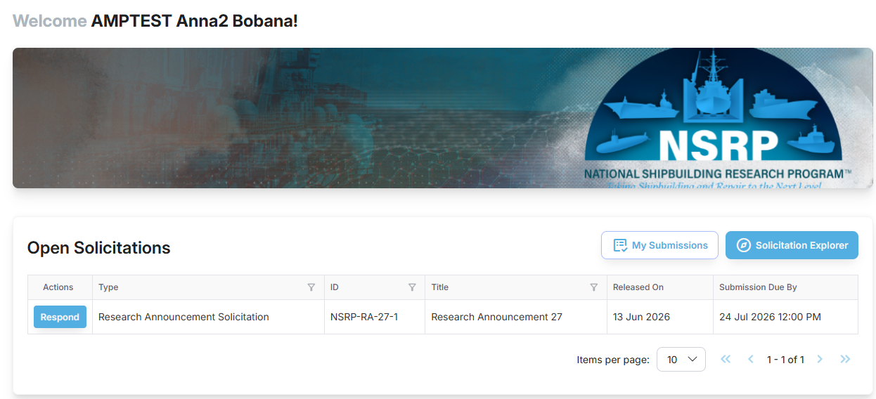
AMP Navigation
Open Solicitations Section|
Located on the Home Page. Displays solicitations currently open for submission.

Slide 10
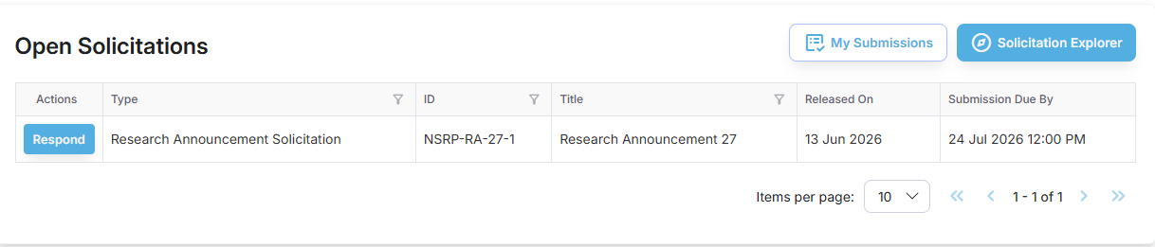
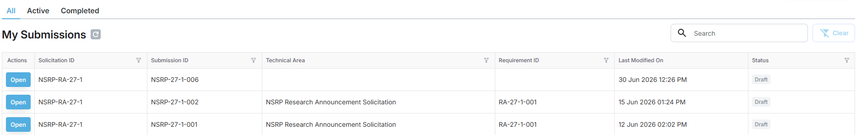
AMP Navigation
My Submission Button|
Allows you to see the status of your submissions.

Slide 11
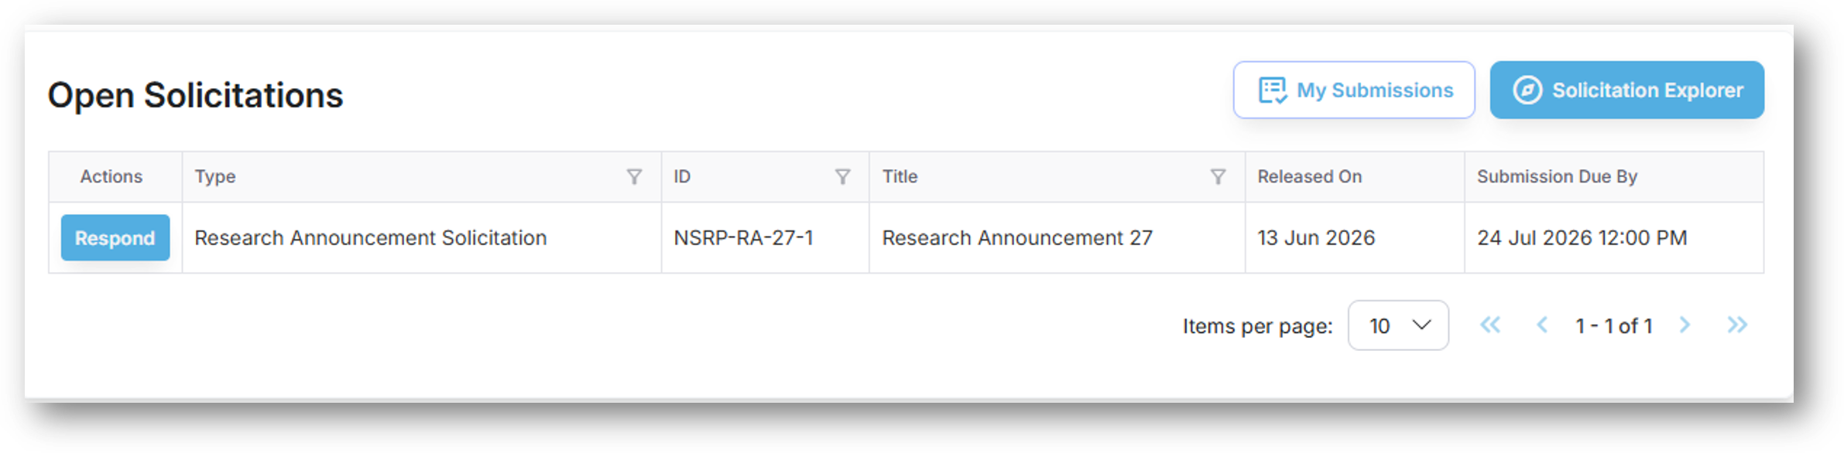
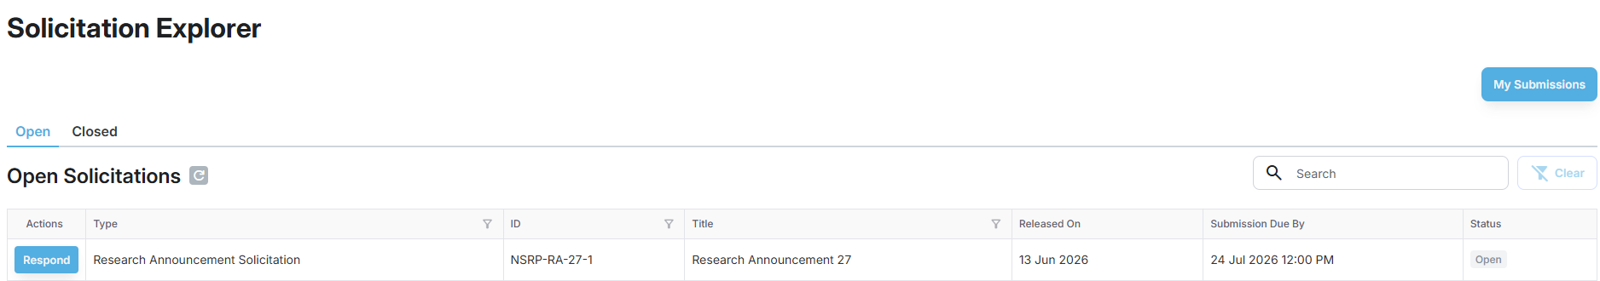
AMP Navigation
Solicitation Explorer Button|
Takes you to the complete list of open and closed solicitations.

Slide 12
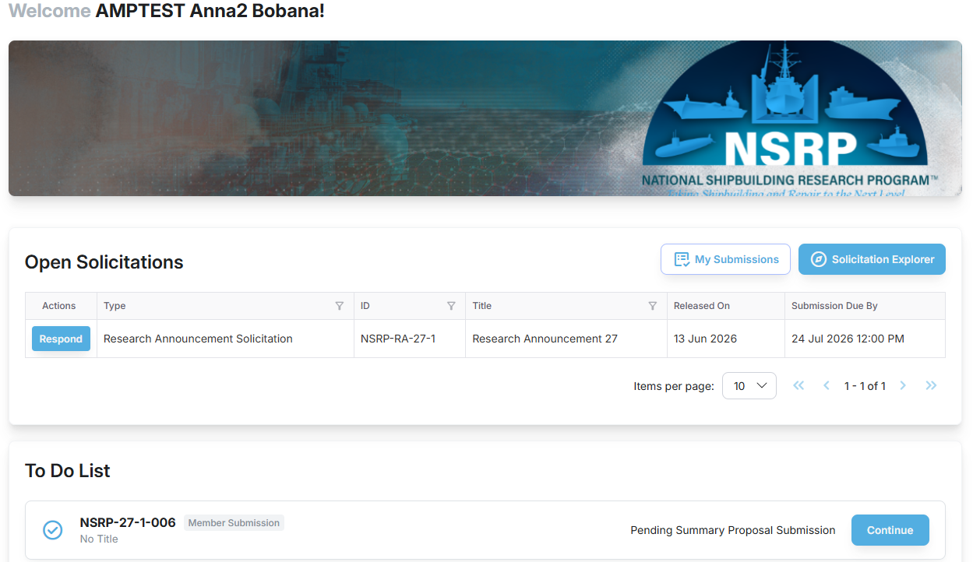
AMP Navigation
To Do List Section|
Displays all pending actions in your queue.
Click “Continue” to see updates or completion for the referenced submission.
NOTE: The To Do List will display any outstanding actions you have for open solicitations. You must complete all actions you wish to be considered and evaluated by clicking “Continue” and completing the submission process detailed in later slides.

Slide 13
SUBMITTING A
PROPOSAL

Slide 14
Submission to NSRP Solicitation
Click the respond button on the open solicitation within the listing.
Fill out submission form associated with the solicitation you are submitting to.
Save frequently and ensure, when completed, to hit the submit summary proposal button.
Log into AMP

Slide 15
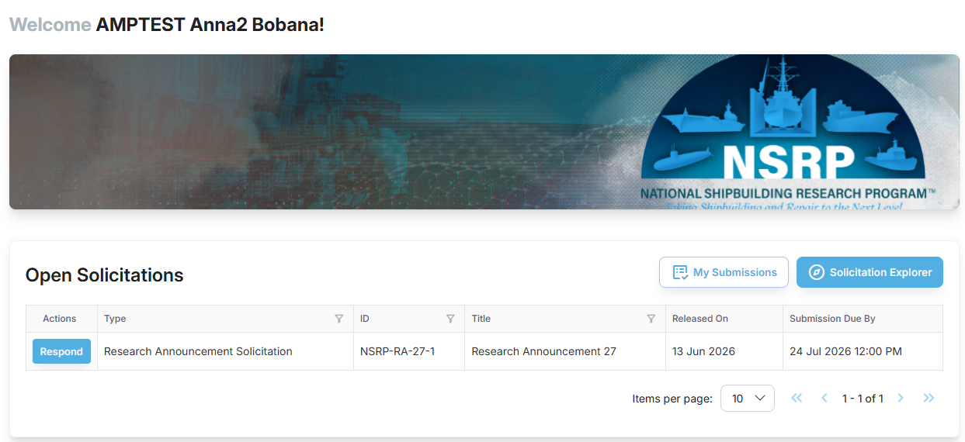
Submission to NSRP Solicitation
Response to Solicitation |
Go to the “Open Solicitations” section on home page.
Click “Respond” on the desired solicitation to prepare a proposal submission.

Slide 16
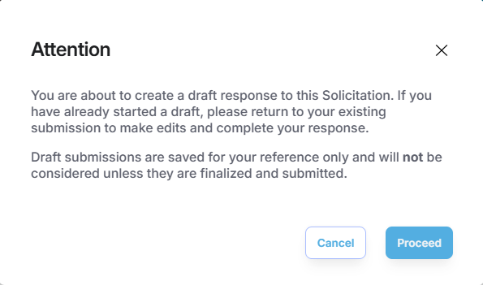
Submission to NSRP Solicitation
Response to Solicitation |
Click “Proceed” in the “Attention” pop-up box. ​

Slide 17
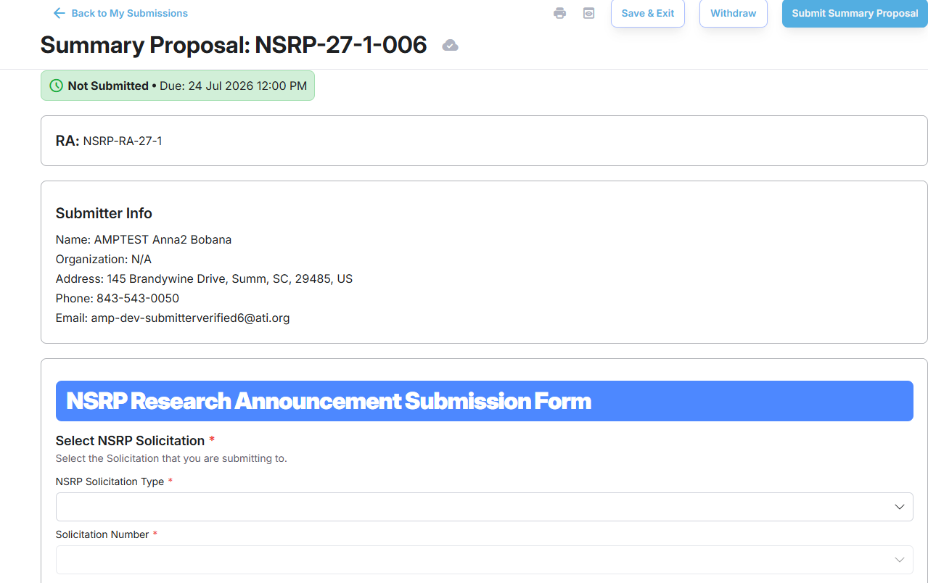
Submission to NSRP Solicitation
Fill out the required information indicated by a red asterisk (*). ​
Click “Submit Summary Proposal” to submit your response for evaluation.
Click “Confirm” in the popup to finalize your submission, or “Cancel” to return and make changes.
TIPS | You can access your active submissions from the “To Do List” or “My Submissions” section on the home page.

Slide 18
Submission to NSRP Solicitation
TIPS:
Your submission is assigned a unique submission number. Please record this number.
After completing the form and uploading all required materials, submit your response promptly to avoid any last minute issues. You may return and make changes anytime before the deadline.
You can access your active submission from the “To Do List” or “My Submissions” section on the Home page.

Slide 19
Submission to NSRP Solicitation
Additional Submission Features
Click the “Save and Exit” button to store a draft of your submission and return later.
Click the “Withdraw” button to remove your submission from consideration.
TIPS:
Your submission status will be reflected in the colored bar beneath the submission number and in your Submission List.
Submission requiring finalization and submission will appear in your To Do List.

Slide 20

Questions?
nsrp.org
Contact us at nsrp@ati.org
Solicitation Questions:
Nsrp-contracts@ati.org

