Slide 1
Southwest Research Institute®
Benefiting government, industry and the public through innovative science and technology
Overview Presentation
March 12, 2024
Notes:
Website SwRI Overview January 2024
The text and notes pages for each of the slides in this presentation are for official, internal use only. Do not distribute the contents of the notes page of this presentation without the express, written consent of senior SwRI management.

Slide 2
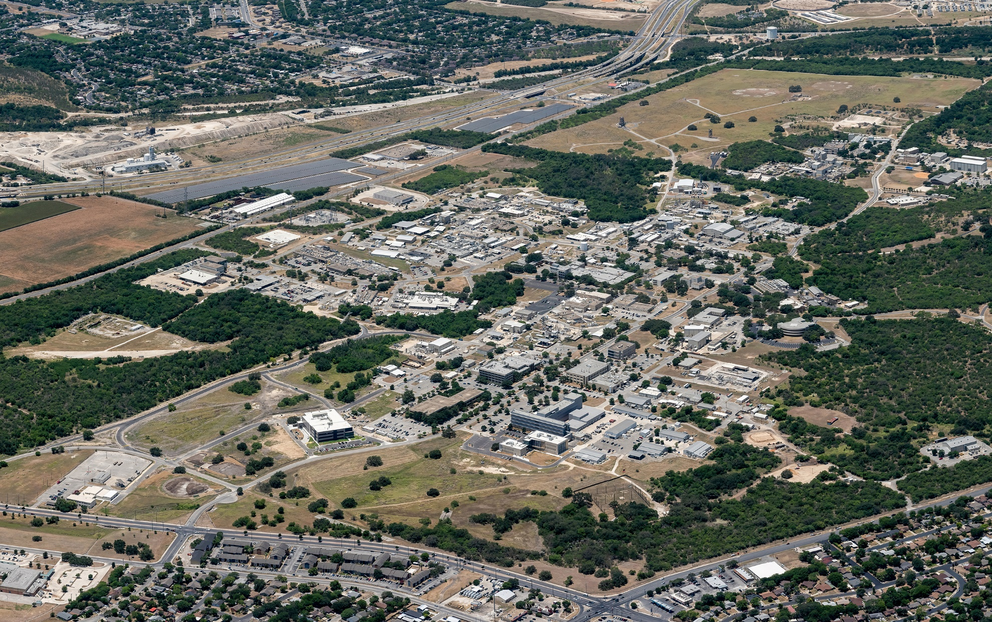
Benefiting government,
industry and the public through innovative science and technology
Notes:
SwRI Today.
Shot in 2022, this aerial view of the SwRI facilities occupies over 1,500 acres in NW San Antonio. More than 3,100 employees work in more than 2.5 million square feet of laboratories, offices and workshops. Research volume reached $844 million in FY2023.
At the close of FY2023, research areas were spread across xx Departments in 11 technical divisions and 1 FFRDC, and covered the complete spectrum of engineering and physical sciences.

Slide 3
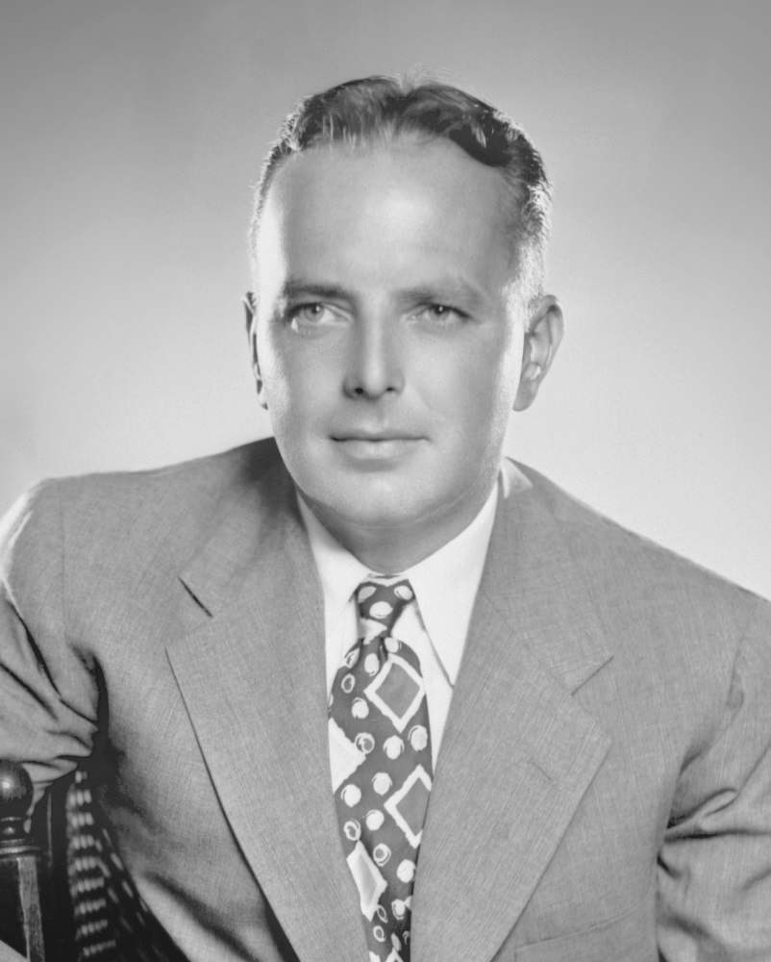
Facts About SwRI
Founded by Thomas Baker Slick Jr. in 1947
501(c)(3) nonprofit corporation
More than 3,100 employees
More than 1,500 acres
More than 2.5 million square feet of laboratories, workshops & offices
More than 1,500 patents
52 R&D 100 awards
Independent, unbiased
Notes:
Facts about Southwest Research Institute.
Established in 1947
501(c)(3), per the IRS: “To be tax-exempt as an organization described in IRC Section 501(c)(3) of the Code, an organization must be organized and operated exclusively for one or more of the purposes set forth in IRC Section 501(c)(3) and none of the earnings of the organization may inure to any private shareholder or individual. In addition, it may not attempt to influence legislation as a substantial part of its activities, and it may not participate at all in campaign activity for or against political candidates.” [http://www.irs.gov/charities/charitable/article/0,,id=96099,00.html]
Of the over 2,700 employees, approximately ?,??? work at the SwRI facility in San Antonio.
The over1,500 acres is almost a ‘city-within a city’. SwRI has control of all internal utilities and land, making it possible for SwRI to rapidly respond to a client requirement that involves facility or infrastructure modification.
Capital-intensive operation. Most clients simply cannot afford to invest in R&D facilities the way SwRI has, because R&D facilities rarely show the kind of return on investment that most stockholders demand. SwRI’s facilities are made 100% available to our clients, without restrictions typically associated with manufacturing demands.
Patents: As part of a long-held tradition, patent rights arising from sponsored research at the Institute can be assigned to the client. SwRI generally retains the rights to Institute-funded advancements.
52 R&D 100 awards, with the first R&D 100 award issued in 1971.

Slide 4
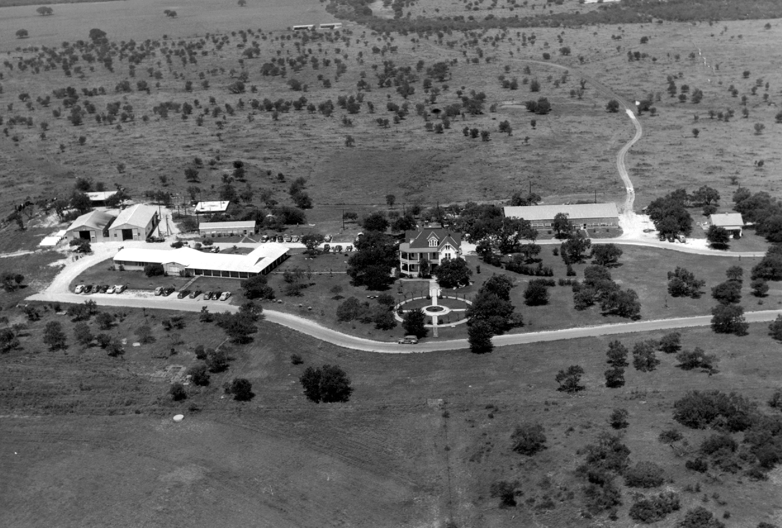
SwRI in the 1950s
Nonprofit
1947 Tom Slick signed charter
Initial budget <$100,000
Fewer than 20 employees
64 projects in the first year
By 1958
Revenue exceeding $4.5 million
437 employees
Notes:
SwRI in the 1950s.

Slide 5

SwRI Today
Nonprofit
More than 3,100 employees
More than 1,500 acres / 6.1 km² facility in San Antonio, Texas
More than 2.5 million ft² / 232,000 m² of laboratories, workshops & offices
More than 1,500 patents
52 R&D 100 awards
Notes:
SwRI today.

Slide 6
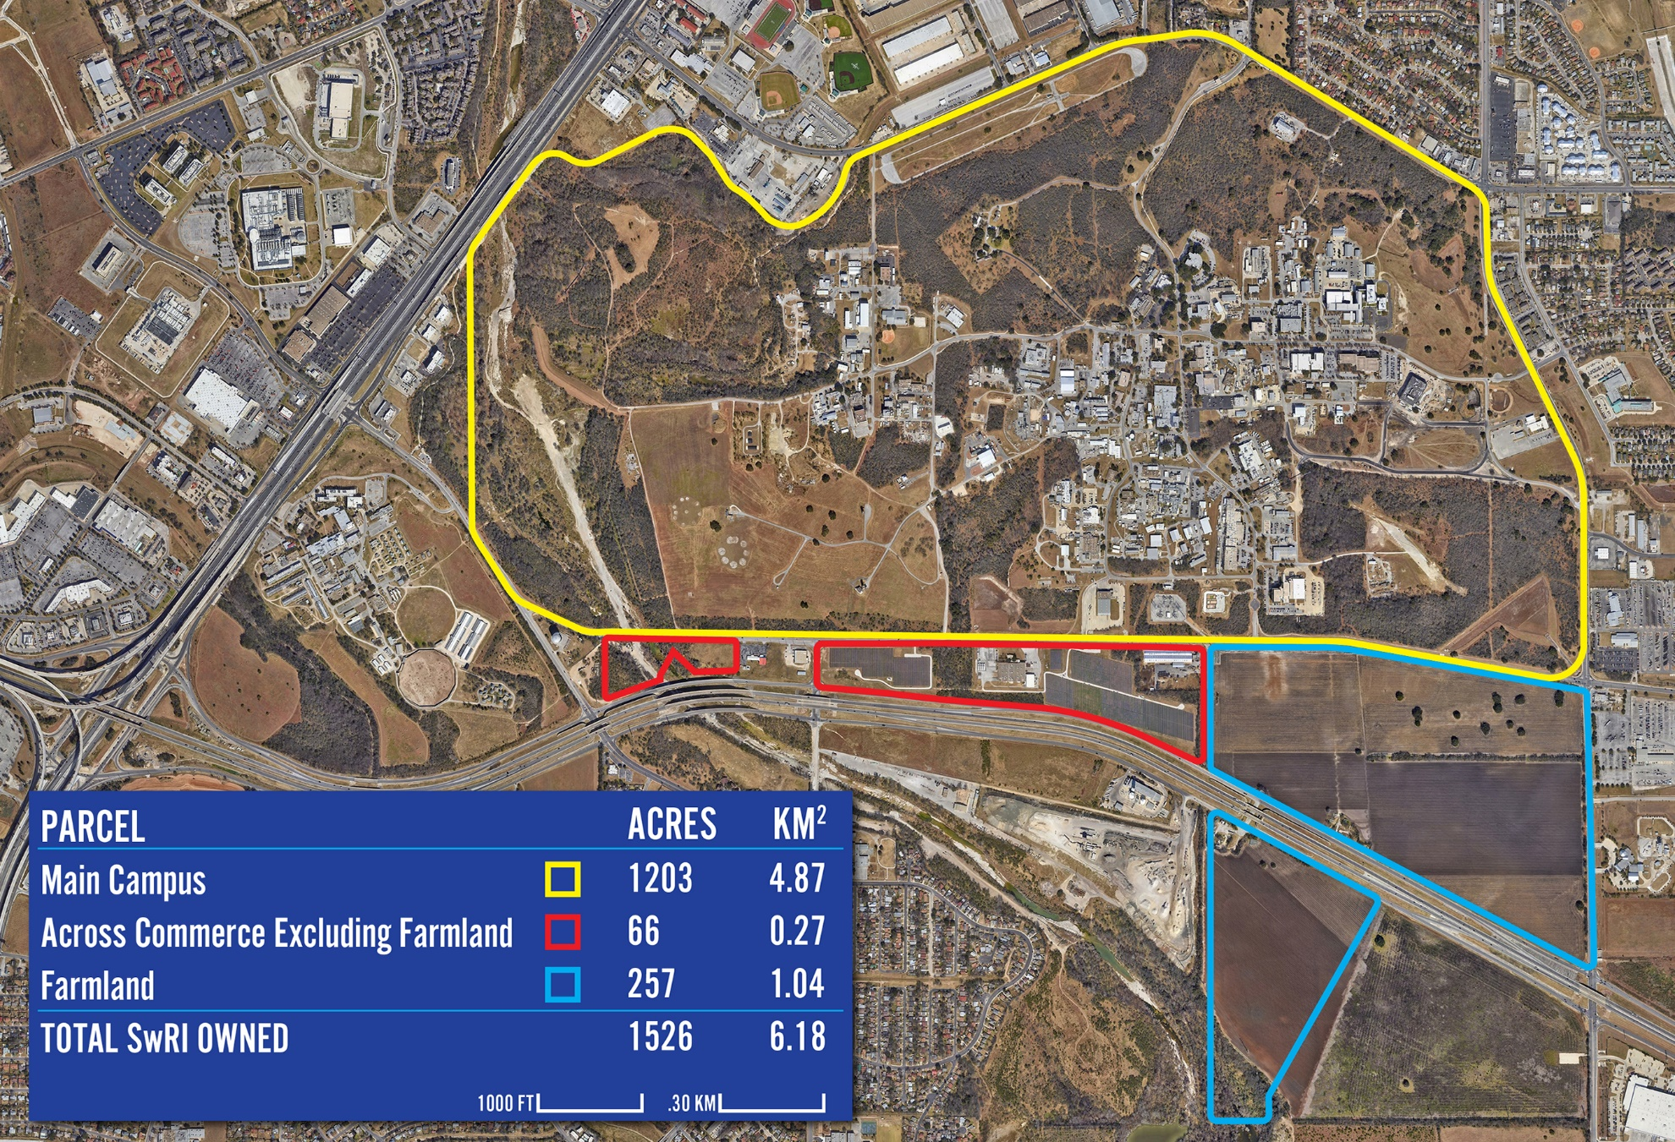


Notes:
SwRI campus map.

Slide 7
Operational Characteristics
Nonprofit
Revenue from contracts
Applied RDT&E services
Physical sciences & engineering
Broad technological base
Capital-Intensive operation
Internal Research program
$9.3 million in FY 2023
103 projects
Notes:
Operational characteristics.
SwRI sustains its business solely on the basis of contract revenue.
While the majority of SwRI’s work is in applied RDT&E, SwRI also conducts basic research as well as limited production in specific areas
Our focus is physical science and engineering, distinguishing us from our sister organization – Texas Biomedical Research Institute.
Our broad technology and customer base prevents unbalanced reliance on a single program area. SwRI is able to adapt and respond to the ebb and flow of government funding cycles and industrial investment in R&D.
SwRI invests in its facilities and equipment so that its customers do not have to.
SwRI’s IR&D program is instrumental in positioning SwRI ahead of its customer’s needs; enabling more rapid transfer of technology and more dynamic response to external market forces.

Slide 8
R&D Institutions in the Technology Spectrum
Technology Spectrum
R&D
Institution
Research
Development
Production
Basic
Applied
Universities
Federal Labs
Southwest
Research
Institute®
Federal Agencies
Industrial Research
Labs
Industry
Independent Nonprofit
Institutes R&D
Notes:
1959 Annual Report, page 1
“Poised midway between the university which is dedicated to the pursuit of fundamentals, and the industrial laboratory which serves the competitive ends of its company, the not-for-profit institute borrows some of the characteristics inherent in each. Owing allegiance to none save the broad public we serve, our research capabilities can boast of depth, perception, and objectivity. The discipline of contract research, on the other hand, permits us no deviation from the goal of converting the creativity of science to useful ends.”
Represented by the bottom bar of this chart, SwRI blends the sparks of innovation from Basic and Applied Research with the discipline of technology transfer to result in solutions that can be readily put into use by our customers.

Slide 9
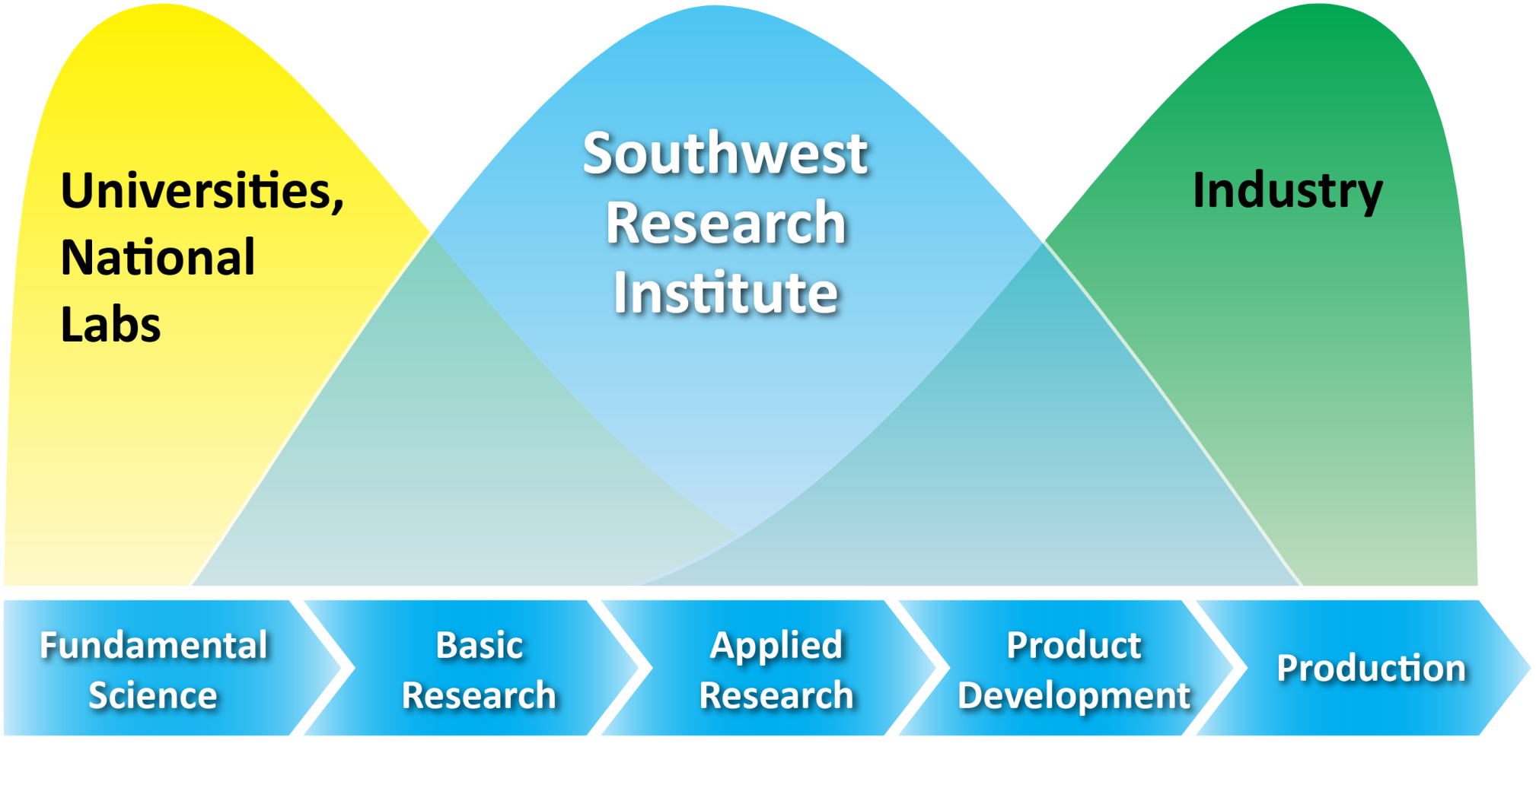
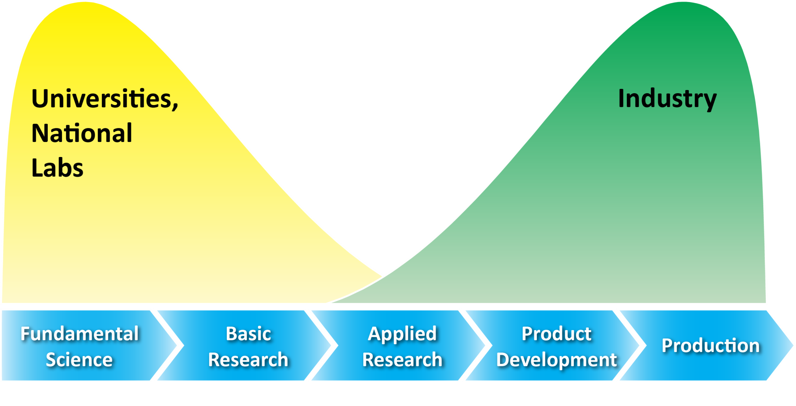
SwRI in the Technology Spectrum
← Bridging the “Valley of Death” →
Notes:
1959 Annual Report, page 1
“Poised midway between the university which is dedicated to the pursuit of fundamentals, and the industrial laboratory which serves the competitive ends of its company, the not-for-profit institute borrows some of the characteristics inherent in each. Owing allegiance to none save the broad public we serve, our research capabilities can boast of depth, perception, and objectivity. The discipline of contract research, on the other hand, permits us no deviation from the goal of converting the creativity of science to useful ends.”
Represented by the bottom bar of this chart, SwRI blends the sparks of innovation from Basic and Applied Research with the discipline of technology transfer to result in solutions that can be readily put into use by our customers.

Slide 10
SwRI Organization Chart
Compliance Officer
Board of Directors
Chief Audit Executive
Office of the President
Center for Nuclear Waste Regulatory Analyses
a U.S. Nuclear Regulatory Commission FFRDC
CEO & President
COO & Executive Vice President
Chief Information Security Officer
Institute Environmental, Safety & Quality Systems
General Counsel
CFO & Vice President - Finance
Legal
Human Resources
Facilities/Services
Operations
Communications
Business Services
Applied Physics
Applied Power
Chemistry & Chemical Engineering
Defense & Intelligence
Solutions
Fuels & Lubricants Research
Intelligent
Systems
Mechanical Engineering
Powertrain
Engineering
Space Science
Space Systems
Solar Systems Science
Notes:
SwRI Organization Chart.
Org chart revised September 2022.

Slide 11
Revenue and Staff Growth
1000
4000
FY 2023 As of Sept. 29, 2023
900
$
844M
800
3000
700
Total Staff
600
$
592M
Total Revenue, $M
500
2000
Regular Staff
400
$
355M
300
$
231M
1000
200
$
115M
100
$
27M
0
0
1973
1983
1993
2003
2013
2023
Year
Notes:
FY2022 Total Revenue and Staff Growth.
SwRI’s growth is driven by the needs of its clients, but its staff growth also illustrates SwRI’s philosophy of hiring talent to address a diverse range of technical challenges.
1973 - $27M to 2023 - $844M
Source: Past Annual Report disclosures.
Staff:
1973 – 1,206
2023 – 3,129

Slide 12
Revenue Distribution by Funding Source
Government Subcontracts (25%)
Commercial (38%)
Government (37%)
Over $795 Million Project Revenue
FY2023
Rev. 01/24
Notes:
2023 revenue distribution by funding source. This is revenue-based data.
(Source: Costpoint query FY23)

Slide 13
Project Distribution by Funding Source
Government Subcontracts 16%
IR&D 4%
Government 17%
Commercial 63%
Over 4,700 Projects
FY2023
Rev. 01/24
Notes:
2023 project distribution. This is revenue-based data. The SwRI staff worked on nearly 4.700 projects in FY23.
(Source: Costpoint query FY23)

Slide 14
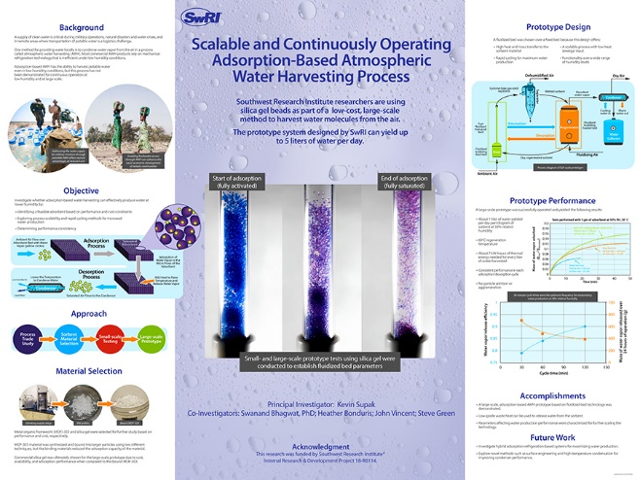
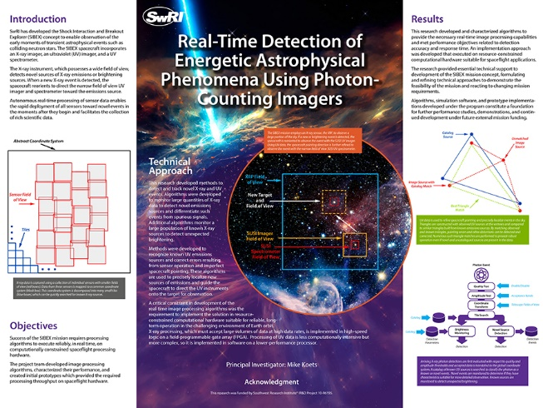
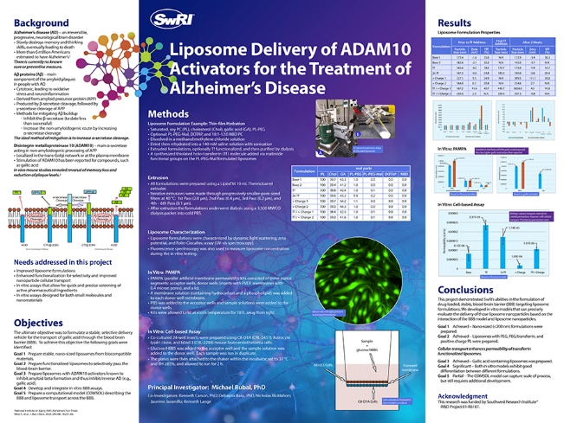
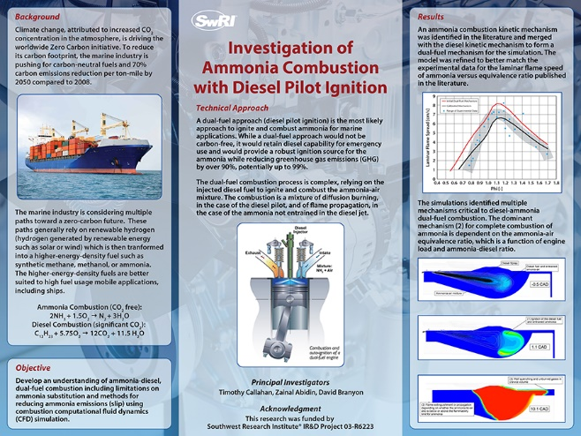
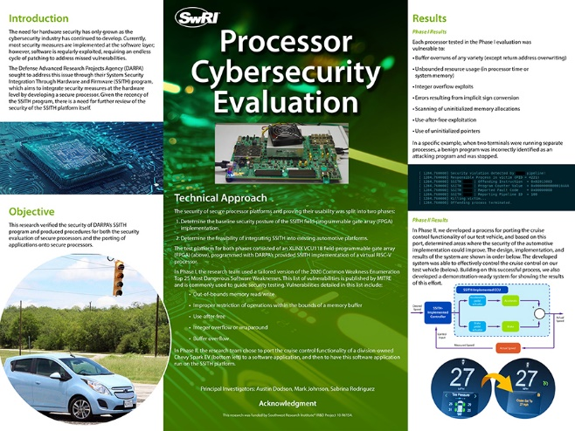
2023 Internal Research & Development Program
Turning Innovative Ideas into Advanced Technologies
103 New Internal Research Projects
Expenditure – $9.3M
Notes:
In 2023, SwRI funded 103 new internal research projects with a contract value of $9.3 million.
The IR&D program bridges new ideas with advanced technologies, to be an investment in the solutions our clients will need in the future.

Slide 15



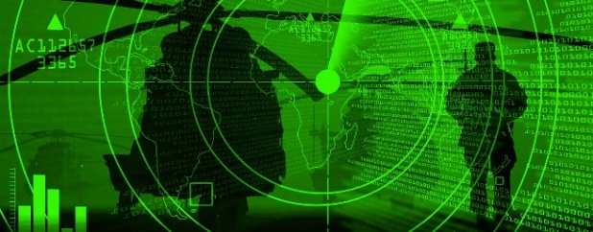



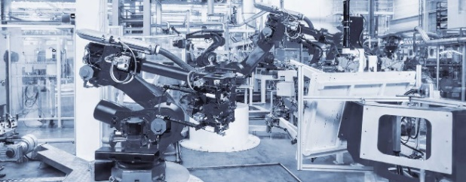
Market Segments We Serve
Automotive & Transportation
Biomedical & Health
Chemistry & Materials
Defense & Security
Earth & Space
Electronics & Automation
Energy & Environment
Manufacturing & Construction
Notes:
Market segments served by SwRI.

Slide 16
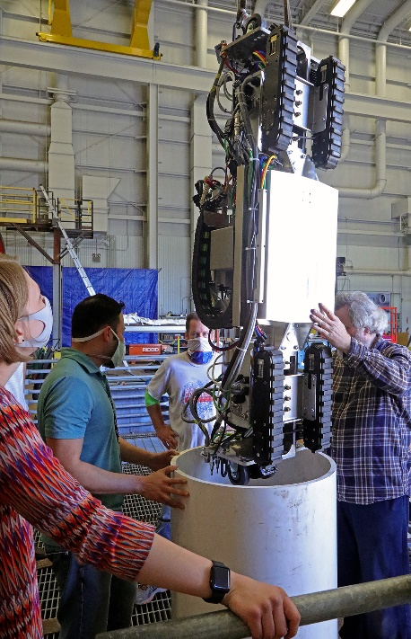
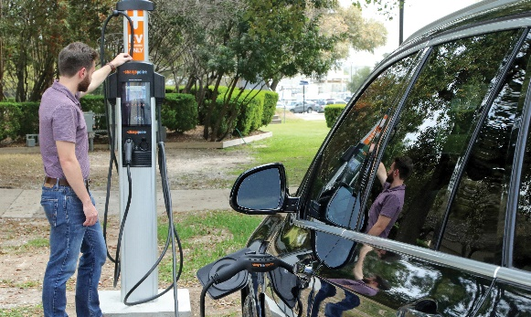
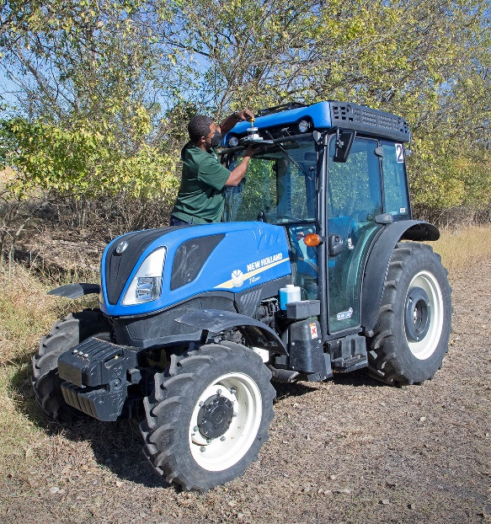
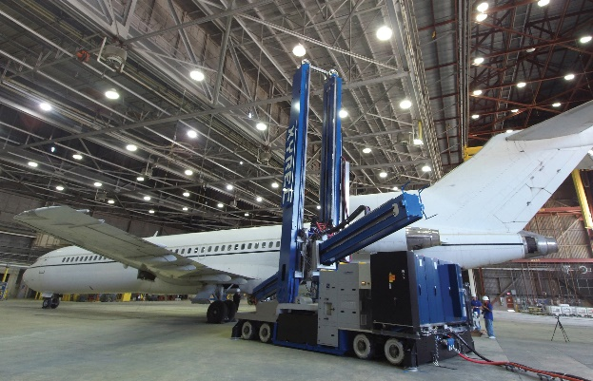
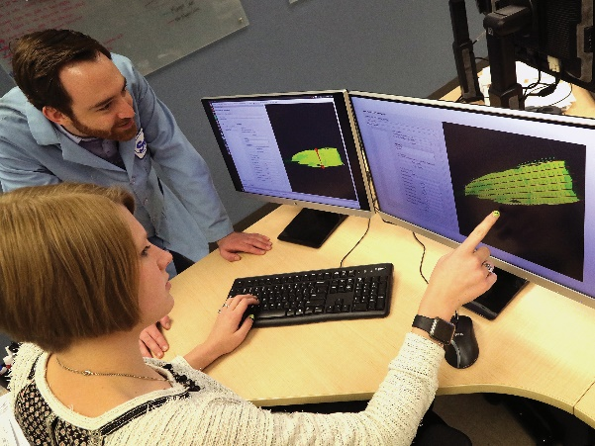
Electronics & Automation
4
1
2
3
5
We use advanced computer tools and electronics to develop innovative solutions for difficult technical challenges. We design and develop custom software programs to meet specific client needs. We license a number of our advanced software programs. We design and implement software products, intelligent transportation systems, automated manufacturing systems, industrial engineering solutions and communications electronics for government and industry clients. Our programs are used in operations and maintenance for military and commercial manned aircraft, unmanned aerial vehicles and training systems..
Notes:
1. To expand our expertise in cyber resilience, cybersecurity specialists worked with automotive engineers to investigate if electric vehicles could be vulnerable to cyberattacks during the charging process.
2. Stripping paint and other coatings from full-body aircraft is costly, time-consuming and potentially hazardous. The Laser Coating Removal (LCR) Robot, the world’s largest robot system developed by SwRI engineers and XYREC, uses machine vision and intelligent processing to precisely and safely ablate aircraft coatings.
3. We used ROS-I software to automate paint stripping from a variety of aerospace parts using either chemical or media blast processes. SwRI’s unique solution automatically generates paths from CAD drawings or 3D scans.
4. SwRI automation and nondestructive evaluation engineers demonstrate how a
custom mobile robot navigates a tight spot to ultimately evaluate the integrity of double-wall storage tanks that hold chemical and nuclear waste.
5. SwRI engineers are developing a fully automated tractor system for vineyard operations management. Multi-sensor data fusion perception systems interface with the autonomy kit to support path planning and navigation.
.

Slide 17
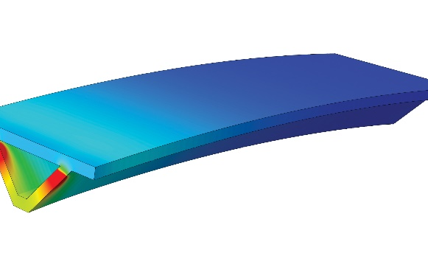
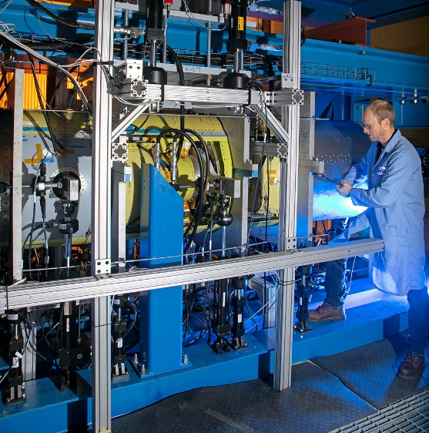
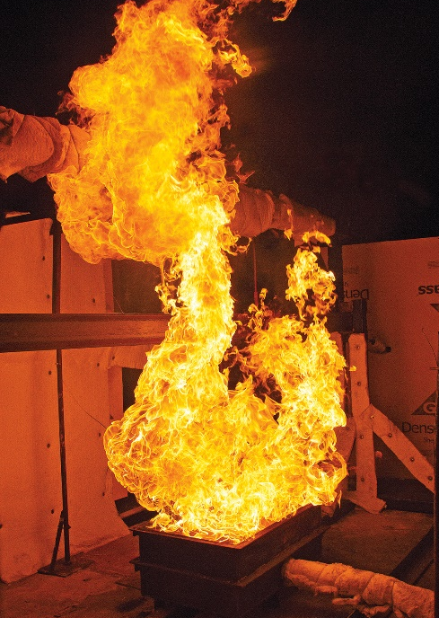
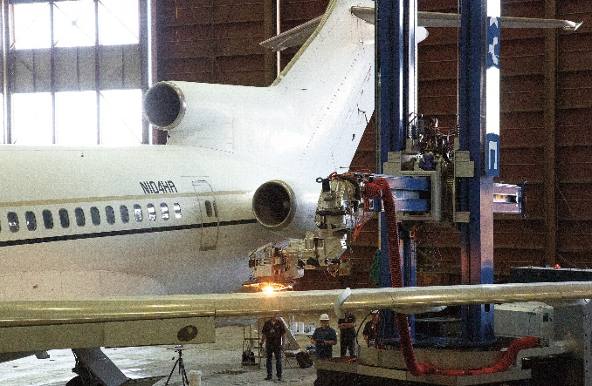
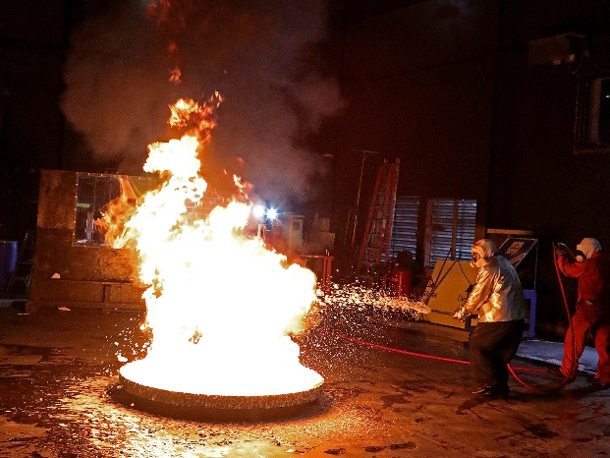
Manufacturing & Construction
1
4
2
3
5
Before going to market, industrial or commercial products must undergo a variety of tests to ensure they meet or exceed international standards for health, safety, and durability. SwRI is proud to play a significant role in helping develop innovative products through advanced science and applied technology. We provide technical services
and support across manufacturing supply chains for many industries. Our product assurance and failure analysis services give manufacturers deep capability to develop heavy-duty solutions and advanced materials that meet
fire and construction standards.
Notes:
1. Through an internal research program, SwRI engineers are developing techniques to predict the thermal profile of a redesigned aerospace component using additive manufacturing computer simulations. High temperatures near the build surface reflect localized heating from the laser heat source.
2. SwRI built and demonstrated the world’s largest mobile robot system. This first-of-its-kind automated system uses a laser to remove coatings from large aircraft.
3. SwRI is testing a client’s compressed air foam delivery equipment designed to optimize the performance of new environmentally friendly fire-suppressing foams for the military.
4. This complex custom test stand evaluates the structural integrity of Next Generation Jammer pods under real-world conditions. The pods are installed on EA-18G Growler aircraft to thwart enemy radar and targeting systems.
5. To validate a client’s computational models with real-world experimental data, SwRI exposed a bare structural I-beam to a 1.8 MW fire scenario. Scientists successfully recorded temperature and displacement data as the beam buckled under the extreme conditions.

Slide 18
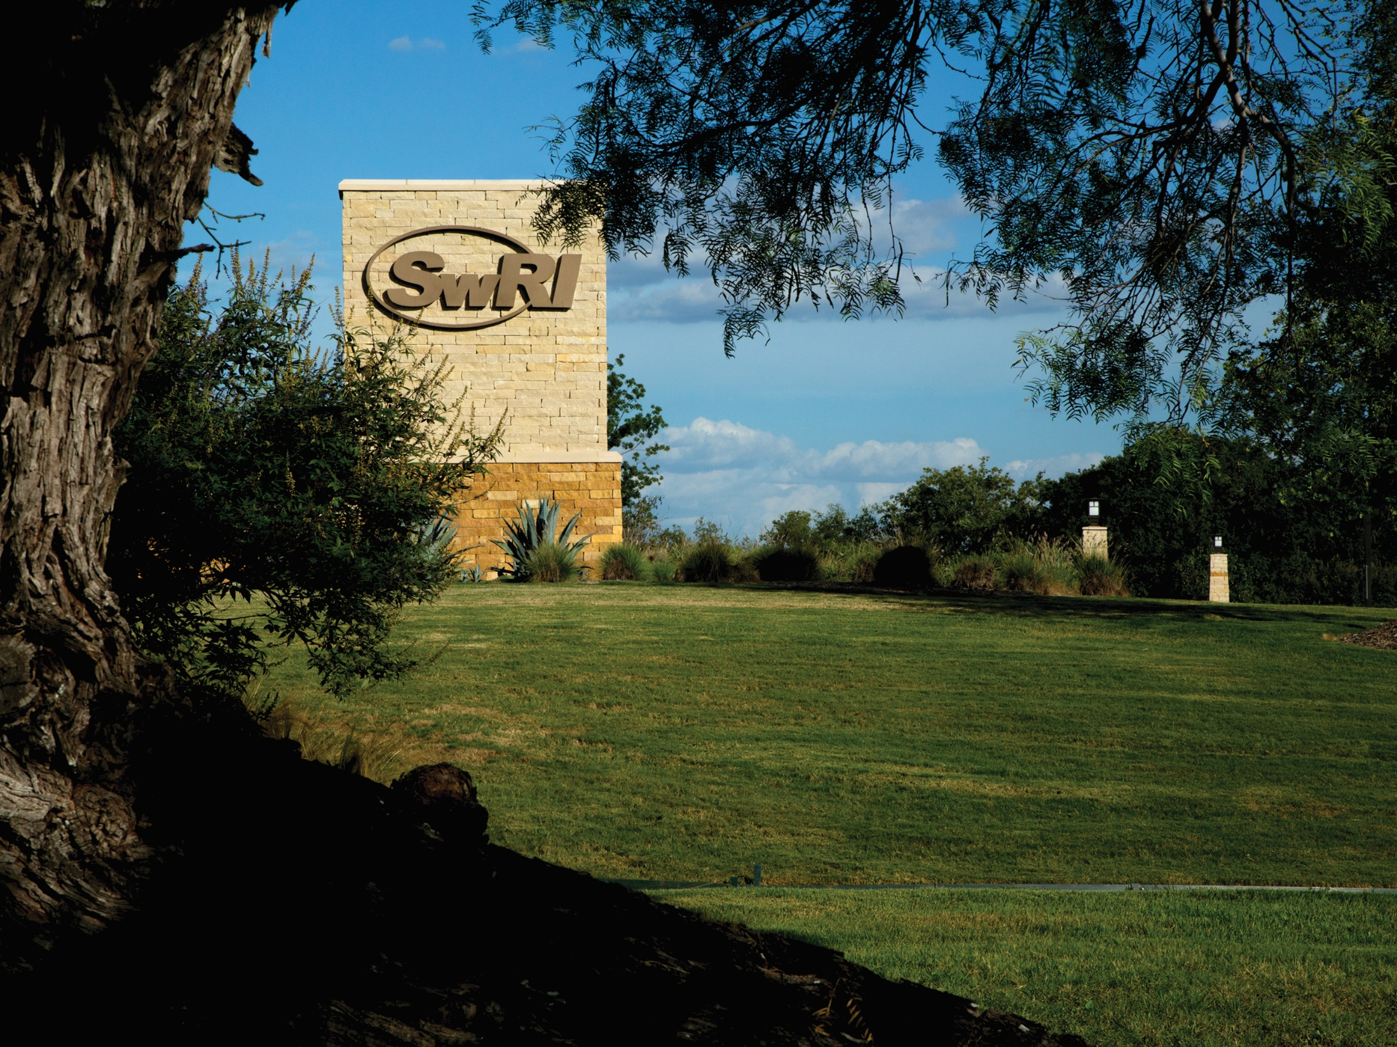
Advanced science. Applied technology.
Notes:
Since 1947, Southwest Research Institute has served as an independent, nonprofit research and development organization helping government and industry clients solve complex problems. Operations began on donated ranchland west of San Antonio, Texas, with early efforts focused on automotive testing, environmental research and radio direction finding. SwRI today occupies more than 1,200 acres and provides more than 2 million square feet of laboratories, test facilities, workshops and offices. SwRI’s research program includes materials research, space science, emissions research, field services for the oil and gas industry, microencapsulation, and much more.
The Institute’s new gate and entrance, complete with attractive landscaping and electronic features to help secure our grounds, is just one component of the infrastructure we have improved to better support clients and staff.

