Slide 1
Technology Training Template
A Template
for
Developing Step-by-Step Technology Training Package
Developed by the Workforce Development Panel
Project year 2012

Slide 2
Technology Training Transfer Template
Table of Contents
Purpose of this Training Template……………………………………………………… 3
How to Use this Training Template………………………………………….………….. 4
Project Title………………………………………………………...……………………....5
Information Page.………………………………………………………………...............7
Table of Contents…………..…………………………………………….……................9
Description of the Technology.…………………………………………........................10
Training Schedule…………………………………………………………...…...............12
Roles & Responsibilities…………………………………………………………….......13
Overview on how to use the Technology……………………….…………………..….14
Overview of the Technology Procedure Steps or Modules……………………….….16
  Simple Procedure Steps…………………………………………………….…...17
  Complex Procedure Modules and Steps………………………….………….. 18
Terms………………………………………………………………………………..….….22
How it Works…………………………………………………………………………........23
Safety Issues…………………………………………………………………….………..25
Each Step of the Procedure………………………..…………………………………....27
Crucial Points…………………………………………………………………………..…29
Icon Legend……………………………………………………………………………….30
References……………………………………………………………………………..…33
Approved for Public Release – Distribution unlimited

Slide 3
Purpose of this Training Template
The purpose of this training template is to provide research-based instructional elements for the development of a complete package that will encourage the implementation of technology with minimal assistance.
Additionally, it is expected that the implementation of the technology by interested shipyards will be encouraged with a training package provided as part of the deliverables.
Technology training is defined as a step-by-step procedure that is performed the same way each time. It may have decision points that determine different pathways of performance, based on existing conditions; however, those decision points are always encountered.
Instructional designers call this type of training “near transfer” because the performance on the job is “near” or very close to how it is performed in the training.
This type of step-by-step technology training is distinguished from principle-based and process-based training (refer back to the “Using the Templates” file)
The purpose of this training template is to provide the instructional elements for only the procedure-based training that is characteristic of most technological applications.

Slide 4
How to use this Training Template
This training template is designed to provide elements that are helpful in the transfer of learning for the step-by-step operation of technological procedures.
Usually, training is an afterthought of a team after the development and testing of the technology.
It is the intent of this template that the familiarization of its training elements will allow for their capture as the technology is being developed and tested.
After becoming familiar with the training elements of the template, the team can identify lists of these elements that may be captured during project development rather than waiting till the end.
After each training element is described, an example will be provided
Once the training package is developed, it can be used by the implementing shipyard for on-the-job training
Often, a subject matter expert has a challenge in identifying with the lack of novice experience. Consequently, it is common for them to assume and skip over vital content.It is important for the subject matter expert to constantly remind themselves of this when developing the training material.
Having someone, not familiar with the technology, review the material is very helpful in making sure that important gaps are not in the training
A good self-assessment of the content when being developed is to ask, “Have I eliminated all other possible interpretations of the point I am trying to get across?”

Slide 5
Project Title
Insert Image of Project Technology
(being used in the job context if possible)
Refer to Appendix B: How to take pictures
Next page: example of project title Page…

Slide 6
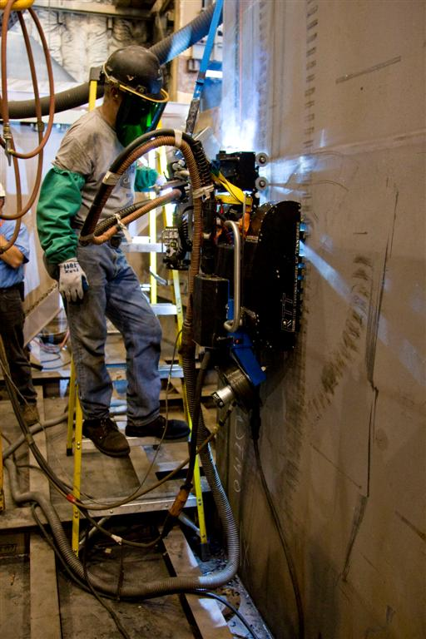
Mobile, Remote Welding System
(example Project Title slide)

Slide 7
Information Page
An information page collects any specific data about the technology
The developing organization, version, where to get more information, etc.
Next page: example of Information Page…

Slide 8
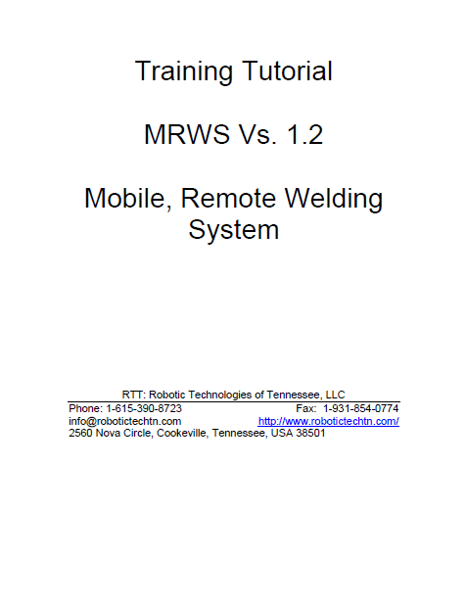
MRWS Information
(example Information Page)

Slide 9
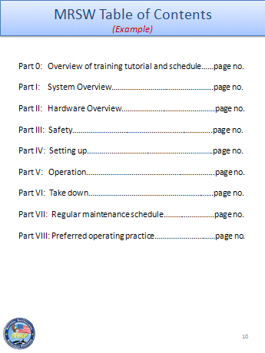
Table of Contents
A table of contents needs no explanation. It’s convenience is understood in allowing users to review topics by referencing their page numbers

Slide 10
Description of the Technology
A description of the technology serves to focus the attention and expectation of the worker being trained.
It should not be detailed but provide enough meaningful information so that the student can visualize what it is all about
See the example on the next page for the description of the MRWS.
The use of a tank and bulldozer analogy (notice that it is in bold, italicized text) serve to relate the new technology to something that the student would be familiar with
Adult learners perform well when they integrate new learning with what they already know.
Next page: example Description of the Technology…

Slide 11
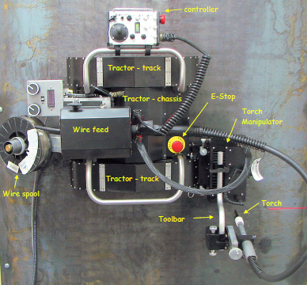
Description of the MRWS
(example Description of Technology)
The MRWS is a twin-track crawler (like a tank or bulldozer) but the tracks are equipped with permanent magnet feet. The machine is capable of operating in any orientation on ferrous surfaces (i.e. steel ship hulls). It provides mobility to an oscillating carriage which in turn holds the welding torch. The system brings mobile automation to the welding task without the need for setting up any fixed track or special requirements in the field. The operator guides/controls the MRWS through a handheld pendant steering only the oscillator carriage (the crawler automatically follows his commands to the carriage).
The RTT Trackless Robotic Welding System has been tested at EWI and BIW and is designed for automated shipyard welding. The twin drive track units are equipped with powerful magnet
pads and a unique suspension system enabling the robot to traverse a wide variety of ferrous structures. Onboard seam tracking and torch manipulator support a wide range of welding operations. RTT’s system is designed for GMAW (standard mig and pulse arc)
Processes.
NOTE:
Notice that there are acronyms not defined in this description
Intentionally left in to demonstrate importance of identifying acronyms

Slide 12
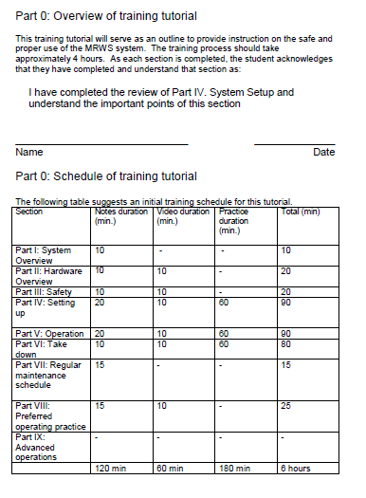
Training Schedule
(below is example of MRSW training schedule)
A training schedule included allows for an organization to plan for the training.
Below is an example of a training schedule used by the MRWS

Slide 13
Roles and Responsibilities
It is important to define the roles and responsibilities of all stakeholders. This provides an expectancy so that everyone involved knows what is expected.
Roles
Responsibilities
Role 1
Examples:
Coordinate with ….
Work with …
Provide guidance for…
Perform evaluation of…
Role 2
Description of responsibility
Role 3
Description of responsibility

Slide 14
Overview on how to use the technology
An overview before the learning is, what an instructional designer calls, an “advance organizer”
The advance organizer serves to provide expectation in the learning that improves levels of understanding and recall.
It is presented before the direct instruction of a learning and at a high level, focusing only on what is important and essential.
It is not the time to go into any detail but to focus on the overall picture.
An overview may be given before the entire learning, one or more modules of learning, or even before a step, depending on complexity of the learning.

Slide 15
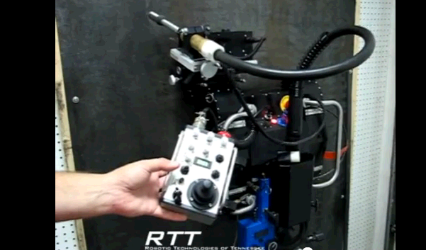
Overview on how to use the MRSW
(example overview)
To position the MRWS for welding, the operator drives the unit using a joystick on the handheld pendant.
It is positioned near the seam and approximately lined up parallel to the seam.
When the weld process is started and adjustments are made to the centering of the torch carriage, the crawler follows his adjustments to line up with the seam lessening the amount of adjusting he needs to do.

Slide 16
Overview of the Technology Procedure
Steps or Modules
An overview of the procedure is positioned at the beginning of the training and after the overview on how to use the technology (before going into detail of the specific steps). With a simple procedure, the steps comprise the overview. A complex procedure would have the modules for the overview and then the steps of a single module would also be an overview at the beginning of that module.
Insert the flow of the steps (with images if possible) and provide a brief” verb and noun” statement of the step
Keep it high level (do not add detailed or extraneous information) at this time
This will serve as an advance organizer for the “big picture” before looking at the individual steps
A procedure may be simple, just composed of steps; or, it may be more complex with modules, each having their own set of steps
See next page for diagrams of each…
See example of step flow for how to determine the bearing of a destination using a map and compass…

Slide 17
Simple Procedure Steps
Step 1
Step 2
Include steps of a simple procedure as overview at the beginning of the training
Step 3
Step…etc.
NOTE: Keep in mind that some of the steps in a procedurel may be decision points that will deviate into branches but eventually come back together

Slide 18
Complex Procedure Modules and Steps
Module 1
Step 1
Include steps as overview at the beginning of each module
Step 2
Include modules only in overview at beginning of training
(before going into detail of steps)
Step…etc.
Module 1
Step 1
Include steps as overview at the beginning of each module
Step 2
Step…etc.
Module etc.
Step 1
Include steps as overview at the beginning of each module
Step 2
Step…etc.
NOTE: Keep in mind that some of these steps may be decision points that will deviate into branches but eventually come back together

Slide 19
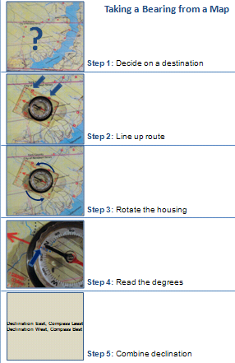
Taking a bearing from a map
(example of simple procedure overview)

Slide 20
MRWS Overview of Modules
(overview using only modules in a complex procedure
without images)
Module 1: Perform safety checks
Module 2: Setup the system
Module 3: System operation
Module 4: Take-down the system
Module 5: System maintenance:

Slide 21
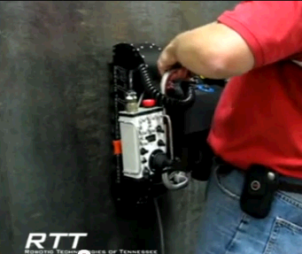
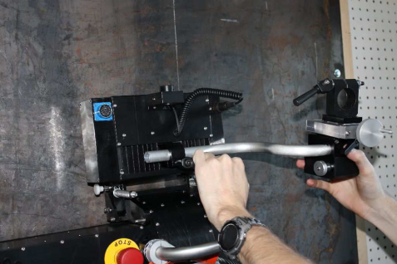
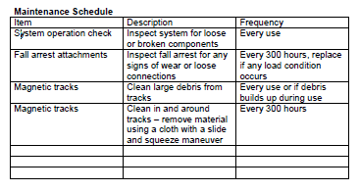
MRWS Overview of Modules
(overview using only modules in a complex procedure
with images…notice how images provide meaningfulness)
Module 1: Perform safety checks
Module 2: Setup the system
Module 3: System operation
Module 4: Take-down the system
Module 5: System maintenance:

Slide 22
Terms:
Collect all terms from each step with their definitions and add diagrams, graphics, and/or pictures where possible
NOTE: notice how these terms do not mean anything to a novice learner until context is provided. Terms should be included when their meaning is required, such as when a module or step is presented.

Slide 23
How it works:
Providing how a device works, sometimes supports the learning and sometimes it does not support the learning
For example, in order to know how to use a calculator, one does not need to know how the electronic circuitry works. In this case, providing how it works would be extraneous information that is not relevant to the learning.
However, if one is learning how to maintain the brakes on a crane, an explanatory visual on how those brakes work is necessary and will support the learning
If “how it works” does support the learning, Insert images with descriptions that depict how the technology works at the appropriate time (when its understanding is necessary for the learning that follows)
See an explanatory visual on how a hand-bellows works on the next page…

Slide 24
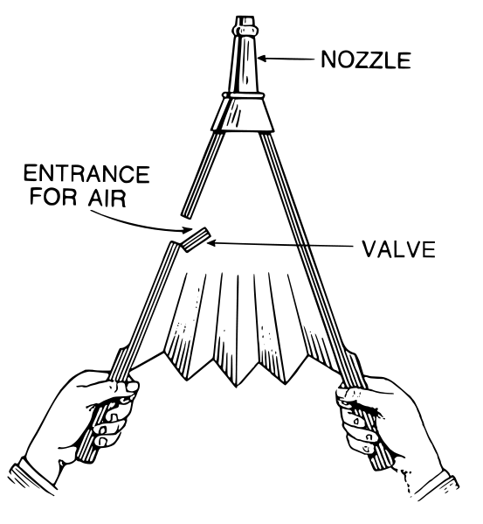
How a Hand-Bellows Works
(An Explanatory Visual):
2. …air pushes the hinged valve open and the air is sucked inside
Open
1. As the handles of the bellows are separated…
3…the air is forced out through the nozzle
2. …the air inside pushes the hinged valve closed and…
Closed
1. As the handles of the bellows are brought together…
Note: see how the brevity of text with images is easy to understand (rather than volumes of text)

Slide 25

Safety Issues
Include any safety concerns that are needed before the actual steps of the procedure are presented;. These safety concerns apply the entire procedure; however, also include relevant safety concerns that apply at any step (this presents the safety concern when it needs to be applied)
Read and understand the following safety instructions prior to beginning operations
Safety
  Never…
Read and perform…
Never place…
Never try to circumvent…
Emergency Procedures
Ensure that the stop button is operational before commencing operations (part of the safety check). In case of fire, equipment failure, injury, and all other emergencies, push the stop button or step onto one of the safety pads before you do anything else. Then contact your supervisor.
See MRWS safety issues example on next slide…

Slide 26
MRWS Safety Issues
General:
  Protect yourself and others from serious injury or death.
  Be sure that all installation, operation, maintenance and repair procedures are performed only by qualified individuals.
Electrical Shock Hazard: ELECTRIC SHOCK CAN KILL
  1. The equipment is not waterproof. Using the unit in a wet environment may result in serious injury. Do not touch the equipment when wet or standing in a wet location.
  2. Never open the equipment without first unplugging the power cord or serious injury may result.
  3. Verify the power connections are made in accordance with all applicable local and national electric safety codes. If none exist, use International Electric Code (IEC) 950.
  4. Never Remove or bypass the equipment power cord ground. Verify the equipment is grounded in accordance with all applicable local and national electric safety codes. If none exist, use International Electric Code (IEC) 950.
Falling Hazard: FALLING EQUIPMENT CAN CAUSE SERIOUS PERSONAL INJURY OR DEATH AND EQUIPMENT DAMAGE
  Only install and operate equipment when properly protected by approved fall protection equipment.
  2. Only operate equipment from a location that is protected from falling material.
  3. Faulty or careless user operation is possible. As a result, never stand, walk or pass underneath equipment.
Keep Equipment in proper operating order: EQUIPMENT DAMAGE POSSIBLE
1. Do not leave the equipment unattended. Remove from the worksite and store in a safe location when not in use.
2. Equipment operation is to be performed only by qualified individuals.

Slide 27
Each step of the procedure comes next
Simple Procedure:
Recall that a simple procedure will just have steps.
These steps will be presented one-at-a-time following the overview of the procedure shown previously.
Each step will include elements shown on the following pages, depending on which elements apply for that specific step.
Complex Procedure:
Recall that a complex procedure will have steps for each module.
The steps of each module will be presented one-at-a-time following the overview of the module as described earlier.
Like the steps of the simple procedure, each step will include elements shown on the following pages, depending on which elements apply for that specific step.
The template is shown for Step 1 but, of course, it is repeated for as many steps as there are in your technology procedure

Slide 28
Step 1 Elements: Verb and Noun statement of a step of the operation
Reason for step: (include relevant reason for the step if not obvious)
Insert picture, graphic and/or diagram that best depicts this step
Terms of step: Include any applicable terms labeled in image or diagram and respective definitions needed to understand this step
How it works: Include visuals and/or description of how the step process, tool, or equipment works if it supports the learning of this step
Crucial Points: Include any applicable crucial points for that specific step. See next page for a list of the crucial points.
Crucial points continued on next page…

Slide 29




Step 1 Crucial Points (continued):
Instructional strategy: When training personnel, it is important to train the simplest performance first. Then, when the novice feels comfortable with the basic procedure, begin introducing the crucial points from simplest to complex. Any crucial points that deviate from this simplest performance should be added as a variation of the procedure later as part of an iterative lesson. Notice the icons below add meaningfulness, at a glance, to the crucial points
Decision Points: conditions that determine decisions to make. Record why the decision is made and what is done as a result of it
Safety
What could cause an Injury: include what to identify and how to control
Pitfalls: what could cause failure
What could delay the task or waste material: Anticipate those things that could make the job longer or cause unnecessary waste of material
What could make the job easier to do or of better quality: (Any best practices, quality criteria, “tricks of the trade”, jigs, motor skill techniques that obtain smoothness, precision and/or timeliness)
NOTE: See next slide for other possible icons that may apply

Slide 30




Icon Legend
(you may have others that you would like to use)
Caution
Stop, Check Proceed
Stop
Tips
Safety
Warning
Safety Issue
Decision Point
Checklist
Danger
Environmental Issue
Signature/Inspection Required

Slide 31
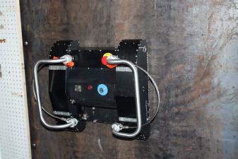
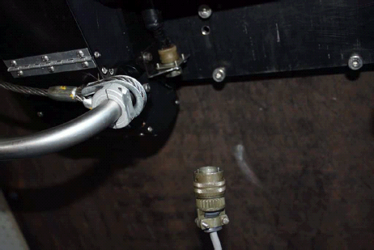
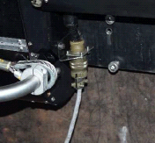
Module 3: MRWS System Setup
(example steps)
These steps have a verb and noun statement; however, notice that they do not have any crucial points.. Think of the extra guidance that may be left out of these steps. Always analyze each step to include any applicable crucial points.
Step 1. Place the tractor tracks and chassis component on a flat section of the steel surface as shown below.
Step 2. Connect the power supply to the tractor chassis as shown below
After connected
Before connected

Slide 32
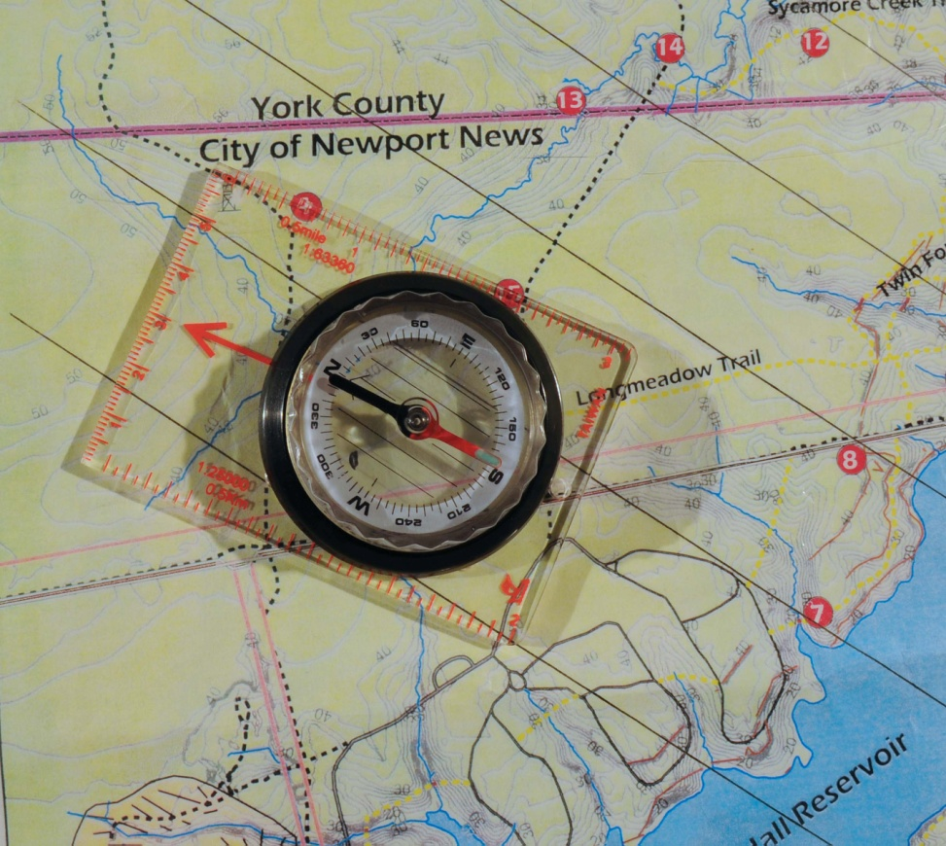
Taking a bearing from a map
(example of a step with crucial points included)
Step 3: Rotate the compass housing so that the orienting lines on the base of the housing are parallel with the true north lines on the map
Need to hold the base plate firmly so that the compass does not move off of the two points
The orienting arrow on the bottom of the housing needs to be pointing true north (if it points south, you will travel in the opposite direction)
Check each end of the orienting lines to ensure that the north grid lines on the map are equal distant; i.e. parallel

Slide 33
References
Clark, Ruth C, (1999) Developing Technical Training , A Structured Approach for the Development of Classroom and Computer-Based Instructional Materials (2nd Ed.), International society for Performance Improvement, Silver Spring, MD
Clark, Ruth C., Mayer, Richard E. (2011) E Learning and the Science of Instruction (3rd Edition), Pfeiffer, San Francisco, CA
Medina, John (2008) Brain Rules: 12 Principles for Surviving and Thriving at Work, Home, and School, Pear Press, Seattle, WA
From: Phillips, Patricia and Phillips, Jack (2007) The Value of Learning: How Organizations Capture Value and ROI, Pfeiffer, San Francisco, CA

