Slide 1
Innovation Program
Pearl Harbor Naval Shipyard & Intermediate Maintenance Facility

Slide 2
History
Shipyard Innovation programs established in 2019 with the issuance of the NAVSEAINST 9000.2
Designates key positions:
  Innovation Program Manager (IPM)
  Technical Insertion Manager (TIM)
  Lean Program Manager (LPM)
Led by NAVSEA 04T2
Goal: To improve the delivery of ships and submarines back to the fleet

Slide 3
Types
Process Improvement
Rapid Prototyping
Lean Six Sigma
Strategic Planning Sessions
Moonshine Program
Innovation LAB (iLAB)
Within our control to change
Utilizes existing capabilities
Quicker implementation
New & Emerging Technology
Information Technology Solutions
Commercial Off The Shelf (COTS) solutions
RDT&E projects
Mobile Workforce Environment
Local and headquarters initiatives
Usually requires outside capabilities
Longer implementation
Larger investment

Slide 4
Innovation Community
Public Shipyards
Sharing of lessons learned and best practices
NAVSEA
Technology Insertion & Innovation Laboratory (TIIL)
Office of Naval Research
ManTech
RepTech
Warfare Centers
NCMS
BMNT
Academia
Naval Sustainment System – Shipyards (NSS-SY)
Educational Partnership Agreements (EPAs)
University-Affiliated Research Center Laboratories (UARCs)
Advance Research Labs (ARLs)
SBIRs
Communities of Practice

Slide 5
How we help
$1M O&M,N
Partnerships
Warfare Centers
$3M RDT&E
Technical
Security
Safety & Environmental
Acquisition
Information Technology
ONR
Academia
Tech Bridge
Recognition & Marketing
Tours
Articles
Technology Showcase
Social Media
Approvals & Guidance
Resources
iLAB
Staff
Awards

Slide 6
Questions?

Slide 7

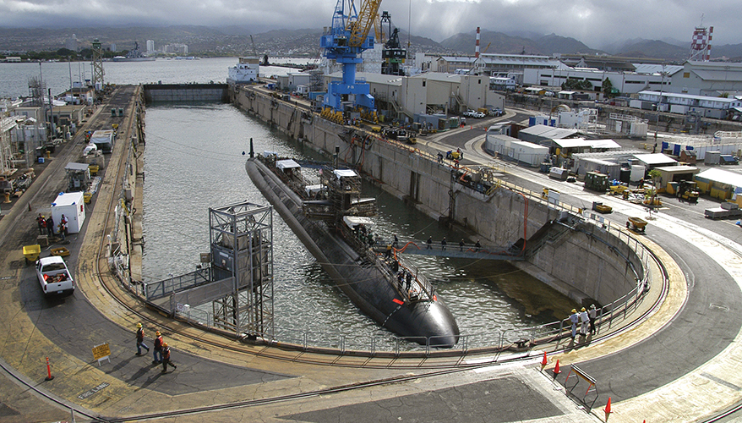

Pearl Harbor Naval Shipyard
Vance Hashimoto
iLAB (Innovation Lab)
Mechanical Engineer
(808) 763-0242

Slide 8
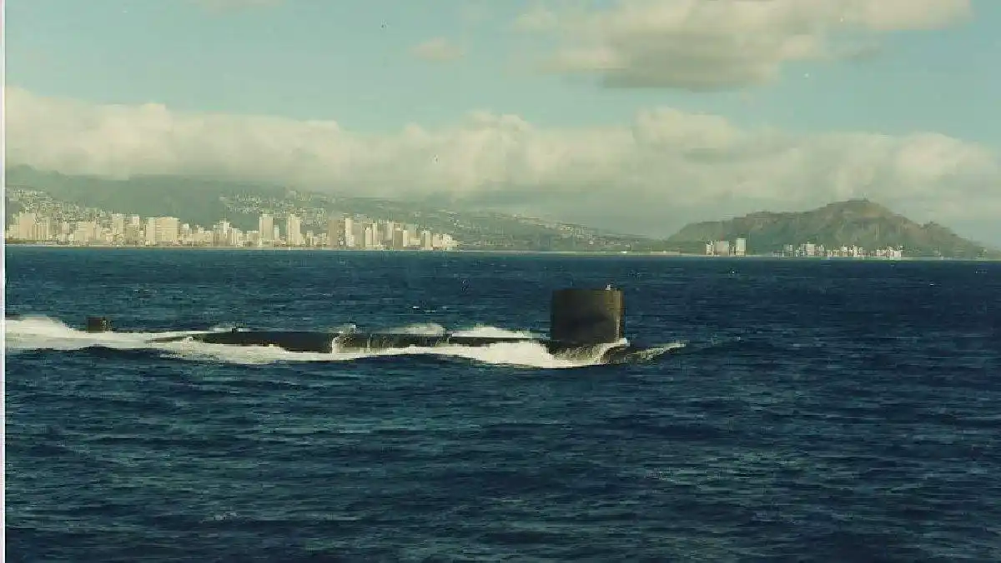

Agenda
Purpose
Virtual Tour
  Spaces
  Capabilities
Partnerships
http://www.navsource.org/archives/08/08639.htm

Slide 9
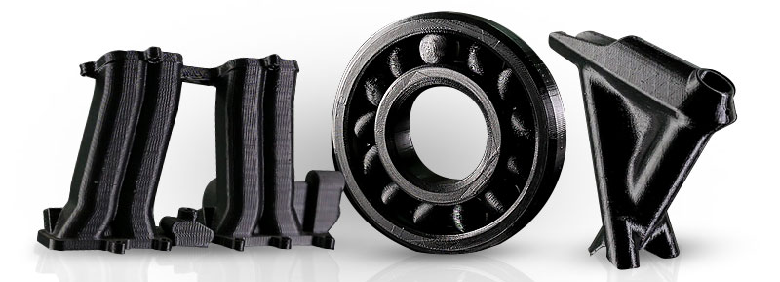
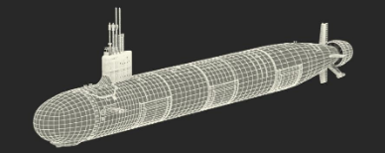
Purpose
The hub of innovation for shipyard
  One stop shop for collaboration, innovation, and rapid prototyping
Transform ideas into actions to advance capabilities of our shipyard
  Common Products
    Training aids (mock-ups)
    Prototype tools, jigs, test equipment
    Prototypes parts
    Safety devices
    CAD models, drawings and renderings

Slide 10
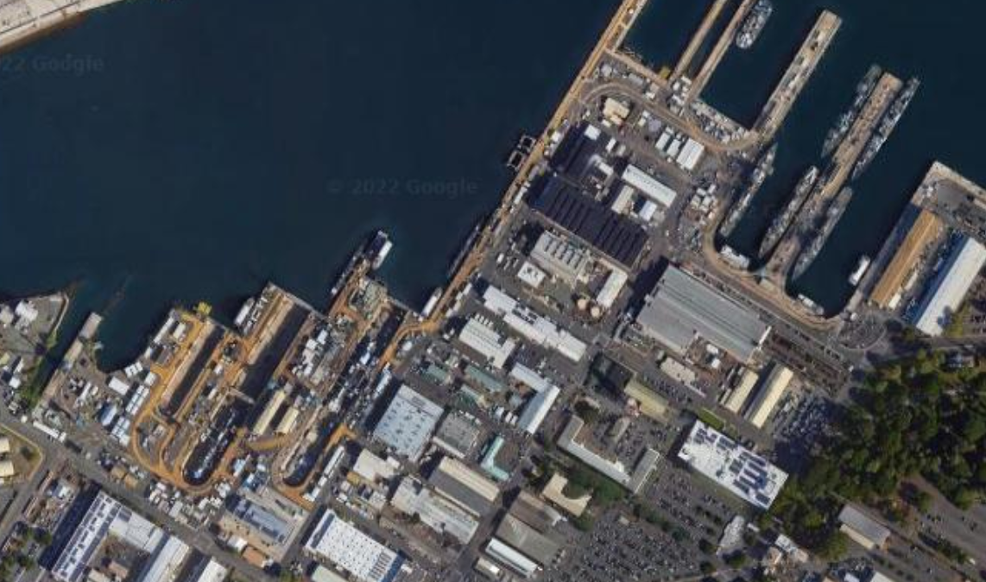
Virtual Tour
Newly repurposed 6800 sqft space
  Non-designated
  Office
  Conference/collaboration room
  Computer lab
  Plastic 3D printing room
  Metal 3D printing room
  Machine shop

Slide 11

Virtual Tour
Office Space (700 sqft)
  8 workstations
    iLAB Manager
    Moonshine Program Manager
    Rotating Engineers (x4)
    IT Specialist
    Innovation Program Analyst
https://news.usni.org/2019/12/24/bae-systems-shuttering-pearl-harbor-maintenance-operation

Slide 12

Virtual Tour
Conference/Collaboration Room (1000 sqft)
  Easy visitor access, non-designated space
  Modular desks
  Future plans
    Sliding partition door
    Video Wall 13’ x 8’
https://news.usni.org/2019/12/24/bae-systems-shuttering-pearl-harbor-maintenance-operation

Slide 13
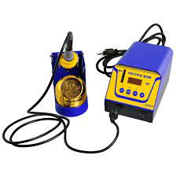
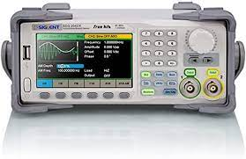
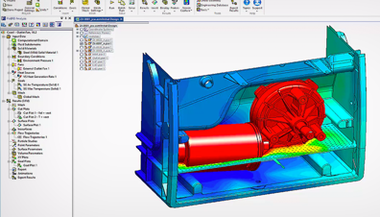
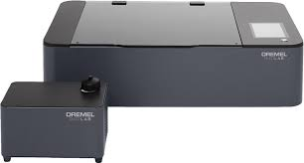
Virtual Tour
Computer Lab (500 sqft)
  8 workstations
    CAD, FEA, Circuit Design, MATLAB
  Electronics Lab equipment
    Power Supplies
    Digital Oscilloscopes
    Waveform Function-Generators
    Soldering Stations
    Laser cutter/etcher

Slide 14


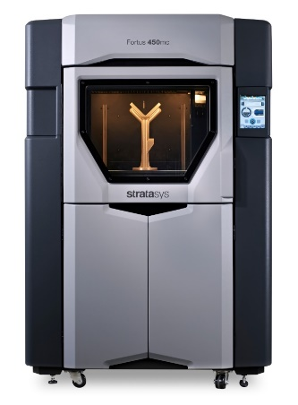
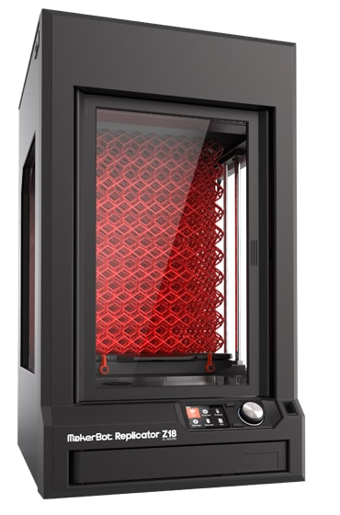
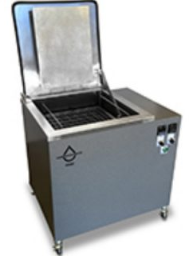
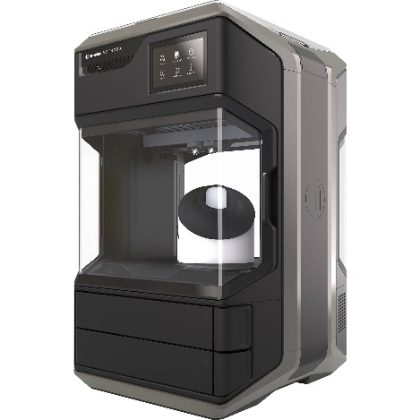
Virtual Tour
Plastic 3D Printing Room (300 sqft)
  3 Stratasys Fortus 450mc
    ASA, ABS, ULTEM, Nylon 12CF
  2 Makerbot Replicator Z18
    PLA
  5 Makerbot Method X
    ABS
  Ultrasonic Cleaner

Slide 15
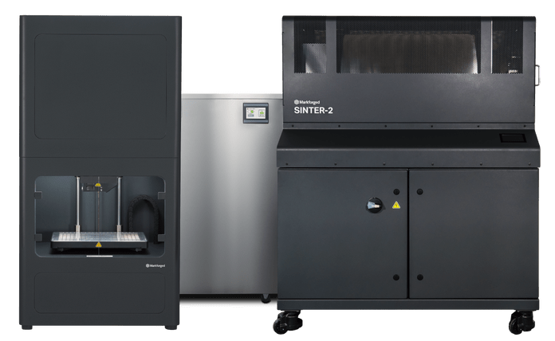

Virtual Tour
Metal 3D Printing Room (300 sqft)
  Markforged Metal X System
    2 Gen 2 Printers
      11.8” x 8.7” x 7.1” Build Volume
      17-4 PH, Tool steel (H13, A2, D2), Inconel 625, Copper
      ~0.002” Resolution
    Wash-1
    Sinter-2

Slide 16
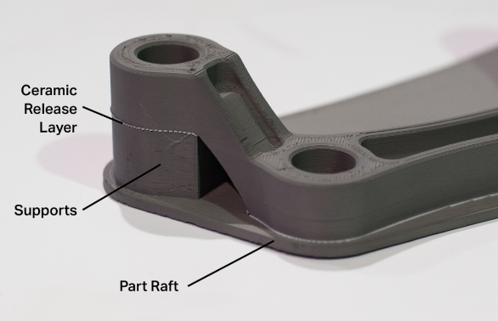
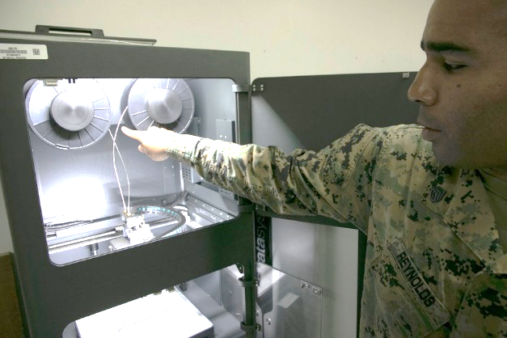
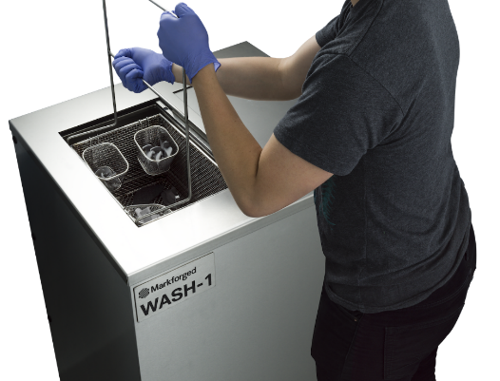
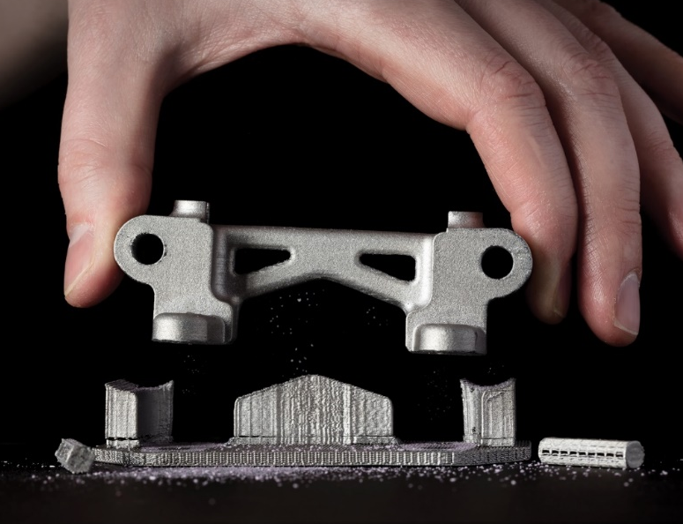
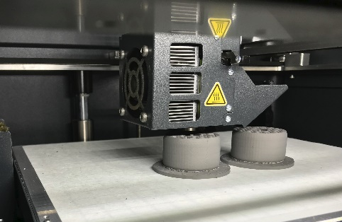
Virtual Tour
Metal 3D Printing Room (300 sqft)
  Markforged Metal X System

Slide 17
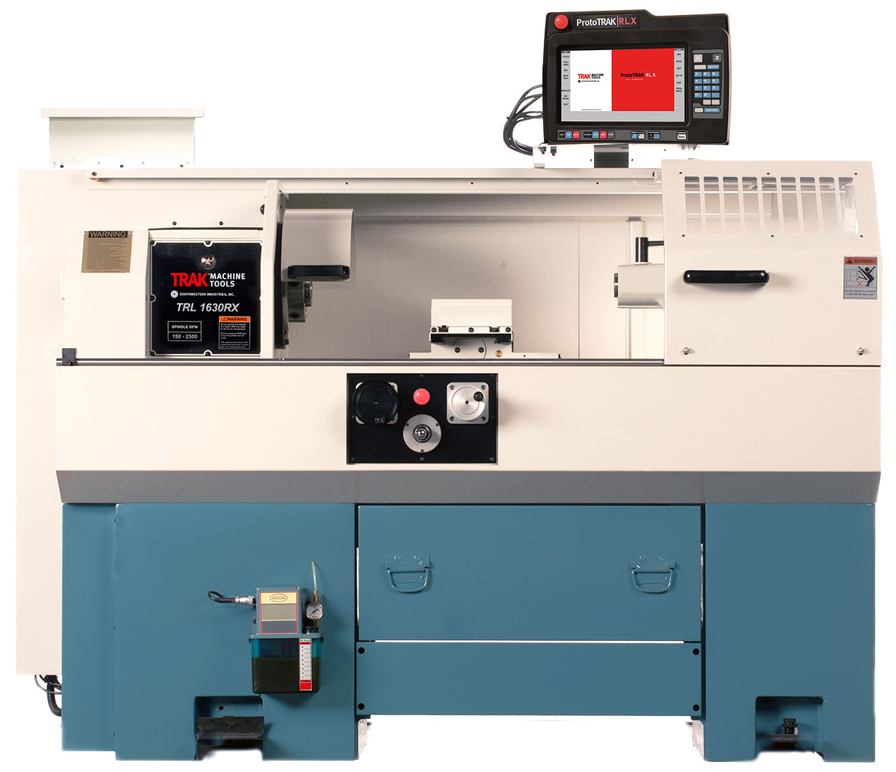
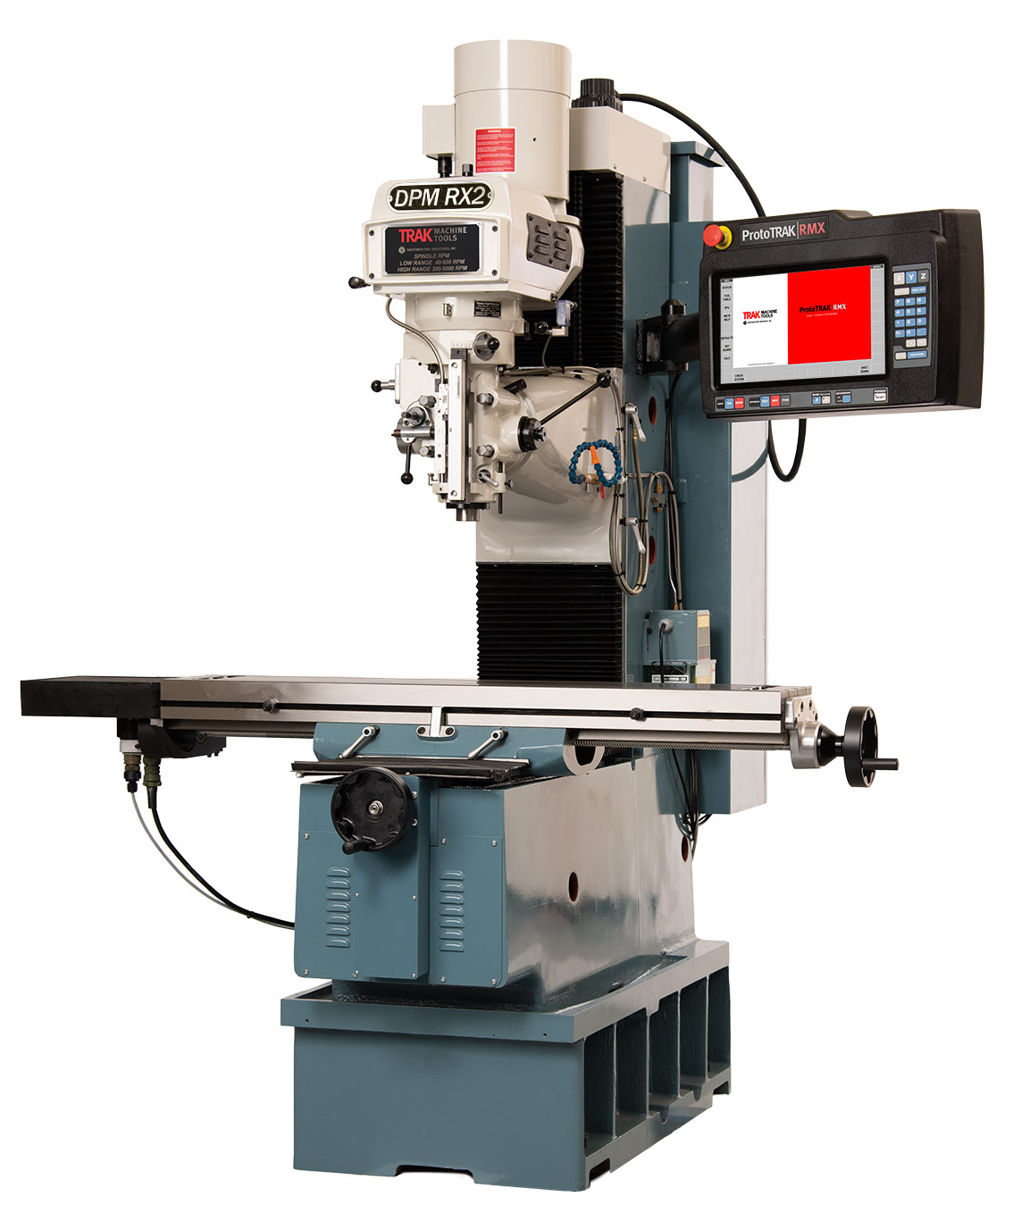
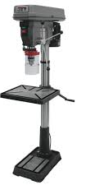
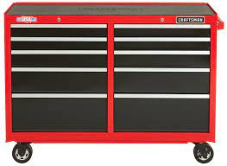
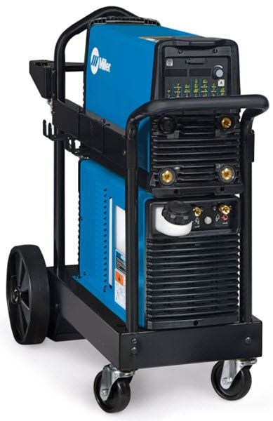
Virtual Tour
Machine Shop (2100 sqft)
  ProtoTRAK CNC Bed Mill
    DPM RX2
  ProtoTRAK CNC Lathe
    TRL 1630RX
  Drill press
  TIG Welder
  Assortment of hand and power tools
https://news.usni.org/2019/12/24/bae-systems-shuttering-pearl-harbor-maintenance-operation

Slide 18


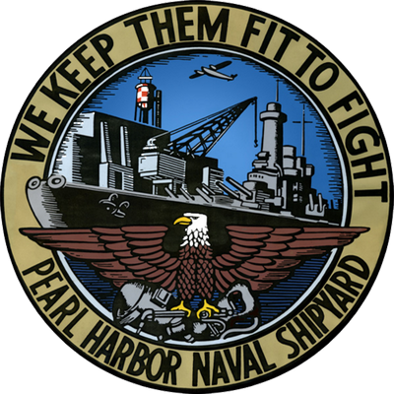
Partnerships
Educational Partnership Agreements with University of Hawai`i
    Internships
    Senior Design Project
    Hacking for Defense
    Metal X Loan
https://news.usni.org/2019/12/24/bae-systems-shuttering-pearl-harbor-maintenance-operation

Slide 19
Questions?

