Slide 1
Sustainment Working Group Status
Alicia D’Aurora Harmon
Acting Panel Chair

Slide 2
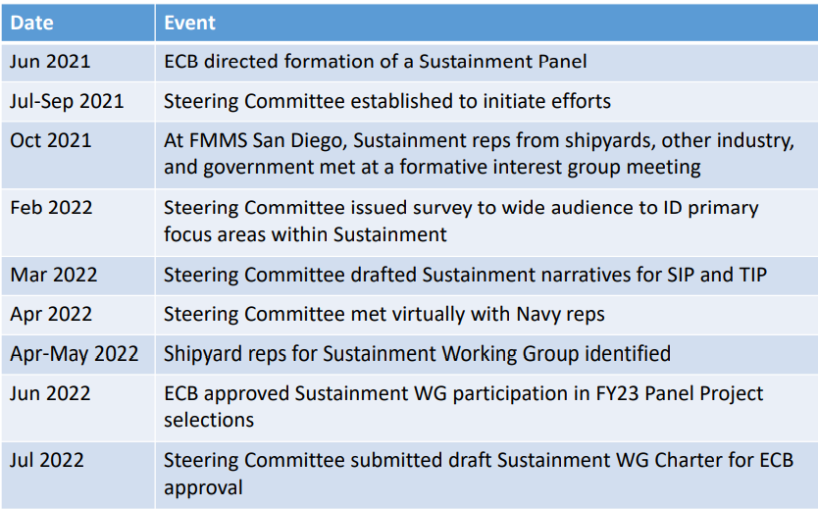
NSRP Sustainment Steering Group

Slide 3
Sustainment Steering Group
Met weekly in February and March to develop the Strategic Investment Plan and Technology Investment Plan initiatives and sub-initiatives
Members
John Walks – Ingalls Shipbuilding
Andy Blackman – Bath Iron Works (BIW)
Dru Khaira – BIW
Alicia Harmon – Newport News Shipbuilding (NNS)
Jim House - ATI
Thank you for the support!

Slide 4
Sustainment WG Mission
The Sustainment Working Group has the mission of reducing the cost of ship logistics and sustainment activities, and increasing operational availability, with a focus on improved technologies, processes and procedures that realize greater efficiencies in lifecycle sustainment of Navy, other Federal government agency, and commercial ships.
The Working Group should also research and evaluate opportunities for how the use of digital tools, new technology, and processes could decrease the time spent in a maintenance availability

Slide 5
Sustainment Initiatives
7.3.2.5 Incorporate sustainment in design
7.3.2.6 Develop new maintenance processes and procedures to support minimal time in availabilities
7.3.2.7 Incorporate advanced technologies to benefit sustainment or improve reliability
7.3.2.8 Supply chain issues
7.3.2.9 Information/data management
Technology Investment Plan input

Slide 6
Sustainment Working Group Charter
Approved by the Executive Control Board (ECB) – July ECB
Working with the Navy Program Manager to get Navy participants from
Regional Maintenance Centers
CNRMC
MARMC
SERMC
SWRMC
Included additional members from other ECB yards
Austal
Marinette
Electric Boat
Ingalls
Newport News

Slide 7
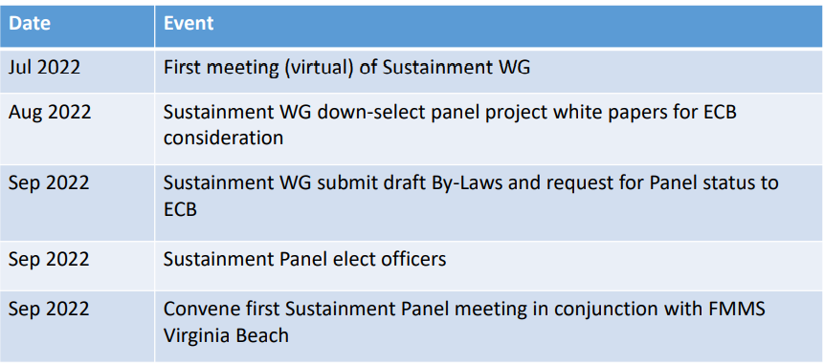
NSRP Sustainment Initiative
Future Plans
First Sustainment Meeting held July 28th

Slide 8
Rapid Adoption Projects
5 projects submitted in 1st solicitation round
UNKNOWN submitted in 2nd solicitation round
Anticipating multiple proposals

Slide 9
Upcoming Activities
Interested in becoming a panel chair?
Panel project voting and selection

Slide 10
Upcoming Panel Meeting
Held in conjunction with the ASNE Fleet Maintenance and Modernization Symposium (FMMS)
Virginia Beach, VA
Sept 20, 2022
9:30 am – 11:45 am
Fleet Maintenance & Modernization Symposium 2022 (navalengineers.org)
More details coming soon!

