Slide 1
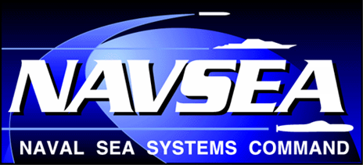
NAVAL SEA SYSTEMS COMMAND
What’s New in NAVSEA Coatings?
NSRP Surface Preparation and Coatings
Sept. 2022
Mr. Mark Ingle, P.E.
SEA 05P2
(202) 781-3665
mark.w.ingle.civ@us.navy.mil
Distribution A: Approved for Public Release

Slide 2
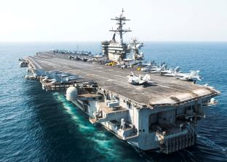
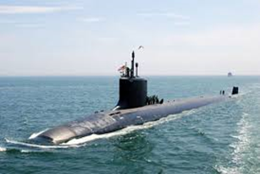
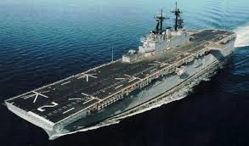
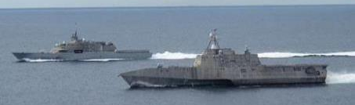
OBJECTIVES
• Summarize evolving Naval Sea Systems Command (NAVSEA) organization
and coating requirements:
•• Headquarters NAVSEA organization & objectives.
• Summarize what’s new in NAVSEA coatings and preservative maintenance coating cost
reduction strategies:
•• Topside corrosion control initiatives.
•• Coating and nonskid supply chain issues.
•• Update to Standard Item 009-32 and working groups on key issues.
•• Publication of new, MIL-PRF-32704 solid flooring and decking specification.
•• Published updated MIL-PRF-24596C that includes latest color requirements.
•• Progress with training for partial blast process.
• Summarize challenges regarding recent listing of Oxsol 100 on California Proposition 65
list of carcinogens.
Distribution A: Approved for Public Release

Slide 3
Naval Systems Engineering Directorate (SEA 05)
Draft: Apr 2022
Deputy Commander / CHENG
(SEA 05)
Executive Director / CHENG Deputy / Chief Technology Officer (SEA 05B)
SEA 05B Deputy / COS
(SEA 05B1)
Office of the CHENG
Chief Workforce Office
(SEA 05B2)
Chief Finance Office
(SEA 05B3)
T&E Technical Advisor
Technical Policy & Standards (SEA 05S)
Technology Office
(SEA 05T)
Chief HR & Admin Office
(SEA 05B6)
Special Projects
(SEA 00U/05X)
Chief Systems Engineer (CSE)
Technical Domain Manager (TDM)
Submarine/Submersible Design & Systems Engineering
(SEA 05U)
Integrated Warfare Systems Engineering (SEA 05H)
Cost Engineering & Industrial Analysis
(SEA 05C)
Explosive Ordnance Engineering
(SEA 05E) (NSWC IH TD)
L&MW Warfare Systems Engineering
(SEA 05M) (NSWCPC TD)
Surface Ship Design & Systems Engineering
(SEA 05D)
Aircraft Carrier Design & Systems Engineering
(SEA 05V)
Undersea Warfare Systems Engineering
(SEA 05N) (NUWCNPT TD)
Ship Integrity & Performance Engineering (SEA 05P)
Surface Warfare Systems Engineering
(SEA 05W) (NSWCDD TD)
CHENGs
CHENGs
SEA 05P2
Marine Engineering
(SEA 05Z)
Distribution A: Approved for Public Release

Slide 4
Technical Authority Pyramid - Coatings & Corrosion Control
Draft: Aug 2022
Code Product Related Specs
All All Technical Products, Managerial All
AF Antifouling Coating Systems MIL-PRF-24647
TNK Tank Coatings, Epoxy Primers MIL-PRF-23236
MIL-DTL-24441
PRM Primers, Single Component TT-P-645
TOP Topside, Alkyds & Polysiloxanes MIL-PRF-24635
INT Interior Coatings (SEA 08) MIL-DTL-24607
MIL-PRF-24596
MIL-DTL-15090
MIL-DTL-1115
HT High Temp Coatings, Metallic TT-P-28
PWD Powder, Interior, Cosmetic MIL-PRF-24712
NSK Nonskid MIL-PRF-24667
MIL-PRF-32577
DCK Deck Coverings MIL-PRF-32584
MIL-PRF-32704
DDD-C-95
MIL-D-3134
MIL-PRF-3135
MIL-PRF-24613
MIL-PRF-32170
MIL-PRF-32171
SUR Abrasive blasting, surface prep MIL-A-22262
SEL Sealants & Preservatives MIL-PRF-16173
DOC Policy Documents Standard Item 009-32
Standard Item 009-26
Standard Item 009-124
NSTM 631, NSTM 634
S636-MAN, CCAMM
COR Corrosion, PCOE DODI 5000.67
NAVSEAINST 9630
RSH Research & Development Reports, Studies
UNDS Regulations, Underwater hull TBD
USMC AVN
Aviation
CNSP N42
Aviation
SEA 08R
SEA 08T
NAVAIR
Aircraft Engines
TWH: Underwater Hull Husbandry
Ingle
all
TWH
USFF N43
Maintenance
Vacant
(EM)
NSK, All
Castle
(EM)
All, COR
HQ
SDMs: Surface, Submarine, Carrier
White
(Act)
All
Duckworth
(EA)
All
Lemieux
(EA)
All, RSH
EAs
Melhuish
(EM)
All, NSK
Haslbeck
(EM)
All, AF
Wegand
(EM)
RSH, NSK
J. Martin
(EM)
TOP, TNK
EMs
Ranero
(EM)
All, NSK
Spicer
(EM)
NSK, DOC
Brinckerhoff
(Other)
All
Tagert
(EM)
NSK, TOP
Klucher
(EM)
All, SUBs
Wigle
(EM)
CCAT
White
(EM)
RSH, DOC
Carroll
(EM)
NSK
Easterday
(EM)
RSH, TNK
Iezzi
(EM)
RSH, TOP
Preston-Baker
(EM)
COR, DOC
Holm
(LE)
AF
Ciscon
(LE)
Subs
Trueman
(LE)
COR
Fazende
(LE)
RSH, DOC
Miller
(LE)
SUR, NSK
Cassidy
(LE)
DOCs
LEs
Huntington
(LE)
RSH, SUR
Stanke
TNK, All
Lieberman
(LE)
AF
Zuk
(LE)
RSH, TOP
Zuwiala
(LE)
COR
Kuljian
(LE)
NSK
Langaster
(LE)
TNK, NSK
Wise
(LE)
NSK
Delegated signature authority
NAVSEA-approved Technical Representative
Moffatt
COR
Merlino
COR, DOC
Eng
DOC
F. Martin
HT, COR
Weathers
TNK, RSH
Webb
RSH
Kogler
SUR
Hall
NSK
Ault
(LE)
TNK, RSH
Intern
All
Navy Employee
Navy Developmental Employee
Contractor
4
Distribution A: Approved for Public Release

Slide 5
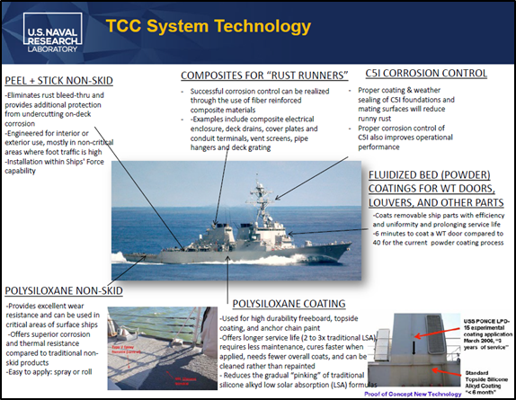
Implementation of Topside Corrosion Control (TCC)
Technology Package
BACKGROUND:
2015 – 2016 - NRL demonstrated TCC on a DDG, showed a 34 fold reduction in ship’s force time
required to address topside corrosion by eliminating sources of “running rust”.
2021 – 2022 – Leadership interest in TCC.
IMPLEMENTATION APPROACH:
2015 – 2022 SEA 05 has updated specifications
and technical requirements to
implement TCC technologies.
Updated coating material specifications.
Updated Standard Item 009-32 coating
application requirements.
Defined practices & procedures with technical
letters and Design Memoranda
TCC technology is available to fleet customers
but technology must be included in work package.
NAVSEA Has Updated Requirements To Transition TCC Technologies To Fleet Service
Distribution A Approved for Public Release
5

Slide 6
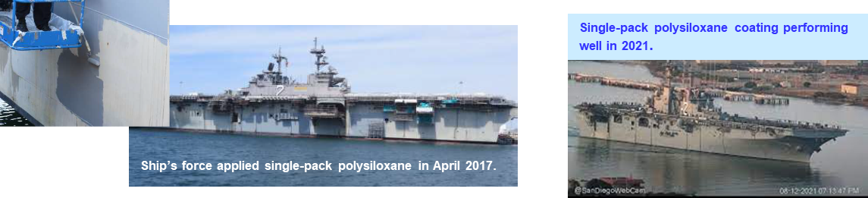
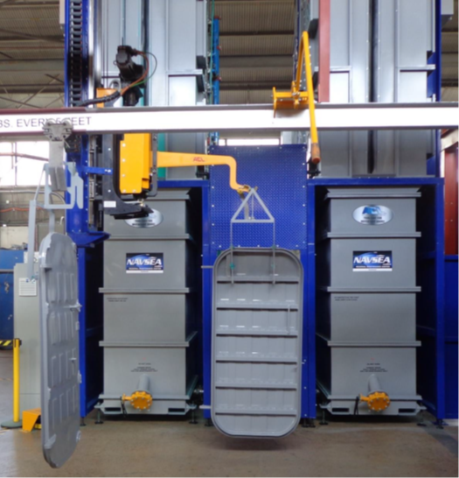
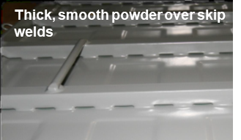
Implementation of Topside Corrosion Control
Topside Coatings
POLYSILOXANE TOPSIDE COATINGS:
Based on TCC success, NAVSEA determined that polysiloxane topside coatings are the only option for topside coatings in NAVSEA Standard Item 009-32:
28 Mar 2018 - FY-19, Standard Item 009-32 requires polysiloxane coatings for topside applications.
21 Apr 2020 - MIL-PRF-24635F topside coating specification includes new single-pack polysiloxane coatings.
FLUIDIZED BED POWDER COATINGS:
TCC fluidized bed powder coating of louvers and hatches fully implemented and being expanded with new East Coast facility.
31 Jan 2011 - FY12, Standard Item 009-32 requires two coat
fluidized bed powder coating for louver preservation.
May 2018 – NAVSEA commissions West Coast fluidized bed powder
coating facility for doors and hatches.
Dec 2022 - Planned start-up of East Coast fluidized bed powder coating facility
for doors and hatches.
NAVSEA Has Updated Requirements To Transition Polysiloxane Topside
Coatings And Fluidized Bed Powder Coatings To Fleet Service.
Distribution A - Approved for Public Release
6

Slide 7
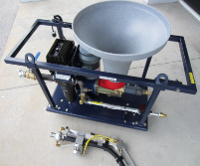
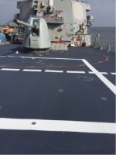
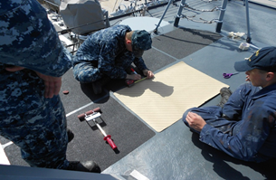
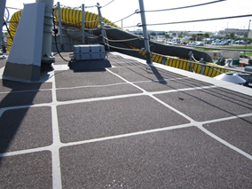
Implementation of Topside Corrosion Control
Nonskid Materials and Processes
POLYSILOXANE SPRAY NONSKID:
Polysiloxane nonskids are qualified for Flight Deck service and spray applied polysiloxane nonskid
implementation is in progress.
25 April 2017 - Published Commercial Item Description (CID) A-A-59982 for
nonskid spray system.
9 Nov 2017 - Qualified first polysiloxane nonskid to MIL-PRF-24667C.
16 Feb 2021 - Published MIL-PRF-24667D nonskid specification that includes new
“Type II” for spray applied nonskid and new “Class 2” for
polysiloxane nonskid.
ONGOING ACTION: Nonskid manufacturers submitting MIL-PRF-24667C product qualification data
packages.
PEEL & STICK NONSKID:
Peel & Stick nonskid qualified to MIL-PRF-24667C with Standard Item 009-26 installation requirements.
19 Jun 2015 - Qualified peel & stick nonskid based on thermal spray nonskid to MIL-PRF-24667C.
8 Apr 2019 - FY-20 Standard Item 009-32 requires only peel & stick nonskid be applied to
LHA/LHD superstructure.
23 Aug 2022 – Released amendment to published MIL-PRF-32704 solid decking specification
that includes clarified “Application C” requirement for wear resistant
peel & stick.
ONGOING ACTION: Amendment to new solid decking specification facilitates
procurement of Application C, wear resistant peel & stick nonskid.
Distribution A - Approved for Public Release
7

Slide 8
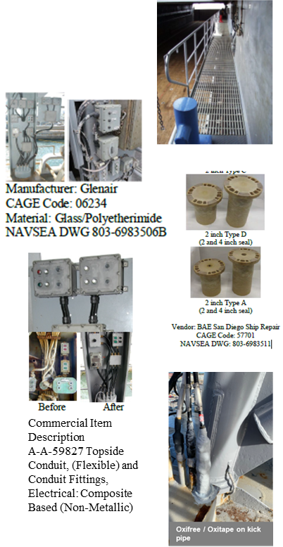

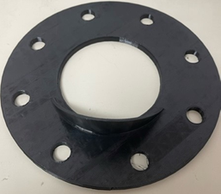
Implementation of Topside Corrosion Control Composite and Corrosion Resistant Materials
COMPOSITE & CORROSION RESISTANT MATERIALS AND HARDWARE:
TCC technologies for composite boxes, connectors, etc. and stainless steel hardware are defined in NAVSEA drawings, letters, and Design Memoranda:
2003 – Published NAVSEA Drawings on composite vent screen installation and
composite deck grating installation.
Nov 2007 – First 38 National Stock Numbers (NSNs) assigned to different composite
electrical box configurations/sizes to support form-fit-function box
replacement.
Dec 2007 – Ship Change Document 609 signed that approved composite box
installation on two stern gate control stations.
12 Nov 2021 – SEA 05Z letter approves use of thermoplastic material on kick pipes.
4 Jan 2022 - Design Memoranda on Corrosion Resistant Material Upgrades
that lists approved composite items (i.e., boxes, deck gratings,
vent screens, conduit, deck drain) and lists stainless steel replacement
hardware for topside fittings.
2022 – Paint Center of Excellence program investigating overboard discharge
extension spouts to minimize freeboard staining
and improve appearance.
NAVSEA Drawings, Letters, and Design Memoranda transition TCC composite and corrosion resistant material technologies to fleet service
Distribution A - Approved for Public Release
8

Slide 9
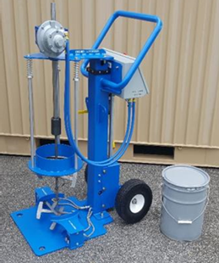
Supply Chain Disruptions Adversely Affecting
Coating / Nonskid Manufacturers
ISSUE: SEA 05P2 addressing issues with qualified coating and nonskid availability since March 2021 when:
- Atypically cold weather in Texas resulted in chemical plant shutdowns that adversely affected
100% of epichlorohydrin, 90% of ethylene glycol, and 60% of epoxy resin production.
- Explosion at an epoxy precursor factory in China in Nov 2020 affected material supplies.
- Fire at alkyd raw material plant in Ohio in Apr 2021 limited resin supply.
- COVID related logistics disruptions (e.g., unavailability of shipping containers, ship
unloading delays, etc.) have adversely affected the coatings supply chain –
coating raw materials costs increased by 34% (Mar 2021 – Mar 2022).
RESPONSE: SEA 05P2 supporting essential coating and nonskid replacement tasks includes rapid response
for qualified coating manufacturers, waterfront work planners, and fleet customers as follows:
1. Assist waterfront teams to locate available supplies of qualified coatings/nonskids:
- Need to check entire QPL on ASSIST database https://quicksearch.dla.mil/qsSearch.aspx
for qualified coating/nonskid suppliers (i.e., there are five qualified nonskid suppliers).
- SEA 05P2 providing senior Navy Account Manager points of contact.
2. Provide technical inspection plan and risk assessment to extend shelf life and use coatings
after expiration date.
- Apr 2022 – Use black ablative antifouling for six months after expiration.
- Feb 2022 – Use of polysiloxane coatings for one year after expiration.
3. Provide options to use alternative nonskid Types to those required by customer or work template with
associated risk assessment.
- Fleet customers prefer MIL-PRF-24667, Type V nonskid than can provide at least 36 months
of service, but use of MIL-PRF-24667, Type I nonskid, that can provide at least 12 months of
service life is technically acceptable – provided nonskids are of the same Composition.
- Changing preferred nonskid Type does not require a DFS.
Coating supply chain issues unlikely to improve until late 2022, and SEA 05P2 will continue to work on
maintaining supplies of essential coatings.
Distribution A - Approved for Public Release

Slide 10
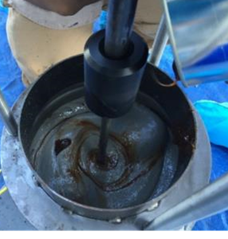

Supply Chain Disruptions Adversely Affecting
Coating / Nonskid Manufacturers
RESPONSE: SEA 05P2 supporting essential coating and nonskid replacement tasks includes rapid response
for qualified coating manufacturers, waterfront work planners, and fleet customers (continued):
4. Provide options to use alternative nonskid Types and Compositions to those required in
Standard Item 009-32 with risk assessment.
- Jul 2021, provided risk assessment for use of alternatives to required, MIL-PRF-24667, Type V
Composition D, low density nonskid.
- Deviating from Standard Item 009-32 requirements requires a departure.
5. Prioritize support for manufacturer’s to modify coating or nonskid formulations to
address raw materials and packaging shortages to maintain coating and nonskid
supply shipyards and contractors:
May 2022 - Published updated ASTM F718 data sheet in less than a week to www.nstcenter.biz website for new
packaging (six gallon can shortage).
Apr 2022 – Recommend manufacturer prioritize available nonskid for CVN (issue: amine shortage).
Mar 2022 - Explain Defense Priorities and Allocations System (DPAS) to classify low-supply nonskid as
“DX” for highest defense urgency (issue: inability to obtain qualified nonskid).
Feb 2022 - Assist naval shipyard in locating bilge coatings (issue: inability to obtain qualified coating).
Jan 2022 - Assist naval shipyard in locating topside coatings by extending shelf life of polysiloxane kits
(issue: inability to obtain haze gray polysiloxane).
Dec 2021 - Approved application of unqualified nonskid to non-critical coated area (issue: inability to obtain qualified nonskid).
Nov 2021 - Posted updated nonskid ASTM F718 data sheets to address packaging in both 5 and 6.5 gallon
cans (issue: can shortage).
Nov 2021 - Provided nonskid manufacturer with streamlined subset of performance requirements to
to allow alternative to fumed silica filler pigment in multiple formulations
(issue: fumed silica shortage).
Oct 2021 - Incorrect raw material supplied to coating manufacturer (issue: alternative resin delivered
in required resin drum).
Sep 2021 - Reviewed streamlined technical data set to rapidly approve alternative to glycidyl ether of
castor oil reactive diluent in multiple nonskid formulations (issue: reactive diluent shortage).
Aug 2021 - Provided risk assessment associated with use of available MIL-PRF-24667C, Composition G
nonskid on flight deck (issue: could not obtain supply of low density nonskid).
Jul 2021 - SEA 21 staff engage coating manufacturer s to locate MIL-PRF-24667C, Type V nonskid
(issue: limited material supply).
Jun 2021 - Extend shelf life of nonskid primer to support production schedule (issue: limited primer supply).
Jul 2021 - Streamlined process for ship testing of reformulated MIL-PRF-24667C, Type I nonskid (issue: limited material supply).
Coating supply chain issues unlikely to improve until late 2022, and SEA 05P2 will continue to work on
maintaining supplies of essential coatings.
Distribution A - Approved for Public Release

Slide 11
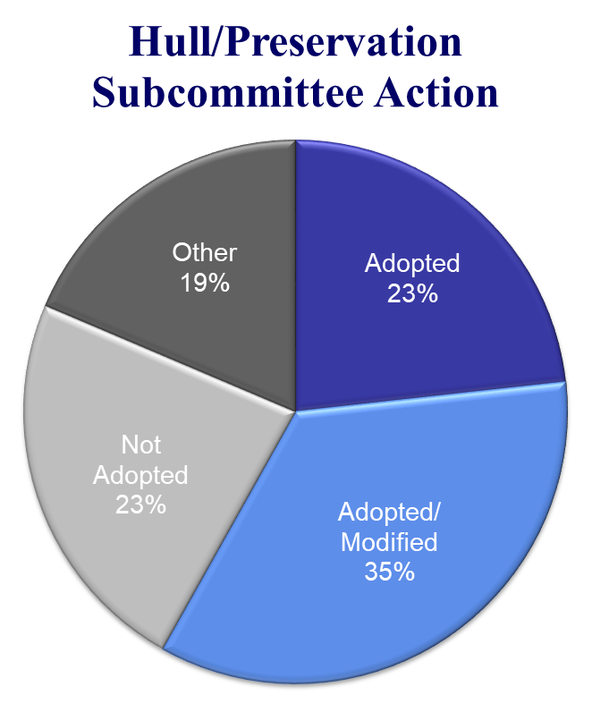
What’s new with Standard Item 009-32?
21 - 23 June 2021, completed in-person Standard Specifications for Ship Repair and Alteration Committee (SSRAC) meeting in Newport News, VA.
23 Aug 2022, FY-24 update to Standard Item 009-32 released for HQ-NAVSEA concurrence.
“Light” year with only 43 total proposals with:
- 10 Adopted
- 15 Adopted/Modified
- 10 Not Adopted
- 8 Other (i.e., open action items and Technical
Warrant Holder directed changes)
- All changes being vetted through established
HQ-NAVSEA (i.e., SEA 04X, SEA 05D, SEA 05P,
SEA 05V, SEA 05U, SEA 05Z, and SEA 08)
review process and all comments will be
incorporated.
Changes to FY-24 Standard Item 009-32 being vetted by established HQ-NAVSEA review process.
11
Distribution A: Approved for Public Release

Slide 12

What’s new with Standard Item 009-32?
“Top Five” updates to FY-24Standard Item 009-32:
1. Technical Authority directed change to define requirements
for removing conventional nonskid from around the visible
perimeter of Thermal Spray Nonskid (TSN).
2. Adopt A-A-60016 non-metallic grit recycling system.
3. Expand use of all MIL-A-22262 qualified abrasive grit
(i.e., including 10X) to aluminum substrates by excluding
coal slag media.
4. Clarified requirements for nonskid installation around
helicopter hangar door.
5. Updated exterior and tank coating requirements
for LCS 2 Class.
6. Technical Authority directed change to eliminate citations
to Amercoat 3258.
FY-24 cchanges to Standard Item 009-32 were vetted using established HQ-NAVSEA review process.
Distribution A: Approved for Public Release
12

Slide 13
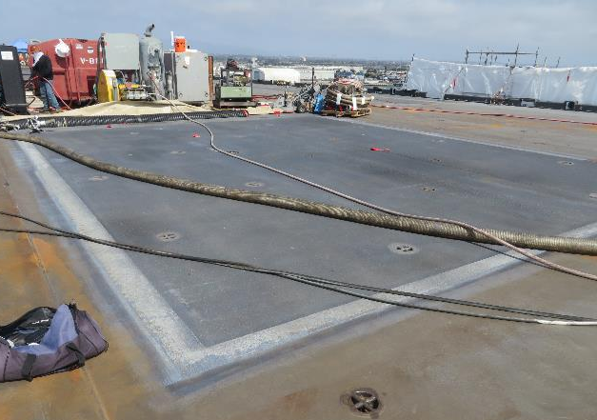
Technical Authority Directed Change to Note (46)
New Requirements to Remove Conventional Nonskid Applied Over Thermal Spray Nonskid
ISSUE: Current NRL “best practices” require iterative process and define successful conventional
nonskid removal that retains some primer and nonskid in the conventional nonskid overlap or
interface area.
Define width of overlap area as 18-inches from
any visible Thermal Spray Nonskid (TSN).
Remove nonskid using High Pressure Waterjet Cleaning starting at 10,000 psi water pressure.
As directed by the SUPERVISOR, increase pressure in 2,000 psi increments to remove nonskid.
Do not use water jet pressure above 25,000 psi to preclude damage to TSN.
RESULT: QA/QC acceptance criteria difficult to define because current “best practices” allow
retention of some nonskid primer in overlap areas.
SUPERVISOR to consult with NAVSEA-approved Technical Representative to accept workmanship.
Updated Note (46) that was “intentionally left blank” to cite a removal process and defer to SUPEVISOR for details.
Distribution A: Approved For Public Release
13

Slide 14
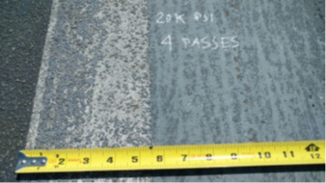
Technical Authority Directed Change to Note (46) (Continued)
New Requirements to Remove Conventional Nonskid Applied Over Thermal Spray Nonskid
RESULT: Updated Note (46) that was “intentionally left blank” in FY-23, Change 2, Standard Item 009-32
to include new requirements for conventional nonskid removal around visible Thermal
Spray Nonskid (TSN) to avoid damage to TSN that is under the conventional nonskid.
New FY-24, Standard Item 009-32 Note (46) to read as follows:
“Note (46) As directed by the SUPERVISOR, remove nonskid within 18 inches
of any visible Thermal Spray Nonskid (TSN) using High Pressure Waterjet
Cleaning (HP WJ) with an initial operating pressure of 10,000 PSI.
Increase HP WJ operating pressure by increments of up to 2,000 PSI until
the HP WJ process removes nonskid without damage to the underlying TSN.
Conduct six passes over the work zone at the operating pressure that
removes nonskid, but does not damage the underlying TSN, to remove the
nonskid. HP WJ operating pressure must not exceed 25,000 PSI.
The updated Note (46) will appear in Table 2, Lines 17 – 20 that define requirements for nonskid work on
LHA, LHD, LPD, and LSD class ships.
The updated Note (46) will rely on the SUPERVISOR to consult with NAVSEA-approved Technical
Representative to avoid damage to the TSN and accept workmanship.
Note: Nonskid removal will take multiple passes and this image was four passes at 20,000 PSI. Note that nonskid “removal” will still result in some remnants remaining and the SUPERVISOR would need to know to accept such a condition, ideally after consultation with the NAVSEA-approved Technical Representative.
Updated Note (46) that was “intentionally left blank” to cite the nonskid removal process and defer to SUPEVISOR for details.
Distribution A: Approved For Public Release
14

Slide 15
Adopted A-A-60016
Commercial Item Description for Non-metallic Abrasive Grit Recycling System
ISSUE: 28 Jul 2020, published Commercial Item Description (CID) A-A-60016, “Recycling Equipment for Non-Metallic
Abrasive Blast Grit,” but limited customer demand.
- System designed to reduce costs and waste disposal volumes from non-metallic abrasive grit blasting
operations by recycling intact grit and separating out paint chips and other “fines.”
- System developed by Naval Research Laboratory (NRL)
using funding from the Paint Center of Excellence (PCOE)
and demonstrated using spent, 16 and 24 mesh aluminum oxide
grit from the USS ESSEX (LHD 2) thermal spray nonskid install.
RESULT: FY-24 update to Standard Item 009-32 includes a new paragraph 3.1.3.9
that states:
“3.1.3.9 Recycled, non-metallic abrasive blast media
conforming to MIL-A-22262, A-A-1722, or SSPC AB-1 can be
used for abrasive blasting processes as specified in
the invoking Work Item or Task Order. Sampling and testing
of the recycled, non-metallic abrasive must meet the
requirements for cleanliness (oil and conductivity)
contained in SSPC AB-1 (paragraph 4.1.14 Water Soluble
Contaminants, and 4.1.6 Oil Content) once per day.
Recycling of non-metallic grit must be accomplished using
equipment meeting CID A-A-60016.”
Grit recycling system can recover 60% to 70% of waste grit for re-use reducing grit costs by ≈38%.
Distribution A: Approved for Public Release

Slide 16
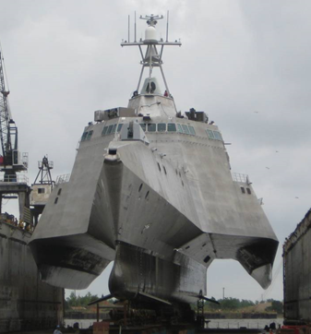
Technical Authority Directed Change to Table 2
Require Topside Coating to be Applied in Amah Tunnels on LCS 2 Class
ISSUE: Current, FY-23, Change 2, Standard Item 009-32, Table 2 is silent
about the area on the LCS 2 Class that is above the boot-top,
and between the central hull and the amah outriggers.
BACKGROUND: The LCS 2 Class trimaran hull is coated with topside coating
system on all vertical, angled, and horizontal surfaces of the
“tunnels” between the central hull and the amah outriggers.
- Spray from high speed operations would cause aluminum
corrosion above boot-top on tunnel vertical/horizontal surfaces.
- New construction ships delivered with epoxy primer and
haze gray silicone alkyd topside coating system in tunnels.
- Silicone alkyd coating system degraded by high speed
spray requires replacement.
Areas coated with topside coating system.
RESULT: Updated FY-24, Standard Item 009-32 to require coating in Table 2, Lines 53 and 54 to cite: “EXTERIOR SURFACES ABOVE BOOTTOP, INCLUDING AMAH TUNNELS, WITH EXCEPTION OF AREAS
RECEIVING NONSKID.”
Column E to add following: “AMAH TUNNEL, ONE COAT HAZE GRAY MIL-PRF-24635, TYPE V OR VI,
CLASS 2, GRADE B OR C, COMPOSITION 1, 2 - 3 MILS”
- Class Standard Work Template (CWST) to provide drawing/details for locating forward edge of
coating system using knuckles and frame numbers.
- Standard Item 009-06, “Maintaining Protection and Cleanliness from Non-Radioactive Contaminate-
Producing Operations; accomplish” defines requirements for masking to prevent coating overspray
on central hull, amah, and transom.
Change requires use of high performance polysiloxane coating system in amah tunnel to increase coating system service life and reduce life-cycle corrosion risk in these areas.
Distribution A - Approved For Public Release
16

Slide 17
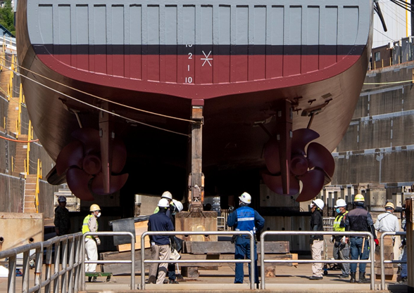
Technical Authority Directed Change to Table One
Eliminate Requirement for Amercoat 3258 on Minesweepers
ISSUE: Current, FY-23, Change 2, Standard Item 009-32, Table One, Lines 20 and 22 require three full
coats and two stripe coats of Amercoat 3258 on minesweeper appendages and on
4 Aug 2022, PPG/Ameron confirmed they are no longer manufacturing Amercoat 3258.
BACKGROUND: The Amercoat 3258 requirements were first included in the FY-06, Standard Item 009-32
Table One, Line 43 for “UNDERWATER HULL APPENDAGES ON MINESWEEPERS ONLY.”
SEA 05P2 knows the change was related to cathodic protection.
- Requirement from adhesion study of MIL-DTL-24441 coatings from
different manufacturers showed maximum adhesion to inherently
difficult to coat, noble metal surfaces.
- August 2008, NAVSEA Advances Coating Message,
cited Amercoat 3258 as being approved for use with
a Preservation Process Instruction, on appendages
and propellers, but included the following:
“(NOTE: PRODUCT AVAILABLE BY SPECIAL ORDER).”
- Over the past decade, SEA 05P2 has addressed multiple DFS that could not
locate Amercoat 3258.
Technical Authority directed change to FY-24 Standard Item 009-32 to replace Amercoat 3258 with MIL-DTL-24441, Type IV.
Distribution A: Approved for Public Release
17

Slide 18
Technical Authority Directed Change to Table One
Eliminate Requirement for Amercoat 3258 on Minesweepers
RESULT: To address multiple DFS that could not locate Amercoat 3258, SEA 05P2 implemented
Technical Authority directed change to FY-24 Standard Item 009-32 .
Current, FY-23 Change 2 Standard Item 009-32 Table One, New, FY-24, Standard Item 009-32 Table One,
Line 20 and 22, Column B requirement Line 20 and 22, Column B requirement
ONE FULL COAT ONE FULL COAT
--- & --- --- & ---
ONE STRIPE COAT ONE STRIPE COAT
--- & --- --- & ---
ONE FULL COAT ONE FULL COAT
--- & --- --- & ---
ONE STRIPE COAT ONE STRIPE COAT
--- & --- --- & ---
ONE FULL COAT AMERCOAT 3258 DARK GRAY, ONE FULL COAT MIL-DTL-24441, TYPE IV
3 - 5 MILS/COAT 3 - 5 MILS/COAT
SEE NOTE (40) SEE NOTE (40)
- To date, SEA 05P2 has had no reports of inadequate adhesion of MIL-DTL-24441, Type IV to
appendages.
- Reduces administrative costs.
Technical Authority directed change to FY-24 Standard Item 009-32 to replace Amercoat 3258 with MIL-DTL-24441, Type IV.
Distribution A: Approved for Public Release
18

Slide 19
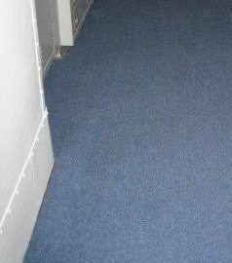
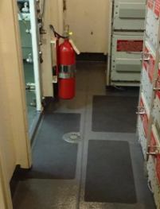
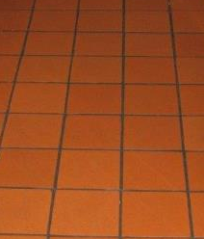
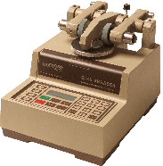
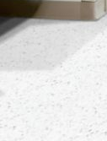
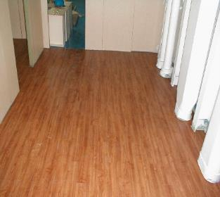
New MIL-PRF-32704 Specification
Consolidates Requirements for Solid Decking
ISSUE: 23 Aug 2022, released amendment to published MIL-PRF-32704, “DECK COVERING MATERIALS, TILE
AND SHEET FLOORING,” that includes the Type XI “Peel and stick” nonskid from
MIL-PRF-24667C to address inconsistency in ASTM D4060 test method and performance
requirement for wear resistance.
- 24 Apr 2022 inactivation notice for MIL-PRF-32170 on halogen-free deck tile.
- Expands requirements for peel & stick nonskid to include wear resistant materials.
CS 17 wheel
1-kilogram (2.2-pound) load
1,000 cycles to wear
Weight loss shall be not
greater than 0.1 gram
(0.004 ounce).
Quarry tile
ANSI A137.1
Carpet
DDD-C-95
Peel & stick
MIL-PRF-24667
Vinyl Tile
ASTM F1700
ASTM F1066
Wear resistant tile
MIL-PRF-32170
New MIL-PRF-32704 includes current MIL-PRF-24667C, Type XI peel & stick nonskid and other solid decking systems.
Distribution A: Approved for Public Release

Slide 20
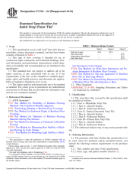
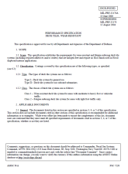
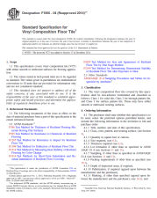
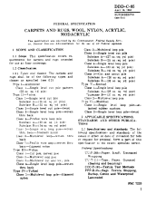
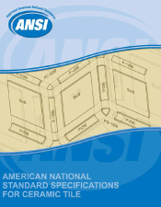
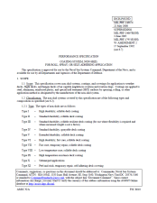
New MIL-PRF-32704 Specification
Consolidates Requirements for Solid Decking
DRAFT MIL-PRF-XX642
PERFORMANCE SPECIFICATION
DECK COVERING MATERIALS, TILE AND SHEET FLOORING
This specification is approved for use by all Departments and Agencies of the Department of Defense.
1. SCOPE
1.1 Scope. This specification covers tile and sheet flooring materials for shipboard use as deck covering systems.
1.2 Classification. Tile and sheet flooring materials are of the following types, classes, grades, and compositions as specified (see 6.2).
1.2.1 Types.
a. Type Ia – Solid vinyl floor tile
b. Type Ib – Vinyl composition tile
c. Type II – Wear-resistant, halogen-free floor tile
d. Type III – Unglazed, porcelain ceramic tile
e. Type IV – Unglazed, quarry ceramic tile
f. Type V – Wool carpet
g. Type VI – Peel and stick nonskid (self-adhering slip-resistant treads)
1.2.2 Classes.
a. Class 1 – For general shipboard use
Class 2 – For submarine use
1.2.3 Compositions
⁓
1.2.4 Applications.
For interior use
For exterior use
For wear resistant use
1.2.5 Grades
⁓
ASTM F1700
MIL-PRF-32170
To be cancelled
ASTM F1066
DDD-C-95
Cancelled - 1998
ANSI A137.1
MIL-PRF-24667
Type XI
Moved
here
New MIL-PRF-32704 presents challenge to industry to qualify products to updated requirements.
Distribution A: Approved for Public Release

Slide 21

FY-23 Standard Item 009-32
Implementation of SSPC-SP 18
KEY ISSUE: Need to waterfront training and support cited during 2021 SSRAC meeting discussion
of Change Proposal to adopt SSPC-SP 18.
- Support for waterfront implementation is accepted challenge:
- Assist personnel with Navy Basic Paint Inspector (NBPI) credential to
adequately assess coating adhesion and surface preparation.
- Need for visual comparators or specialized QA/QC
materials be to support partial blast.
- Need QA/QC process slow to accommodate myriad possible
combinations retained coating, staining, and profile on rough,
irregular surfaces? What are go/no-go criteria for accepting or
rejecting workmanship?
Training and Waterfront support options include:
1. Personnel that worked on NSRP projects available – need funding.
2. NRL working on Paint Center of Excellence Project - not planning on-site support.
Bristle blast to SSPC-SP 11
NAVSEA planning to support SSPC-SP 18 as new Table/Line citations in Standard Item 009-32.
Distribution A: Approved for Public Release

Slide 22
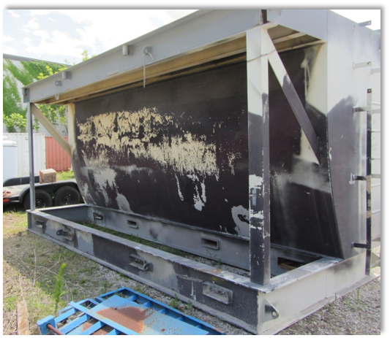
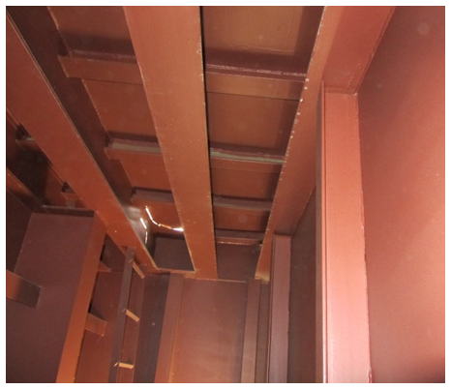
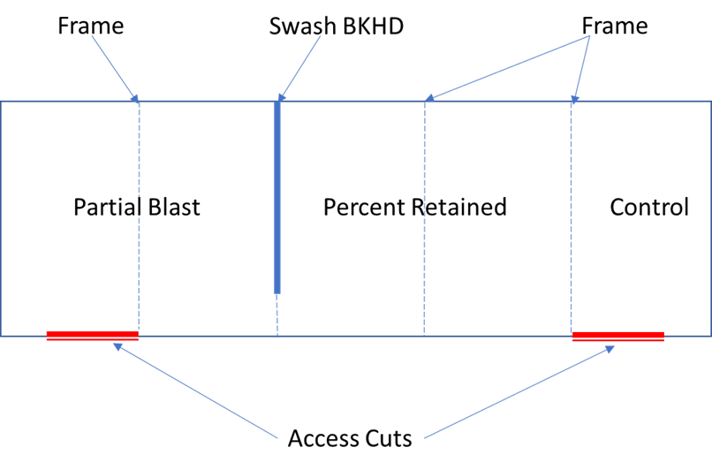
FY-23 Standard Item 009-32
Implementation of SSPC-SP 18
KEY ISSUE: Need for waterfront training and support cited during 2021 SSRAC meeting discussion
of Change Proposal to adopt SSPC-SP 18.
• Support for waterfront implementation of SSPC-SP 18 being developed.
• NRL has a mock tank project to develop “lessons learned”
and training materials for partial blast process:
- July 2022 to demonstrate process on mock tank in Norfolk, VA
with invitation to RMC staff to observe process.
- NRL requesting Paint Center of Excellence funding for
waterfront support in FY-23.
• NRL preparing training webinars to support SSPC-SP 18 rollout,
will be posted to NRL Wiki page in Jun 2022.
• Second NRL webinar planned to follow the mock tank demonstration in Sep 2022.
Zone #1 - Full coating removal to SSPC-SP 10 (control)
Zone #2 - Majority retained paint
Zone #3 – Majority SSPC-SP 10
Artificially age
newly installed
UHS system
Exterior of Mock Tank
Majority SSPC-SP 10
Majority retained
paint
Bristle blast to SSPC-SP 11
NAVSEA working with NRL to support SSPC-SP 18 implementation with training materials and additional information.
Distribution A: Approved for Public Release

Slide 23
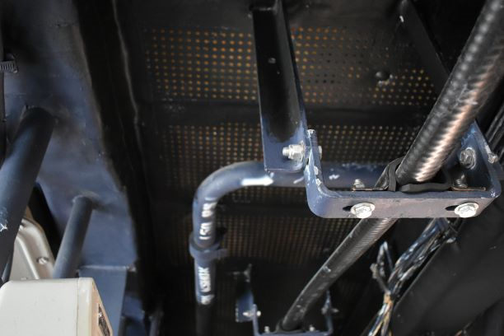
Published MIL-PRF-24596C and MIL-DTL-24607
Updated Interior Topcoat Specification to Address Fleet Needs
4 Jan 2022, published MIL-PRF-24596C, COATING COMPOUNDS, NONFLAMING, FIRE-RESISTANT,
that includes previous amendments regarding viscosity, batch volatile organic compound
certification, and other issues since MIL-PRF-24596B was published in 2009.
Updated formula to cite current raw materials and ingredients and to update colors.
Fleet had been requesting to use “bright white” in place of soft white to lighten spaces and
increase visibility.
SEA 05P2 noted need for flat, dark blue as per NSTM 631 Table 631-8-11, Note 9:
“Pastel blue, color number 25526, MIL-DTL-24607 shall be used on bulkheads in CIC spaces
and outboard operations and communications spaces with Broad Band Blue Operation
Lighting systems. Overheads shall be insignia blue, color number 35044.”
Increased Fleet customer interest in dark, flat, insignia blue
(SAE AMS-STD-595, Color Number 35044).
- Only MIL-DTL-24607 has insignia blue NSN.
- Color “Not Stocked” in supply system.
- Supply of coating limited by demand.
MIL-PRF-24596C and MIL-DTL-24607 available on ASSIST and manufacturers can prepare qualification update packages.
Distribution A: Approved for Public Release
23

Slide 24
Streamlined MIL-PRF-24596C and MIL-DTL-24607 Topcoat Colors
Color reduction in interior alkyd specifications reduces logistics and waste.
Rosewood #22519 | Yellow Gray #26400 | Sunglow #23697 | Clipper Blue #24516
Pastel Green #24585 | Pastel Blue #25526 | Bulkhead Gray #26307 | Beach Sand #22563
Pearl Gray #26493 | Green Gray #26496 | Soft White #27880
Pastel Green #24585 | Pastel Blue #25526 | Bulkhead Gray #26307 | Beach Sand #22563
Insignia Blue #35044 | Bright White #27925 | Soft White #27880
Distribution A: Approved for Public Release
24

Slide 25
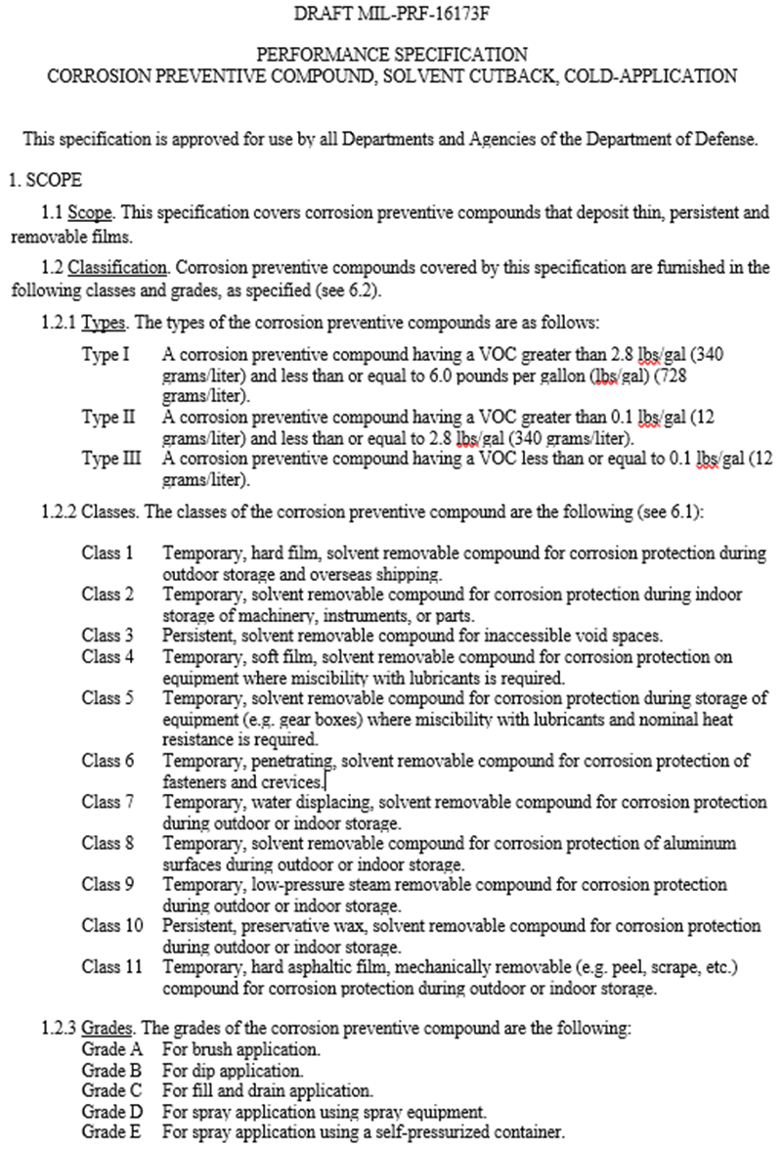
Updating MIL-PRF-16173F Specification
Including New Preservative Types, Modified Classes, and Revised Grades
Created new Types of products to include lower VOC levels (e.g., <12 g/l)
Modified Classes to include new, “Persistent” preservatives
Modified Classes to include specific applications (e.g., gear boxes, fasteners, etc.)
Modified Classes to cite MIL-PRF-16173E Grades that required specific preservative removal methods (e.g., steam removable)
Revised Grades to define the application methods (e.g., self-pressurized container)
MIL-PRF-16173E cites 14 archaic Federal specifications while current MIL-PRF-16173F cites only one Federal specification
Distribution A: Approved for Public Release

Slide 26
Regulatory Issue
Oxsol 100 Defined as Carcinogen in California
ISSUE: Oxsol 100 or parachlorobenzyltrifluoride (PCBTF), an exempt solvent used in Navy coatings,
was listed under California Proposition 65 as a carcinogen based on a 2018 study from the
National Toxicological Program.
South Coast Air Quality Management District, (SCAQMD)
proposing to eliminate exempt solvent status.
AFFECTED NAVSEA SPECIFICATIONS: Performance specifications like MIL-PRF-24635 and detail
specifications like MIL-DTL-24607.
ACTIONS: Sep 2022 support for American Coatings Association (ACA) conference call with
South Coast Air Quality Management District (SCAQMD) about de-listing PCBTF and
noted solvent used in paints in 64% of NAVSEA’s coatings specifications.
1 Sep 2022 SCAQMD will host a public workshop to solicit comments for Proposed, Amended
Rule 1168 (Adhesive and Sealant Applications).
- Delays effective date for certain categories where the technology assessment has
demonstrated need for more time.
- Prohibits the use of Para-Chlorobenzotrifluoride (pCBtF) and Tertiary-Butyl Acetate (t-Bac).
- Allows some higher VOC limits due to the prohibition on pCBtF and t-Bac.
PCBTF
De-listing of PCBTF as an exempt solvent in California could adversely affect ability of U.S. Navy to coat ships in San Diego, CA.
Distribution A: Approved for Public Release

Slide 27
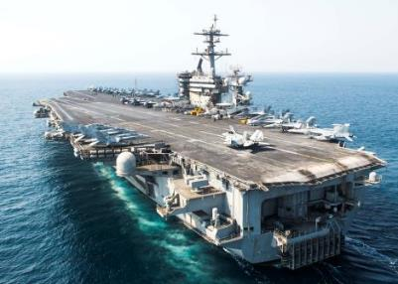
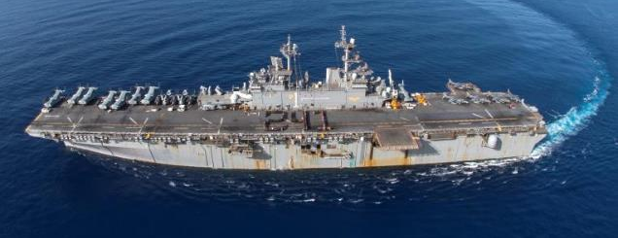
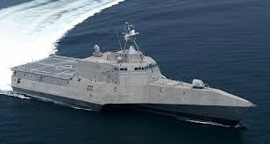
Conclusions
• NAVSEA goal is to support Fleet customer by updating coating specifications and enhancing
coating application processes.
• NAVSEA publishing FY-24 update to Standard Item 009-32 to address multiple, issues including
requirements for conventional nonskid removal around TSN, update of LCS 2 Class requirements
removal of archaic coatings.
• NAVSEA publishing amendment to MIL-PRF-32407 to consolidate requirements for solid decking
and flooring.
• NAVSEA published MIL-PRF-24596C and MIL-DTL-24607 to better align colors with emerging
Fleet customer needs.
• NAVSEA goal to work with NSRP attendees and waterfront community to address evolving
regulatory issues.
Distribution A: Approved for Public Release

Slide 28
QUESTIONS?
Distribution A: Approved for Public Release
28

