Slide 1
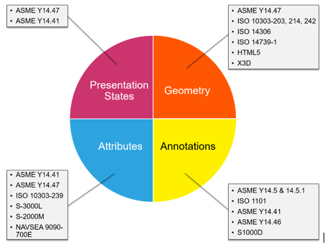
Minimum Standardized Content to Enable a Navy Digital Enterprise (NSRP RA 2001-05) BT & SDMT Joint Panel Meeting September 1, 2022 Honolulu, Hawaii
Newport News Shipbuilding a Division of HII
Presenters:
Mark Debbink
Alicia D’Aurora-Harmon
Project Team:
HII - Newport News Shipbuilding
HII - Technical Solutions
Action Engineering
Bath Iron Works
LMI
NAVSEA
Huntington Ingalls Industries, All Rights Reserved 2022

Slide 3
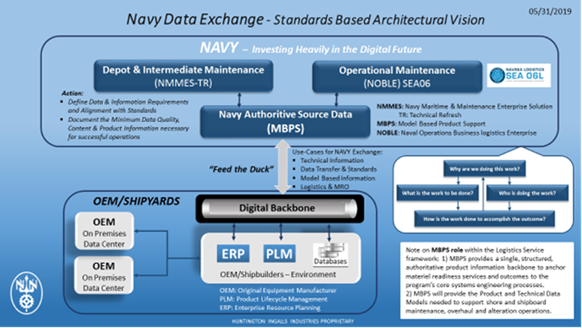
Agenda - Minimum Standardized Content to Enable a Navy Digital Enterprise
Project Overview & Objectives
Phases 1 & 2 Recap
Phase 2B Activities:
Discipline Specific 3D Models
Presentation Tool Configuration
Publishing
What does the ideal product look like?
End-User Evaluation & Feedback
Standards Organization Engagement

Slide 4
Project Overview
PROBLEM :
The Navy is investing heavily in the Digital Future and is aware that the transition from legacy Shipbuilding “Drawing Centric Processes” to “Digital Data Centric Processes” is considered High Risk.
OBJECTIVE:
The objective of this project is to enable Navy advanced data collaboration through the configuration management of content & format that conforms to defined standards and specifications.
Phase 2B
Develop discipline specific standard models & address Standards Organizations
Duration: Six Months
Phase 1
Research Format and Structure
Duration: Six Months
Phase 2
Develop Standards Models & Use-Cases
Duration: Six Months

Slide 5
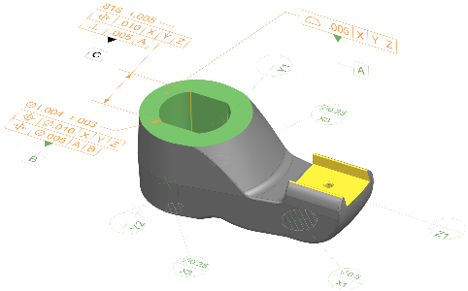
Minimum Standardized Content to Enable a Navy Digital Enterprise
Phases 1 & 2 Project Recap
This Project completed:
Phase 1, The team conducted research of Industry Standards, defined information necessary for Navy operations, and identified standards for minimum data required for exchange.
Phase 2, Identified the data elements that should be considered a priority to be included in the minimum set of data, applicable data standards, impact on data retention policy, and recommendations for subsequent phases.
We successfully completed our objectives by applying a systematic Model Based System Engineering (MBSE) approach to developing requirements for data exchange and the fulfilling them.

Slide 6
Phase 1 Recap: Technical Findings
Major NAVSEA Technical Data
ISO 10303 – 203 | Configuration controlled 3D designs of mechanical parts and assemblies
ISO 10303 – 239 | Product Lifecycle Support
ISO 10303 – 242 | Managed model based 3D engineering
S1000D | International specification for technical publications using a common source database
S2000M | International specification for Material Management
S3000L | International procedure specification for Logistics Support Analysis
S3000L | International procedure specification for Logistics Support Analysis
NAVSEA 7070-900 | Ship Configuration and Logistics Support Information System
EIA 649C | Configuration Management Standard
GEIA-HB-649 | Configuration Management Standard Implementation Guide
ASME Y14- Series Standards
ASME Y14.1, Decimal Inch Drawing Sheet Size and Format
ASME Y14.1M, Metric Drawing Sheet Size and Format
ASME Y14.2, Line Conventions and Lettering
ASME Y14.3, Orthographic and Pictorial Views
ASME Y14.5, Dimensioning and Tolerancing
ASME Y14.24, Types and Applications of Engineering Drawings
ASME Y14.34, Associated Lists
ASME Y14.35, Revision of Engineering Drawings and Associated Documents
ASME Y14.36, Surface Texture Symbols
ASME Y14.38, Abbreviations and Acronyms for Use on Drawings and Related Documents
ASME Y14.41, Digital Product Definition Data Practices
ASME Y14.100, Engineering Drawing Practices
TDP Functional Categories
3D Geometry
3D Model-Based Definition
Solid Model Geometry and Basic Dimension
3D Model-Based Product Definition for Manufactured parts
Domain Specific 3D Model-Based Definition
3D Model-Based EARLY STAGE SHIP Product Definition
3D Model Based Product Definition for molded forms
3D Model-Based Product Definition for Structural Systems
3D Model-Based Product Definition for Arrangements
3D Model-Based Product Definition for Plant Spatial Systems
3D Model-Based Definition for Facilities
Defeatured 3D Model-Based Definition
Alternative 3D Model-Based

Slide 7
Phase 1 Recap: Information Cohorts & Use Cases
Cohort Personas (Analysist, Inspector, Consumer, Command) and Interview Questions:
Use case 1, maintenance scenario
Who does the routine maintenance?
An example of a specific maintenance event and the related information
Benefits and concerns be around moving this use case into a 3D Digital platform?
Use Case 2, casualty incident
Who reacts in this situation?
What training goes into repair response?
An example casualty incident
Benefits and concerns be around moving this use case into a 3D Digital platform?
Use Case 3, general component information for replacement
Who would need to access data around a component?
Why do they need to access it?
How do they get that information today?
Benefits and concerns be around moving this use case into a 3D Digital platform

Slide 8
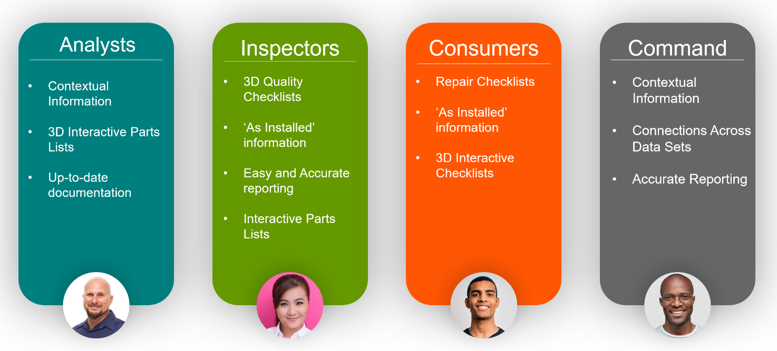
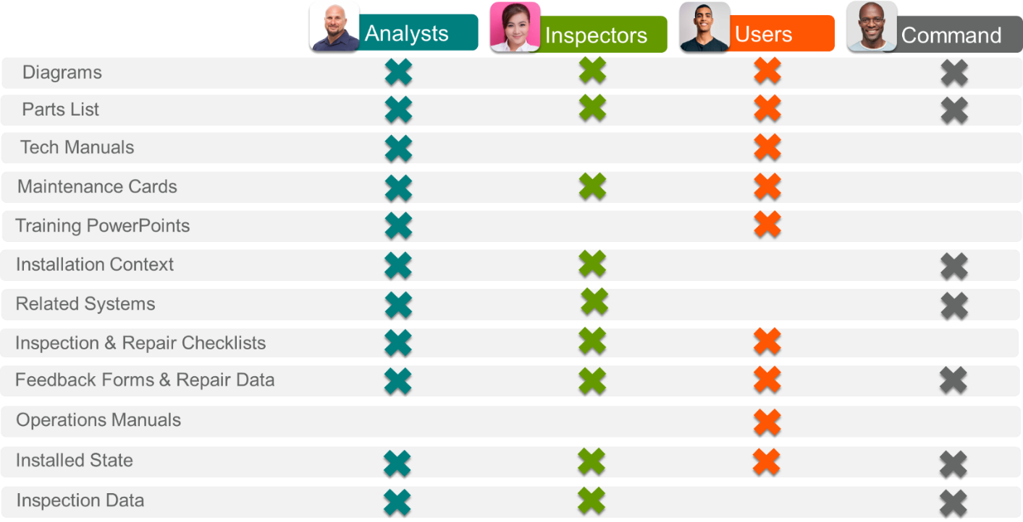
Phase 1 Recap: Cohorts Information & Key Artifacts
Key Artifacts
Mapped to information cohorts
Are essential to identification of which standards are required
Mapped to the Digital Shipbuilding phases depict when each standard is used
Information Cohorts
Developed from personas
Developed to identify artifacts
Action Engineering, LLC Proprietary – do not reproduce, repurpose, or distribute without written permission from Action Engineering, LLC
Huntington Ingalls Industries, All Rights Reserved 2022

Slide 9
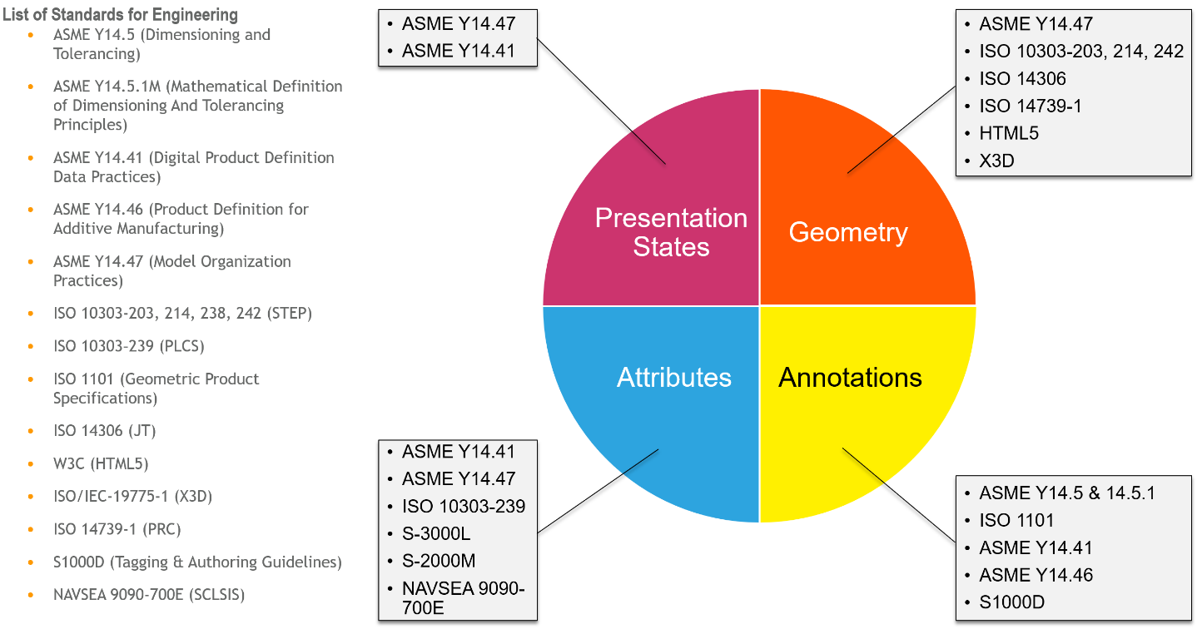
Phase 1 Recap: Engineering Information Standards
Action Engineering, LLC Proprietary – do not reproduce, repurpose, or distribute without written permission from Action Engineering, LLC

Slide 10
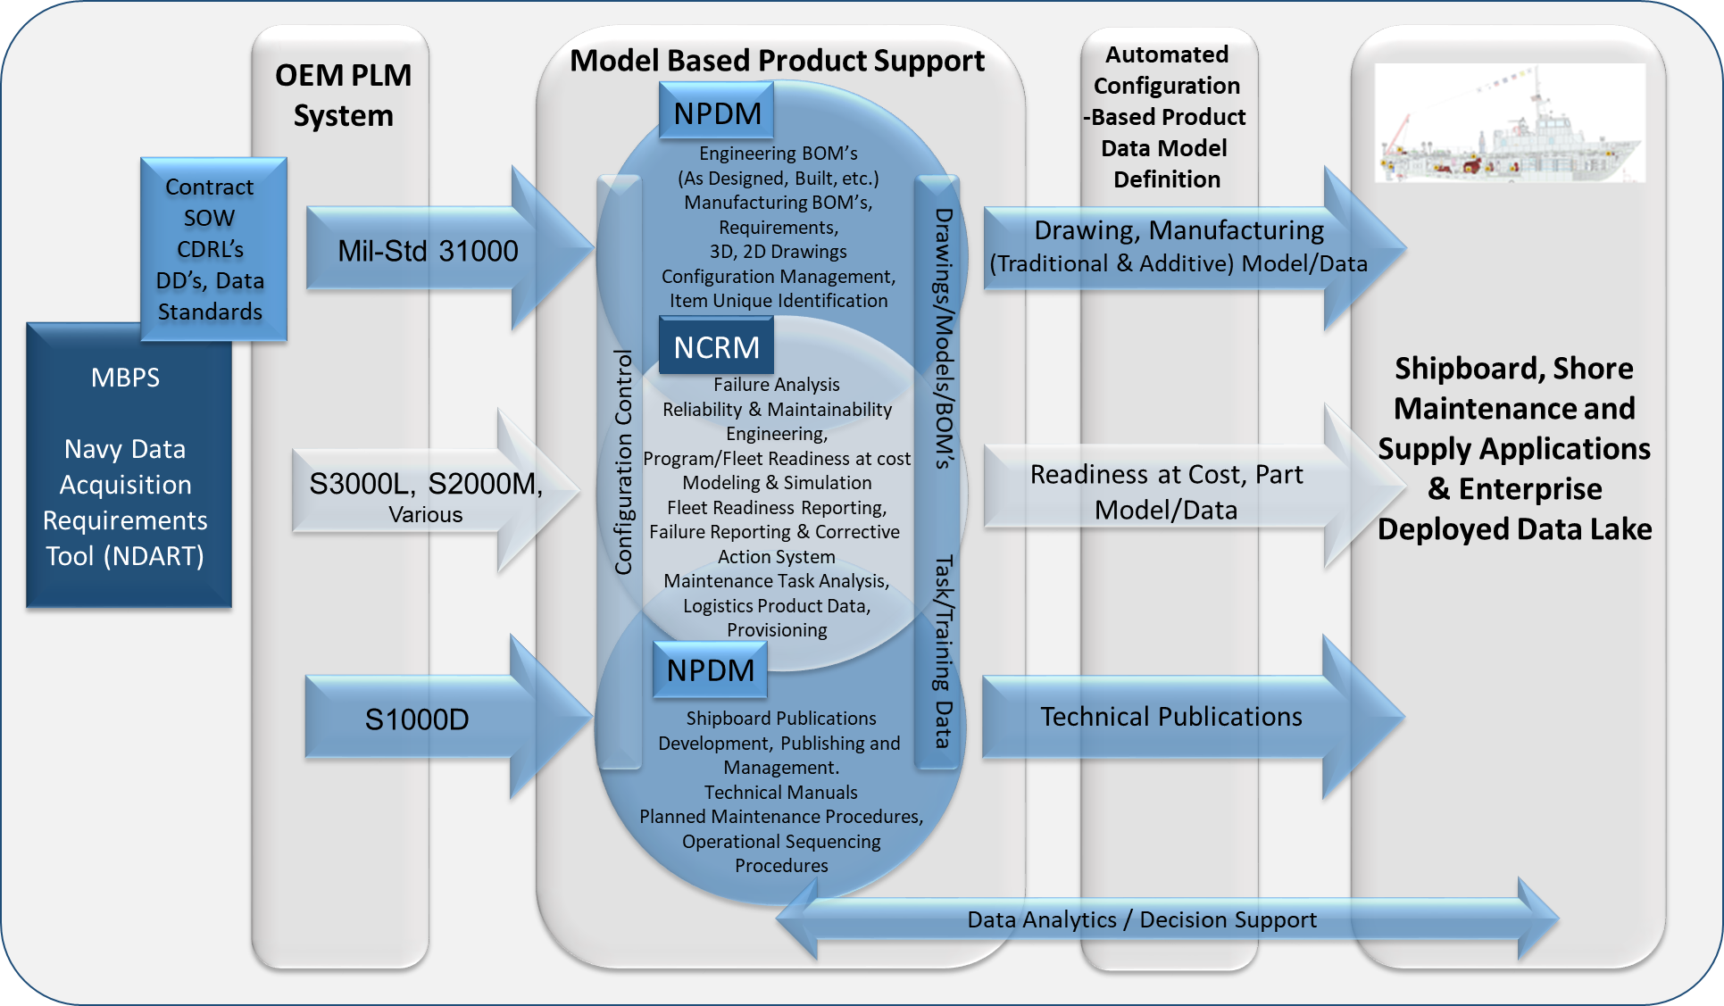
Minimum Standardized Content to Enable a Navy Digital Enterprise
The Model Based Process – Standards Exchange
Phase 1 Recap:
Cloud
Environment
Standard
Referenced
ASME
ISO
Mil-STD
EIA
QIF
ISO
S-Series
NAVSEA
Need to Know
OEM Engineering Design Artifacts
N-PLM Model Based Product Support (MBPS) Process
Project Deliverables:
Minimum Attribute List with associated specification source for Logistic use cases
Data & Specification Compliant Model (Watertight Door Frame)
Published Information Package example for end-user consumption
Newport News Shipbuilding, a Division of Huntington Ingalls Industries, All Rights Reserved 2021

Slide 12
Phase 2 Recap: Identification of Impacts to Data Retention policies
Infrastructure | Employ a standards-based, open systems architecture that enables the digital thread, advanced methods for cybersecurity, and protection of intellectual property.
Technical Data | Ensure the right model-based technical data is available in the right place at the right time for the right cost.
Digital Engineering Technologies | Solutions to support DoD’s Digital Engineering Strategy and Digital Modernization efforts for NAVSEA such as 3D TDPs, artificial intelligence, augmented realities, digital twin, and machine learning.
Workforce | Providing a relevant development program that captures the interest of the next generation workforce and enables the current workforce to become proficient with new technologies while motivating both groups.
Collaboration | Information sharing within NAVSEA as well as across the enterprise boundaries with the other services and the DLA, other government agencies, and industry.

Slide 13
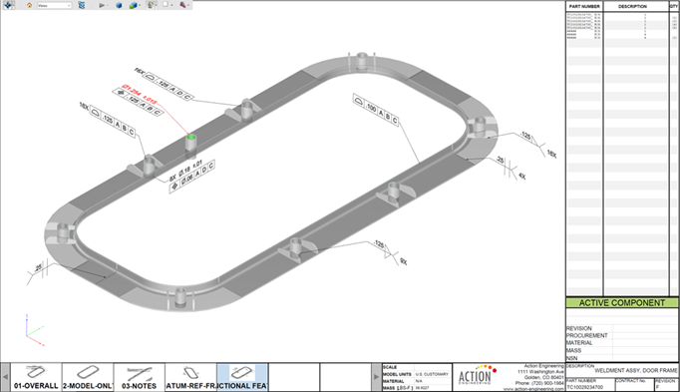
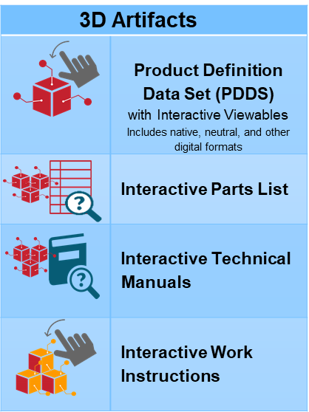
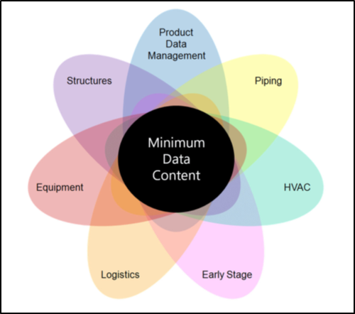
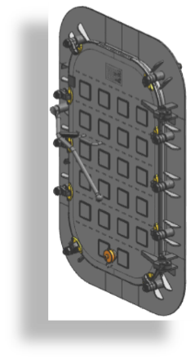
Phase 2 Recap:
Minimum Standardized Content to Enable a Navy Digital Enterprise
The Model Based Product - Published
Information Publishing Combines Data and Geometric Views to meet Persona needs.
Bi-Directional BOM
Minimum Data Content is
Defined and Structured
Model Based
Capabilities
Preset Views / Links
Data spans entire lifecycle
Includes both processes & products
Process includes
Configuration Management
Manufacturing Operations
Maintenance
Installation
Training
3D
Model
Set 2D
Views
3D
Notes
Ref.
Data
Weldment Assembly
Door Frame Example
FEA
Project Benefits
Remove cost associated with non-standard digital data by eliminating:
Additional work for data validation due to lack of authoritative traceability
Additional work associated with configuration management of data mapping software to align Shipyard and Navy data fields
Ensuring the pedigree of shared technical data to the authoritative source
Newport News Shipbuilding, a Division of Huntington Ingalls Industries, All Rights Reserved 2021

Slide 14
Phase 2B SOW Kick-Off :
Develop Discipline Specific Standard Models & Address Standards Organizations
Develop additional discipline specific 3D standards models and publish examples for training
Provide test and findings report on HTML 3D Viewable publishing capabilities (COTS)
Provide a report on the integration requirements of attributes and 3D Viewables into end-user Systems
Test & analyze 3D viewable data sets with working sailors (end-users)
Draft and propose new Shipbuilding standards for selected standards organizations
(e.g. Liaise with ASME, AIA, ISO, NAVSEA SCLSIS, etc.)
Develop standard end-to-end technical disclosure workflow process for publishing

Slide 15
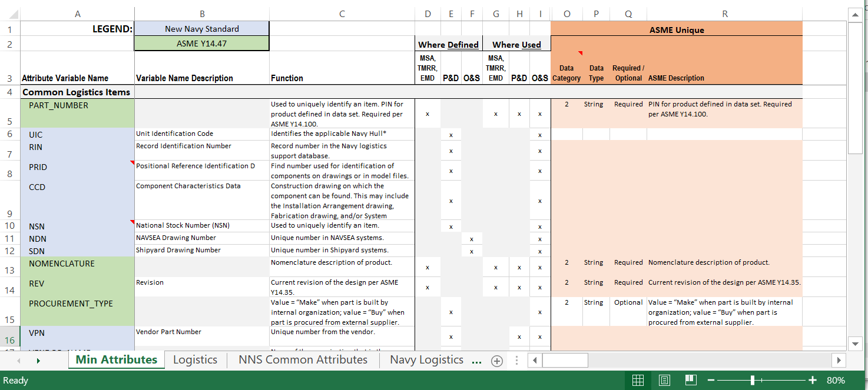
Phase 2B: Metadata Updated
Attribute Spreadsheet is being updated with discipline specific info & validated

Slide 16
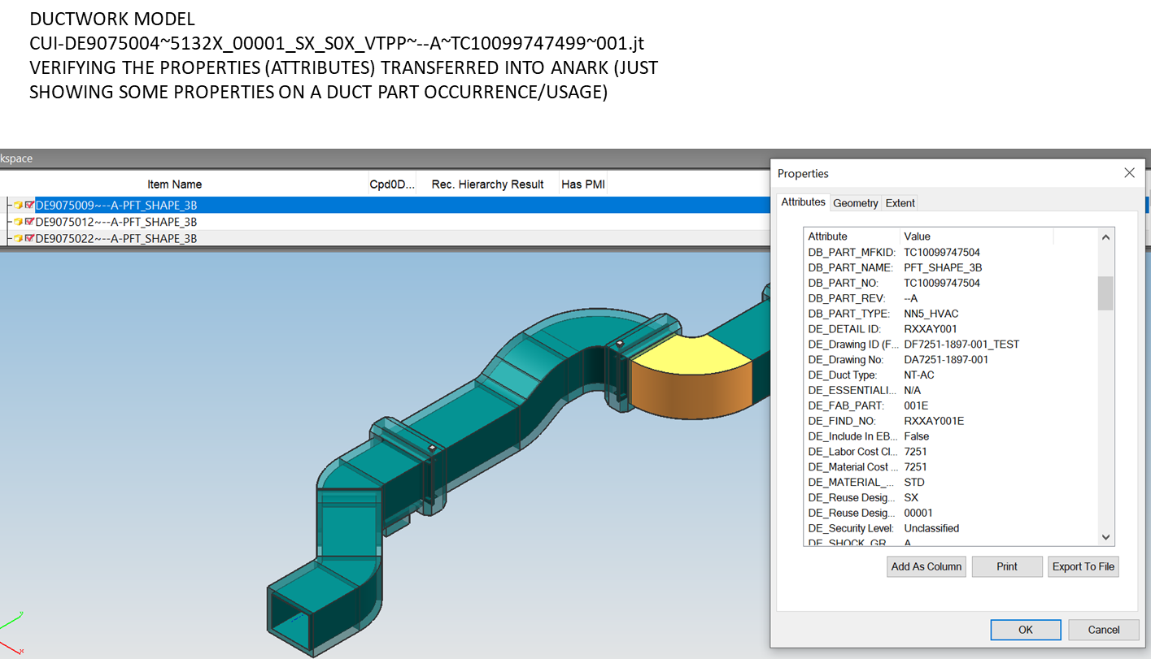
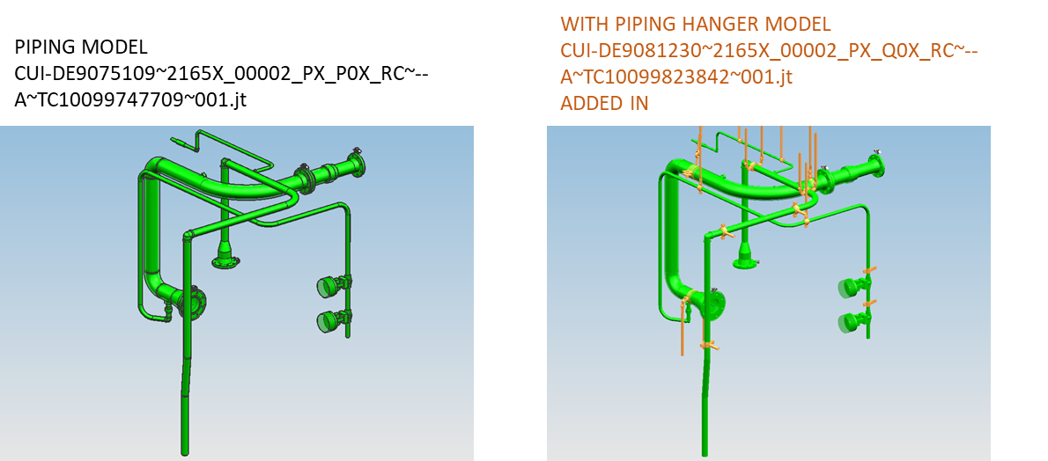
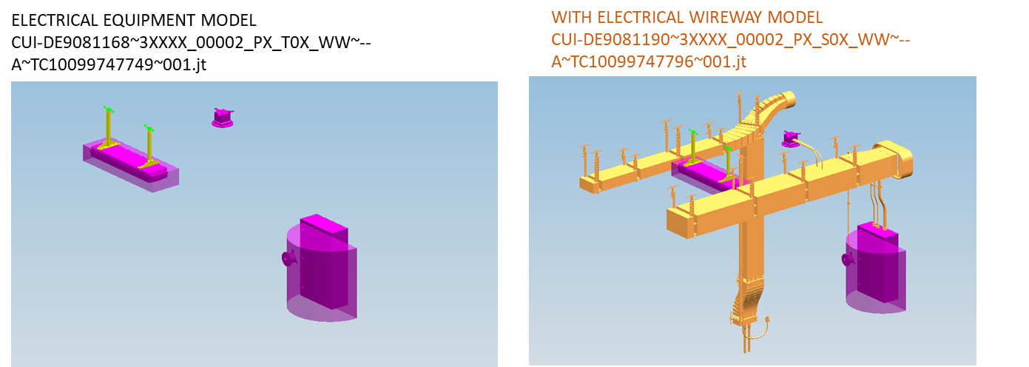
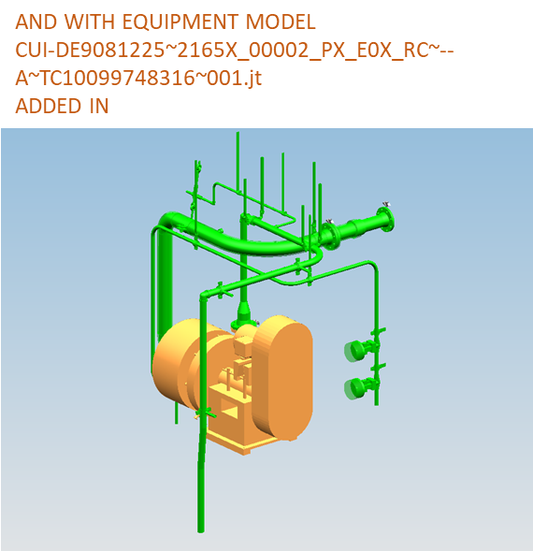
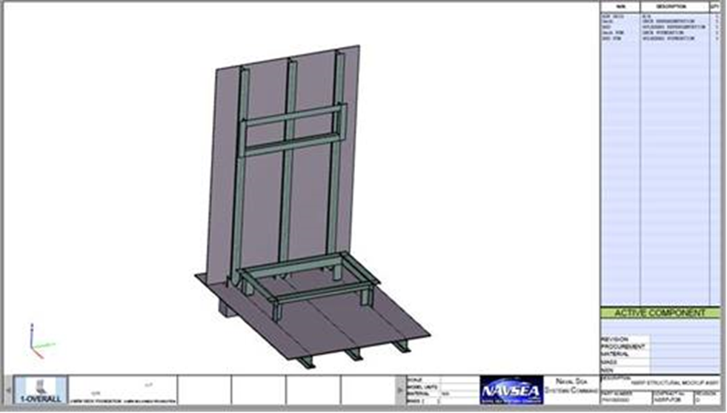
Phase 2B: Conducted Discipline Specific Data Capture & Publishing
HVAC Ductwork
Models
Piping Models
Electrical Models
Equipment
Models
Structural Models

Slide 17
Minimum Standardized Content to Enable a Navy Digital Enterprise
We are in the process of wrapping up the project.
Phase 2B: End-User (Navy) Evaluations
STATUS:
Evaluation are complete and Results are being Consolidated & incorporated into the baseline documents
Phase 2B: Standards Organization Socialization
STATUS:
Draft of Shipbuilding Standards is underway for presentation to Standards Organizations
Phase 2B: ECD 9-18-2022

Slide 18
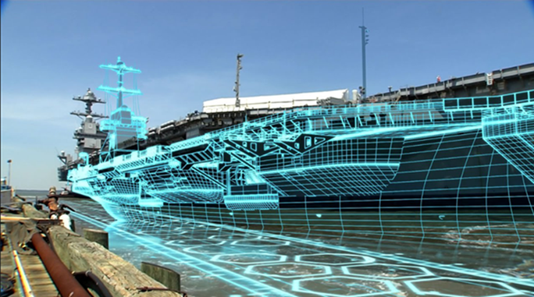
Thank you for your attention,
discussion…
NNS POC’s:
Chris Belter chris.belter@hii-nns.com
Mark Debbink mark.debbink@hii-nns.com
Greg Heinrich greg.heinrich@hii-nns.com

