Slide 1


Laser Ablation of Preconstruction Primer on
HSLA Steels
9/13/2022
Dr. Melissa Klingenberg – PSU/ARL Mr. Steve Brown – PSU/ARL Mr. James Brooks – NNS
DISTRIBUTION STATEMENT A: Approved for public release on 09/13/22, distribution unlimited. ONR DCN#: 43-10208-22
1

Slide 2

Today’s Presentation
Issue Description
Project Goal and Objectives
Project Approach
What We’ve Accomplished
Next Steps
Questions

Slide 3
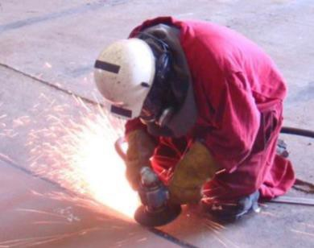
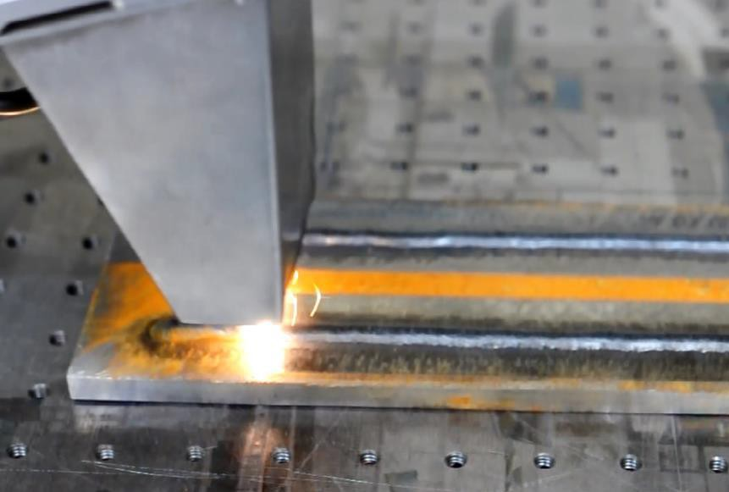
Issue, Goal, and Objectives
Issue
Preconstruction primer (PCP) must be removed
prior to welding in ship construction.
Removal is conducted using needle guns,
handheld or walk-behind grinders, and/or
abrasive blast equipment.
Methods are laborious, dangerous, often cause
Manual grinding removal of PCP
material erosion, and may produce excessive amounts of waste material. A
better solution is desired.
Goal:
  Transition LA technology for the (semi- or fully-) automated removal of PCP
from HSLA steels within the Steel Fabrication and Assembly (SFA) facilities at
NNS.
Objectives:
Laser ablation trials during NSRP project – courtesy of NNS
Reduce labor costs associated with PCP
removal during construction of the CVN.
Reduce substrate erosion associated with
current methods of PCP removal during
CVN construction.
Reduce consumables associated with PCP removal during CVN construction.

Slide 4
Project Approach
Phase 1: Equipment Procurement and Qualification Testing Planning – nearing completion
  Evaluate SPF Flow vs. LA equipment capabilities – completed Q2FY19
  Socialize project ideas – completed Q4FY20
  Develop qualification test plan – completed Q2FY21
  Outline and initiate procurement plan – completed Q2FY20
  Install and debug LA system at PSU/ARL – completed Q1FY21
  Conduct process optimization / preliminary coupon testing – ongoing (ECD Q1FY23)
Qualification Testing and Transition Planning – in process
  Prepare qualification test specimens – initiated (ECD Q2FY23)
  Conduct qualification testing – ECD Q3FY23
  Report to TWHs and draft approval letter – ECD Q4FY23
  Update business case – ECD Q4FY23
  Conduct implementation planning – ECD Q4FY23
Preparing request for project extension; dates shown are preliminary estimates

Slide 5
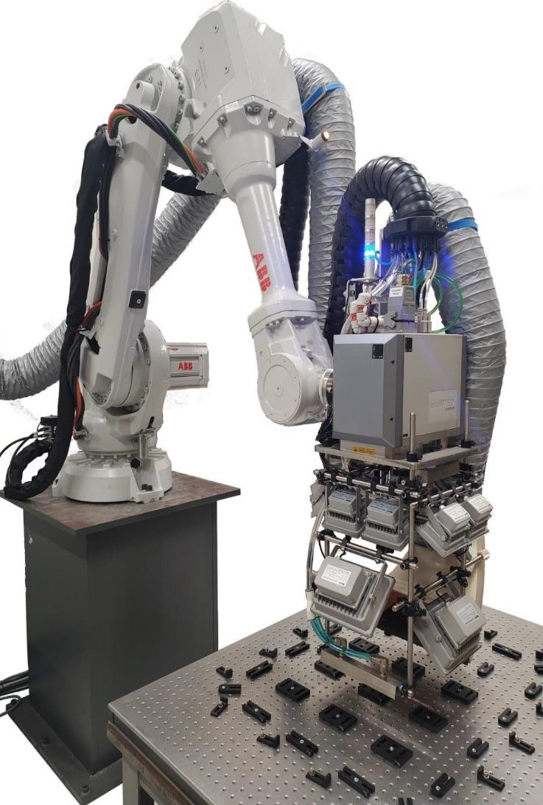
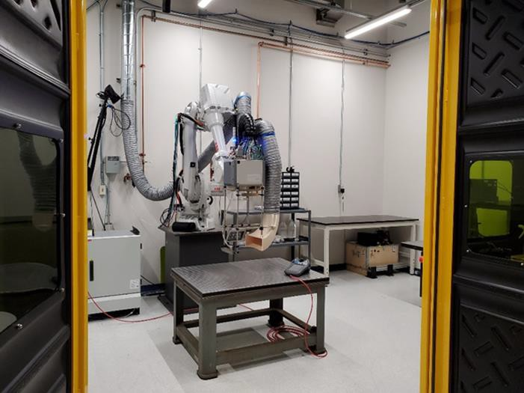
What we’ve accomplished
Designed, built room and integrated components for full LA system

Slide 6
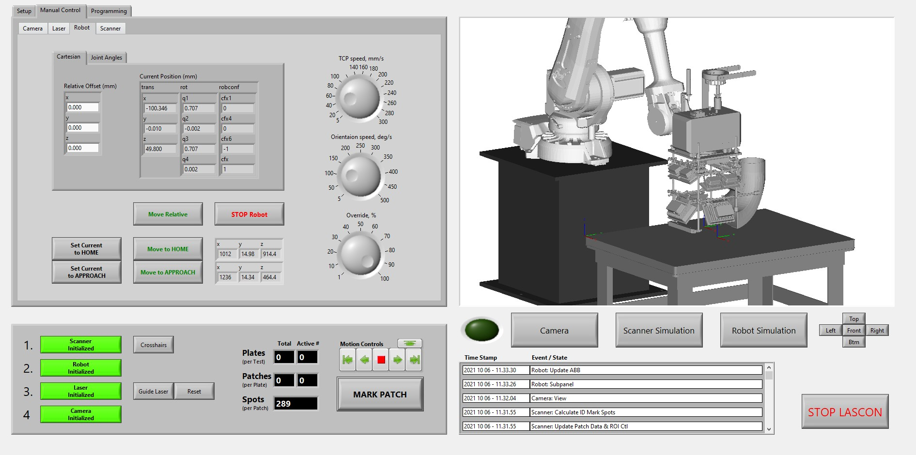
What we’ve accomplished
Completed and continuously improved programming to enable high energy stripping
  Allows ordered and non-ordered layouts, ID marking, etc.
  Allows user to programmatically vary Patch Parameters
  Allows multi-parameter settings to reduce substrate damage
  Allows multiple, subsequent scan paths without having to do multiple sweeps over substrate

Slide 7
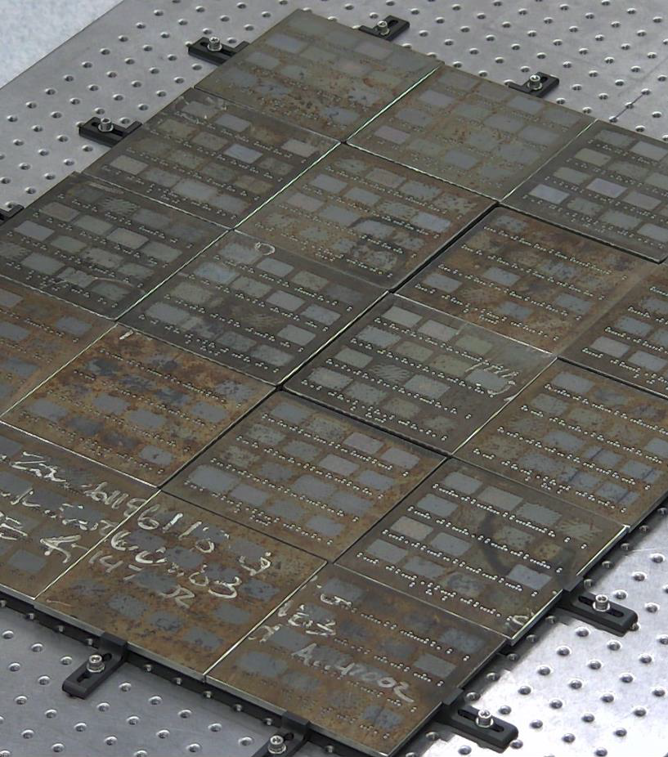
What we’ve accomplished
Conducted many design of experiments (1000+ stripping trials) for optimization
  Ex. DOE 1 = 320 unique parameter sets to 640 test patches
  Optimized stripping of green and red weathered primers on HSLA 100 and HSLA 65 steel
  Developed isoenergy bands and overlaid processing bands
    Enables quick reduction of processing variables for more difficult to remove coating systems
  Further improved program for system
    Enabled lower energy clean up step to reduce blueing (substrate damage) while
improving strip rate and completeness of stripping
Rusted samples with test patches
Found optimal parameters for weathered green and red inorganic zinc (IOZ) PCP, but learned unweathered primers and new primer colors would be encountered and were more difficult to strip

Slide 8






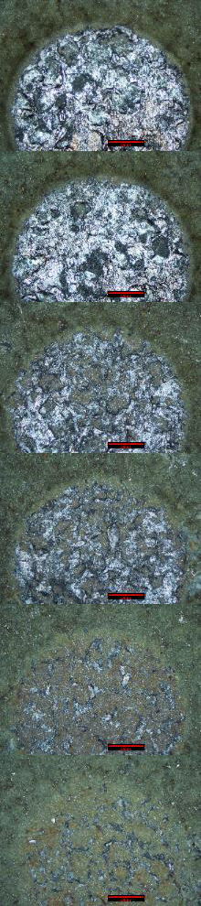
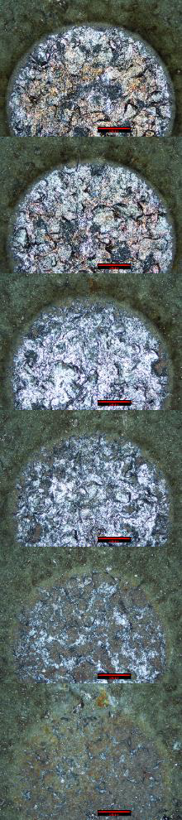
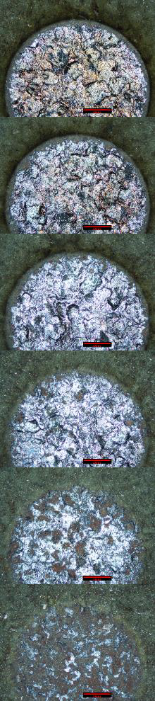
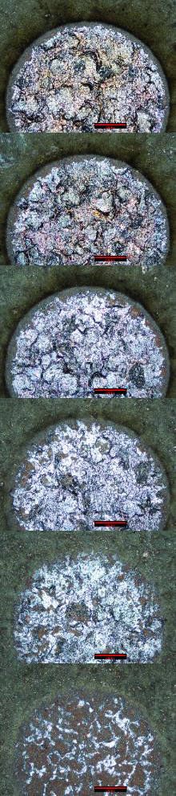
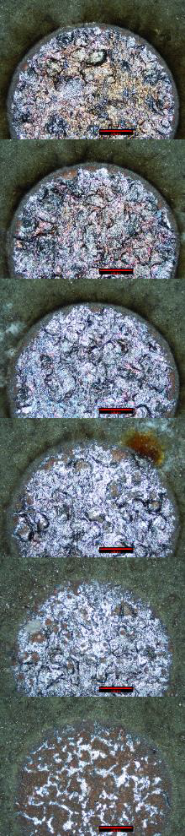
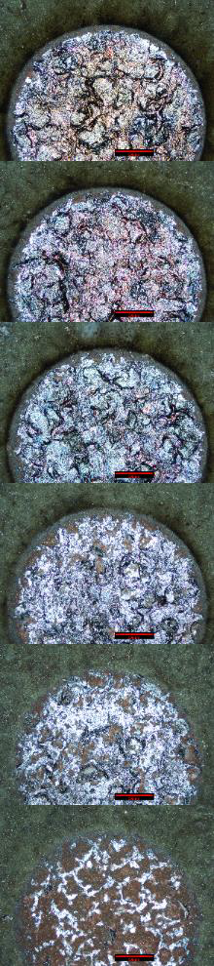
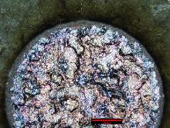
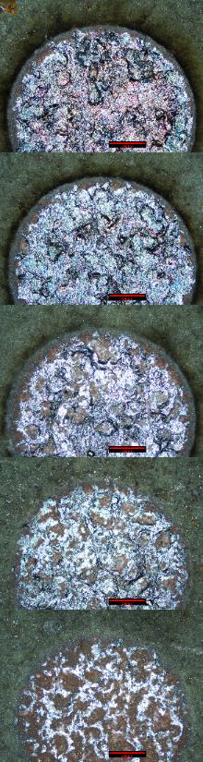
Multi-Parameter Testing – Isoenergy Contours
700 mJ
1200 mJ 1700 mJ 2200 mJ 2700 mJ
1.75
1.50
1.25
Peak Power (MW)
1.00
0.75
200 mJ
0.50
8 12 16 20 24 28 32 pulses
“Peak Power (density)” vs. “Absolute Number of Levels” plot provides Isoenergy contours that shows bands of similar processing regimes
  Team ablated a single spot (unit area of substrate) a specific number of times (# of Pulses)
  Overlaid (yellow) lines show increasing levels of average energy input
  More (average) energy leads to more melting

Slide 9








Multi-Parameter Testing – “Iso-LA” & “Iso-Speed” Contours
Red lines show our (maximum, theoretic) processing speed [in^2/s]; reference = NNS blast speed is 2.5 in^2/s
Yellow lines show that the ablation (PCP removal) reaches a steady-state after about 20 pulses (for this scenario); melting occurs thereafter
Orange dotted box represents sweet-spot; higher Peak Power rows show onset of bluing and lowest Peak Power row shows steady-state of primer removal after 20 pulses (similar in other rows, too).
Processing window ideal is between the 5 and 10 in^2/s (red) processing bands, which is 2 to 4 time faster than NNS blasting/grinding
Need to be in the 8-16 pulses to be in the regime of being cost effective (equates to 5-10 in2/sec)
1.75
1.50
2.5 in²/s
1.25
Peak Power (MW)
1.00
0.75
5 in²/s
0.50
10 in²/s
8
12
16
20 in²/s
20
24
28
32 pulses

Slide 10



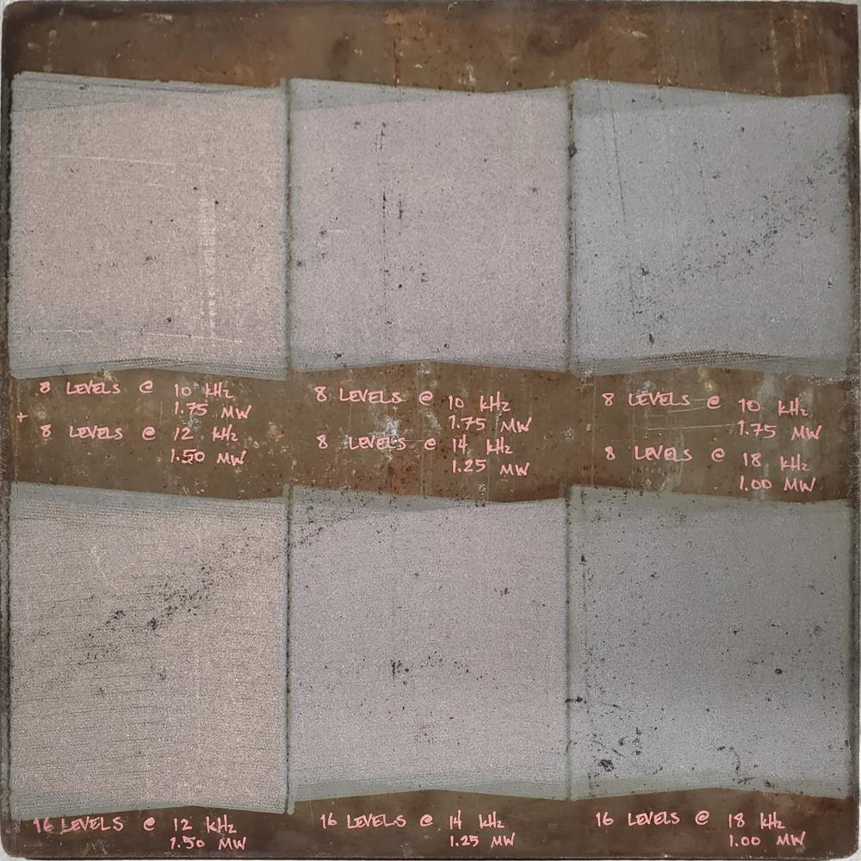
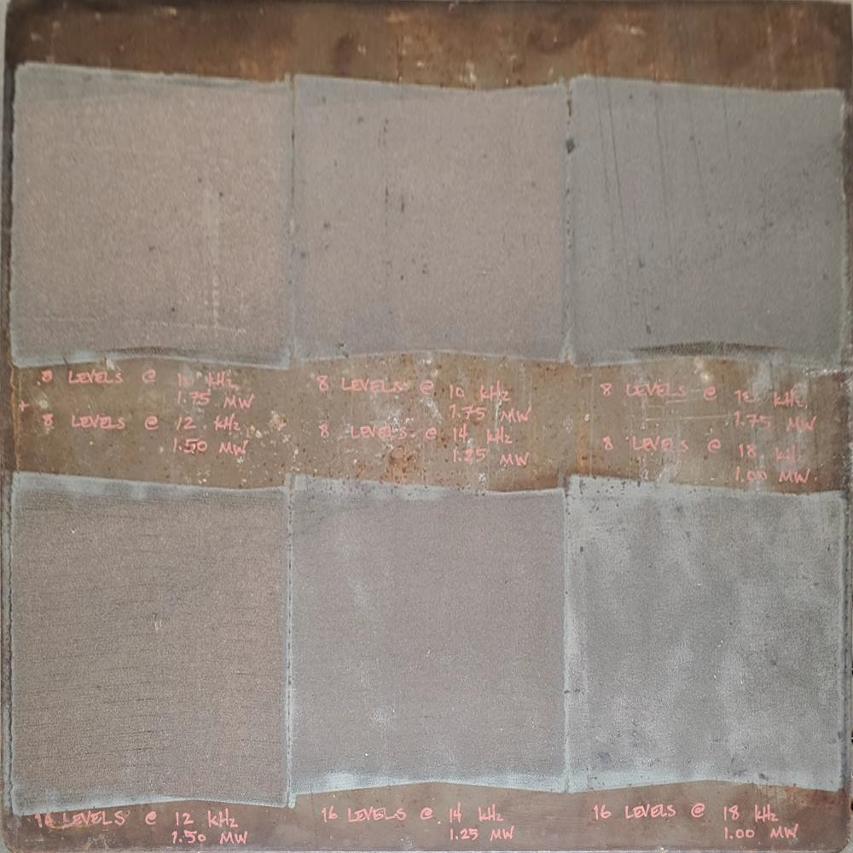








Multi-Parameter Testing
(Result of “DOE3”)
Single best parameter set (DOE3 result) removed the primer, but slightly blued the substrate; not truly uniform.
A multi-parameter approach (hit harder, but fewer times, followed by softer hits) removed the primer and the shallow
bluing of the substrate.
Multiparameter Set uses:
Same
Two-Param.
No Bluing No PCP
Laser Settings:
Average Power
Pulse Duration
100%
50 ns
Scanner Settings:
Spot Size (dia.)
Spot Overlap
Hatch Angle (alt.)
2.5mm 54%
± 5°
Modified
Laser Settings:
Pulse Frequency
10/18 vs. 12 kHZ
Scanner Settings:
Patch Layers
2/2 vs. 4
One-Param.
Bluing…but No PCP
Normalized Parameters:
Output Power
Peak Power
Peak Power Density
Absolute Levels
875 W
1.75 / 1.00 MW vs. 150 MW
350 / 200 kW/mm² vs. 300 kW/mm2
8 / 8 vs. 16
Normal Lighting (easier to see bluing)
Dark Field Lighting (easier to see residual PCP)

Slide 11









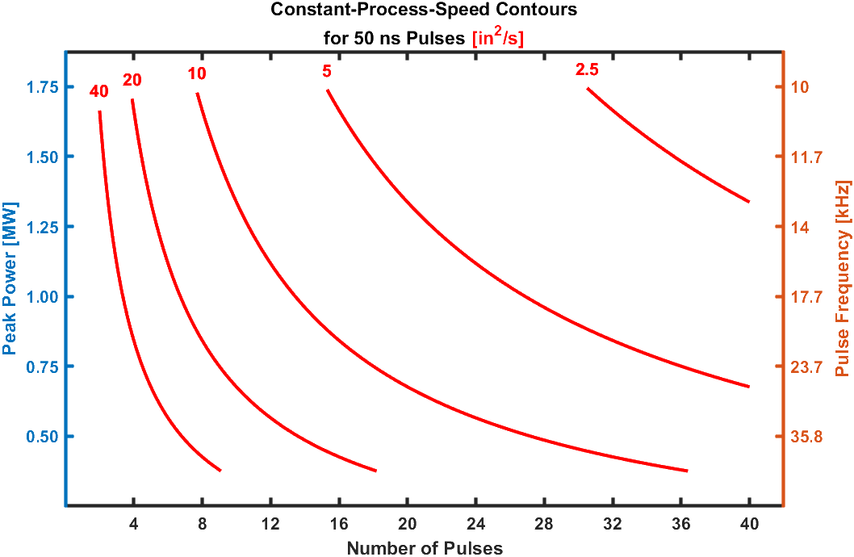
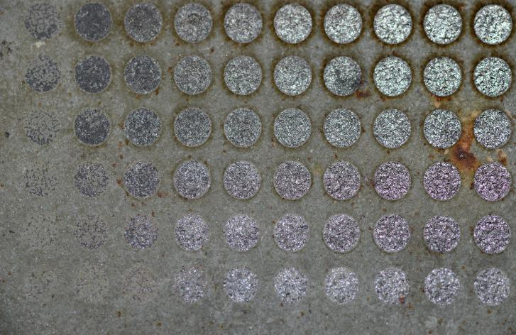
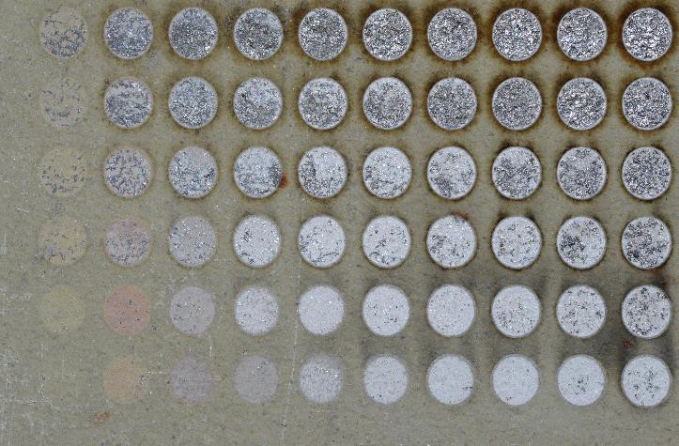


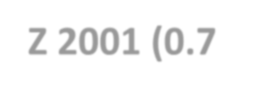

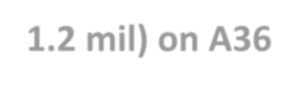
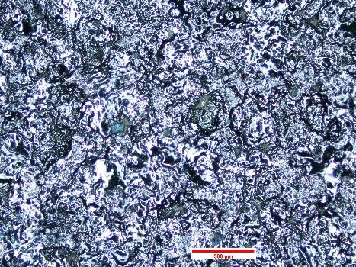
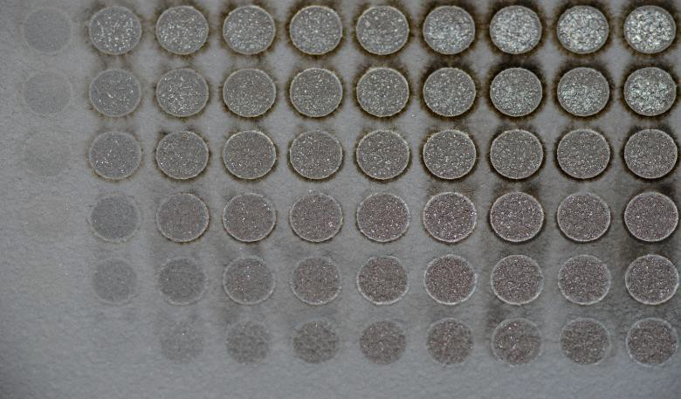
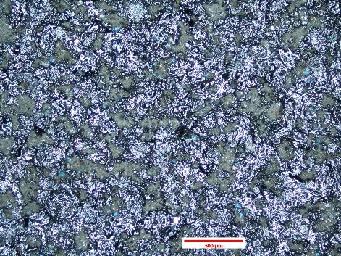
Project Status
Green IOZ PCP (0.8 – 1.2 mil) on HSLA-100
Weathered Green: Consistent Ablation
Newly applied green: Inconsistent / Patchy Ablation
DOE2
DOE3
DOE1
Gray Jotun Muki Z 2001 (0.7 – 1.2 mil) on A36
Newly applied gray: Incomplete ablation at uppermost energy density

Slide 12










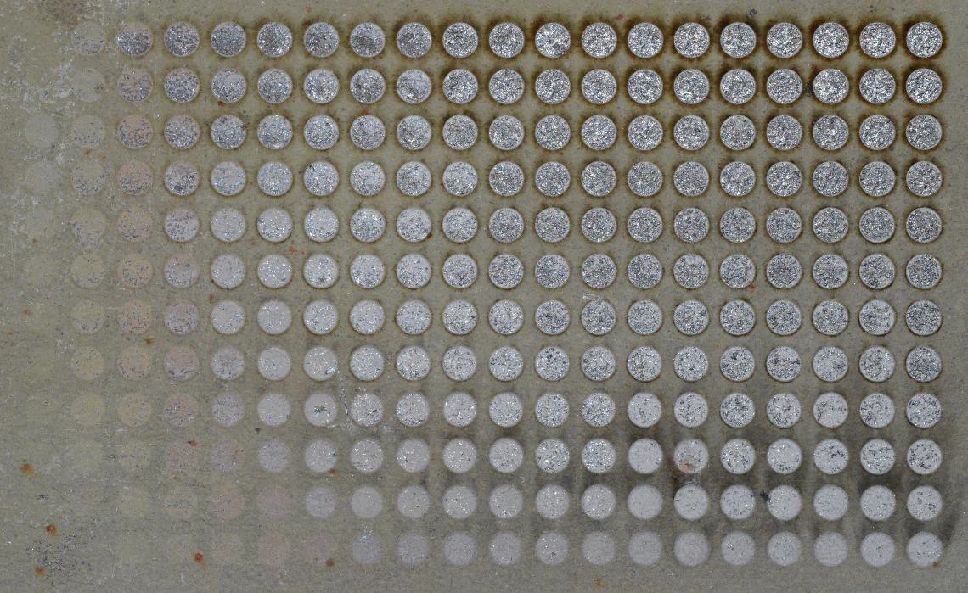
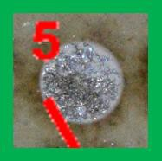
Insufficient Peak Power Density?
Qualification Testing Material (SAMPLE 2b)—Green IOZ PCP (0.8 – 1.2 mil) on HSLA-100
16 pulses @ max. Peak Power (1.75) reaches steady- state effectiveness and yet leaves PCP.
Higher Peak Power (density) is needed.
Higher resolution of unweathered Green IOZ PCP on HSLA 100 steel is ~2x faster than current process (e.g., green box = 5 in²/s)
o PCP is mostly removed in some areas…but not entirely in others
Slightly higher Peak Power (density) is needed for complete removal of primer
Current laser/optic combination was incapable of complete removal over entire spot even with multiparameter setting.

Slide 13












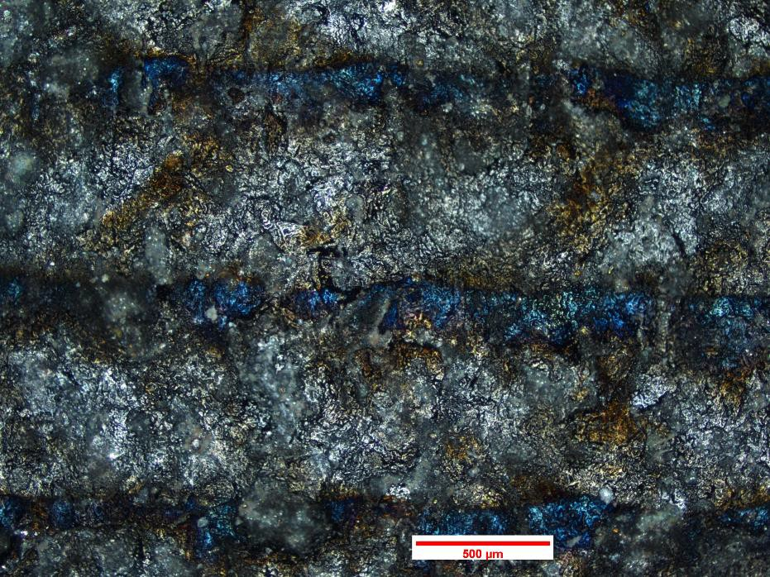
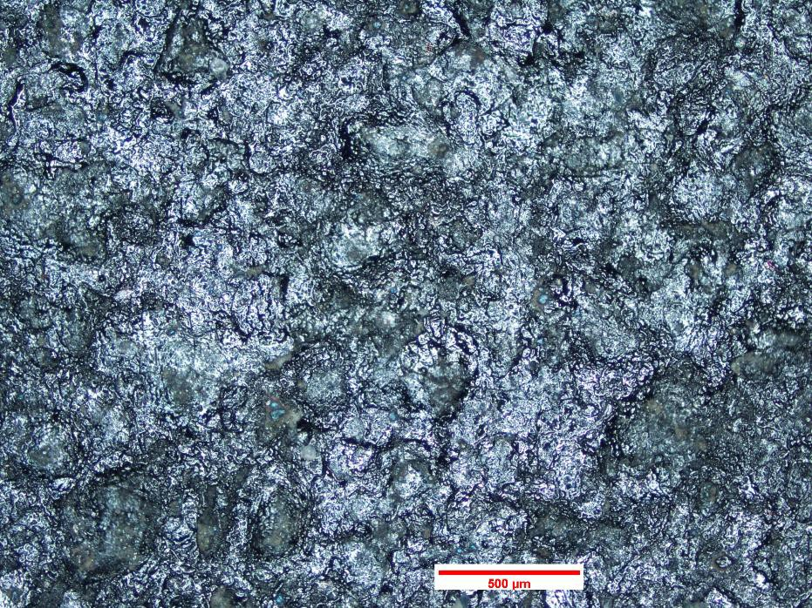
Insufficient Peak Power Density Clean Area
Qualification Testing Material (SAMPLE 2b)—Green IOZ PCP (0.8 – 1.2 mil) on HSLA-100
8 Pulses
Ablation-only step Ablation & “clean-up” steps
Multi-parameter process starts with ablation-only step (dark/ugly), and finishes with “clean-up” step (bright)
We expected a minimum of 8 Pulses (absolute levels of processing) to be needed
13

Slide 14












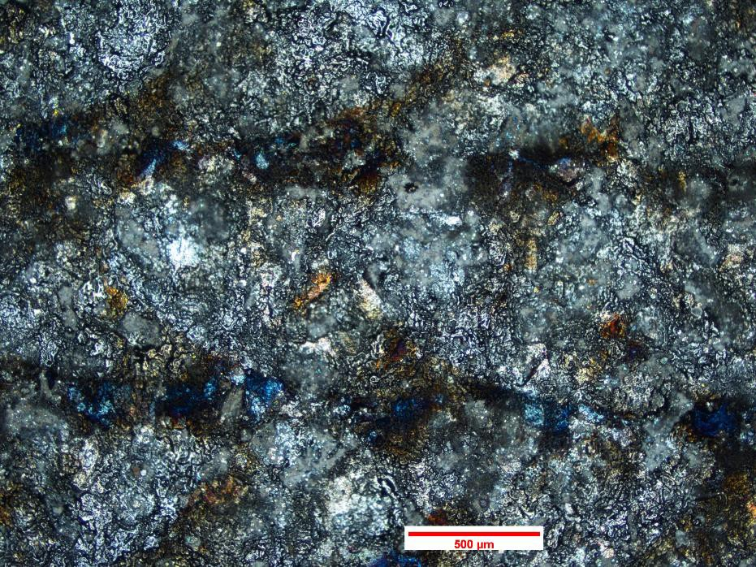
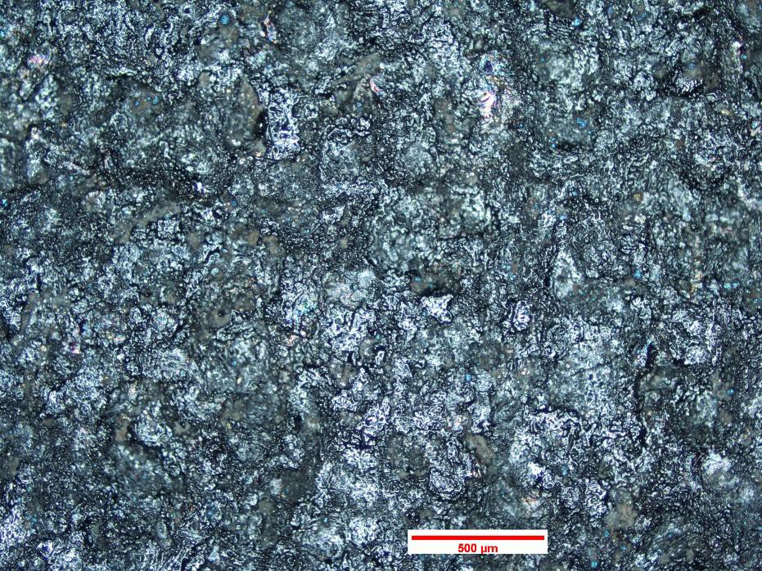
Insufficient Peak Power Density Remaining Primer Evident
Qualification Testing Material (SAMPLE 2b)—Green IOZ PCP (0.8 – 1.2 mil) on HSLA-100
12 Pulses
Ablation-only step
Ablation & “clean-up” steps
Progression of processing: No melting is observed

Slide 15

Coating Removal Successes and Challenges
Developed and Optimized LA parameters through successive DOEs:
Large LA parameter set was distilled into just a few key variables
Optimized parameters for weathered materials (red and green IOZ PCP)
“Multi-parameter” ablation aggressively strips the coating (within a parameter range), then cleans up the surface
Unweathered and new primer coatings were more difficult to remove with existing energy density limitations of current system*
Addressing higher energy density need for qualification specimens
Additional (peak power density) increases possible with reduced spot size or increased power laser that is now available (2kW)
Ordered new lens to increase (~double) system peak power density
Conducted testing at IPG with 2 kW pulsed laser and reduced spot size to enable greater power density range
  “Distilled LA variables” were easily tweaked to optimize specific coating / substrate conditions for newly applied coatings and new colored coating systems
  “Multi-parameter” ablation successfully removed more difficult coating systems without blueing
* Note: Nominal coating thickness, at varying (though unknown/uncontrolled) ages/conditions

Slide 16

Challenges Addressed
Initiated stripping trials at IPG Photonics using 2 kW laser and smaller spot size (1.66 mm)
  Panels were easily stripped using project parameters on iso-energy curve
    872W in two passes (85% pulse-to-pulse [x] / 35% hatch [y] overlap) with one clean up (50% / 50% overlap)
      Microscopy in process, but no blueing noted
Ordered new optic to produce smaller spot size (1.2 mm) = increased energy density
o Calculations and preliminary testing at IPG show slightly smaller optic will enable removal of gray and unweathered primers using 1kW system – a cost consideration
  Initiated preliminary fatigue testing on unwelded, weathered specimens
    HSLA specimens being run at 50 ksi and R= -1.0 to test worst case scenario of over- ablation
      Controls (primer in tact) are currently being tested to determine best load to discern between treatments.
Qualification panels cut to size for subsequent processing and welding
o Planned to strip qualification specimens using “refined processing parameters” for unweathered coatings
Gathering updated cost information for updating project ROI
o Updating materials and labor costs as well as usage rates.

Slide 17

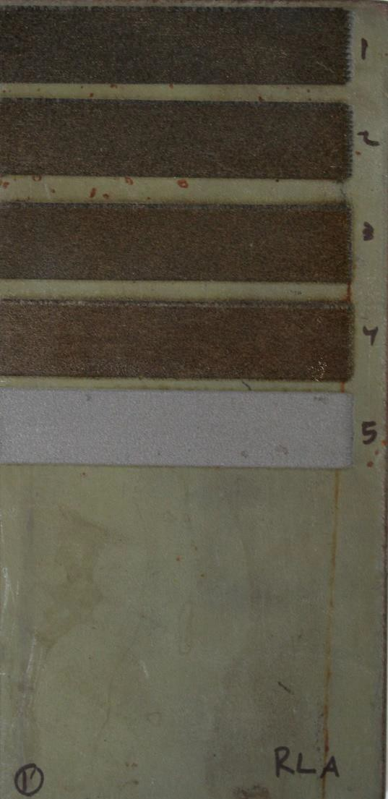
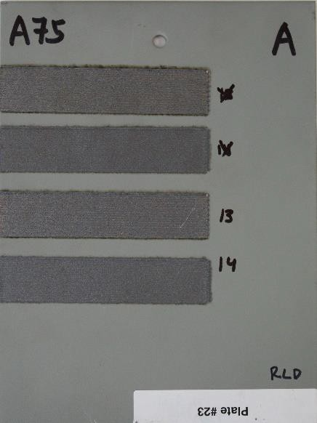
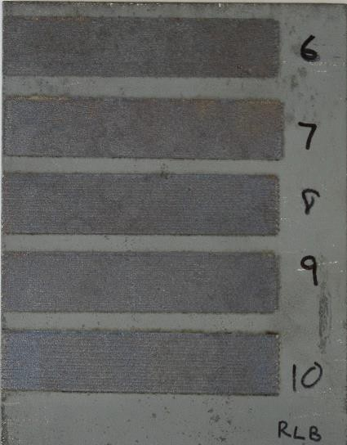
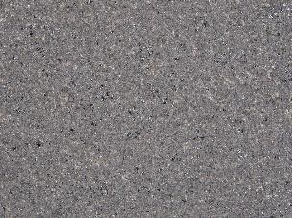
IPG Photonics 2 kW Laser Testing
HSLA-100 w/ Aged IOZ
Primer
A36 w/ Gray IOZ PCP
HSLA-65 w/ Gray IOZ PCP
2-Stage Cleaning Process
Optimal Conditions | Setting | Pulse to Pulse Overlap | Hatch Overlap | # of Passes | Zinc Remaining
All Primers & Steel Types | 872W | 85 | 30% | 2
 | 600W | 75 | 75% | 1 | 0%

Slide 18
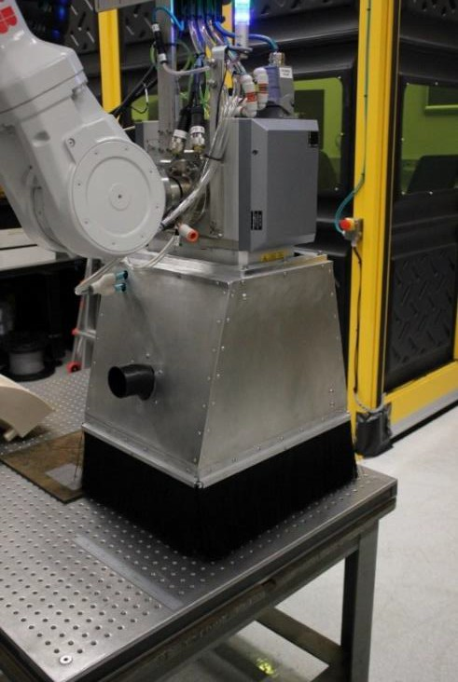
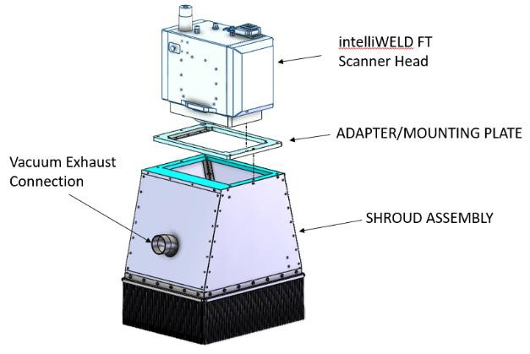
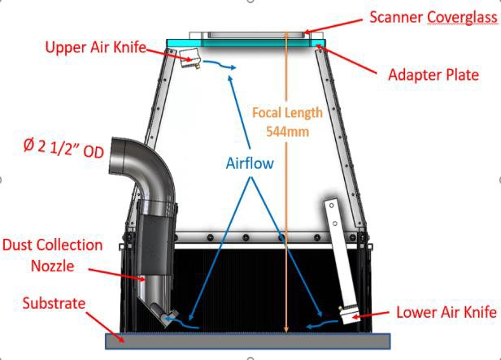
What we’ve accomplished
Completed NSRP project focused on mitigating ocular hazards of PSU/ARL system
  Very low levels of radiation were present in most areas where personnel would
be located, but some concerns still existed with
    Using the system on other, more reflective materials
    Complex surfaced materials causing the incident beam to be off normal
    Maintenance activities where personnel would be closer than 200 mm to the impingement area of the beam.
  Designed shroud for additional protection for shiny and other more reflective surfaces.
    To address potential concerns with stray radiation, a shroud was designed, built and installed on the PSU/ARL laser ablation system.
    Measurements were taken outside the bristles of the brushes showed an 8-fold reduction in radiation by the double layer of bristles and laser blocking fabric.
Shroud Integrated with Laser Scanner/Robotics
Shroud Concept
Auxiliary Components

Slide 19
Next Steps
Near-Term Milestones to be Addressed
  Finalize process parameter development / optimization using increased energy density.
  Complete preliminary testing (fatigue, optical microscopy, SEM analysis, ).
Technical Progress to be Accomplished
  Finish process refinement on unaged coating systems.
    Complete optical microscopy assessment.
Risk Reduction Items to be Addressed
  Optimizing with smaller spot size for multiple preconstruction primer coating scenarios that may be encountered in the shipyard, including new primer.
  Continue communication with fatigue vendor.
  Continue early investigation of best means to implement in the facility (e.g., equipment logistics).
  Determine schedule/cost impact due to difficulty achieving sufficiently high energy density with current optic in order to strip newly applied primers and gray primer.

Slide 21


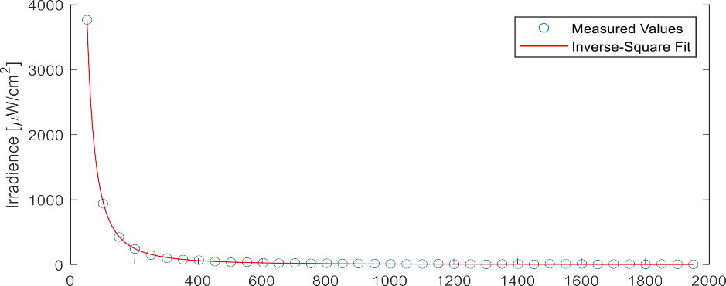
Project Status: Ocular Hazards
Ocular Hazard Testing of 1064 nm laser radiation on HSLA Steels
  Maximum expected personnel exposure levels are well below danger threshold (~5 mW/cm²), even at distances near the LA process
    Exposure levels decrease by a factor of 4 when doubling the observation distance.
Only region deemed to be hazardous for personnel is effectively within the bounds of the LA system, where processing occurs
  Includes the space below the scanner body and above the substrate being processed.
    Open beam could burn one’s skin, and direct viewing into the scanner optics or of the LA process itself could injure one’s eyes (e.g., cause blindness if receiving levels exceeding the MPE threshold).
.

Slide 22
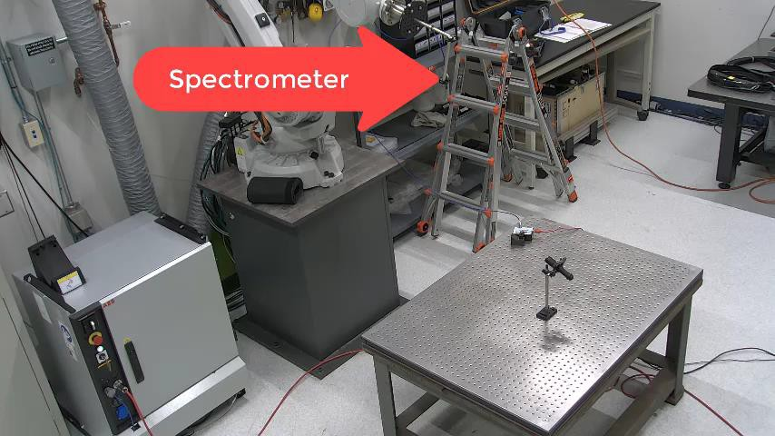
What we’ve accomplished
Accomplished robotics programming work for measurement of stray radiation as follows:
  Used offline programs (e.g., MasterCam and Robot Master)
Execution of Kinematic Model

Slide 23
Delays we’ve experienced
Delayed delivery of laser by manufacturer ~ 4 mos
Pandemic issues (permitting, room construction, and installation delays) ~ 5 mos
Installed damaged laser – required return to Germany for repair ~ 4 mos
Delayed optimization/preliminary testing ~ 8 mos
  Programming took longer than anticipated to develop unique approach to stripping to reduce damage to steel, but ensure removal of PCP ~6 mos
  Back-ups at vendor facilities in specimen preparation and at test facilities ~3 mos
Experienced difficulty removing unweathered primer and newly added primer color (est. Q3FY22) ~ new issue
DISTRIBUTION STATEMENT A: Approved for public release on 09/13/22, distribution unlimited. ONR DCN#: 43-10208-22

