Slide 1
ASTM F1387 Testing for Mechanically Attached Fittings (MAFS)
Update 08-2022 by William Dutcher, Viega LLC

Slide 2
Viega’s history in Marine Industry
  Viega founded in 1899
  Press technology introduction (ProPress/Seapress) 1989
  Shipbuilding USA ABS 2003 – Dakota Creek – University of Delaware Research Vessel & Nichols Brothers Riverboat
  2006 T-EPF (Austal) – 14 hulls to date
  2007 NEJ W&O Cover
  2017 T-AO (NASSCO) – 6 hulls to date
  2018/2021 NSRP Panel Project ASTM F1387 Testing for Mechanically Attached Fittings (MAFS) (2005-337-054 & 2018-447-012)
  NAVSEA letters 2021 Rev 2022
  Viega press technology – greatest number of standards in the Industry, only NAVSEA approved press type MAF

Slide 3
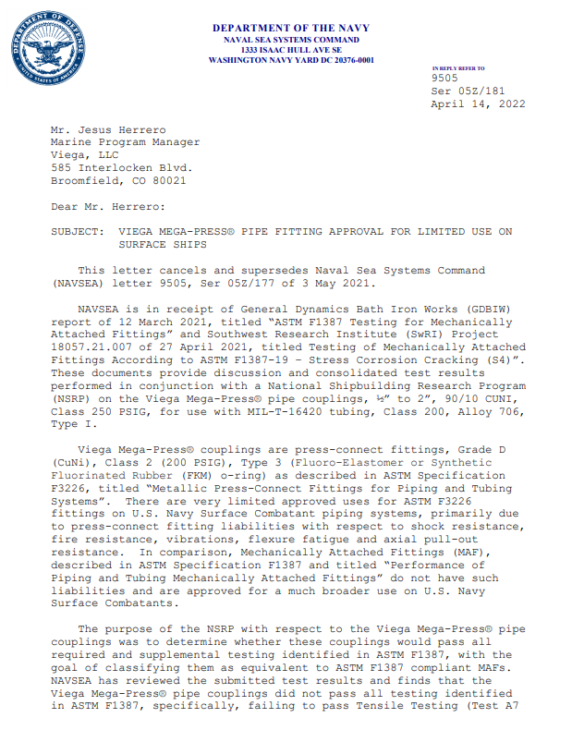
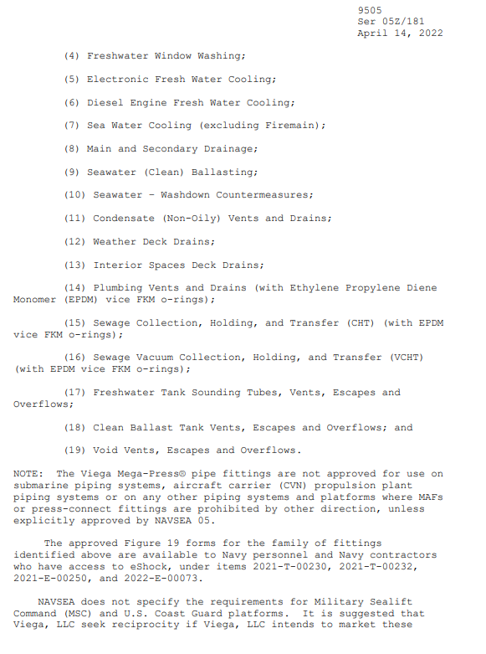
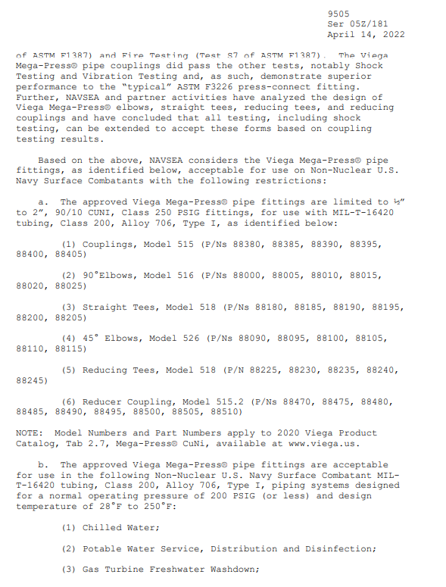
NAVSEA Letter – MegaPress CuNi ½” thru 2” Couplings

Slide 4
What's included?
What's next?
19 systems, in lieu of silver brazed fittings
Couplings, elbows, reducers, tees
EPDM sealing element requirement for 3 systems due to NAVSEA requirement
Special tooling required for NAVSEA SHOCK requirements (see next slide)
Threaded adapters/tees, flanges, No-stop couplings in consideration for inclusion
XL configurations 2-½" - 4"

Slide 5
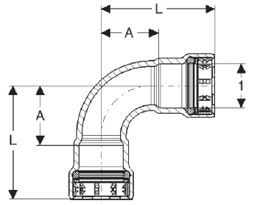
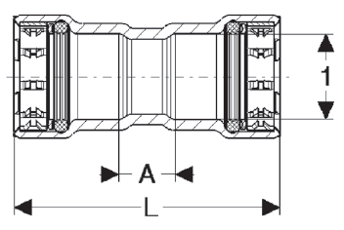
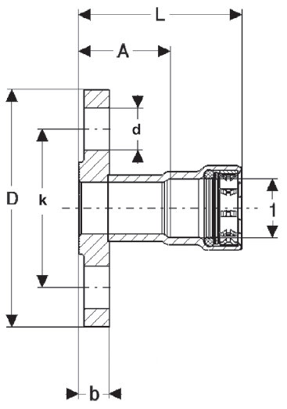
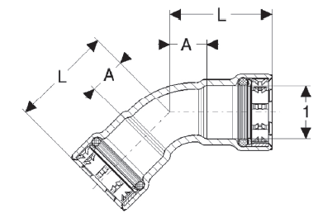
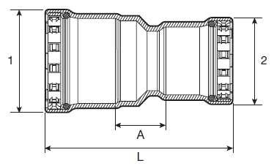
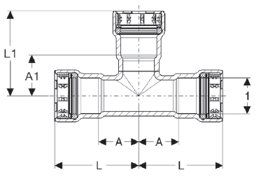
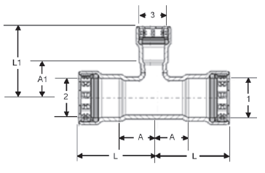
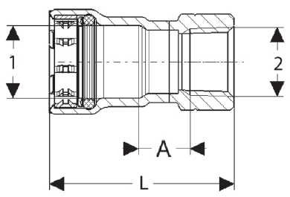
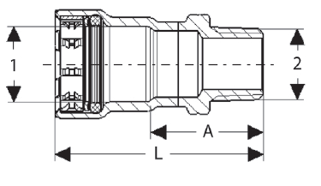
Configurations (Pending Shock Extensions)
Couplings ½” thru 2”
45 elbow
90 elbow
Reducer Couplings
TEEs
Reducing TEEs
Pending:
Flanges
Adapters (MPT/FPT)
Threaded TEEs
No-stop couplings
Notes:
As of today, only couplings ½” thru 2” are included in the NAVSEA letter. However, Shock Extensions for additional shapes are in the works by Gibbs and Cox for the FFG-62 program and we expect those results very soon resulting in the extension of the NAVSEA approval for additional shapes. So a much more complete product offering available for use on Surface Combatants, USCG and wherever MIL-STD-777 is invoked.

Slide 6
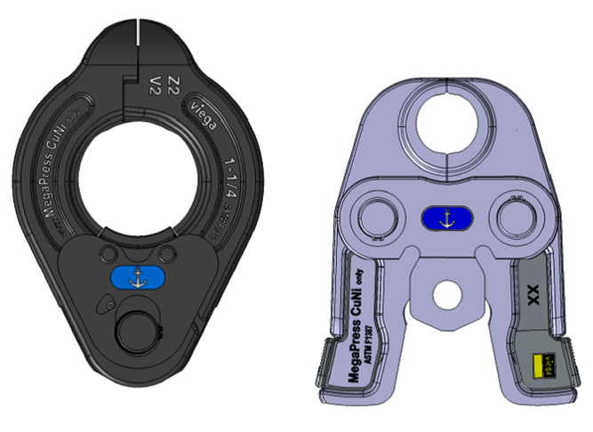

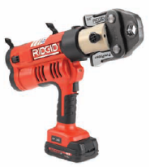

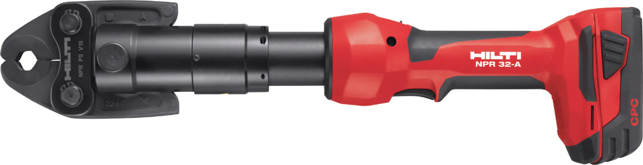
Innovative Tooling
Viega, RIDGID, Milwaukee, Hilti – your pick
ASTM F1387 specific jaw/ring kit (Anchor)
Press rings & actuators for tight areas
Hand tool = no spark
Notes:
There is most probably a tool to match your current selection. We have worked with several tool vendors to make sure we remain tool agnostic. While the press tool is your choice, for Shock Rated Systems, you do have to use a specifically developed set of rings and jaws. They feature tighter tolerances and greater pressing force and are strictly for use with MegaPress CuNi. In order to distinguish them, they do specify ASTM F1387, for MegaPress CuNi Only and feature an anchor to easily identify them.

Slide 7
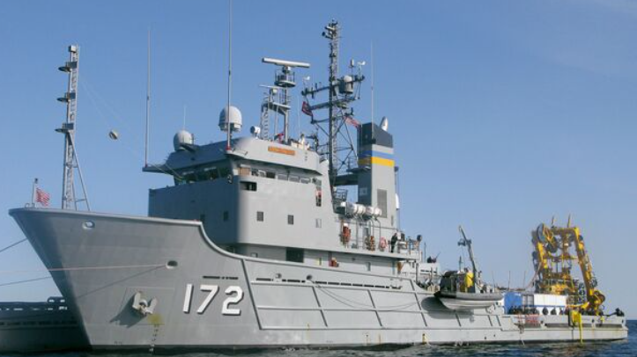
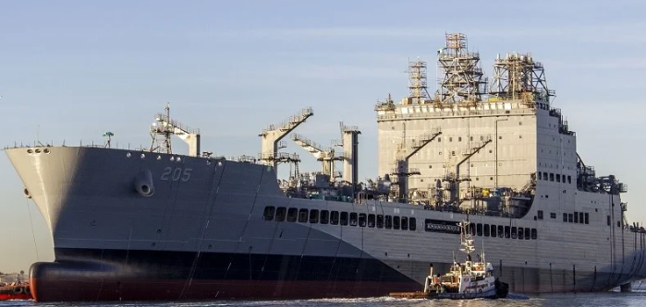
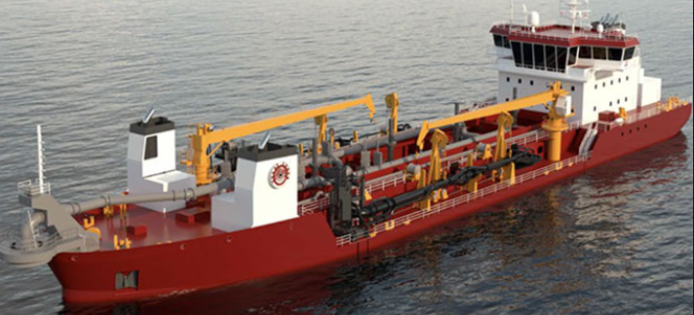
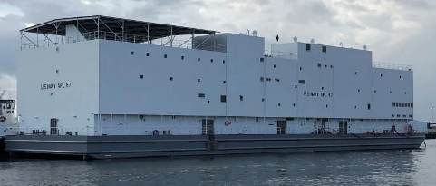
NSRP Associated Programs
Austal:
T-EPF (ExPeditionary Fast Transport)
T-ATS (Towing Salvage and Rescue) – multiple systems MegaPress & ProPress ½”-4”
GD NASSCO:
T-AKE (Auxiliary Cargo (K) and Ammunition (E) Ship)
T-AO – Replenishment Oiler
Conrad Shipyard:
Hopper Dredge
YRBM barges
Vigor:
APL Barges

Slide 8
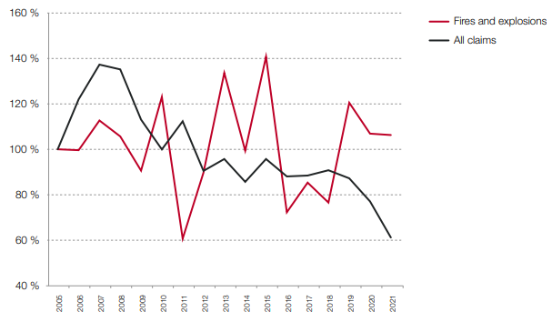
Viega solutions enhance project schedules and safety compared to traditional methods without sacrificing reliability and quality.
Flameless press technology eliminates the risk and procedure of hotwork
A quick learning curve allows crews to quickly become proficient joining pipe
Faster consistent connections keep projects on schedule and lower installed costs.
Reliable connections that have successfully passed stringent testing
Consistent first time quality allows for system commissioning on the first run (NASSCO)
While overall incidents are down, fires remain a constant claim on insurance

Slide 9
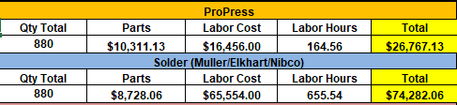
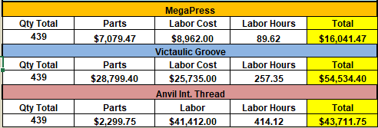
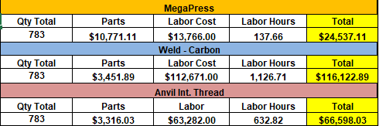
Did you know?
  Independent study by NAVSEA has shown 53% reduction in total cost of installation of MegaPress CuNi versus silver-brazing
  Does not include savings due to consumables such as flux, solder, threading oil, purge gas or any other items which would be required
  Estimates do not include callbacks and re-work.
  Labor savings more than make up for part cost differential
~64% savings
~71% savings
~63% savings
~79% savings

Slide 10
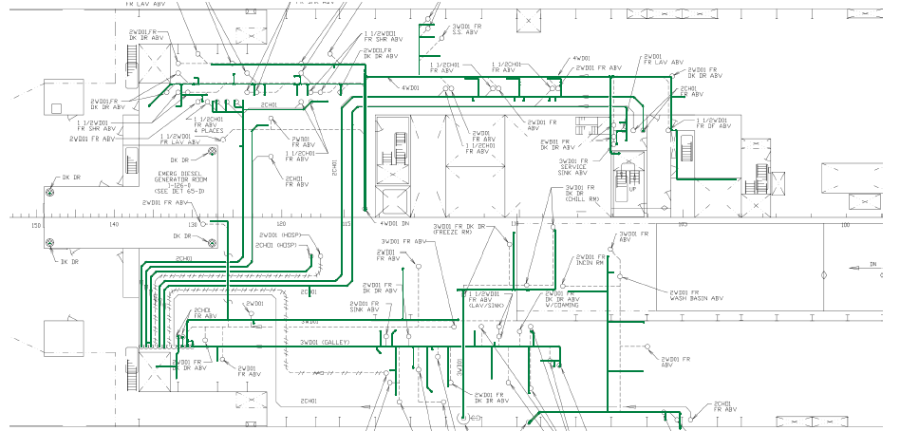
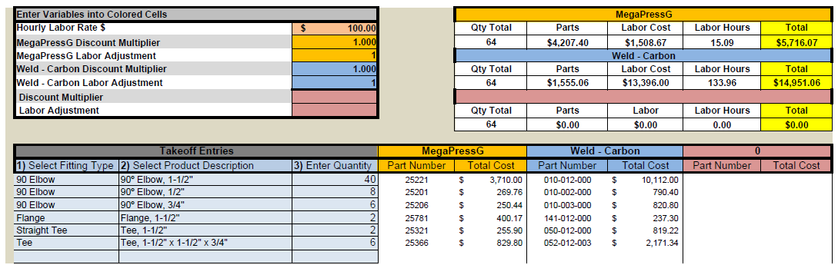
Engineering Services
  Helped with design of sanitary drainage system
  Created takeoff list for quotation
  Provided cost comparison vs weld – 61% total cost savings
~61% savings

Slide 11
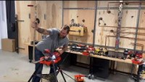
Viega: ASTM F1387 Testing for Mechanically Attached Fittings Panel Project
https://www.youtube.com/watch?v=VqTFb75XZRQ

Slide 12
Questions?

