Slide 1


Digital Objective Quality Evidence
Megan Brinker, COO, TruQC
NSRP BT + SDMT Join Panel Meeting
Honolulu, Hawaii
August 30, 2022

Slide 2









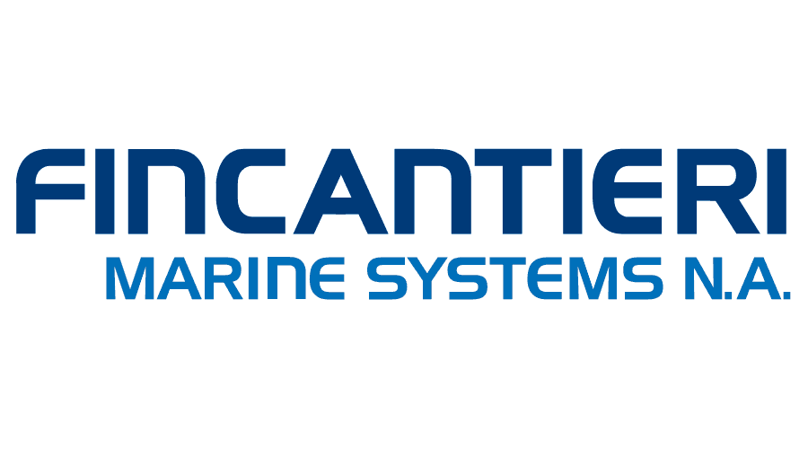


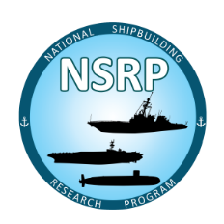









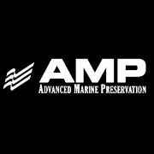


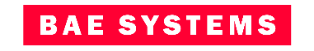

Your Process, Digitalized
Our proven software framework quickly streamlines your workflow and makes compliance easy.
Founded 2011
Home office in St. Louis, MO
2,100+ Users
Industrial Process Focused
Used in over 50 countries
Rapidly configurable platform
Robust document management
Permission-based
Real-time syncing
Full offline capability
Annotation & issue tracking
Role-based views & summaries
API & systems integrations
Device integrations
Industry-leading security
Oil & Gas • Marine • Infrastructure

Slide 3
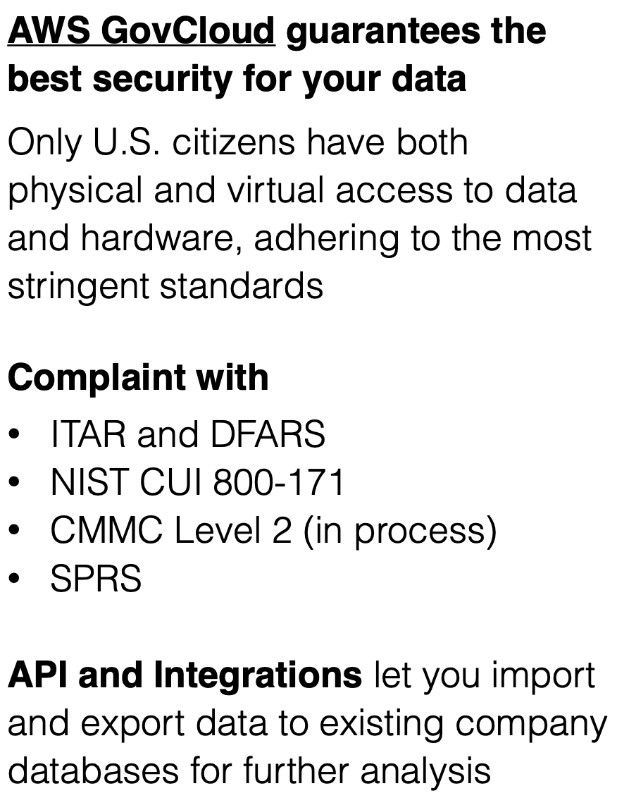
Security
98/110
Notes:
Add Fincantieri Marinette Marine (FMM) for analysis of the new ship build process and Vigor to understand existing vessel repair.

Slide 4
Solutions in Shipbuilding and Ship Repair
Marine
Vigor Industrial: Environmental, Health and Safety, Paint Quality (since 2015)
Bath Iron Works: Safety and Paint Quality (since 2015)
Newport News Shipbuilding: Replacing old Paint Quality System E4749 (since 2020)
BAE Systems: Paint Quality 009-32 (since 2019)
NAVSEA: Tie-downs + Non-skid (exploratory phase)
NSRP – Surface Preparation and Coatings Panel
Project 1: Digitalizing 009-32, 2013, complete
Project 2: Out of Spec Flagging for 009-32, 2015, complete
Project 3: Implementing 009-32 on the deck plate, 2017, complete
Project 4: Standardization and Digitalization of Visual Inspection for Shipbuilding and Ship Repair, 2020, complete
NRL
Phase I: Digital Paint/Preservation Quality Assurance Records as a Data Source for Improved Decision Making in partnership with Rampart LLC and sponsored by the Navy Corrosion Executive, Ted Lemieux
Phase II: Optimized Blast and Paint Quality Assurance Data for Improved Operational Availability
NSRP – RAP
Project 1: Optimized Weld Records, 2021, In Process
Notes:
Add Fincantieri Marinette Marine (FMM) for analysis of the new ship build process and Vigor to understand existing vessel repair.

Slide 5

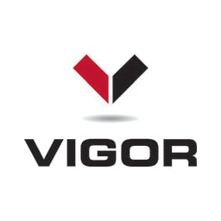
ROI
Customer: Bath Iron Works
Project: Zumwalt Class
Application: D06 Quality, 2506 Weld Process and Compartment Work List(s)
Timeframe: July 2016–July 2017 (savings annualized) product still in use at study site
Savings: 4,160 hours/year, 2,548 hours/hull
Customer: Vigor Industrial
Project: USS Gridley – USS Kidd
Application: TruQC was implemented following the USS Gridley project in which 103 Corrective Action Requests (CARs) were raised by the Navy, 60% of which were coatings and OQE related. 480 hours
were spent correcting paperwork on the contractor side alone
Timeframe: March 2018–July 2018 (product still in use at study site)
Savings:
        D06 Quality Team & the 2506 Process
        Travel Time:
        1 hour a day per person for a crew of 7=1,820 hrs/yr
        Redundant Data Entry:
        1 FTE per year = 2,080 hrs/yr
        Improved Efficiency for QA Manager:
        1 hour a day = 260 hrs/yr
        Compartment Work Lists:
        100 photos from iPad to PC
        30 minutes per compartment = 364 hours per hull
        Type/Handwrite Defect Comments
        2 hours per compartment = 1,456 hours per hull
        Distribute to Hull Supervisor Team
        1 hour per compartment = 728 hrs/hull
        103 CARs reduced to zero
        Fewer than 15 administrative revisions
        480 review hours eliminated
        More accurate OQE packages

Slide 6
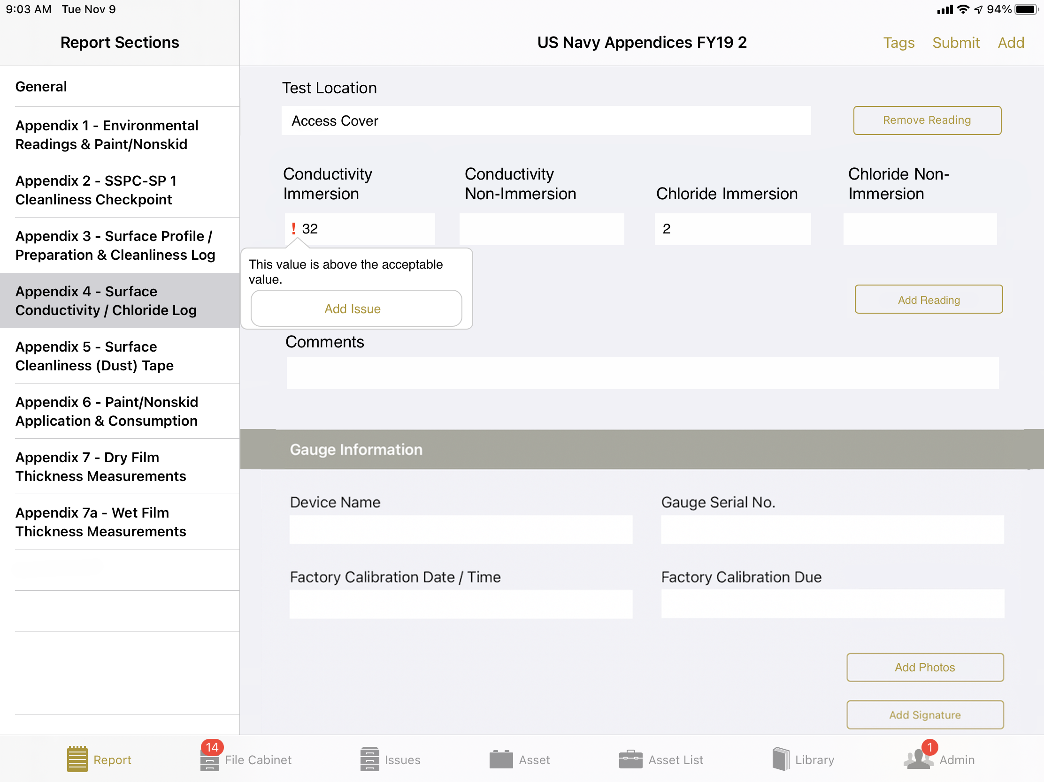
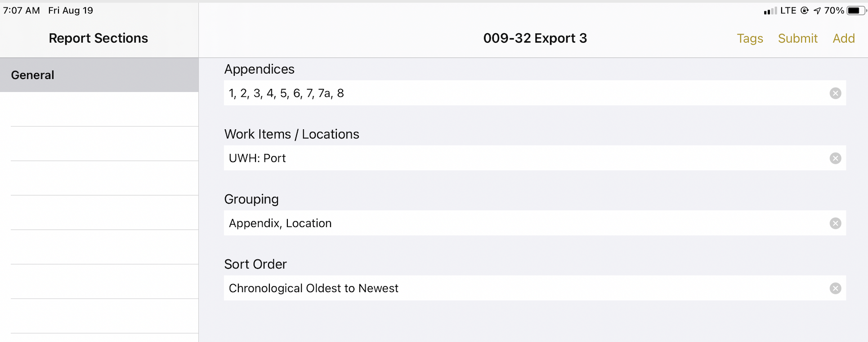
Digital Paint OQE - Repair
Improvements made to TruQC Navy software provide out-of-spec flagging based on embedded standards and acceptance criteria, along with real time view of current state and Condition Found Report (CFR) status.
Software allows:
Faster, cleaner OQE bundling and sign-off
Reporting results visible via dashboard
Assured data integrity via barcode scanning of paint products and QA device integration
Role based data availability allows for easy adoption
Web editable
Permissioned- All players in single account
Audit trail for changes after signoff
Management by exception with data queries
Minimize rework by real time access to data
API to tie into legacy systems
Notes:
Configurable workflow simplifies 3rd party interaction
Results visible via dashboard for KPI tracking
Enable clean, standardized data for AI/BI purposes
Bottom-up, contractor-centric solution

Slide 7
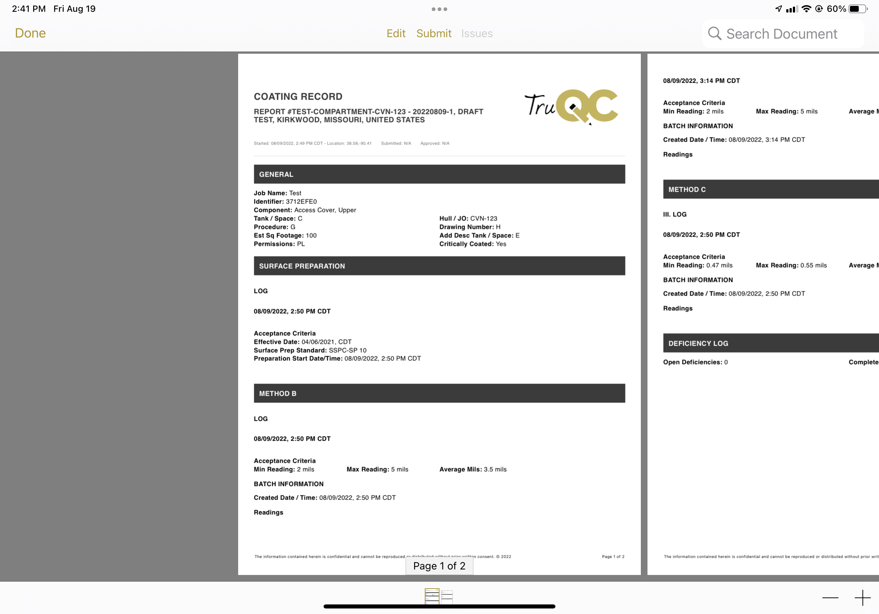
Digital OQE - Shipbuilding
Implementation and evolution of coating record, component log and exclusions log
Custom user permissions: Sub Contractor, GOV, Engineering, Quality, Trade, Admin, Supervisor, Inspection
IP Allow List/Certifications
API Import to Job Admin
Versioned Acceptance Criteria with ability
to push at any time
API export
Configurable Job Admin
OOS Flagging
Remarks log with if/then logic
Section Locking after signature
Custom Dashboards for management
Sherwin-Williams Barcode scanning
Stage of Construction for work items
Ship Class specific sections
004 Summaries
Deficiency Tracking Log
Unique Identifier for reports
Ability to search report data via web admin

Slide 8
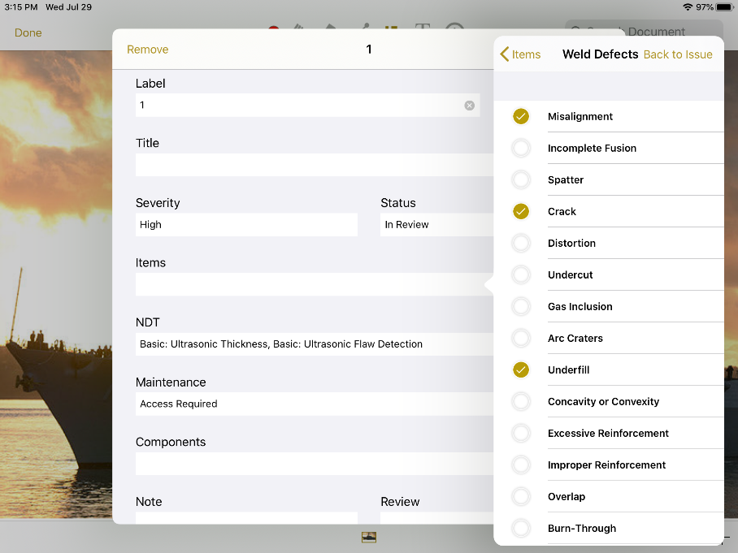
Digital Weld OQE – Shipbuilding + Repair
Optimized Weld Records
Project Lead Organization: TruQC
Project Team Members: EWI, Vigor, FMM
Concept/Idea
Benefits/Justification
Problem:
Welding processes require input from multiple individuals, documents and specifications, making proper management a challenge
Quality Assurance (QA) procedures can be expensive, inefficient, and difficult to administer
Proposed Solution:
TruQC, a commercial off the shelf (COTS) software, will be configured to manage welding requirements and records
TruQC will be a single access point to the data needed to complete and document welds for engineers, inspectors, supervisors and welders
More access to welding requirements and records will improve efficiency of planning, process improvement, and troubleshooting
Expedite decision-making, reducing analysis costs and associated downtime
Automated document organization for easier audits
Consolidates data for re-work tracking with weld specific information
Minimize or eliminate delays associated with adjudication of out of spec items
Reduce inspection costs
Eliminate costs incurred to re-create history of assessments
Increase transparency of inspection to the welding process
Project Approach
Cost/Image/Relevant Information
High Level Statement of Work:
TruQC will develop a weld requirement and record specific solution that connects resources and documents
TruQC will work with EWI and Vigor to test and introduce the solution to shipyard personnel
Metrics of Success:
TruQC solution for creating weld requirement documents, collecting weld record data and limited deployment to shipyard personnel for buy-in development
Compare digitalized weld lifecycle process using TruQC to the traditional paper method previously used
Project Estimated Cost: $150,000
TruQC will work with partner shipyards to create and administer a survey to shipyard personnel to examine current weld requirements, record management and NDT requirements with plans to grow this into an RA project
Notes:
Milestones and Deliverables
Requirements Document - April 2022
Reports available for testing on internal servers - September 2022
Final Reports available in Production - October 2022
Training and User Acceptance Testing - November 2022

Slide 9
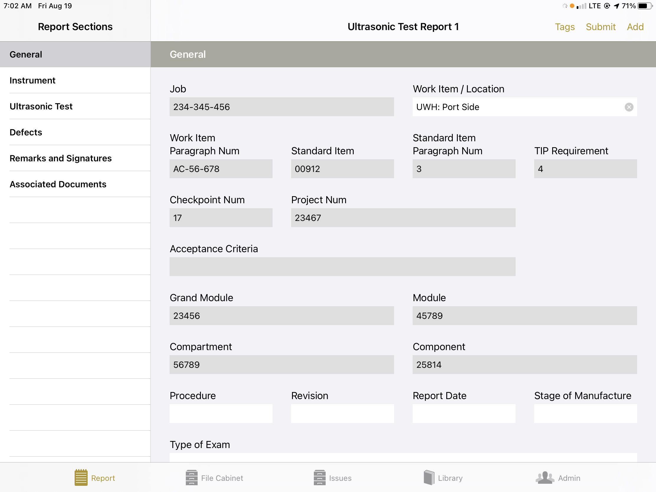
Digital Weld OQE – Future Project Expansion
Potential Solution Enhancements
Out of Spec Flagging
Inspector Certification Flagging and tracking for different weld types
NDT Gauge Integration
Integration with NMD and other legacy systems
Defect tracking to resolution
Importing of Welding standards and specifications

Slide 10

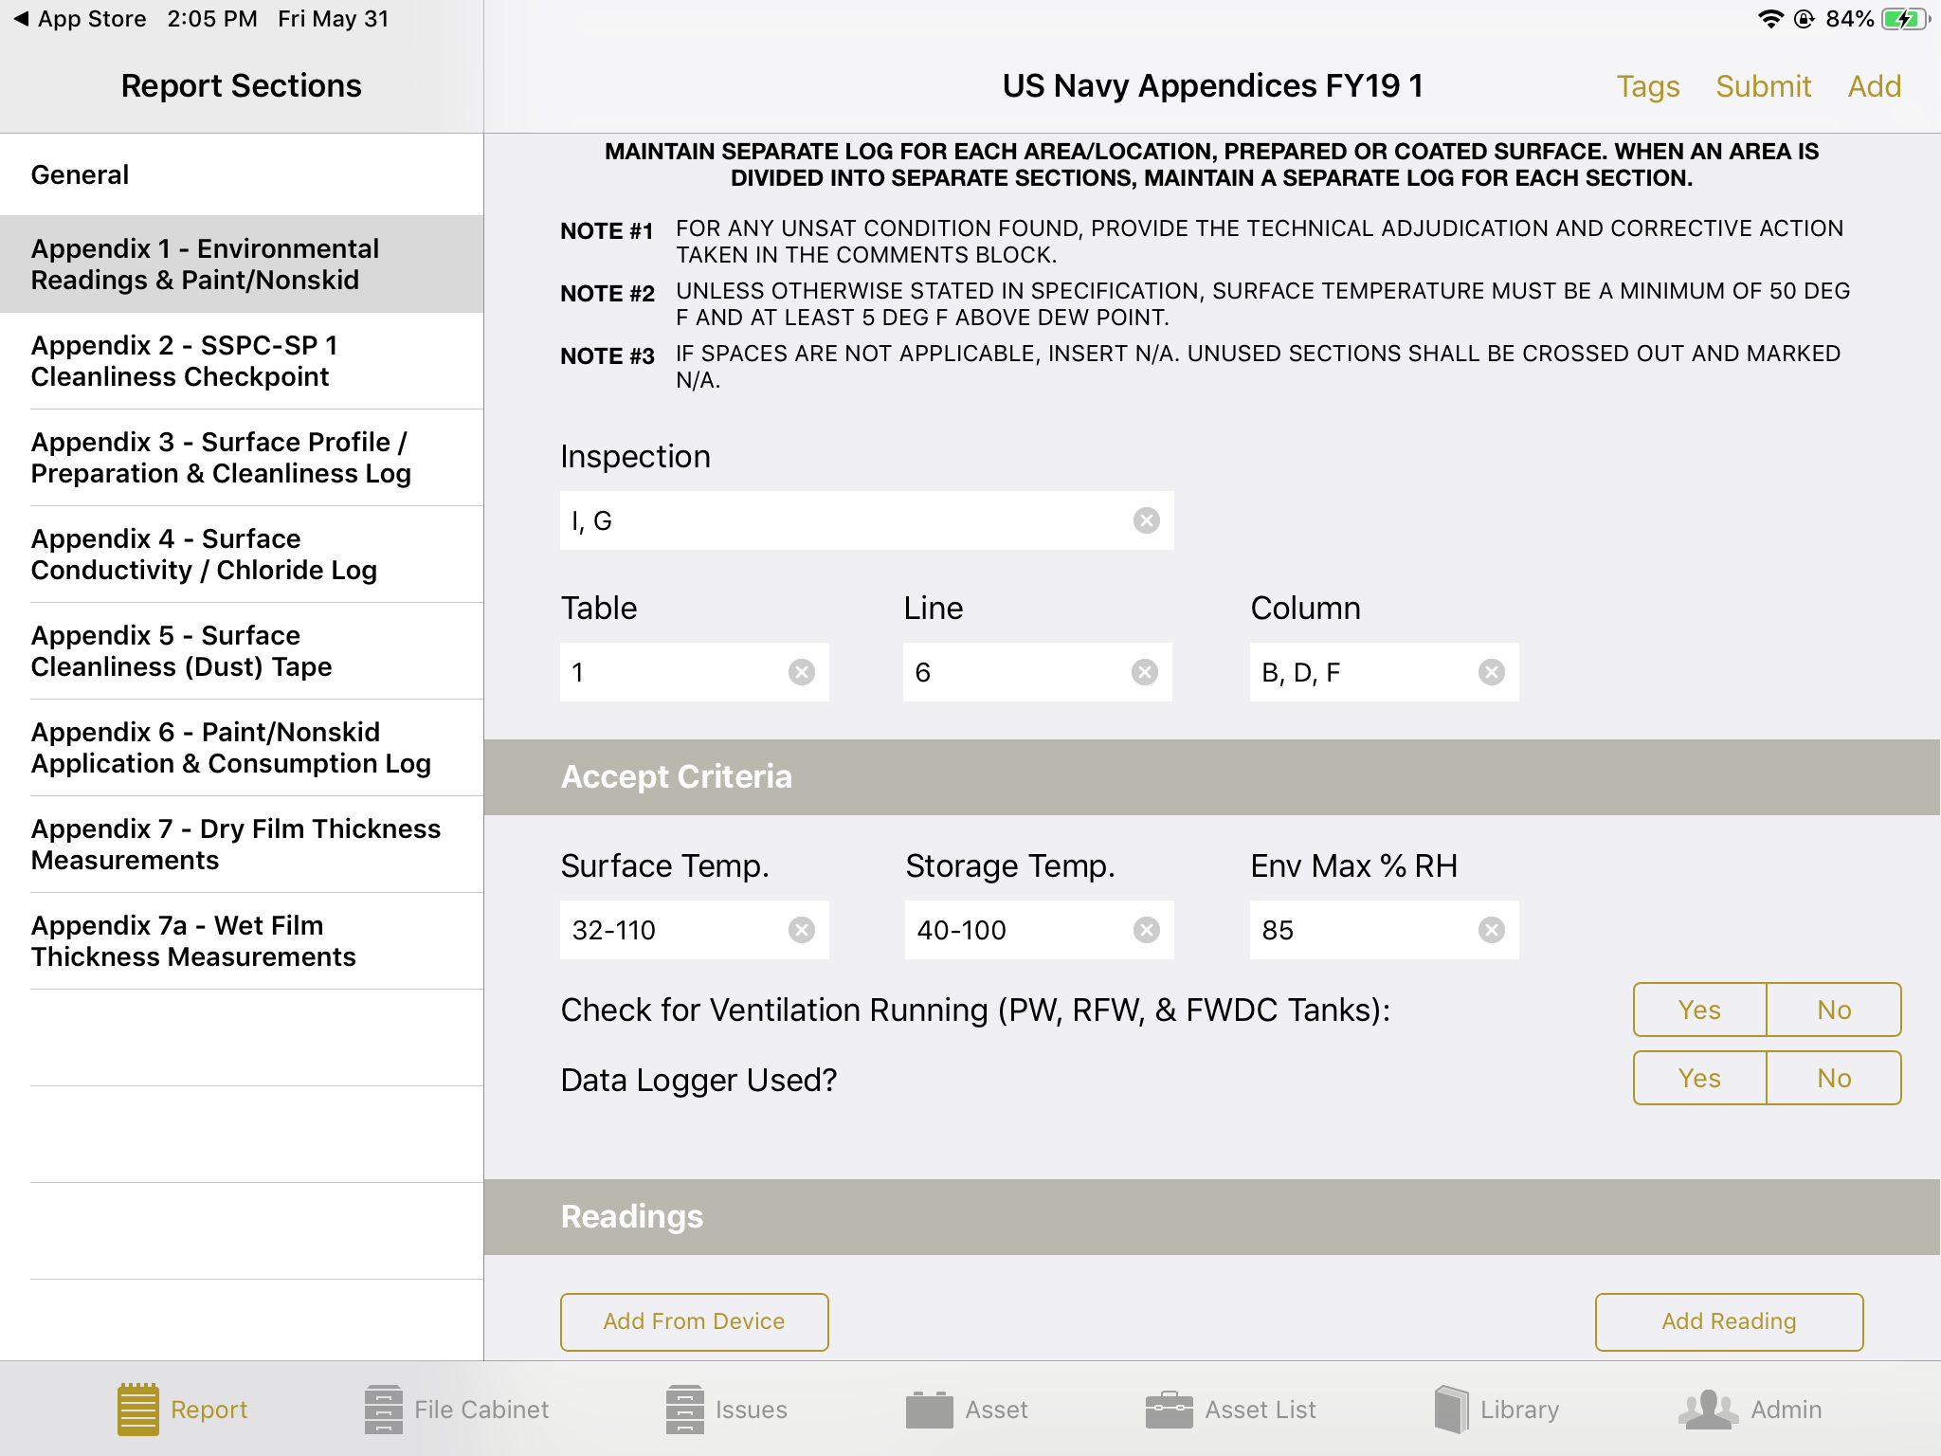
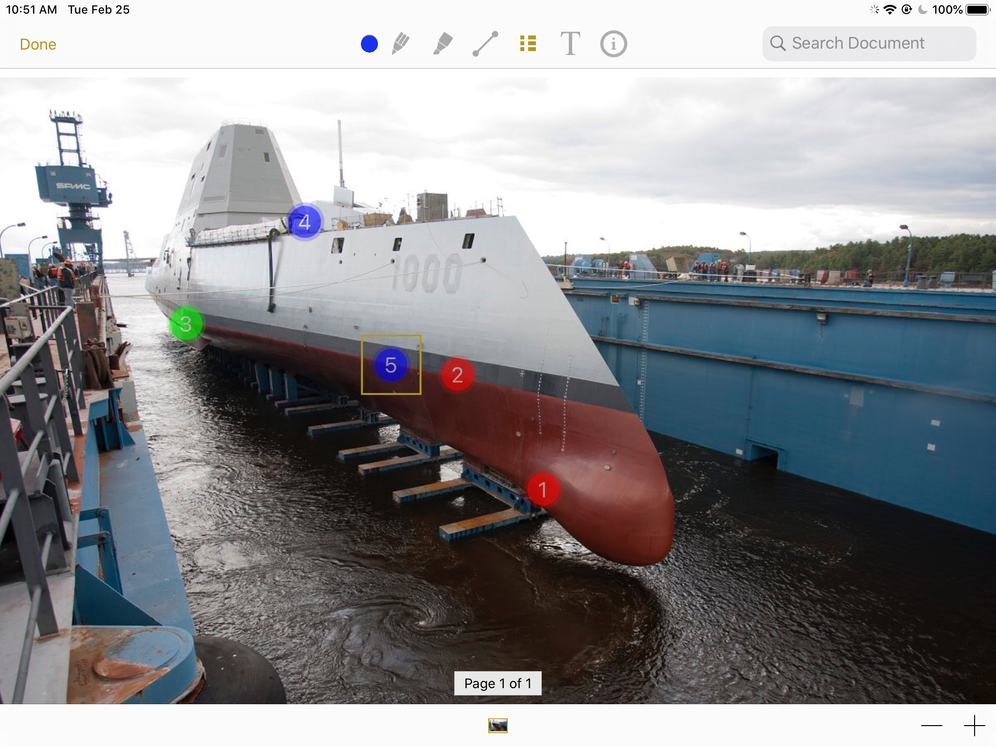
Megan Brinker
314.324.7469
megan@TruQC.com
DEMO + Questions

