Slide 1




Advanced Development and Implementation of the High Mobility Manufacturing Robot
August, 24, 2022
NSRP RA Project TIA #2020-303
Stephen Canfield, RTT
Jim Hansen, EWI
Patrick Cahill, Cahill Consulting
NSRP PPPF/Workforce Joint Panel Meeting, Green Bay WI
Robotic Technologies of Tennessee
EWI
Vigor Shipyards
Cahill Consulting

Slide 2
Part 1: HMMR Hardware Development for Shipyard Application
Work led by RTT
Discuss the activities associated with developing the HMMR for use on shipyard welds (focus on fillet welds)

Slide 3
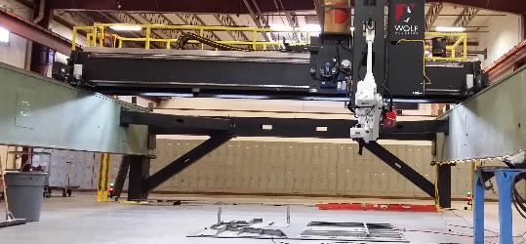
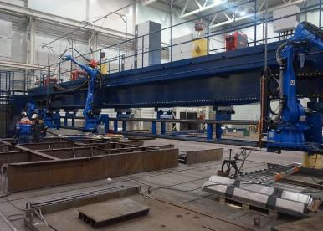
Focus on improved tool for weld mechanization
Background: SHIPYARD ROBOTICS CHALLENGES
Shipyard Characteristics
Limit Automation & Robotics To:
Large structures
Spaces that are relatively easy to access
Variable weld types
Robots that can be stationary or guided
by track, adjacent surfaces or gantries
Poor fit ups
Hard to access spaces
Materials that can be brought to robots
Current solutions:

Slide 4
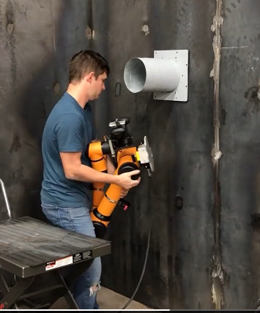
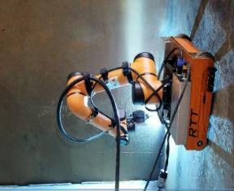
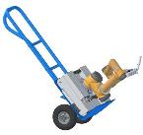
Proposed Approach: HMMR and HMMR-lite
High Mobility Manufacturing Robot
Mobile and Portable
Based on Cobot

Slide 5
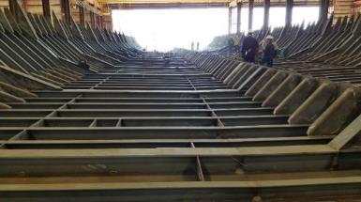
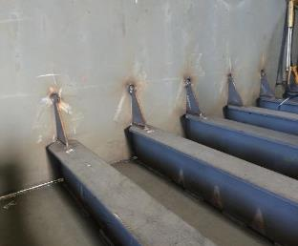
NSRP Project Objective
Motivating problem:
Increase the range of opportunities for mechanized welding through a lightweight, portable (or mobile) robot
First, apply to general fillet weld types
  2F (Horizontal)
  3F (Vertical)
  4F (Overhead)
Second, apply to specific jobs (welds joining stiffeners to deckplate, bulkhead intersections)

Slide 6
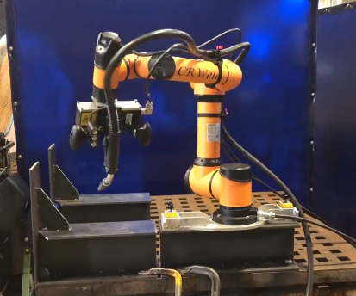
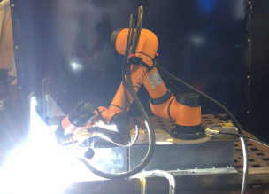
Overview of Proposed System
Operator places HMMR on stiffener and switches mag-locks
Robot scans and welds stiffener and gusset on either side
Operator releases mag-locks, slides HMMR to the next stiffener
Repeat

Slide 7
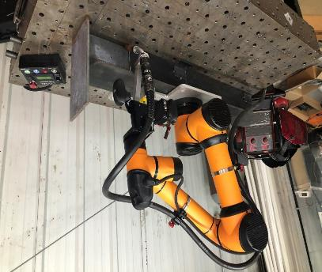
Develop Platform Hardware (HMMR-lite)
Base: Magnetic switchable
Arm: Aubo i5 commercial cobot
End-effector: Supports torch and user interface
Algorithms: Control robot motion, path, and job planning
System is man portable (approx. 50 lb)

Slide 8
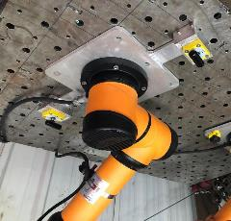
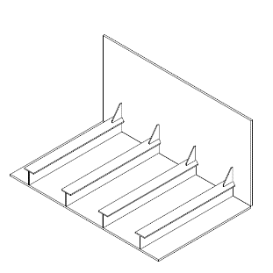
Mobility Requirements
Task: T-stiffeners with fillet welds at deckplates and bulkheads
Task workspace: ~300 mm (12 in) sphere
HMMR workspace: ~ 950 mm (37 in) sphere
HMMR positioned on stiffener

Slide 9
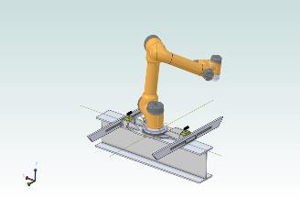
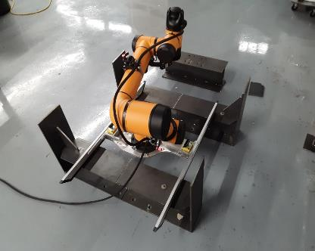
Sled for Traversing Stiffeners
Current design is a compliant mechanism fabricated in sled
Test data:
Table II: Test Results for HMMR Mobile Base Sled
Test | Result | Reach Goal? (Y/N)
Force required to move HMMR over T-stiffeners | 10.8 lb | Yes
Shear force stability when sled is locked | 79.2 lb | Yes
Bending moment about the X axis when sled is locked | 47.0 ft-lb | Yes
Bending moment about the Y axis when sled is locked | 166 ft-lb | Yes

Slide 10
Mobility Requirements for Arm:
Arm specs to meet weld requirements
Tool motions tested at 600 ipm
Axis/Joint | Range | Speed | Torque
Axis rotation base J1 | (+/-) 175 ° | 150 ° / sec | 207 Nm (153 ft-lb)
J2 Axis rotation shoulder | (+/-) 175 ° | 150 ° / sec | 207 Nm(153 ft-lb)
J3 Elbow rotation axis | (+/-) 175 ° | 150 ° / sec | 207 Nm(153 ft-lb)
J4 Rotation axis wrist | (+/-) 175 ° | 180 ° / sec | 34 Nm (25 ft-lb)
J5 Wrist axis | (+/-) 175 ° | 180 ° / sec | 34 Nm (25 ft-lb)
J6 Rotation axis wrist | (+/-) 175 ° | 180 ° / sec | 34 Nm (25 ft-lb)

Slide 11
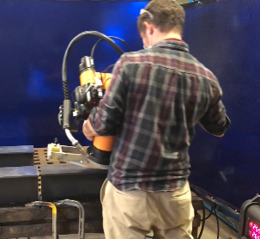
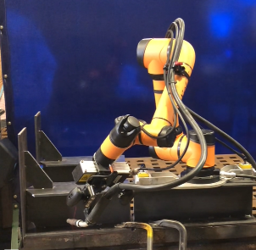
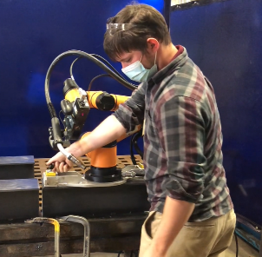
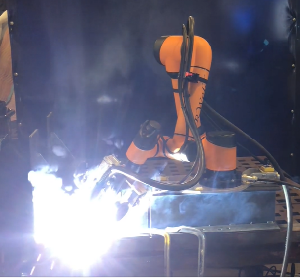
Demonstration of HMMR Hardware

Slide 12
Algorithm and Controls Development
Path planning is performed by the robot
Robot maps the workspace
  Develops high-level path guide
Scans weld seams
  Builds model of weld seam and develop accurate weld path
  Integrates the weld schedules according job requirements
Scanning tools
  Lidar
  Structured light vision

Slide 13
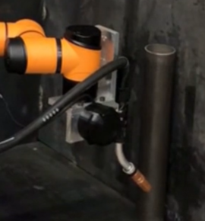
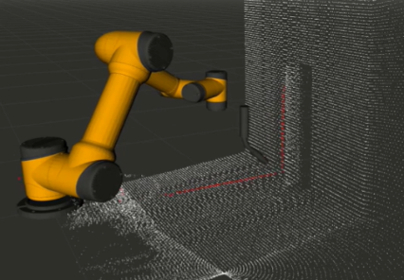
Scanning Tool – Lidar
Scanning Lidar
  Generate point cloud
  Use to find key features
  Detect objects

Slide 14
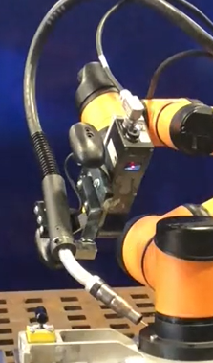
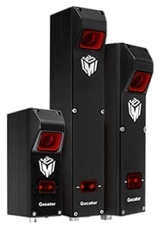
Scanning Tool – Structured Light Scanner
Weld seam scanning sensor
  High resolution capability
  Less dense data than scanning Lidar
  Gocator 2300 series 3D laser line profiler
  Builds 3D model of seam
  Key seam parameters pulled from scan
    Torch tip path
    Fit-up accuracy
    Joint depth and width
Algorithm

Slide 15
Integrating Communication with Welding Power Source
Capability of closed-loop weld control without processing overhead of complete robotic welding system
  Specific power source, wire feeder, specific integrator and hardware
Employed a new product by Miller – Miller cobot controller
  Interface for cobot control of large range of Miller power supplies
  Works with popular S-74 MPa wire feeder
Path planning includes selecting proper weld schedule – pull from selected set of validated weld schedules

Slide 16
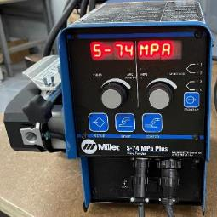
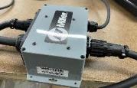
Development of Open/Closed Loop Welding
Weld power source communication
  HMMR controller communicates with power source and wire feeder through Miller’s cobot adapter
  Team designed PCB interface for HMMR controller to adapt
  Provides full control over voltage/wire speed and process settings

Slide 17
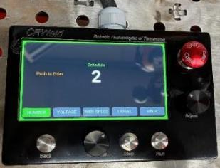
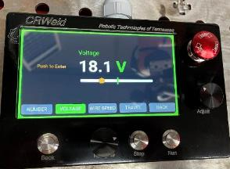
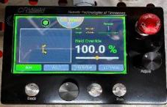
Updated the HMMR Interface to Monitor Both Cobot and Weld
HMMR control interface
  Pendant update for operator ease of interface
  Rotary knobs and large screen similar to typical welding power sources
  Control and display of voltage, wire speed, and other power source parameters
  Simple recall of schedules and selection for different portions of job

Slide 18
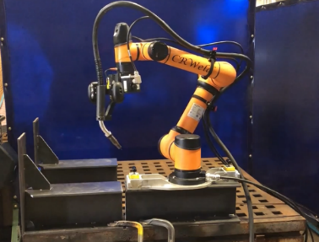
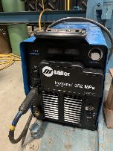
HMMR Prototype Ready for Testing on Selected Joints
HMMR arm with portable base attached to stiffener
Control system configured with integrated welder control (Miller Invision 352 MPa shown here)

Slide 19
Part 2: Welding Process Development for Selected HMMR Application
Work led by EWI
Discuss the activities associated with developing and demonstrating welding procedures with the HMMR for use on the selected application

Slide 20
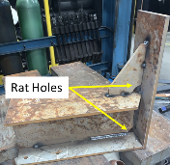
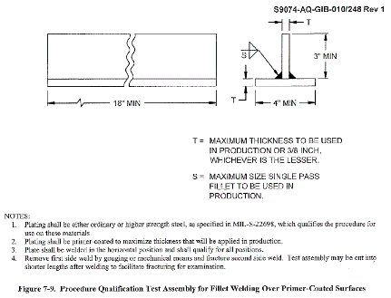
Overview of Welding Process Development and Evaluation
Procedures were developed to meet requirements of Tech Pub 248 Rev. 1
Base materials: 5/16 in and 3/8 in thick primer coated DH36 steel
Wire: MIL-71T-1
Shielding gas: 100% CO₂
Gap tolerance: 0 to 1/16 in
Minimum leg size: 1/4 in

Slide 21
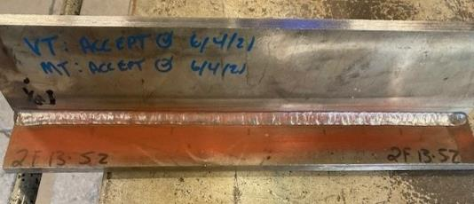
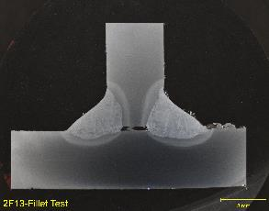
2F Welding Procedure Development and Evaluation
2F13-S2
Side 1
Side 2
ID | Position | Set Wire Feed Speed (ipm) | Set Voltage (V) | Travel Speed (ipm) | Travel Angle (deg) | Work Angle to Web (deg) | Contact Tip-to-Work Distance (in) | Weave Freq. (Hz) | Weave Width (in) | Dwell Right (sec) | Dwell Center (sec) | Dwell Left (sec)
2F13 | 2F | 415 | 29 | 14.1 | 5° Drag | 40° | 3/4 | 4.5 | 0.15 | 0.4 | 0.0 | 0.4

Slide 22
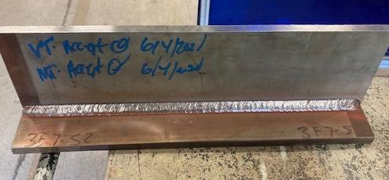
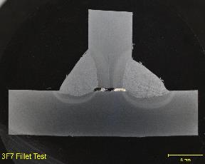
3F Welding Procedure Development and Evaluation
3F7-S2
Side 1
Side 2
ID | Position | Set Wire Feed Speed (ipm) | Set Voltage (V) | Travel Speed (ipm) | Travel Angle (deg) | Work Angle to Web (deg) | Contact Tip-to-Work Distance (in) | Weave Freq. (Hz) | Weave Width (in) | Dwell Right (sec) | Dwell Center (sec) | Dwell Left (sec)
3F7 | 3F | 265 | 25 | 6.1 | 5° Push | 45° | 3/4 | 2.0 | 0.13 | 0.4 | 0.0 | 0.4

Slide 23
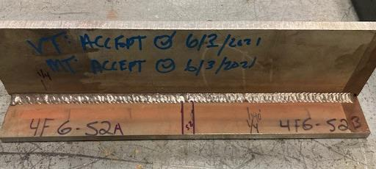
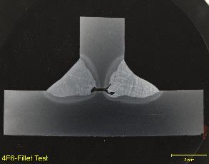
4F Welding Procedure Development and Evaluation
4F6-S2
Side 1
Side 2
ID | Position | Set Wire Feed Speed (ipm) | Set Voltage (V) | Travel Speed (ipm) | Travel Angle (deg) | Work Angle to Web (deg) | Contact Tip-to-Work Distance (in) | Weave Freq. (Hz) | Weave Width (in) | Dwell Right (sec) | Dwell Center (sec) | Dwell Left (sec)
4F6 | 4F | 375 | 27 | 11.0 | 5° Push | 45° | 3/4 | 3.0 | 0.20 | 0.4 | 0.0 | 0.4

Slide 24
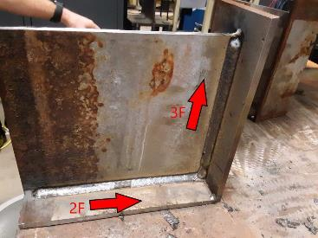
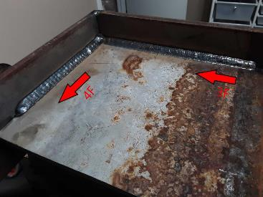
Procedure Implementation
Step 1: General Fillets
  Develop procedures to create acceptable tie-in and weld profile between welding positions
4F
3F
2F
3F

Slide 25
Procedure Implementation
Step 2: Bulkhead Mockups
Implement mechanized welding
Difficult positions to reach
Perform wrap-around welds with minimal rework
  Area for significant improvement from current operation

Slide 26
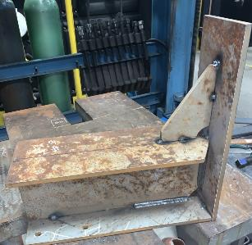
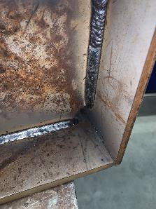

Welding on Bulkhead Mockups
4
Rat Holes
3
2
1
Welding on the bulkhead mockups requires development of wrap procedures
Accessibility considerations prove challenging to complete full wraps with acceptable tie-in and weld profile

Slide 27

Testing
Process development
Qualification
Time studies
Reliability
Testing location | Primary purpose | Operation time* (hrs) | Scan time** (hrs) | Weld time** (hrs) | Other** (hrs)
RTT | Motion control development | 75 | 19 | 37 | 19
EWI | Weld process development | 20 | 3 | 4 | 13
Vigor | Process qualification, training, evaluation | 16 | 2.4 | 5 | 8.6
Total |  | 111 | 24.4 | 46 | 40.6

Slide 28
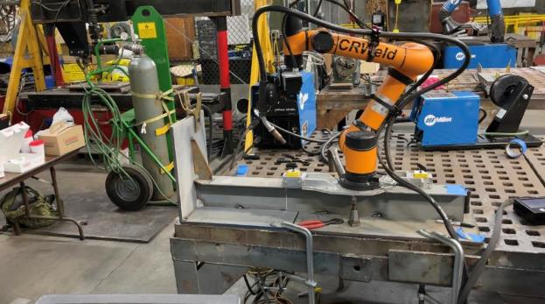
Testing at Vigor
Spring, 2022
Weld Qualifications
Training
Replicated systems

Slide 29
Qualification procedures

Slide 30
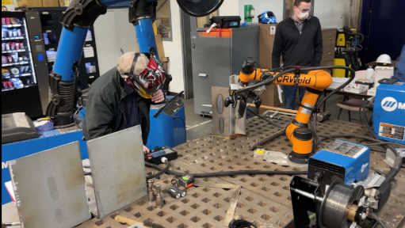
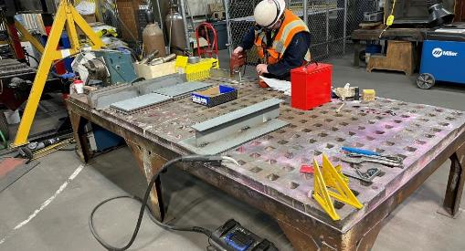
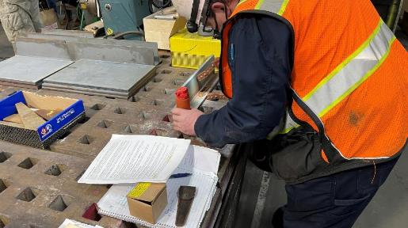
Training/Qualification/Testing

Slide 31
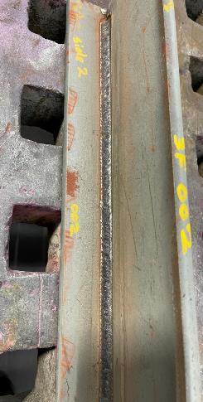
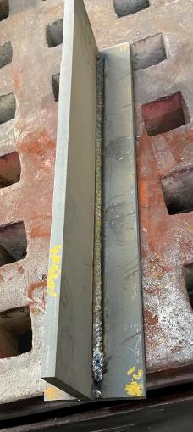
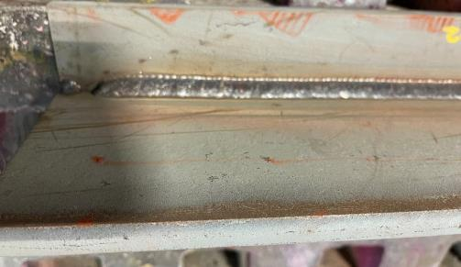
2F/3F/4F

Slide 32
Testing
Videos of operation
Complete scan and weld
https://vimeo.com/528391072/171c0faace
Welding of gusset
https://vimeo.com/528392166/d6e4eb581d

Slide 33
Cost-Benefit Analysis
Sub 8 min process time with robot, 80% efficiency
12X increase in Operator through-put
Speed, reduced stress, high arc-on time

Slide 34
Next Steps
Transferring equipment to longer-term testing
Support in-field testing and implementation

Slide 35
Questions

