Slide 1
NSRP Surface Preparation and Coatings (SP&C) Panel Update
Arcino “Q” Quiero, Jr., Panel Chair
September 13-14, 2022 – Pittsburgh, PA

Slide 2
NSRP Collaboration 11 Membered Shipyards
Notes:
NSRP is an industry-led collaboration with the U.S. Navy focused on reducing the total ownership costs of ships for the Navy and National Security Customers
10 Member Shipyard Collaboration
Allows competitors to partner on common shipbuilding/ship repair problems to benefit of industry and their clients as a whole
Industry cost share multiplies impact of every government dollar provided
Sponsored by NAVSEA and 6 Program Executive Offices
NAVSEA 06, PEO C4I, PEO Aircraft Carriers, PEO IWS, PEO USC, Team Ships, and Team Submarine collectively provide ~$13.5M in annual funding

Slide 3
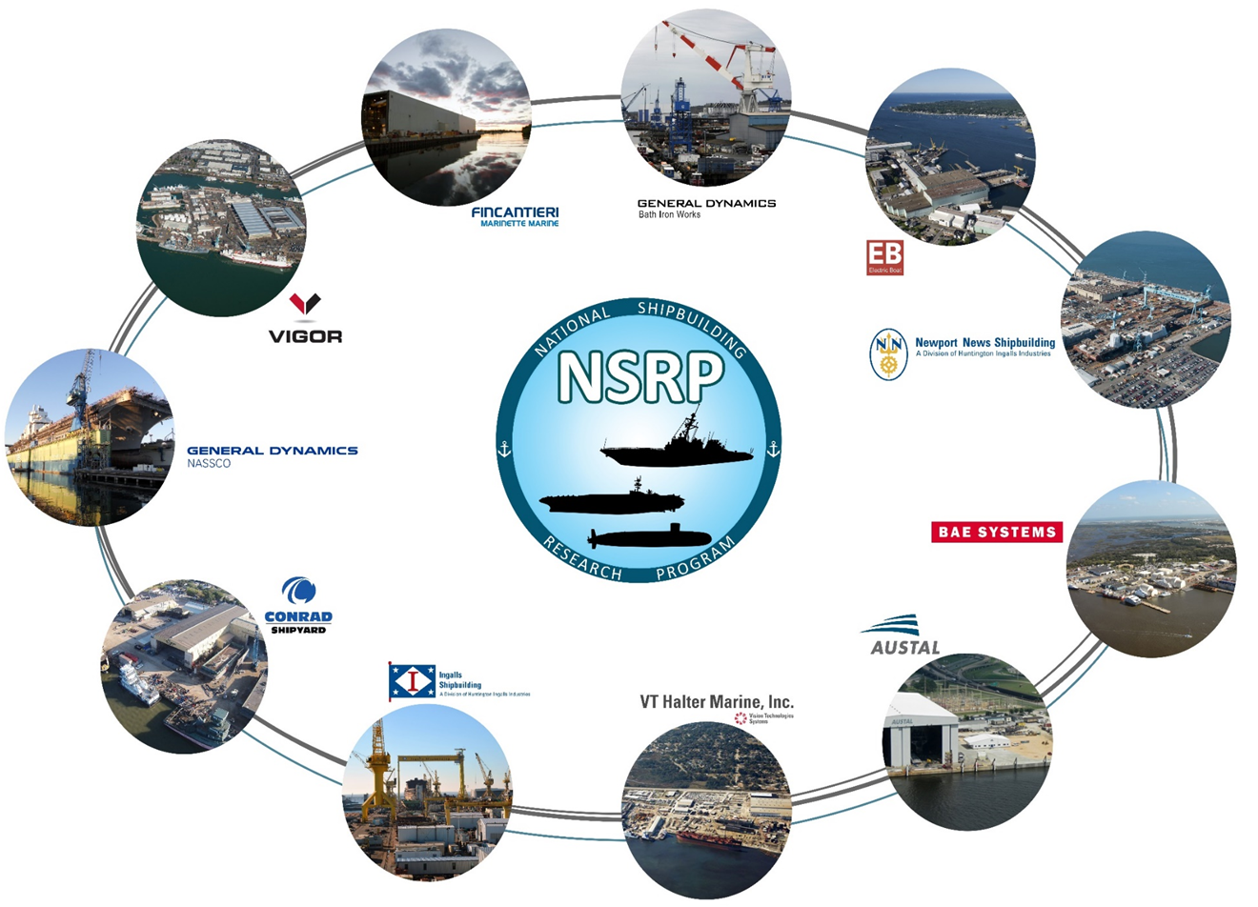
SP&C Panel – Mission
Specs to Decks Approach
Research, evaluate, develop, and sustain current and emerging technologies that will reduce cost and maintain or enhance quality
Notes:
Dynamic environment

Slide 4
SP&C Panel – Steering Committee
Member Shipyards & NAVSEA:
Austal USA – Marian Busca
BAE Shipyard – TBD
Bath Iron Works – Brian Thiele
Conrad Shipyard – Harry Verret
Electric Boat – Chris Wowk
Halter Marine – Bill Tanner
Ingalls Shipbuilding – John Walks
Marinette Marine – Sean Smith
NASSCO – Angel Zepeda
NN Shipbuilding – Arcino “Q” Quiero, Jr.
Vigor Shipyard – TBD
NAVSEA 05 – Mark Ingle & Howard Castle
Panel Officers (10/1/21-9/30/23):
Panel Chair – Arcino “Q” Quiero, Jr.
Panel Vice-Chair – Robert Cloutier
Past Panel Chair – Steve Cogswell
TWH – Mark Ingle
DTWH – Howard Castle
NSRP / ATI:
Ryan Schneider – Project Manager
Lydia Szydlo – Panel Coordinator
AMPP Global Center (7/1/21-6/30/24):
Steve Cogswell – Board of Director
Arcino Quiero – Board of Director
Notes:
Focus:
People, Specs., Surface Prep, Coatings, Environmental, QA & Documentation
People + Processes = Performance
Innovation + Technology = Increased / Improved Performance

Slide 5
SP&C Panel - Purpose
What We Do?
Engage Suppliers, Applicators, and Specifiers of preservation systems, including NAVSEA
Facilitate Panel meetings, facilities tours, and demos – See Agenda
Partner with Industry Experts
Why?
Ensure a common understanding of requirements and what’s next
Benchmark Best Practices and utilize Lessons Learned
Increase the Panel, Shipyards, and Navy overall success rate
Bob
“Q”
Notes:
Focus:
People, Specs., Surface Prep, Coatings, Environmental, QA & Documentation
People + Processes = Performance
Innovation + Technology = Increased / Improved Performance

Slide 6
Benefits of the SP&C Panel
US Navy – NAVSEA
Offers a source for addressing opportunities, issues, and concerns
Includes all in the selection and review process of Panel Projects
Enhances the Navy Standard Item 009-32 SRRAC proposals and annual review process
Provides ROIs of implemented projects
Member Shipyards (11)
Interact with NAVSEA TWH
Learning from other Shipyards (Sharing Best Practices)
Funding Opportunities:
(RAs, Panel Projects, Joint Panel Projects, & RAP)
Suppliers
Understand customer needs
Associations - Academia
Ensuring the next generation of “Job Ready” Shipbuilders
Processes
Resources
Craft Workers
People + Processes = Performance

Slide 7
SP&C Panel – Projects (Funded Projects 2014-2020)
Completed Projects 2018-2020:
Optimize Power Tools Surface Preparation
Survey of Surface Prep & Coatings Automation
Standardization and Digitization of Visual Inspection for Shipbuilding & Repair
Primers with Extended AF Overcoat Window Surface Preparation
Certification Program – Shipbuilding Industry Surface Prep & Coatings Training
Virtual Spray Paint Training System
Thermal Insulating Aerogel Filled Coatings
Evaluation of Plasma Coating Removal & Surface Preparation
Completed Projects 2014-2017:
Partial Blast of UHS Coated Tanks II
Retention of Epoxy Type VI under Ultra High Solids
Boomlift Carried Environ. Enclosure
Implementation of Paperless Paint
Universal Primer & Surface Prep Process
Partial Blast of UHS Coated Tanks
Technical Guide for Inaccessible Void Coatings & Treatments
Reducing Inspection Costs Using the Latest Digital Inspection Tools
Cost Savings Comparison in Appling Polysiloxane vs. Silicone Alkyd Topcoats
Paperless Paint Documentation II
2020
2017
2016
2015
2019
2018
2014
Notes:
18 Funded Project since becoming SP&C Panel Chair
People + Processes = Performance
Certification & Virtual Spray + Automation, Standardization, & Power Tools
Tools & Equipment To Do My Job

Slide 8
TruQC Paperless Projects
Surface Preparation & Coatings Panel
Led to a Rapid Adoption Project (RAP) – Weld Digitalization Solution
PROJECT # / TITLE / SUPPORTING SHIPYARDS | OBJECTIVES
Project Title: Paperless Paint Documentation, Paperless Paint Documentation II, Implementation of Paperless Paint, and Digitalization and Standardization of Visual Inspection in Ship Building and Ship Repair Project Lead: BAE Southeast Shipyards and Elzly Technology, Corp. Supporting Shipyards: BAE, Vigor, BIW, NNS | Increase transparency of inspection to the surface preparation and coatings process Improve efficiency of inspection efforts Transmit inspection data efficiently to decision-makers Archive inspection data for future use Leverage inspection data to its fullest extent
IMPLEMENTATION – LEVEL OF EFFECTIVENESS | RETURN ON INVESTMENT / BENEFIT TO THE NAVY Tangible / Non-Tangible
Once TruQC was implemented on the above Yards they saw immediate ROI and deployed TruQC for other digital paperwork and reporting beyond paint. They found it reduced rework significantly and even stopped them from making costly mistakes on compartments that had previously happened using legacy software. NAVSEA cannot specify the use of TruQC. They are a big supporter of paperless paint and encourage its use. | ROI has been as high as 390%. Customers report a savings of 1 hour per day/per user on reporting time, a 20% reduction in rework and hundreds of hours saved on audit preparation Vigor saw a 100% reduction in corrective action requests and eliminated 480 hours of paperwork review An objective, standardized, paperless, and truly digital defect identification and resolution system that can be used for internal process improvement Useable data consistent across Programs, contracts, and processes
Notes:
18 Funded Project since becoming SP&C Panel Chair
People + Processes = Performance
Certification & Virtual Spray + Automation, Standardization, & Power Tools
Tools & Equipment To Do My Job

Slide 9
Optimize Power Tools Surface Prep
Surface Preparation & Coatings Panel
Led to a Rapid Adoption Project (RAP) SUBMITTAL – Power Tools
PROJECT # / TITLE / SUPPORTING SHIPYARDS | OBJECTIVE
Project Title: Optimize Power Tools Surface Prep Project Lead: Elzly Technology Corp. Supporting Shipyards: BAE Systems Southeast Shipyards & HII-Ingalls Shipbuilding | Generate the necessary data to allow Shipyards and the Navy to optimize procedures for power tool cleaning prior to coating application. Work with a stakeholder team to; consolidate power tool performance data, develop a comprehensive list of the generic type of power tools available to the industry, and generate data on tool effectiveness in a shipyard setting.
IMPLEMENTATION – LEVEL OF EFFECTIVENESS | RETURN ON INVESTMENT / BENEFIT TO THE NAVY Tangible / Non-Tangible
Consolidate Power Tool performance data Develop comprehensive list of generic type of power tools available by industry Generate data of tool effectiveness in a Shipyard setting | Shipyard User Guide to optimize power tool cleaning Improve Safety relative to Power Tool Cleaning Improve Quality relative to Power Tool Cleaning Increase adherence to Schedule Reduced Cost in Power Tool cleaning processes Lengthen new coatings lifespan for Shipyards and the Navy
Notes:
18 Funded Project since becoming SP&C Panel Chair
People + Processes = Performance
Certification & Virtual Spray + Automation, Standardization, & Power Tools
Tools & Equipment To Do My Job

Slide 10
Partial Blast Projects
Surface Preparation & Coatings Panel
Led to a Rapid Adoption Project (RAP) SUBMITTAL – Partial Blast
PROJECT # / TITLE / SUPPORTING SHIPYARDS | OBJECTIVE
Project Title: Partial Blast of UHS Coated Tanks Project Lead: Elzly Technology Corp. Supporting Shipyards: HII-Ingalls, BAE Southeast Shipyards, | Develop, demonstrate, and institutionalize a “Thorough Spot and Sweep Blast” process (aka, Partial Blast) for re-preservation of tanks and/or voids with ultra-high solids coatings on surface ships.
IMPLEMENTATION – LEVEL OF EFFECTIVENESS | RETURN ON INVESTMENT / BENEFIT TO THE NAVY Tangible / Non-Tangible
Implementation Within Shipyards The process has been demonstrated in follow-on efforts sponsored by the Navy at NASSCO Next demonstration will be on USS Kearsarge NAVSEA Requirements Included in SURFMEPP Design Memorandum Proposed for inclusion in 2022 NSI 009-32 | Tangible 6.4:1 ROI with conservative assumptions 1.5-year payback after implementation Non-Tangible Reduced cost of re-preservation, material & labor Shortened re-preservation schedule Potentially higher quality repair
Notes:
18 Funded Project since becoming SP&C Panel Chair
People + Processes = Performance
Certification & Virtual Spray + Automation, Standardization, & Power Tools
Tools & Equipment To Do My Job

Slide 11
NRSP SP&C Panel 2022 Project Proposals (8)
Project Type | Prime / Lead | Title / Description | NSRP Yards
Panel | Elzly Technology | Zinc Rich Coatings Over High Strength Steel The project will evaluate the effect that Zn-rich coatings have on high strength structural steels, such as HY-100 and HSLA-100. In shipbuilding, Zn-rich coatings are often avoided on high strength steels during any phase of the build process due to concerns of hydrogen embrittlement, particularly in the heat affected zones of welds. However, there are several research papers suggesting that zinc primers do not induce hydrogen embrittlement in alloys of this yield strength. Zn-rich coatings provide added corrosion resistance during construction as the various components tend to stay in lay-down areas for extended periods of time. The use of Zn-rich coatings can aid in reducing rework associated with repairing pitted or rusted steel. Additionally, in the case of inorganic Zn-rich coatings, their high tolerance to heat can allow a reduction in the amount of coating removal prior to hot work applications like cutting and welding. | HII-Newport News Shipbuilding
Panel | GD-Bath Iron Works | Cleanable Nonskid Deck Covering: Determine if SiloxoGrip N-9020A Deck Gray MIL-PRF 24667 Type I nonskid can easily and effectively be cleaned and kept clean throughout the new construction process. Assess the nonskid capability to be cleaned through the service life of the coating. Work with vendor and other shipyards to develop tools and methods for cleaning. | GD-Bath Iron Works
Panel | GD-Bath Iron Works | SilvaGrip Peel and Stick Nonskid Application Testing Recently released MIL-Specs open up options for new types of peel and stick non-skid material that can improve manufacturing time for new construction ships. Prior to requesting these materials be used aboard currently manufactured Navy ships, a series of assessments need to be made. This project will test a metal mesh base nonskid that meets MIL-PRF-32704 TY VI application in high traffic areas and will allow shipyards to understand the labor impact associated with using this material in shipyards. | GD-Bath Iron Works
Panel | Elzly Technology | Visual Guide for Laser Ablation (AMPP-SP21511) Implementation into Shipbuilding Laser ablation surface preparation and coating removal is a technology that has proven to provide benefits to the Navy not only in coating performance, but in a production setting as well. With a new surface preparation standard currently being developed by AMPP (Tentative # AMPP-SP21511 – Laser Ablation for Metallic Surface Preparation), this technology has been a highly anticipated priority in Navy shipbuilding. Due to the nature of laser ablation technology, the visual conditions of the surface treatment will vary from normal operations, such as abrasive blasting, power tooling, and water jetting. The proposed “Visual Guide for Laser Ablation of Metallic Surfaces” would facilitate fair and consistent implementation of the requirements, minimizing rework and time spent adjudicating differences in interpretation. This guide will provide inspectors with a convenient waterfront tool with the necessary information to make appropriate decisions when deciding if a surface has been adequately cleaned via laser ablation. The visual guide developed by this project would support implementation of the new standard in both public and private shipyards for new construction and sustainment applications. | HII-Newport News Shipbuilding
Panel | Marinette Marine | Ultra Heat Resistant Primer Work with relevant industry professionals and material manufacturers to develop and study an Ultra Heat Resistant Primer. It will be performed in conjunction with Northern Coating & Chemical of Menominee, MI. This primer could be applied under on the overhead of modules and remove the need for landing bars or masking in way of erection seams from higher modules. The primer would also reduce the amount of paint rework needed due to steel modification and repair such as installing or moving hangars late in the build process. | Fincantieri Marinette Marine
Panel | HH-Ingalls Shipbuilding | Utilizing Ship Product Model Information for Corrosion Control and Coatings 3D Ship product models typically do not include information on corrosion control and specific coatings, despite containing the majority of data needed to design those systems. The data that is pulled from the model for corrosion control and coating applications is incomplete and requires extraction, duplication, and manipulation in other applications for use. The proposed solution is to develop effective techniques for utilizing the 3D models in corrosion control design and develop automated solutions using back end data to tasks that otherwise might have been done after manual front end data extraction. | HII-Ingalls Shipbuilding
Pane; | PSU / ARL | Low Cost Pulsed-Laser Processing Feedback Loop 1) Develop an inexpensive, feedback system concept based on simple visual indictors and a prototype that may be adapted for use in hand-held or automated laser ablation (LA). 2) Rapidly train workers to employ laser paint/rust removal by making the system(s) simpler to operate in a manner that precludes harm to the substrate and worker. | HII-Newport News Shipbuilding
Panel | Blast One | Real-Time Blast Tracking Technology to Optimize Blast Cleaning operations during Shipyard Construction and Repair Blasting is #1 surface preparation method in our shipyards, blasters get little formal training which results in cost and schedule blow-outs due to blasting efficiencies not being met because of difficulty in obtaining accurate data that can be acted upon. Constantly as a community looking ways to optimize. New cloud based system are being evaluated that have the ability to report blasting productivity and efficiency metrics in real time, to provide accurate and timely data to supervisors and management that they can act upon and have a positive impact on the blasting efficiency and schedule of a blasting project. | Fincantieri Marinette Marine GD- Electric Boat GD-NASSCO HII-Newport News Shipbuilding
Surface Preparation & Coatings

Slide 12
SP&C Panel – 2022/2023 Road Map
Event | Data | Location
AMPP Conferences; Eastern, Standards & Technical Exchange, & CoatingsPro Contractor | October 26 – November 2, 2022 | Tampa, FL
NSRP Day @ NAVSEA | November 2022 | Washington Navy Yard
NSRP SIP / TIP Meeting | January 2023 | Charleston, SC
NSRP All Panel Meeting SP&C Panel In Conjunction W/All Panel | March 2023 | Charleston, SC
AMPP 2023 | March 19-23, 2023 | Denver, CO
MegaRust 2023 SP&C Panel In Conjunction W/MegaRust | June 13-15, 2023 | Hampton, VA
NAVSEA SSRAC Standard Item Review | August 2023 | Newport News, VA
SP&C Panel Meeting | September 2023 | TBD

Slide 13
SP&C Panel – “For the Good of the Panel”
Challenges:
Shipyard Membership
Panel Funding
Travel – Limited F2F Meetings
Projects:
Research Announcements (RA)
Panel Projects
Joint Panel Projects
Rapid Adoption Projects (RAP)
Opportunities:
New Membership / Fresh Perspective
Panel Funding
RAP (2)
Panel Projects (8)
Joint Panel Projects (4 of 8)
Embracing the New Norm – Enhanced Panel Mtgs.
Increase NSRP / ManTech / NRL Collaboration
Seats at AMPP’s Table
Board of Directors Chairs (2)
Emerging Leaders Program – Eric Shoyer
Advisory Board – Allen Valencia
Thanks in Advance:
For Your Attendance 9-9-22
In-Person 47
Virtual 9
For Your On-Going Support
Processes
Resources
Craft Workers
People + Processes = Performance

Slide 14
Surface Preparation & Coatings Panel’s Responsibilities & Takeaway
“You, the Coatings Community, are the subject matter experts (SMEs). You owe it to yourselves, your Shipyards, and your Companies to stay aware of and understand the current and proposed coatings requirements. Don’t allow someone else to determine your fate and/or that of your Company without your input”.
“Remember, the work isn’t completed until the ship is painted and/or cleaned (Polysiloxane) and the coatings system is documented; preferably paperless”.
“Together, let’s paint a picture that allow the Coatings Community and the US Navy to be successful”!!!
“Q”

Slide 15
Questions?

