Slide 1
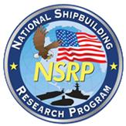
RAP Project Overview
Weld Digitalization Solution
Megan Brinker, COO, TruQC
NSRP Welding Technology Panel
August 2, 2022

Slide 2
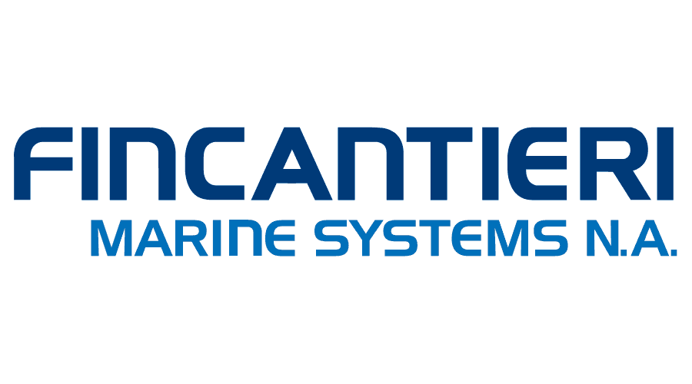
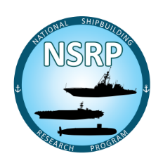
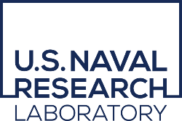
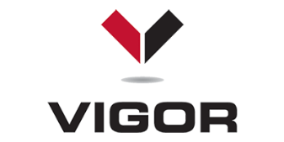
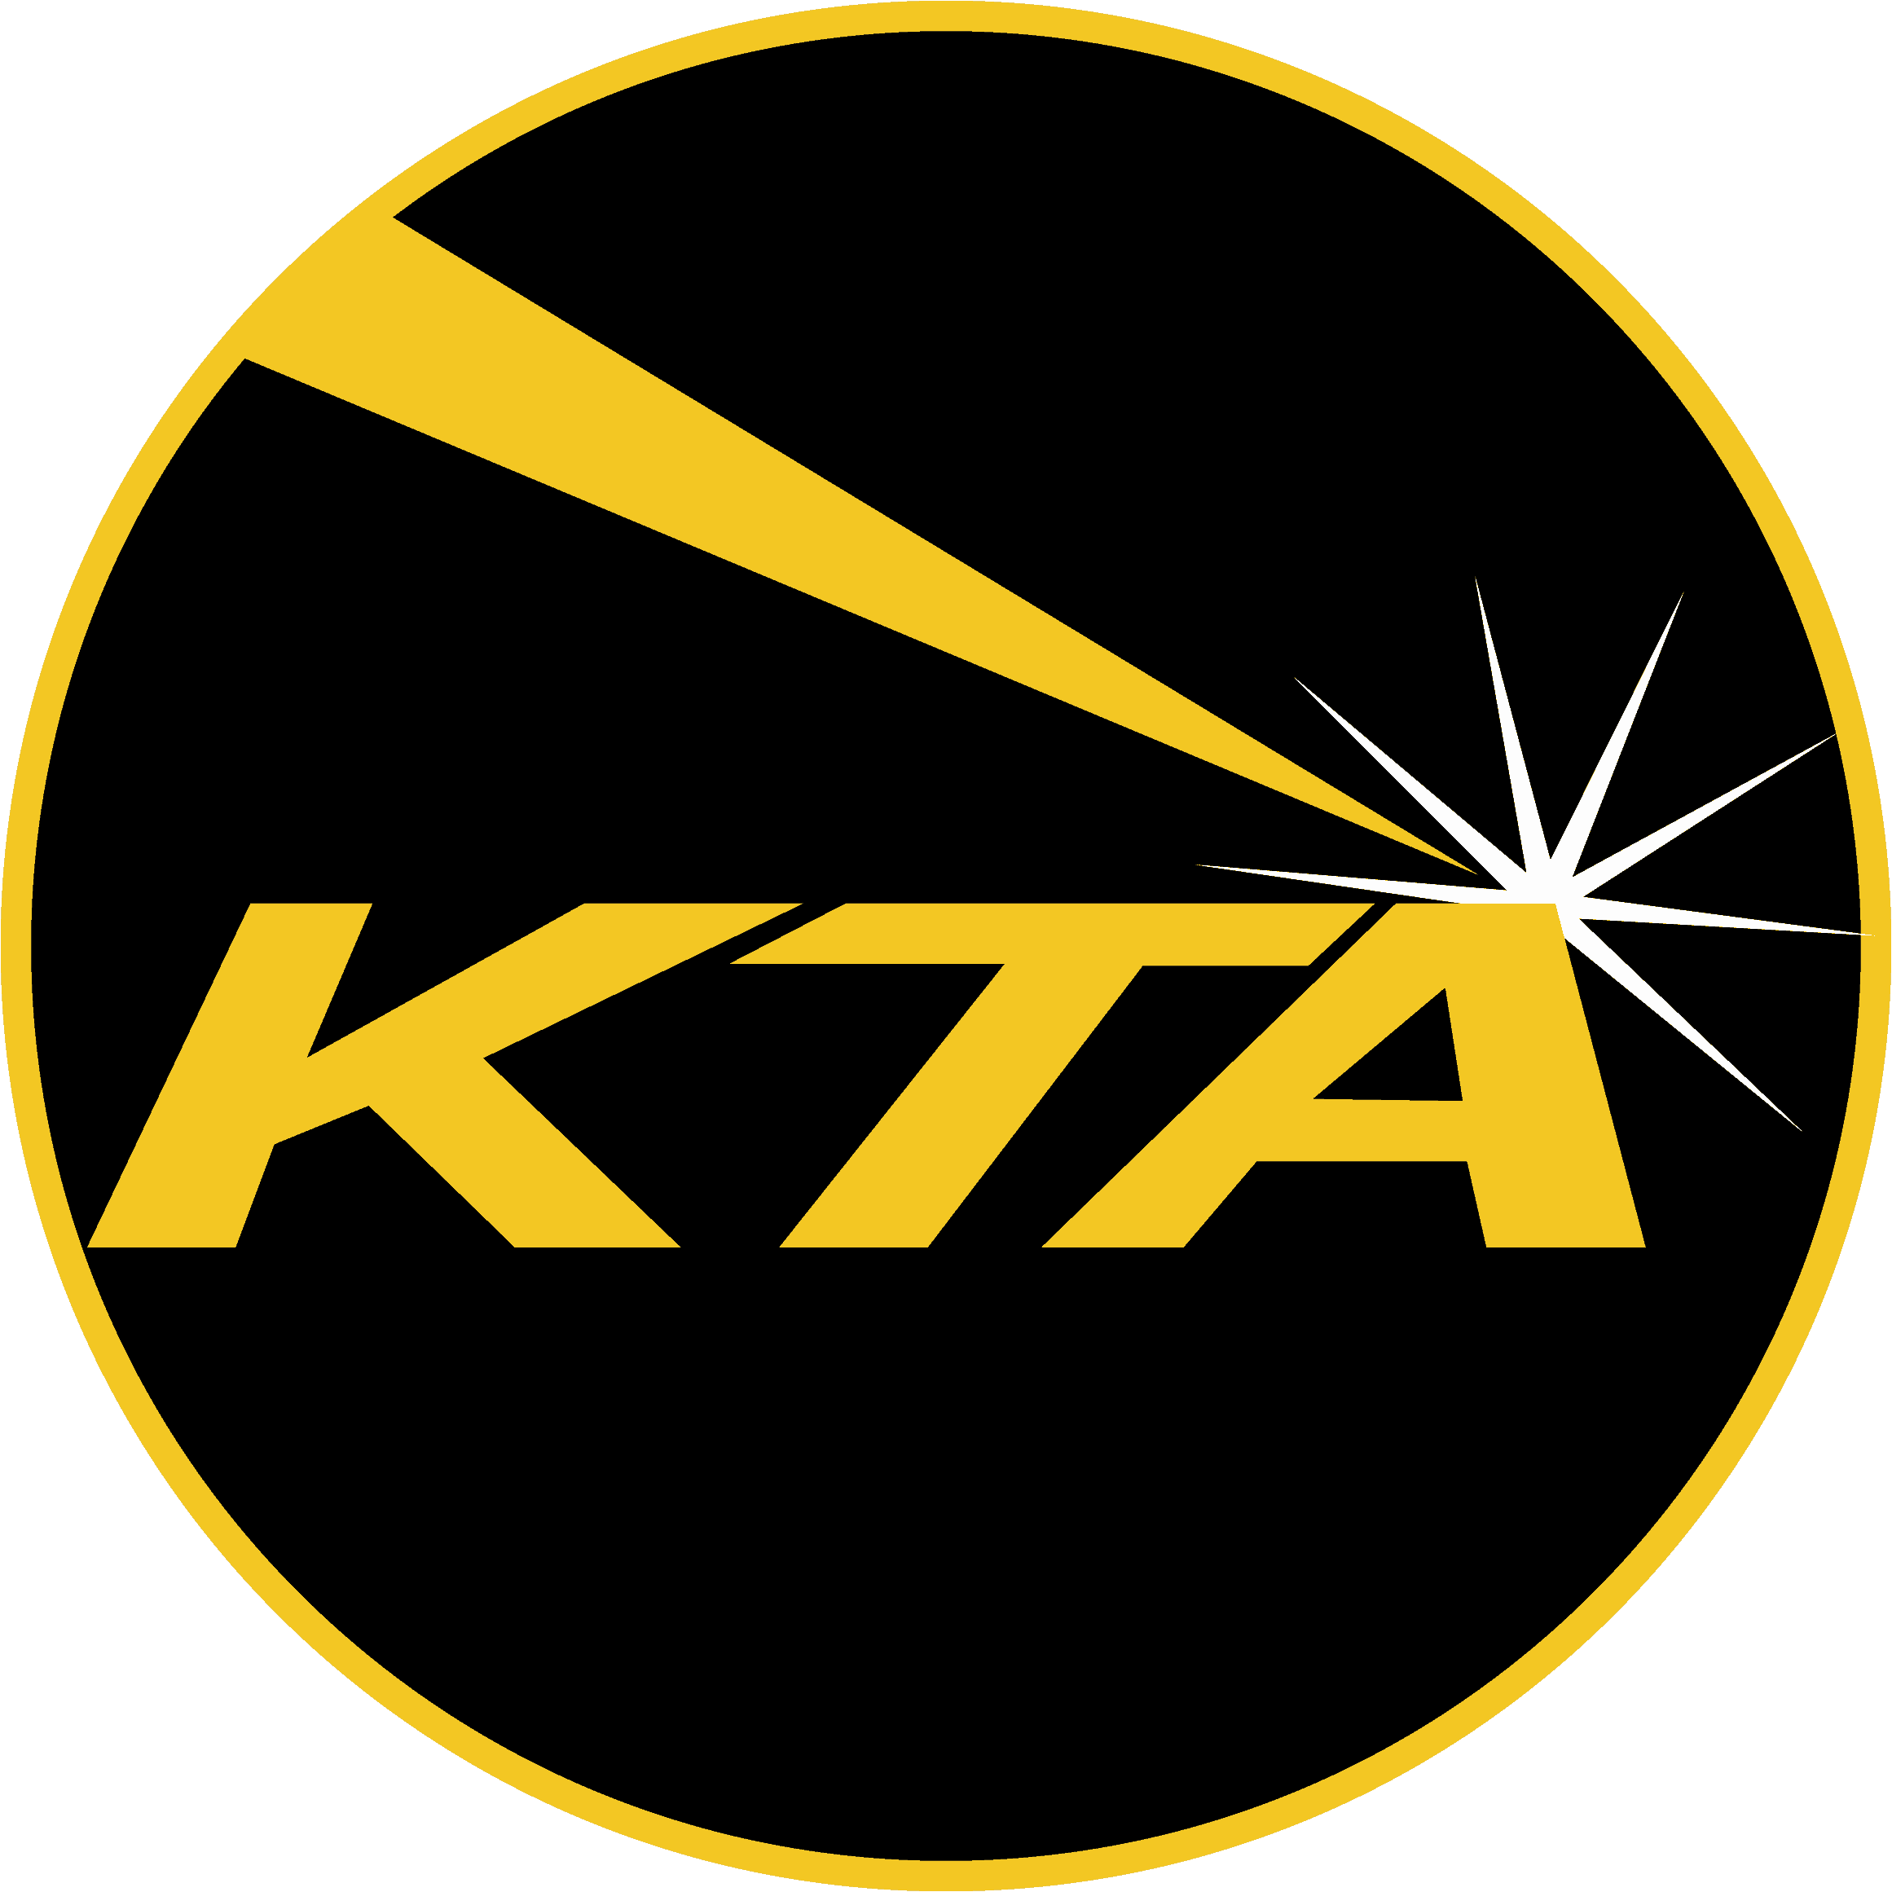
Your Process, Digitalized
Our proven software framework quickly streamlines your workflow and makes compliance easy.
Founded 2011
Home office in St. Louis, MO
2,100+ Users
Industrial Process Focused
Used in over 50 countries
Rapidly configurable platform
Robust document management
Permission-based
Real-time syncing
Full offline capability
Annotation & issue tracking
Role-based views & summaries
API & systems integrations
Device integrations
Industry-leading security
Oil & Gas • Marine • Infrastructure

Slide 3
Solutions in Shipbuilding and Ship Repair
Marine
Vigor Industrial: Environmental, Health and Safety, Paint Quality (since 2015)
Bath Iron Works: Safety and Paint Quality (since 2015)
Newport News Shipbuilding: Replacing old Paint Quality System E4749 (since 2020)
BAE Systems: Paint Quality 009-32 (since 2019)
NAVSEA: Tie-downs + Non-skid (exploratory phase)
NSRP – Surface Preparation and Coatings Panel
Project 1: Digitalizing 009-32, 2013, complete
Project 2: Out of Spec Flagging for 009-32, 2015, complete
Project 3: Implementing 009-32 on the deck plate, 2017, complete
Project 4: Standardization and Digitalization of Visual Inspection for Shipbuilding and Ship Repair, 2020, complete
NRL
Phase I: Digital Paint/Preservation Quality Assurance Records as a Data Source for Improved Decision Making in partnership with Rampart LLC and sponsored by the Navy Corrosion Executive, Ted Lemieux
Phase II: Optimized Blast and Paint Quality Assurance Data for Improved Operational Availability
NSRP – RAP
Project 1: Optimized Weld Records, 2021, In Process
Notes:
Add Fincantieri Marinette Marine (FMM) for analysis of the new ship build process and Vigor to understand existing vessel repair.

Slide 4
RAP Project Specifications
Program Requirements
The National Shipbuilding Research Program (NSRP) developed this Rapid Adoption Project (RAP) Pilot Program to provide the U.S. shipbuilding and ship repair industry and the U.S. Navy with a methodology for rapidly identifying and implementing mature, commercial technologies, products, processes and services that will specifically benefit U.S. Naval shipbuilding and ship repair.
The selection process will be more streamlined than the current, annual NSRP Research Announcement (RA) and Panel Project (PP) solicitations, which usually involve less mature or non-commercial technologies, products, processes or services. The goal is for the technology, product, process or service to be ready for implementation within 12 months of the idea being initially submitted to NSRP. The intent is that a technology, product, process or service candidate for a RAP be Technology Readiness Level (TRL) 8 (Actual system completed and qualified through test and demonstration) or TRL 9 (Actual system proven through successful mission operations) in its current environment or application.
RAPs may include one or more of the following:
Transition of an existing commercial or COTS solution in another industrial environment (e.g., aircraft or automotive manufacturing) to shipbuilding and repair
Minor modifications, as defined in paragraph (3) (ii) of the “Commercial” definition above, of the product, process or technology may be permitted.
Modification or waiver of a technical reference document such as a:
- Ship specification
- MIL-STD/Technical Publication/Qualified Product List/other technical requirement
- Standard shipyard work package
Testing in a shipboard or shipyard industrial environment.
User acceptance and familiarization training in the shipyard industrial environment
Technical Authority approval activities, project status meetings and support documentation
Extension and applicability of one U.S. Navy’s platform’s existing qualification or certification of the technology process or product to a new U.S. Navy platform

Slide 5
Product Team and Management Structure
Vigor Industrial:
Seth Bishop - Quality Assurance Manager-Seattle Operations
Chelsea Brown - Inspection Supervisor - Seattle
Lindsay Docherty - Director - Quality
Ken Johnson - Corporate Weld instructor
Andrew Lusk - Inspection Supervisor – Portland
Gregg Cherry - QA Manager
FMM:
Dale Samples - Vice President of Quality Assurance
John Krueger - Director of Manufacturing Production
Rodney Klann - Production Manager (Module Construction)
Joe Harrison - Quality Engineer
Ben Dorris - Methods Engineer
Charles Jackson - Sr. R&D Engineer, NSRP SD
EWI:
Michael Carney - Senior Engineer, Arc Welding and Directed-energy Deposition Process
Tom Hite - Principal Program Manager
Katherine Hardin - Government Sr. Project Manager
TruQC:
Megan Brinker - COO
Tari Hess - Project Manager
Josh Jaffe - Senior Project Manager
NNS:
Paul Hebert - PTR
ATI:
Mark Smitherman - Deputy Director, National Shipbuilding Research Program

Slide 6
Project Timeline + Deliverables
Project Plan and Schedule
December 2021
Develop Criteria and Metrics
January 2022
Project Status Report 1
March 2022
Testing
June 2022 Updated to August 2022
Briefing at Panel Meeting
August 2022
Project Status Report 2
August 2022
Briefing and Demo at Panel Meeting
November 2022
Final Report with Recommendations
November 2022

Slide 7
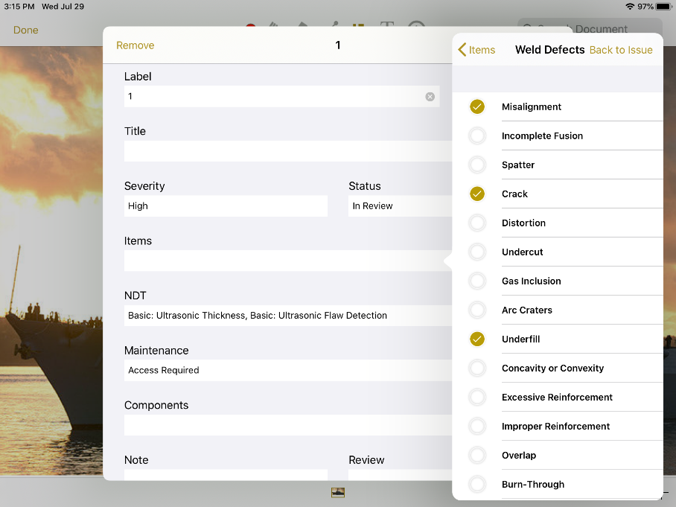
RAP Project: Weld Digitalization Solution
Optimized Weld Records
Project Lead Organization: TruQC
Project Team Members: EWI, Vigor, FMM
Concept/Idea
Benefits/Justification
Problem:
Welding processes require input from multiple individuals, documents and specifications, making proper management a challenge
Quality Assurance (QA) procedures can be expensive, inefficient, and difficult to administer
Proposed Solution:
TruQC, a commercial off the shelf (COTS) software, will be configured to manage welding requirements and records
TruQC will be a single access point to the data needed to complete and document welds for engineers, inspectors, supervisors and welders
More access to welding requirements and records will improve efficiency of planning, process improvement, and troubleshooting
Expedite decision-making, reducing analysis costs and associated downtime
Automated document organization for easier audits
Consolidates data for re-work tracking with weld specific information
Minimize or eliminate delays associated with adjudication of out of spec items
Reduce inspection costs
Eliminate costs incurred to re-create history of assessments
Increase transparency of inspection to the welding process
Project Approach
Cost/Image/Relevant Information
High Level Statement of Work:
TruQC will develop a weld requirement and record specific solution that connects resources and documents
TruQC will work with EWI and Vigor to test and introduce the solution to shipyard personnel
Metrics of Success:
TruQC solution for creating weld requirement documents, collecting weld record data and limited deployment to shipyard personnel for buy-in development
Compare digitalized weld lifecycle process using TruQC to the traditional paper method previously used
Project Estimated Cost: $150,000
TruQC will work with partner shipyards to create and administer a survey to shipyard personnel to examine current weld requirements, record management and NDT requirements with plans to grow this into an RA project
Notes:
Milestones and Deliverables
Requirements Document - April 2022
Reports available for testing on internal servers - September 2022
Final Reports available in Production - October 2022
Training and User Acceptance Testing - November 2022

Slide 8
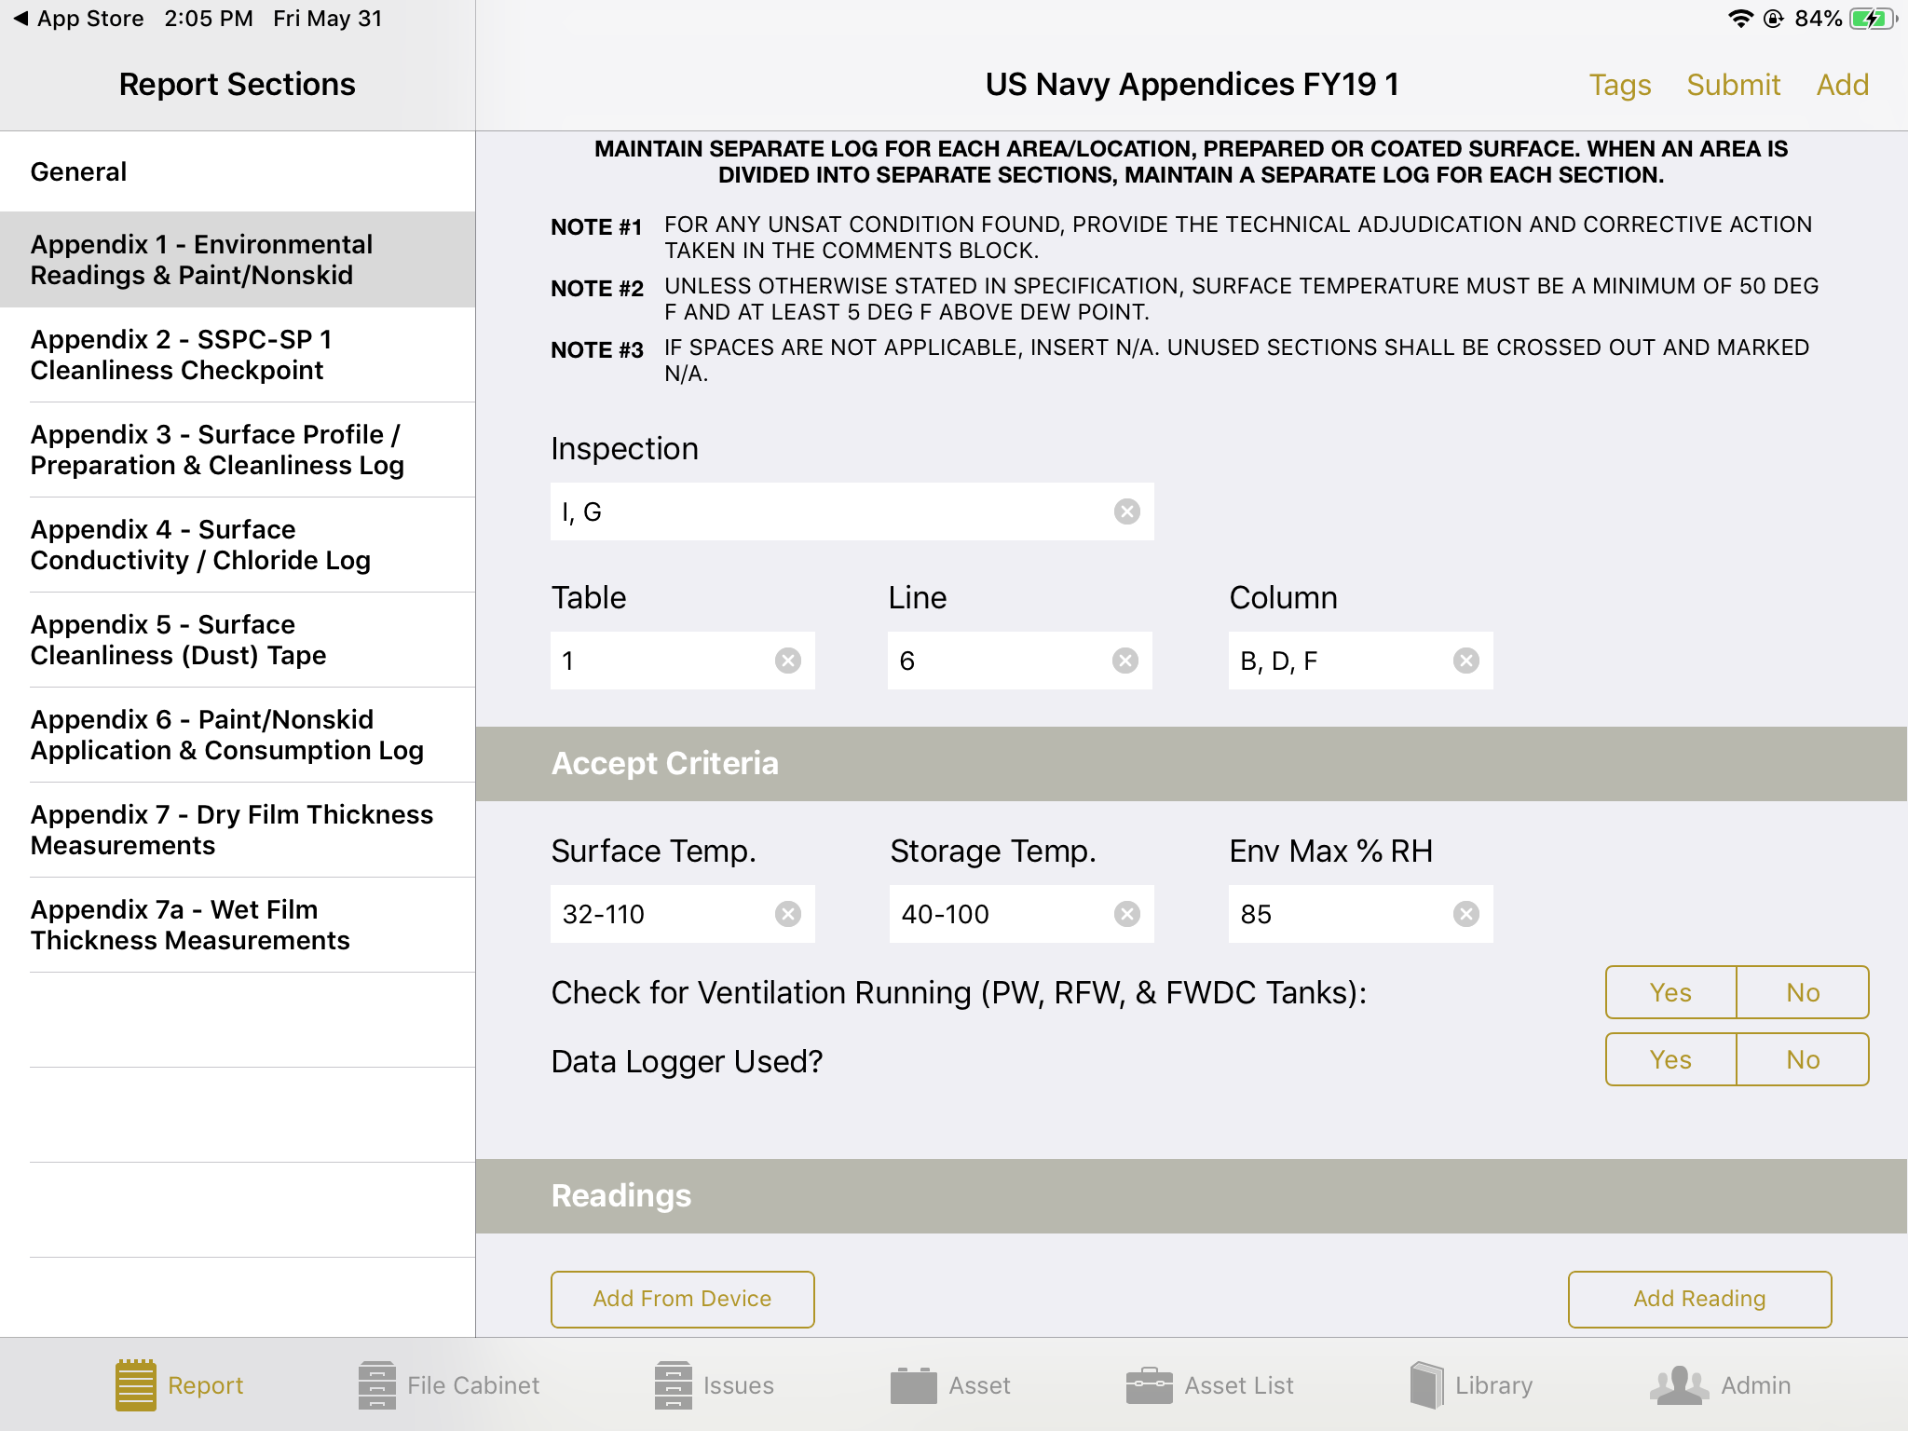
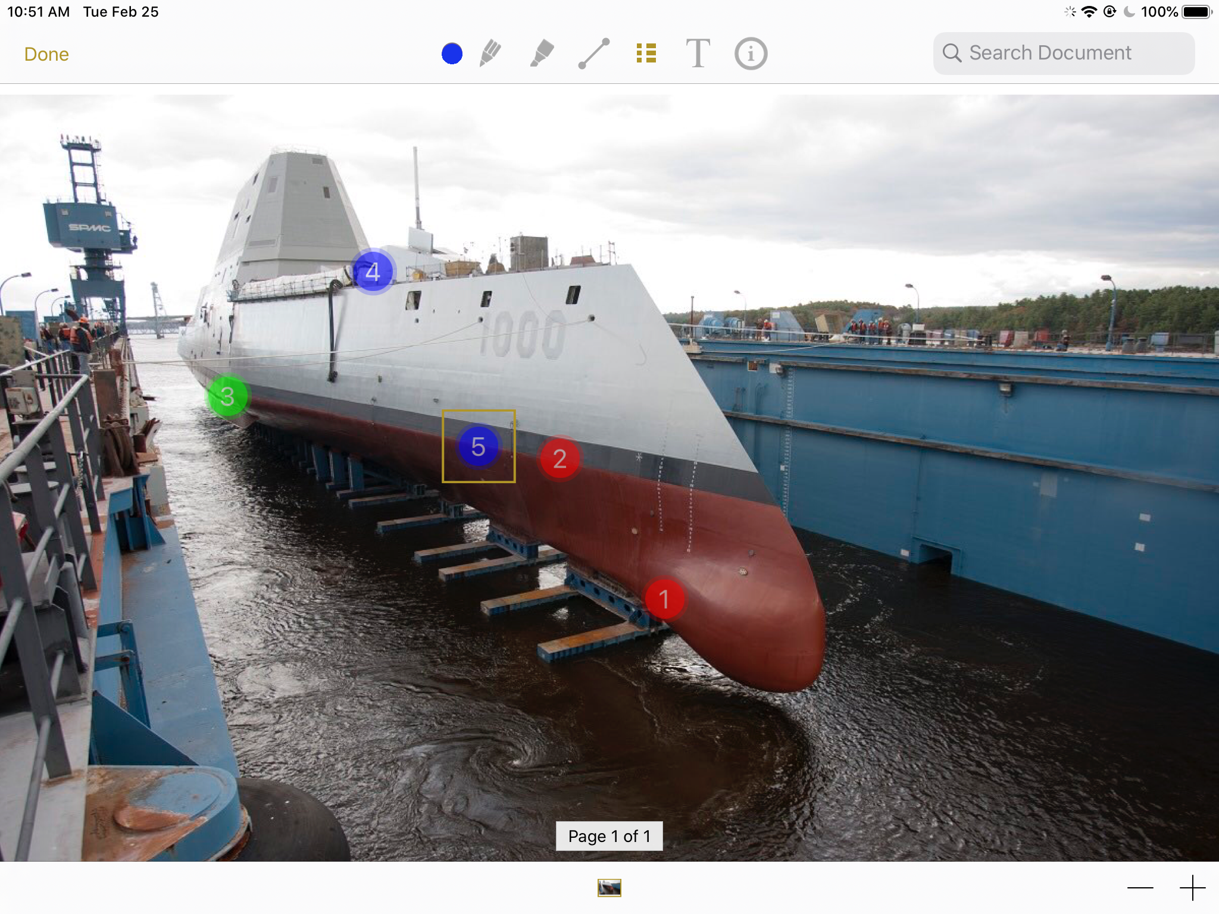
Future Project Expansion Enhances the Foundational RAP Digitalization Solution
Potential Solution Enhancements
Out of Spec Flagging
Inspector Certification Flagging and tracking for different weld types
Gauge Integration
Integration with NMD and other legacy systems
Defect tracking to resolution
Importing of Welding standards and specifications
DEMO + Questions?
Megan Brinker
314.324.7469
megan@TruQC.com

