Slide 1
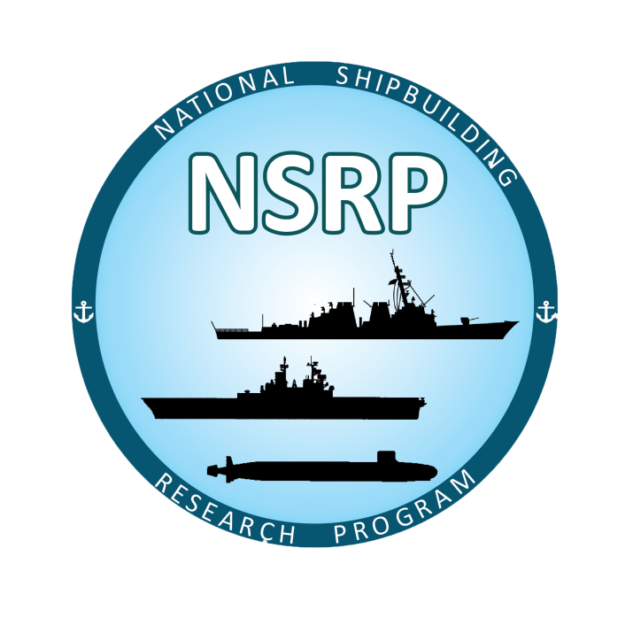
Spatter Guard for Welding Through Primer
NSRP Welding Technology Panel Meeting
August 2nd, 2022

Slide 2
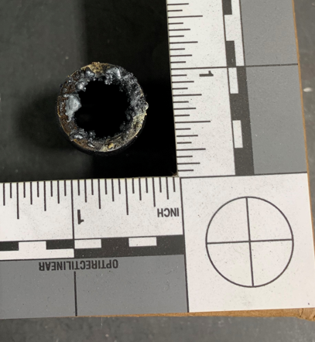
NSRP Welding Technology Panel Meeting
Background
Current ManTech project No. S2809 has found that significant spatter adheres to the weld nozzle when welding over primer
The accumulation of spatter prevents welding of distances longer than 3-ft. which eliminates the process’ usefulness in panel line applications
New proposed OSHA requirements dictate 4-in. of primer is to be removed from the weld joint area
Eliminating this work will create significant improvements to cost and schedule
Fig. 1. Excessive spatter buildup on nozzle.

Slide 3
NSRP Welding Technology Panel Meeting
Proposed Project:
Task 1 – Project Initiation and Kickoff Meeting
Task 2 – Market Survey of Commercial off the Shelf (COTS) Anti-spatter Coatings
Task 3 – Testing of Anti-spatter coatings
Task 4 – Demonstration and Downselection
Task 5 – Technology Transfer and Reporting

Slide 4
NSRP Welding Technology Panel Meeting
Project Benefits/ Value Proposition
Preconstruction primer will no longer need to be removed before welding if spatter free welds can be demonstrated
Antispatter coatings are an inexpensive fix to a cost intensive issue
Qualification of spatter guards could be beneficial to other applications that generate substantial weld spatter

Slide 5
NSRP Welding Technology Panel Meeting
Questions?

