Slide 1




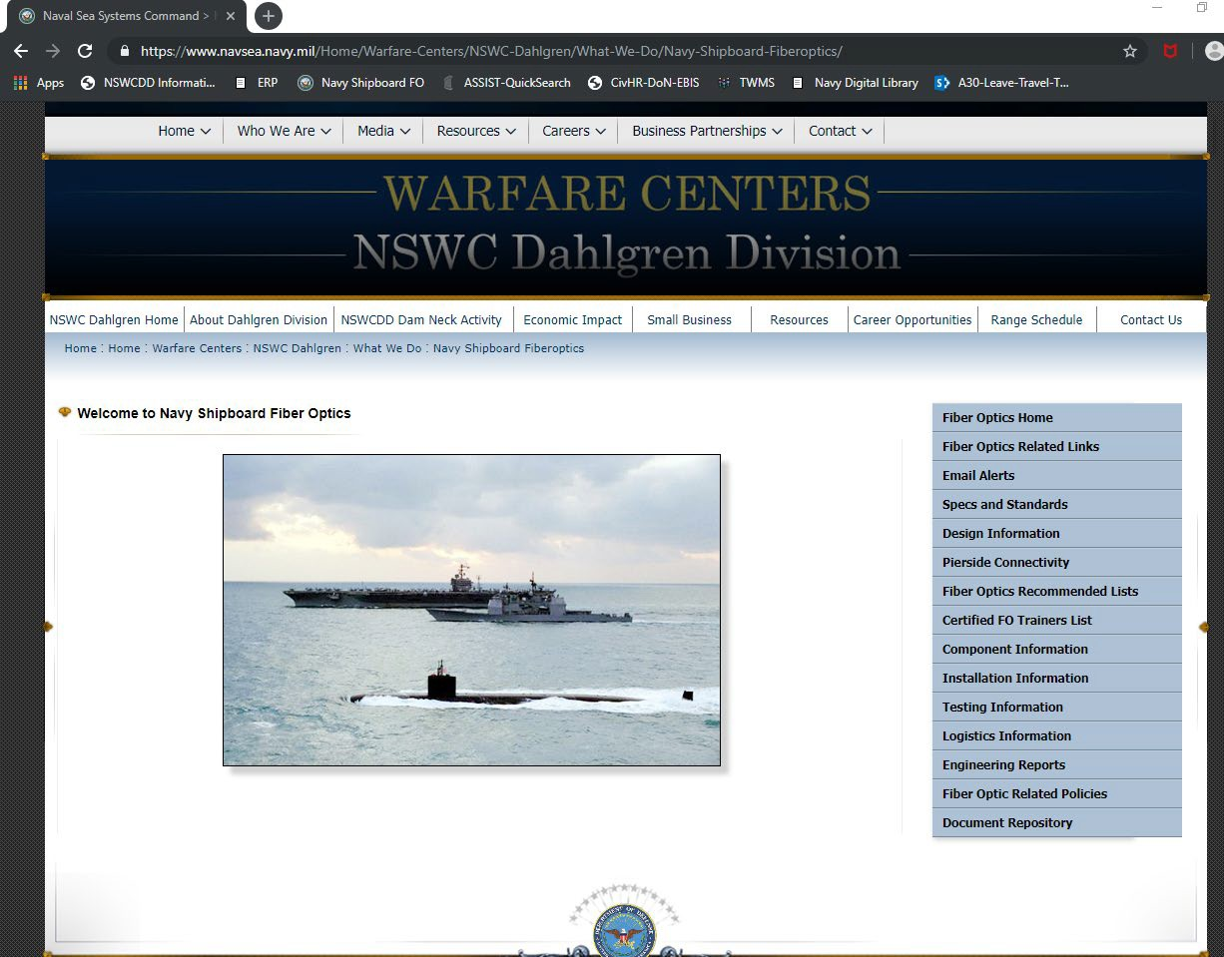
Navy Shipboard Fiber Optics: Specifications/Standards
Presented By
Source: https://www.navsea.navy.mil/Home/Warfare-Centers/NSWC-Dahlgren/What-We-Do/Navy-Shipboard-Fiberoptics/
Chris Good/ NSWCDD A31 Fiber Optic Chief Engineer Christopher.good@navy.mil
August 10, 2022
Unclassified / Distribution Statement A
1

Slide 2


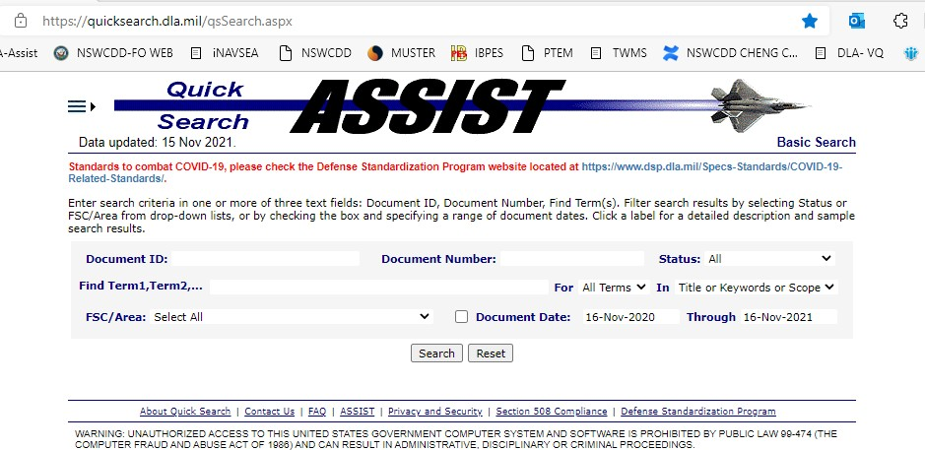
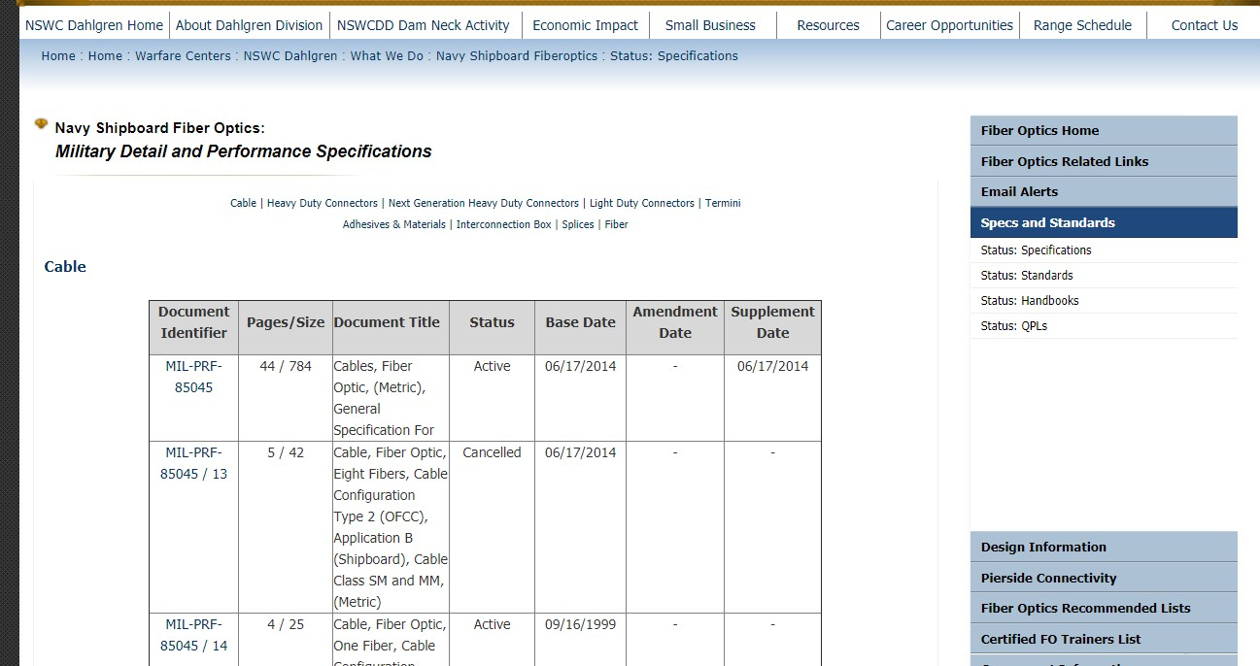
Navy Shipboard Website / Specs & Standards
Source: https://www.navsea.navy.mil/Home/Warfare-Centers/NSWC-Dahlgren/What-We-Do/Navy-Shipboard-Fiberoptics/Status-Specifications/
https://landandmaritimeapps.dla.mil/programs/MILSpec/docsearch.aspx https://quicksearch.dla.mil/qsSearch.aspx
Unclassified / Distribution Statement A
2

Slide 3


Specifications & Standards: Fiber Optic Documents
3
MIL Designation | Title | STATUS | ACTIVITY
MIL-STD-2052A | Fiber Optic System Design | Draft In-process: | -Updates for >10Gig, Tabular/ref approach vs. calculations. Draft parts 1-5 complete. -Q32022 Working part 6 and new appendices
MIL-STD-2042C, 1-6 | Fiber Optic Cable Topology Installation Standard Methods for Naval Ships | Rev C, Published – 2016 -New Project approved for FY22 -Pre GIR/SRB work in process | -Draft work, adjudicated comments rcvd since last publication (~50, parts 2 & 5) -Tech Editor compliance review completing in August -GIR/SRB release. Q1FY23 / Publication Target: FY23 Q4
MIL-STD-1678, 1-6 | Fiber Optic Cabling Systems Requirements and Measurements | -Parts 2-6 under revision FY22 -Part 5 still in progress | -parts 2,3,4,6 update published Jan 2022 -part 5, in process, FOVIS work: ECD: Q4FY22
MIL-PRF-85045G & slants | Cables, Fiber Optic, General Specification for | 85045revF&slashes: Published Nov ‘21 | -Qualification/Conform inspection table clarification (impact at low temp)
MIL-PRF-28876E & slants | Connectors, Fiber Optic, Circular, Plug and Receptacle Style, Multiple Removable Termini, General Specification For | -Published March 1, 2021 (Rev F), -Interim amendment, 4/14/2021 -New Project: M28876 base spec full coordination in FY23 | -CAD alternative transition: HAPTFE/SnZn: HAPTFE parts shipping -28876/6 corrected error in PIN table, published May 2022 -28876/32 adjustable backshell, comment adjudication/restart: FY22
MIL-PRF-29504 & slants | Terminus /4, /5 Military Aircraft, /18 & /20 common; /14, /15 Naval Ships; /22, /23 splice-on | /14 & /15 Published January 2021 /4 & /5 Published Feb 2022 | -Updated conformance tables
MIL-PRF-24728, & slants | Interconnection Box, Fiber Optic, General Specification for | -Published (2018-2020) -New Project approved for FY22 | -Base, /1, /4, /5. Industry/DLA comments -Qualification/Conform inspection table clarification: Water pressure, Op Temp
MIL-PRF-24623 | Splice, Fiber Optic Cable, General Specification for | -24623/8 Ribbon Splice, Published Jan 22 | -Base: Ref Update. Slant /4 & /5: Inactivation: Published Sept 2020 / Ribbon splice
MIL-PRF-49291 /6C & /7C | Fiber, Optical | -49291 base: validation 2019 -/6 & /7: Published: 2018 | n/a
MIL-DTL-83522 /16C, 17C | Connectors, Fiber Optic, Single Ferrule, | Published: 2017/2018 | n/a
CID A-A-59940/1 | Connectors, Fiber Optic, Single Fiber, Small Form Factor, LC Type | Published 2021 | -Project Request submitted to NAVSEA 05S, started FY21 -Update straight pull requirement
Various | High Density (M85045/24623/59799B) | -Specs published (Next slide) | -CID 59799B: Ribbon splicer configuration added
Unclassified / Distribution Statem | Naval Ships’ Technical Manual (NSTM), Rev 4 GSO Section 408 _{e}F_{n}O_{t} C_{A}T MAINTENANCE PLAN | Updates processed in FY22 | Updated SCAT codes Updated/resolved open comments, additional optical power budget tables
3

Slide 4

Recently Published Documents
Page 4
Spec Sheet | Component Type | Title: Component Configuration | Latest Doc Date or Preparation & Submission Status
85045/33 | Cable | CABLE, FIBER OPTIC, ROLLED FLEXIBLE RIBBON, TWELVE FIBER, SINGLE SUBUNIT | Published: 18 May 2022
85045/34 | Cable | CABLE, FIBER OPTIC, FOUR SUBUNITS, TWELVE FIBER ROLLED FLEXIBLE RIBBON SUBUNIT | Published: 18 May 2022
85045/35 | Cable | CABLE, FIBER OPTIC, EIGHT SUBUNITS, TWELVE FIBER ROLLED FLEXIBLE RIBBON SUBUNIT | Published: 18 May 2022
85045/36 | Cable | CABLE, FIBER OPTIC, THIRTY SIX SUBUNITS, TWELVE FIBER ROLLED FLEXIBLE RIBBON SUBUNIT | Published: 18 May 2022
85045/37 | Cable | CABLE, FIBER OPTIC, LOOSE TUBE, TWELVE FIBER, SINGLE SUBUNIT | Published: 7 Jan 2022
24623/5 | Cable Splice | Splice, Fiber Optic, Cable Housing | Published: 23 May 2022
24623/8 | Fusion Splice | Splice, Fusion, Fiber Optic, Twelve Fiber Ribbon, Protector | Published: 28 Jan 2022
1/ GIR = Government & Industry Review 2/ https://landandmaritime.dla.mil/Programs/MilSpec/DocSearch.aspx
Unclassified / Distribution Statement A
4

Slide 5
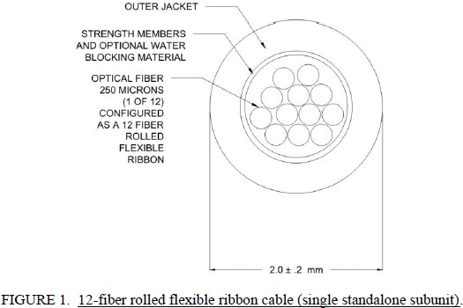
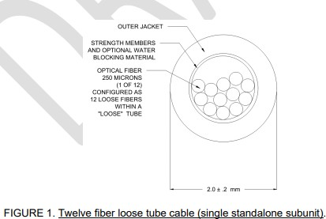
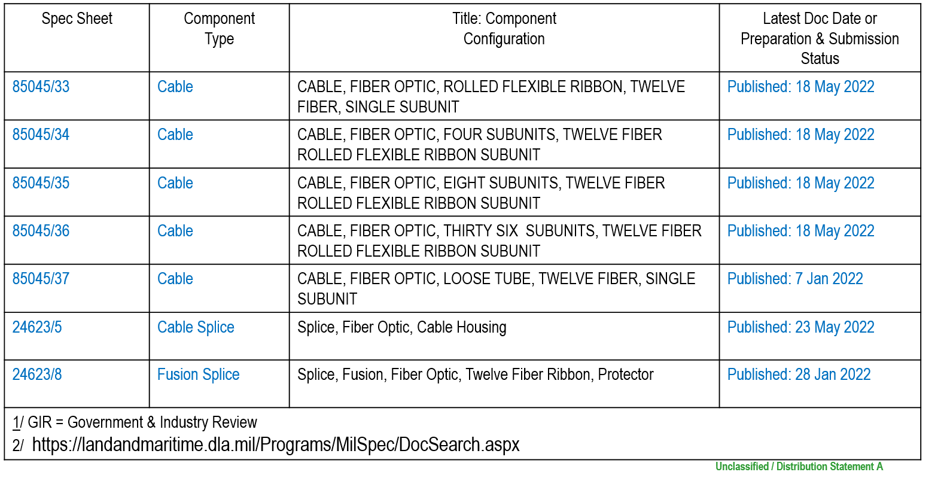
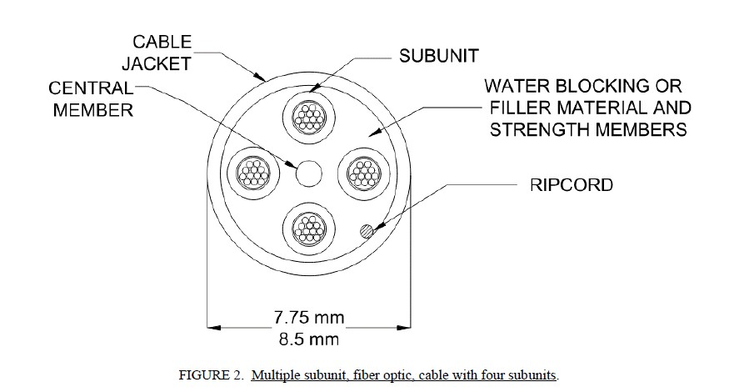
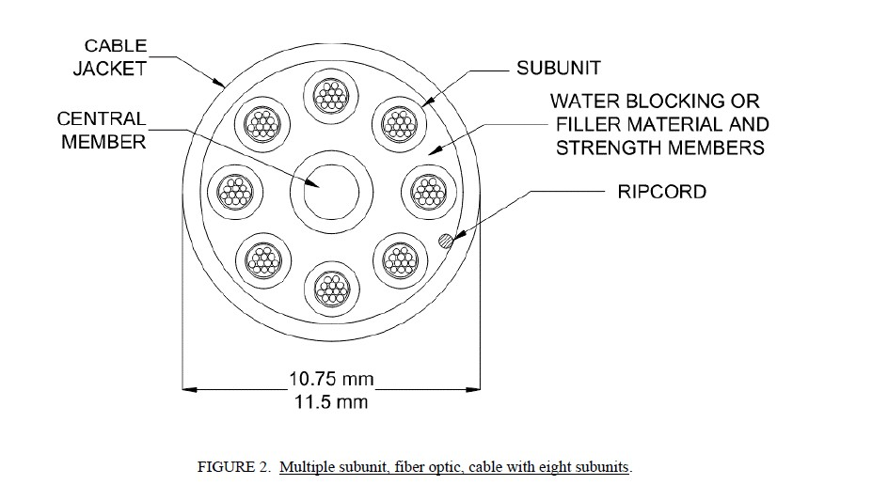
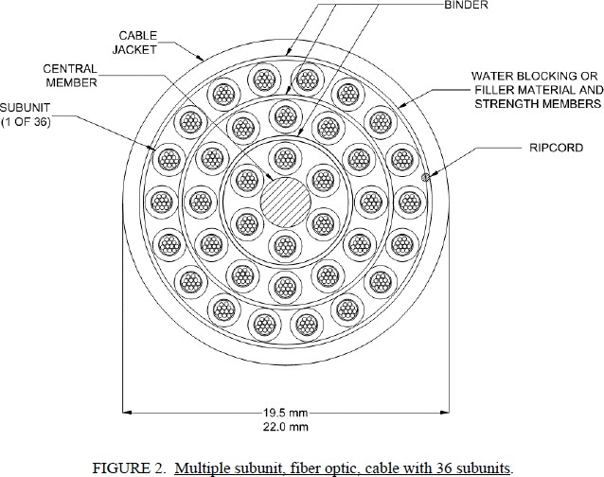
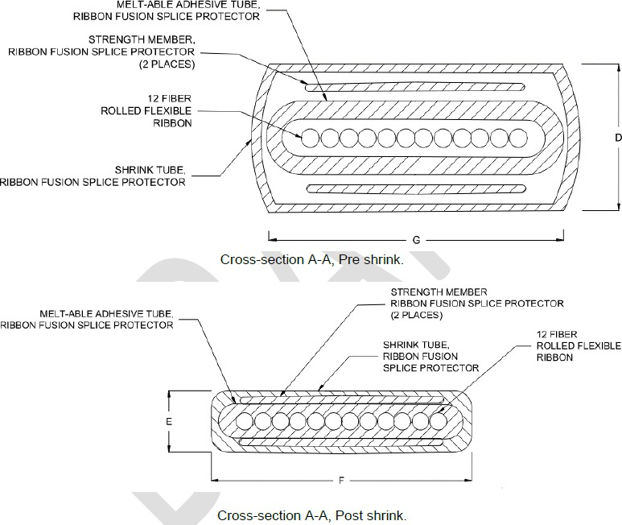
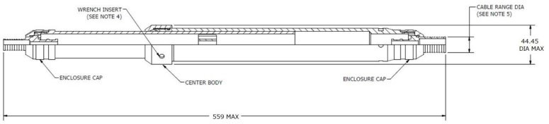
Page 5
Recently Published Documents
85045/33
85045/37
85045/34
85045/35
85045/36
24623/5
24623/8
Unclassified / Distribution Statement A
5

Slide 6





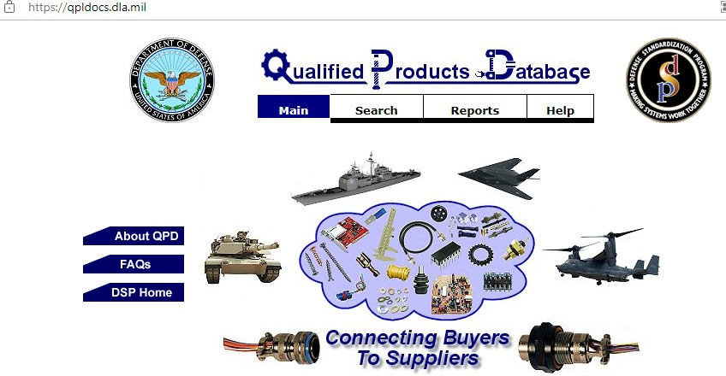


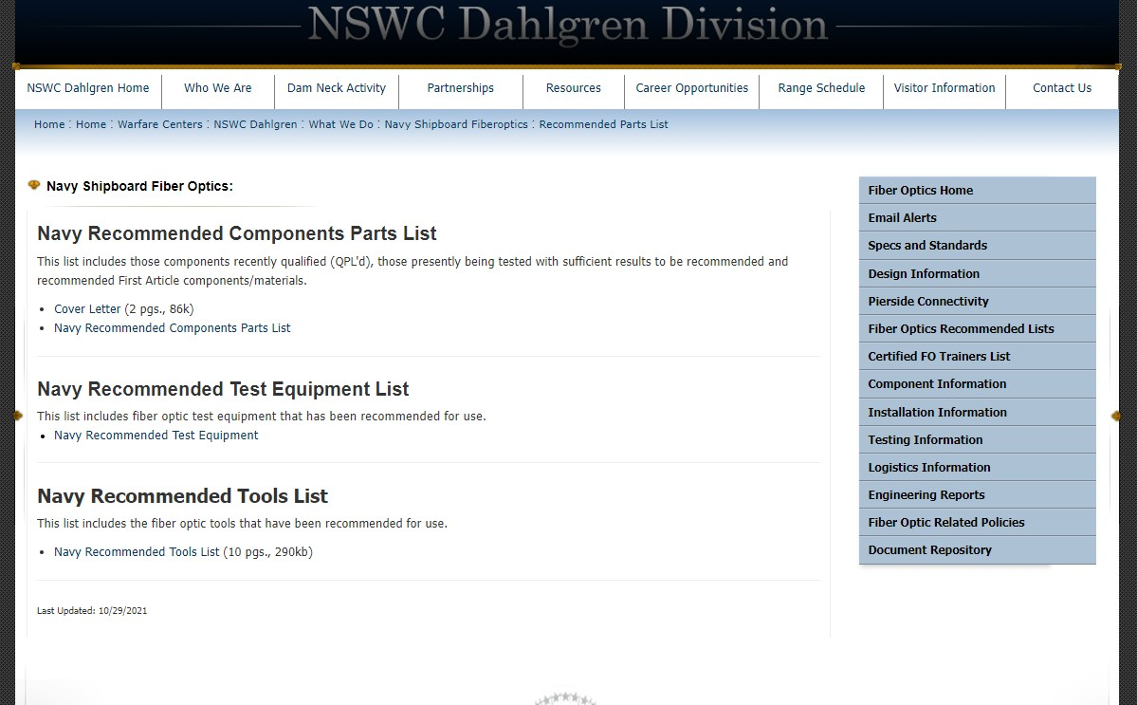
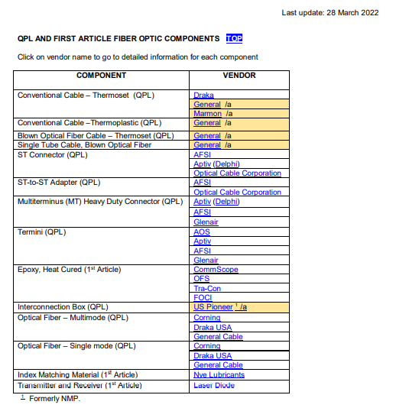
Navy Shipboard Website / Component Specs -> Recommended Lists / Qualification Parts List
Unclassified / Distribution Statement A
Source: https://www.navsea.navy.mil/Home/Warfare-Centers/NSWC-Dahlgren/What-We-Do/Navy-Shipboard-Fiberoptics/Status-Specifications/ https://landandmaritimeapps.dla.mil/programs/qmlqpl/
6

