Slide 1
The FUTURE of Welding Engineered Fasteners…TODAY

Slide 2
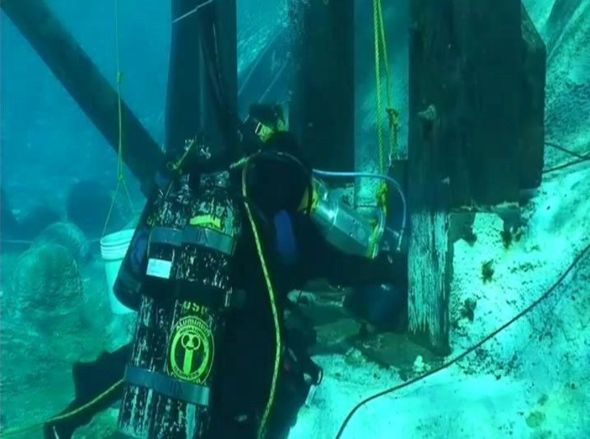
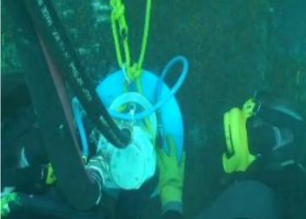
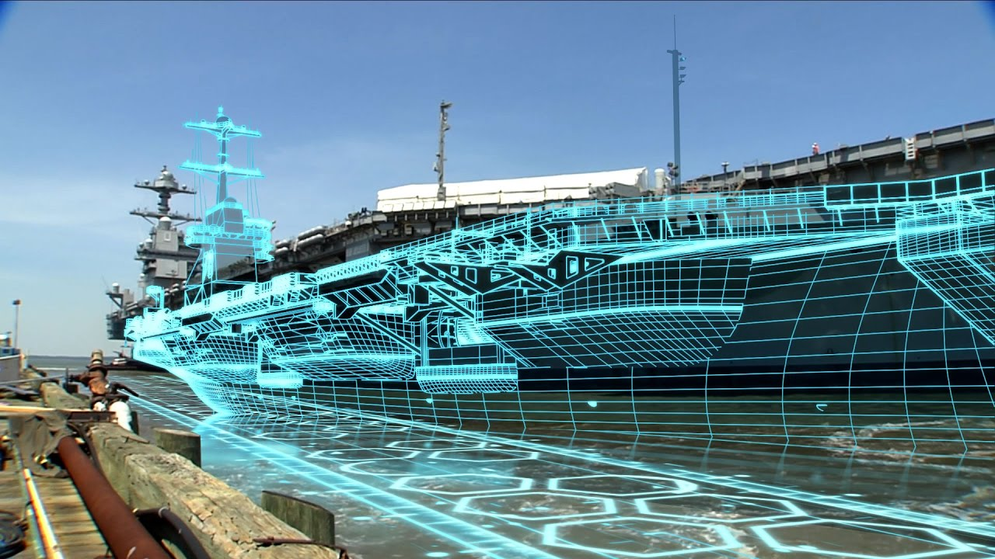
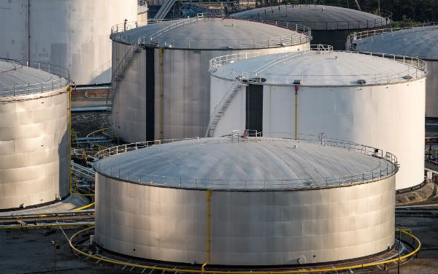
Space
Manufacturing
Military
Shipbuilding
Energy
The FUTURE…TODAY

Slide 3
Our Company at a Glance
Florida based five-year early-stage business focused on designing and producing unprecedented portable rotary friction stud welding machine tools, accessories, consumables and product support services
Ormond Beach, FL: Innovation, R&D, training
Houston, TX: Manufacturing, Quality Control
Unmatched leadership team with 120+ years of remarkable experience, expertise, and track record of success
Broad and diverse Board of Directors with decades of combined experience
Fully operational expansion-ready organization
Agile and Adaptively positioned to deliver on revolutionary demand and supply opportunity

Slide 4
Problem
Traditional, “arc” welding methods are dangerous, expensive, restrictive, and damage the environment
Between 2013-2017, welding tools started 1,670 fires killing 10, injuring 75, and causing $132 million in damages
The average age of welders in the U.S. is 55, causing a shortage of 400,000+ welders and increasing the length and cost of projects
Arc welding produces significant levels of dangerous air pollutants such as carbon monoxide and nitrogen dioxide
There are many instances in new ship construction and/or ship repair when a sparkless, cold-work, permanent bonding process would be preferred over traditional hot-work stud and plug welding

Slide 5
Solution
Fusematic’s revolutionary portable friction welder is:
Safer: Releases & requires no gas, electricity, flame, spark, flux, rods
Cheaper: No expertise required; anyone can learn to operate our technology effectively within a few hours
Greener: Powered by clean air or electric, an environmentally-friendly solution that significantly reduces pollution and supports ESG requirements
Stronger: Delivers better joint integrity than traditional welding Capacitor Discharge or Drawn Arc Stud Welding methodologies
During demonstrations of the technology at several shipyards, user feedback included the desire for a smaller, more agile hand-held device that could be used by one person.
A certified non-hot-work system provides flexibility to shipyards, improves safety, reduces cost, and delivers stronger bonds.

Slide 6
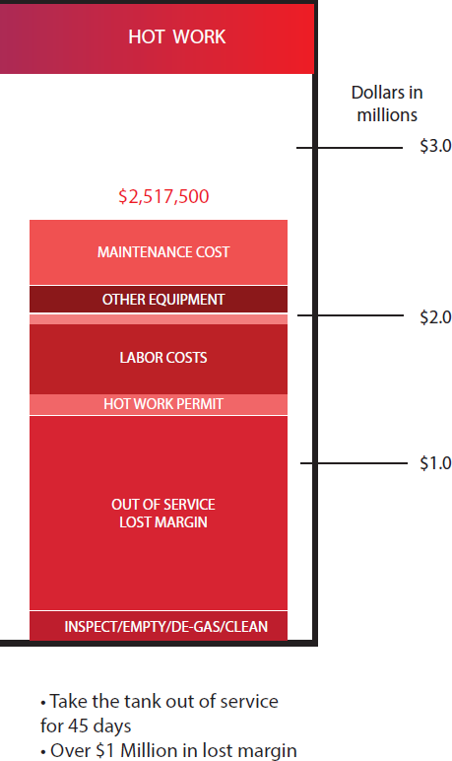
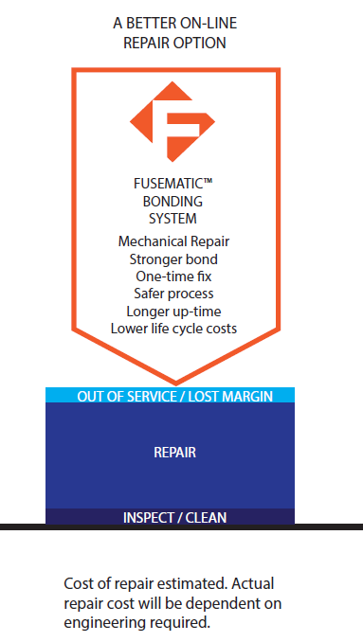
Substantial Cost Savings: Energy Sector ($2.45M) A typical hydrocarbon fuel storage tank roof and/or wall (shell) repair
Traditional Welding
Cost: $2.5 Million
45 days down time
Fusematic
Cost: $40,000
Stronger Bond
Safer
No down time
No lost margin

Slide 7
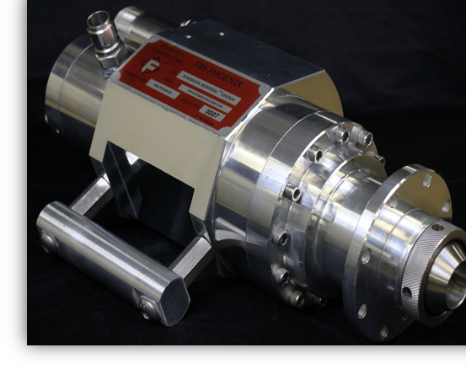
Flagship Fusematic Bonding System Gen 3: FBS PhoenixTM
API 653 Standard approved
Bonds on a molecular level
Welds in seconds, delivers a stronger bond
No flame; mitigates risk of fires or explosions
Pneumatically driven, environmentally clean
Proprietary technology, patents pending
Eliminates operator variability
Works on dirty, rusted, painted or oily surfaces
Easy to use, no certifications
Sale, lease purchase, rental optionality
R&D, training & education continuum
FBS unit, peripherals, consumables

Slide 8
Technology Advancement From the Ocean Depths to Outer Space
Gen 7: FBS Electric Space (FBS-eSX)TM
Hand-held, Portable astronaut use in a variety of applications, e.g., vehicles, facilities, infrastructure, interplanetary deployment
Gen 4: FBS-eVTM
Electric Powered, Compatible with:
Remotely-Operated Vehicles (ROV)
Autonomous Underwater Vehicles (AUV)
Unmanned Aerial Vehicles (UAV)
Unmanned Surface Vehicles (USV)
Remote Space applications (various)
Gen 6: FBS Electric Professional (FBS-eP)TM
Industrial, Commercial, and Consumer Use
Gen 5: FBS Electric Manufacturing (FBS-eM)TM
Production line tool for manufacturing environments, electrically-driven, industry 5.0 compliant, e.g., IIOT, machine-learning, remote monitoring & operations
Gen 3: FBS PhoenixTM
First Commercial Product (Available now)
*American Petroleum Institute (API) 653 Standard approved*

Slide 9
NSRP Innovation: $150K for 12-month panel project FBS Electric Professional (FBS-eP)TM

Slide 10
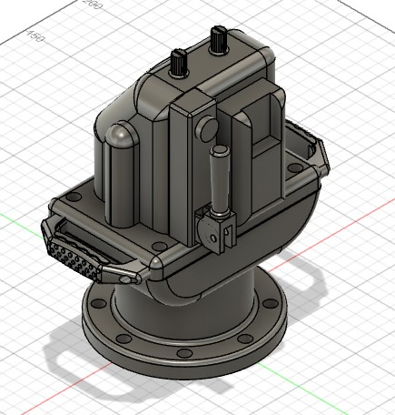
FBS Electric
Professional
(FBS-eP)TM

Slide 11
FBS Electric Professional (FBS-eP)TM
FBS-ePTM is a portable, lightweight, electrically powered, rotary friction stud welder that will attach engineered fasteners using a precise balance of kinetic friction and pressure
With FBS-ePTM, the ability to generate intrinsically safe bonds is made possible without the need for a constant clean air supply, as well as the gained maneuverability that comes with an untethered unit
The FBS-ePTM will deliver reliable, safe, and certifiable bonds by utilizing the same proven formulas we established in our previous pneumatic models, only now with the benefit of being completely self contained.

Slide 12
Scope of Work (12 months)
Project Management (Months 1-12)
Identify Preferred Use Cases w/Shipyard Partners (Months 1-2)
Design Proof of Concept Device (Months 2-3)
Build and Test Proof of Concept Device (Months 4-6)
Develop Working Prototype Device (Months 7-9)
Test Prototype Device in Shipbuilding & Ship Repair Environments (Months 10-12)
Deliver Final Report, Workshop Demonstration, and Commercialization & Implementation Plan (Month 12)
Looking for S/Y Partner

Slide 13
Why should NSRP select FBS-eP?
Requirements for stud welding are prevalent in the shipbuilding industry, both for construction and repair:
Attaching threaded studs and bosses for pad eyes, anodes, lap plates, rope access, patch panels, pinhole leak sealing, gusset installations, etc.
Diverse applications where bonds need to be made with minimal alterations to the surrounding environment
Bond is stronger, safer, less costly, and kinder to the environment
Eliminates operator variability
Easy to use, no certifications
Works on dirty, rusted, painted or oily surfaces
Sale, lease purchase, rental optionality when deployed
R&D, training & education continuum

Slide 14
Questions John M. Griffin President and CEO, Fusematic Corp. Cell & WhatsApp: +1.386.846.0346 Email: jmgriffin@FusematicCorp.com Website: www.FusematicCorp.com

