Slide 1
Procedure Qualification Schemes for DED Additive Manufacturing – Nickel Aluminum Bronze and High Strength Steel Demonstrations D.D. Harwig, PhD.¹, W. Mohr, PhD.¹, N. Kapustka¹, M. Carney¹, S. Hovanec², E. Handler², J. Rettaliata, PhD.³
August 1st, 2022
¹EWI Columbus, OH ²NSWCCD, West Bethesda, MD ³NAVSEA
DISTRIBUTION A. Approved for public release: distribution unlimited

Slide 2
Acknowledgement
This program is funded by the Naval Sea Systems Command Technology Office (NAVSEA 05T) Additive Manufacturing Program.
DISTRIBUTION A. Approved for public release: distribution unlimited

Slide 3
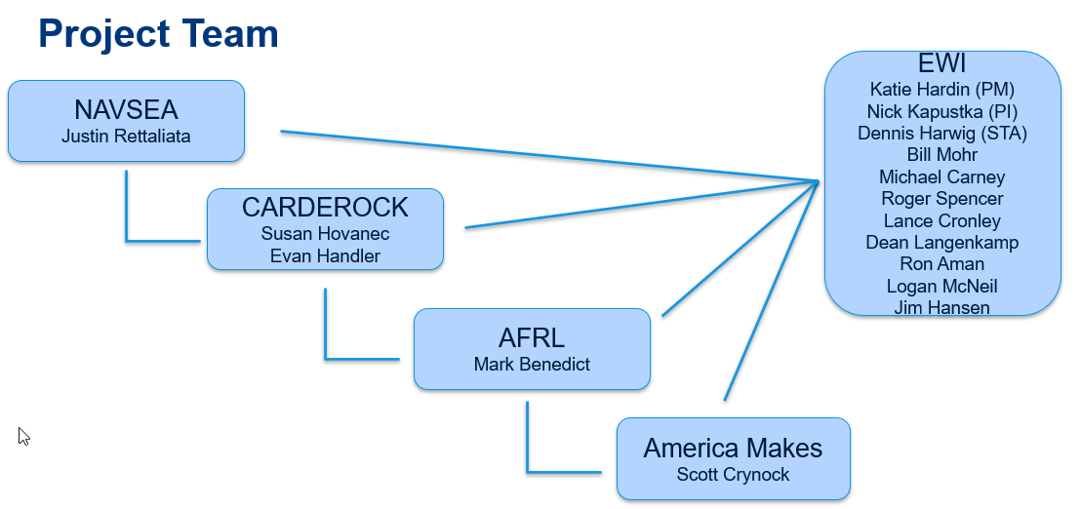
Team Overview
Ongoing development
in-progress
DISTRIBUTION A. Approved for public release: distribution unlimited

Slide 4
Project Overview
Problem Statement:
Metal Additive Manufacturing (AM) process implementation is impeded by a lack of prescriptive standards.
Detailed requirements are needed for a wide range of Metal Powder Bed Fusion (PBF) and Directed Energy Deposition (DED) AM processes and build features/scale applications.
Implementation is needed for new platforms, supply chains, and platform sustainment.
Objectives:
Develop DED AM procedure qualification scheme portfolio
Harmonize requirements with welding standards when possible
Develop DED build material property data for common Naval materials
Stainless steels, NiAl bronze, advanced steels, titanium, etc.
Support NAVSEA/NSWCCD who will directly implement methods and requirements via revisions/updates to:
NAVSEA Technical Publication – Requirements for Metal Powder Bed Fusion Additive Manufacturing.
NAVSEA Technical Publication – NAVSEA Process Requirements for Metal Directed Energy Deposition Additive Manufacturing.
DISTRIBUTION A. Approved for public release: distribution unlimited

Slide 5
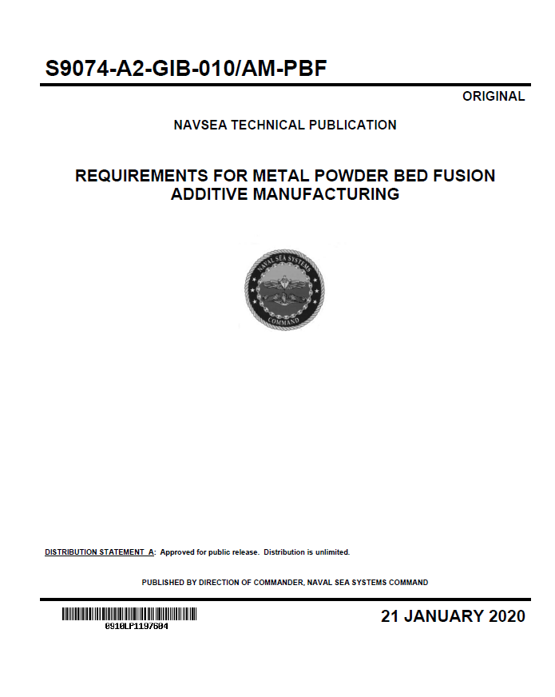
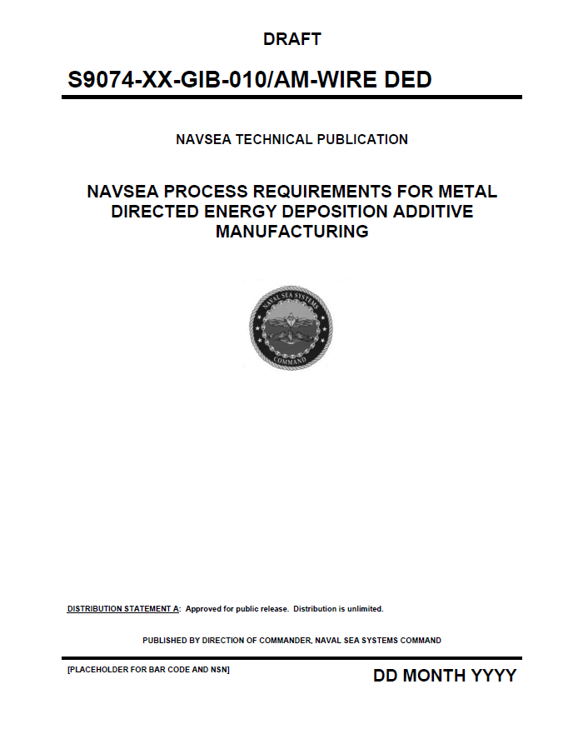
Technical Publications Qualification Requirements – Two Parts
Procedure qualification
Establishes procedure-feature-property relationships
Procedure qualification can support a range of component applications
Part verification
Demonstrates the ability to manufacture high quality DED AM component (or component groups) that may have specific geometric features and process control requirements
DISTRIBUTION A. Approved for public release: distribution unlimited

Slide 6
Autodesk PowerMill Build Categories
*Courtesy Autodesk
DISTRIBUTION A. Approved for public release: distribution unlimited

Slide 7
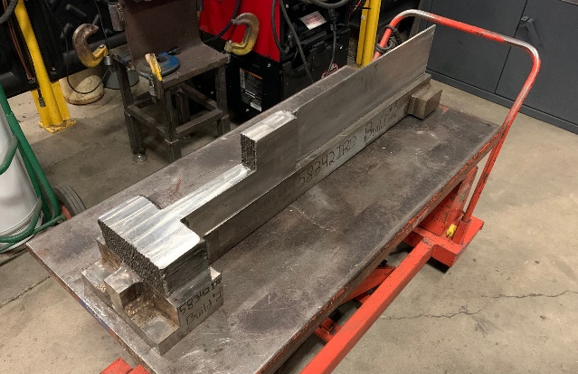
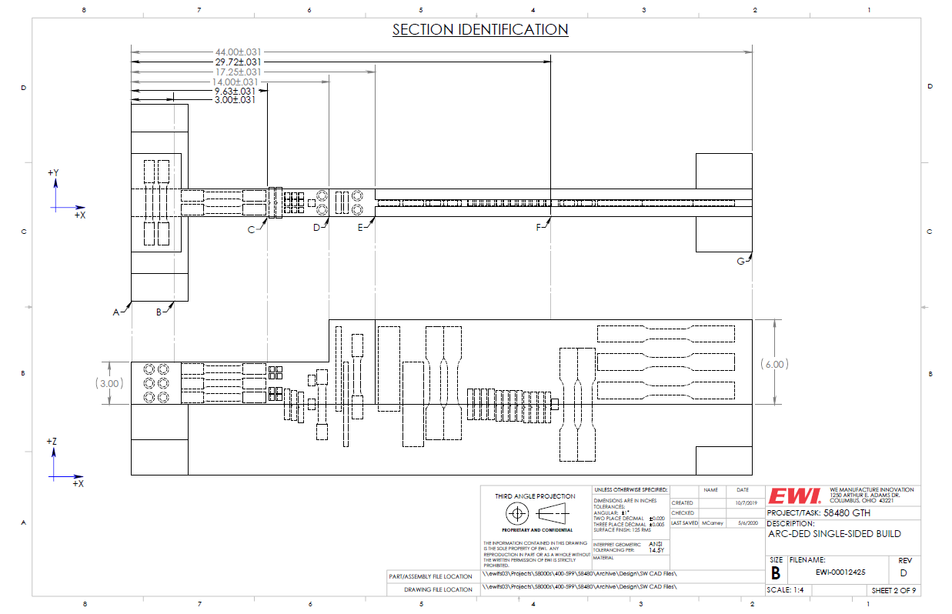
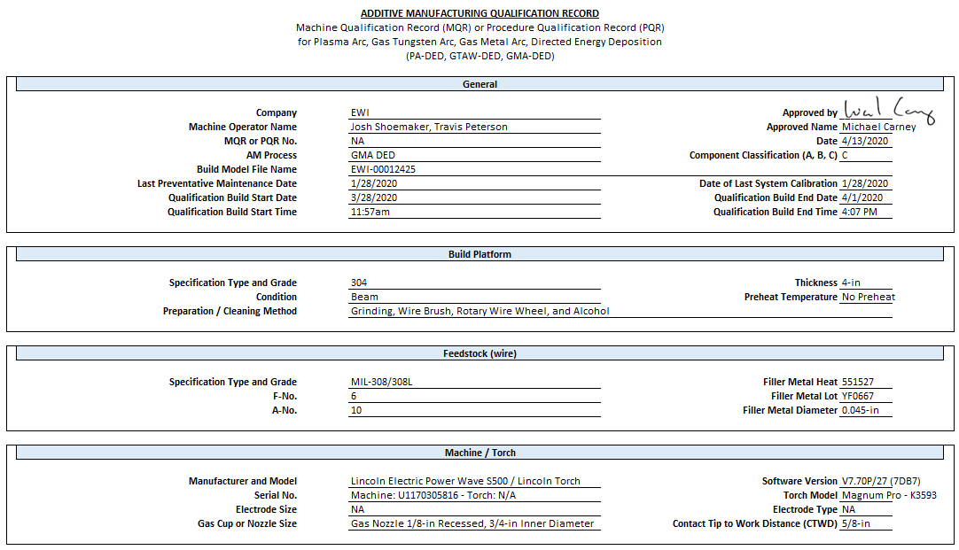
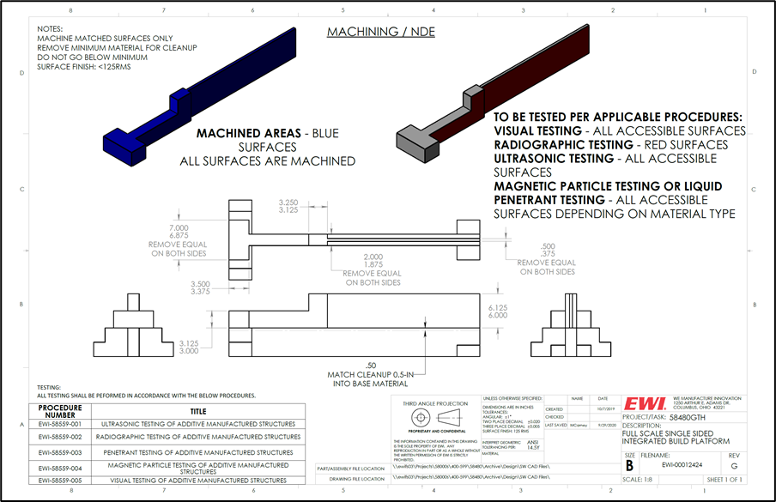
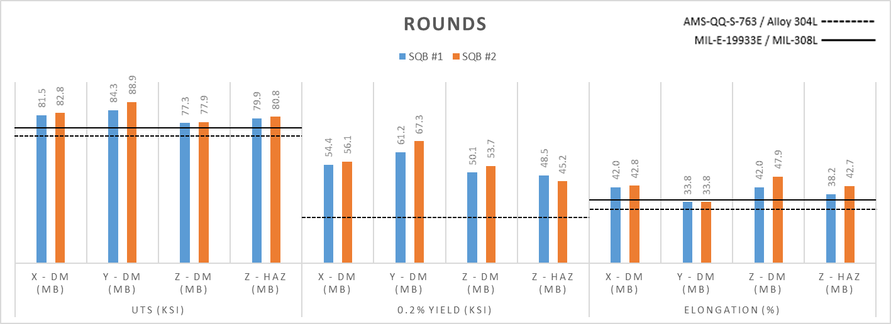
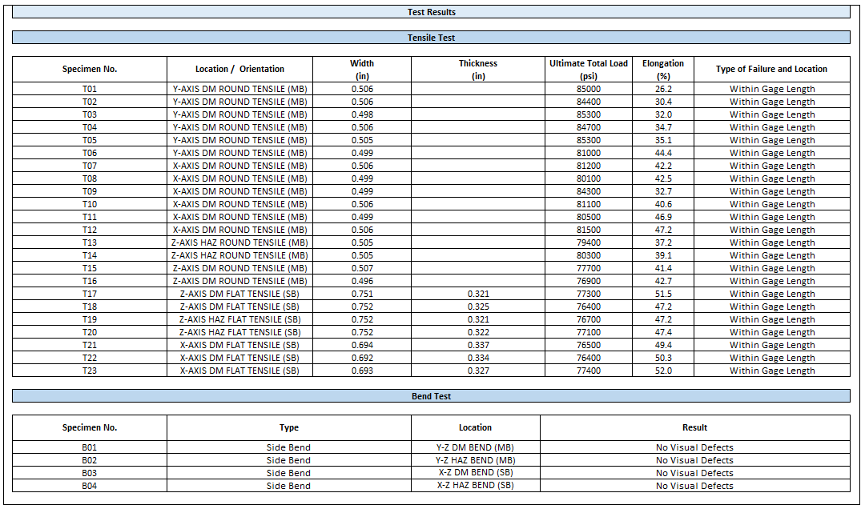
Procedure Qualification Scheme Components
Design
Build
Machine
308L GMA-P DED
Property Test
Report
NDE
Block Tensile Results
DISTRIBUTION A. Approved for public release: distribution unlimited

Slide 8
Technical Approach (1 of 2)
Develop procedure qualification schemes:
Design standard qualification build (SQB) designs for different build platform applications
Design test specimen matrices based on platform and material test requirements
Demonstrate SQB schemes on various DED build-material applications
Arc, laser, and electron beam DED processes
Develop inspection maps and evaluate SQBs using NDE testing (VT, PT, MT, RT, and UT)
Report Directed Energy Deposition Procedure (DEDP)
AWS: Additive Manufacturing Procedure Specification (AMPS)
Report Procedure Qualification Test Report (PQTR)
AWS: AM – Procedure Qualification Record (AM-PQR)
DISTRIBUTION A. Approved for public release: distribution unlimited

Slide 9
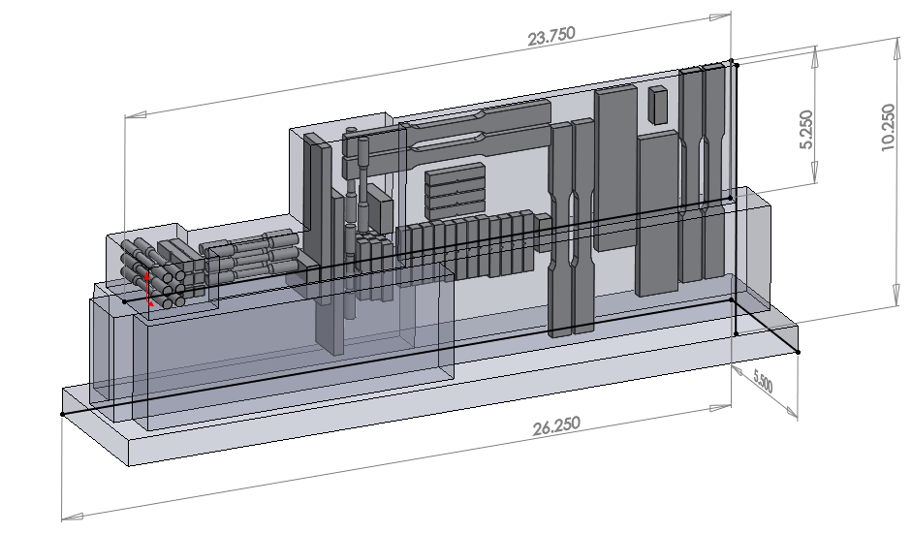
Technical Approach (2 of 2)
Build platform applications:
Double-sided with integrated build platform (DS-IBP)
Single-sided with integrated build platform (SS-IBP)
Single-sided with non-integrated build platform (SS-NIBP)
SQB designs for three scales
Full-scale, sub-scale, and mini-scale
SQB scale selection based on process fidelity
Flat build platform SQB designs complete (9 total)
Curved build platform SQB designs in-process
Sub-scale SS-IBP
DISTRIBUTION A. Approved for public release: distribution unlimited

Slide 10
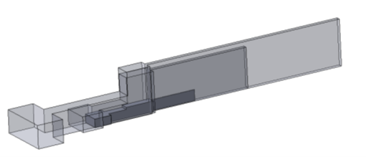
SQB Nomenclature
FS-DS-IBP – Full-scale DS-IBP
FS-SS-IBP – Full-scale SS-IBP
FS-SS-NIBP – Full-scale SS-NIBP
SS-DS-IBP – Sub-scale DS-IBP
SS-SS-IBP – Sub-scale SS-IBP
SS-SS-NIBP – Sub-scale SS-NIBP
MS-DS-IBP – Mini-scale DS-IBP
MS-SS-IBP – Mini-scale SS-IBP
MS-SS-NIBP – Mini-scale SS-NIBP
Build Volume Scale Comparison for SS-IBP SQBs
Full-scale 256 in.³
Sub-scale 103 in.³
Mini-scale 14 in.³
DISTRIBUTION A. Approved for public release: distribution unlimited

Slide 11
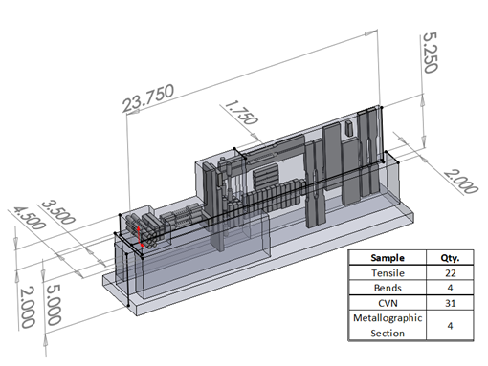
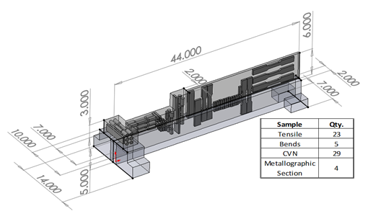
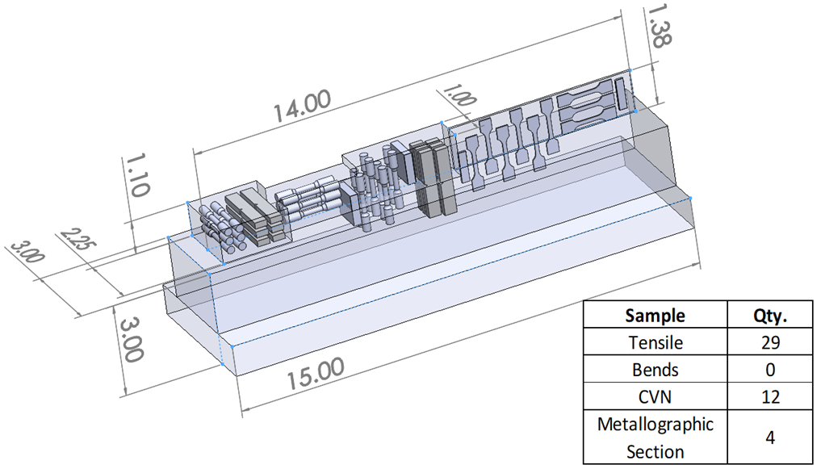
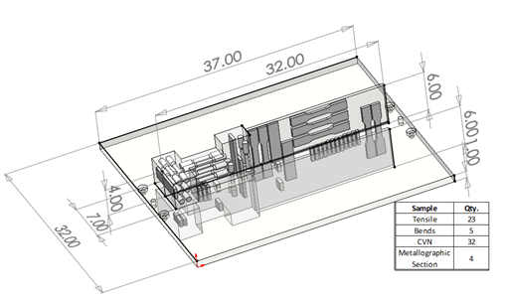
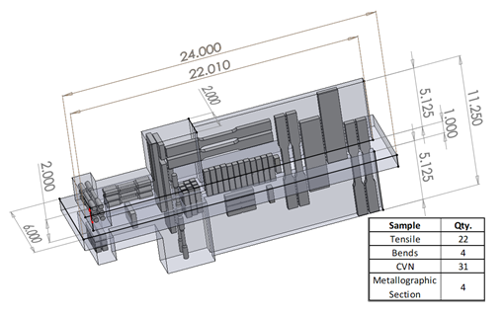
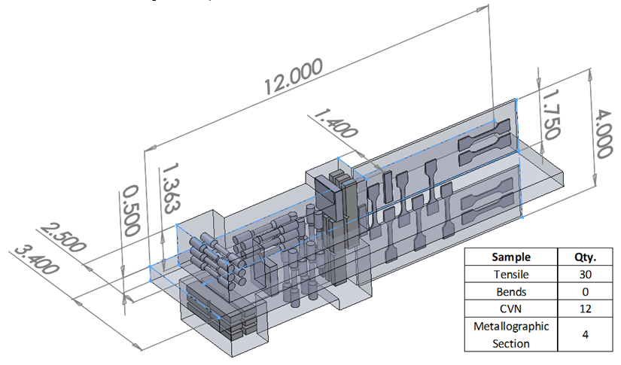
DED SQB Portfolio – Flat platforms
Full-scale SS-IBP
Sub-scale SS-IBP
Mini-scale SS-IBP
Full-scale DS-IBP
Sub-scale DS-IBP
Mini-scale DS-IBP
DISTRIBUTION A. Approved for public release: distribution unlimited

Slide 12
DED SQB Demonstration Matrix (Phases 1- 4)
Application | Full Scale (FS) | Sub Scale (SS) | Mini-Scale (MS)
Double Sided – Integrated Build Platform (DS-IBP) | MIL-100S-1 GMA-P DED on HY80 Platform MIL-308L EB-DED on 304L Platform* |  | 316L PL-DED on 316L Platform*
Single Sided – Integrated Build Platform (SS-IBP) | NiAl Bronze GMA-P DED on NiAl Bronze Platform + Cryo Cooling SQB* MIL-308L GMA-P DED on 304L Platform** (NSRP) MIL-308L EB-DED on 304L Platform* MIL-308L TW-GMA-P DED on 304L Platform (NSRP) | MIL-308L WL-DED on 304L Platform NiAl Bronze Dual Wire PA-DED on NiAl Bronze Platform* | 316L PL-DED on 316L Platform*
Single Sided – Non-integrated Build Platform (SS-NIBP) | ER308L GMA-P DED on 304L Platform (4) Matrix - Bead Size x Interpass Temp.
* Phase 4 (America Makes Ph. 1); **Repeated on ICBP
DISTRIBUTION A. Approved for public release: distribution unlimited

Slide 13
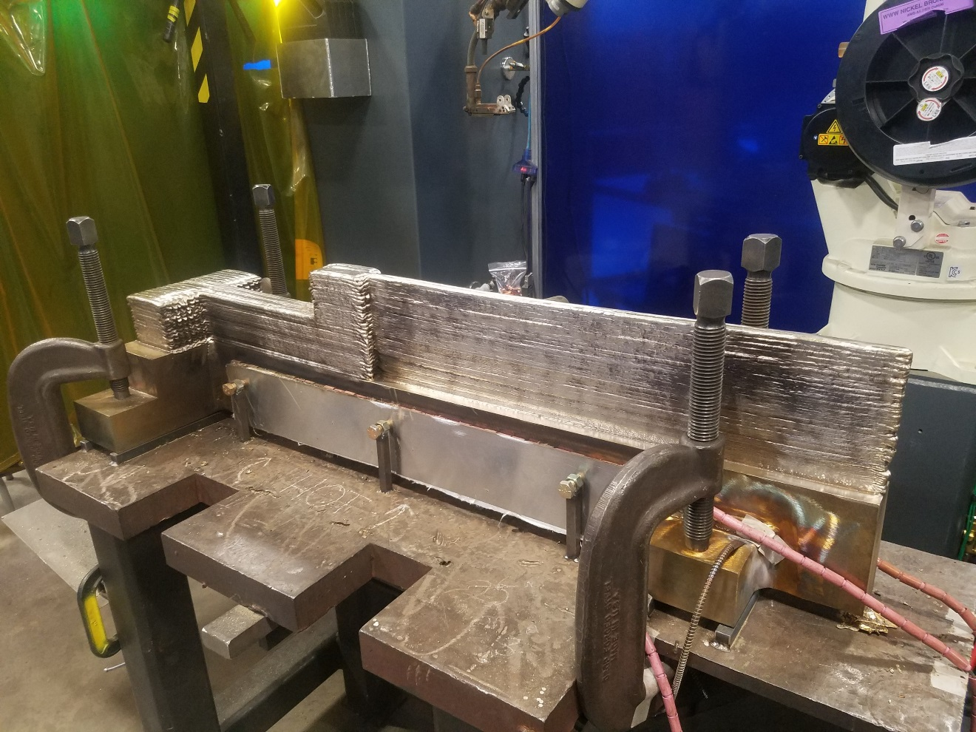
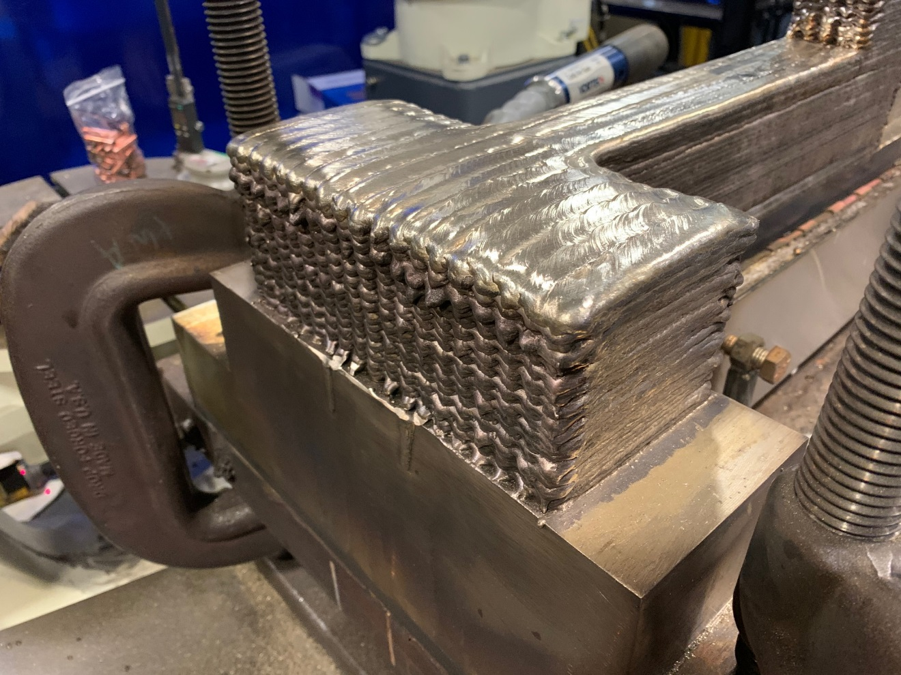
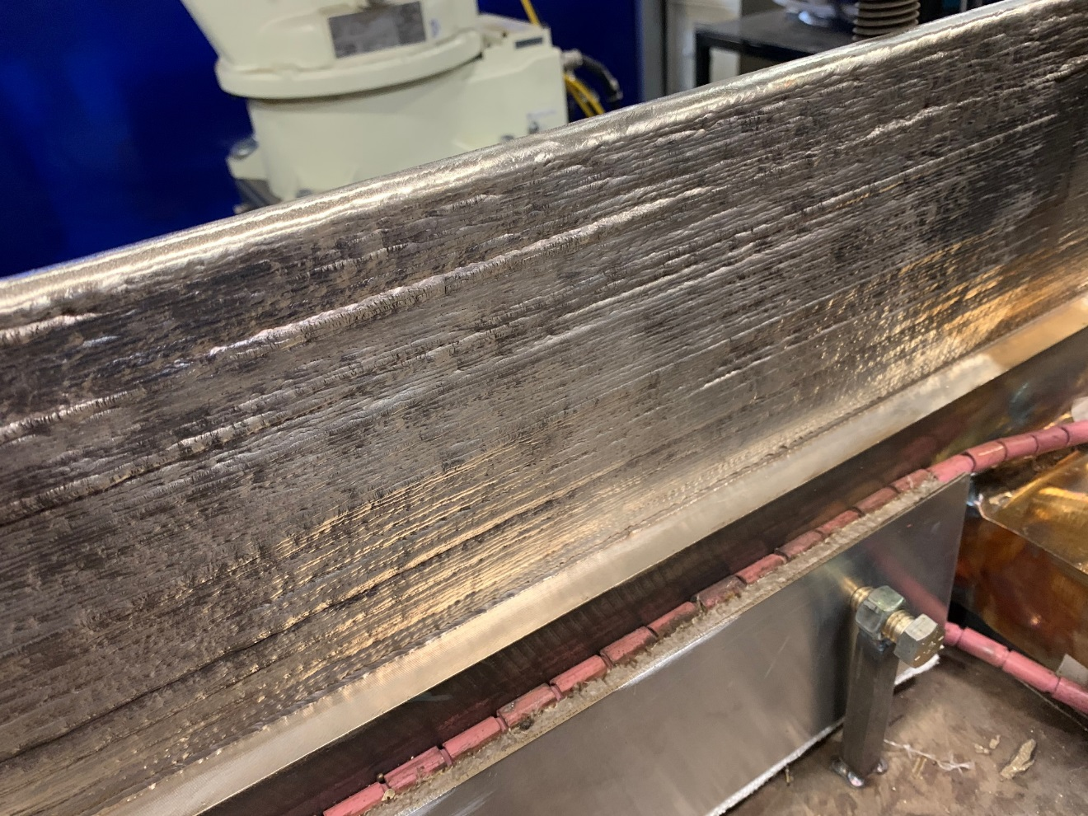
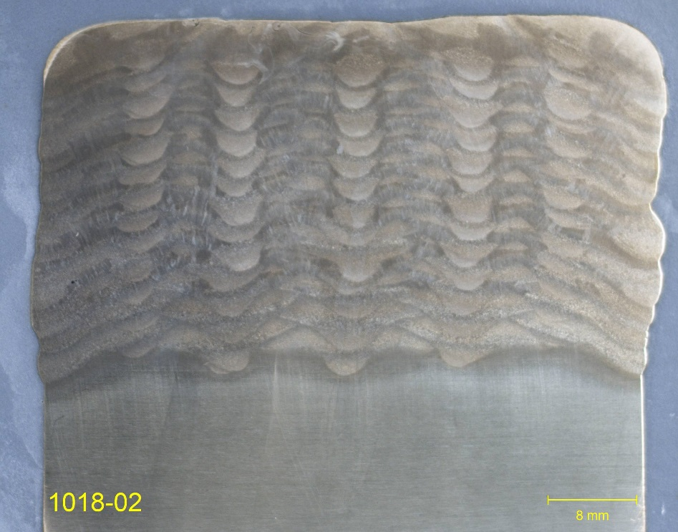
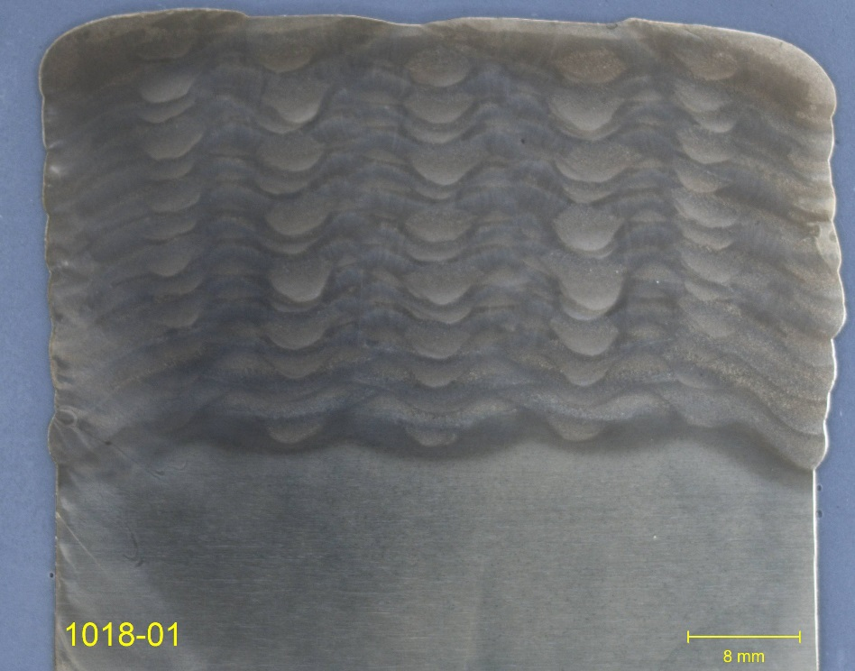
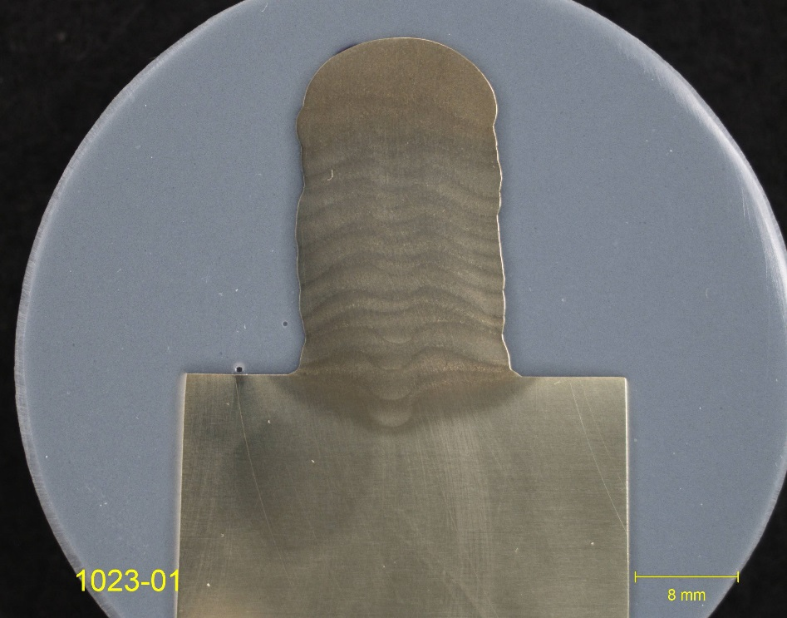
FS-SS-IBP NiAl Bronze (NAB) Build Results
DISTRIBUTION A. Approved for public release: distribution unlimited

Slide 14
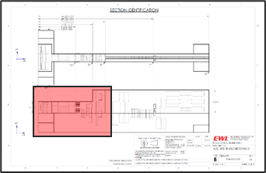
Block Area Tensile Test Results NAB GMA-P FS-SS-IBP SQB
Deposit material (DM) round tensile specimens met the minimum tensile strength requirement of MIL-CuNiAl wire.
DM/HAZ interface round tensile specimens met the minimum requirements of both Mil-CuNiAl wire and the C63000 build platform.
Z-Axis DM/HAZ Interface Yield & Elongation
Invalid per ASTM E8
DISTRIBUTION A. Approved for public release: distribution unlimited

Slide 15
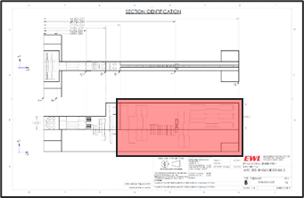
Wall Area Tensile Test Results NAB GMA-P FS-SS-IBP SQB
Deposit material (DM) rectangular tensile specimens met the minimum tensile strength requirement of the MIL-CuNiAl wire.
DM/HAZ interface rectangular tensile specimens met the minimum requirements of both the MIL-CuNiAl wire and the C63000 build platform.
Z-Axis DM/HAZ Interface Yield & Elongation
Invalid per ASTM E8
DISTRIBUTION A. Approved for public release: distribution unlimited

Slide 16
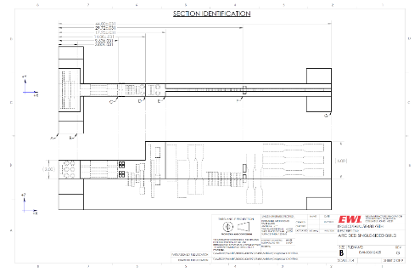
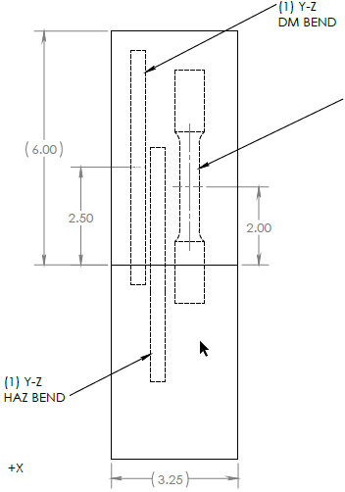
Bend Test Results NAB GMA-P FS-SS-IBP (1 of 2)
12% Elongation selected for bend tests
MIL-CuNiAl wire specification does not list elongation requirement
C63000 base material specification lists a minimum elongation of 12%
Block area
B01 (Y-axis DM) and B02 (Z-axis DM) broke
No visual defects on fracture surfaces
B03 (Z-axis DM/HAZ interface) passed
Wall area
B04 (Z-axis DM) and B05 (Z-axis DM/HAZ interface) passed
B01
B02
DISTRIBUTION A. Approved for public release: distribution unlimited

Slide 17
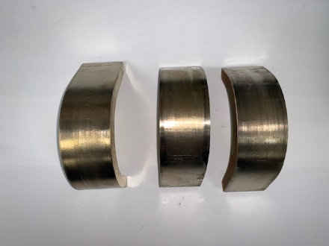
Bend Test Results NAB GMA-P FS-SS-IBP (2 of 2)
B01 (Y-axis DM) and B02 (Z-axis DM) broke
No visual defects on fracture surfaces
ONR ManScience project – investigating bend behavior
B01
B01
B01
B03, B04, B05
B02
B02
B02
DISTRIBUTION A. Approved for public release: distribution unlimited

Slide 18
Conclusions – NAB GMA-P DED on NAB FS-SS-IBP SQB _{(1 of 2)}
NDE
No indications during VT, PT, RT, and UT that were unacceptable to the Class 1 requirement of MIL-STD-2035.
Tensile test results
DM round tensile specimens met the minimum tensile strength requirement of the MIL-CuNiAl wire.
DM/HAZ interface round tensile specimens met the minimum requirements of both the MIL-CuNiAl wire and the C63000 build platform.
Bends test results
Block area
B01 (Y-axis DM) and B02 (Z-axis DM) broke
No visual indications on fracture surfaces
B03 (Z-axis DM/HAZ interface ) passed with no visual defects.
Wall area
B04 (Z-axis DM) and B05 (Z-axis DM/HAZ interface) passed with no visual defects.
DISTRIBUTION A. Approved for public release: distribution unlimited

Slide 19
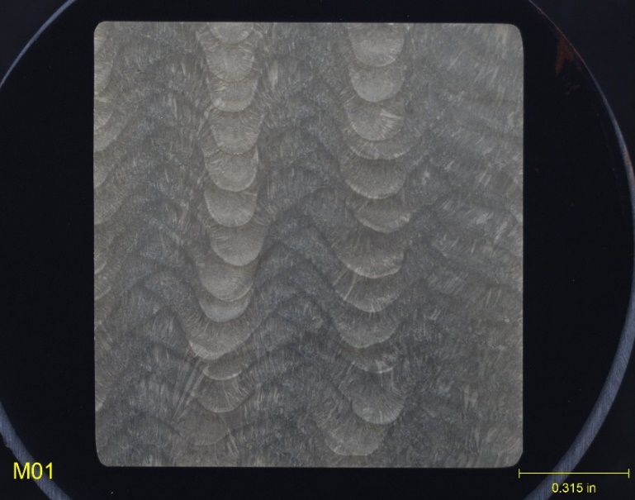
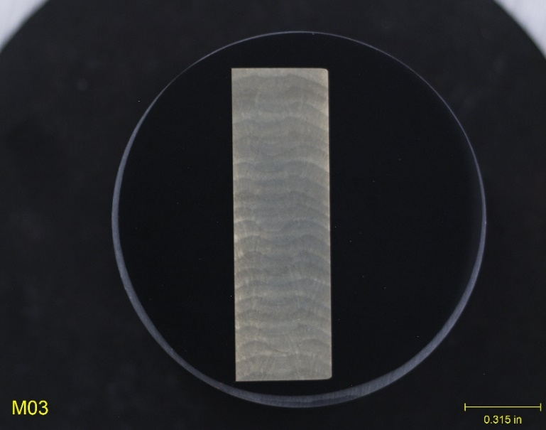
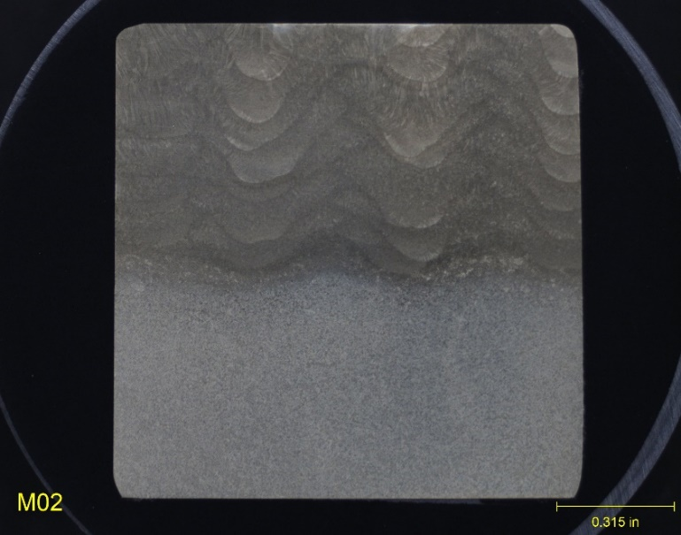
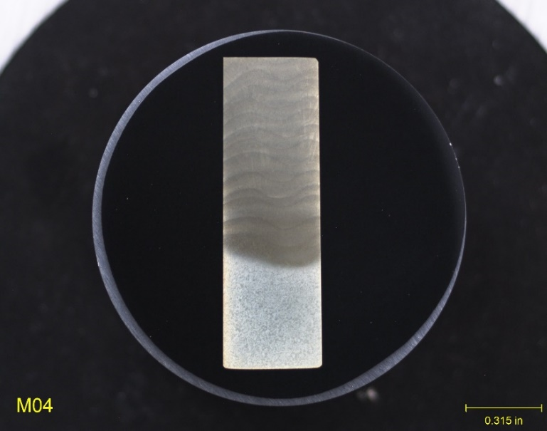
Conclusions – NAB GMA-P DED on NAB FS-SS-IBP SQB _{(2 of 2)}
Metallographic sections had no notable discontinuities.
Block – DM
Wall – DM
Block – DM/HAZ
Wall – DM/HAZ
DISTRIBUTION A. Approved for public release: distribution unlimited

Slide 20
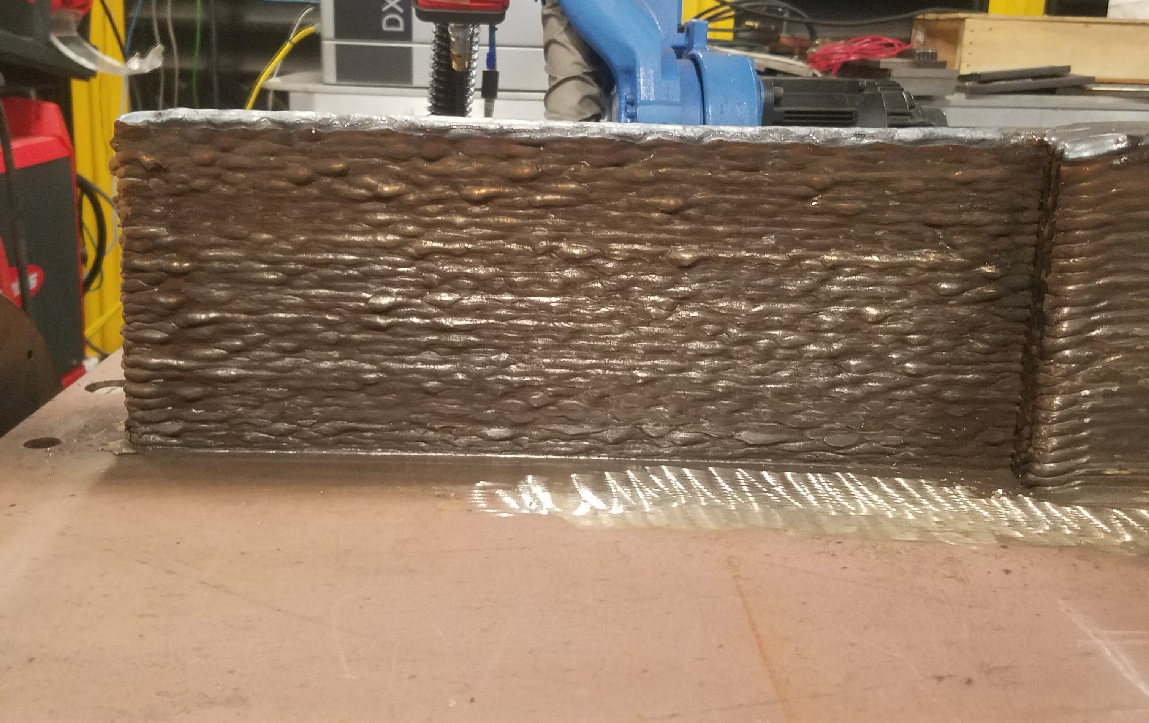
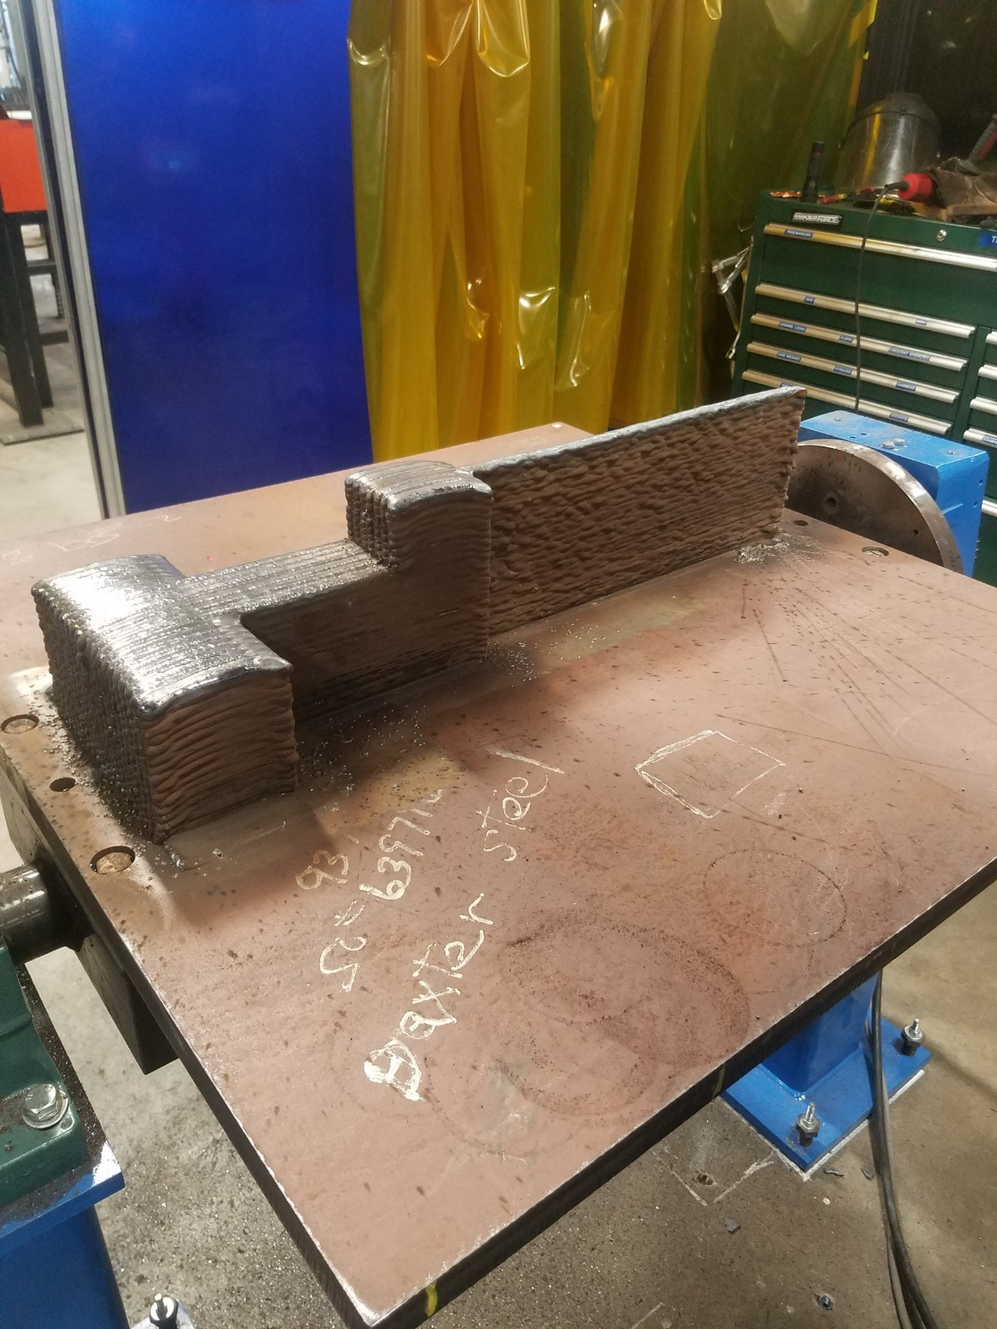
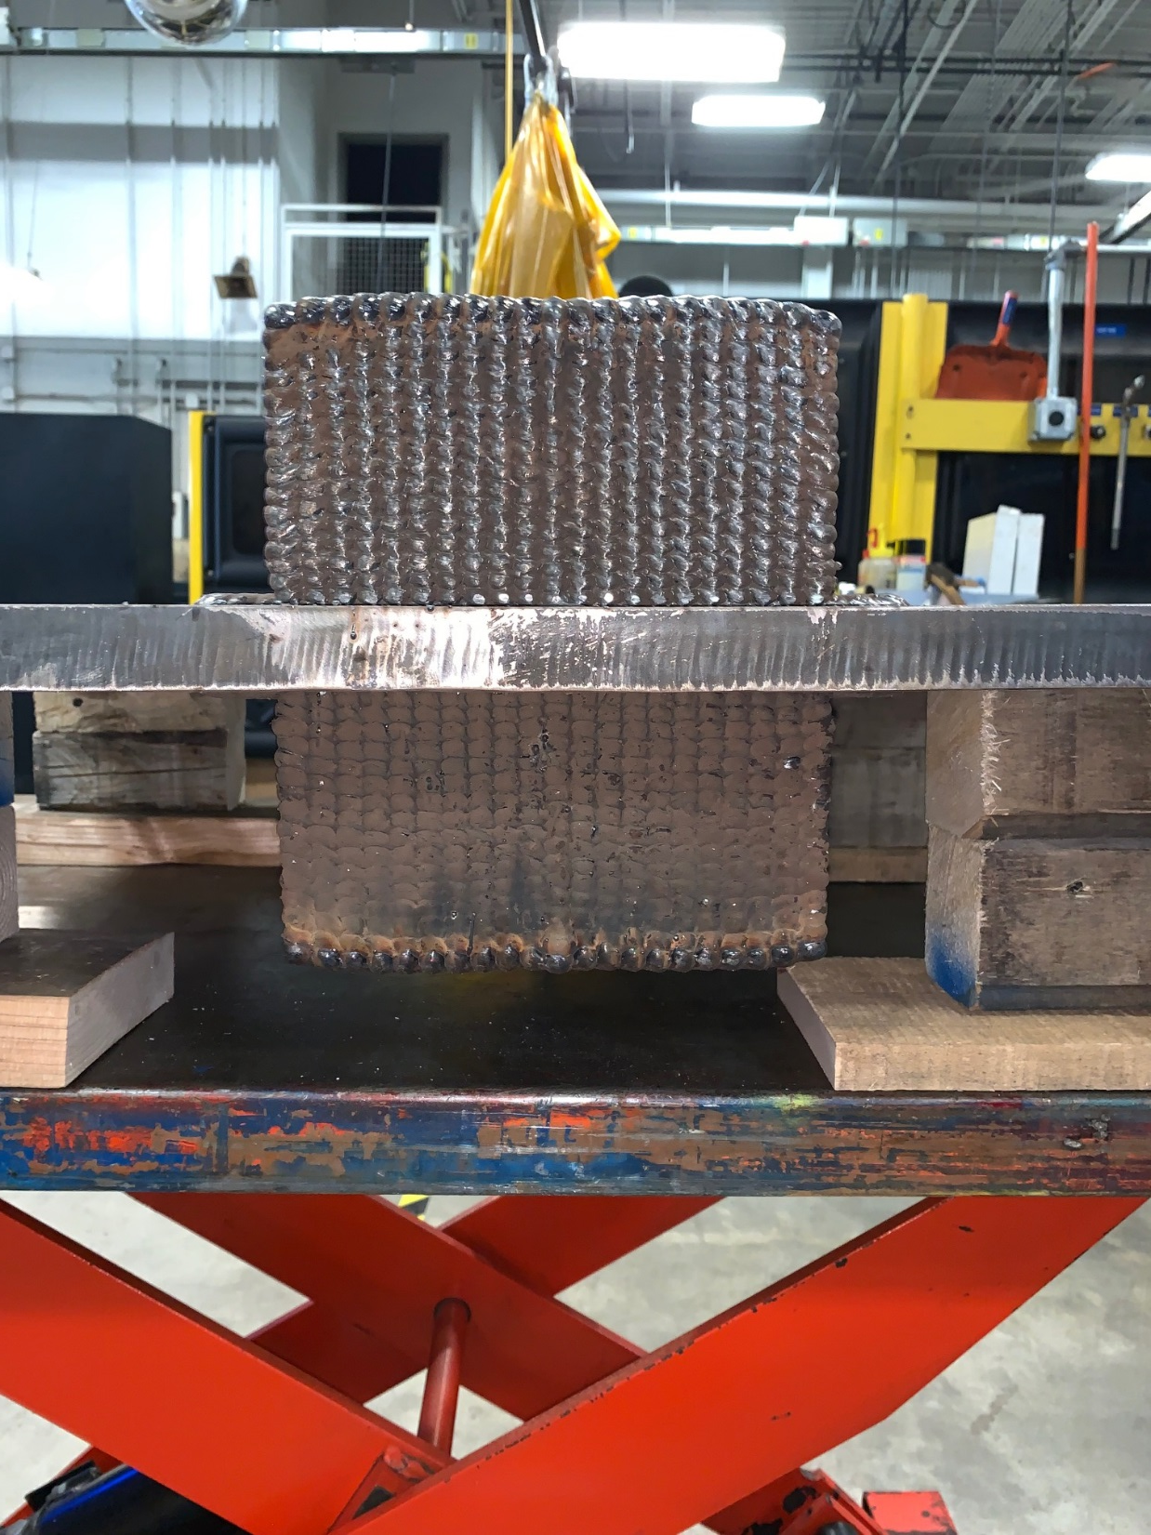
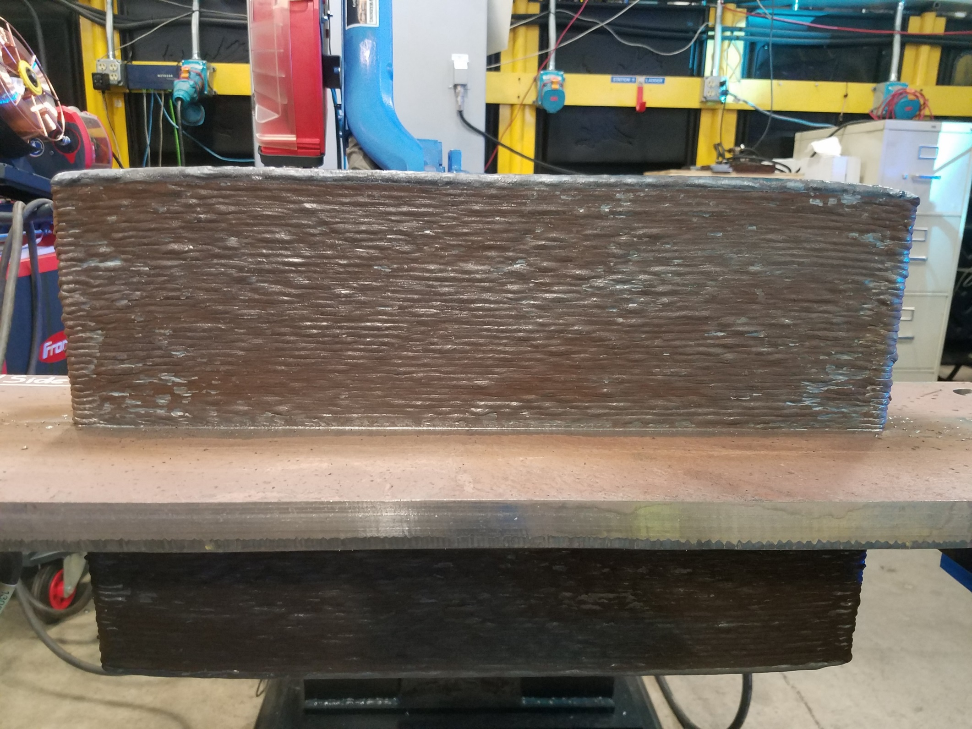
FS-DS-IBP High Strength Steel Build Results
DISTRIBUTION A. Approved for public release: distribution unlimited

Slide 21
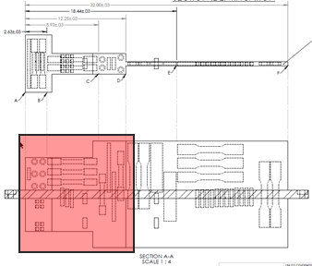
Block Area Tensile Results – MIL-100S-1 GMA-P on HY-80 FS-DS-IBP SQB
All DM round tensile specimens met the minimum tensile strength requirement of MIL-100S-1 wire.
DM/HAZ interface round tensile specimens met the minimum requirements of both MIL-100S-1 wire and the HY-80 build platform.
Z-Axis DM/HAZ Interface Yield & Elongation
Invalid per ASTM E8
DISTRIBUTION A. Approved for public release: distribution unlimited

Slide 22
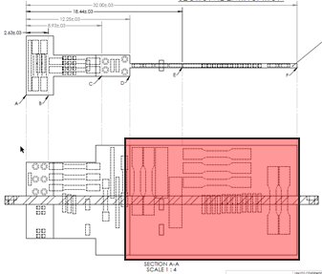
Wall Area Tensile Results – MIL-100S-1 GMA-P on HY-80 FS-DS-IBP SQB
All DM rectangular tensile specimens met the minimum tensile strength requirement of MIL-100S-1 wire.
DM/HAZ interface rectangular tensile specimens met the tensile strength requirements of MIL-100S-1 wire
Yield and elongation are invalid for these specimens, so results can’t be compared to HY80 platform requirements
Z-Axis DM/HAZ Interface Yield & Elongation
Invalid per ASTM E8
DISTRIBUTION A. Approved for public release: distribution unlimited

Slide 23
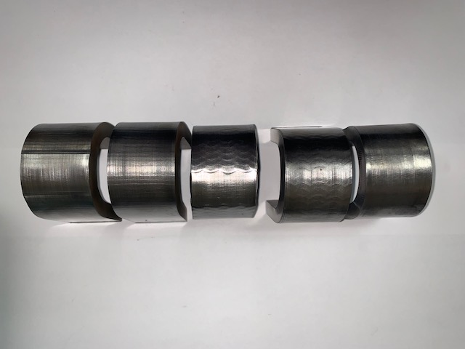
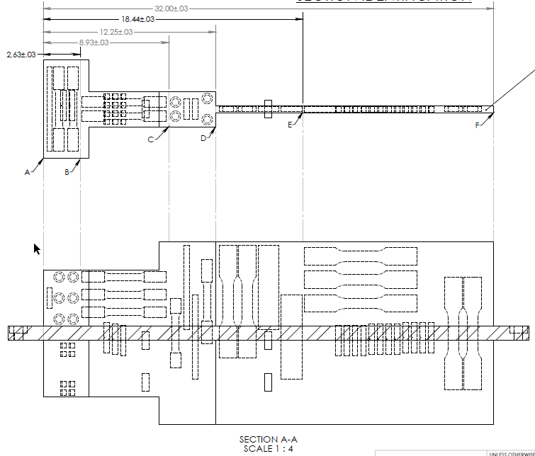
Bend Test Results – MIL-100S-1 GMA-P on HY-80 FS-DS-IBP SQB
20% Elongation selected for bend tests.
MIL-100S-1 wire specification does not list elongation requirement.
HY-80 base material specification lists a minimum elongation of 20%.
Block area
All bend test specimens passed with no visual defects.
Wall area
All bend test specimens passed with no visual defects.
DISTRIBUTION A. Approved for public release: distribution unlimited

Slide 24
Impact Testing Approach – MIL-100S-1 GMA-P on HY-80 FS-DS-IBP SQB
Both the wire and the base material specifications have impact testing requirements for two test temperatures.
Each group in the SQB has four Charpy V-notch (CVN) specimens.
Two specimens were tested at each test temperature.
All DM CVN specimens and CVN specimens with the notch centered at the interface were tested in accordance with the MIL-100S-1 wire specification.
CVN specimens with the notch located in the HAZ were tested in accordance with the HY-80 build platform specification.
Material | Specification | Test Temperature 1 |  |  | Test Temperature 2
 |  | Test Temp. (°F) | Min. Impact Energy (ft-lbs) | Min. Shear Fracture (%) | Test Temp. (°F) | Min. Impact Energy (ft-lbs) | Min. Shear Fracture (%)
MIL-100S-1 (Wire) | MIL-E-23765-2E | -60 | 35 | -- | 0 | 60 | --
HY-80 (Build Platform) | T9074-BD-GIB-010/0300 | -120 | 35 | 50 | 0 | 60 | 90
DISTRIBUTION A. Approved for public release: distribution unlimited

Slide 25
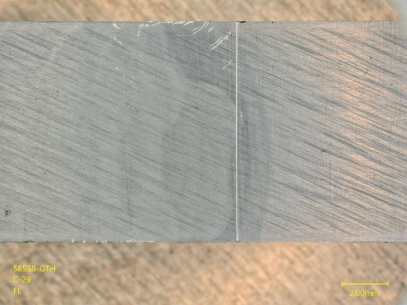
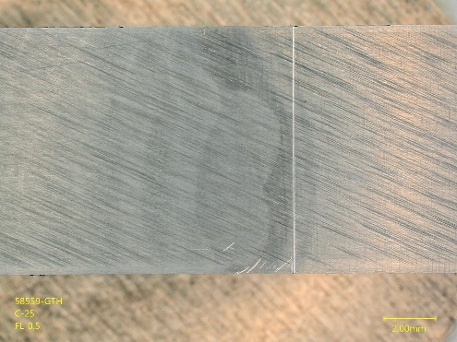
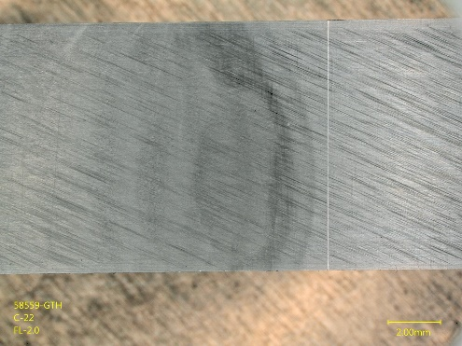
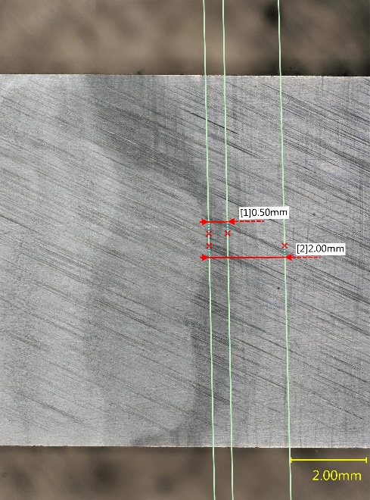
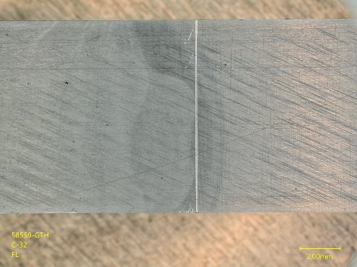
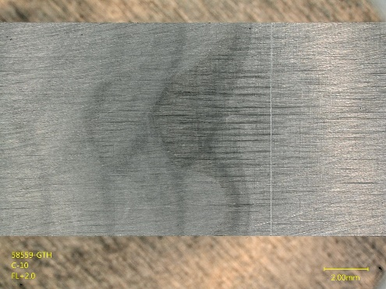
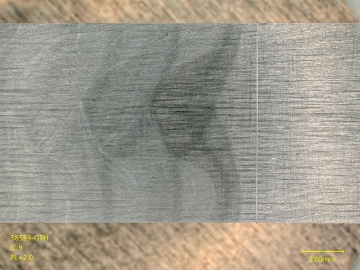
Notch Location – Fusion Line and HAZ CVNs
Deepest penetration point was selected as the centerline of the fusion line CVN specimens.
The two HAZ CVN locations were selected so that both locations were within the HAZ.
Macrographs were taken to show the scribe mark on each CVN specimen prior to notching.
Wall – FL
Wall – FL+0.5-mm
Wall – FL+2.0-mm
Block – FL
Block – FL+0.5-mm
Block – FL+2.0-mm
DISTRIBUTION A. Approved for public release: distribution unlimited

Slide 26
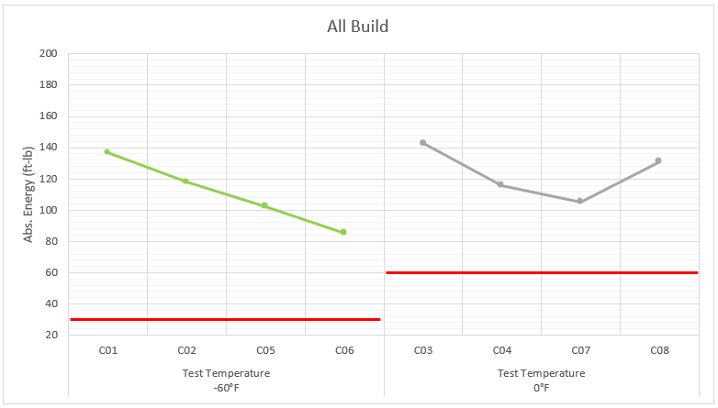
Block DM Impact Results –MIL-100S-1 GMA-P on HY-80 FS-DS-IBP
All DM CVN Specimens Meet MIL-100S-1 Wire Requirements.
DISTRIBUTION A. Approved for public release: distribution unlimited

Slide 27
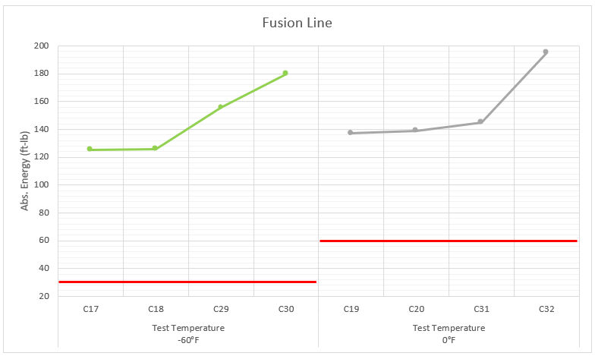
FL Impact Results – MIL-100S-1 GMA-P on HY-80 FS-DS-IBP
CVN Specimens with Notch Centered at the Fusion Line Met MIL-100S-1 wire Requirements.
DISTRIBUTION A. Approved for public release: distribution unlimited

Slide 28
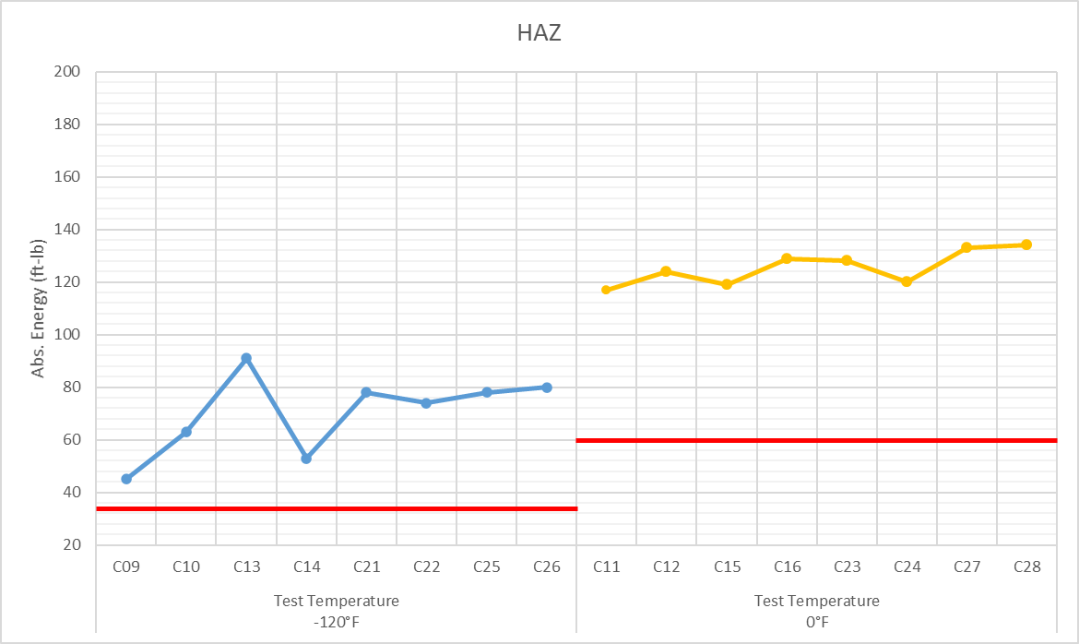
HAZ Impact Results – MIL-100S-1 GMA-P on HY-80 FS-DS-IBP
CVN Specimens with Notch in HAZ Met the HY-80 Base Material Requirements, Minus C09 & C10 Shear Area.
+2.0 mm
+0.5 mm
+2.0 mm
+0.5 mm
+2.0 mm
+0.5 mm
+2.0 mm
+0.5 mm
+2.0 mm
+0.5 mm
+2.0 mm
+0.5 mm
+2.0 mm
+0.5 mm
+2.0 mm
+0.5 mm
DISTRIBUTION A. Approved for public release: distribution unlimited

Slide 29
Conclusions – MIL-100S-1 GMA-P DED on HY-80 FS-DS-IBP SQB (1 of 2)
NDE
Build met the Class 1 VT, MT, and RT requirements of MIL-STD-2035.
One planar UT indication detected near end of block did not meet Class 1 requirements
Tensile test results
DM tensile specimens from block and wall met MIL-100S-1 requirements.
DM/HAZ interface tensile specimens from block and wall met MIL-100S-1 requirements
Gage section of the DM/HAZ interface specimens include DM, HAZ, and HY-80 base material
Tensile results of the DM/HAZ interface specimens cannot be compared to the yield strength, elongation, and reduction in area requirements of HY-80 base material
Bends test results
All bend test specimens passed with no visual defects.
DISTRIBUTION A. Approved for public release: distribution unlimited

Slide 30
Conclusions – MIL-100S-1 GMA-P DED on HY-80 FS-DS-IBP SQB (2 of 2)
CVNs
All specimens in build DM and with notch at HAZ interface met the impact energy requirements of MIL-100S-1 wire.
All specimens with notch in HAZ met impact energy requirements of HY-80 base material.
Met section evaluation
Metallographic sections had no notable discontinuities.
Block – DM
Block – DM/HAZ
Wall – DM
Wall – DM/HAZ
DISTRIBUTION A. Approved for public release: distribution unlimited

Slide 31
Final Conclusions
A prescriptive qualification scheme provides a clear path to accelerate implementation of high impact DED AM technology.
The acceptance criteria of these standard qualification builds should leverage property requirements for the consumable and / or representative base materials (if available).
New property requirements will need to be developed to accommodate new process-feature-property relationships that are established through standard qualification builds.
These DED procedure qualification schemes should be considered by other compliance organizations to harmonize requirements across the DOD and industry and reduce mfg. supply chain qualification and certification costs.
DISTRIBUTION A. Approved for public release: distribution unlimited

Slide 32
Disclaimer
EWI disclaims all warranties, express or implied, including, without limitation, any implied warranty of merchantability or fitness for a particular purpose.
Under no circumstances will EWI be liable for incidental or consequential damages, or for any other loss, damage, or expense, arising out of or in connection with the use of or inability to use the report delivered under this engagement. This report may not be reproduced or disseminated to individuals or entities outside of your organization without the prior written approval of EWI.
DISTRIBUTION A. Approved for public release: distribution unlimited

Slide 33
EWI Facilities and Labs
Columbus, Ohio
EWI (Headquarters)
1250 Arthur E. Adams Drive
Columbus, OH 43221
614.688.5000
info@ewi.org
Buffalo, New York
Buffalo Manufacturing Works
683 Northland Ave.
Buffalo, NY 14211
716.710.5500
info@BuffaloManufacturingWorks.com
Loveland, Colorado
Rocky Mountain Center for Innovation & Technology
815 14th Street SW, Ste. D190
Loveland, CO 80537
970.635.5100
info@ewi.org
EWI empowers industry leaders to overcome complex manufacturing challenges and integrate new processes to bring products to market more quickly and efficiently. Since 1984, EWI’s comprehensive engineering services have helped companies identify, develop, and implement the best options for their specific applications. Key customers include but are not limited to aerospace and defense, automotive, aviation, energy, consumer electronics, medical devices, industrial products, and heavy equipment. Backed by unmatched professional expertise, state-of-the-art lab facilities, and technology resources, EWI offers customized solutions that deliver game-changing results.
How can EWI help your organization? Visit www.ewi.org, email info@ewi.org, or call 614.688.5000 to learn more.
DISTRIBUTION A. Approved for public release: distribution unlimited

Slide 34
Thank you for
your time.
DISTRIBUTION A. Approved for public release: distribution unlimited

