Slide 1

Fiber Optic
Distributed Temperature Sensing for Ships’ Electrical Systems’ Conditions Based Maintenance
NSRP Electrical Technologies Panel
August 10, 2022
G. Tomasi

Slide 2
PROBLEM STATEMENT(S)
Methods used to detect loose connections in Medium Voltage (MV – 4,160 VAC) and High Voltage (HV – 13,400 VAC) electrical panels via acoustic sensors identify the condition of a fault AFTER it has become critical.
  Actual location of fault is NOT identified.
  Panel must be de-energized and ALL connections inspected.
  Very time consuming.
If Thermal Scanner is used when panel is energized, strict safety procedures must be followed.
  Protective equipment for personnel.
  Clear area and create safety zone.
  Dangerous for personnel and time consuming.
  Scanner does not “see” all connections.

Slide 3
SOLUTION
Fiber optic Distributed Temperature Sensing (DTS) system.
  All non-metallic fiber optic cable.
  Entire length of fiber optic cable acts as temperature sensor.
  Continuous, real-time monitoring for Conditions Based Maintenance.
  Detect conditions BEFORE they become critical.
  Redundant, fault-tolerant system configuration.
Mature technology used extensively in many industries.
  Oil and gas exploration, transport, and processing.
  Electrical cables’ real time thermal rating.
  Machinery monitoring.
  Fire detection in buildings and tunnels.
  Food storage spaces.
Ships’ DTS System configuration is the result of five (5) NSRP projects and one (1) CDC/NIOSH funded project.

Slide 4
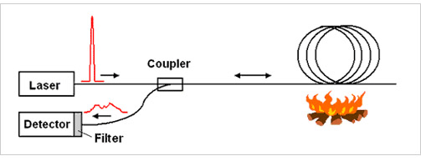
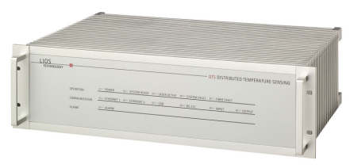

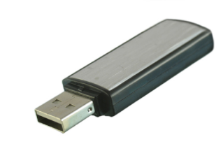


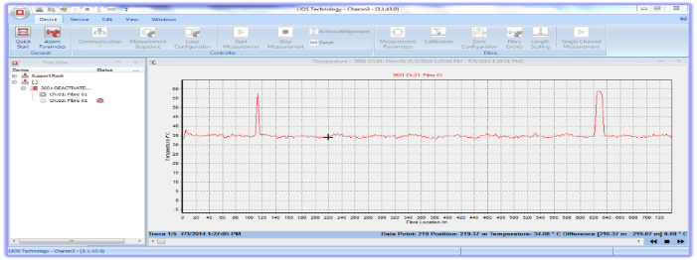
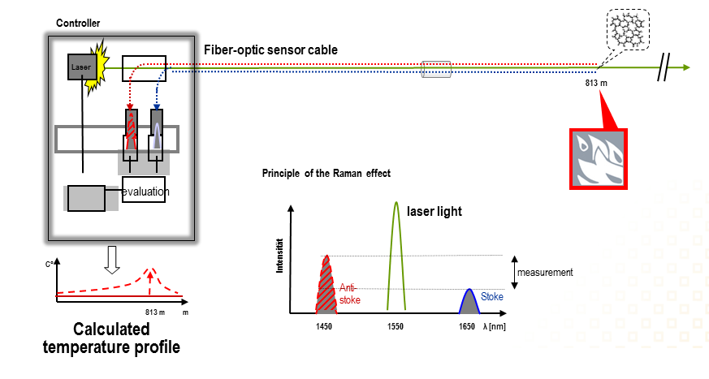
DISTRIBUTED TEMPERATURE SENSING
Outputs
Inputs
Entire fiber is the sensing unit – up to 1000 zones per fiber channel.
Standard MM 50/125, 62.5/125 or SM fiber.
Up to 30 Km MM, 40 Km SM - real time monitoring across entire length.
Temperature rise of 0.5ºC
Spatial Resolution down to 50 cm.
Based on Raman Scattering.
Display Options
Temperature profile
Graphics
Alarm panel
RAMAN SCATTERING DTS
PROs | CONs
Use standard MM or SM fibers. | Need ~ 50 cm of separation between sensing locations.
Long Sensing Cable Lengths. | Need ~ 1 m of fiber for sensing.
Ability to program / re-program Zones w/in Zones. | Require fusion splicing to connect cable sections.
Notes:
A DTS uses the fiber optic cable as a continuous lineal temperature sensor. The fiber cable can be embedded in the power cable or placed over the cable to detect temperature changes.
DTS systems can be configured to the specific application, with distances, sampling intervals, alarms and other parameters customized as needed.

Slide 5
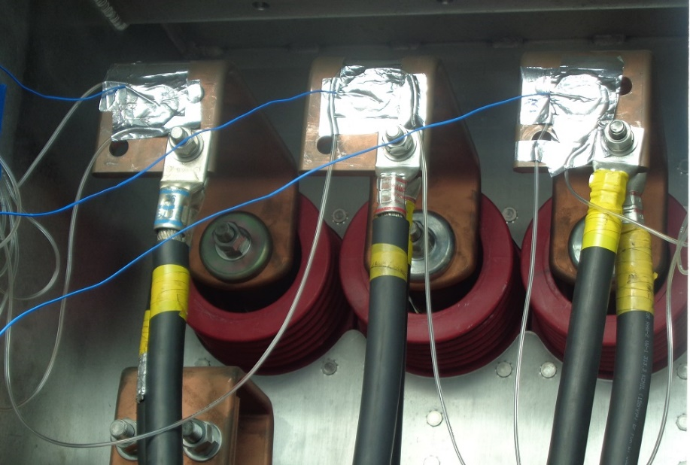
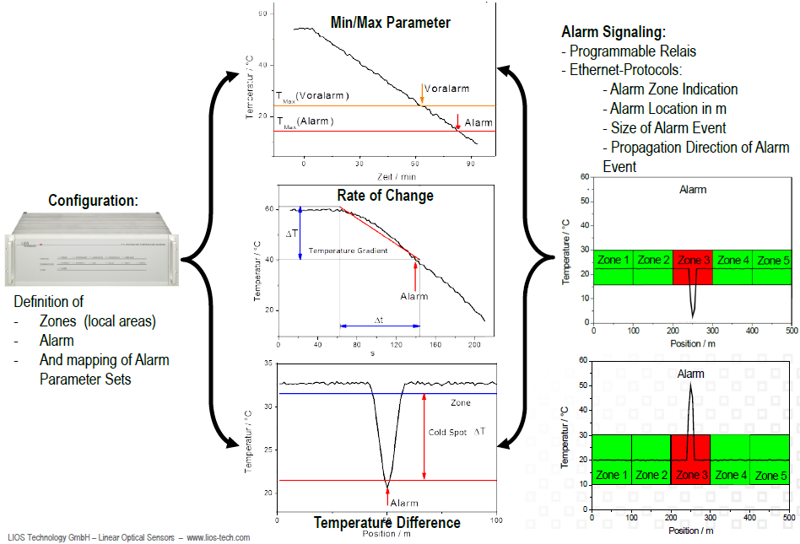
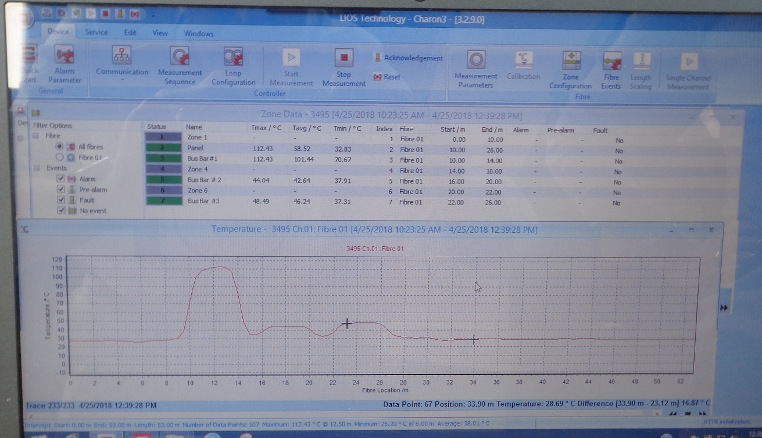
ZONES AND ALARM PARAMETERS
Alarms in each individual Zone can be set for:
Exceeding Min / Max operating Temperature range
Rate of change > standard ΔT/ Δt
Difference > T or < T allowed between zones
Photos Courtesy of PSU EOC - NSRP 2017-422
Notes:
5
DTS alarms can be set based on Min-Max temperature parameters, rate of change, and temperature difference.

Slide 6
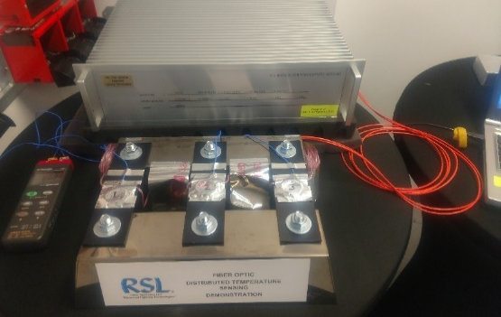
ZONES AND ALARM PARAMETERS
Sensing Zones can overlap and encompass multiple zones.
Sensing Zones can be remotely re-positioned and re-programmed.
DTS Demo Unit
Notes:
6
DTS alarms can be set based on Min-Max temperature parameters, rate of change, and temperature difference.

Slide 7
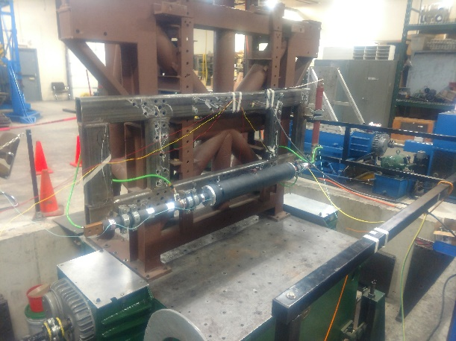
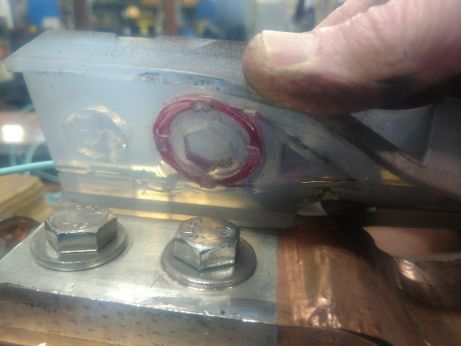
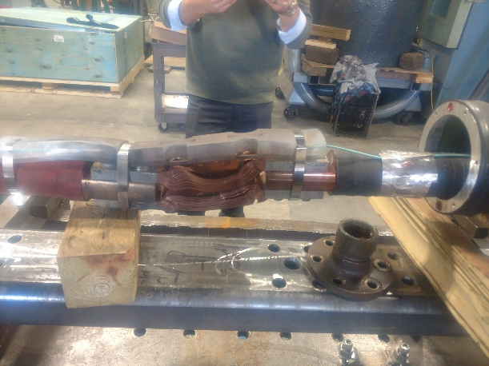
DTS FIBER OPTIC ASSEMBLY TESTING
  DTS fiber optic sensing assemblies were tested to Vibration (MIL-STD-167-1A) and Medium Weight Shock (MIL-S-901D) as part of the Insulated Bus Pipe testing program (NSRP RA 19-01).
  The assemblies passed all tests with no damage to the optical fibers and no degradation in performance.
  The testing program:
  Identified the optimal sensing fiber cable construction for use internal to equipment.
  Identified the sensing assembly constructions.
  Identified the attachment methods to the contact being monitored.
  Confirmed the ability of the optical fibers to continue operating during and after mechanical events.

Slide 8
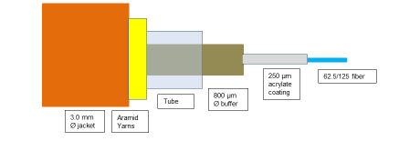
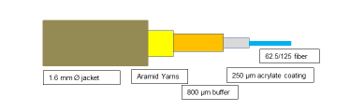
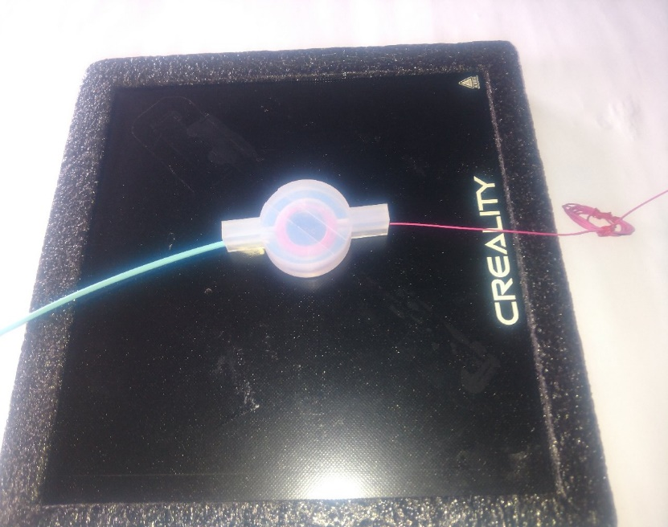
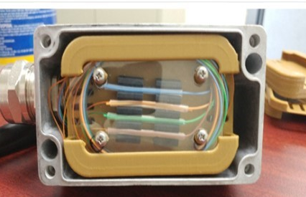
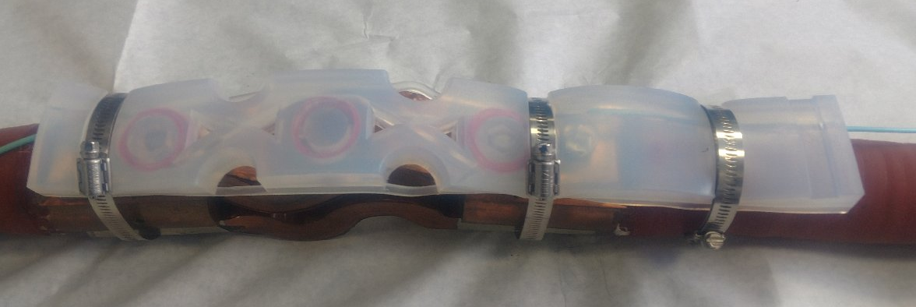
DTS SYSTEM LAYOUT
Fiber Cable from DTS Controller to Electrical Device:
MIL-PRF-85045 Shipboard (62.5/125 fiber in cable with enhanced abrasion resistance per NSRP 2019-477-01).
Sensing Cable Internal to Equipment
Single fiber in protective cable (Hepburn and Sons NSRP RA 20-01)
Fiber Optic Sensors
Molded fiber optic sensing assembly (Hepburn and Sons NSRP RA 19-01)
Secured to equipment using metal straps
Connection from M85045 to Sensing Cable:
Fusion splice enclosure at equipment (PSU EOC NSRP 2019-482-002)
Photo Courtesy of PSU EOC
Notes:
8

Slide 9
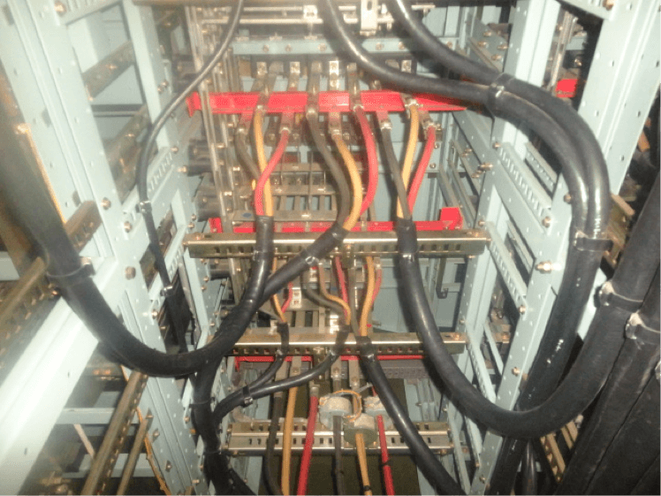
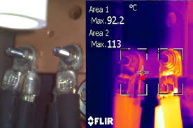
DTS SHIPBOARD IMPLEMENTATION
Splice M85045 Cable to Cable Assembly internal to Equipment
M85045 Fiber Cable Routing to Electrical Device
Integration
Into ship control & monitoring system
Sensing Zones Configuration
Set Alarm Parameters
Condition Based Maintenance for early warning to loose connections and potentially dangerous situations
Notes:
9

Slide 10
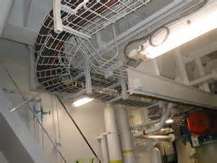
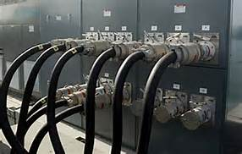
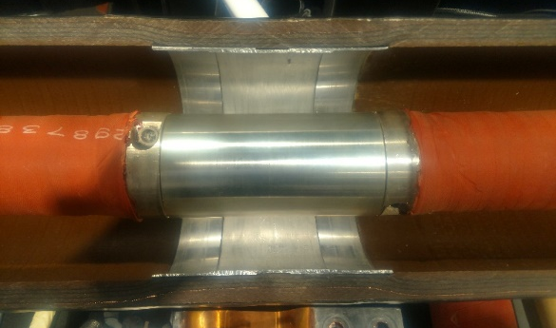
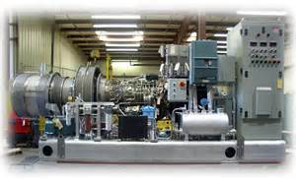
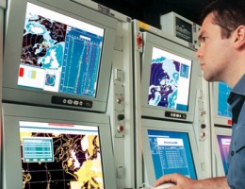
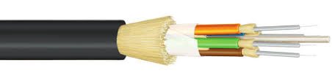
DTS – POSSIBLE SHIPBOARD APPLICATIONS
MV and HV electrical panels
Insulated Bus Pipe Connections
Fire detection
Machinery
Cabling systems
Food storage spaces
Others…
Single DTS and single cable for multiple functions
Data displayed on Integrated Bridge System Controller

Slide 11
QUESTIONS?

