Slide 1
NSRP Program Overview April 28, 2022 Electrical Technologies Panel Meeting

Slide 2
Anti-Trust Rules
Regarding your company’s and/or your competitor’s product & services:
Do not discuss current or future prices.
Do not discuss any increase or decrease in price.
Do not discuss pricing procedures.
Do not discuss standardizing or stabilizing prices.
Do not discuss controlling sales or allocating markets for any product.
Do not discuss future design or marketing strategies.
Notes:
Since NSRP is a collaboration of competing shipyards, it is important to cover the Anti-Trust rules. (read slide)

Slide 3
Anti-Trust Rules
Regarding your company’s and/or your competitors’ selection of their supplier companies:
Do not discuss refusing to deal with a company because of its pricing or distribution practices.
Do not discuss strategies or plans to award business to remove business from a specific company.
Regarding your company’s and/or competitors’ trade secrets:
Do not discuss trade secrets or confidential information of your company or any other participant.
Notes:
Since NSRP is a collaboration of competing shipyards, it is important to cover the Anti-Trust rules. (read slide)

Slide 4
NSRP Mission
The mission of the National Shipbuilding Research Program (NSRP) is to employ a unique collaborative framework to research, develop, mature, and implement industry-relevant shipbuilding and sustainment technologies and processes, improving efficiency across the U.S. shipyard industrial base and meeting future demand.
Notes:
NSRP mission is centered around reducing the total ownership cost of ships and the key to the program is the collaborative framework.

Slide 5
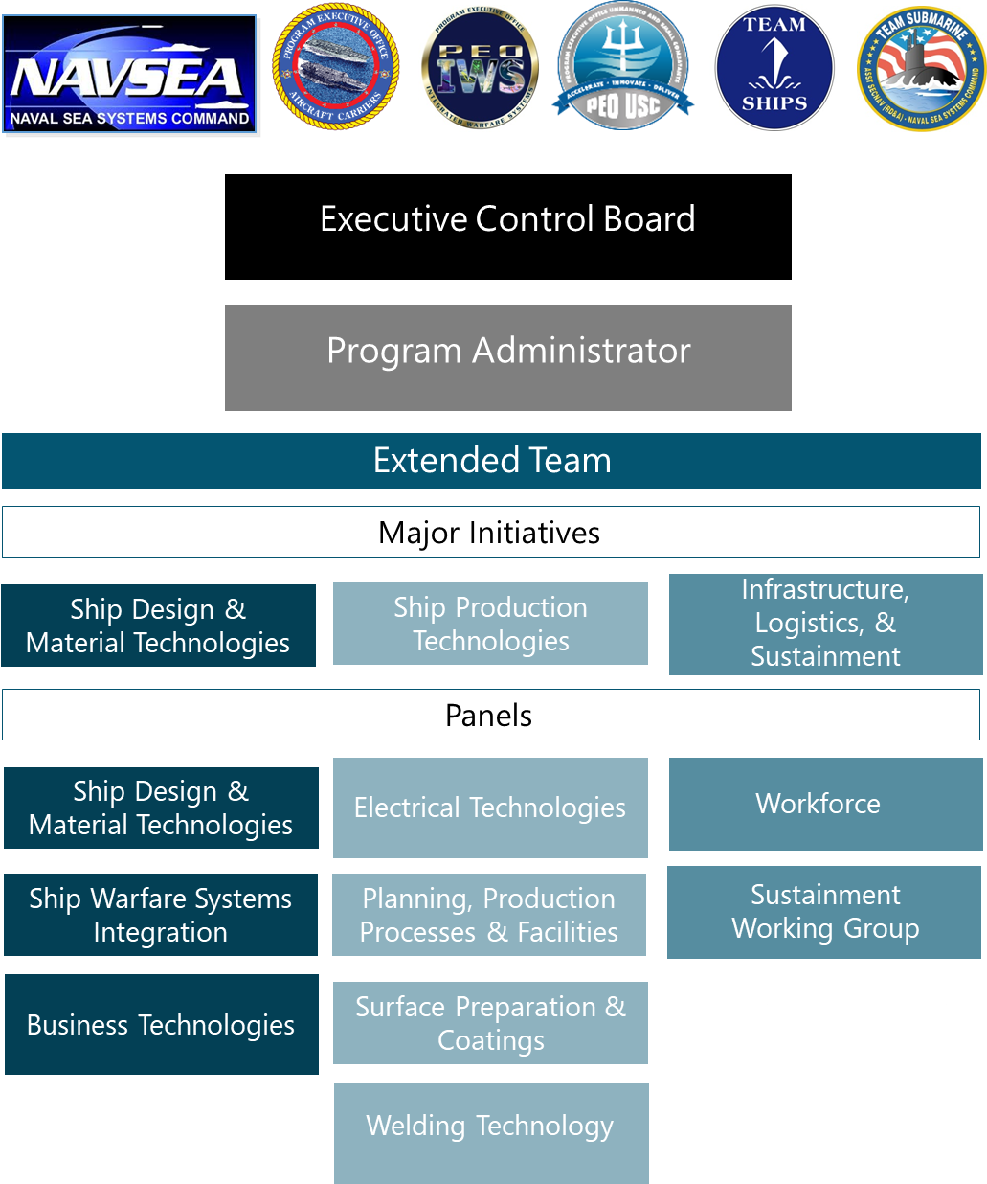
Organization
Notes:
7 sponsors who provide funding
10 member Executive Control Board
Executive Director and staff
Extended Team is divided into 4 Major Initiative Areas which align with the shipbuilding enterprise
10 Panels

Slide 6
Major Initiative Teams
Structure
From NSRP member yard
Relevant shipbuilding experience
Responsibilities
Provide technical oversight on projects aligned with Major Initiative
Engage in technology transfer activities
Provide input/feedback on Program documents
Stay abreast of shipyard/industry issues
Ship Design & Material Technologies
Ship Production Technologies
Infrastructure, Logistics, & Support
MITL-At-Large
Dan Sfiligoi (NASSCO)
Michael Gerardi (BIW)
Craig Haverly (EB)
Ken Johnson (Vigor)
Alicia Harmon (NNS)
Dru Khaira (BIW)
John Walks (Ingalls)
Gary Zimak (NNS)
Adam Sprecace (EB)
Pat Kitchel (BAE Ship Repair)
Adam Sprecace (EB)
Tony Ardito (Austal)
Patrick Hilgendorf (Austal)
Derek Hewson (BIW)

Slide 7
Panel Leadership
Ship Design & Material Technologies
Ship Production Technologies
Infrastructure, Logistics, & Support
Ship Design & Material Technologies
Electrical Technologies
Workforce
Chair: Jason Farmer (Ingalls)
Vice Chair: Walter Skalniak (Ashby)
Chair: Ryan Lee (Austal USA)
Vice Chair: Maurissa D’Angelo (D’Angelo Technologies)
Chair: Monika Skowronska (NASSCO)
Vice Chair: Victoria Dlugokecki (Consultant)
Planning, Production Processes & Facilities
Sustainment Working Group
Ship Warfare
Systems
Integration
Chair: Dale Samples (FMM)
Vice Chair: Pat Cahill (Cahill Consulting)
Chair: Vacant
Vice Chair: Vacant
Chair: Perry Haymon (Ingalls)
Vice Chair: Harold Howard (NNS)
Surface Preparation & Coatings
Chair: Arcino Quiero Jr. (NNS)
Vice Chair: Bob Cloutier (Consulting)
Business Technologies
Chair: Jamie Breakfield (Ingalls)
Vice Chair: Patrick Roberts (ShipConstructor)
Welding Technology
Chair: Paul Herbert (NNS)
Vice Chair: Kevin Roosinck (Ingalls)

Slide 8
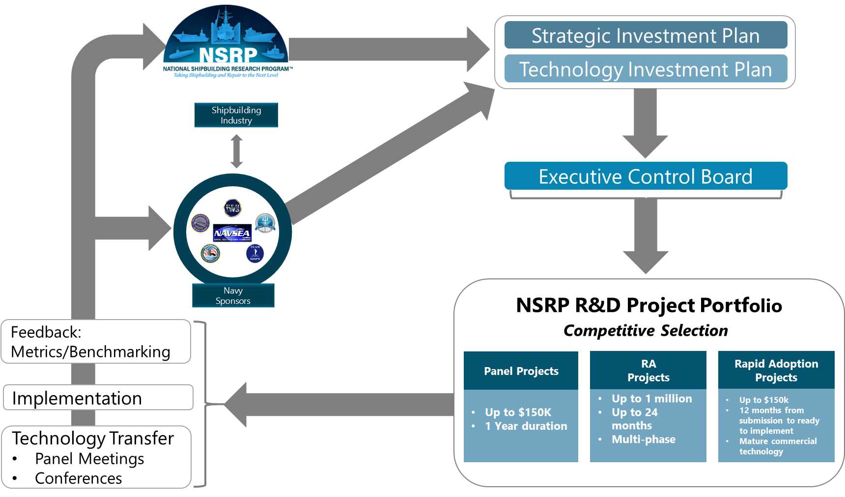
Operations

Slide 9
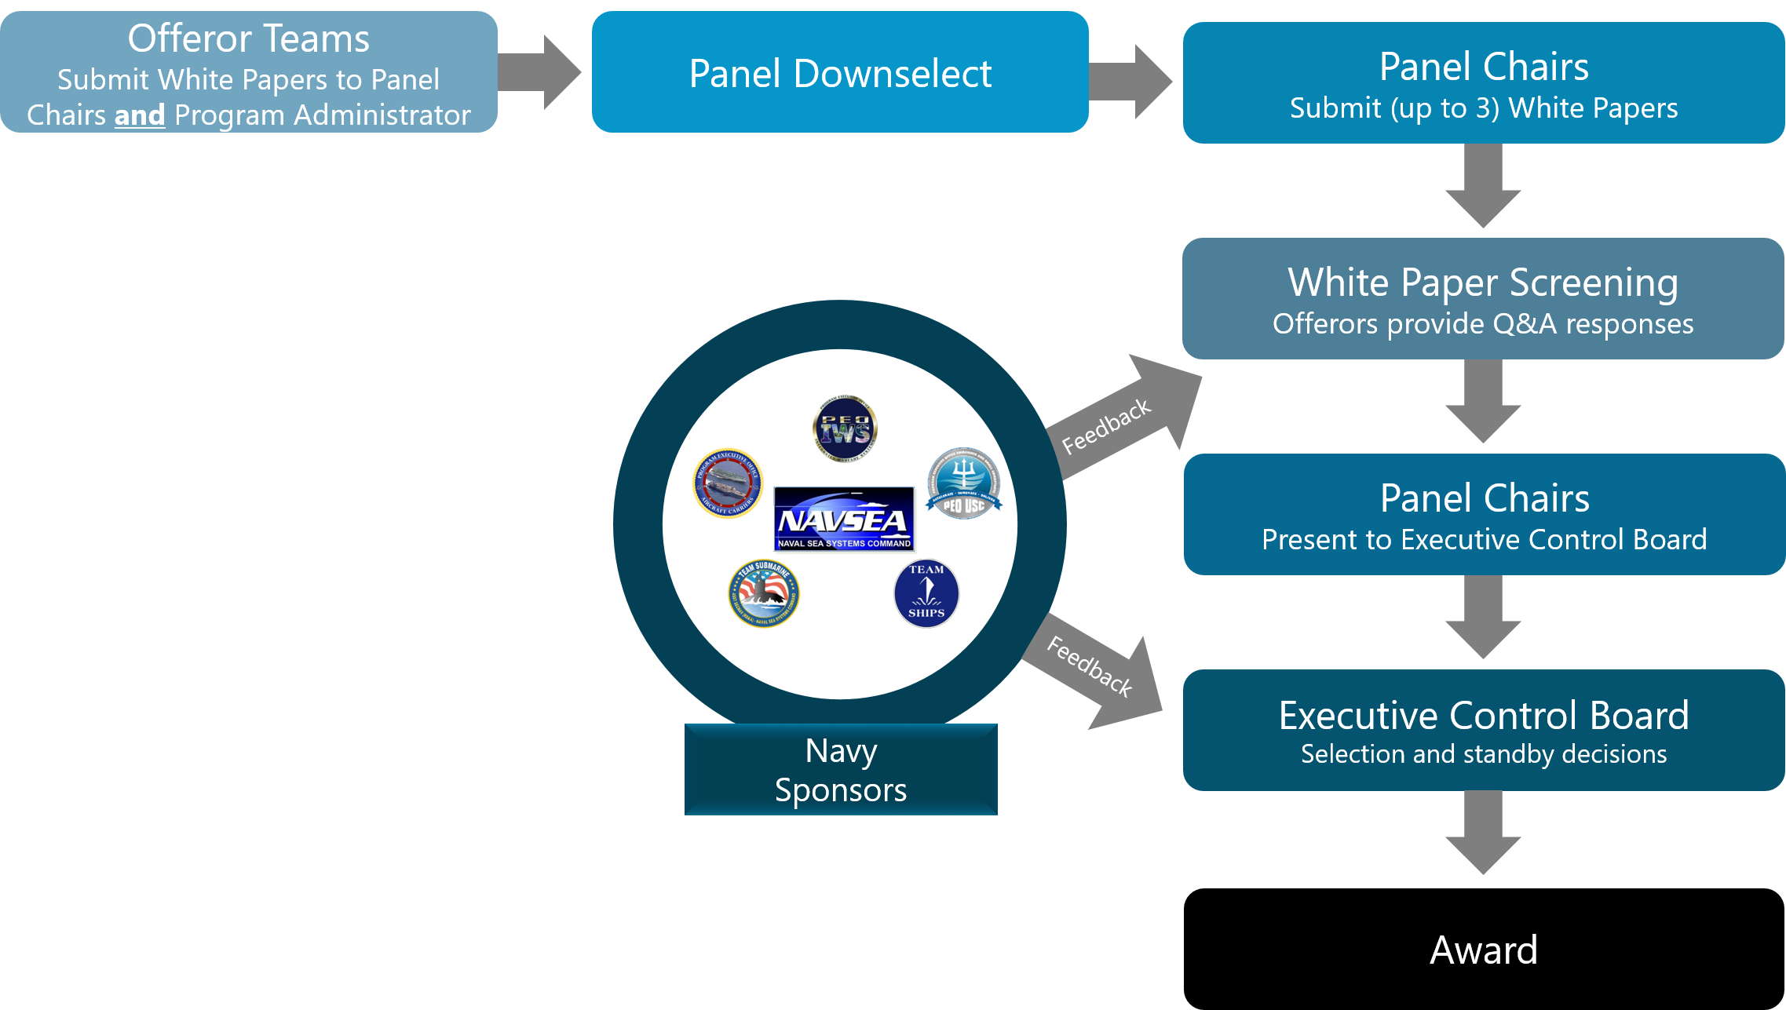
Panel Project Process

Slide 10
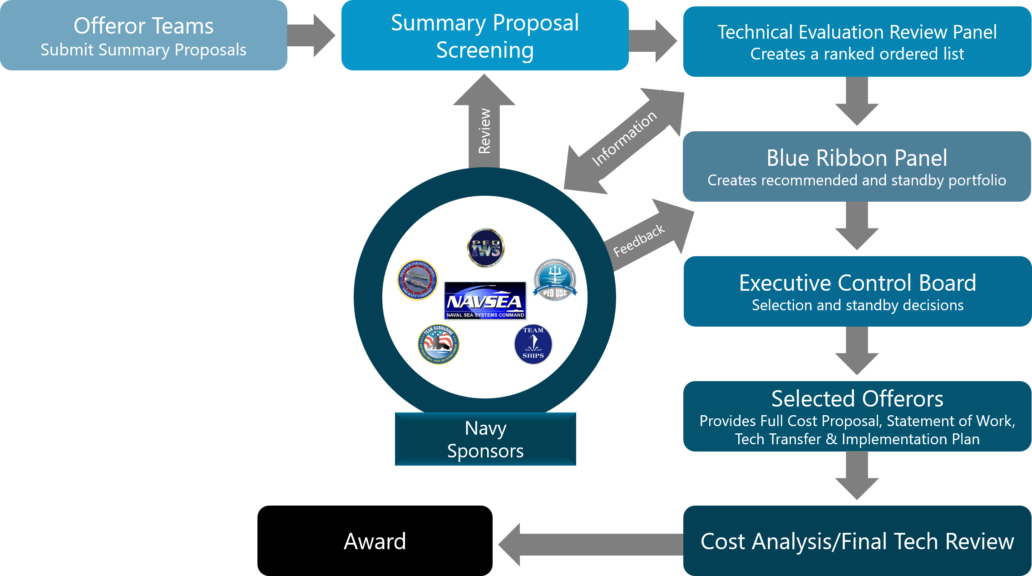
Research Announcement (RA) Process

Slide 11
Research Announcement Timeline
Action
Pre-Solicitation Notice Mar
Research Announcement Released Mar/Apr
Offerors’ Conference Apr 27
Summary Proposals Due Jul 18
Technical Evaluation Review Panel (TERP) Jul
Blue Ribbon Panel (BRP) Aug
ECB Project Selection Meeting Sep
RA final SOW and cost proposals due Oct
Project Task Order awards Dec-Feb

Slide 12
Rapid Adoption Project Process

Slide 13
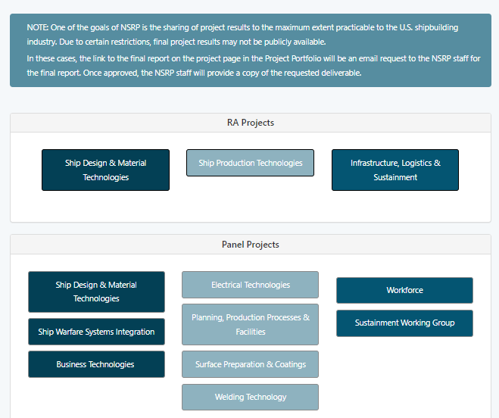
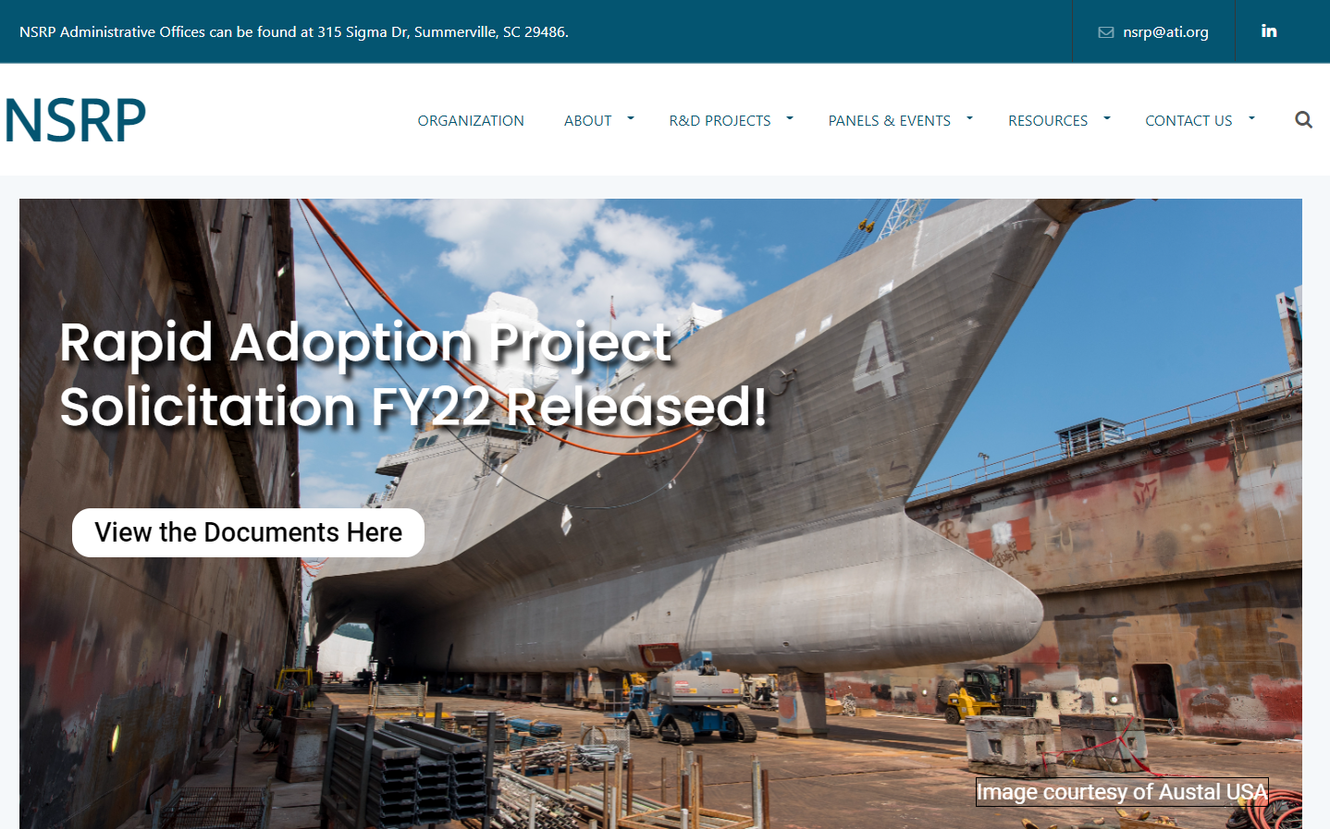
NSRP Latest Info and Project Portfolio
NSRP.org

Slide 14
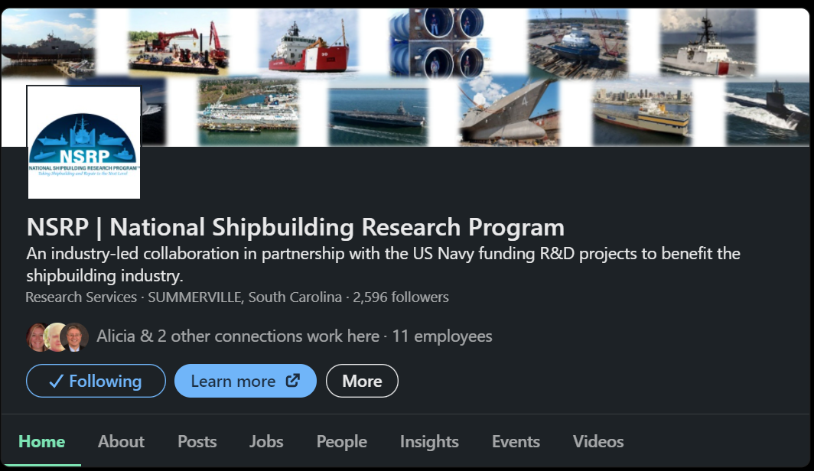
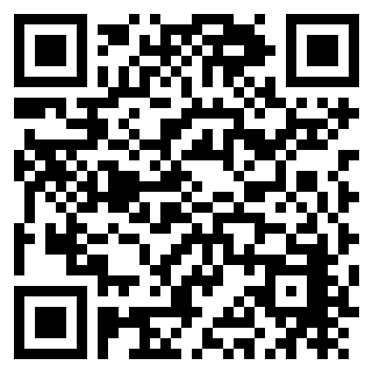
NSRP LinkedIn Page and Mailing Lists
Follow NSRP on LinkedIn to get the latest Program updates, event notifications, shipyard updates, and networking opportunities.
Email NSRP@ati.org to subscribe to the NSRP General Info mailing lists or individual panel mailings lists.
NSRP LinkedIn Page

Slide 15
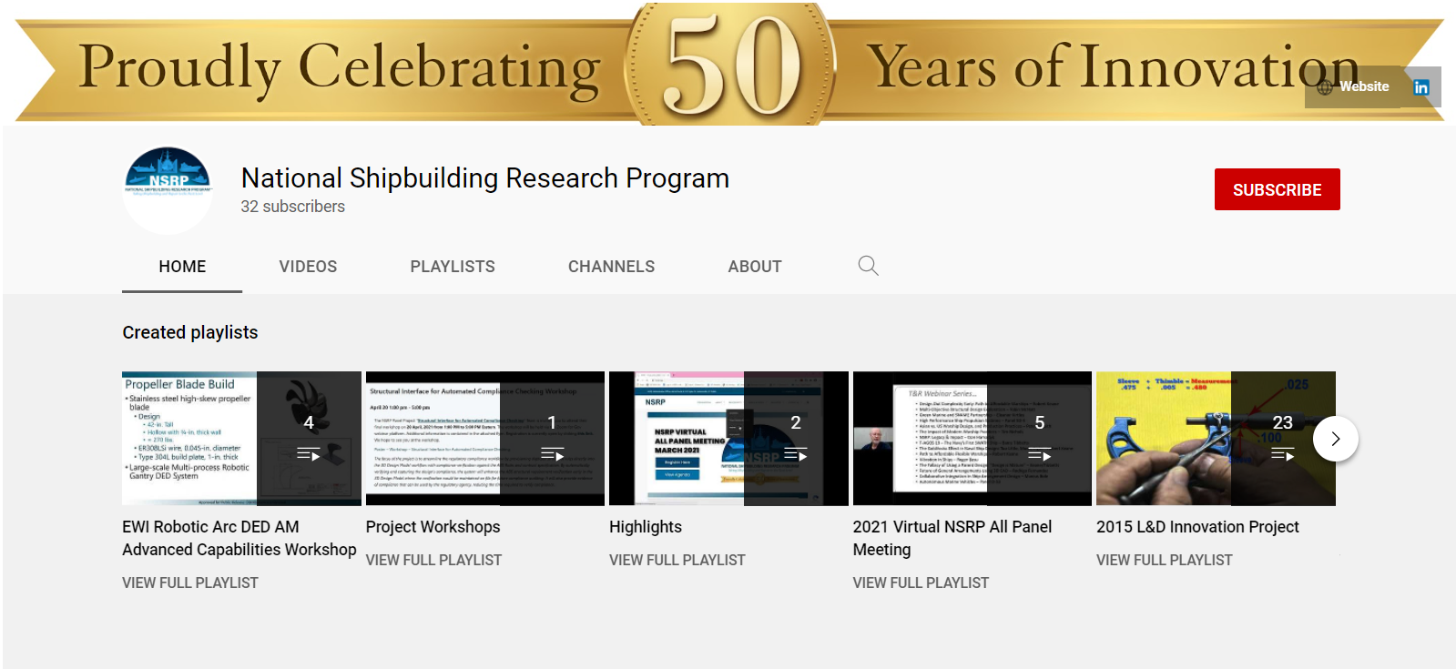
NSRP YouTube Page
NSRP YouTube Page

Slide 16
Questions?

