Slide 1
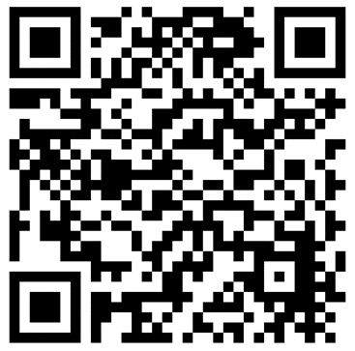
Title [Segoe UI 20]
Team: LEAD | Team Member 1 | Team Member 2 | Team Member 3 | Team Member 4 [Segoe 11]
Project Summary [Segoe UI 12]
Graphic Placeholder
Agenda [Segoe UI 18]
Date:
Time:
Place:
Workshop Registration [Segoe UI size 18]
2:00 Item 1
2:30 Item 2
3:00 Item 3
3:15 Item 4
3:30 Item 5
Registration link / button:
Graphic Placeholder
Questions?
Contact the NSRP Team at: nsrp@ati.org
nsrp.org

