Slide 1
Identifying, Evaluating, and Mitigating Ocular Hazards in Laser Processing 9/14/2021
Dr. Melissa Klingenberg – PSU/ARL Project Lead
Mr. Steve Brown – PSU/ARL Project Co-lead
Mr. James Brooks – NNS Project Lead

Slide 2
Today’s Presentation
Issue Description
Project Goal and Objectives
Project Approach
What We’ve Accomplished
Next Steps
Questions

Slide 3
Issue Description
Shipyards are becoming increasingly more interested in using laser ablation (LA) to remove rust, preconstruction primer, and other coating systems during construction and repair operations.
Reduces use of consumables.
Improve process flow time and reduces labor hours.
Reduce solid waste.
Reduces operator exposure to hazardous conditions.
Reduces substrate erosion.
Use of high power (Class 4) lasers in open manufacturing or refurbishment environments can be an ocular hazard.
Stray radiation during processing must be characterized to determine appropriate mitigation techniques to integrate into laser materials processing operations.

Slide 4
Project Goal and Objectives
Goal: To measure ocular hazards associated with LA surface preparation processes and determine means to mitigate those hazards in areas where a fully controlled environment is not possible.
Objectives:
Measure diffuse and/or specular reflections emanating from the laser beam interaction with the selected substrate surfaces (ex. aluminum and steel, coated and uncoated) when operating LA under various configurations.
Determine potential hazards to personnel co-located in the area.
Research and identify means to control reflection and protect personnel from stray radiation (if hazardous radiation is measured).
Determine/develop means/methods to ensure against occupational laser hazards during manufacturing in shipyards (if found to be necessary).

Slide 5
Project Approach
Define Testing Requirements - completed
ID materials to be subjected to laser interaction
ID material condition: surface finishes to be tested
Determine potential distances and angles of incidence to be evaluated
Define laser conditions: source, spot size, power, stand-off distance from the substrate(s), and scanning technology
Assess potential worker interaction: distance and angles from laser source
Execute Evaluations – in process
Establish an experimental setup
Calibrate Spectrometer
Prepare robotic system to accept spectrometer
Develop program to move spectrometer to desired positions/angles
Execute process recipe and measure reflectance
Evaluate hazards to SY personnel in the open area
Determine if shielding is required

Slide 6
Project Approach
Identify Radiation Control Means – not started
Conduct literature searches to review commercial-off-the-shelf items or existing designs that could be used to mitigate exposure of personnel to stray radiation
Develop concepts to shield personnel from radiation if COTS options are not suitable
Complete Final Report – not started
Documentation of all project activities
Selection of materials, conditions, etc.
Spectrometer/Robot programming
Spectrometer readings
Laser safety analysis
Shielding needs and options/design
Path forward

Slide 7
What we’ve accomplished
Experienced significant project delays on the sister (ONR ManTech) project which is responsible for laser equipment
Delayed delivery of laser, followed by pandemic related issues (installation delays), followed by laser being damaged thus requiring repair
Delay is approximately 1 yr to this project
Designed and built a frame to hold the scanner in a fixed position
Enables robot to manipulate the spectrometer from different positions (angles, heights, etc.) to get an idea of occupational hazards
Gathered testing requirements/conditions specific to NNS – e.g., surface finish, types of steels, condition of materials and sources of reflection in the manufacturing environment.
Contacted General Dynamics Electric Boat, General Dynamics Bath Iron Works, Ingalls, and Austal to obtain similar information
Pending sufficient funding, additional information from these shipyards could be used to gather more information on laser safety for similar applications.
GDEB provided substrate material and coating info (and their associated conditions and surface finishes). At the time of discussion they had no planned specific insertion points, so that the distances/sources of reflection were unknown.

Slide 8
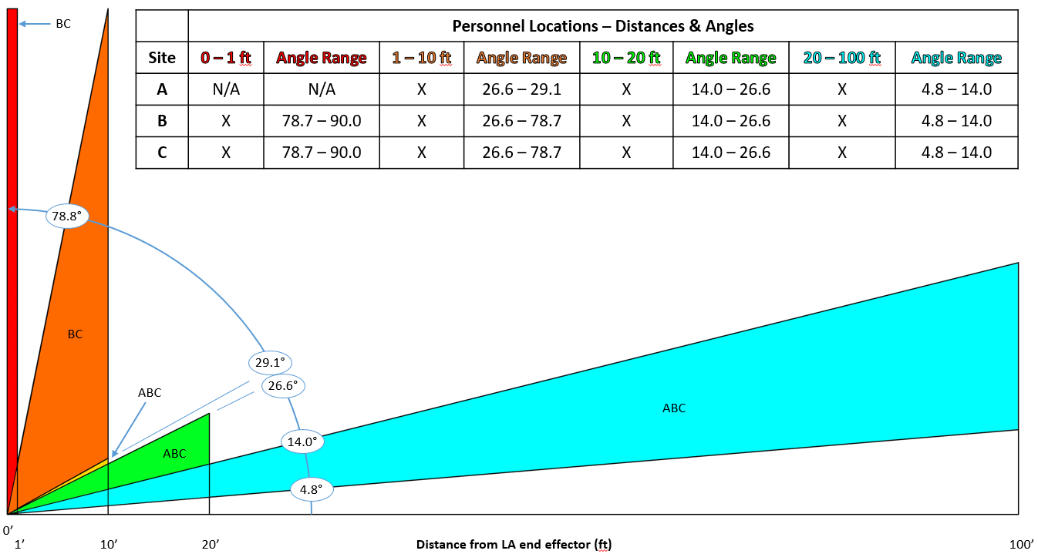
What we’ve accomplished
NNS provided anticipated distances and angles of incidence of concern to co-located personnel based on planned insertion points.
Machine operator may go to blast area to assess cleanliness in conventional removal operations (see orange triangle in Figure 1 below).
Other color coded triangles in the image below relate to the operators’ “normal” position or passers-by at those stations.
Figure 1. Possible Distances and Angles of Personnel Locations

Slide 9
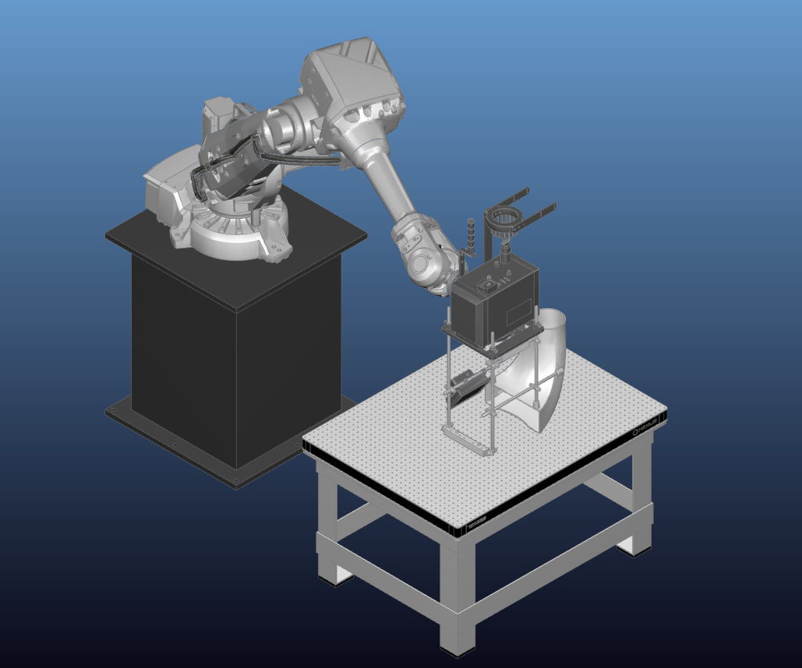
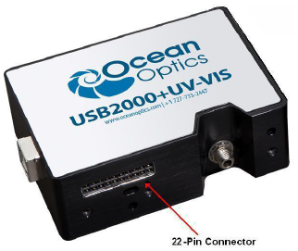
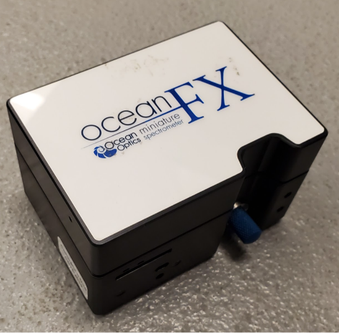
What we’ve accomplished
Mounted laser scanner to a frame fixed to the table to enable spectrometer to be mounted to the robot.
Allows for various angles and positions to be monitored during laser stripping.
Scanner will be mounted to an X-Y translator during stripping experiments that will be conducted for stray radiation measurements.
Calibrated USB2000+UV-VIS spectrometer (Fig 2)
Ideal for measuring reflections, but very low level reflections may not register.
Ocean FX spectrometer (Fig 3) is more sensitive for lower levels of radiation.
Determining best means to collect data and synchronize it with the robot.
Leveraging code developed for another project, which enables communication between spectrometer and robot.
Modeled robotic motion to be used radiation measurements (Fig 4)
Figure 4. Robotmaster Software Image
Kinematic model uses the actual locations and orientations of the table, spectrometer, and robot in the laboratory. Modeling in this environment should directly produce code that can be uploaded to the robot controller for operations.
Figure 2. USB2000+UV-VIS
Figure 3. Ocean FX

Slide 10
What we’ve accomplished
Conducted modeling of the robotic motion to be used during radiation measurements
Kinematic Model

Slide 11
What we’ve accomplished
Accomplished robotics programming work for measurement of stray radiation as follows:
Used offline programs (e.g., MasterCam and Robot Master)
Execution of Kinematic Model

Slide 12
Next Steps
Measure reflectance at desired power thresholds using targeted scanning patterns and different focal lengths
Probe the extremes, average depths of field, and out of focus conditions before focusing on processing scenarios defined by the existing ManTech project
Place spectrometer at varying distances, heights and angles from laser incident angle with substrate
Record all radiation measurements (e.g., absolute measurements of intensity) and associated processing parameters and spectrometer location
Evaluate the potential hazards to personnel working in the area based on measurements and calculations
Determine if shielding will be required for NNS (or like) open manufacturing environments
Identify or develop design concept for radiation control means, if required
Write final Report
Notes:
Jamal to talk

Slide 13
Conclusion
Original project approach and timeline had to modified to adapt to pandemic and equipment issues from the associated ManTech project in order execute
Significant tasking will occur in the next 3-4 months
No-cost extension has been granted to project through January 15, 2022
Notes:
Jamal to talk

