Slide 1


Optimize Power Tool Surface Preparation
Tuesday, September 21, 2021
Eric Shoyer,
Elzly Technology Corporation
a KTA-Tator Company
Approved for public release; distribution is unlimited.
Category B Data – Government Purpose Rights.

Slide 2
Optimize Power Tool Surface Preparation
PROJECT TECHNICAL REPRESENTATIVE
  Arcino Quiero, Jr., HII-NNS
INDUSTRY INVOLVEMENT
  BAE Systems JSR – Patrick Kitchel
  HII-Ingalls Shipbuilding – Conlan Hsu
NAVY INVOLVEMENT
  NSWC-Carderock – Omar Ramos

Slide 3
Optimize Power Tool Surface Preparation
SCOPE
Task 1 – Literature Review
Task 2 – Shipyard Demonstration
Task 3 – Laboratory Testing
Task 4 – Develop Guide Document

Slide 4
Optimize Power Tool Surface Preparation
SCOPE
Consolidate power tool performance data from independent studies
Develop a comprehensive list of generic type of power tools available to the industry
Generate data on tool effectiveness in a shipyard setting which can be used by shipyards and industry to advance the state of the practice in power tool cleaning

Slide 5
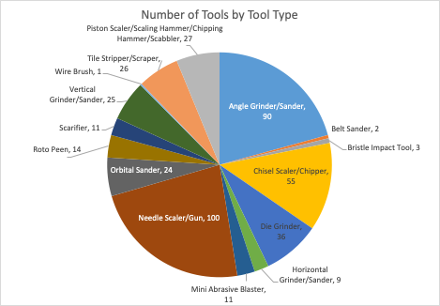
Literature Review
Literature Review Database
435 Unique Tools
15 Distinct Categories
  One Hand Tool
Five NSRP / Navy Studies

Slide 6
Power Tool Categorization
What type of motion does the tool use to operate (reciprocating or rotary motion)?
Relative to the substrate, in which plane of motion does the tool operate (parallel or perpendicular to the substrate)?

Slide 7
Literature Review – SSPC Power Tool Update
Generic Categories
Grinding Wheels Vitrified
Coated Abrasive Discs/Belts
Coated Abrasive Flaps
Non-woven Abrasive
  Unified
  Flap
Nonmetallic Brush (Abrasive filled)
  Extruded
  Molded
Metallic (Wire) Brush
Rotary Flapper Metallic/Ceramic
Cutter Bundle Metallic/Ceramic
Needle Gun
Scaler or Chisel
Bristle Impact
SP11, SP15
Removes Initial Condition (SSPC VIS 3) | Complete Millscale (A)
 | Partial Millscale (B)
 | Complete Rust (C)
 | Rust and Pitting (D)
 | Thin Coating Over Blast Cleaned Surface (E, F)
 | Weathered Multi-coat System (G)
Remove Pack Rust
Remove Stratified/Laminar Rust
Coating Removal (THICK FILM over 40 mils
Create Anchor Profile | 1 mil
 | 2 mils
 | 3 mils
 | 4 mils
Clean Large Pits (define “large pits”) up to 3 mm deep?
Ability to access complex geometries
Minimal Damage to Existing Profile
Feather Edges
Welds | Clean
 | Profile
Roughen Existing Coating
Cold Spark
Non-Spark
Controlled Emissions (e.g., Vacuum Capability)

Slide 8
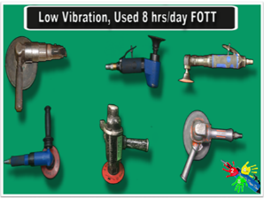
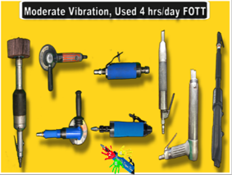
Power Tools used in Shipyards Selected for Laboratory Testing
Grinders (four types)
  Test two angle grinders and two die grinders
Needle Gun (two types)
Bristle Impact Tool
Palm Sander, Cup Brush, Clean-N-Strip
Roto Peen
Scarifier
Vacuum Blast

Slide 9
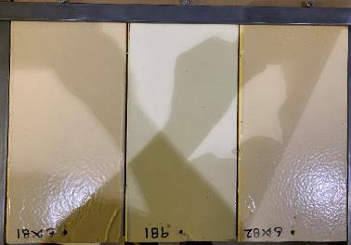
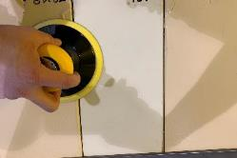
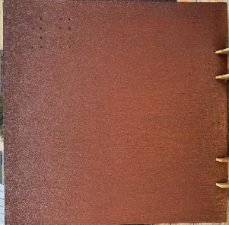
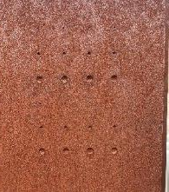
Test Scenarios -1 to 3 (of 8)
Flat panels (1/8" by 24" by 24") coated with a Navy Topside system (Epoxy/ Polysiloxane) will be used to evaluate how effectively tools remove a standard coating.
A configuration of aged, coated test panels will be used to determine how effectively tools removed aged tank epoxies and how well they get into tight crevices.
Flat panels (1/8” by 24” by 24”) with 6 rows of 4 machined pits (varying sizes) will be rusted to an SSPC VIS-3.

Slide 10
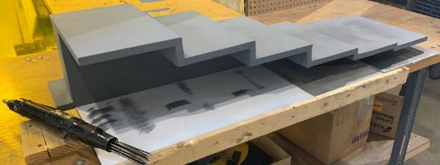
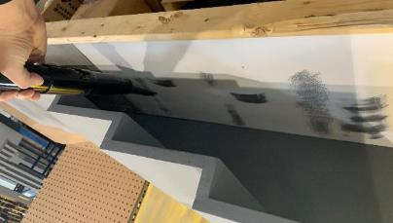
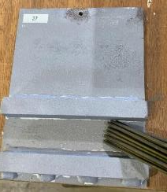
Test Scenarios - 4 to 6 (of 8)
Flat panels (1/8” by 24” by 24”) with mil scale will be used to determine how quickly the tools remove mill scale.
A wooden fixture will be used to determine how well tools can access tight configurations. The wooden fixture creates an interfering surface parallel to the plate being cleaned at 6 distinct distances - 8, 6, 4, 2, 1, and 1/2-inches
Panels that have welded parallel bars will be used to evaluate a tools ability to clean welds and difficult to access corners. The panel will be abrasively blasted then coated with a Navy epoxy 8-12 mils thick.

Slide 11
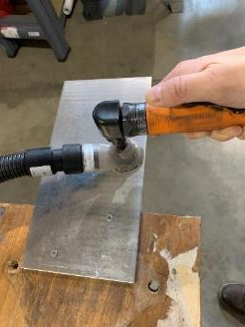
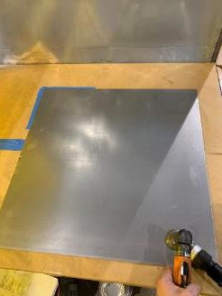
Test Scenarios - 7 to 8 (of 8)
Flat (1/8” by 24” by 24”) cold rolled steel will be used to determine how effectively tools work over a 1-hour period without changing consumables.
Flat (1/8” by 6” by 12”) bare 6061-T6 aluminum will be used to quantify how each tool impacts aluminum surfaces.

Slide 12
Testing Metrics
Ability of a tool to achieve an SSPC SP-11 (SP-10 for Vacuum blast) finish in a variety of surface conditions and geometries (pits, corners, crevices)
  Productivity
  Cleanliness
  Surface profile
  Surface roughness
  Ergonomics

Slide 13
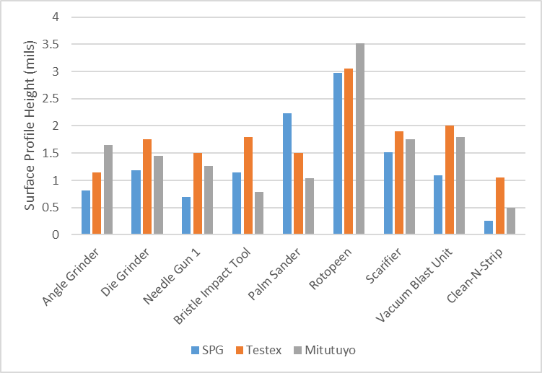
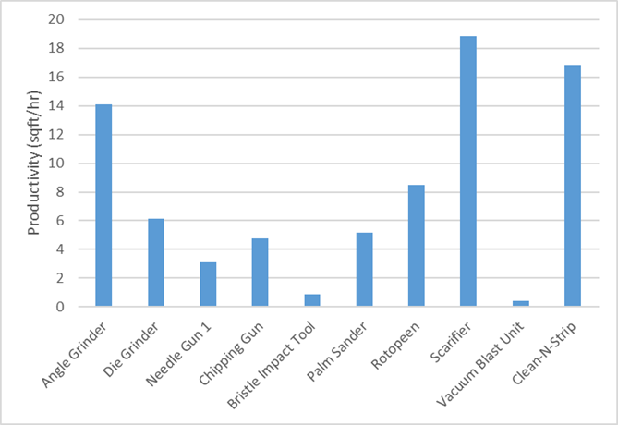
Assessment 1: Epoxy/ Poysiloxane Results
Most profile heights between 1 and 1.5 mils
Scarifier created slightly deeper profile; Rotopeen created much deeper profile
Angle Grinder, Clean N Strip, and Scarifier most efficient at removing 009-32 topside system
Bristle blaster tool and Vacuum Blast were least efficient
Rotary tools other than Clean N Strip generated large amounts of dust

Slide 14
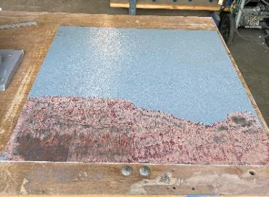
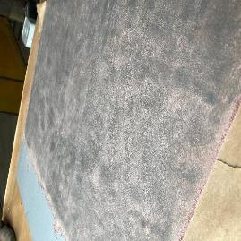
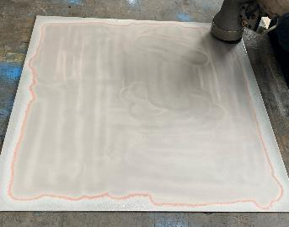
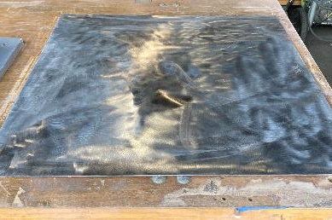
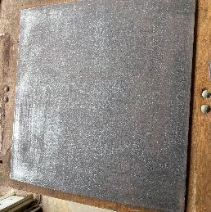
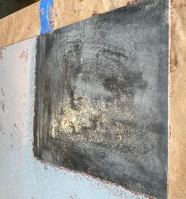
Assessment 1: Epoxy/ Poysiloxane Photos

Slide 15
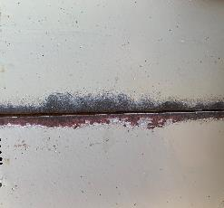
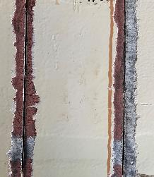
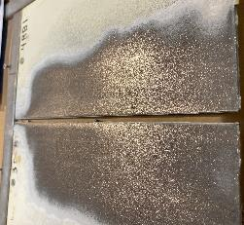
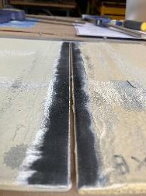
Assessment: 2 Adjacent Panels
Most power tools struggled with the high coating thickness
None of the tools were able to completely clean the 1/8” edge in the gap between the panels.
  The needle gun, chipping gun, and rotopeen performed better than the other tools but still were unable to clean the entire crevice.
  The angle grinder, scarifier, and Clean-N-Strip attachment were essentially unable to access the crevices
 | Angle Grinder | Die Grinder | Needle Gun 1 | Chipping Gun | Bristle Impact Tool | Rotopeen | Scarifier | Vacuum Blast Unit | Clean-N-Strip
Crevice Cleanliness (%) | 0 | 15 | 25 | 30 | 10 | 30 | 0 | 10 | 5

Slide 16
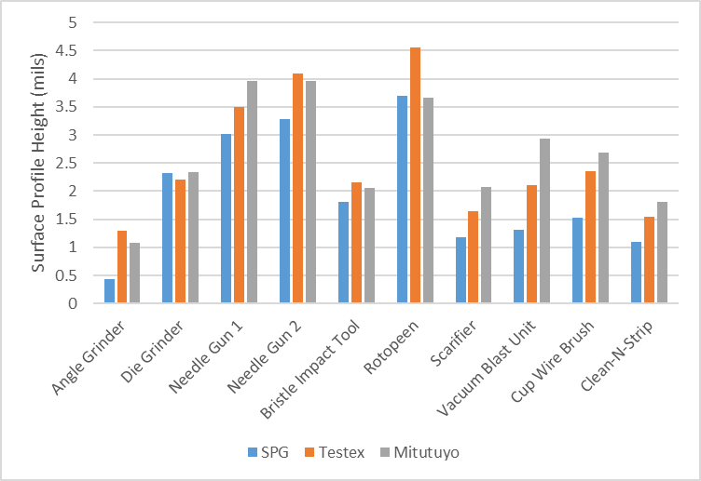
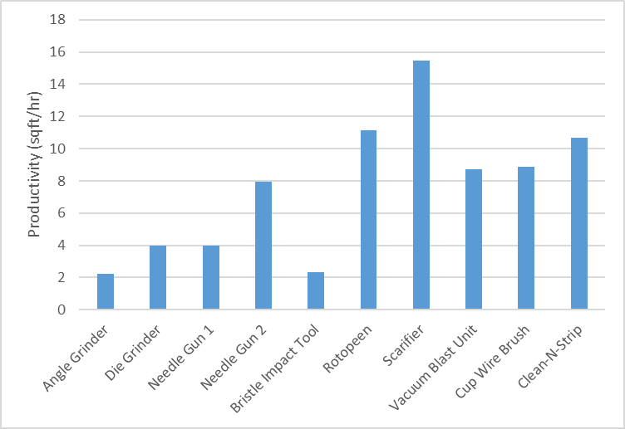
Assessment 3: Rust Grade C Removal
The scarifier and rotopeen tools had the highest production rates.
The Angle Grinder, Cup Wire Brush, and both needle guns could only clean to an SP15 level of cleanliness
Needle guns and the cup wire brush were the only tools other than the blast unit that could effectively access the large pits. The bristle impact tool and Clean-N-Strip tools were able to access the upper edges of the pits, but the deepest portion in the center was not able to be touched by these tools.

Slide 17
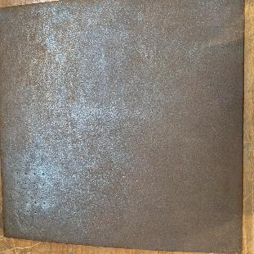
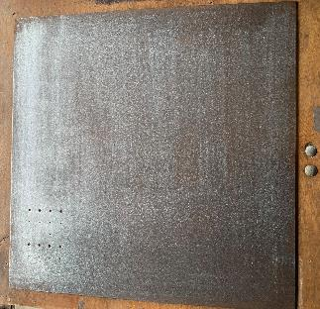
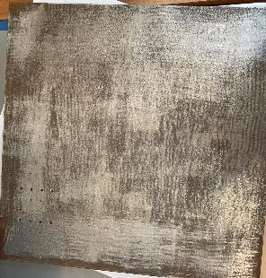
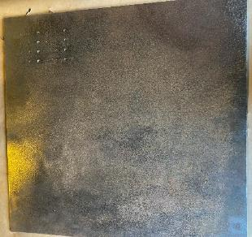
Assessment 3: Rust Grade C Removal
 | Angle Grinder | Die Grinder | Needle Gun 1 | Needle Gun 2 | Bristle Impact Tool | Rotopeen | Scarifier | Vacuum Blast Unit | Cup Wire Brush | Clean-N-Strip
Cleanliness of the ¼-inch diameter Pit (%) | 0 | 0 | 90 | 80 | 50 | 0 | 5 | 100 | 70 | 50

Slide 18
Assessment 3: Ergonomics
Tool | Noise (dB) | Vibration RMS (m/s²) | Time to reach EAV (Hours) | Time to reach ELV (Hours)
Angle Grinder | 102.8 | 2.0170 | 12:17 | >24
Die Grinder | 94.5 | 2.6430 | 7:24 | >24
Needle Gun 1 | 108.7 | 2.1093 | 11:14 | >24
Needle Gun 2 | 114.8 | 1.9321 | 13:24 | >24
Bristle Impact Tool | 99.5 | 2.0836 | 11:31 | >24
Rotopeen | 118.2 | 3.0500 | 5:22 | 21:30
Scarifier | 121.6 | 10.1242 | 0:29 | 1:57
Vacuum Blast Unit | 115.0 | N/A | N/A | N/A
Cup Wire Brush | 88.2 | 2.0975 | 11:22 | >24
Clean-N-Strip | 93.0 | 2.1950 | 10:23 | >24
Chipping Gun | 120.8 | 18.1513 | 0:09 | 0:36

Slide 19
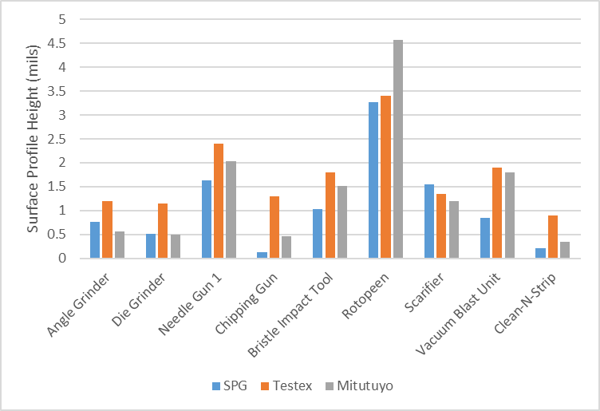
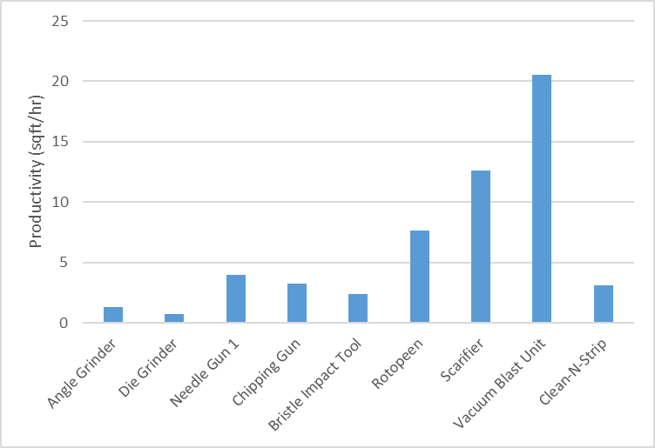
Assessment 4: Mill Scale
Similar trends to what was observed in Assessments 1-3
Rotopeen created deepest profile
Clean N Strip attachment created minimal profile
All rotary tools (angle grinder, die grinder, Clean N Strip) struggled to remove heavy layer of mill scale

Slide 20
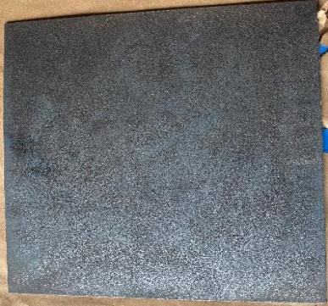
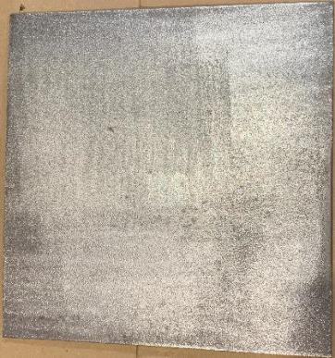
Assessment 4: Mill Scale
All tools cleaned to SP-11 cleanliness except for needle guns, which again seemed to push mill scale into profile (left photo needle gun, right photo rotopeen)

Slide 21
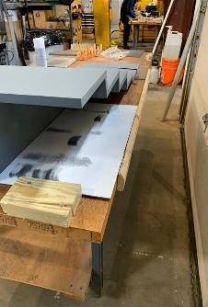
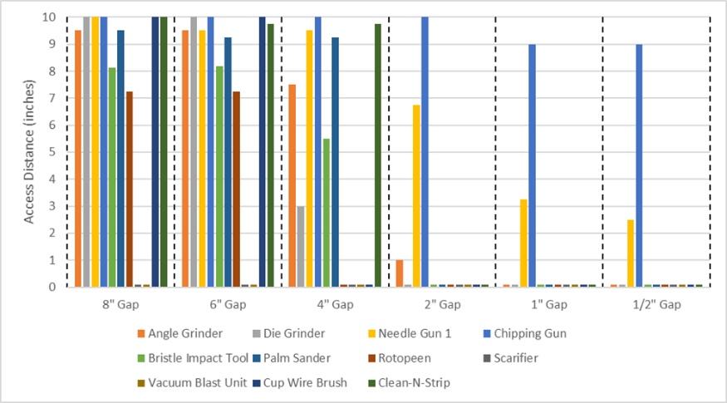
Assessment 5: Narrow Gap
Scarifier and Vacuum Blast Unit: The tools were too large to fit into any of the gaps.

Slide 22
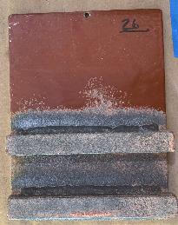
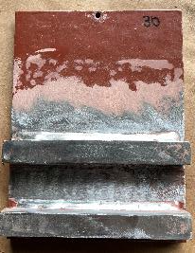
Assessment 6: Weld Cleaning
Die grinder, Model 18 needle gun, Vacuum Blast and chipping gun most effective at cleaning welds
Palm sander and Clean N Strip were effective but limited by radius of abrasive disc
Angle grinder, bristle blaster, and rotopeen were ineffective
 | Angle Grinder | Die Grinder | Needle Gun | Chipping Gun | Bristle Impact Tool | Palm Sander | Rotopeen | Vacuum Blast Unit | Cup Wire Brush | Clean-N-Strip
Weld Cleanliness (%) | 5 | 80 | 90 | 80 | 0 | 60 | 0 | 95 | 30 | 65

Slide 23
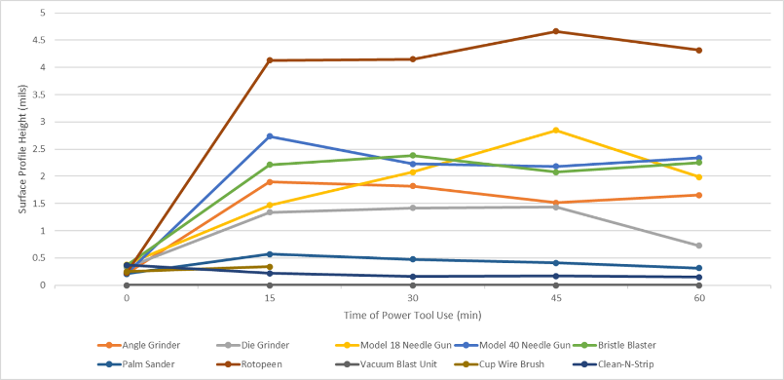
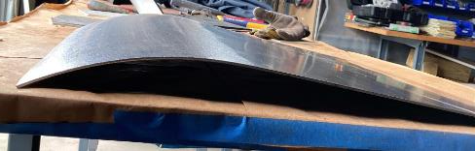
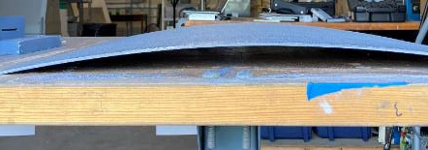
Assessment 7: Cold Rolled Steel
No real change in surface profile over time seen.
Needle Gun 2 and rotopeen were bowed significantly after hour of surface preparation

Slide 24
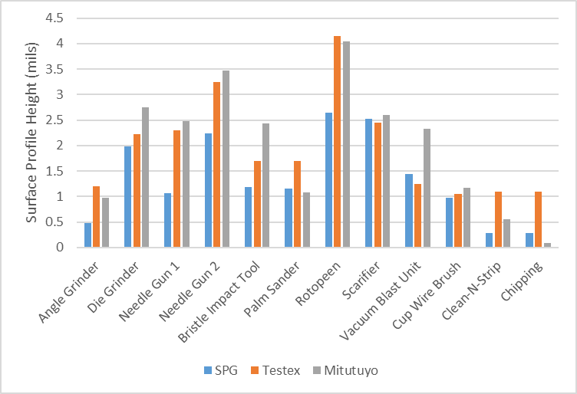
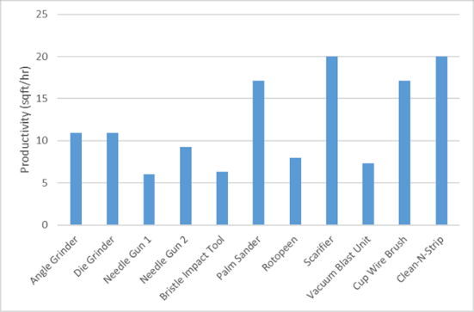
Assessment 8: Bare Aluminum
Productivity of each power tool was higher than on steel
Scarifier, Clean N Strip, cup wire brush, and palm sander were most efficient
  Scarifier created a more aggressive profile
  Clean N Strip still did not create profile
All profile heights were consistently higher than those measured on steel in Assessments 1-4
Relative “ranking” of profile depths remained the same

Slide 25
Shipyard Demonstration
Conducted to collect data from various power tools and to witness areas where the tools are commonly used during the shipbuilding process.
Five different vessels were observed for power tool use and operations.
The observed tools were:
  a 7-inch sander,
  4.5-inch sander,
  needle gun,
  rotary burr on Angle grinder (Used in corners)
  one instance of a mobile blast unit.
  Roughness data, electronic surface profile data, conductivity, and noise levels were collected on each vessel at varying locations

Slide 26
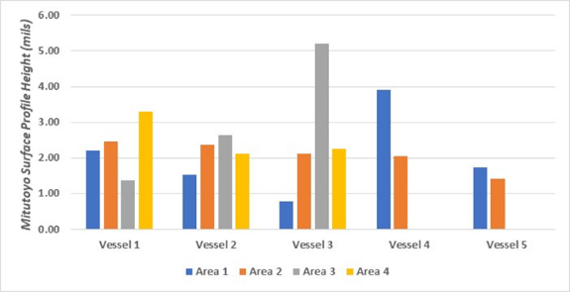
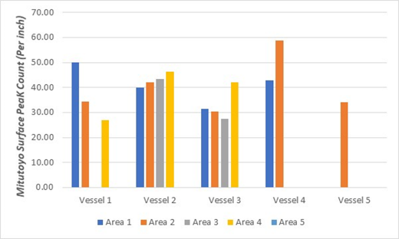
Shipyard Demonstration – Surface Profile
All data shown was on areas cleaned with 4.5-inch and 7-inch 36-grit aluminum oxide sanding discs, except :
  Area 3 on Vessel 3 (needle gun)
  Area 1 on Vessel 4 (vacuum blast unit)
  Both areas on Vessel 5 (4.5” Cubitron discs).
Note: All readings were recorded on an SP-11 cleaned area with the exceptions of Area 3 on Vessel 2, and Areas 3 and 4 on Vessel 3 which were all taken on SP-3 areas with some coating still intact.

Slide 27
Shipyard Demonstration – Surface Profile
 | Noise (dB) | Tool
Vessel 1 | 96.3 | 4.5" Grinder
Vessel 3 | 104.9 | Needle
Vessel 4 | 102.5 | Needle
 |  | Conductivity
 | Tool | uS/cm | mg/cm
Vessel 1 | 4.5/7" (36 grit AlOX) | 26 | 31
Vessel 2 | 4.5/7" (36 grit AlOX) | 16 | 19
Vessel 3 | 4.5/7" (36 grit AlOX) | 15 | 18
Vessel 4 | Needle Gun | 19 | 23
Note: these areas did not yet receive an SP-1 solvent wipe treatment.
Additional Observations
Most power tool operations took place in areas with multiple complex shapes, sharp corners/ edges, crevices, and welds. Flat areas found on floors and bulkhead walls.
Most power tool operations were completed using a combination of tools and not just one single tool.
Surface profile readings were seen to vary when using the Mitutoyo stylus profilometer compared to the SPG probe.

Slide 28
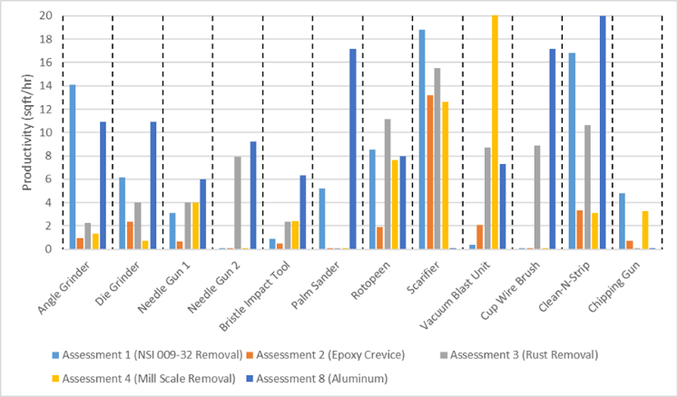
Summary and Conclusions (Part 1 of 4)
Tools vary in performance depending on the surface being prepared or coating being removed
For a given task, some tools are more applicable than others

Slide 29
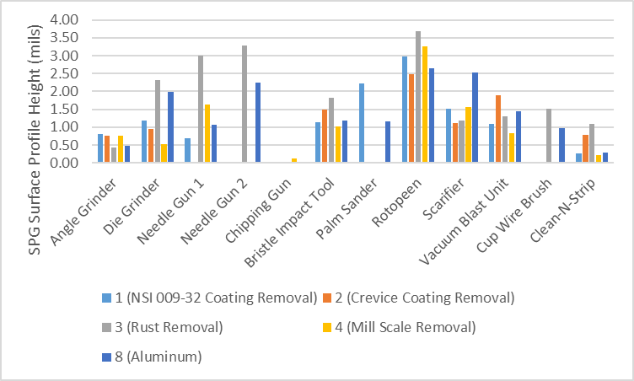
Summary and Conclusions (Part 2 of 4)
Surface Profiles can vary greatly from tool to tool and from substrate to substrate.
Important to consider these differences and effects when selecting a tool to achieve a target surface profile.

Slide 30
Summary and Conclusions (Part 3 of 4)
Results suggest the following:
A combination of tools should be used for coating removal and subsequent surface preparation.
  For example, for a small section on a topside bulkhead aboard a Navy ship, a proper attachment could be used to efficiently remove the topside coating system, then a needle gun could be used to create a surface profile on the bare substrate.
For large areas of substrate to be prepared, tools with low production rate (i.e., bristle impact tool or angle grinders with small discs) should not be used.
The tools found to induce large amounts of vibration (i.e., chipping gun, scarifier, rotopeen) should be used only in limited periods of time per operator.
  Prolonged use of these tools can cause damage to operators over long periods.

Slide 31
Summary and Conclusions (Part 4 of 4)
Results suggest the following:
The data collected suggests that surface profile heights over bare or rusted surfaces after preparation with a given tool will be higher than surfaces after coating removal and subsequent substrate preparation with the same tool.
Production rates for tools were found to be lower than what was reported in previous studies discussed in the Literature Review section of this report. It is important for end users to evaluate productivity data of new tools to gather metrics of effectiveness.

Slide 32
Path Forward Recommendations
Perform power tool evaluations on use of multiple power tools at time
Provide guidance on best combination of power tools for various shipyard scenarios
Questions?
Email: eshoyer@elzly.com

