Slide 1
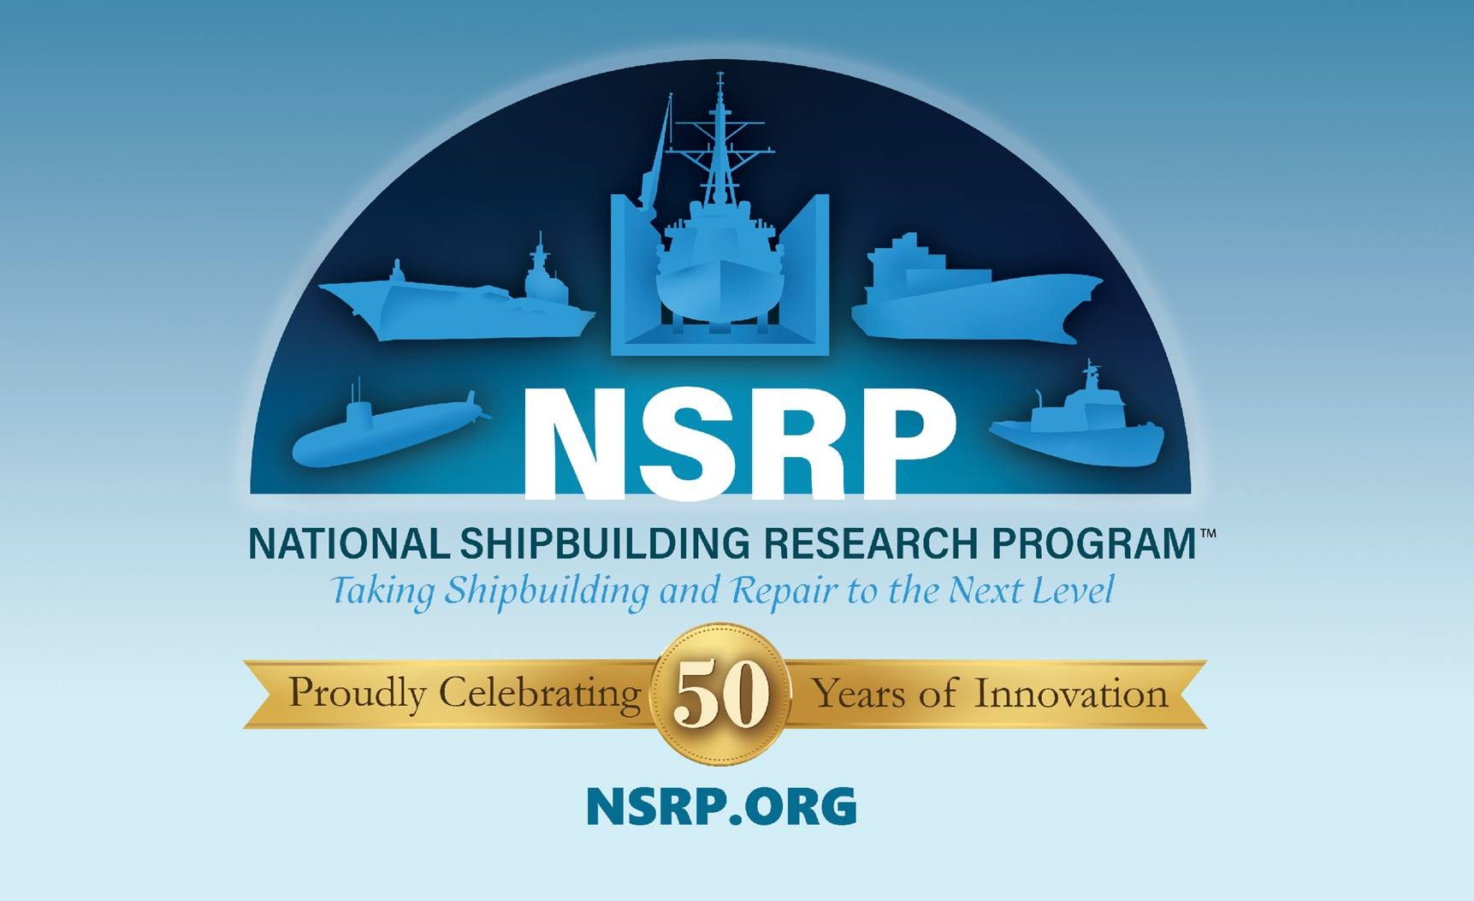

Slide 2
NSRP Program Update
Surface Preparation and Coatings Panel Meeting
September 21, 2021 MegaRust 2021
Ryan Schneider (ATI Project Manager)

Slide 3
NSRP Mission
The mission of the National Shipbuilding Research Program is to reduce the total ownership cost and improve the capabilities of both United States Government and U. S.-flag commercial ships.
The Program accomplishes this mission by providing a collaborative framework to manage, focus, develop and share research & development, and leverage best practices in shipbuilding and ship repair.
Notes:
NSRP mission is centered around reducing the total ownership cost of ships and the key to the program is the collaborative framework.

Slide 4
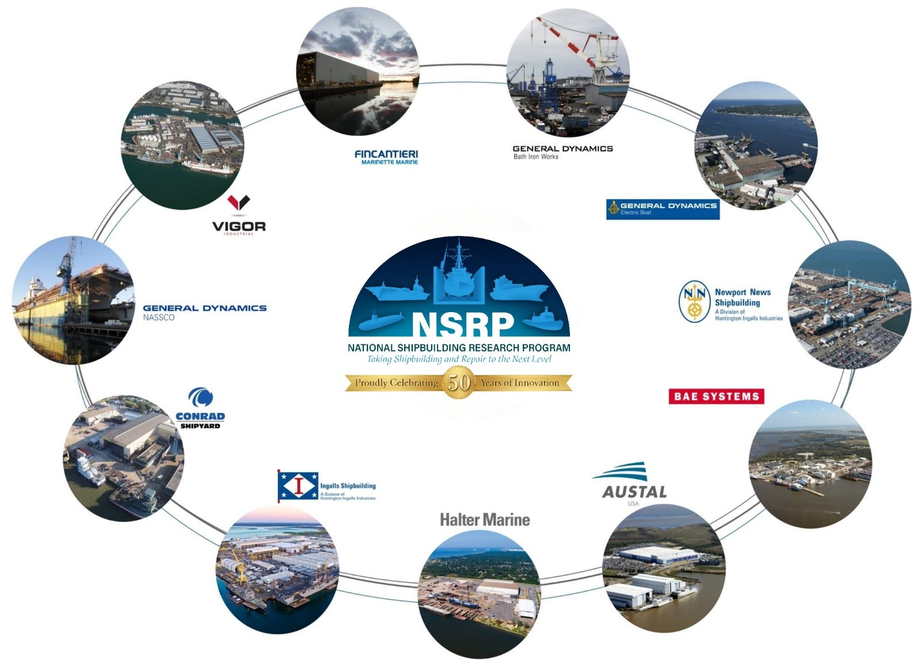
NSRP Collaboration
Notes:
NSRP is an industry-led collaboration with the U.S. Navy focused on reducing the total ownership costs of ships for the Navy and National Security Customers
10 Member Shipyard Collaboration
Allows competitors to partner on common shipbuilding/ship repair problems to benefit of industry and their clients as a whole
Industry cost share multiplies impact of every government dollar provided
Sponsored by NAVSEA and 6 Program Executive Offices
NAVSEA 06, PEO C4I, PEO Aircraft Carriers, PEO IWS, PEO USC, Team Ships, and Team Submarine collectively provide ~$13.5M in annual funding

Slide 5
Anti-Trust Rules
Regarding your company’s and/or your competitor’s product & services:
  Do not discuss current or future prices.
  Do not discuss any increase or decrease in price.
  Do not discuss pricing procedures.
  Do not discuss standardizing or stabilizing prices.
  Do not discuss controlling sales or allocating markets for any product.
  Do not discuss future design or marketing strategies.
Notes:
Since NSRP is a collaboration of competing shipyards, it is important to cover the Anti-Trust rules. (read slide)

Slide 6
Anti-Trust Rules
Regarding your company’s and/or your competitors’ selection of their supplier companies:
  Do not discuss refusing to deal with a company because of its pricing or distribution practices.
  Do not discuss strategies or plans to award business to remove business from a specific company.
Regarding your company’s and/or competitors’ trade secrets:
  Do not discuss trade secrets or confidential information of your company or any other participant.
Notes:
Since NSRP is a collaboration of competing shipyards, it is important to cover the Anti-Trust rules. (read slide)

Slide 7
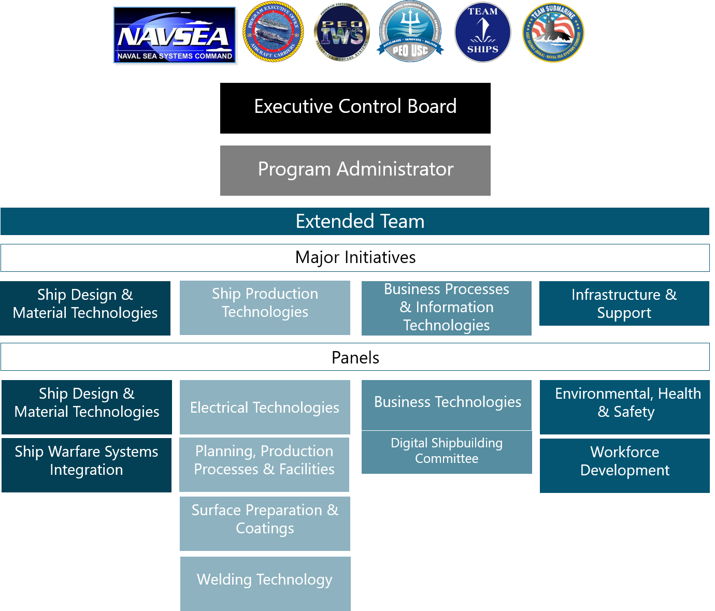
FY21 Organization
Notes:
7 sponsors who provide funding
11 member Executive Control Board
Executive Director and staff
Extended Team is divided into 4 Major Initiative Areas which align with the shipbuilding enterprise
10 Panels

Slide 8
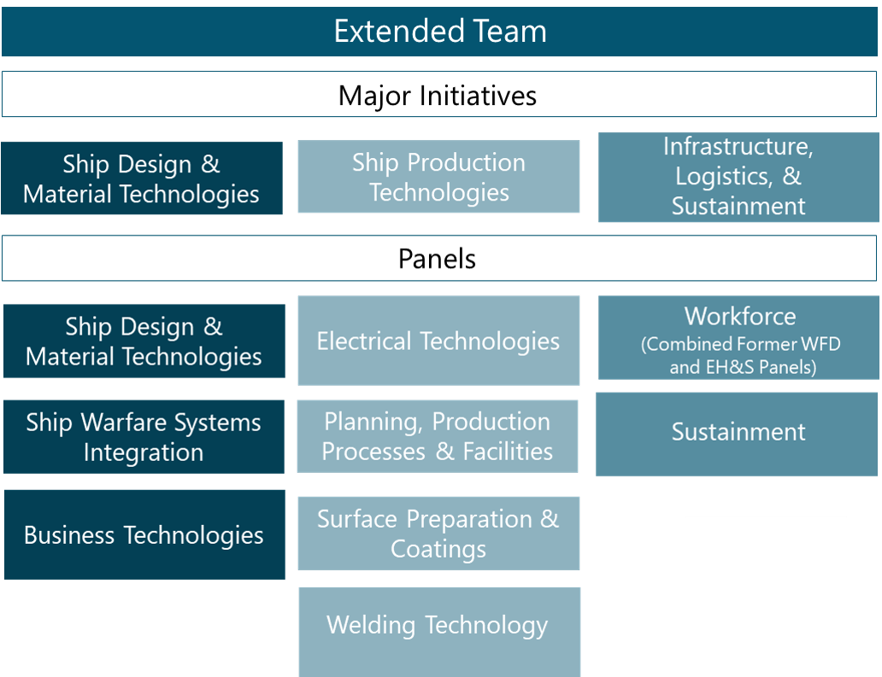
FY22 Organization
Notes:
7 sponsors who provide funding
11 member Executive Control Board
Executive Director and staff
Extended Team is divided into 4 Major Initiative Areas which align with the shipbuilding enterprise
10 Panels

Slide 9
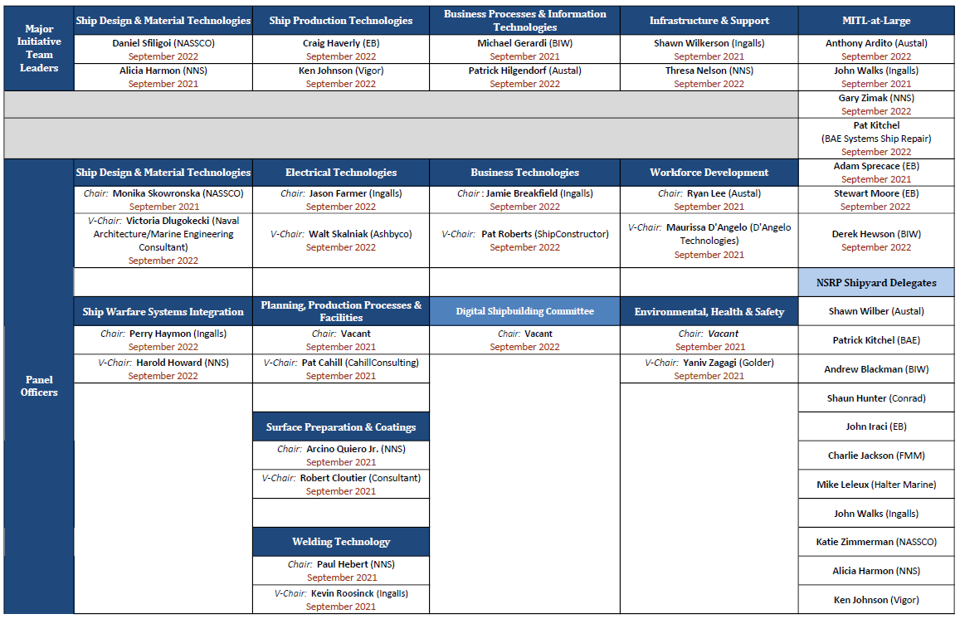
Current NSRP Extended Team
Notes:
7 sponsors who provide funding
11 member Executive Control Board
Executive Director and staff
Extended Team is divided into 4 Major Initiative Areas which align with the shipbuilding enterprise
10 Panels

Slide 10
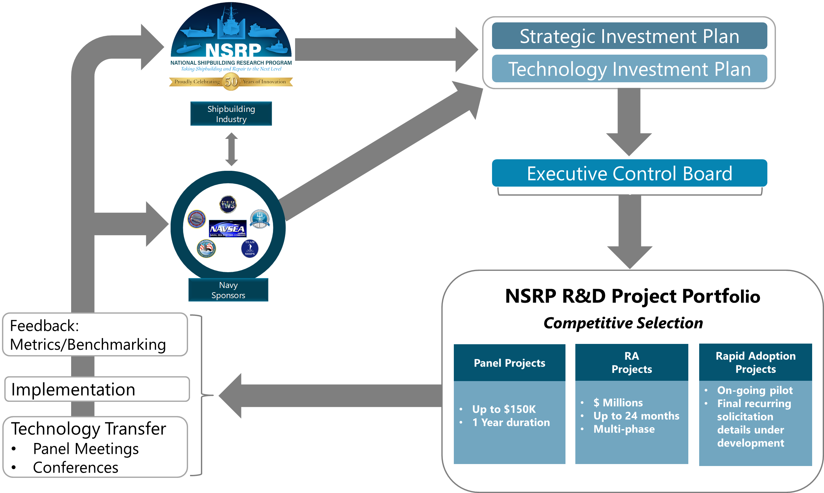
Operations
Notes:
Industry & Navy stakeholders provide recommendations on priority issues related to NSRP’s mission and objectives; those recommendations provide the basis for the Strategic Investment Plan and Technology Investment Plan which outlines how the program operates and identifies high priority issues and current industry challenges of particular interest to the program.
ECB serves as the governing body and approves and awards projects.
The Strategic Investment plan directs the project selection process and defines relevant ad hoc initiatives. These projects and special initiatives form the program portfolio and are carried out within the industry through the execution of projects, panel meetings, and conferences.
Feed back is then relayed back to Industry and Navy stakeholders who incorporate recommendations for the next cycle.

Slide 11
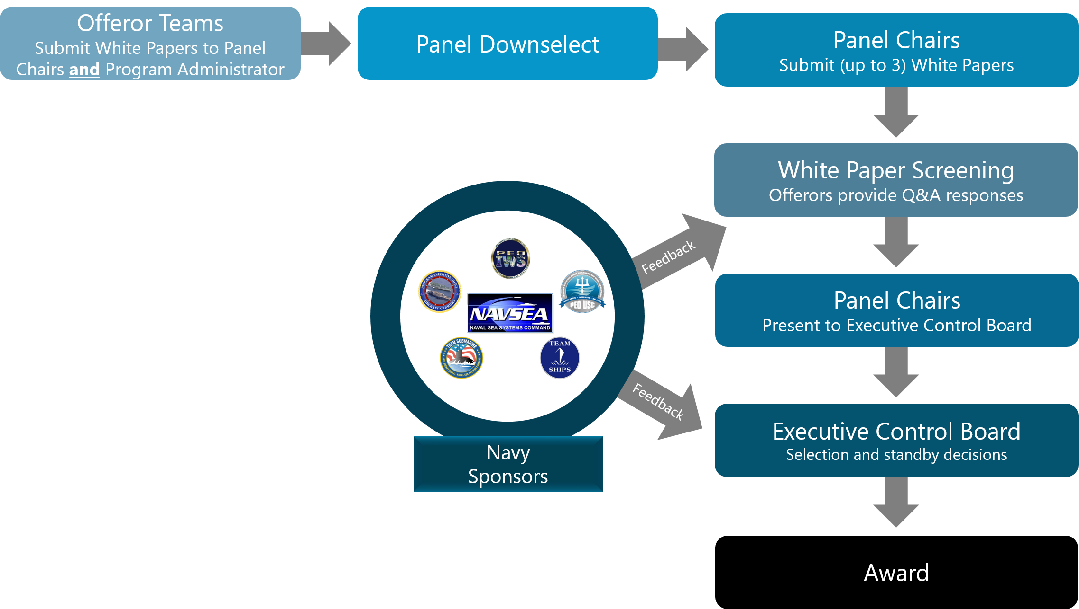
Panel Project Process

Slide 12
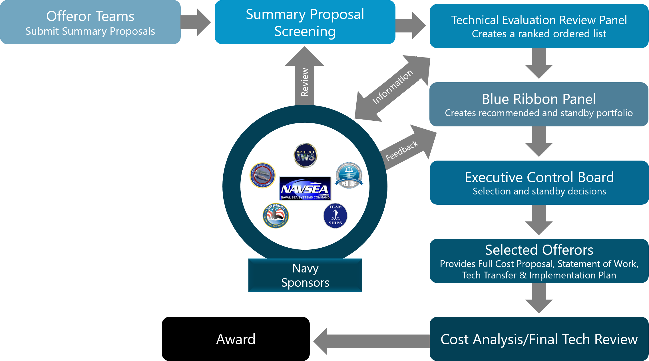
Research Announcement (RA) Process

Slide 13
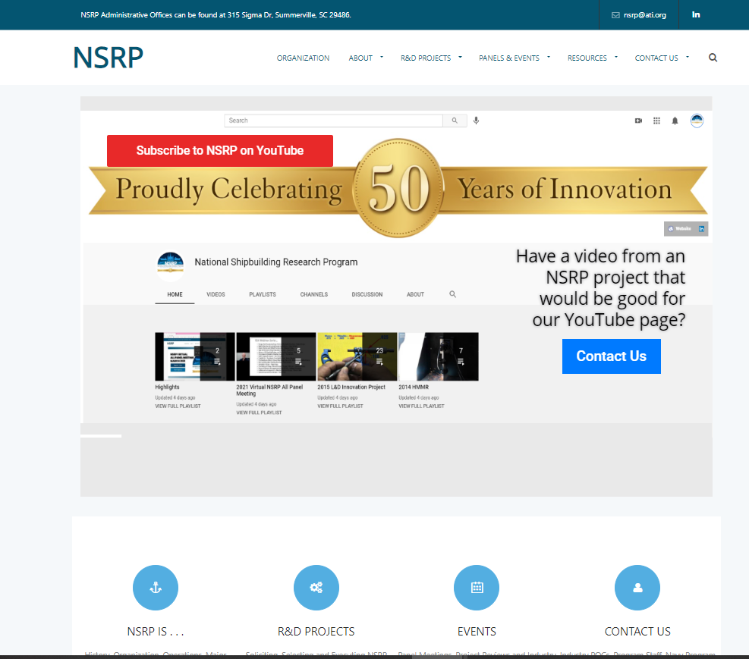
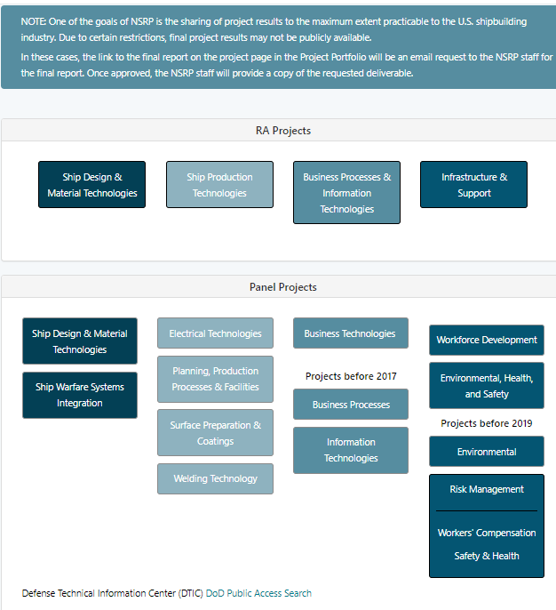
NSRP.org – Latest Info and Project Portfolio

Slide 14
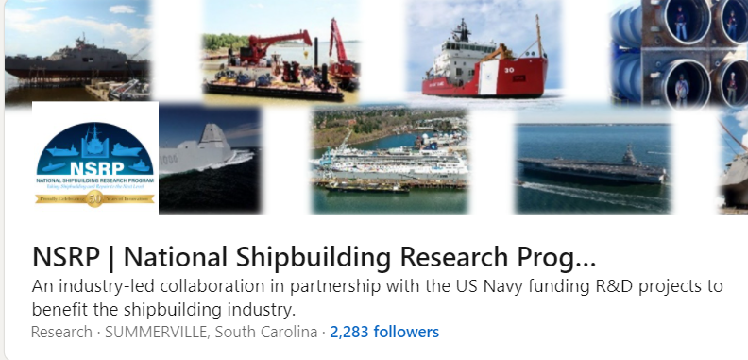

NSRP LinkedIn Page and Mailing Lists
Follow NSRP on LinkedIn to get the latest Program updates, event notifications, shipyard updates, and networking opportunities.
Email NSRP.@ati.org to subscribe to the NSRP General Info mailing lists or individual panel mailings lists.

Slide 15
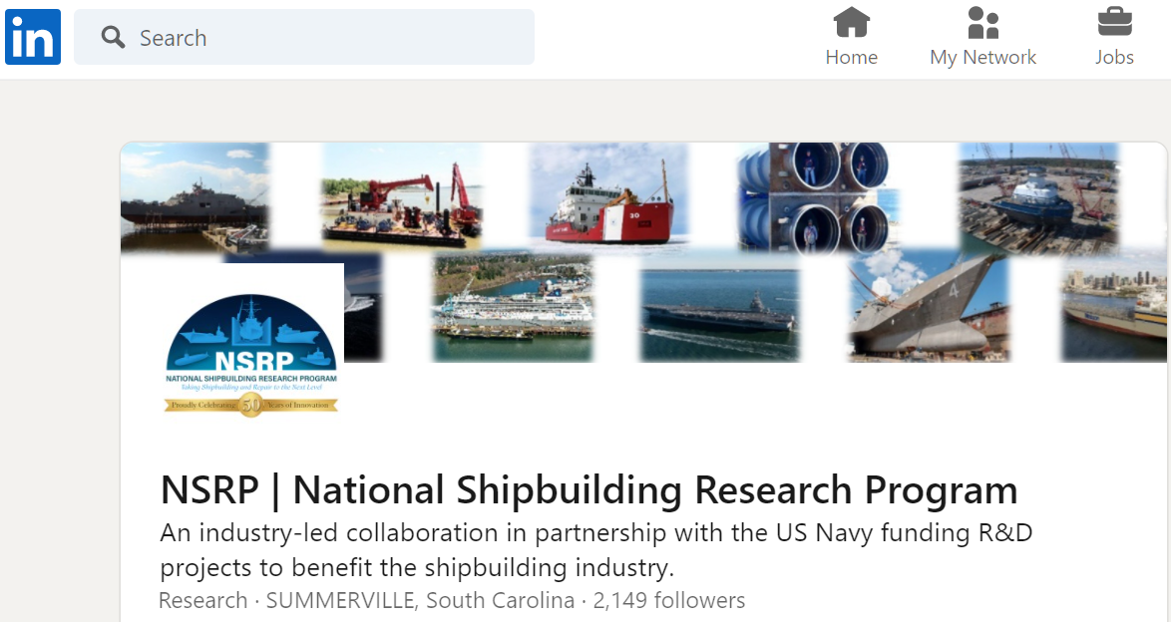
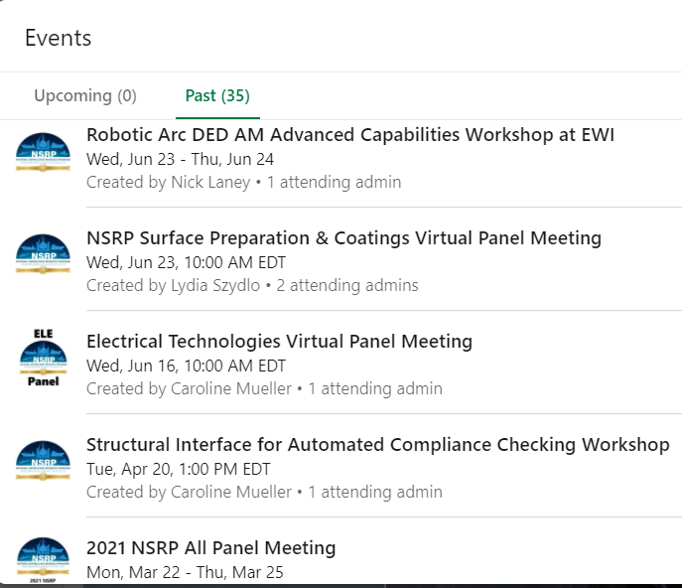
NSRP LinkedIn Page

Slide 16
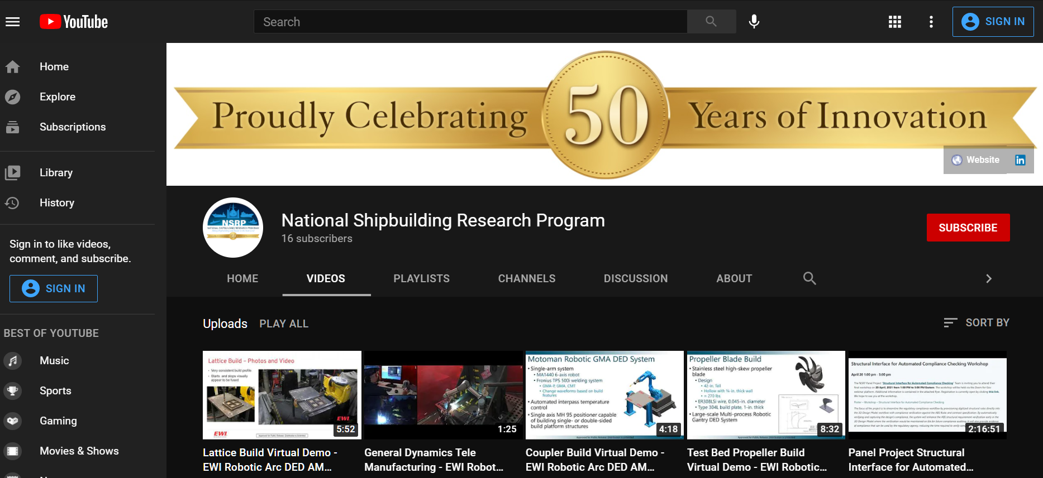
NSRP YouTube Page

Slide 17
Questions?

Slide 18
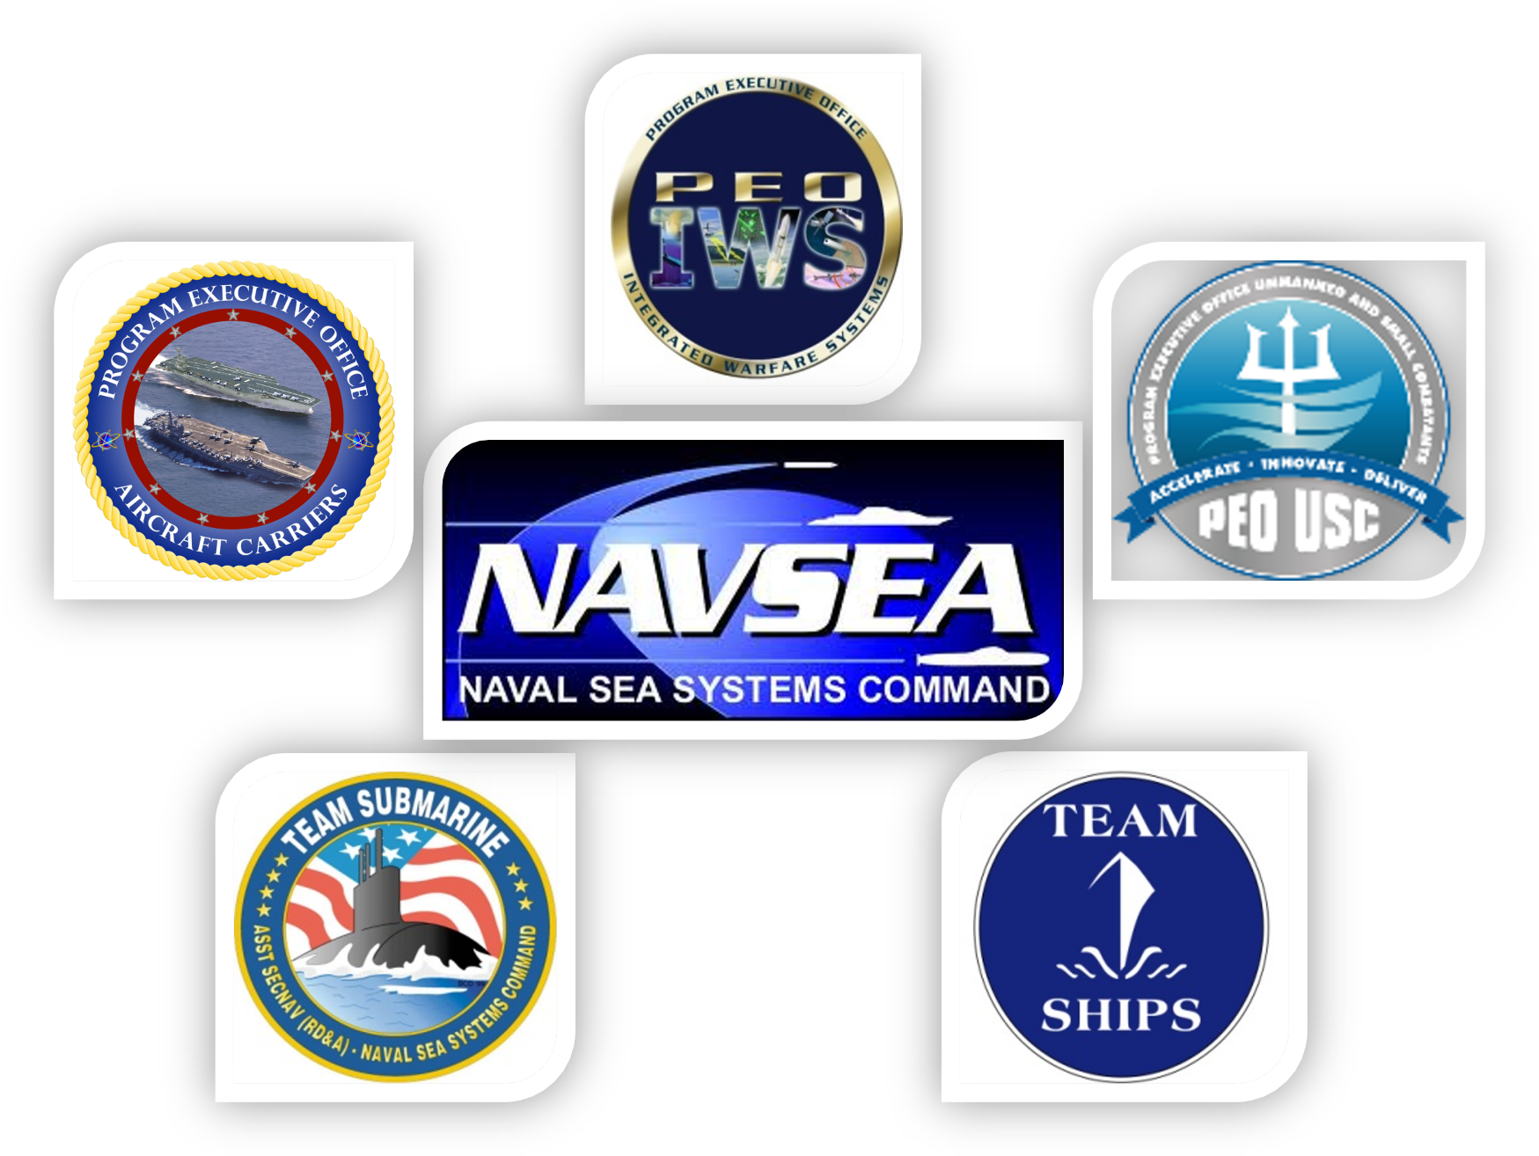
Special Thanks to Our Funding Sponsors!!!

Slide 19
Business Processes and Information Technologies (BP&IT) Major Initiative
The Business Processes and Information Technologies Major Initiative focuses on emerging technology research and education, and the blending of process and technology to manage information and develop advanced solutions that support the product lifecycle from concept to disposal. This Major Initiative is executed through the Business Technologies (BT) Panel.
Sub-Initiatives Include:
Digital Shipbuilding
Cybersecurity Compliance, Solutions, Education & Awareness
Information Management
Emerging Technologies & Business Processes
*Beginning 1 October 2022, the Business Processes and Information Technologies Major Initiative will no longer be a distinct MI and the BT Panel will be aligned with the Ship Design and Material Technologies Major Initiative.
Notes:
NSRP mission is centered around reducing the total ownership cost of ships and the key to the program is the collaborative framework.

Slide 20
Infrastructure and Support (I&S)
Major Initiative
Infrastructure and Support is a Major Initiative area focused on functions that support all direct shipbuilding and sustainment processes. The Major Initiative consists of two panels:
Environmental, Health, and Safety (EH&S) Panel
The EH&S panel’s mission is to research, develop, and sustain current and emerging environmental, health and safety issues to promote and improve health and safety, wellness, and environmental stewardship of shipyards. The panel provides an open and interactive forum for technology transfer and broad industry interaction in support of the NSRP mission to reduce the total cost of ship construction and repair.
Workforce Development Panel
The Workforce Development panel’s mission is to reduce the cost of shipbuilding through effective projects centered on training and development, human resources, change management and technology transfer. It ensures that all NSRP panel projects include consideration of issues regarding human capital as part of project implementation.
*Beginning 1 October 2022, the Infrastructure and Support Major Initiative will no longer be a distinct MI. A new Infrastructure, Logistics, & Sustainment Major Initiative will be established. This new Major Initiative will combine the EH&S and Workforce Development Panels into a single entity and stand up a new Sustainment Panel.
Notes:
NSRP mission is centered around reducing the total ownership cost of ships and the key to the program is the collaborative framework.

Slide 21
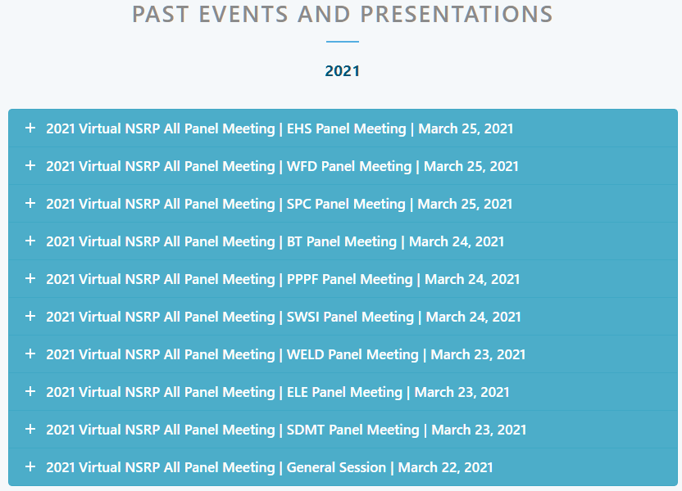
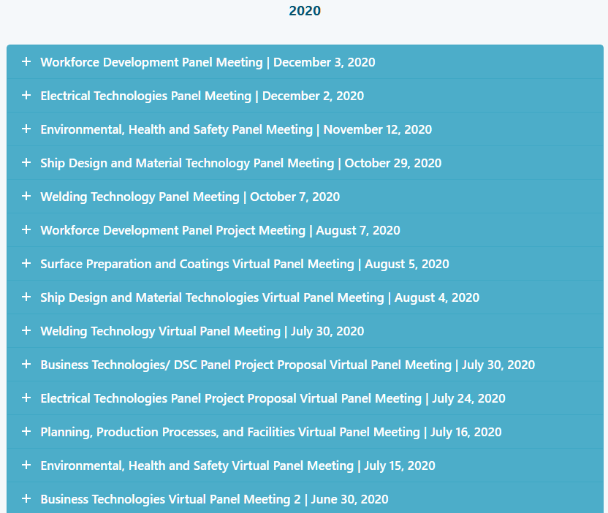
NSRP.org – Past Events and Presentations

