Slide 1
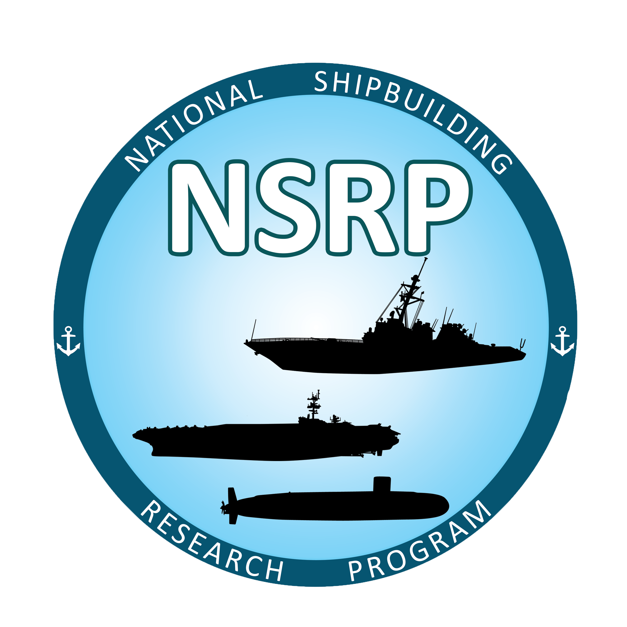
Standardization and Digitization of Visual Inspection for Shipbuilding
NSRP Surface Preparation and Coatings (SPC) Project

Slide 2
Past NSRP SPC Projects
An initial project successfully modified COTS (Commercial Off-The-Shelf) technology to output QA data in accordance with requirements of NAVSEA Standard Item 009-32.
NSRP SPC Projects completed
Phase I: Electronically populated the NSI 009-32 appendices
Phase II: Customized app functionality, OOS flagging, storage recall and communication between government and contractor
Phase III: Implementing paperless paint

Slide 3
Past NSRP SPC Projects
Once the system was developed, the project team worked with Regional Maintenance Center QA representatives to identify a path forward to integrate the paperless capability into the Navy Maintenance process.
Features which take advantage of the paperless technology in the QA process include:
Electronic event notification
Auto-flag out of spec conditions
Automate Non-Conformance reporting and resolution
Quality control reports for contractor process improvement
Deck plate sign offs
Audit tracking for reports after sign off

Slide 4
Benefits of Paperless QA System
PROCESS IMPROVEMENT | COST REDUCTION
Increase transparency of inspection to the welding process | Minimize or eliminate delays associated with adjudication of out-of-spec items
Improve efficiency of inspection efforts | Reduce inspection cost
Transmit inspection data efficiently to decision-makers | Expedite decision making, reducing analysis cost and associated downtime
Archive inspection data for future use | Eliminate costs incurred to re-create history for assessments
Leverage inspection data to its fullest extent | More accessible information could be used for more efficient planning, facilitating process improvement, troubleshooting, etc.

Slide 5
Current NSRP SPC Project:
Standardization and Digitalization for Visual Inspection for Shipbuilding
Visual Inspection Technology
Offline capable easy-to-use field data collection tool
Document issue resolution in real time
Rapid implementation with quick ROI
Quickly update risk profile and asset strategy
Organizes and simplifies the collection, workflow, aggregation and reporting of visual inspection data
Standardizes responses to see trends

Slide 6
Business Case
Visual Inspection with TruQC
Task | Before TruQC | After TruQC
Preparation | 60 minutes | 10 minutes
Inspection | 8 hours (avg) | 4 hours
Report Generation | 4 hours | 5 minutes
Engineer Review | 1 hour | 1 hour (now real-time updates)
Conflict Resolution | (days) | (hours)
Strategy Update | 1 hour | 1 hour

Slide 7
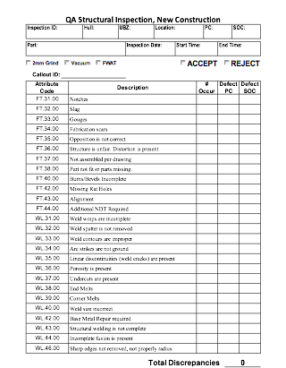
Standardization & Digitalization for Visual Inspection for Shipbuilding and Repair
Identified two inspections:
QA Structural Inspection, New Construction Report
Compartment Closeout Report

Slide 8
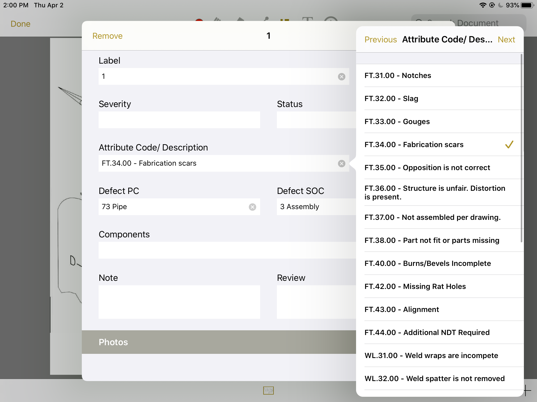
QA Structural Steel – New Construction Report Lists
Attribute Code/Description
Notches
Slag
Gouges
Fabrication scars
Opposition is not correct
Structure is unfair. Distortion is present.
Not assembled per drawing.
Part not fit or parts missing
Burns/Bevels Incomplete
Missing Rat Holes
Alignment
Additional NDT Required
Weld warps are incomplete
Weld spatter is not removed
Weld contours are improper
Arc strikes are not ground
Linear discontinuities (weld cracks) are present
Porosity is present
Undercuts are present
End Melts
Corner Melts
Weld size incorrect
Base Metal Repair required
Structural welding is not complete
Incomplete fusion is present
Sharp edges not removed, not properly radius
Defect PC
Steel
Pipe
Machinist
Ventilation
Electrical
Metal Outfitting
Paint
Defect SOC
Planning
Shops
Sub Assembly
Assembly
Unity/Block Outfitting
Block Assembly/Outfitting
On Board
Testing/System Completion

Slide 9
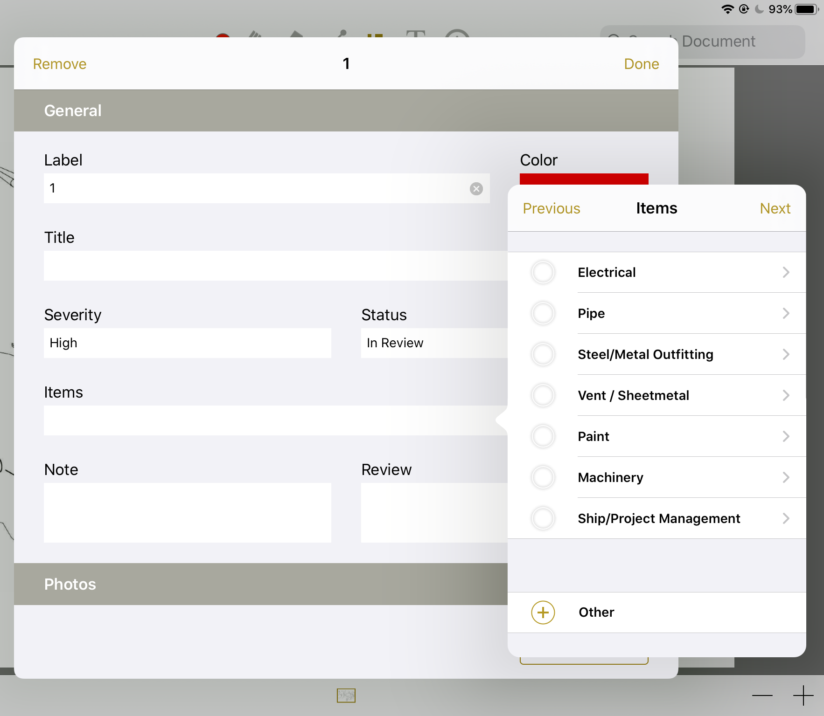
Compartment Closeout Report Lists
Electrical
Cables
Hook Ups
Power
Wireways
Connections
Banding/Packing
Hardware complete/tight
Grounding
Cleanliness
Tags/Labels
Pipe
Pads/Gaskets
Hardware complete/tights
Hydros/Air/Tightness Systems
Hotwork
Cleanliness
Tags/Labels
Steel/Metal Outfitting
Hardware complete/tight
Gaskets
Hydros/Air Tight
Hotwork
Cleanliness
Tags/Labels
Vent/Sheetmetal
Screens/Flashing
Hardware complete / tight
System Balances
Hotwork
Cleanliness
Tags/labels
Paint
Overspray Removed
Touch Up Complete
Knife Edges Clear
Color Coding
Cleanliness
Tags/Labels
Machinery
Hardware complete / tight
Torque Requirements Complete
System Leaks
Hotwork
Cleanliness
Tags/Labels
Ship/Project Management
Cards/Discrepancies Cleared
Testing Complete
Final Clean

Slide 10
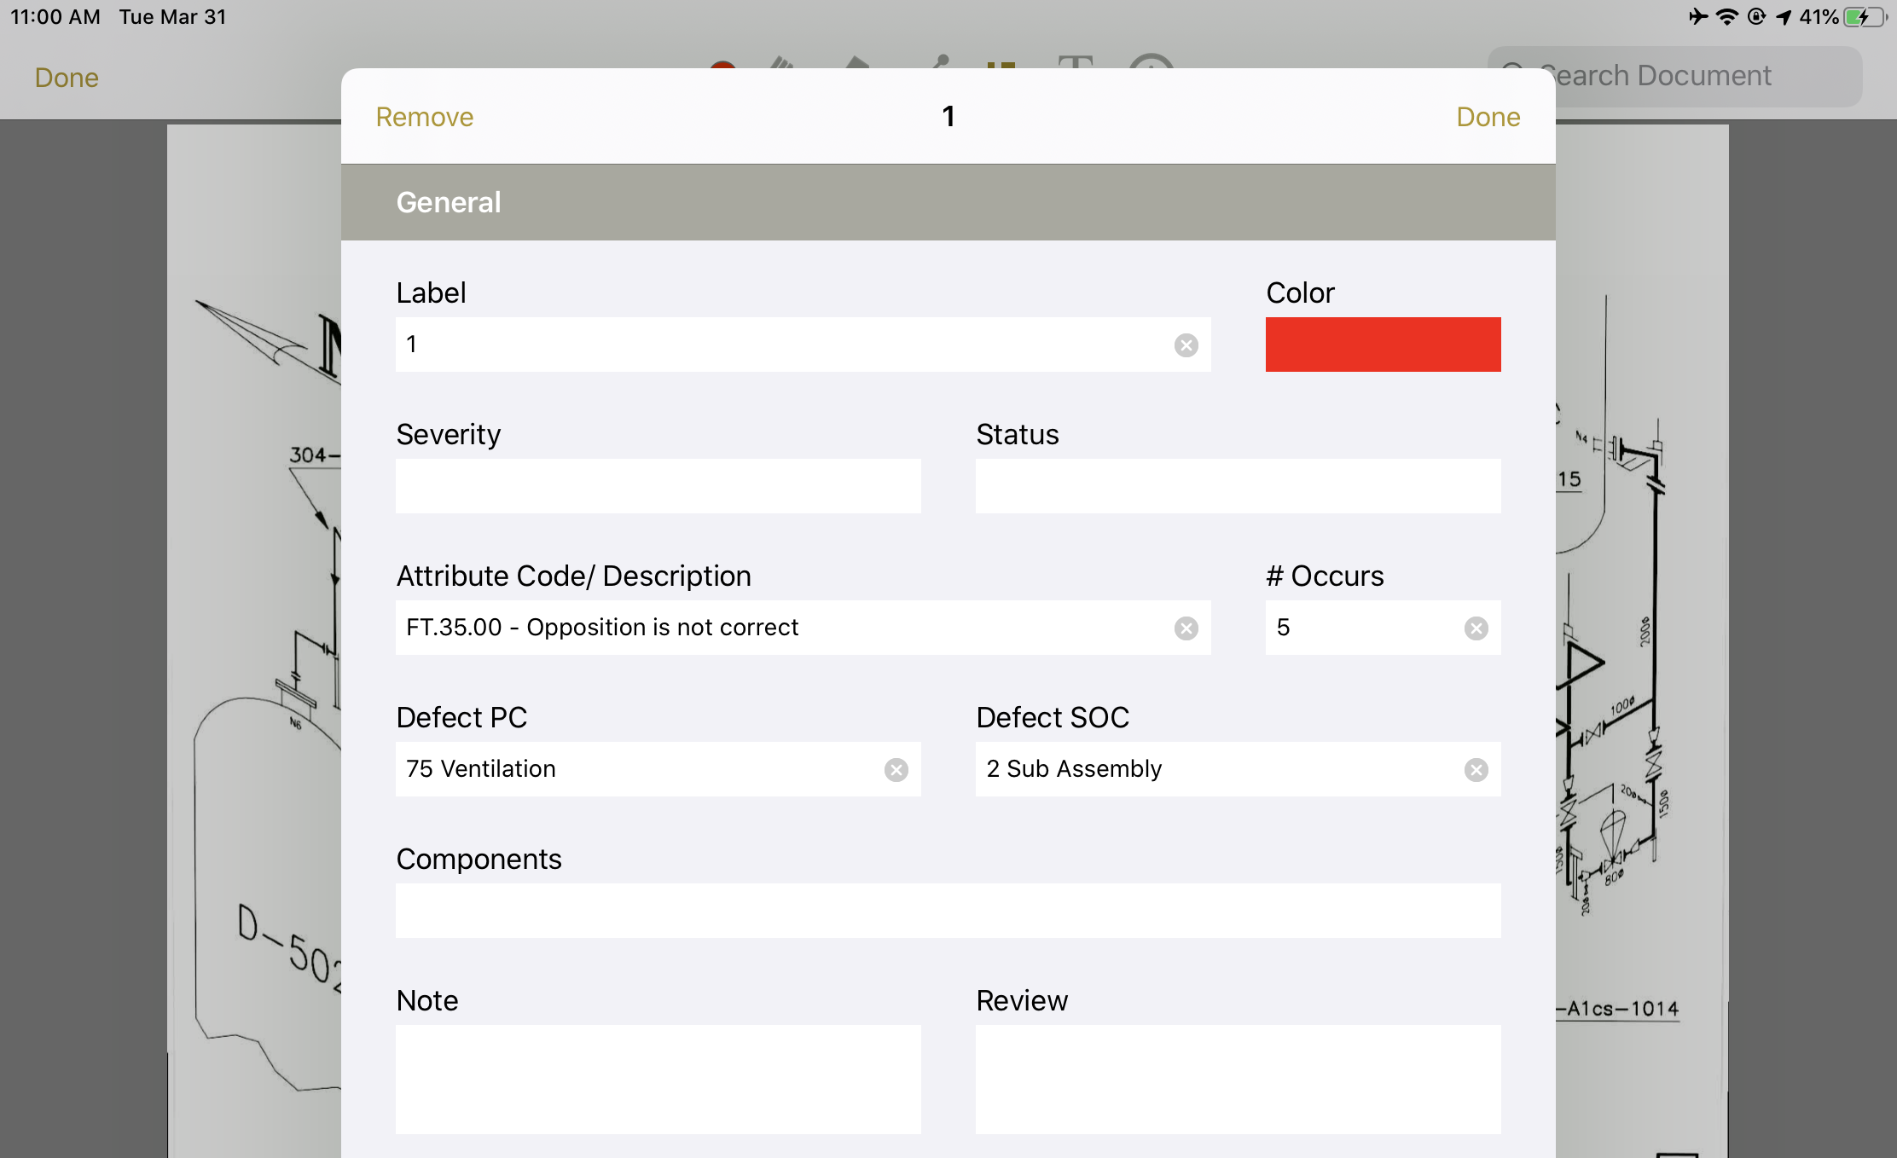
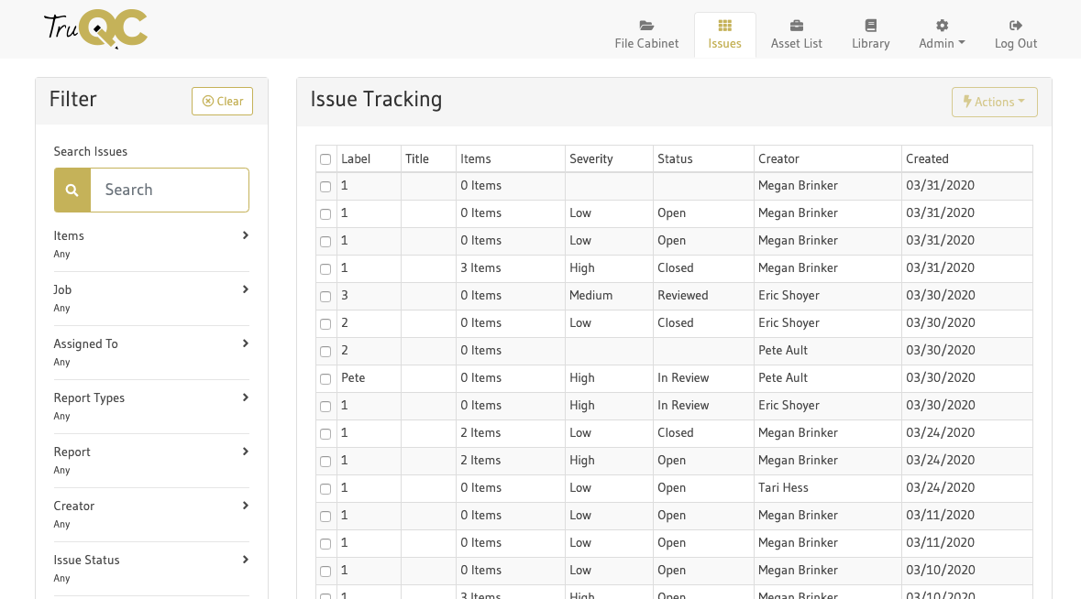
Issue Assignment and Inspection Summary Data
Issue Assignment
Issues identified during inspection are then assigned to a person or craft to begin resolution
Progress updated and tracked at every stage
Issue annotation within Compartment Closeout Report on iPad
Inspection Summary Data
All issue data can be pulled at any time using summaries
Gives users access to the full scope of issue data during a project or for analysis
Issue Tracking tab on TruQC Web App

Slide 11
Shipyard Feedback/Testing
Virtual demonstrations of the app were provided to all shipyards and at NSRP panel meetings
Software provided for BAE Systems and HII-Newport News Shipbuilding
A questionnaire was provided for feedback
Tool can be tailored to accommodate unique aspects of the processes in any specific shipyard
Common terminology can be digitized for all QA data to improve communication among the US Navy shipbuilding community
Questionnaire
Need stages of constructions for Repair- Do you have a list?
Do you have an area for work items listed for space?
Craft List- See the craft list below- any others or edits?
Compartment closeout items – this is what we have. Do you have any additions?
Rework listing codes- Do you have list?
Should the rework code go on modal for both structural and compartment closeout?
Any other inspections you think this could work for?
What summaries of your data would be helpful – Here are some examples? Any others?

Slide 12
Current Digitalization Efforts
Digitalization offers predictive analytics that can drastically help with planning rework and overall time spent on a given job.
Related TruQC digitalization efforts include:
Using inspection data to develop trends over construction life
Using data analytics to make effective changes to the overall QA process
Integrating with other software via APO (Application Program Interface) to reduce manual data entry and allow it to flow properly without additional work for users
Applying projects like paperless paint and digitalization of inspection to digitalize weld process with new NSRP Panel Project
Digitalizing and standardizing environmental and safety reporting
Aligns multiple customers (NAVSEA can have “one” process)
Provides “quick looks” for conflict resolution

Slide 13
Recommended Path Forward/Conclusion
Communication between developers of inspection programs, TruQC, and end users is essential to delivering the proper tools needed for effective digitalization
Consistent, clear and accurate data is able to be captured more effectively
Digitization of paint QA/QC forms (Appendices of NSI 009-32) has shown an increase in efficiency of coating close-out procedures
Efforts to-date have focused on shipyard procedures associated with new build, maintenance, and repair activities
Navy uses much of the same information in their management procedures
Future digitalization for additional time and cost savings:
Expanding digitization to other forms commonly used in Naval corrosion control Complete digitalization of the ship life-cycle
Maintenance Requirement Cards, Material Assessment Forms and other docs would become more robust if the ships historical information was accessible and readily searchable from within a single system

Slide 14
NSRP SPC Project Timeline
April 2019: Group brainstorm at Megarust Conference
May 2019: Discussion completed at NASSCO SD
September 2019: Project update meeting in Rhode Island
October 2019: Developed QA Structural Steel Inspection for New Construction
November 2019: Contract Completed
February 2020: Developed QA Compartment Closeout Inspection
May 2020: Received feedback from BAE and NNS
June 2020: Standardizing lists between new build and repair
July 2020: Testing and paper
July/August 2020: Compiling info from NNS and BAE to make changes
August 2020: Final product for testing use
September 2020: Final paper completed

