Slide 1
Extension Basis for 72 Inch POA Enclosure Systems to DDG and CG Ships
SWSI Panel Meeting
March 24, 2021
Michael Talley, D.Sc. and Lisa McGrath
Ship Survivability
Newport News Shipbuilding

Slide 2
Project Goals, Objectives, & Deliverables
Proposer Identification:
  Prime: HII-NNS, Michael Talley, D.Sc.
  Participants: HII-Ingalls, John Walks and BIW, Nat Bedford
Goals to Achieve
  Ability to easily insert cutting edge technology as it evolves
  Commonality and extendibility of components among systems and ships
  Flexibility in varying physical system configurations
  A reduction in acquisition and life-cycle costs by buying components at the drawer level
  Reduced test time and costs
Objectives
  Provide a basis for extending 72 Inch POA Enclosure Systems to DDG and CG ships
  Define processes, skill levels, and organizational responsibilities for implementing 72 Inch POA Enclosure Systems
Deliverables
  Final report documenting basis for extending 72 Inch POA Enclosure Systems to DDG and CG ships, processes, skill levels, and organizational responsibilities for implementation
  Presentations at workshops to showcase results

Slide 3
What is Physical Open Architecture (POA)?
POA is a flexible mounting methodology enabling use of open architecture systems (plug-and-play, common components, modular design, COTS, etc.), while meeting Navy shock and vibration requirements.
POA is implemented by standardizing physical attachments and qualification procedures, including the following:
  Enclosures
  Shipboard interfaces (i.e., foundations)
  Shock mount solutions
  Component attachment methods
  Environmental test processes and procedures
POA’s flexible mounting methodology provides the ability to install components in different positions stacked within a rack enclosure, and install enclosures in different configurations such as multi-packs.

Slide 4
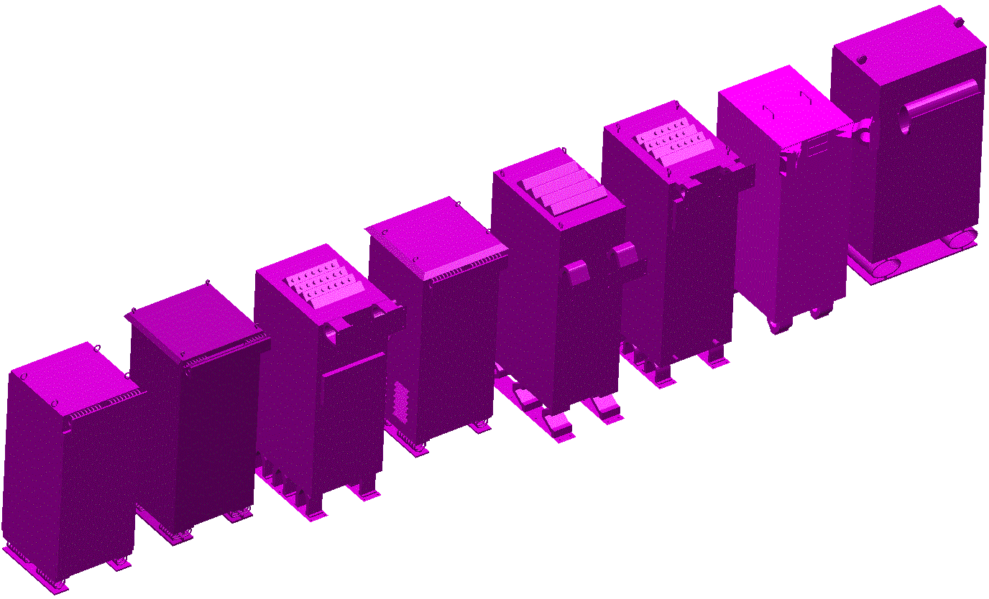
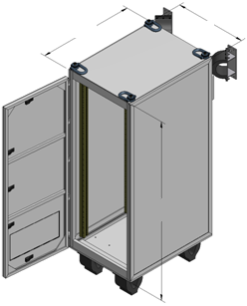
Previous Work: Standardized POA Enclosures and Ship Interfaces
POA consolidates custom-built enclosures in the fleet to standardized POA enclosures
For example, custom-built enclosures (purple) having similarity are reduced to a single POA enclosure (gray)
A survey of existing enclosures indicates that 10-12 POA enclosures will accommodate a majority of enclosures in the fleet

Slide 5
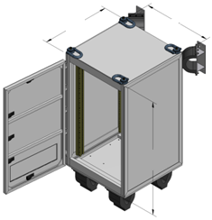
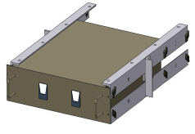
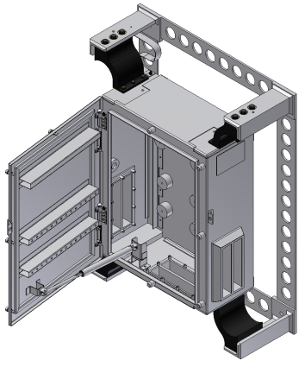
Roadmap for Implementing at the Drawer or Component Level Using POA Enclosures
Continue Implementing POA Enclosures in Fleet:
Carriers, Amphibious Ships, Destroyers, Cruisers, Frigates, etc.
Mid Range
Tall
Shorter
Internal mounts
Box Type
Components with standardized attachment methods
Tall 72” already implemented
2022 2023 2024

Slide 6
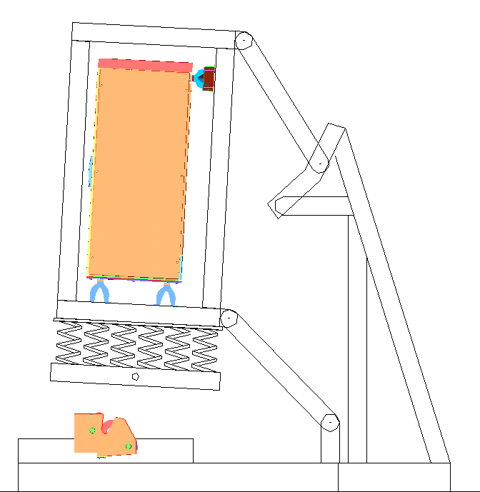
Standardized Environmental Test Processes and Procedures
Shock tests of components at the drawer level satisfying prescribed test criteria can then be installed in the POA enclosures using standardized attachment methods.
Already implementing process for 72” tall enclosures
Deck Simulating Shock Machine (DSSM)

Slide 7
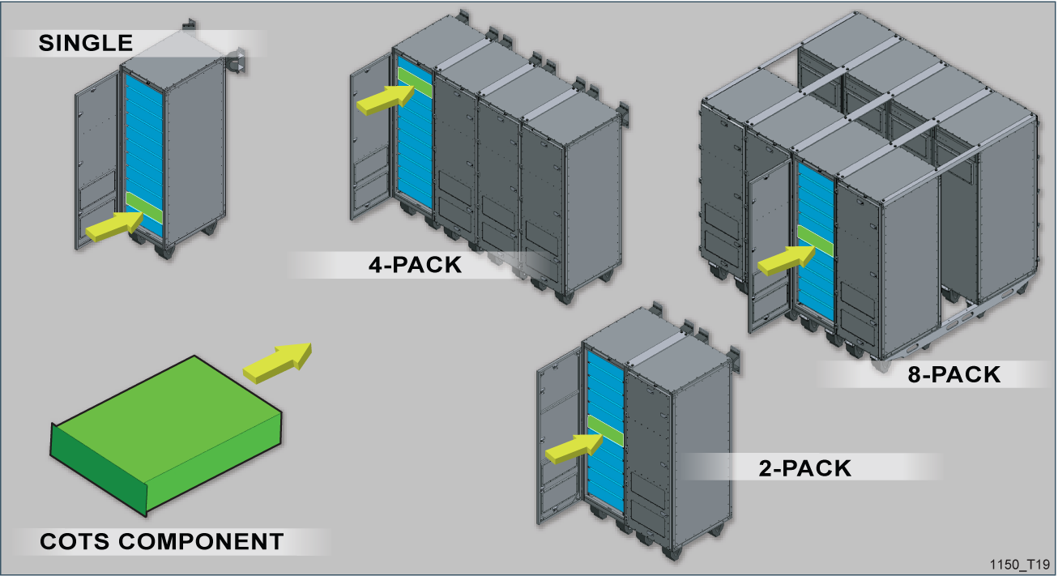
Previous Work:
Approved 72” POA Packaging Methods
2-, 3-, and 6-Packs In development
State of the art components with standardized attachment methods may be hosted anywhere within POA enclosures, bringing the ship interface to the component level.
All mounts have standardized solutions and interfaces for ships
No sway mounts on 8-packs

Slide 8
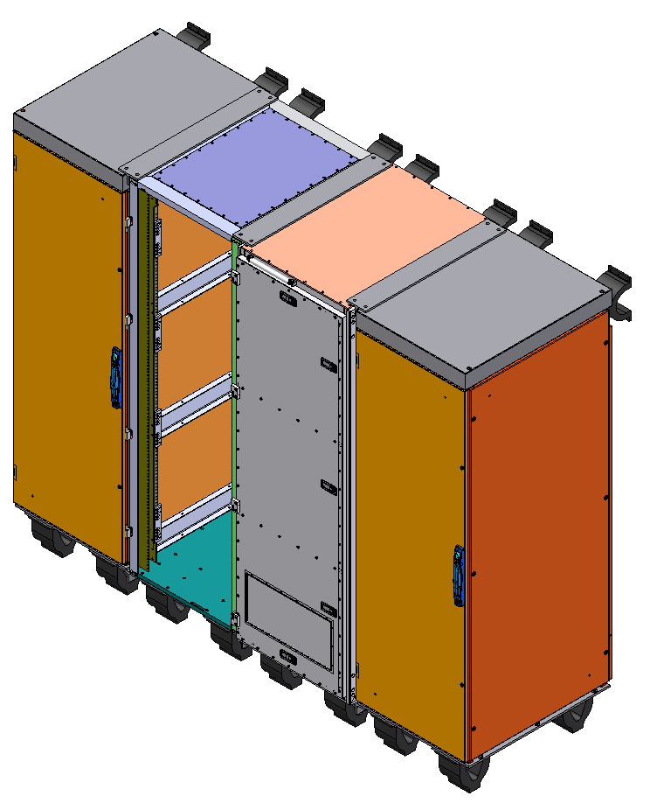
Previous Work: Standardization Enables Interconnectivity of Enclosures from Multiple Suppliers
HOFFMAN ENCLOSURE
901D ENCLOSURE
A & J ENCLOSURE
HOFFMAN ENCLOSURE
SWAY MOUNT
BASE MOUNT
8

Slide 9
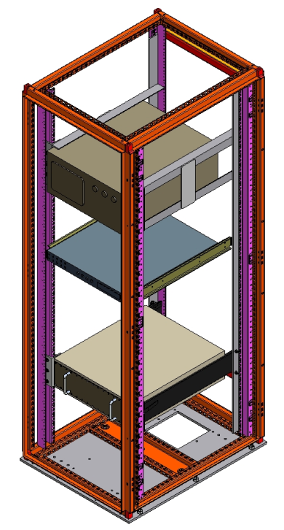
Previous Work: Examples of Standardized Attachment Methods
NNS Angle Frame
Jonathan 128QD-22
General Devices CTHRS-222
1
2
3
9

Slide 10
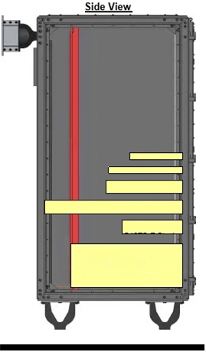
Previous Work: Engineered Mount Sets for 1-pack
Sway
All mount part numbers are ShockTech
Base 2
Base 1
10

Slide 11
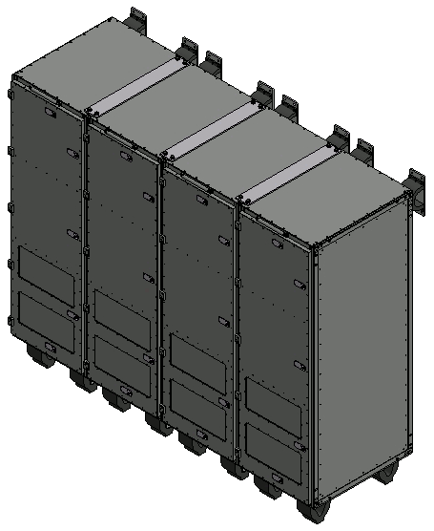
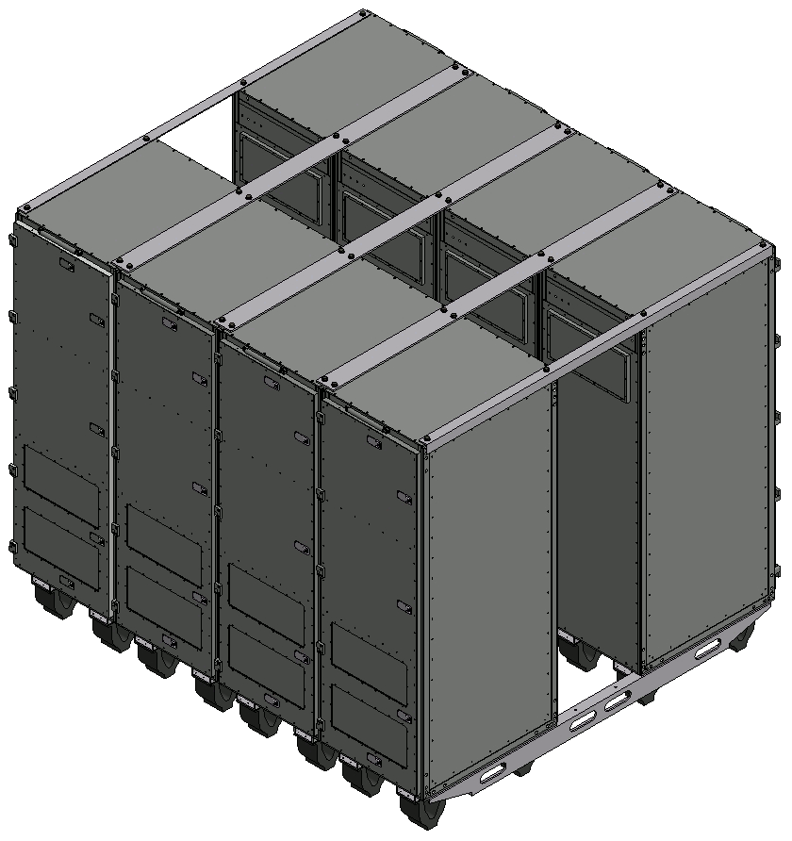
Previous Work:
Engineered Mount Sets for 4- and 8-packs
11

Slide 12
Previous Work: Standardized NNS Cable Methods
Methods are developed IAW DOD-Std-2003.
12

Slide 13
Previous Work:
4 Phase Approach to Carrier Shock Qualification
  Phase A: Heavyweight shock testing of worst case simulated Principal Unit Assemblies
    Completed 2008
      Single Racks
      4-Pack Multipack
      8-Pack Multipack
  Phase B: Heavyweight shock testing of representative components
    Completed 2008
  Phase C: Type B shock testing in Shock Mounted Standardized Enclosure (SMSE) on Deck Simulating Shock Machine (DSSM)
    First Tests Completed 2010
    Over 10 tests performed for Carrier components so far
  Phase D: Shock Qualification Extension Packages
    Part A – General Extension – First Approved 2012, Revised as needed, Most recent Revision: Rev. 3, 2017
    Part B – Specific Extension – First Approved 2012, Revised as needed

Slide 14
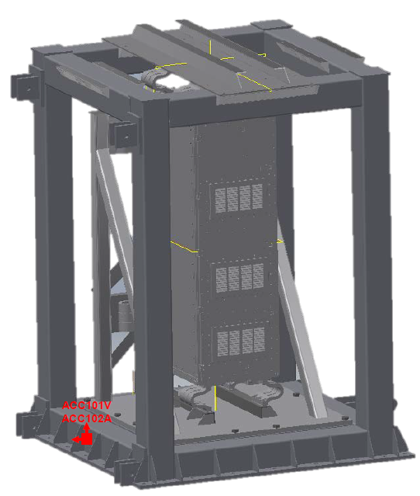
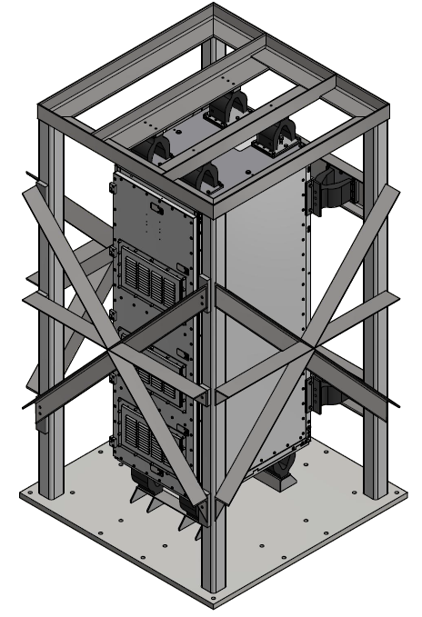
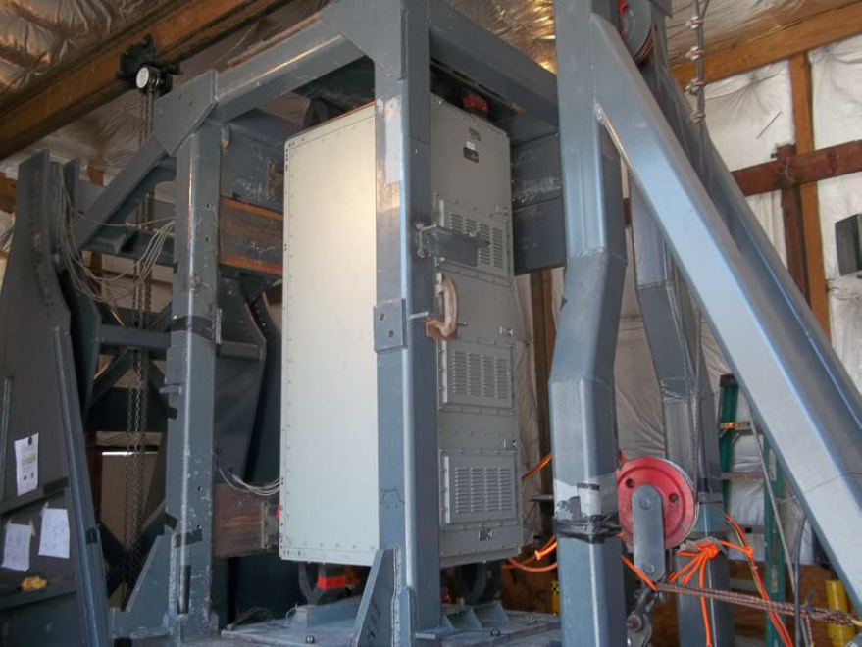
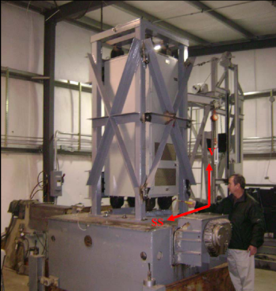
Previous Work:
Phase C Shock and Vibration Testing
Shock Test Setup
Shock Mounted Standardized Enclosure (SMSE)
Vibration Test Setup
Notes:
Shock and Vibration setup photos are from testing conducted under HII-NNS purchase orders.

Slide 15
Previous Work:
Phase D: Shock Qualification Extension Packages
The extension for equipment is done in two parts.
Part A is the Generic Extension, which applies to every enclosure. This contains the general rationale for extensions based on Phases A, B, and C, and has already been approved by NAVSEA.
Part B is the Specific Extension for each unique enclosure.
  Provides information required by 901E and DI-ENVR-80706, Shock Test Extension Request for the similar extension of the specific assembly created by combining the enclosures tested in Phases A and B of the four-phase approach with the equipment tested in Phase C.
  Fulfills requirements of Phase D of the four-phase approach to shock qualify equipment.
  Fig 19’s are created for each subsidiary component and unique rack assembly.

Slide 16
Previous Work:
Shock Qualified Enclosure Calculator (SQEC)
Enables cost effective design efforts and configuration management
16

Slide 17
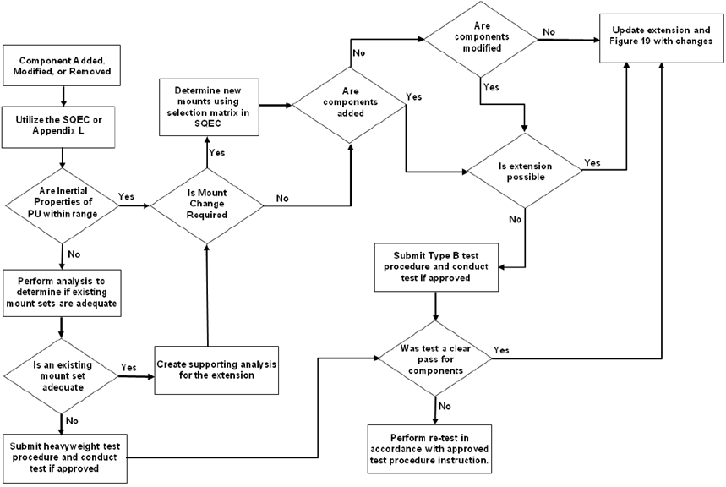
POA Life Cycle Configuration Management Approach

Slide 18
Methods and Procedures Required for Accomplishing Goals and Objectives
Identify DDG and CG spaces that will benefit from 72-inch POA enclosures: HII-Ingalls shall perform.
Identify environmental requirements gaps between CVN, DDG, and CG (e.g., higher frequency vibe testing, rack height, EMI variances, etc.): HII-NNS performs and HII-Ingalls participates.
Develop initial rearrangement concepts for each space using POA enclosures: HII-Ingalls shall perform.
Develop analysis & test plan to close gaps and submit to NAVSEA for approval: HII-NNS performs and HII-Ingalls participates.
Define ordering and supplier information for POA enclosures, hardware, and mounts for DDG and CG platforms: HII-NNS performs and HII-Ingalls participates.
Define processes, skill levels, and organizational responsibilities associated with POA enclosure builds, testing, ship outfitting, and enclosure configuration management
BIW shall provide reviews and comments to all NSRP reports.

Slide 19


Develop Initial Rearrangement Concepts
Space rearrangement example
Legend
8-pack
4-pack
Manned Area
2-pack
3-pack
1-pack
Rearrangements will be iterated considering constraints and requirements
Doorway or structure

Slide 20
Status, Next Steps, Future Work
Status
  DDG: ~8 spaces containing 36 enclosures identified for potential rearrangements using POA enclosures
  CG: ~37 spaces containing 124 enclosures identified for potential rearrangements using POA enclosures
Next Steps
  Develop analysis & test plan to close gaps and submit to NAVSEA for approval.
  Define ordering and supplier information for POA enclosures, hardware, and mounts for DDG and CG platforms.
Future Work
  Pursue funding to achieve “Roadmap for Anytime and Anywhere at the Drawer or Component Level Using POA Enclosures”
20

Slide 21

Discussion / Questions
Questions

