Slide 1
Surface Preparation and Coatings Panel Thursday, March25, 2021
State of the Panel
Arcino ”Q” Quiero, Jr., Panel Chair
Huntington Ingalls Industries, Newport News Shipbuilding
Notes:
Introduction

Slide 2
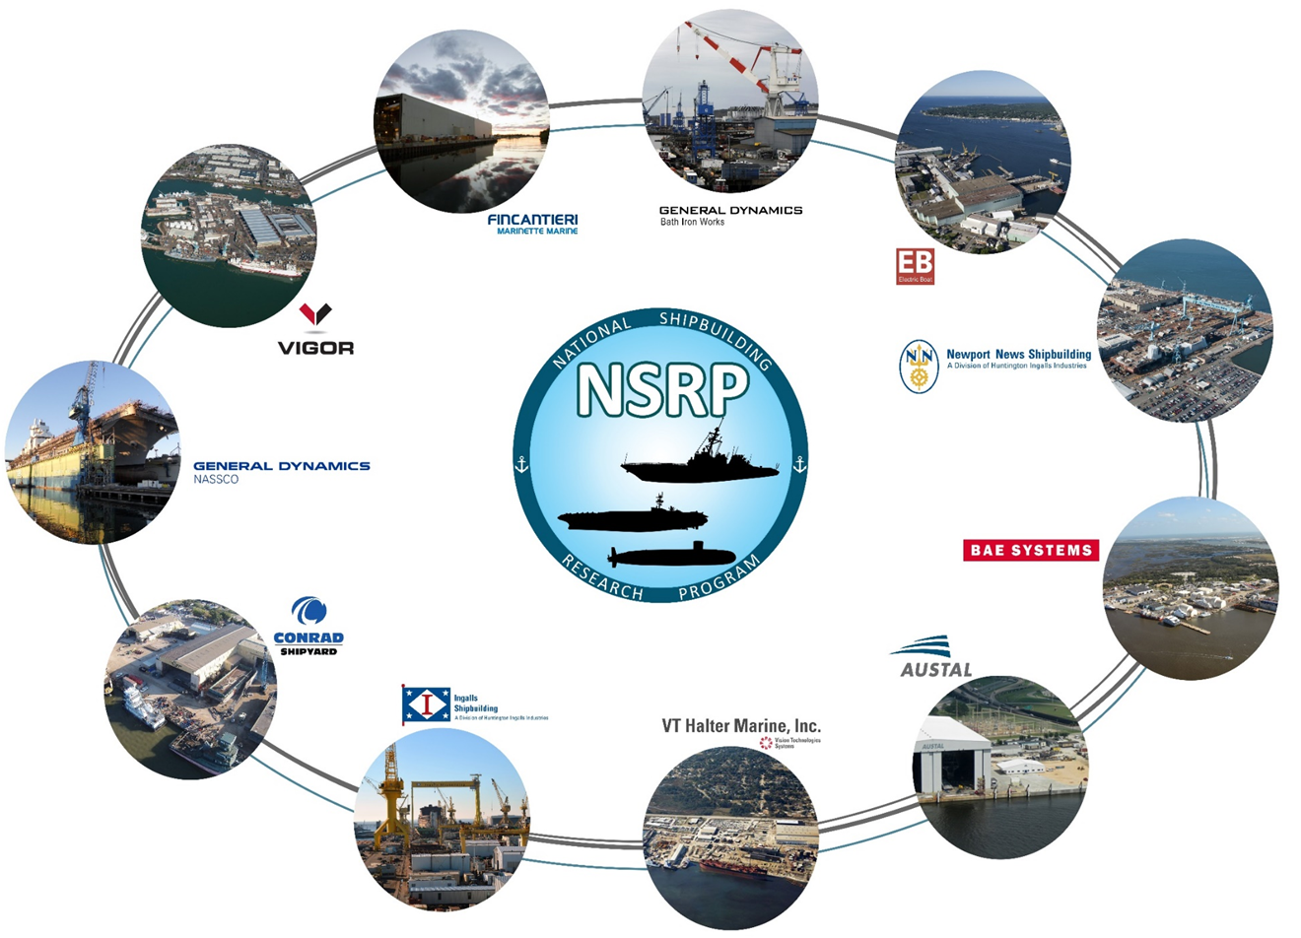
Surface Preparation and Coatings Panel’s Mission
Specification to Deck Plate Application (Specs to Decks)
Research, evaluate, develop, and sustain current and emerging technologies that will reduce cost and maintain or enhance quality
Notes:
Dynamic environment

Slide 3
Panel’s Purpose
Why?
Offers everyone; AMPP, Corrosion CoP, ManTech, MegaRust, etc., a seat at the table
Enables the Panel to grow and learn from each other
Walk away with a common understanding of requirements
Increases the Panel, the Shipyards, and the Navy overall chances of success
What does the panel do?
Engage Suppliers, Applicators, and Specifiers of preservation systems, including NAVSEA
Facilitate Panel meetings, facilities tours, and demos to encourage broad and active participation
Network with Industry Experts
Notes:
Focus:
People, Specs., Surface Prep, Coatings, Environmental, QA & Documentation
People + Processes = Performance
Innovation + Technology = Increased / Improved Performance

Slide 4
Benefits of the NSRP SP&C Panel
US Navy – NAVSEA
Value, Implementation, ROI
One stop shop to address issues with Industry
Part of the review process as to which SP&C Panel projects move forward
Voice of the industry during the Navy Standard Item 009.32 SRRAC proposals and review
Vendors – Suppliers
Understand customer needs
Participating Shipyards
Funding for projects
Networking with counterparts
Interact with NAVSEA Reps, Technical Warrant Holder (TWH)
Associations - Academia
How they can support the industry

Slide 5
Surface Preparation and Coatings Panel’s
Completed Projects 2018-2020:
Optimize Power Tools Surface Preparation
Survey of Surface Prep & Coatings Automation
Standardization and Digitization of Visual Inspection for Shipbuilding & Repair
Primers with Extended AF Overcoat Window Surface Preparation
Certification Program – Shipbuilding Industry Surface Prep & Coatings Training
Virtual Spray Paint Training System
Thermal Insulating Aerogel Filled Coatings
Evaluation of Plasma Coating Removal & Surface Preparation
Completed Projects 2014-2017:
Partial Blast of UHS Coated Tanks II
Retention of Epoxy Type VI under Ultra High Solids
Boomlift Carried Environ. Enclosure
Implementation of Paperless Paint
Universal Primer & Surface Prep Process
Partial Blast of UHS Coated Tanks
Technical Guide for Inaccessible Void Coatings & Treatments
Reducing Inspection Costs Using the Latest Digital Inspection Tools
Cost Savings Comparison in Appling Polysiloxane vs. Silicone Alkyd Topcoats
Paperless Paint Documentation II
2020
2017
2016
2015
2019
2018
2014
Notes:
18 Funded Project since becoming SP&C Panel Chair
People + Processes = Performance
Certification & Virtual Spray + Automation, Standardization, & Power Tools
Tools & Equipment To Do My Job

Slide 6
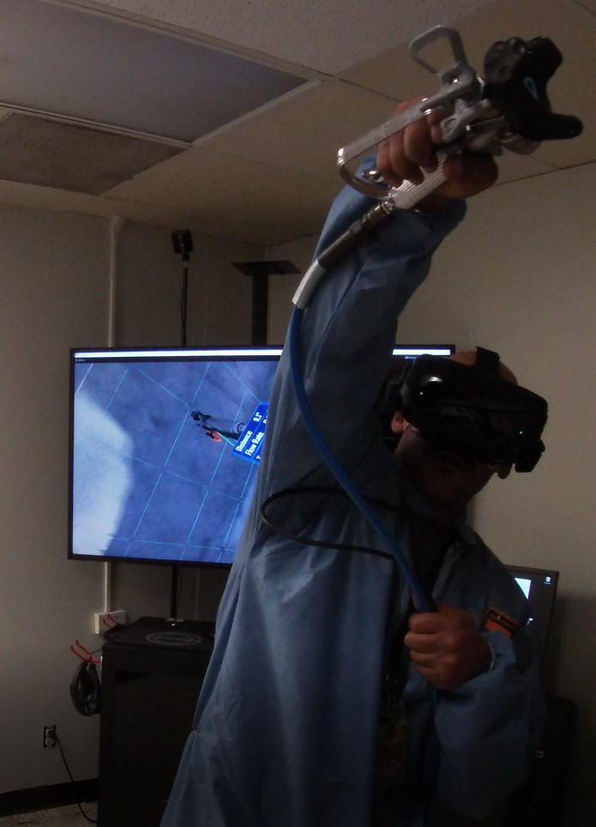
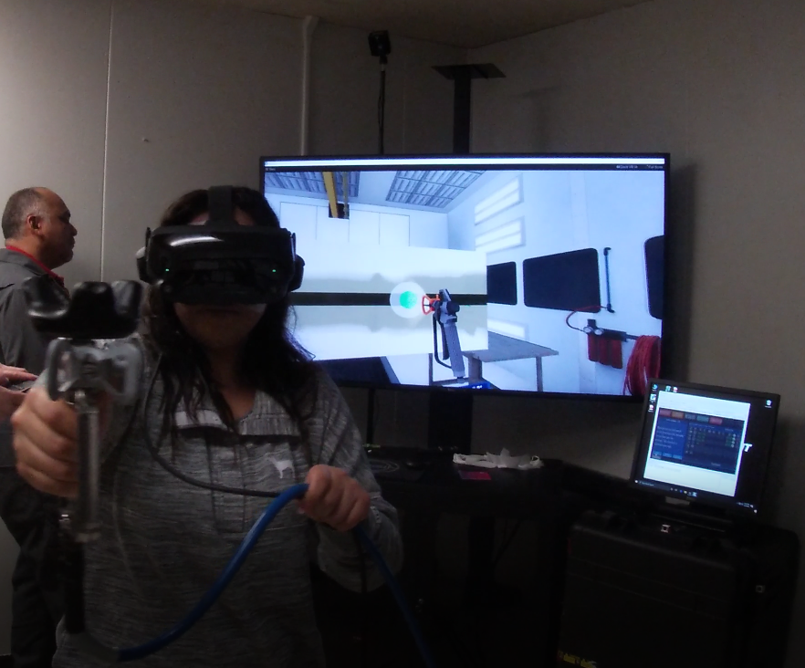
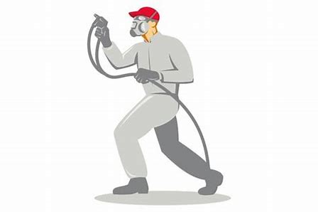
Past Projects
Virtual Paint (VP) – A Virtual Reality (VR) training system
Provides a realistic simulation of coatings application
Takes into account the spray gun, coatings material, and the spray environment
Provides performance feedback for spray technique, time, and cost
Potential value to the Navy:
Increased quality performance
Potential material savings
Enhance schedule performance
Possible overall cost savings
Certificate Program – Shipbuilding Industry Surface Prep and Coatings Training
Shipbuilding industry is experiencing a short-fall in entry-level applicants
Hiring entry level Blasters & Painters significantly under-skilled
The training will include marine and industrial applications for new hires and the general population
Potential value to the Navy:
Increase quality performance
Improve EH&S performance due to increase coatings knowledge
Possible cost reduction in a labor intensive work environment

Slide 7
Current Projects
Survey of Surface Prep and Coatings Automation
Identify the current state in two areas, SP&C automation in other industries and Robotics & Automation currently utilized within Shipbuilding today
Perform a gap analysis for automating Shipbuilding SP&C activities
Potential value to the Navy:
Possible cost reduction in a labor intensive work environment
Standardization & Digitization of Visual Inspection for Shipbuilding & Repairs
Capture data electronically at all sites
Efficiently report finds without duplicate steps
Immediate access to consistent, objective, and clean data
Potential value to the Navy:
Less touch time, no manual data entry
Increase records accuracy
Clean hand-off to Navy
Optimize Power Tools Surface Prep
Consolidate power tool performance data
Develop comprehensive list of power tools available by industry
Generate data of tools effectiveness in a Shipyard setting
Potential value to the Navy:
Guidance on how to optimize power tool Surface Prep
Improve quality and possible cost reduction

Slide 8
Surface Preparation and Coatings Panel & Overall Panel Meeting Attendance
Notes:
Path Forward:
Virtual for now
Going back and reexamine past projects
Continue relationship with TWH

Slide 9
SP&C Panel Path Forward
Opportunities:
COVID 19 moving forward
Rapid Adoption Projects
New Membership / Insight / Ideas
Increase NSRP / ManTech Collaboration
Challenges:
Impact of COVID 19
Funding constraints
Member Yards Evolution
Administrative Issues:
Complete the All Panel Meeting Survey
2Q21 Meeting Draft Agenda – Topics & Demos accounting for eight hours identified
Thank You:
142 Attendees - Outstanding
All Presenters – Awesome
NSRP (Caroline) – You’re the WOMAN
Vice-Chair (Bob) – You’re the MAN

Slide 10
SP&C Panel – Upcoming Events
Event | Data | Location
NSRP All Panel Meeting | March 22-25, 2021 | Virtual
CORROSION 2021 | April 19-30, 2021 | Virtual
SP&C Panel – Mid-Year Meeting | June 2021 | Virtual
MageRust | September 21-21, 2021 | Hampton, VA
SNAME Maritime 2021 | October 25-29, 2021 | Providence, RI
NSRP Day @ NAVSEA | TBD | D.C. Navy Yard
Coatings+ | December 13-16, 2021 | Phoenix, AZ
AMPP Annual Conference | March 6-10, 2022 | San Antonio, TX

Slide 11
Surface Preparation and Coatings Panel’s Responsibilities & Takeaway
“You, the Coatings Community, are the subject matter experts (SMEs). You owe it to yourselves, your Shipyards, and your Companies to stay aware of and understand the current and proposed coatings requirements. Don’t allow someone else to determine your fate and/or that of your Company without your input”.
“Remember, the work isn’t completed until the ship is painted and/or cleaned (Polysiloxane) and the coatings system is documented; preferably paperless”.
“Together, let’s paint a picture that allow the Coatings Community and the US Navy to be successful”!!!
“Q”

Slide 12
Questions?

