Slide 1
2021 Virtual NSRP
All Panel Meeting
Program Overview
March 22-25, 2021

Slide 2
NSRP Mission
The mission of the National Shipbuilding Research Program is to reduce the total ownership cost and improve the capabilities of both United States Government and U. S.-flag commercial ships.
The Program accomplishes this mission by providing a collaborative framework to manage, focus, develop and share research & development, and leverage best practices in shipbuilding and ship repair.
Notes:
NSRP mission is centered around reducing the total ownership cost of ships and the key to the program is the collaborative framework.

Slide 3
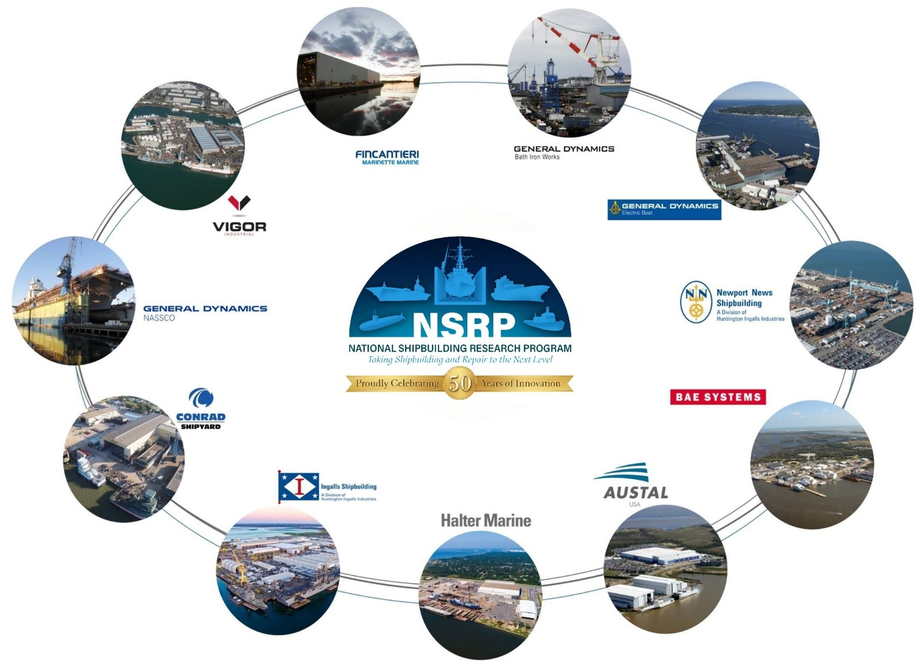
NSRP Collaboration
Notes:
NSRP is an industry-led collaboration with the U.S. Navy focused on reducing the total ownership costs of ships for the Navy and National Security Customers
10 Member Shipyard Collaboration
Allows competitors to partner on common shipbuilding/ship repair problems to benefit of industry and their clients as a whole
Industry cost share multiplies impact of every government dollar provided
Sponsored by NAVSEA and 6 Program Executive Offices
NAVSEA 06, PEO C4I, PEO Aircraft Carriers, PEO IWS, PEO USC, Team Ships, and Team Submarine collectively provide ~$13.5M in annual funding

Slide 4
Anti Trust Rules

Slide 5
Anti-Trust Rules
Regarding your company’s and/or your competitor’s product & services:
  Do not discuss current or future prices.
  Do not discuss any increase or decrease in price.
  Do not discuss pricing procedures.
  Do not discuss standardizing or stabilizing prices.
  Do not discuss controlling sales or allocating markets for any product.
  Do not discuss future design or marketing strategies.
Notes:
Since NSRP is a collaboration of competing shipyards, it is important to cover the Anti-Trust rules. (read slide)

Slide 6
Anti-Trust Rules
Regarding your company’s and/or your competitors’ selection of their supplier companies:
  Do not discuss refusing to deal with a company because of its pricing or distribution practices.
  Do not discuss strategies or plans to award business to remove business from a specific company.
Regarding your company’s and/or competitors’ trade secrets:
  Do not discuss trade secrets or confidential information of your company or any other participant.
Notes:
Since NSRP is a collaboration of competing shipyards, it is important to cover the Anti-Trust rules. (read slide)

