Slide 1
Minimum Standardized Content to Enable a Navy Digital Enterprise
Completion of Phase 1 of 2
Newport News Shipbuilding, a Division of Huntington Ingalls Industries, All Rights Reserved 2021

Slide 2
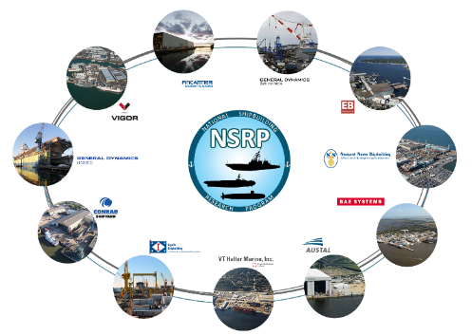
Agenda
Project Overview & Objectives
Goals & Expected Outcomes
Technical Approach
Technical Findings
Current Shipbuilding Standards
Use-Cases/Interviews
Detailed Use Cases
Information Cohorts & Key Artifacts
Product Definition Standards
Model Based Product Support
3D Data Information Flow
Information Future State Alignment
Conclusions
Newport News Shipbuilding, a Division of Huntington Ingalls Industries, All Rights Reserved 2021

Slide 3
Problem & Objectives
PROBLEM TO BE ADDRESSED
The Navy is investing heavily in the Digital Future and is aware that the transition from legacy Shipbuilding “Drawing Centric Processes” to “Digital Data Centric Processes” is considered High Risk. This is High Risk due to the magnitude of change and consequences of failure for not having data exchange and delivery standards (level of quality & common language) defined and in use. It is clear that introduction of digital engineering will have a disruptive impact on Navy processes. The costly results to the Shipbuilding/Navy Enterprise, from a lack of defined minimum data standards, will be composed of data recreation, lost or missing information, and a lack of trust in data due to traceability.
PROJECT OBJECTIVE
The objective of this project is to enable Navy advanced data collaboration through the configuration management of content & format that conforms to defined standards and specifications. The project will work to establish a Shipbuilding Industry and Navy-wide generic process for data collaboration through alignment with Navy “Model Based Product Support” (MBPS) requirements. It will also address Original Equipment Manufacturer (OEM’s) and Vendor data exchange format and standards. Standard will provide ease of understanding each other, and clarity of requirements with no ambiguity.
Newport News Shipbuilding, a Division of Huntington Ingalls Industries, All Rights Reserved 2021

Slide 4
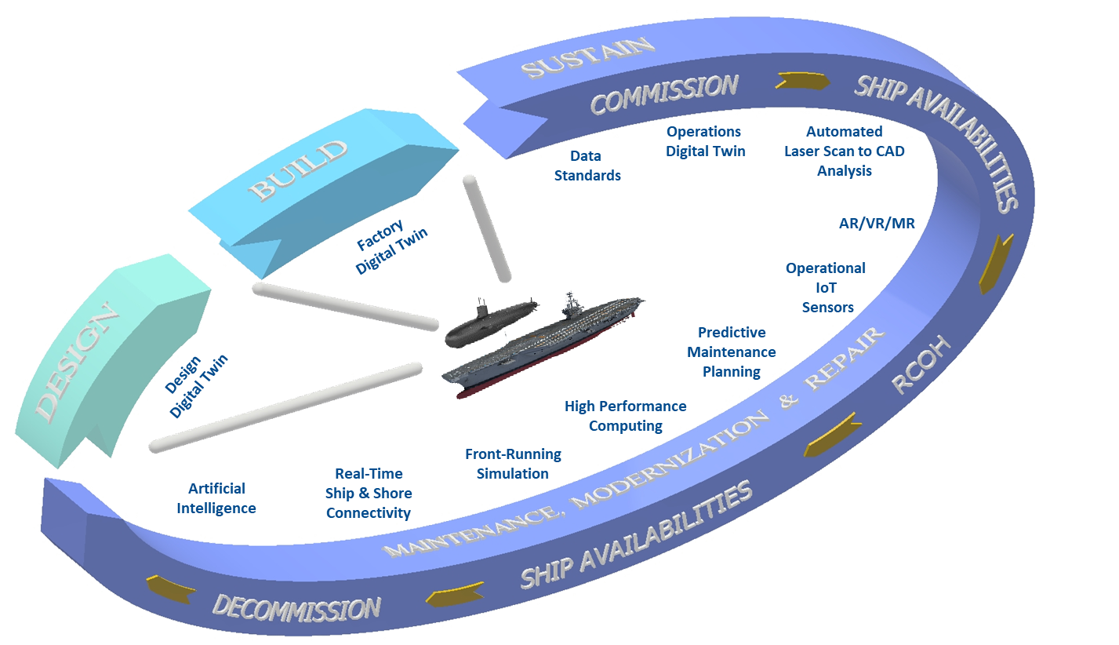
Goals & Expected Outcomes
Establish common standards / requirements for use in contracts to successfully procure technical data for use in a modern PLM environment.
Establish common / modern product model definition for current and future programs to acquire and sustain procured Technical Data Packages (TDPs).
Establish configuration and data / model reuse tied to a common readiness model (integrates with NCRM capability), publications, and logistics / maintenance source data from program inception.
Establish integrated capability with configuration, models / drawings, training, and logistics / maintenance data (digital twin / thread).
Acquire, store, retrieve and view technical documentation by providing a central point of access to technical data for use by the Navy to include Planned Maintenance System and Engineering Operational Sequencing System (EOSS) information.
Newport News Shipbuilding, a Division of Huntington Ingalls Industries, All Rights Reserved 2021

Slide 5
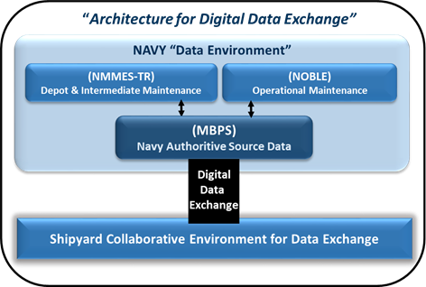
Technical Approach
Research Format Standards & Structure
Research Standards Format and Structure
Review the Navy’s Digital Data Exchange requirements
Develop Functional Digital Models with Algorithms
Align the Navy and Shipbuilder Source Data
Provide Recommendations on Shipbuilder and Navy 2-Way Data Exchange
Submit for Phase 2 Go/No-Go Request
Newport News Shipbuilding, a Division of Huntington Ingalls Industries, All Rights Reserved 2021

Slide 6
Technical Findings
Major NAVSEA Technical Data
ISO 10303 – 203 | Configuration controlled 3D designs of mechanical parts and assemblies
ISO 10303 – 239 | Product Lifecycle Support
ISO 10303 – 242 | Managed model based 3D engineering
S1000D | International specification for technical publications using a common source database
S2000M | International specification for Material Management
S3000L | International procedure specification for Logistics Support Analysis
S3000L | International procedure specification for Logistics Support Analysis
NAVSEA 7070-900 | Ship Configuration and Logistics Support Information System
EIA 649C | Configuration Management Standard
GEIA-HB-649 | Configuration Management Standard Implementation Guide
ASME Y14- Series Standards
ASME Y14.1, Decimal Inch Drawing Sheet Size and Format
ASME Y14.1M, Metric Drawing Sheet Size and Format
ASME Y14.2, Line Conventions and Lettering
ASME Y14.3, Orthographic and Pictorial Views
ASME Y14.5, Dimensioning and Tolerancing
ASME Y14.24, Types and Applications of Engineering Drawings
ASME Y14.34, Associated Lists
ASME Y14.35, Revision of Engineering Drawings and Associated Documents
ASME Y14.36, Surface Texture Symbols
ASME Y14.38, Abbreviations and Acronyms for Use on Drawings and Related Documents
ASME Y14.41, Digital Product Definition Data Practices
ASME Y14.100, Engineering Drawing Practices
TDP Functional Categories
3D Geometry
3D Model-Based Definition
Solid Model Geometry and Basic Dimension
3D Model-Based Product Definition for Manufactured parts
Domain Specific 3D Model-Based Definition
3D Model-Based EARLY STAGE SHIP Product Definition
3D Model-Based Product Definition for molded forms
3D Model-Based Product Definition for Structural Systems
3D Model-Based Product Definition for Arrangements
3D Model-Based Product Definition for Plant Spatial Systems
3D Model-Based Definition for Facilities
Defeatured 3D Model-Based Definition
Alternative 3D Model-Based
Newport News Shipbuilding, a Division of Huntington Ingalls Industries, All Rights Reserved 2021

Slide 7
Current Shipbuilding Standards
Standard | Nomenclature | Functional Area
MIL-STD-1388-2B | DOD REQUIREMENTS FOR A LOGISTIC SUPPORT ANALYSIS RECORD | Allowance & Outfitting (A&O)
NTS 9090-1500 | PROVISIONING ALLOWANCE, AND FITTING OUT SUPPORT (PAFOS) | Allowance & Outfitting (A&O)
MIL-STD-2186A(SH) | REAL-TIME OUTFITTING MANAGEMENT INFORMATION SYSTEM, GENERAL REQUIREMENTS | Configuration Status Accounting (CSA)
NTS 9090-700 | SHIP CONFIGURATION AND LOGISTICS SUPPORT INFORMATION SYSTEM (SCLSIS) | Configuration Data Manager (CDM)
NTS 9090-820 | PREPARATION AND REVISION OF DAMAGE CONTROL BOOKS AND DIAGRAMS FOR U.S. NAVY SURFACE SHIPS | Damage Control (DC)
S9086-CN-STM-020 | DAMAGE CONTROL PRACTICAL DAMAGE CONTROL, REV 03 | Damage Control (DC)
MIL-HDBK-470 | DESIGNING AND DEVELOPING MAINTAINABLE PRODUCTS AND SYSTEMS (VOLUME I) (04 DEC 1997) | Reliability & Maintenance
MIL-HDBK-471 SS by MIL-HDBK-470) | MAINTAINABILITY VERIFICATION/DEMONSTRATION/EVALUATION (04 AUG 1997) | Reliability & Maintenance
MIL-HDBK-472 | MAINTAINABILITY PREDICTION (24-MAY-1966) | Reliability & Maintenance
MIL-HDBK-781A | RELIABILITY TEST METHODS, PLANS, AND ENVIRONMENTS FOR ENGINEERING, DEVELOPMENT QUALIFICATION, AND PRODUCTION (01 APR 1996) | Reliability & Maintenance
MIL-STD-470 (SS by MIL-HDBK-470) | MAINTAINABILITY PROGRAM FOR SYSTEMS AND EQUIPMENT (30 MAY 1989) | Reliability & Maintenance
MIL-STD-471 (SS by MIL-HDBK-471) | MAINTAINABILITY VERIFICATION/DEMONSTRATION/EVALUATION (27 MAR 1973) | Reliability & Maintenance
MIL-STD-756 (Cancelled) | RELIABILITY MODELING AND PREDICTION (18 NOV 1981) | Reliability & Maintenance
MIL-STD-781 (SS by MIL-HDBK-781A) | RELIABILITY TESTING FOR ENGINEERING DEVELOPMENT, QUALIFICATION, AND PRODUCTION (17 OCT 1986) | Reliability & Maintenance
MIL-STD-785 (Cancelled) | RELIABILITY PROGRAM FOR SYSTEMS AND EQUIPMENT DEVELOPMENT AND PRODUCTION (15 SEPT 1980) | Reliability & Maintenance
MIL-STD-883 | MECHANICAL TEST METHODS FOR MICROCIRCUITS PART 2: TEST METHODS 2000-2999 | Reliability & Maintenance
MIL-STD 1629 (Cancelled) | PROCEDURES FOR PERFORMING A FAILURE MODE, EFFECTS, AND CRITICALITY ANALYSIS (24 NOV 1980) | Reliability & Maintenance
MIL-STD-1635 (Cancelled) | RELIABILITY GROWTH TESTING (RGT) (03 FEB 1973) | Reliability & Maintenance
MIL-STD-2068 (SS by MIL-STD-781) | RELIABILITY DEVELOPMENT TEST PROGRAM (15 JUL 1987) | Reliability & Maintenance
MIL-STD-3034 | RELIABILITY-CENTERED MAINTENANCE (RCM) PROCESS (21 JAN 2011) | Reliability & Maintenance
MIL-P-24534A (SS by MIL-STD-3034) | PLANNED MAINTENANCE SYSTEM; DEVELOPMENT OF MAINTENANCE REQUIREMENT CARDS, MAINTENANCE INDEX PAGES, AND ASSOCIATED DOCUMENTATION (07 MAY 1985) | Reliability & Maintenance
NTS 9090-800 | SHIP SELECTED RECORD DRAWINGS | Selected Record Drawing (SRD)
SL720-AA-MAN-030 | NAVY MODERNIZATION PROCESS MANAGEMENT AND OPERATIONS MANUAL (NMP-MOM) | Allowance & Outfitting (A&O) Configuration Data Manager (CDM) Damage Control (DC)
Newport News Shipbuilding, a Division of Huntington Ingalls Industries, All Rights Reserved 2021

Slide 8
Use Cases
Interview Summary:
Maintenance scenario
Who does the routine maintenance?
An example of a specific maintenance event and the related information
Benefits and concerns be around moving this use case into a 3D Digital platform?
Casualty incident
Who reacts in this situation?
What training goes into repair response?
An example casualty incident
Benefits and concerns be around moving this use case into a 3D Digital platform?
General component information
Who would need to access data around a component?
Why do they need to access it?
How do they get that information today?
Benefits and concerns be around moving this use case into a 3D Digital platform?
Use Case | Purpose
Maintenance/Repair Initiate a routine repair. | Identify and locate a component to be repaired, repair/replace item
Casualty incident Report evaluation assessment of damage | Understand and assess a damaged space, plan and repair of that space across systems as needed
Replacement | All Other Events: example: identify a part that exists in multiple places, plan and repair replacement
Newport News Shipbuilding, a Division of Huntington Ingalls Industries, All Rights Reserved 2021

Slide 9
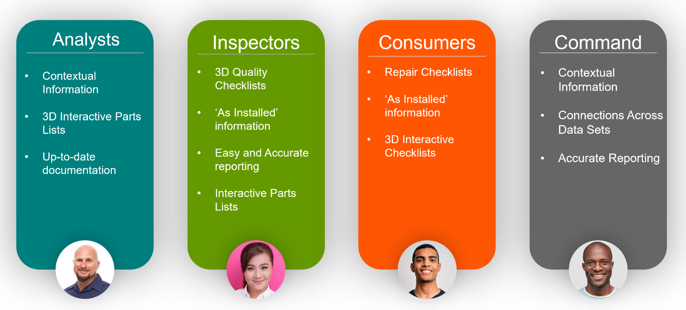
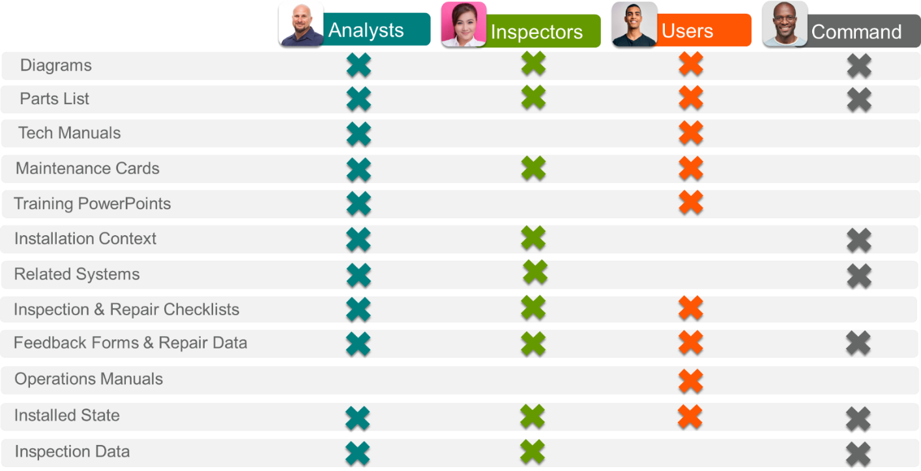
Information Cohorts & Key Artifacts
Information Cohorts
Developed from personas
Developed to identify artifacts
Key Artifacts
Mapped to information cohorts
Are essential to identification of which standards are required
Mapped to the Digital Shipbuilding phases depict when each standard is used
Action Engineering, LLC Proprietary – do not reproduce, repurpose, or distribute without written permission from Action Engineering, LLC
Newport News Shipbuilding, a Division of Huntington Ingalls Industries, All Rights Reserved 2021

Slide 10
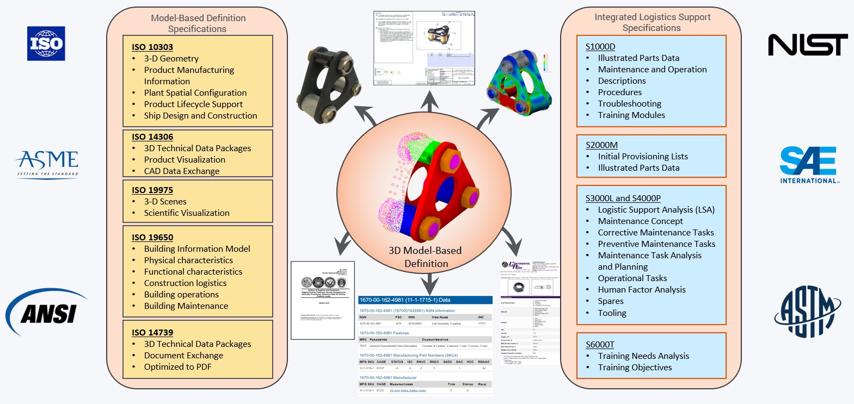
Product Definition Standards
Newport News Shipbuilding, a Division of Huntington Ingalls Industries, All Rights Reserved 2021

Slide 11
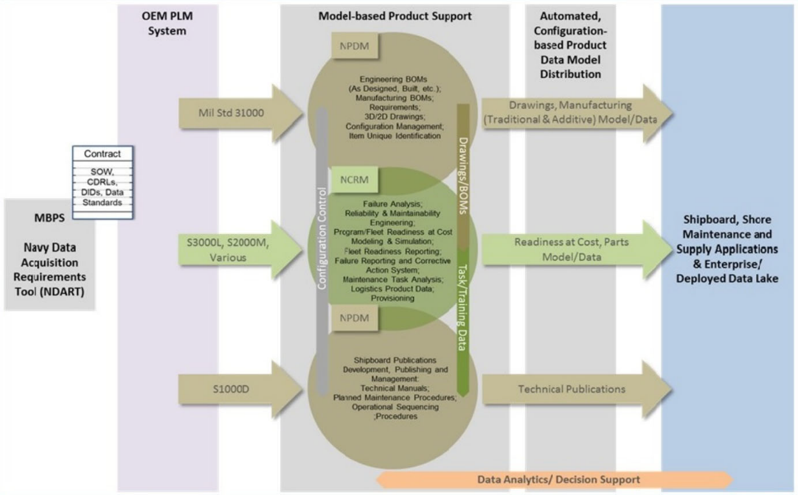
Model‐Based Product Support
Newport News Shipbuilding, a Division of Huntington Ingalls Industries, All Rights Reserved 2021

Slide 12
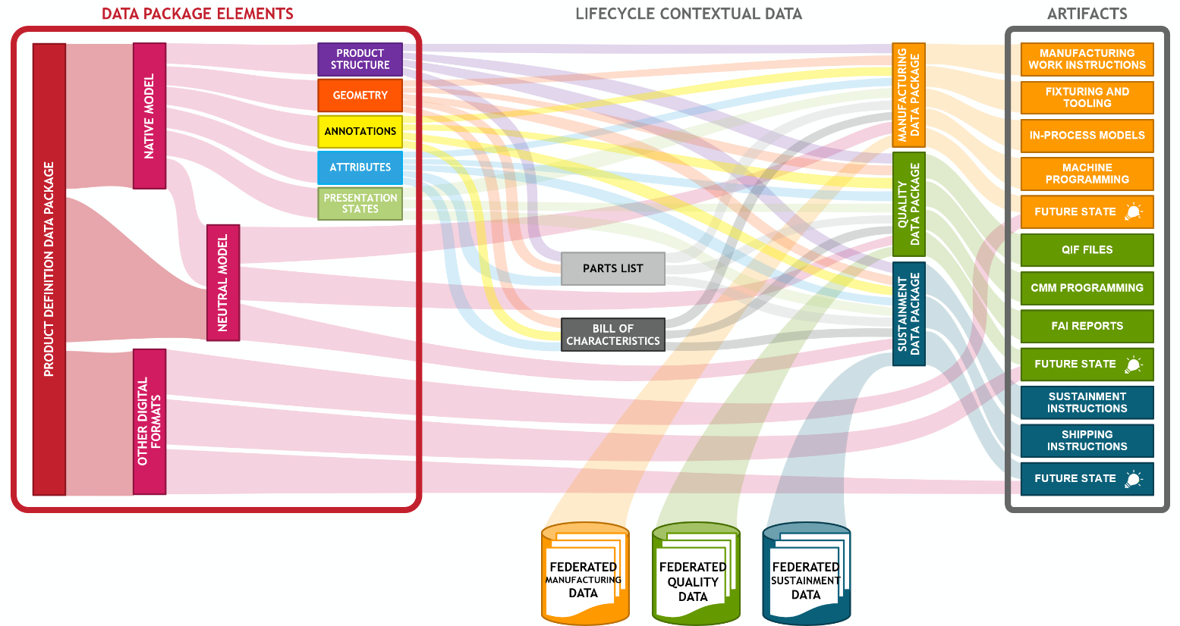
3D Data Information Flow
Action Engineering, LLC Proprietary – do not reproduce, repurpose, or distribute without written permission from Action Engineering, LLC
Newport News Shipbuilding, a Division of Huntington Ingalls Industries, All Rights Reserved 2021

Slide 13
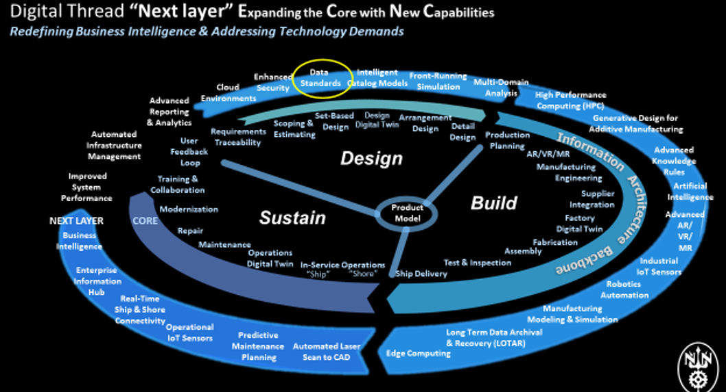
Information Future State Alignment
Newport News Shipbuilding, a Division of Huntington Ingalls Industries, All Rights Reserved 2021

Slide 14
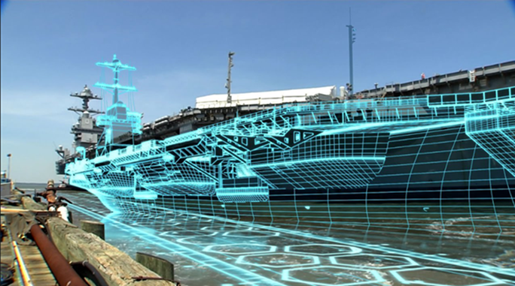
Conclusions
Phase 1 Summary:
Brought together a diverse group of government and industry stakeholders
Came through comprehensive review of existing standards
Developed practical use cases and theoretical solutions
Met the milestones and deliverables for phase 1
Next steps:
Received Phase 2 funding
Execute Phase 2 kick off meeting
Newport News Shipbuilding, a Division of Huntington Ingalls Industries, All Rights Reserved 2021

Slide 15
Questions?
Newport News Shipbuilding, a Division of Huntington Ingalls Industries, All Rights Reserved 2021

