Slide 2
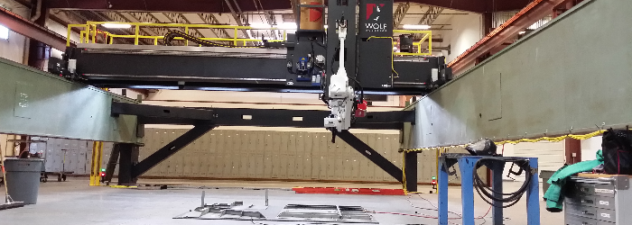
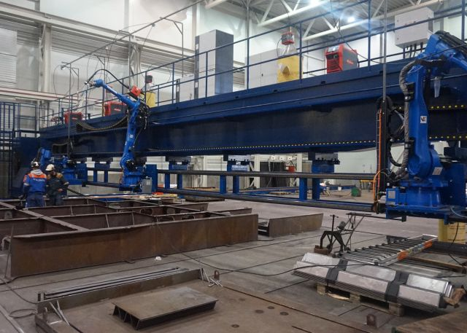
Focus on improved tool for weld mechanization
Background: SHIPYARD ROBOTICS CHALLENGES
Shipyard Characteristics
Limit Automation & Robotics To:
Large structures
Spaces that are relatively easy to access
Variable weld types
Robots that can be stationary or guided
by track, adjacent surfaces or gantries
Poor fit ups
Hard to access spaces
Materials that can be brought to robots
Current solutions:

Slide 3
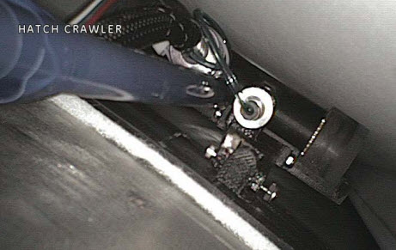
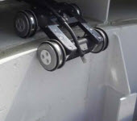
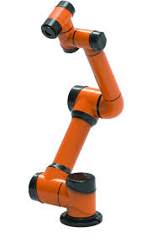
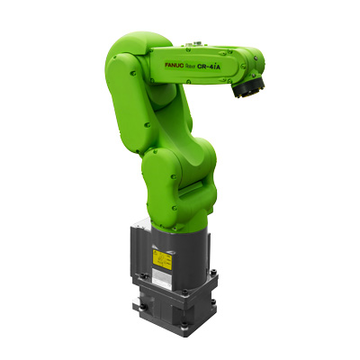
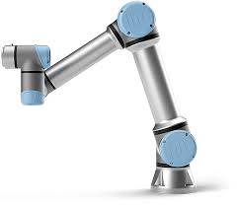
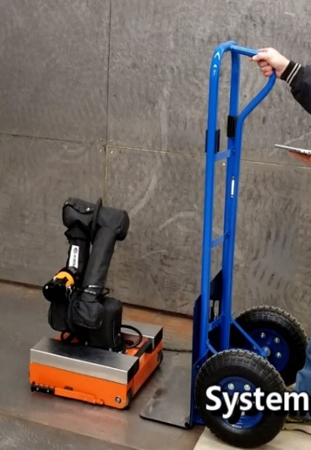
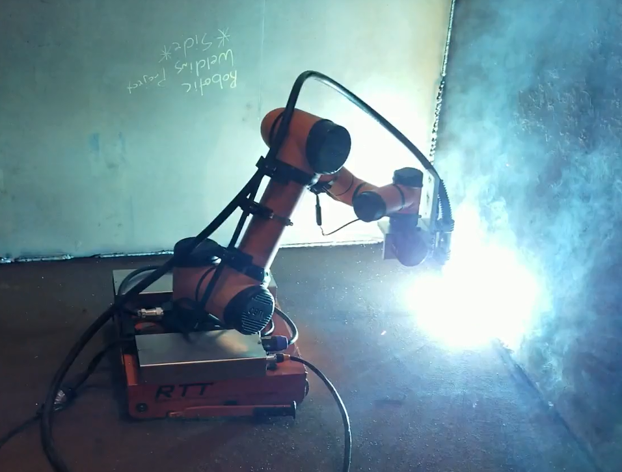
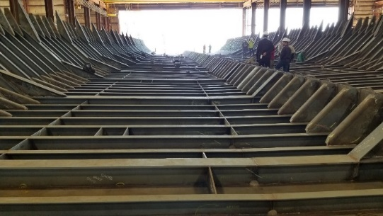
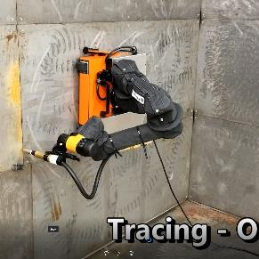
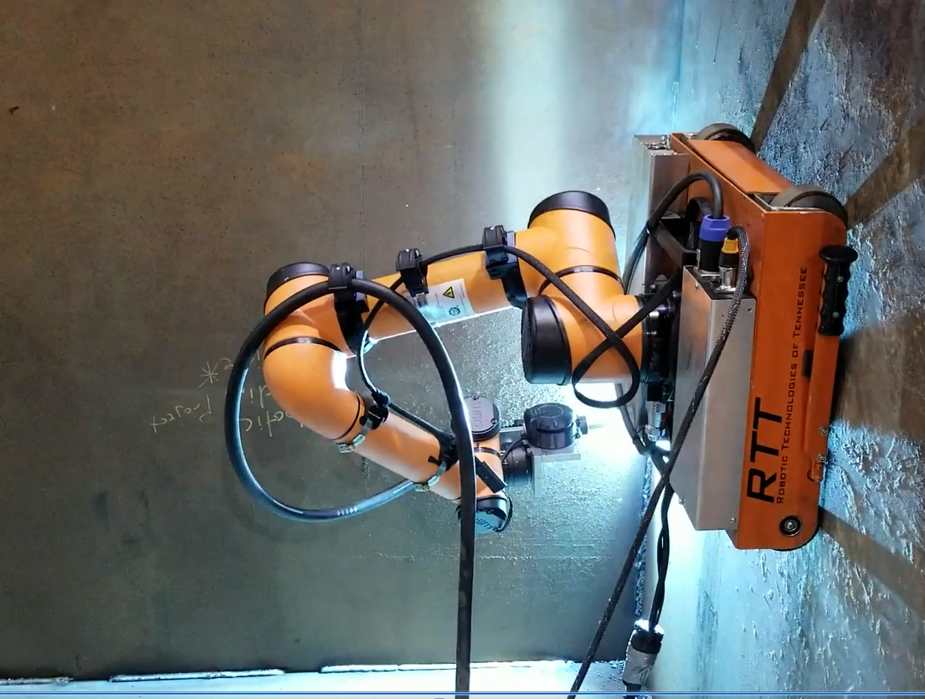
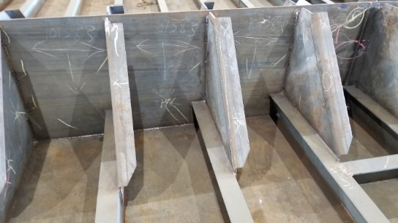
Limitations/opportunities
Challenge with existing solutions:
High cost
Difficult to scale
Lose effectiveness as product moves out of Panel lines
Rely on accurate Cad models
Do not cope well with un-modeled staging
Recent/Continual Advances in robots
Advanced mobility
Collaborative robots
Full 6 dof pose
Lighter, safer, cheaper
Enhanced sensing, actuators
PROPOSED SOLUTION
HMMR:
High Mobility Manufacturing Robot

Slide 4
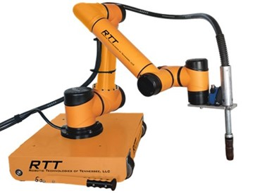
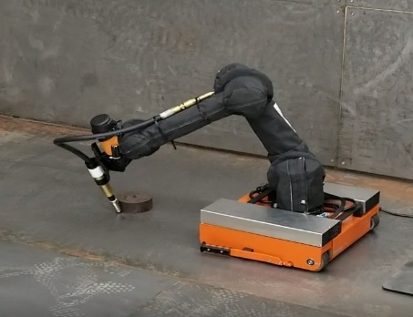
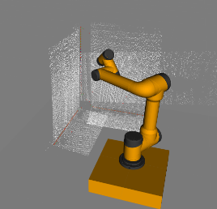
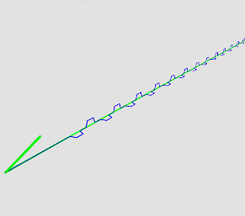
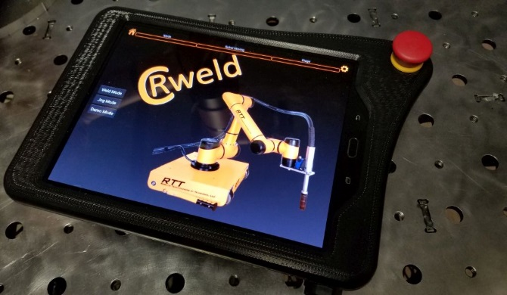
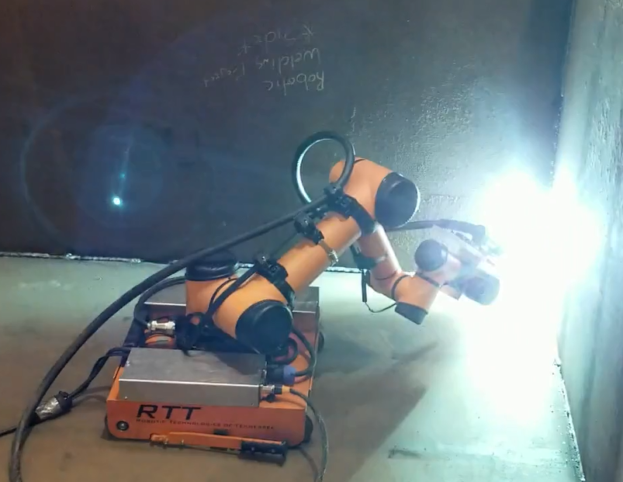
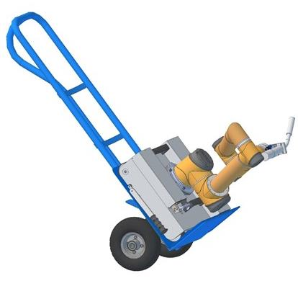
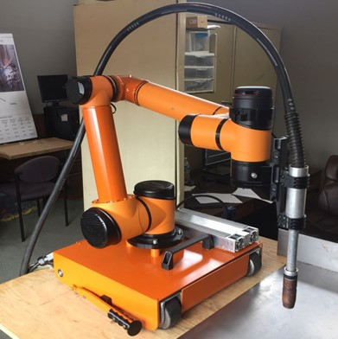
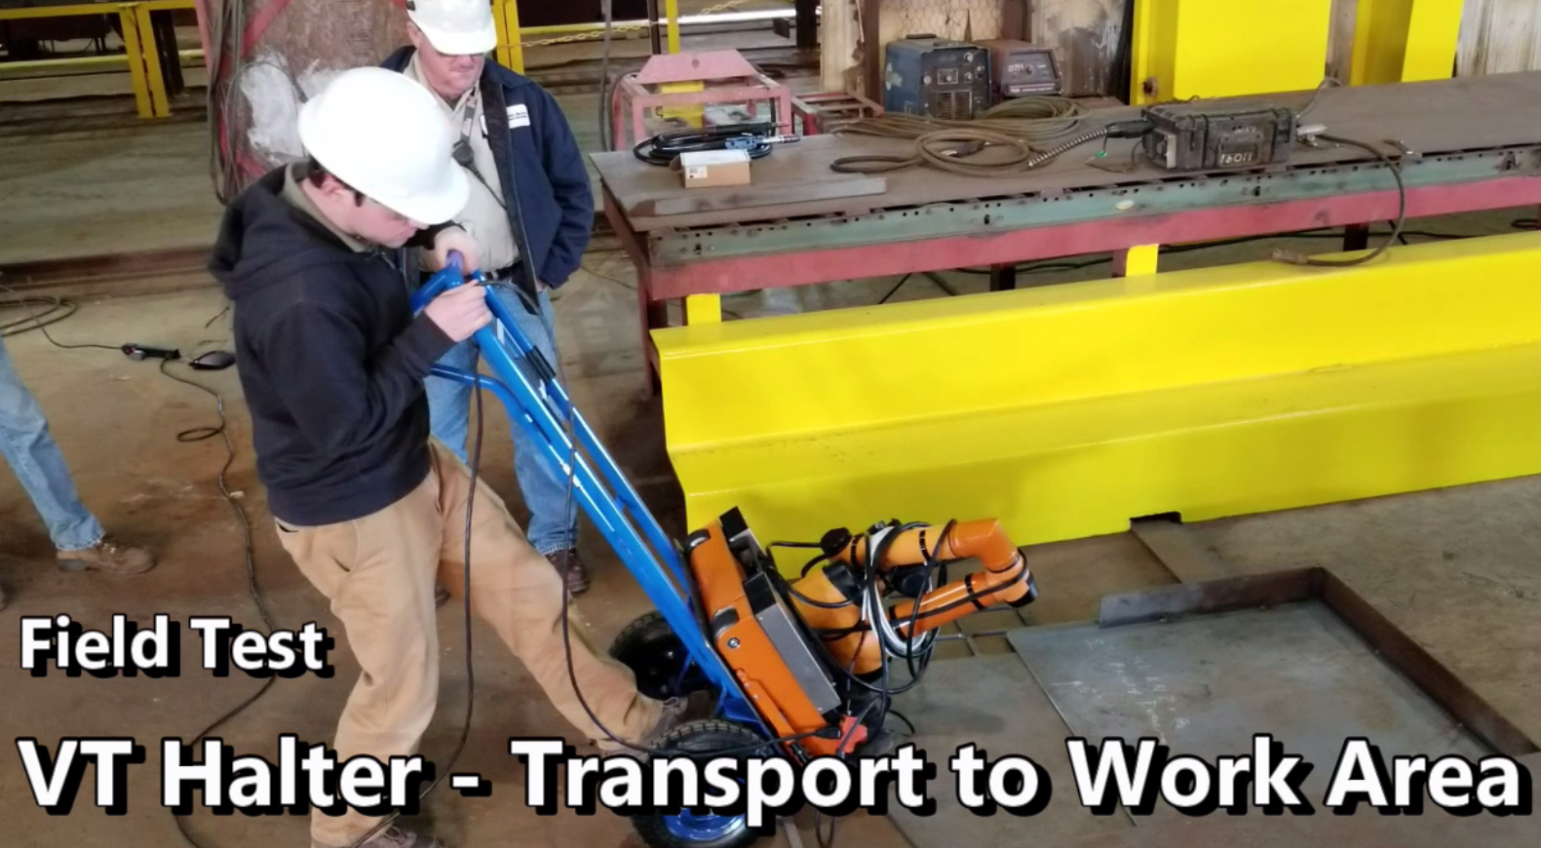
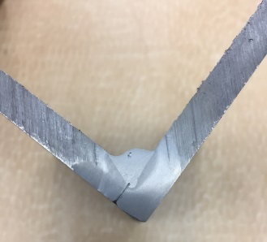
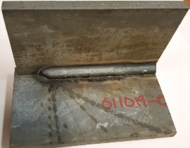
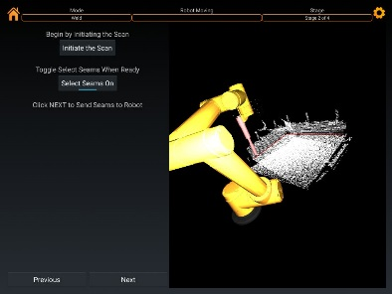
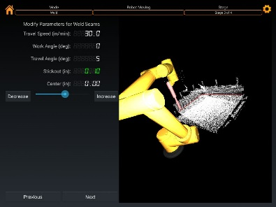
RTT Prior Projects Addressed (RA-2017-427)
Primary Technical Tasks
1. Integration of HMMR hardware
Improved weld-seam sensing to be robust to non-ideal fitup
Improved weld-seam sensing and algorithms for automated weld-path training
2. Robot control system and interface
Adaptable welding options: open-loop and closed-loop weld capability
3. Developed man-portability around shipyard
4. Automated weld-path training (using lidar mapping)
Advanced workspace mapping for real-time obstacle avoidance
Advanced Lidar options + SW
5 . Validated weld operations in 2F/3F positions (horiz./vertical fillets)
Develop supports and guides to aid in-field use
Improved operator interface and experience

Slide 5
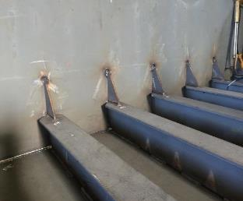
Early Task Selection: Vigor Shipyards
Challenges
Welding stiffeners and gussets at intersection between deckplate and bulkhead
Non-mechanized welding tasks in this region
Difficult positions to reach
Wrap-around welds require inspection and some amount of rework

Slide 6
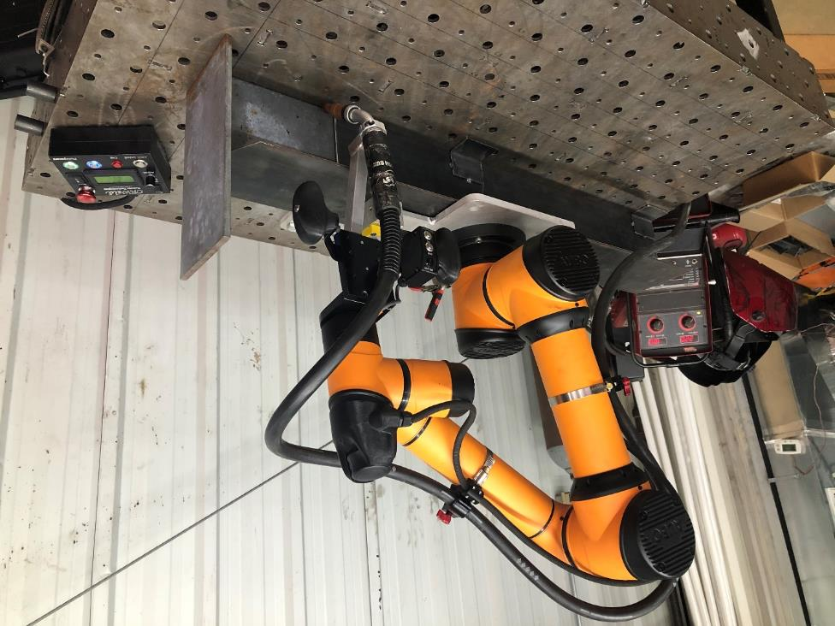
Approach:
Prototype Platform with Hardware (HMMR)
Modes of operation:
Drag-through teach mode
Teach job positioning mode
Automatic job positioning mode
Base: Magnetic switchable
Arm: Aubo i5 commercial cobot
End-effector: Supports torch and user interface
Algorithms: Control robot motion, path and job planning

Slide 7
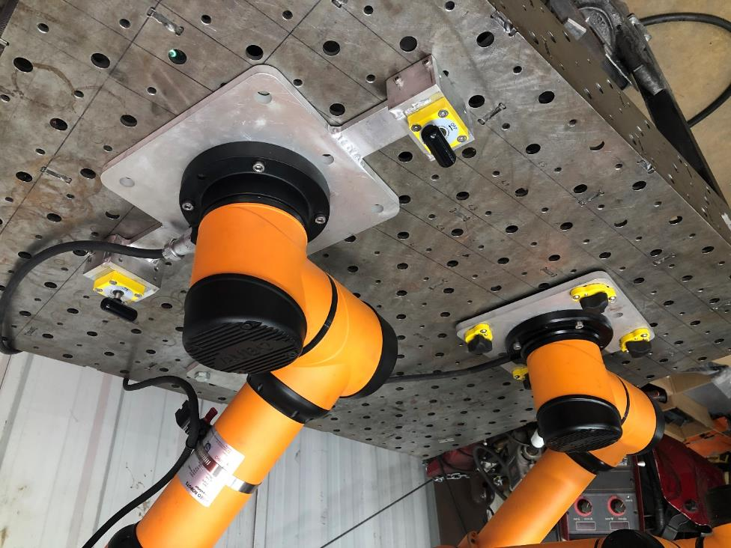
Target Job:
Preliminary Approach and Hardware
Welding stiffeners and gussets at intersection between deckplate and bulkhead
HMMR is man portable (approx. 50 lb)
Operator places HMMR on the flange of a stiffener approximately 2 feet from the bulkhead
Switchable magnetic base secures robot to stiffener
HMMR measures key points on the stiffener to teach weld path

Slide 8
Mobility Requirements
Task: T-Stiffener with gussets welds at deck plate and bulkheads
Task workspace: ~300mm (12 inch) sphere
HMMR workspace: ~ 950 mm (37 inch) sphere
HMMR positioned on stiffener

Slide 9
Prototype Mobile Base
Mobile Base is magnetic switchable base to attach to top of stiffeners
To be moved by operator
Weight of Arm and base is ~50 lbs.

Slide 10
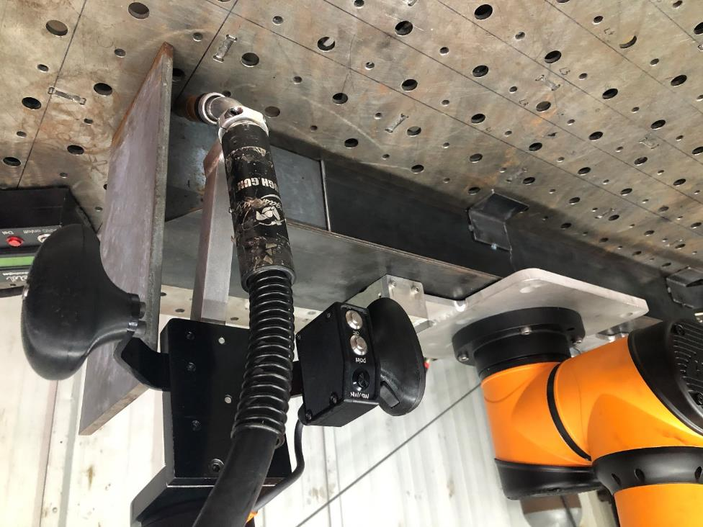
Mobile Base Testing
Mock-up of weld task constructed
Full-scale testing to include sensor and weld testing
Robot able to reach weld jobs with full orientation capability
Tested motion and live weld testing

Slide 11
Mobility Requirements for Arm:
Arm Specs to meet weld requirements
Tool motions tested at 600 ipm
Axis/Joint | Range | Speed | Torque
Axis rotation base J1 | (+/-) 175 ° | 150 ° / sec | 207 Nm (153 ft-lb)
J2 axis rotation shoulder | (+/-) 175 ° | 150 ° / sec | 207 Nm(153 ft-lb)
J3 Elbow rotation axis | (+/-) 175 ° | 150 ° / sec | 207 Nm(153 ft-lb)
J4 rotation axis wrist | (+/-) 175 ° | 180 ° / sec | 34 Nm (25 ft-lb)
J5 wrist axis | (+/-) 175 ° | 180 ° / sec | 34 Nm (25 ft-lb)
J6 rotation axis wrist | (+/-) 175 ° | 180 ° / sec | 34 Nm (25 ft-lb)

Slide 12
Prototype hardware, base + Arm + Torch:
Modes of operation:
Drag-through teach mode
Teach job positioning mode
Automatic job positioning mode
Base: Magnetic switchable
Arm: Aubo i5 commercial cobot
End-effector: Supports torch and user interface
Algorithms: Control robot motion, path and job planning

Slide 13
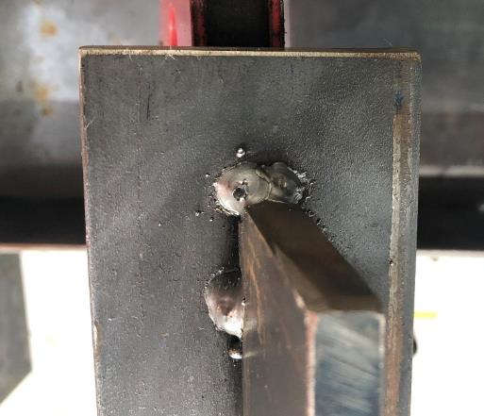
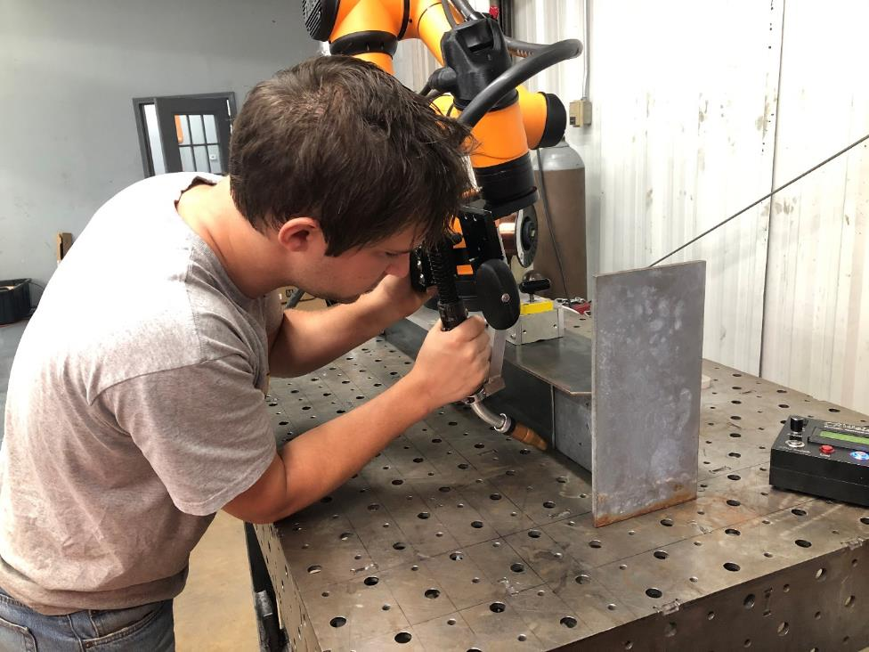
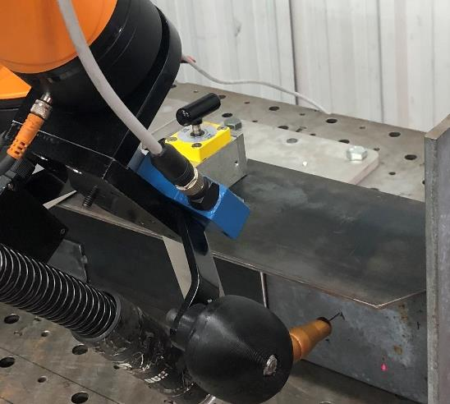
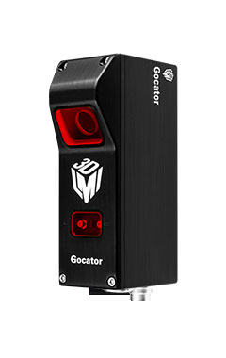
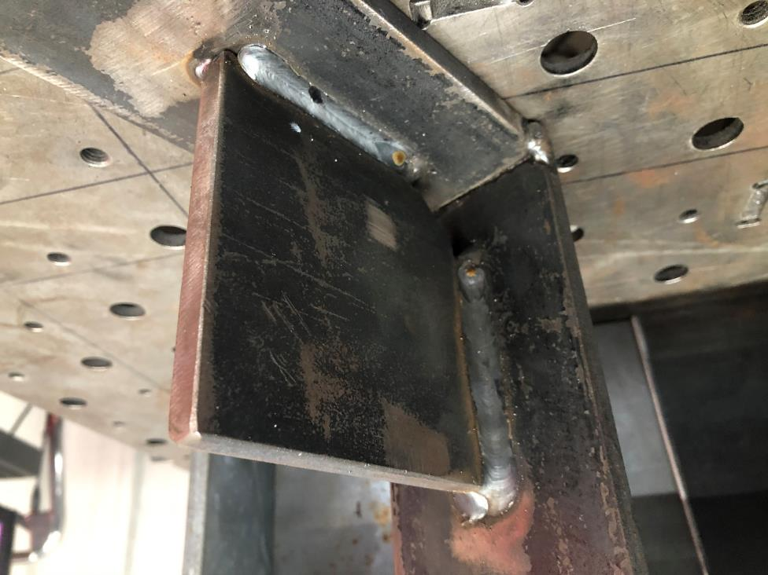
Strategies
Preliminary Testing
Algorithms developed
Path planning
Mapping Weld path to robot frame
Torch wire-tip sensing
Laser-based point sensing
Laser-base line sensing
Testing covered:
Wrap-arounds *
Vertical up fillets *
Horizontal fillets*
Teaching weld paths
Weld Job alignment
* All welding guided by EWI
* Powerwave 450, Pulse mode, Tregassis torch

Slide 14
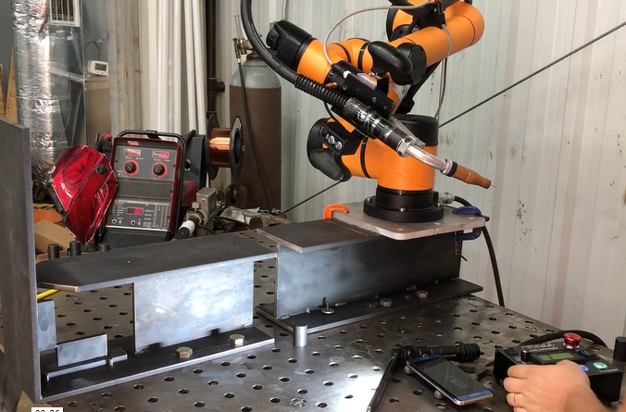
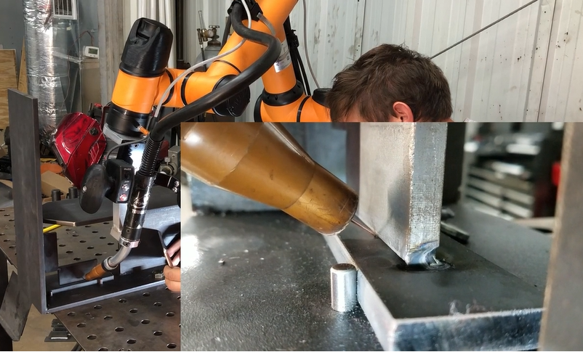
Video demonstration
https://vimeo.com/463090662/3c813a4745

