Slide 1
Shore Power Connector Tester
D’Angelo Technologies (D5T)
3182 Rodenbeck Suite D
Beavercreek, OH 45432
216-650-1552
Electrical Technologies Panel Meeting
2 December 2020
A: Approved for public release: distribution unlimited

Slide 2
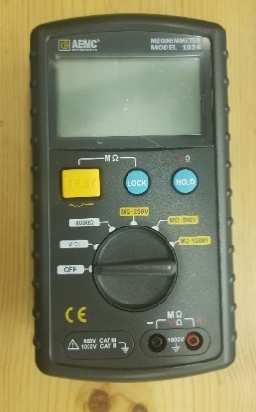
Project Overview
A Dec. 2014 NSWCCD-SSES report notes a significant number of 450V 400A surface ship shore power connection plug and receptacle failures.
These connectors are subject to corrosion at the connection pins themselves. Corrosion leads to high impedance contact and subsequent heating of the pins and eventual failure.
The connectors are tested before connection to shore power with a MegOhm meter (“Megger”) to verify that there are no accidental low impedance paths between the phases or to ground.
In Feb. 2018, a pin failure in a 450V shore power connector on a DDG-51 class destroyer led to an Arc Flash Event in which the connector exploded.
Due to similar issues in the fleet, a new Maintenance Requirement Card (MRC) has been issued that requires Megger testing from each pin in the receptacle to every other pin and also to ground, rather than just a single phase to phase and phase to ground tests.
(a)
Fig. 1 (a) Results of an arc flash event at 450 V Shore Power Connector on destroyer
(b) MegOhm Meter currently used to measure isolation between connector pins.
A: Approved for public release: distribution unlimited
(b)
Distribution Statement A: Approved for public release: distribution unlimited

Slide 3
Project Overview
The number of permutations for the new tests results in a significant increase in the time and effort to perform these tests and also increases the opportunity for human error.
  Phase A (7 pins) to (Phase B (7) and to Phase C (7)) is 7 X 14 = 98 tests
  Phase B (7) to Phase C (7) is 7 X 7 = 49 tests
  All Phases (21 pins) to ground = 21 tests
  Total tests per receptacle = 168 X 12 receptacles per ship = 2016 tests
Fig. 2: 450 V Shore Power Connector
The Project
Investigate the suitability of COTS equipment first and determine if such equipment can be adapted to this application.
Should it prove suitable, develop any required modifications, including a connector to mate the equipment to the ship connectors, and program the equipment for the appropriate tests.
If there is a fundamental issue with the equipment, the project will develop a design concept for switching the Megger measurement device between all the test permutations and offloading or recording the test data.
If sufficient funds remain at this point, a prototype proof of concept device will be constructed.
The goal is to develop a portable tester that can be plugged into the shore power connector and run the required tests at a single command or button push.
Distribution Statement A: Approved for public release: distribution unlimited

Slide 4



Project Team
Huntington Ingalls Pascagoula Shipbuilding – Shipyard representative – arranging final demo
Gulf Coast SUPSHIPs – government stakeholder – first identified the issue.
Project Technical Representative – Walt Skalniak, Panduit Corporation.
NAVSEA 05Z IPT Members – Chris Nemarich and Peter Andrich
The Penn State Electro-Optics Center – project administration, requirements and test plans, evaluations.
D’Angelo Technologies, LLC – programming and testing COTS equipment, recommending modifications.
Distribution Statement A: Approved for public release: distribution unlimited

Slide 5
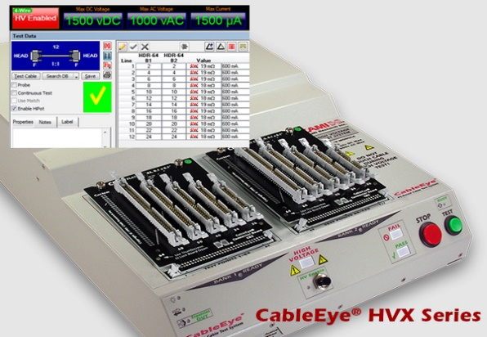
Project Approach
Define firm requirements and test conditions for performing the required tests.
A candidate COTS device has been identified that is potentially suitable.
  It is the CableEye HVX High Voltage Cable Tester from CAMI Research (Acton, MA).
  Nominally it tests a cable from end to end, but appears to be configurable to make the required measurements.
  Portable table top device with interface to a laptop computer. Generates and records a full report in less than a minute.
  In-house at D’Angelo Technologies, LLC and available for tests.
Perform laboratory tests on the COTS device, including developing of programming to perform the required test. Simulate low and high impedance connections via resistors.
Fig. 3 CableEye HVX High Voltage Cable Tester
CAMI Research, Acton, MA.
Distribution Statement A: Approved for public release: distribution unlimited

Slide 6
Project Approach (cont.)
Mate an appropriate cable and connector to the tester for testing with a shipboard connector.
  Perform initial testing with a surrogate connector and mating connector with the appropriate number of contacts.
  Purchase the same connector pair used for shore power connections and modify them for use with the cable tester.
Discuss with the shipyard to determine if a realistic test can be made aboard ship or in another test facility to verify the prototype tester performance in actual tests and whether a detectable failure can be simulated.
Perform this test and collect data if schedule and availability can be worked out.
Identify the path forward for implementation.
Distribution Statement A: Approved for public release: distribution unlimited

Slide 7
Project Task Status
Task 1- Review Project Requirements along Gulf Coast SUPSHIPS to develop a requirements document
>> Complete. Kickoff meeting held Nov. 12, 2019. Test documents reviewed.
Task 2 - Assess CableEye tester applicability to requirements
>> Complete. Testing verified that tester could be programmed to make tests from one connector rather than end to end. Used surrogate connectors and simulated failures.
Task 3 - Program CableEye tester for laboratory tests and test against requirements
>> Complete. Actual shipboard connector purchased and modified. Macros programmed in tester to perform the test automatically.
Task 4- Host a simulation demonstration D’Angelo Technologies, LLC facility demonstrating the lab tests for Penn State, IPT members and invited participants.
>> Complete. Testing demonstrated for IPT for both good and simulated bad connectors.
Task 5 - Support a field demonstration at a shipyard of equipment with actual connector.
>> Complete. Attempted testing on-board ship (discussion)
Demonstrated in-lab testing of both good and simulated bad connectors.
Task 6- Final Report
>> Complete. Submitted to NSRP and recommended additional follow-on testing
Distribution Statement A: Approved for public release: distribution unlimited
Notes:
Navy test documents =
Maintenance Requirement Card (MRC) 65 2PN5 N for testing of shipboard shore power connectors.
MIL-STD-2003-2A(SH) – primarily Appendix E on shore power connectors.

Slide 8
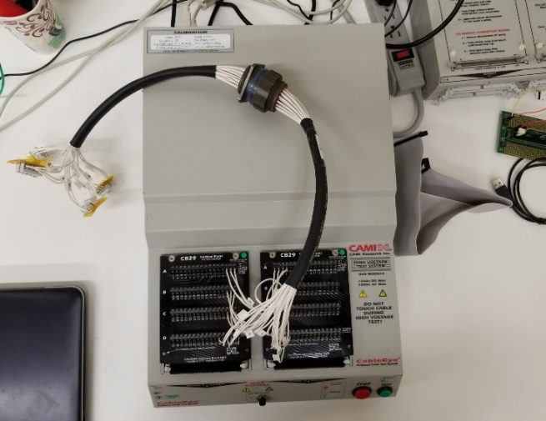
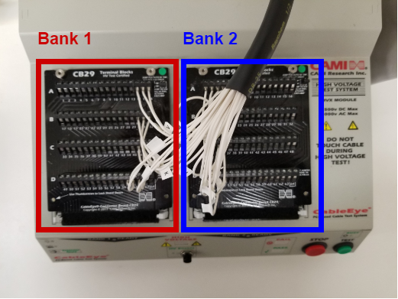
System Set-Up
System and Programming Set Up with Surrogate Connector
Receptacle represents ship side, plug represents shore side
Pins on receptacle side connected by phase (all 7 phase A together, all 7 phase B together, etc.)
Pins on plug side connected to tester, but half for each phase to bank 1 and remaining to bank 2
This allows tester to complete circuit through the pins connected on the back of the receptacle.
Surrogate cable connected to tester
Wire connections to tester

Slide 9
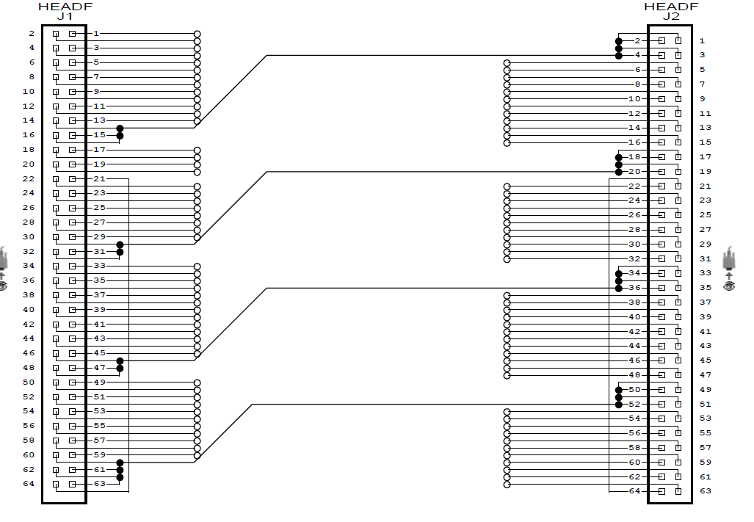
Good Cable Test Schematic
Tester generates a schematic of what it sees connected or uses a stored schematic.
Tester runs low voltage test comparing cable under test with stored schematic.
If it passes, runs high voltage test. Parameters set to 500VDC and 1 MΩ pass/fail to meet test card requirements.
Test takes 51 seconds to complete and checks every terminal pin against every other.
Phase A
Good Cable Schematic
Phase B
Phase C
Ground

Slide 10
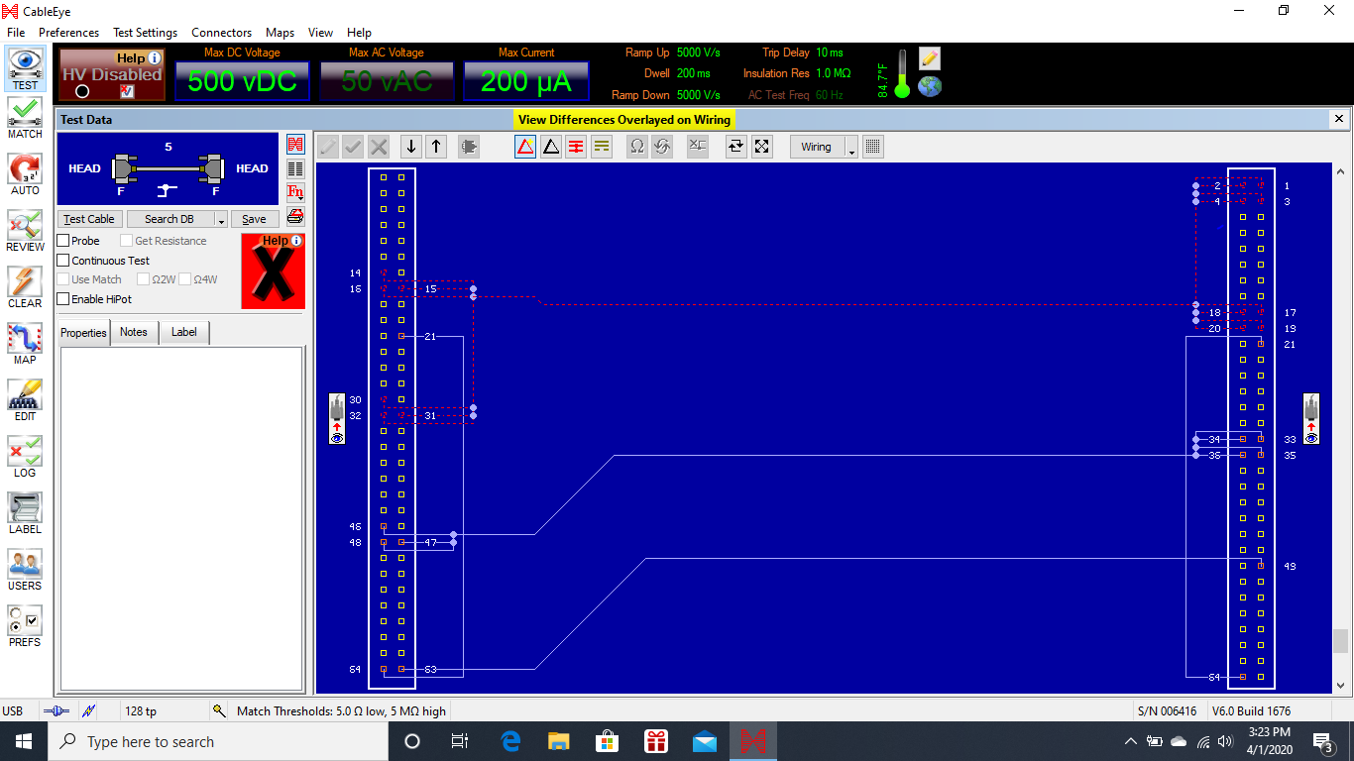
Failed Cable Results
A low impedance fault was simulated by connecting a resistor between two of the tester terminals representing different phases.
During low voltage test, tester identifies difference between test cable and stored connection and flags it with Failure Mark (X on Red) and schematic highlighting problem. HV test not run.
Other fault simulated by resistor in series with one connection – simulating one corroded pin.
Failed Cable showing unintended connection between Phase A and Phase B (red lines)

Slide 11
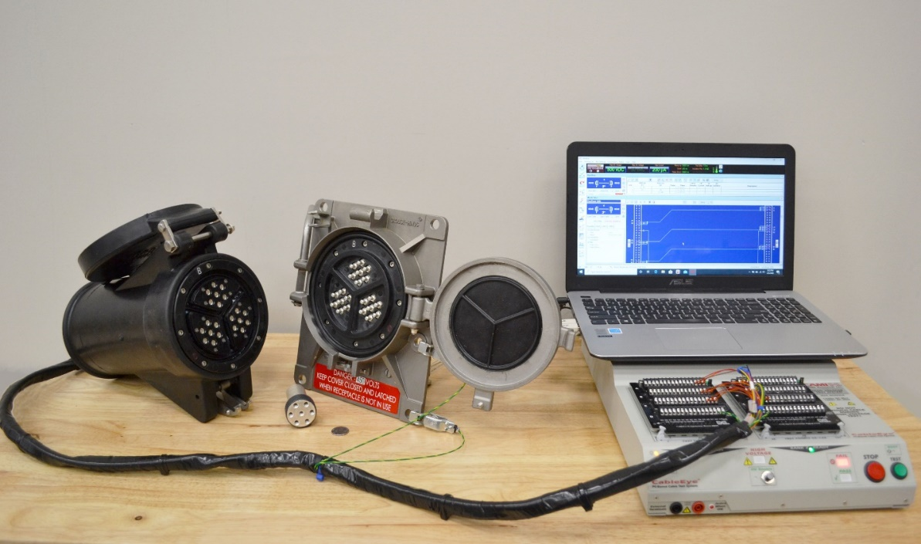
Ship Connector (Lab) Test Set-Up
The actual shore power plug was modified to bring a wire out from each pin so that the pins could be individually connected to the tester
The receptacle pins were wired together by phase the same as the surrogate receptacle.
A ground connection was added (clipped to receptacle)
Tester connected to shore plug (L) with ship receptacle (C) shown

Slide 12
Team Lab Demonstration
The setup shown on the previous slide was demonstrated at D’Angelo Technologies’ facility on Feb. 20, 2020 for some members of the IPT. A summary report was sent to those who could not attend in person.
Feedback from the IPT included:
  The cable tester configured in this manner can perform the required shipboard tests
  It is permissible to use the ground clips to the receptacle bolts to provide a ground connection for the test.
  This was a good proof of concept demonstration using a benchtop COTS tool adapted for the purpose.
  However, a practical tester needs to be simplified. Ideally it would all be built into the plug, with an on/off switch and a pass/fail indicator. Data could be saved or extracted as necessary, but would not be part of the normal day to day testing.
  The question was raised about calibration requirements and who might perform the calibrations.

Slide 13
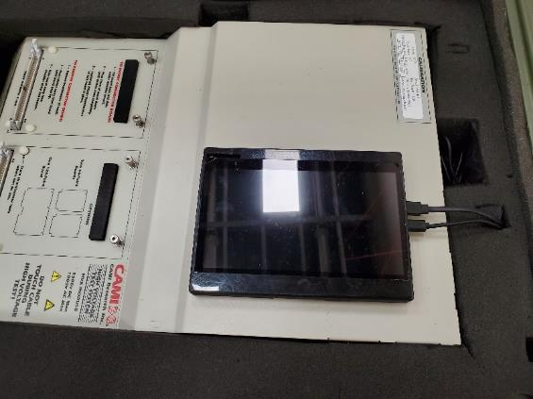
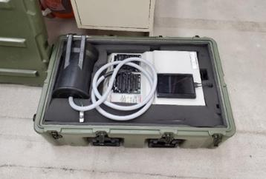
Shipyard Preparation
Package Tester and shipboard connector to facilitate shipboard demonstration
  Pocket PC
  Touch Screen
  Packaged in Case

Slide 14
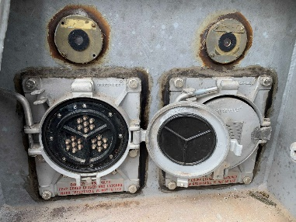
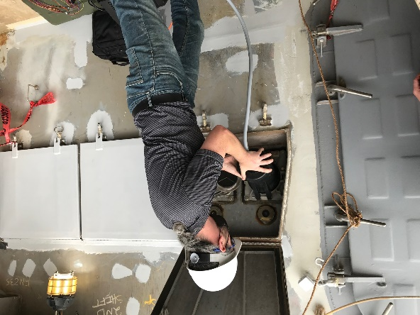
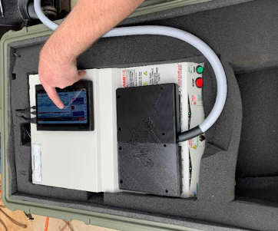
Shipyard Demonstration (Real-World)
Field Demonstration 6 October 2020 at Huntington Ingalls (Pascagoula, MS)
On-board DDG 121 and at Ingalls Research and Development Laboratory
Testing On-board DDG 121
  Starboard end of shore power receiving station
  Ship operating on generator power
  Receptacle circuit secured and locked out
  Power for tester
    120VAC
    Ship’s power (generator)

Slide 15
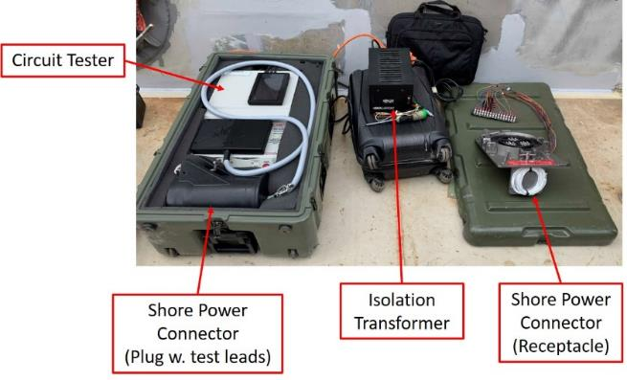
Ship Testing – Issues
Tester unable to perform tests with shipboard shore power receptacle
  Detected 9V discrepancy between Phase A and B
    Speculated due to induced voltage on line from adjacent powered cables
  Detected 800kOhm resistance between Phase B and C

Slide 16
Ship Testing – Resolutions
Code in allowance for voltage / resistance discrepancies based on known issues
  Eliminate / account for electrical noise
Increase dwell time allowance (resolve resistance issues)
Iterative process to reduce tester sensitivity to noise
  Reduce test threshold resistance
  Increase dwell time
Develop test set up with metal plate
  Connect or disconnect to earth ground (or a test pin) as necessary
  Verifies need for isolation

Slide 17
Path Forward Recommendations
Optimization of Code to Account for Noise
Testing and Validation at Shipyard
Miniaturization of System
  Size
  Weight
  Portability
  Robustness
The use of an automated tester has great potential to save hundreds of hours of work, avoid costly and dangerous arc flash events and provide confidence that the receptacles are 100% inspected prior to each use.

Slide 18

Project Benefits
The former test procedure required 6 tests (phase to phase and phase to ground), manually performed on 12 connector or 72 tests. The new requirement changes this to 2016 tests, or a x28 increase in labor effort and time. An automated tester can check each connector in about 2 minutes or roughly one half hour for all the tests, a significant savings in labor.
Once the tester is completed, acquisition costs are fixed.
Another strong benefit is the reduction in potential for human error.
  Each of these tests is repetitive and the connector pins are identical in appearance.
  The sheer number of identical tests increases the likelihood of a mistake being made.
  Manual recording of data is also prone to error.
  An automated tester that performs all the combinations of tests and records the data eliminates these sources of error.
The recording of impedance measurements of the same connector over time can yield information on whether corrosion is starting to affect the integrity of the pins. This allows replacement of pins before they fail or show external signs of degradation.
Exact cost estimates for the tester acquisition will be determined by how the design develops during the course of the project. The benefits are extendible to all ships using this type of connector, or to other connector types by substituting the mating connector on the tester.
Distribution Statement A: Approved for public release: distribution unlimited

Slide 19

Questions
Contact:
Maurissa D’Angelo, D’Angelo Technologies, LLC
  maurissa@dangelotechnologies.com
  216 650 1552
Jeff Callen, Penn State Electro-Optics Center
  jnc13@arl.psu.edu
  724 295 7000 x7141

