Slide 1
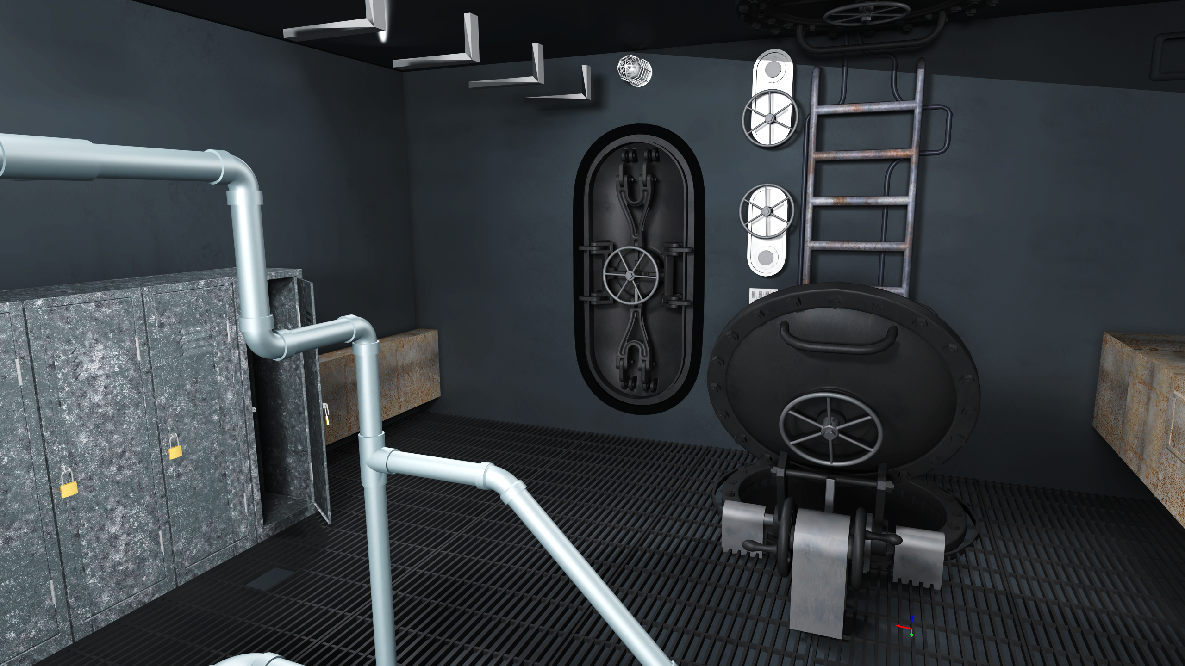
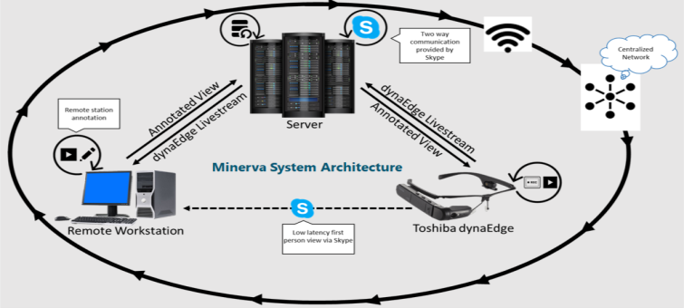
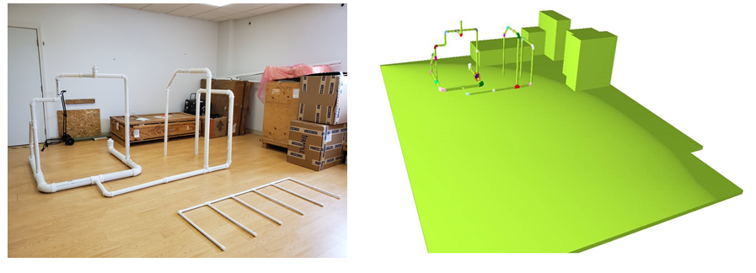
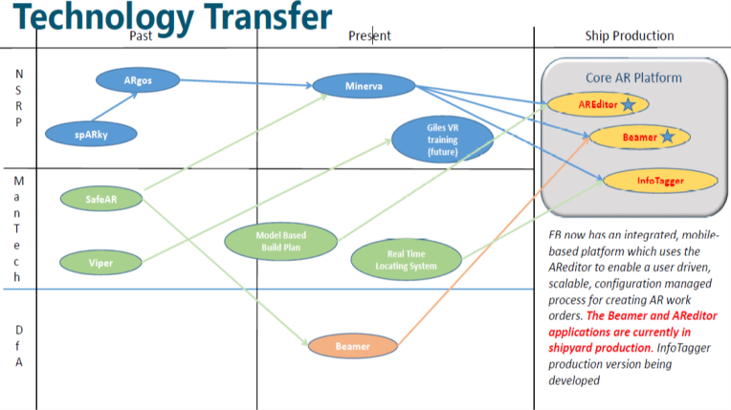
Minerva
(A Mixed Reality System for Real-time Construction Problem Resolution)
ROI: During the course of construction a typical ship experiences numerous reported construction problems. In addition to the cost entailed in correcting the problem, these episodes adversely impact the critical construction path. It is assumed that the Minerva tools will eliminate 5 days in the overall construction period of performance for a single ship hull. Moreover, it is assumed that Minerva tools will account for 1 hour savings per reported construction problem.
.
Team: GD - Electric Boat| SIEMENS | GD - BIW| GD - APS | GD – MS | ESI North America | Navatek, LTD| D’Anagelo Technologies| PEO Carriers
Problem Statement
Need accurate 3D information for Maintenance & Repair
Solution/ Approach
The goal of the project is to make a step reduction in construction costs for ships by making an appreciable reduction in the construction span time. This project will provide the capability to establish real-time video and audio connections from the deck plates to the engineering office and to provide resolutions, both static and dynamic, from engineering back to the deck plates via AR, VR and CAD techniques.
The Minerva project will apply an innovative combination of Augmented Reality (AR) and Virtual Reality (VR) technology to produce a Mixed Reality (MR) tool that will provide real-time resolution of construction problems.
The Minerva project will apply an innovative combination of Augmented Reality (AR) and Virtual Reality (VR) technology to produce a Mixed Reality (MR) tool that will provide real-time resolution of construction problems.
Project Benefits
Enable the technicians, designers, and engineers to solve construction problems not only faster than before but also better than before by creating a shared problem-solving environment.
Project Results
Phase 1 & 2 complete, Phase 3 completion December, 2020
Developed and installed three AR applications for construction use in the shipyard
Providing commercial AR/VR solutions for other shipbuilder consideration.
Providing commercial Mixed Reality solutions for other shipbuilder consideration.

Slide 2
Things to keep in mind….
You have about 2 minutes to convince a person to stay in the virtual room.
Have visual aids.
Tell your story using images or video.
Convince the people with the check book to give you money. Talk about impact to the various programs.
Have the technical people in the room to answer the Technical Warrant Holder (TWH) questions.
Be prepared to answer questions about benefits, roadmap, what it takes to get it implemented.
Have pictures of things that have been built.
Please keep professional presence at all times.

