Slide 1
Support Delivery of Shipbuilder Product and Technical Data to an In-Service Navy Product Lifecycle Model (PLM)
2019 NSRP Business Technologies Panel Project
Task Order 12 of Task Order Agreement 2018-453
May 21, 2020

Slide 2
Project Participants
Project Primary Integrated Project Team (IPT)
  Nick Laney, Program Manager, NSRP
  Caroline Mueller, NSRP Panel Coordinator/ECB Administrator
  Patrick Roberts, Program Technical Representative, SSI
  Virgel Smith, NSRP Business Technology Chair
  Vesmiene Ceasor, Project Manager, Ingalls
  John Walks, Ingalls
  Mark Debbink, Newport News
  Michael Gerardi, Bath Iron Works (BIW)
  Shawn Wilber, Austal USA (Independent Project Participant)*
  Paul Koester, Navy SEA 06L1
  Ann Mackinnon, Navy SEA 06L1
  Lt. Connor Rentz, Navy SEA 06L1
Project IPT Support Team
  April Martin, Ingalls
  Charles Wilson, Ingalls
  Rebecca Sparkman, Ingalls
  Michael Salvetti, Ingalls
  Cameron Colegrove, Ingalls
  Wayne Bertrand, Ingalls
  Angela O. Woods, Ingalls
  Cody Griffith, Newport News
  Philip Jennings, Newport News
  Luke Lyndakar, BIW
  Eric London, BIW
  Kent Eliassen, BIW
  Supervisor of Shipbuilding, Gulf Coast
*Austal USA was an independent, self-funded participant. Participation was limited and there were no assessment inputs captured for this shipyard.

Slide 3
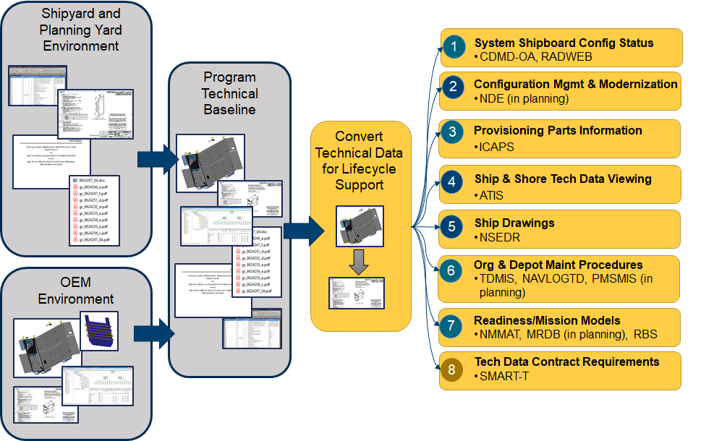
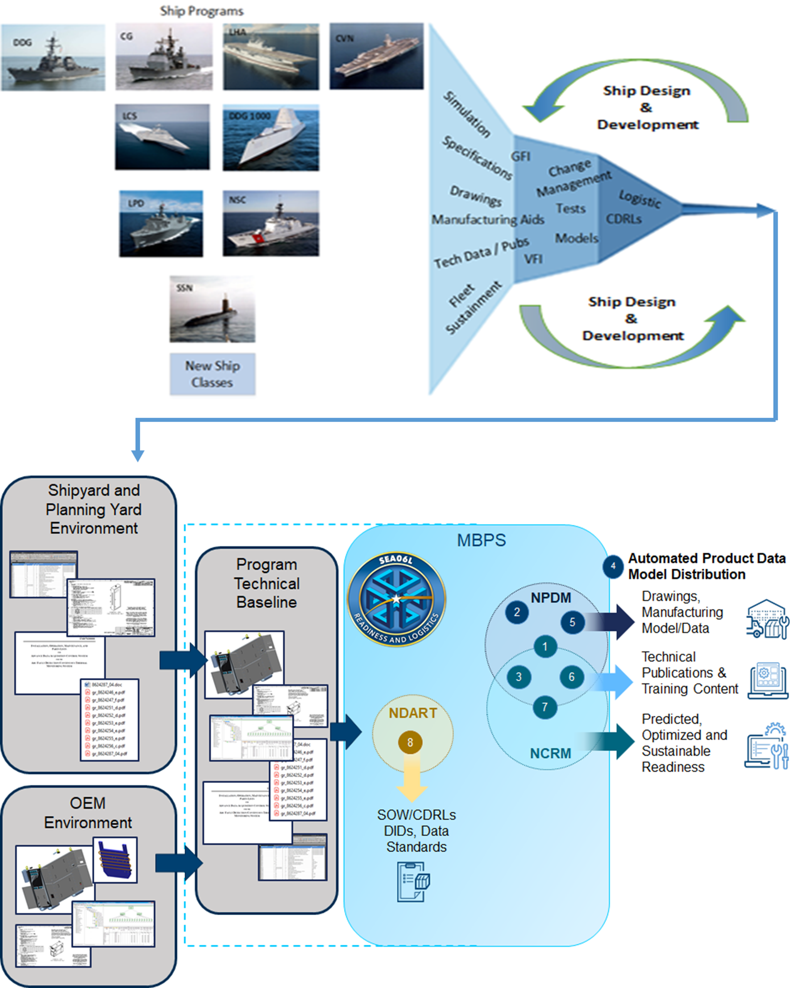
Background
The Navy seeks to replace eight stand-alone information systems
  Legacy systems lack common standards and processes & have outdated software
  Do not support artificial and machine intelligence or, Navy digital transformation goals
To rationalize the Navy’s current information systems into a more modern product lifecycle model (PLM), the Navy is developing a Model Based Product Support System (MBPS) comprised of three core business capabilities
  Navy Product Data Management (NPDM)
    Accommodate integration of product model environment, technical and engineering drawings/models, digital twin of the systems
  Navy Common Readiness Model (NCRM)
    Accommodate readiness modeling and simulation of data and cost and predictive analytics
  Navy Data Acquisition Requirements Tool (NDART)
    Accommodate and simplify requirements and standards
The MBPS System is intended to address both legacy and new weapon system data

Slide 4
Goal, Tasks & Deliverables
Overall Project Goal
  To assess the MBPS System requirements (Top Level) and alignment with and / or impact to shipyard capabilities – data and format types, processes, tools and current program contractual requirements.
Tasks:
  Gather data delivery requirements with Navy Shipbuilders. Compile data on current state capabilities and current contract data delivery requirements.
  Compile known Navy PLM requirements and compare to data delivery capabilities at the project team member shipyards on existing contracts.
  Define Impacts of Navy PLM requirements to Individual Shipbuilders.
  Provide recommendations that will help the Navy as they pursue the establishment of an In-Service PLM.
Deliverables
  Shipyard consolidated current state matrix.
  Shipyard consolidated requirements impact matrix.

Slide 5
Not Included in the Study
Assessment of data delivery requirements – The data input requirements into each MBPS core module was not defined in the requirements document at the time of this study.
Assessment of impact of performing analysis – At the time of the this study it was unclear if analyses would be performed during the acquisition phase or only "in-service".
Assessment of future standard changes – S1000x series standards not clearly defined at the time of this study

Slide 6
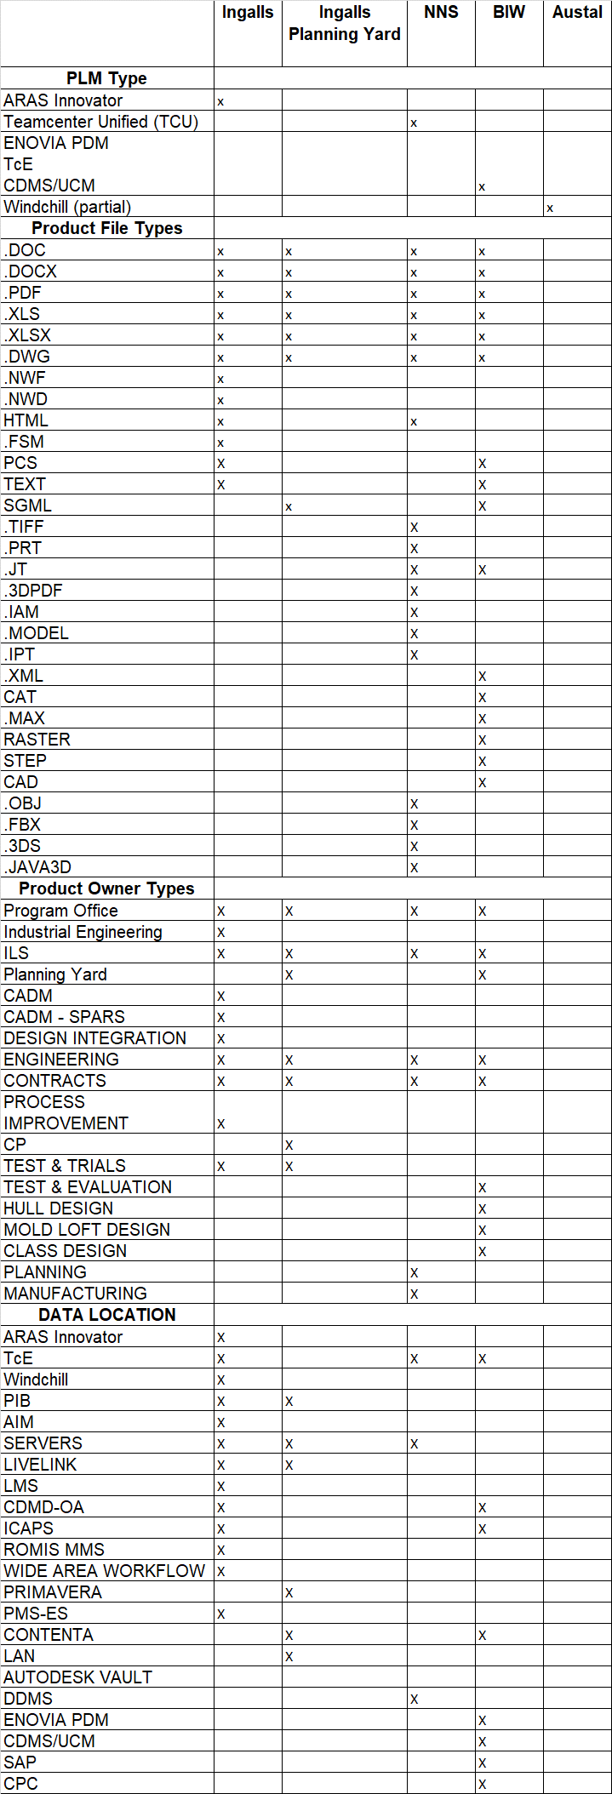
Approach & Results - Shipyard Current State Matrix
The purpose of the current state matrix is to
  Give Navy a consolidated view of the shipyard current capabilities across ship programs
  Give a view of the current requirements and deliverables to take into consideration as the MBPS Systems is being developed
  Allow future assessment for standardization of product types and formats – Benefit to new programs
Current state evaluation
  Tools
  Product deliverable types
  Product formats
  Ship applicability
Current state results
  Each shipyard uses a different PLM
    Not all ship classes maintained in PLMs
    Limited customer interfacing and access
  32 different Product types
  30 different Product file types
  22 different data storage locations across shipyards

Slide 7
Approach & Results - Shipyard Requirements Impact
Assessment based on:
  MBPS System top level requirements (TLR)
    Requirements mapped to a set of standards and ranked by the Navy based on an evaluation criteria
  Set of assumptions on how shipyards would utilize the MBPS core business capabilities
    Shipyards will utilize NDART to ensure they acquire the correct technical data when purchasing major equipment (e.g., generators, motors, pumps etc.).
    Shipyards will have access to NPDM data as reference to support their work processes (e.g., drawings, specs, technical manuals, etc.).
    Shipyards may use NCRM tools and capabilities for conducting trade-offs and selecting equipment.
    Shipyards will ensure data outputs and reports align with MPBS data structures and attributes (e.g., S1000 data, cost data).
    Shipyards will submit completed work packages to include modified drawings, updated specifications, and LSA data through Windchill via a change request workflow for incorporation into baseline configuration(s).
    Assessment of non-functional requirements may be dependent upon fully developing all shipyard use cases as the functional needs of the system may impact non-functional requirements (e.g., interface requirements.). Prior to full development of those use cases, the assumption is that current non-functional requirements for MPBS will support Shipyard requirements and likely use cases.
*
*Defined by the Navy

Slide 8
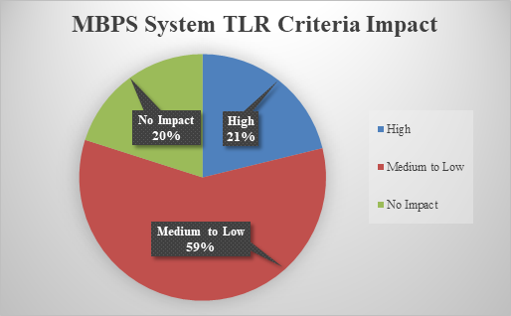
Approach & Results - Shipyard Requirements Impact
The MBPS System TLRs covers.
  14 design areas & 269 requirements.
21% of the requirements ranked high.
  will have a potentially significant impact on the shipyards.
59% of the requirements ranked medium to low.
  Requirements are essentially associated with the use of the NCRM MBPS module, which addresses supportability, maintenance tasks and reliability type analysis.
  Essentially there should not be any major process change to the shipyards with use of NCRM, but there could be impact to data format delivery.
20% of the requirements ranked no impact to the shipyards.
  These requirements were identified to be strictly related to the Navy’s business domain.
Overall, there will have some level of impact to the shipyards data deliverables, either in format, delivery method, or shipyard processes/procedures.

Slide 9
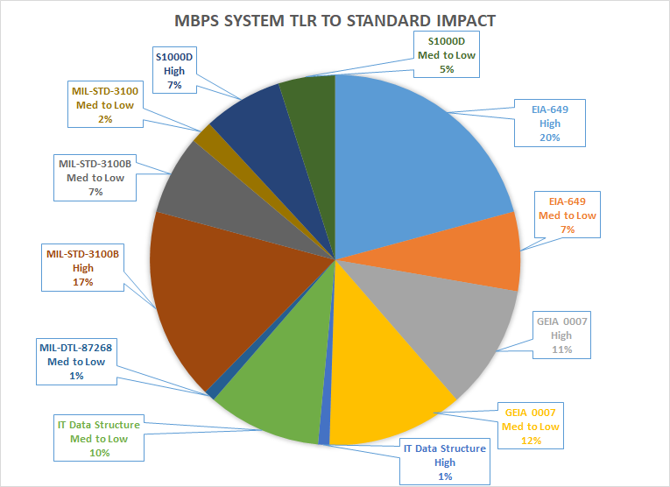
Approach & Results - Shipyard Requirements Impact
Each requirement was mapped to a set of relating standards.
    EIA 649
    MIL-STD-3100 and 3100B
    MIL-DTL-87268
    GEIA-STD 0007
    S1000D
System will be largely driven by EIA-649, GEIA-STD 0007 and MIL-STD-3100B standards.
The S1000D standard is noted to be an invoked standard relating to NDART and NPMD.
  There is no contractual requirement for shipyards to use S1000D at this time.
MBPS requirements and supporting standards identified will not be invoked on current or legacy contracts.
  Business as usual for all shipyards on legacy contracts.

Slide 10
Summary
The project aimed to evaluate the MBPS System requirements and potential impacts to Shipbuilder’s processes and tools that provide the product and technical data to support each class of Navy Ships.
Based on the shipbuilders overall assessment of requirements and standards, the shipyards conclude that there will be potential impact to the shipyards processes, data and tool infrastructure.
Legacy ship programs, the shipyards will continue to do business as usual and do not expect any changes
  Legacy data is expected to be rationalized into the appropriate MBPS System authoritative data source for configuration management.
Future ship programs, there will be impact to processes, data sets and formats, as well as standards, which are not fully known at the time of this study.
As the MBPS System requirements, specification and standards mature, shipyards suggest continued discussions with the Navy to ensure MBPS requirements alignment with shipyard capabilities to facilitate a successful development of a new Navy PLM.

Slide 11
Recommendations
As the MBPS System continues to mature that there be some form of communications and continued assessments of requirements to ensure the proper alignment of MBPS System and shipyard processes, data and tool sets.
  Suggested recommendations:
    Navy to provide shipyards with data input requirements for the new MBPS System.
    Navy to evaluate the feasibility of shipyards transitioning to S1000D, S2000M, S3000L, S4000P standards.
    Recommend Shipyard to do design work in their own IDE.
    Navy to provide clear understanding and requirements for Interface of file transfer to true electronic interface. What will be the impact to shipyards?
    Recommend shipbuilders to be proactive in realizing changes as NAVSEA 06 develops and implements its infrastructure and data exchange environment.
    Shipyards advancing its understanding of the configuration management data exchange process and formal contract deliverable requirements as the MBPS submodules; NDART, NPDM, and NCRM, evolve.

Slide 12
References
NAVSEA 06L Navy Model-Based Product Support (MBPS) Project Technical Supplement, 17 January 2019
  Appendix H – MBPS TLRs Table
Model Based Product Support Program, Business Capability Requirements Document (BCRD), Version 1, 31 May 2019
Model Based Product Support Overview Presentation, September and October 2019
Support Delivery of Shipbuilder Product and Technical Data to an In-Service Navy Product Lifecycle Model (PLM) Final Report, Version “-”, April 2020

