Slide 1
Electrical Technologies Panel
Jason Farmer

Slide 2
Organic LED, Low Voltage Shipyard Lighting Testing and Demonstration
Electrical Technologies Panel
1 of 3
PROJECT INFORMATION | OBJECTIVE
Prime/Lead: OLEDWorks LLC Team Members: Acuity Brands, Ingalls Shipbuilding, Bath Iron Works Duration: 12 Months | Follow-on to the earlier Low-Voltage Shipboard Lighting Feasibility Study project. This project will refine shipboard configuration, optimize size & weight to maximize inherent advantages of OLED technology. The benefits of an OLED option will be evaluated and quantified.
DELIVERABLES/BENEFITS/ROI | FINANCIAL
Final report with applicable metrics, drawing, procedures and improvement opportunity for shipbuilders and lighting specifiers Prototype light fixture Cost-comparison of standard LED vs. Organic LED Measure TOC reduction including space, weight, maintenance and disposal impacts | Program Funds: $150K Cost Share: $11K

Slide 3
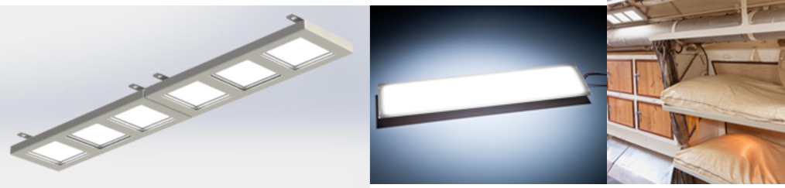
Organic LED, Low Voltage Shipyard Lighting Testing and Demonstration
Electrical Technologies Panel
Identified need to reduce cost of bonding & grounding for shipboard lighting
Builds on previous project, “Low Voltage Shipboard Lighting Feasibility Study”
This project will:
  Address system design & layout for OLED luminaires
  Evaluate savings from reduced weight and space
  Lay foundation for final fixture platform and
  installation design

Slide 4
Advanced Topside Lighting System
Electrical Technologies Panel
2 of 3
PROJECT INFORMATION | OBJECTIVE
Prime/Lead: RSL Fiber Systems Team Members: Signal Mate, PSU ARL Electro-Optics Center, Austal USA, Ingalls Shipbuilding, Newport News Shipbuilding, NAVSEA 05Z33, Bath Iron Works Duration: 12 Months | Provide a plan for utilizing advanced lighting technologies on new construction and in-service ships based on the specific design of each ship type. The lighting systems will provide ease of installation, long life, low maintenance, self monitoring, and parts commonality.
DELIVERABLES/BENEFITS/ROI | FINANCIAL
Reports on: topside lighting issues; functional requirements; available devices; system blueprint; cost/effort estimates for system qualification Reduced TOC thru modernization, use of LED, non-metallic parts | Program Funds: $149K Cost Share: $0K

Slide 5
Advanced Topside Lighting System
Electrical Technologies Panel
Lighting on U.S. Navy ships is one of the top 20 maintenance burdens and corrosion is the # 1 maintenance problem
Advances in lighting technologies and in composite materials offer potential to address topside lighting and corrosion issues
This project will:
  Reduce Total Ownership Cost
  Provide a plan for best use of advanced lighting technologies – new construction and in-service ships based on ship design & rqmts
  Concentrate primarily on navigation &
  signaling lights but will evaluate other topside
  lighting based on severity of issues.

Slide 6
Fiber Optic Sensor for Structural Shipboard Monitoring
Electrical Technologies Panel
3 of 3
PROJECT INFORMATION | OBJECTIVE
Prime/Lead: D'Angelo Technologies Team Members: PSU ARL Electro-Optics Center (technical lead), Austal USA Duration: 12 Months | Demonstrate a fiber optic strain sensor for monitoring the loosening of bolts and/or the separation of two adjoining structural pieces. Evolve to a condition-based monitoring system having multiple applications throughout the ship.
DELIVERABLES/BENEFITS/ROI | FINANCIAL
Report with study details and fiber optic sensor demonstration Real-time monitoring=timely warning of failure Concept that can mature into a condition-based monitoring system with multiple shipboard applications | Program Funds: $150K Cost Share: $0K

Slide 7
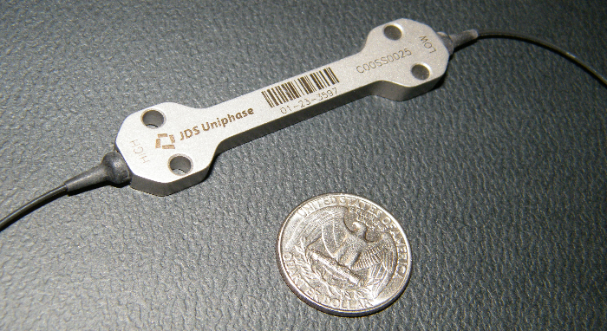
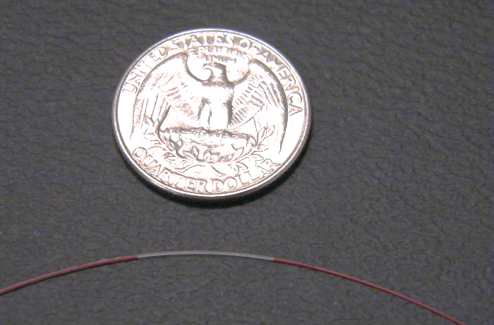
Fiber Optic Sensor for Structural Shipboard Monitoring
Electrical Technologies Panel
Will develop an application scenario to demonstrate the capability of fiber optic mechanical monitoring sensors
Design a fiber optic network and demonstrate its measurement capabilities in a shop environment
Compare results to currently used sensors such as strain gages

