Slide 1
Program Update Business Technologies and Ship Design & Material Technologies Joint Panel Meeting
October 16-17, 2019
Buffalo, NY

Slide 2
NSRP Mission
Manage and focus national shipbuilding and ship repair research & development funding on technologies and processes that will:
Reduce the total ownership cost of ships for the U.S. Navy, other national security customers and the commercial sector
Develop and leverage best commercial and naval practices to improve the efficiency of the U.S. shipbuilding and ship repair industry
Provide a collaborative framework to improve shipbuilding-related technical and business processes.
Notes:
NSRP mission is centered around reducing the total ownership cost of ships and the key to the program is the collaborative framework.

Slide 3
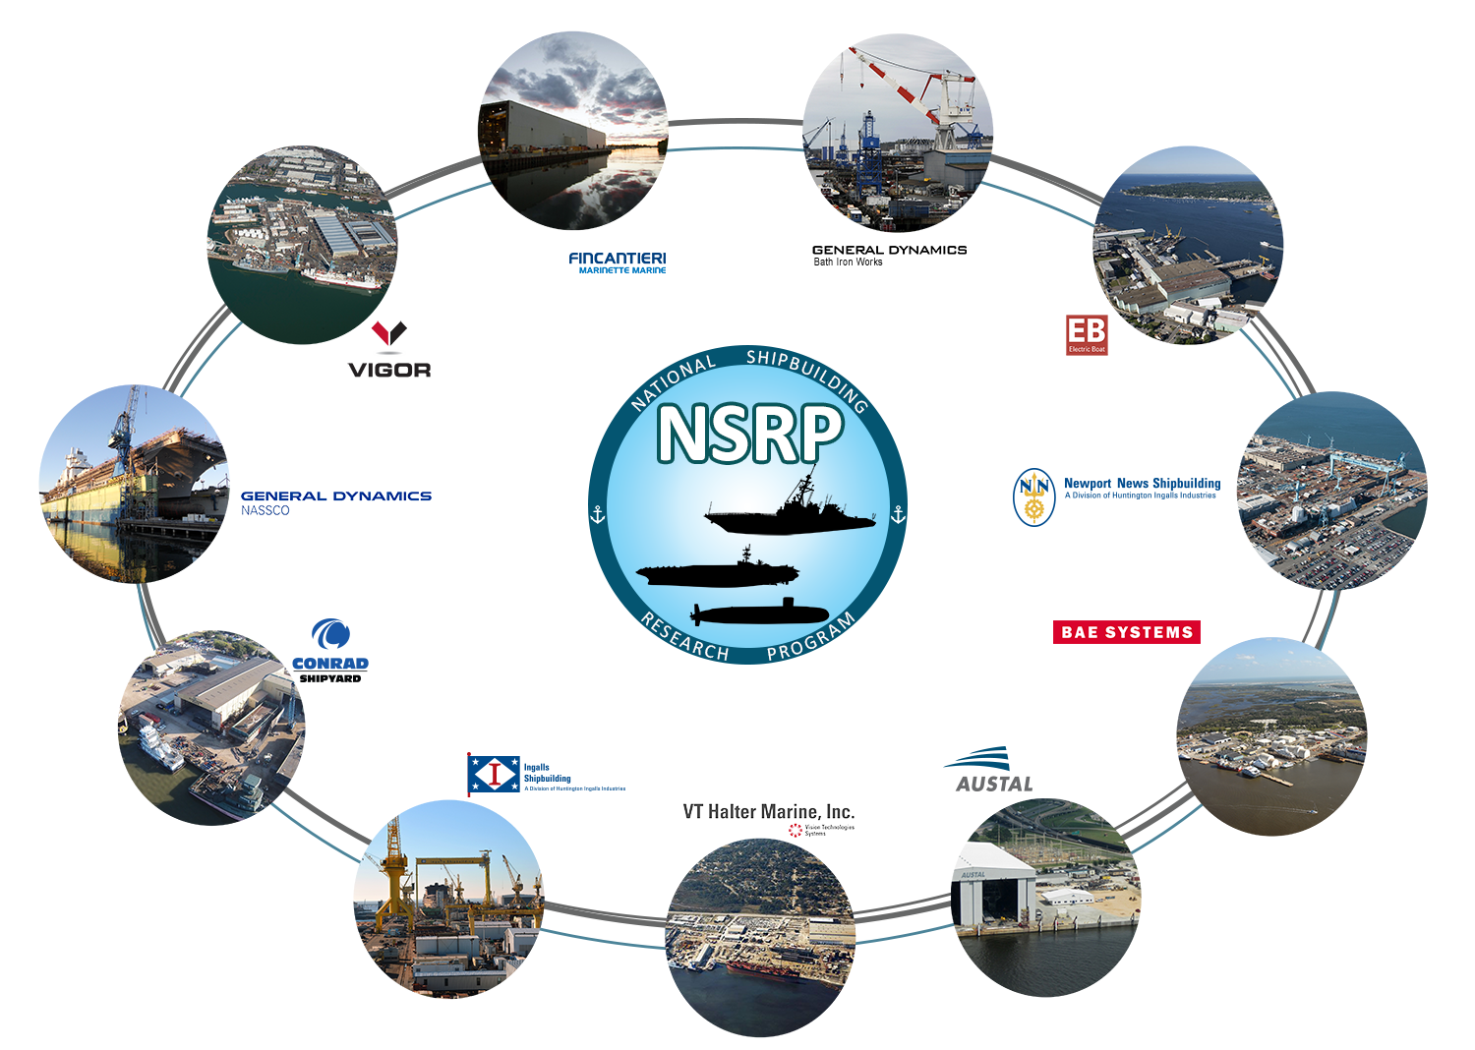
NSRP Collaboration
Notes:
NSRP is an industry-led collaboration with the U.S. Navy focused on reducing the total ownership costs of ships for the Navy and National Security Customers
11 Member Shipyard Collaboration
Allows competitors to partner on common shipbuilding/ship repair problems to benefit of industry and their clients as a whole
Industry cost share multiplies impact of every government dollar provided
Sponsored by NAVSEA and 6 Program Executive Offices
NAVSEA 06, PEO C4I, PEO Aircraft Carriers, PEO IWS, PEO USC, Team Ships, and Team Submarine collectively provide ~$13.5M in annual funding

Slide 4
Anti-Trust Rules
Regarding your company’s and/or your competitor’s product & services:
Do not discuss current or future prices.
Do not discuss any increase or decrease in price.
Do not discuss pricing procedures.
Do not discuss standardizing or stabilizing prices.
Do not discuss controlling sales or allocating markets for any product.
Do not discuss future design or marketing strategies.
Notes:
Since NSRP is a collaboration of competing shipyards, it is important to cover the Anti-Trust rules. (read slide)

Slide 5
Anti-Trust Rules
Regarding your company’s and/or your competitors’ selection of their supplier companies:
Do not discuss refusing to deal with a company because of its pricing or distribution practices.
Do not discuss strategies or plans to award business to remove business from a specific company.
Regarding your company’s and/or competitors’ trade secrets:
Do not discuss trade secrets or confidential information of your company or any other participant.
Notes:
Since NSRP is a collaboration of competing shipyards, it is important to cover the Anti-Trust rules. (read slide)

Slide 6
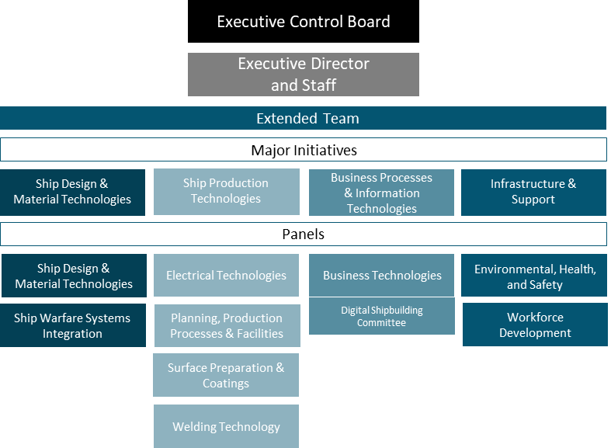
Organization
Notes:
7 sponsors who provide funding
11 member Executive Control Board
Executive Director and staff
Extended Team is divided into 4 Major Initiative Areas which align with the shipbuilding enterprise
10 Panels

Slide 7
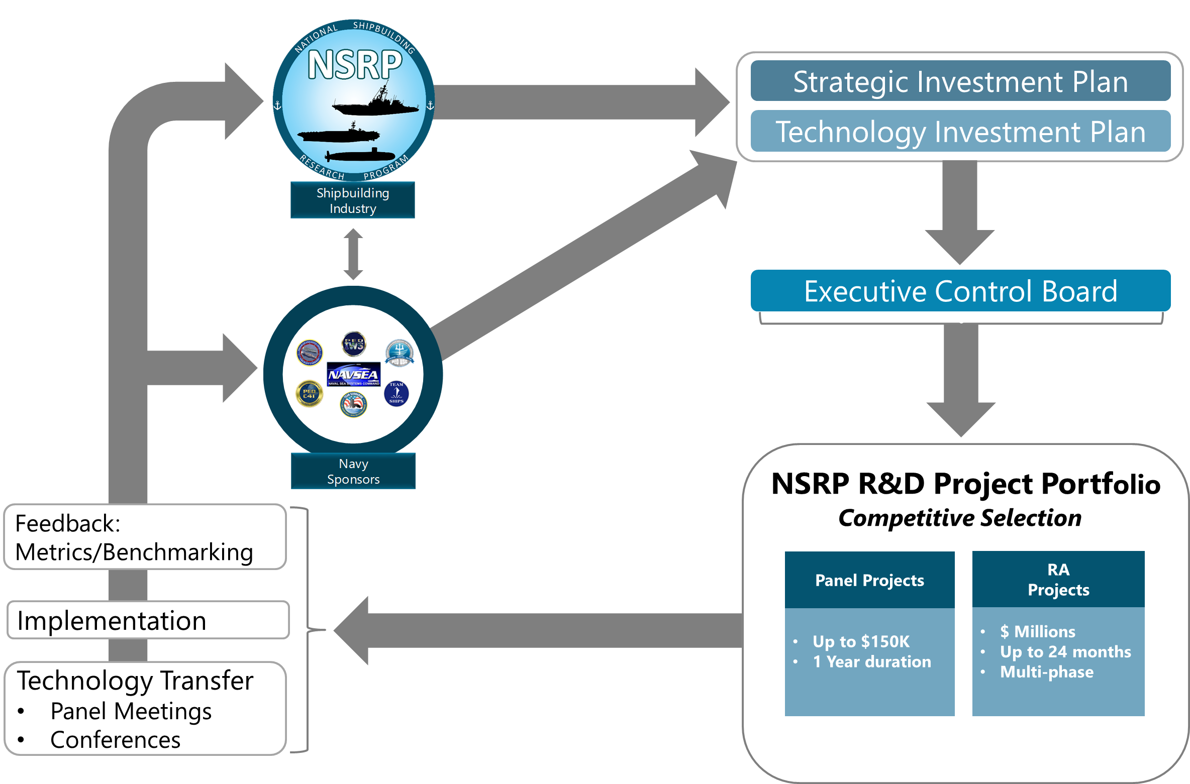
Operations
Notes:
Industry & Navy stakeholders provide recommendations on priority issues related to NSRP’s mission and objectives; those recommendations provide the basis for the Strategic Investment Plan and Technology Investment Plan which outlines how the program operates and identifies high priority issues and current industry challenges of particular interest to the program.
ECB serves as the governing body and approves and awards projects.
The Strategic Investment plan directs the project selection process and defines relevant ad hoc initiatives. These projects and special initiatives form the program portfolio and are carried out within the industry through the execution of projects, panel meetings, and conferences.
Feed back is then relayed back to Industry and Navy stakeholders who incorporate recommendations for the next cycle.

Slide 8
Current Extended Team Leadership

Slide 9
Major Initiative Teams
Structure
Team Lead/Assistant Team Lead
From NSRP member yard
Relevant shipbuilding experience
Responsibilities
Provide technical oversight on projects aligned with Major Initiative
Engage in technology transfer activities
Provide input/feedback on Program documents
Stay abreast of shipyard/industry issues
Ship Design & Material Technologies
Ship Production Technologies
Business Processes & Information Technologies
Infrastructure & Support
MITL-At-Large
Lead: Dan Sfiligoi (NASSCO)
Asst Lead: Alicia Harmon (NNS)
Lead: Gary Zimak (NNS)
Asst Lead: Kirk Daniels (EB)
Lead: Jeff Schaedig (NASSCO)
Asst Lead: Michael Gerardi (BIW)
Lead: Thresa Nelson (NNS)
Asst Lead: Shawn Wilkerson (Ingalls)
John Walks (Ingalls)
Mark Poitras (BIW)
Adam Sprecace (EB)
Steve Cogswell
(BAE Systems – JSR)
Tony Ardito (Austal)
Denny Moore (EB)

Slide 10
Panel Leadership
Ship Design & Material Technologies
Ship Production Technologies
Business Processes & Information Technologies
Infrastructure & Support
Ship Design & Material Technologies
Electrical Technologies
Business Technologies
Environmental, Health & Safety
Chair: Jason Farmer (Ingalls)
Vice Chair: Walter Skalniak (Panduit Corp)
Chair: Virgel Smith (Ingalls)
Vice Chair: Patrick Roberts (ShipConstructor)
Chair: Vacant (NNS)
Vice Chair: Monika Skowronska (NASSCO)
Chair: Chris Blankenfield (Austal)
Vice Chair: Yaniv Zagagi (Golder)
Planning, Production Processes & Facilities
Digital Shipbuilding Committee Co-Chair: Jamie Breakfield (Ingalls)
Ship Warfare
Systems
Integration
Chair: Ken Fast (EB)
Vice Chair: Bob Watkins (Fincantieri Marinette Marine)
Workforce Development
Chair: Ryan Lee (Austal)
Vice Chair: Maurissa D’Angelo (D’Angelo Technologies)
Chair: Perry Haymon (Ingalls)
Vice Chair: Glenn Dorsey (NNS)
Surface Preparation & Coatings
Chair: Arcino Quiero Jr. (NNS)
Vice Chair: Bob Cloutier (BIW)
Welding Technology
Chair: Paul Herbert (NNS)
Vice Chair: Kevin Roosinck (Ingalls)

Slide 11
Solicitations

Slide 12
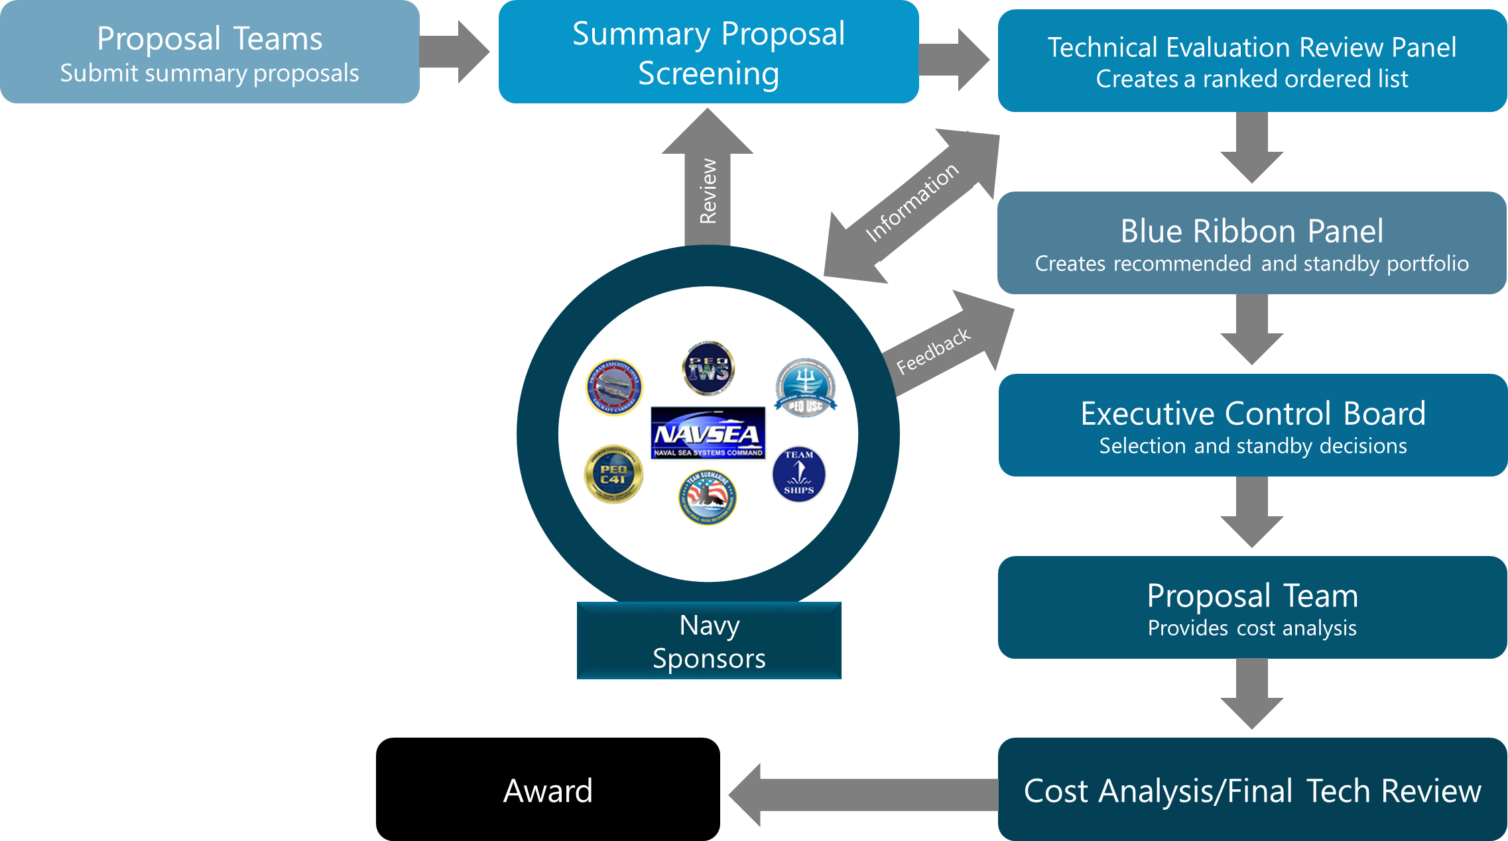
Research Announcement Proposal Process
Notes:
The bulk of NSRP funding goes to soliciting, selecting, and executing R&D projects
The NSRP Project Portfolio value is approximately $18M annually
Research Announcement Projects ($20.1M in FY19)
Duration: Up to 24 months
Funding: Millions (cost share required with a 50% goal)
Focus: Align with NSRP Strategic Objectives and Focus Areas
Proposers submit Summary Proposals to the Executive Director and staff for screening. They provide copies to Navy stakeholders for review
Technical Evaluation Review Panel reviews and submits a rank-ordered list to the Blue Ribbon Panel.
Blue Ribbon Panel hears oral presentations by proposers and submit the recommended portfolio and standby recommendations to the ECB.
ECB approves and awards the portfolio as a whole – with any changes or conditions approved during the selection discussions.

Slide 13
Research Announcement Solicitation Cycle
Release RA Solicitation
Panel
Project
Solicitation
Released
Proposals
Due ATI
Proposers Submit White Papers to Panel Chairs
Panel Chairs Submit Top 3 Panel White Papers to ATI
ECB Panel Project Selection
3/8
7/9
6/12
8/12
9/5
11/18-19
Jan
Feb
Mar
Apr
May
Jun
Jul
Aug
Sep
Oct
Nov
Dec

Slide 14
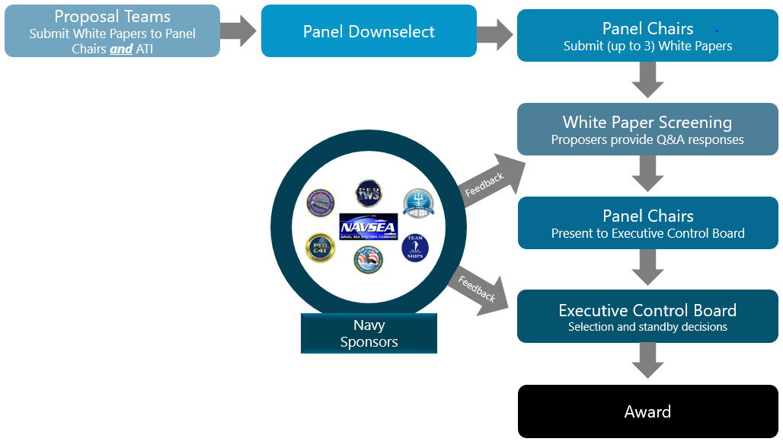
Panel Project Proposal Process
Notes:
Panel Projects ($3.5M to be awarded in FY19)
Duration: 12 months or less
Funding: $150K or less (no cost share required)
Focus: Should align with the mission of one or more NSRP Panels and the overall objectives of the Program
Proposers submit white papers to Panel Chairs/Ad Hoc Group Leads
Panels downselect
Panel Chairs submit top 3 to the Executive Director
Panel Chairs present top 3 to ECB
ECB selects projects for award

Slide 15
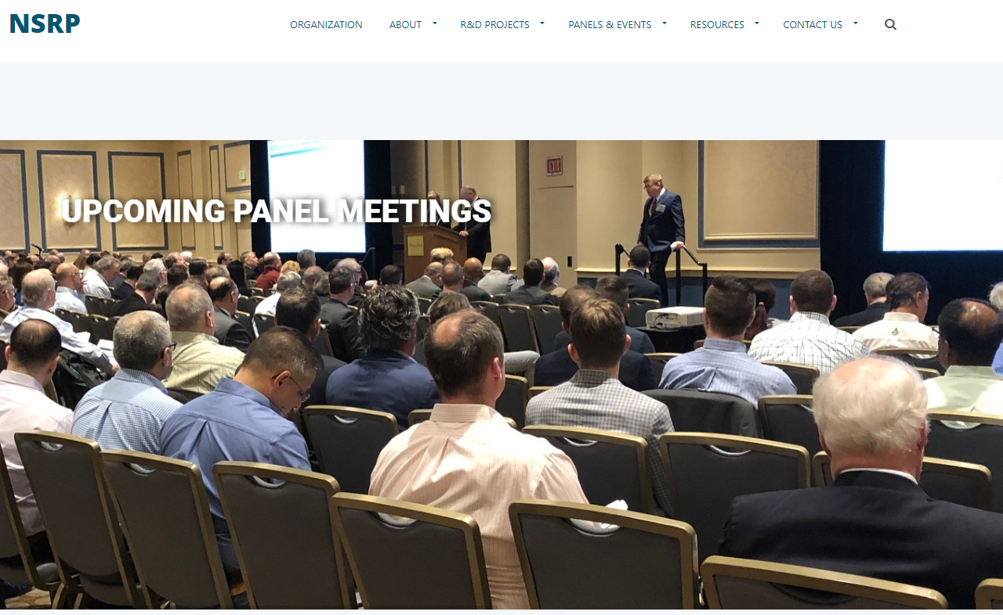
Looking for more information?
Resource Documents
Contact Information
Panel Information
Ad Hoc Initiatives
Presentations
NSRP History
Solicitations
Teaming
www.nsrp.org

Slide 16
Questions?

