Slide 1
ExpressMarine Integration Status Update Business Technology Panel Project
Pat David SSIUSA
Business Technologies & Ship Design & Material Technologies Joint Panel Meeting
October 16th, 2019 – Buffalo, NY

Slide 3
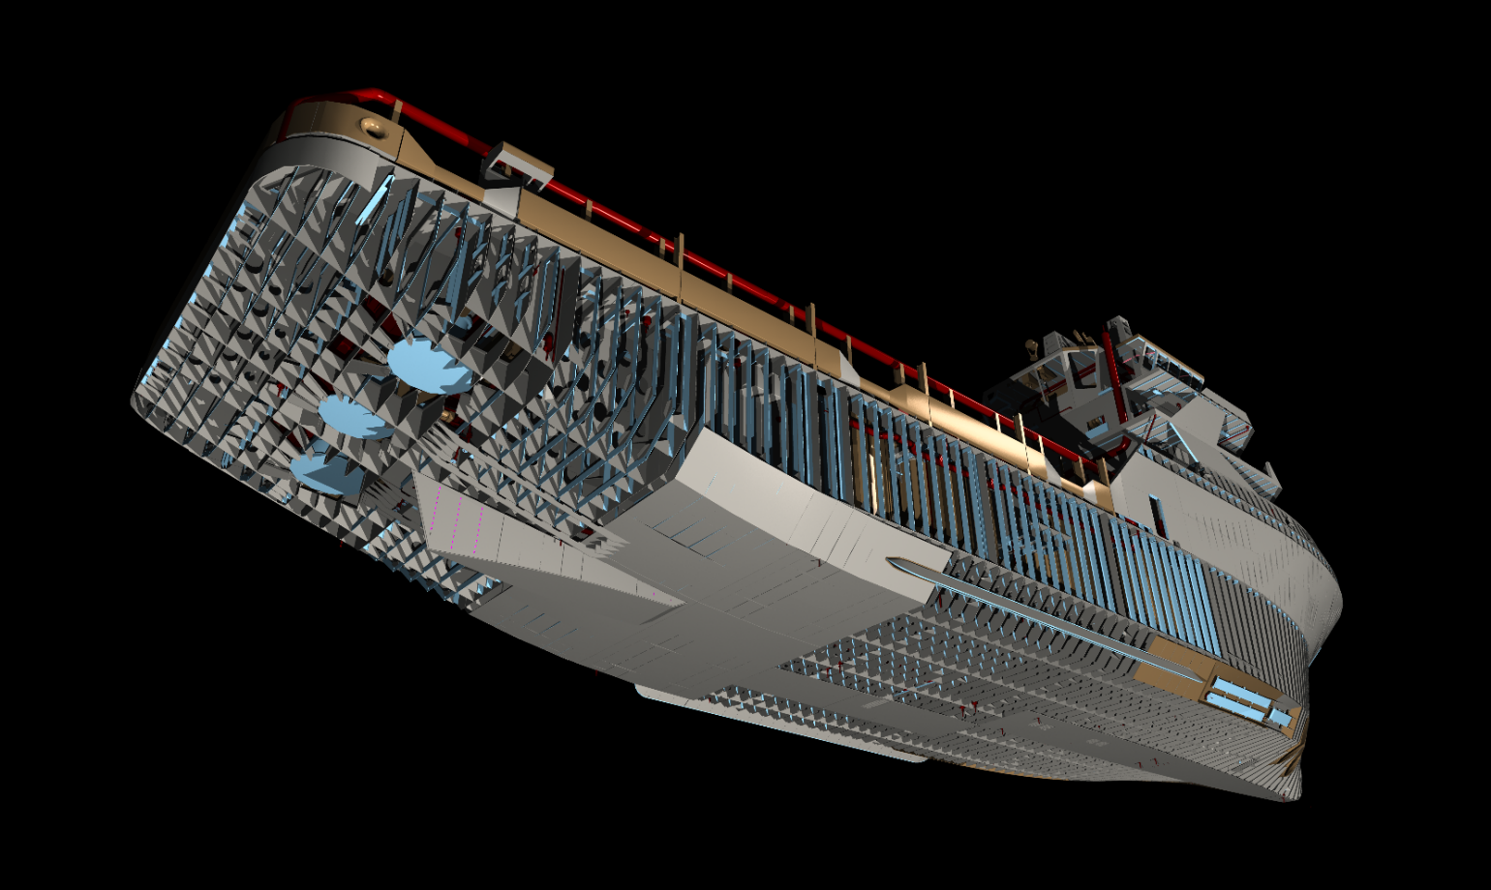
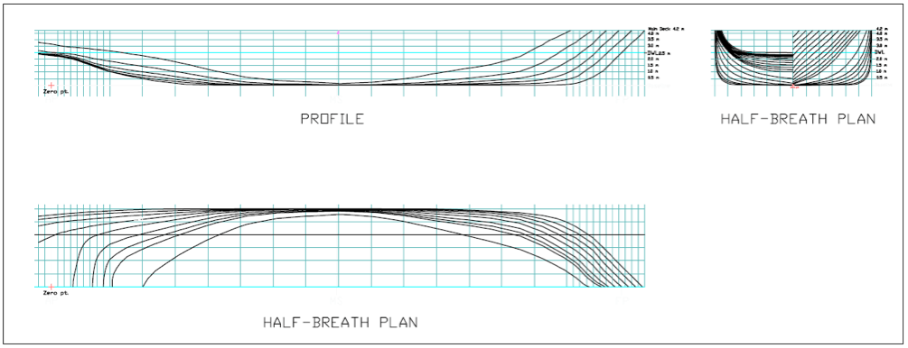
Objective
Pass rich, early phase structure-model to a detail-engineering production tool without losing properties and metadata (early stage design into detail production models).

Slide 4
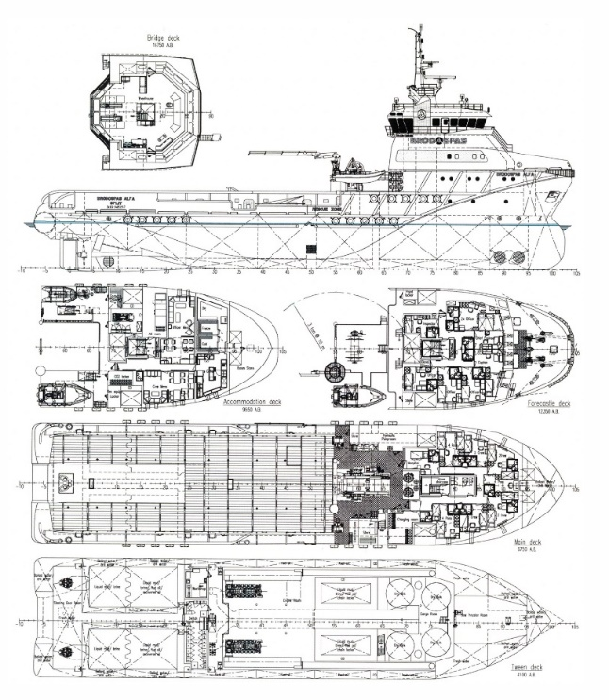
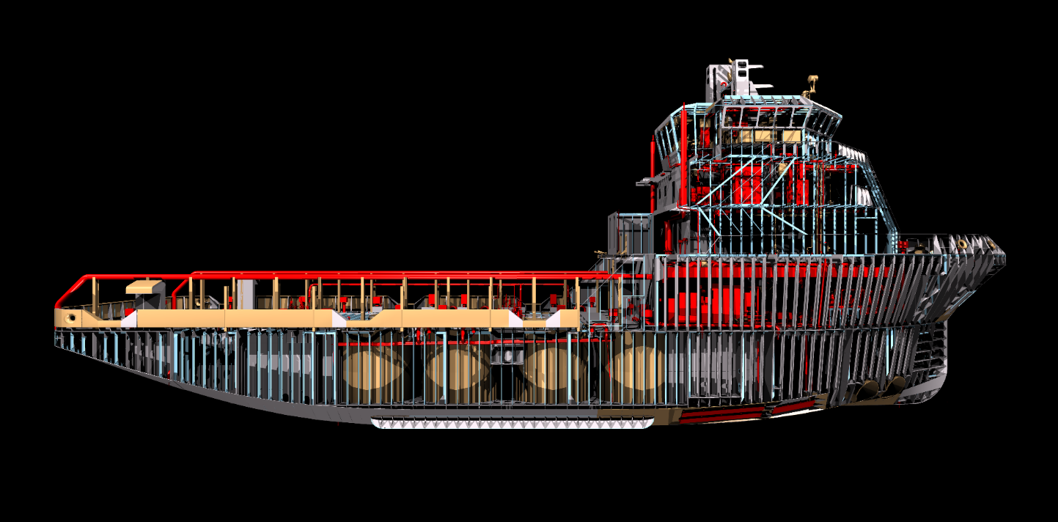
Goal
Export the ExpressMarine model to ShipConstructor so the model appears as if it was built there from scratch

Slide 5
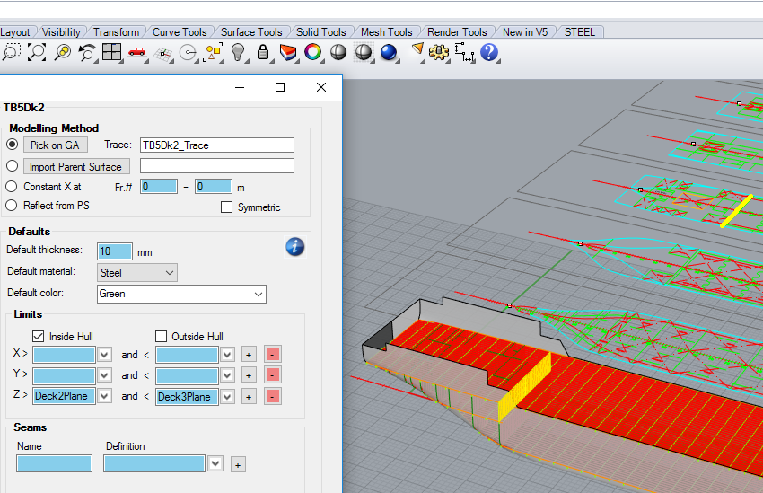
Fast · Parametric · Intuitive

Slide 6
Programmed the export using the SSI Genesis Application Programming Interface (API) Framework

Slide 7
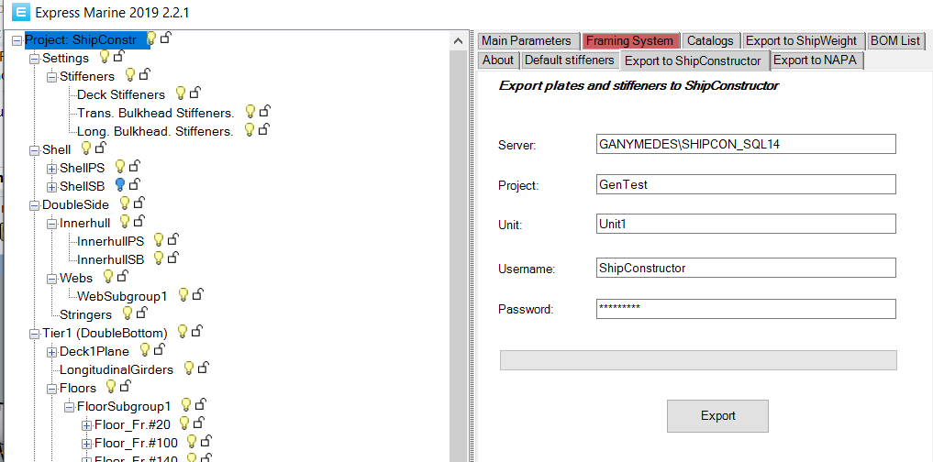
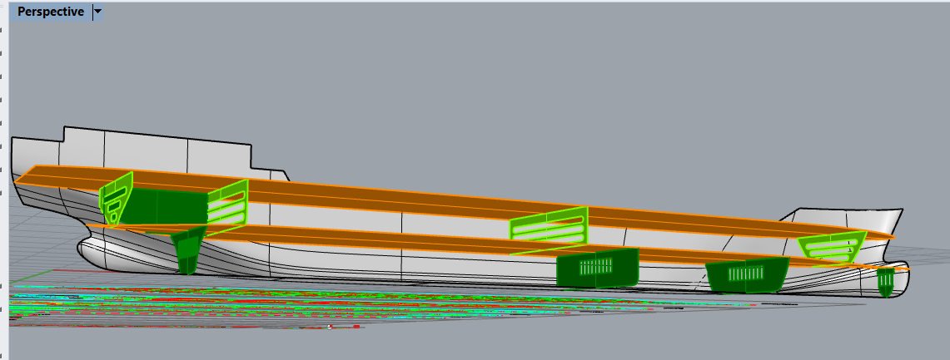
ExpressMarine

Slide 8
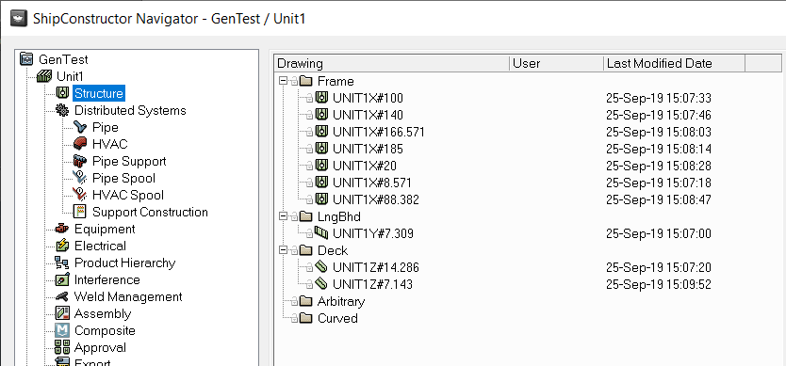
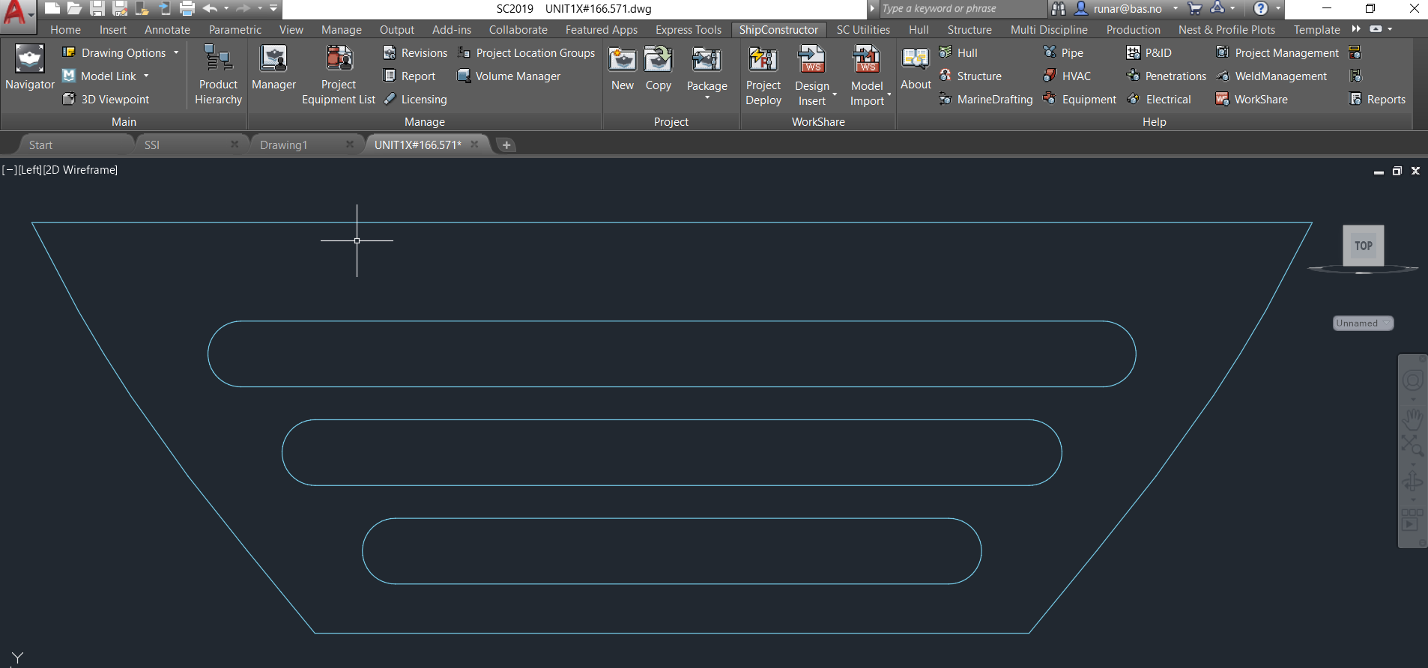
ShipConstructor

Slide 9
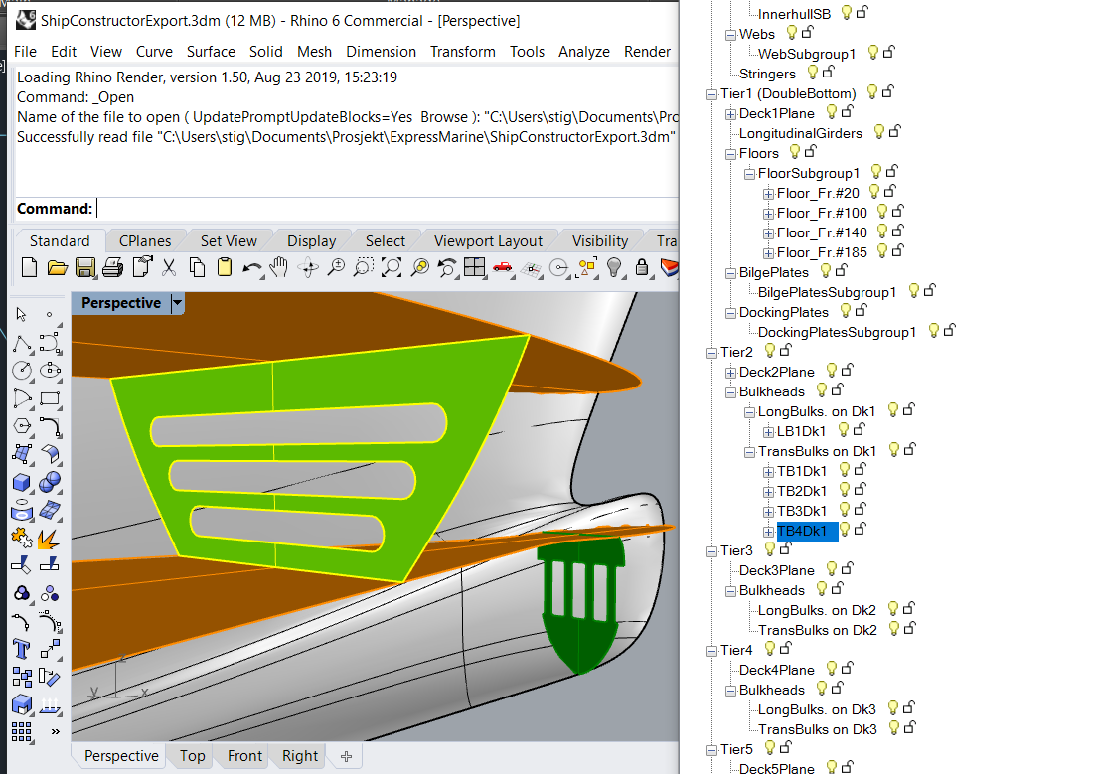
Summary

Slide 10
Next Steps
Beta version released to project members this month
Feedback, testing, and refinements will continue until final version released spring 2020

Slide 11
Tasks - Status
✓01 | Conduct Project Kick-off Meeting
✓02 | ExpressMarine Training for VTHM, SSI
✓03 | Investigate potential ExpressMarine to ShipConstructor data mapping
✓04 | Capture business processes and workflow (VTHM & Austal USA)
05 | Develop and test data integration from ExpressMarine to ShipConstructor
06 | Demonstrate successful data integration
07 | Conduct Final Workshop (March 2020)
08 | Develop Final Report (April 2020)

Slide 12
Questions?
Pat David
Patrick.David@SSI-Corporate.com

