Slide 1
Additive Manufacturing Qualification, Certification and Implementation
Dongchun, Mary, Qiao and Demetri Stroubakis
American Bureau of Shipping (ABS)
Oct 16, 2019

Slide 2
Outline
Background
Benefits
Additive Manufacturing Processes
Qualification
Certification
Implementation
Summary

Slide 3
Background
Traditional Manufacturing
Materials Manufacturing
Rolling, Casting, Forging etc.
To meet mechanical properties by Heat Treatment etc.
Machining
To meet dimension and special features by CNC machine, Lathe etc
Welding
To join multi-pieces together
Additive Manufacturing
Integrated process with materials manufacturing machining and welding
Add materials layer by layer
Controlled by sliced CAD model, software and hardware

Slide 4
Benefits
Digital Scanning
Digital Design
Digital Engineering
Digital Manufacturing
Manufacturing On-Demand
Prototype new design
Reduce inventory of spare parts
Remanufacture obsolete parts
Reduce lead-time
Repair or Special Feature
Apply functional/new materials
Add specific features
Repair damaged parts
Manufacturing End Use Components
Increase design freedom for complex shapes
Integrate multiple pieces to single part
Add materials for weight saving
Small Batch Production
Cost-effective small volume production
Small batch production under dynamic vs static build

Slide 5
Additive Manufacturing Processes
Objectives of ABS are Qualification of AM Facilities to enable reliable quality products through a developed certification scheme which focuses on:
Design verification and validation
Additive manufacturing procedure approval
Initial and periodic factory audits

Slide 6
Additive Manufacturing Processes
Categories of Additive Manufacturing Processes
Materials Extrusion
Material Jetting
Vat Photopolymerization
Sheet Lamination
Binder Jetting
Direct Energy Deposition
Powder Bed Fusion
ASTM F42

Slide 7
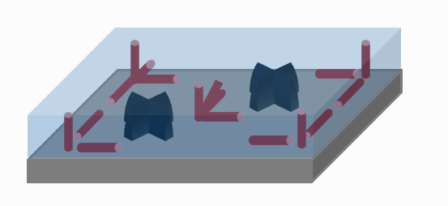
Powder Bed Fusion Example
Powder Bed Fusion (PBF): An AM process in which thermal energy selectively fuses regions of a powder bed.
Energy Source & Beam Controller
Powder Roller
Powder Matrix
Example of Build Diagram Showing Location, Number, Type, and Orientation of Test Specimens and Reference Parts
Powder Supply
Build Platform / Baseplate
Nesting
Distance Between Parts
Type and Arrangement of Part and Support Structures

Slide 8
Directed Energy Deposition Example
Direct Energy Deposition (DED): An AM process in which focused thermal energy is used to fuse materials by melting as they are being deposited.
Multi-Axis Arm
Maximum Working Envelope / Build Volume
Deposition Path
(Contour or Fill Types, Contour Shown)
Build Platform or Existing Part
Z
Part Fixture
(Can be Static or Dynamic)
Y
X
Process Coordinate System

Slide 9
Binder Jetting Examples
Indirect Metal Production
Binder Jetting (BJ): An AM process in which liquid bonding agent is selectively deposited to join powder materials
To Casting Facility
Loose Powder
Bound Sand Mold
Bound Part Cores
(if applicable)
Powder Spreader and / or Inkjet
Bound Powder
Direct Metal Production
To Infiltration & Heat Treatment
Bound Metal Powder Parts
Build Box

Slide 10
Additive Manufacturing Processes
Subcategories of Metal Additive Manufacturing Processes | Abbreviation
Laser Powder Bed Fusion | L-PBF
Electron Beam Powder Bed Fusion | EB-PBF
Laser Directed Energy Deposition | L-DED
Electron Beam Directed Energy Deposition | EB-DED
Plasma Arc Directed Energy Deposition | PA-DED
Gas Tungsten Arc Directed Energy Deposition | GTA-DED
Gas Metal Arc Directed Energy Deposition | GMA-DED
AWS D20.1

Slide 11
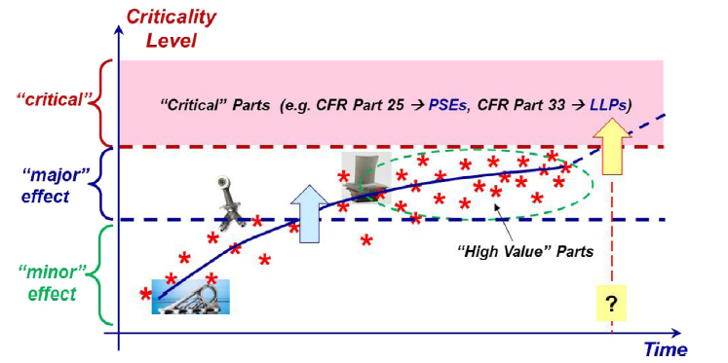
Qualification
Critical:
Failure would cause significant danger to personnel, loss of control, loss of a system, loss of a major component or an operating penalty.
Semi-critical
Failure would reduce the overall strength of the equipment or system or preclude the intended functioning or use of equipment, but loss of the system or the endanger of personnel would not occur.
Non-critical
Failure would not affect the operation of the system or endanger personnel.
June 2016, International Journal of Fatigue 94,
DOI: 10.1016/j.ijfatigue.2016.07.005 Michael Gorelik, Federal Aviation Administration
AWS D20.1
Critical/Severity level for application may be determined and agreed. Appropriate AM process is selected and routing out.

Slide 12
Qualification
Feedstock
(Powder/Wire)
Additive Manufacturing Service Provider
Production Parts
Reference Parts
Test Samples
Test Artifacts
Partial Black Box
Machine operations are observed, but data may not be well-understood or shareable.
Part/Coupon Design
(CAD files, functional and technical design specs)
Application
Heat Treatment
(AM processes can build significant residual stresses)
Cleaning/Machining
(Not trivial if complex geometry)
Testing
Destructive
Nondestructive
Functional

Slide 13
Qualification
Additive Manufacturing Qualification Process
Additive Manufacturing Project Setup
Initial Cradle to Grave File Population
Cradle to Grave File
Qualification Stages
Process Configuration and Workflow Diagram
Feasibility Stage
Part Design Package
Verification Stage
Part Manufacturing Description
Pre-Production Validation Stage
Part Inspection and Testing Package
Production Stage

Slide 14
Qualification
Sample Additive Manufacturing Qualification Record: Machine Qualification or Procedure Qualification Record:
General
Build Platform
Feedstock
Machine
Environment
Build Parameters
Post Processing
Examination and Testing Results (additional testing by design requirements)
Refer to AWS D20.1

Slide 15
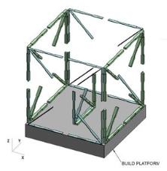
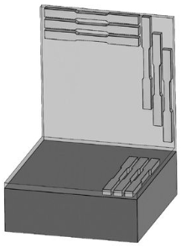
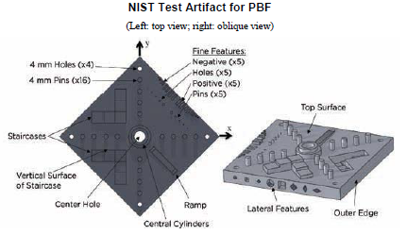
Qualification
Challenges
Process-Microstructure-Properties
Mechanical properties (anisotropy, fracture toughness, fatigue properties etc.)
Process-Feature-Function
Non-destructive testing
Verification and validation in manufacturability, maintainability and reliability
http://senvol.com/database/

Slide 16
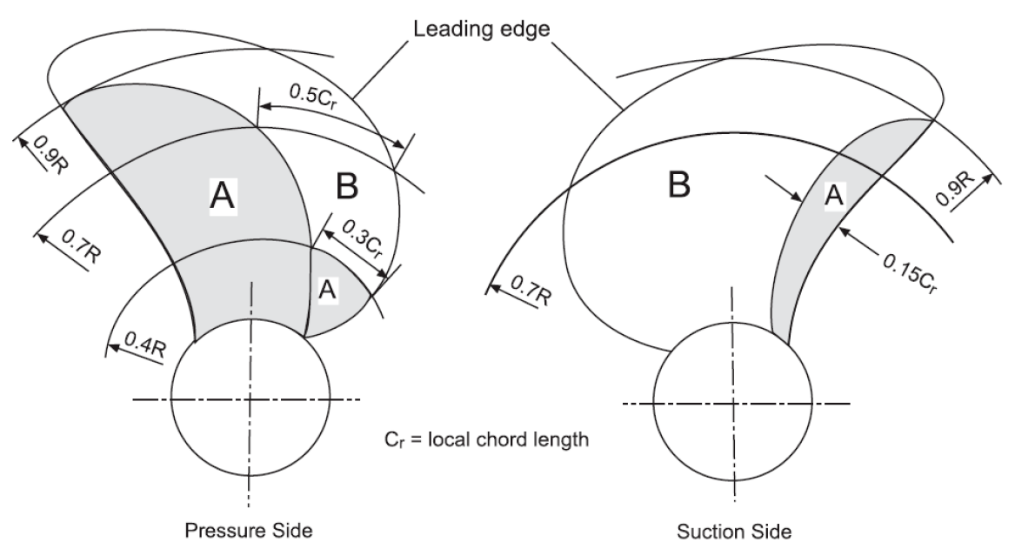
Qualification
Fit-For-Service
Severity zone based
Engineering Critical Assessment
BS 7910
Crackwise developed by the welding institute, UK
Risk based
Statistics data of traditional manufacturing vs additive manufacturing

Slide 17
Certification
Request for Approval
Instruction Letter
Submittal Review
Audit
Maturity Letter or Provisional Approval Letter
Capability Demo.
Approval Letter or Certificate
Additive Manufacturing Service Provider
Quality Management System
Additive Manufacturing Capability
Metal Additive Manufacturing Component
Product Design Assessment
Manufacturing Assessment
Product Quality Assessment
Unit Certification

Slide 18
Implementation
Approved Design
Approved Raw Material Supplier
Outsourcing Suppliers
Approved AM
Machine Procedure Operator
Approved Production Plan
Accepted Inspection and Testing Report
Traceable during Operation
Performance Evaluation or Failure Analysis
Additive manufacturing process is continuously improved using a close-loop product lifecycle management.

Slide 19
Summary
Metal AM for end-use can bring many benefits for shipping industry.
Manufacturing on-demand
End-use components
Repair or add features
Small batch production
Three common metal AM processes:
PBF
DED
Binder Jetting
NTQ for other processes requested
ABS streamlined qualification scheme, certification and implementation process.
Additive Manufacturing Service Provider
Metal Additive Manufacturing Components

Slide 20
Summary
ABS Advisory
https://ww2.eagle.org/content/dam/eagle/advisories-and-debriefs/ABS_Additive_Manufacturing_Advisory_17294.pdf
ABS Guidance Notes
https://ww2.eagle.org/content/dam/eagle/rules-and-guides/current/other/299-gn-on-additive-manufacturing-2018/additive-manufacturing-gn-sept18.pdf
ABS Steel Vessel Rules
https://ww2.eagle.org/en/rules-and-resources/rules-and-guides.html
ABS Current Engagement
Joint Development/Industry Project to improve the technology readiness level of additive manufacturing technology for marine and offshore application.

