Slide 1
NACE International Update
September 2019

Slide 2
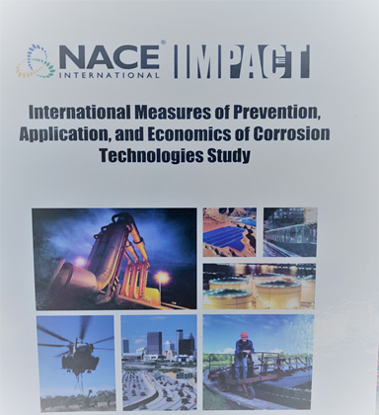
IMPACT Study Launched – October 2014
The IMPACT study:
Updates the global cost of corrosion
Assesses corrosion management practices
Corrosion management templates
Financial tools
Benchmarking
Notes:
Published in 2016, IMPACT—the International Measures of Prevention, Application, and Economics of Corrosion Technologies study2—determined that the GLOBAL cost of corrosion is US$2.5 trillion, or 3.4% of a country’s GDP.

Slide 3
Most Critical Findings of IMPACT Study
A change in how decisions are made is required
Continue investment in technology for corrosion control
Corrosion Management System Framework
Justify corrosion control actions by business impact
Notes:
Today one of the challenges for corrosion professionals is to communicate the need for investment in corrosion prevention. Something very relevant to the consortium is a continued investment in technology, new advancements for corrosion control. The system framework allows a common lens of perspective for evaluating companies within various industries. Ultimately being able to communicate the impact of corrosion and actions to control corrosion by their impact on the business unit is beneficial to the corrosion profession.

Slide 4
Corrosion Management
Definition: “The process of reviewing the existing Integrity Management measures, regular monitoring of their performances, and assessment of their effectiveness post-commissioning.”
“An Introduction to Asset Corrosion Management in the Oil & Gas Industry,” by Dr. Ali Morshed
Should include Corrosion Engineering and Corrosion control efforts comprised of policies, processes and procedures that address corrosion across the complete lifecycle of the asset, from design to decommissioning.
A Corrosion Management Program must include an accepted philosophy within the organization and ingrained into that corporate culture. “An Introduction to Asset Corrosion Management in the Oil & Gas Industry,” by Dr. Ali Morshed
Notes:
This really speaks to a lack of that common lens of perspective with regards to corrosion management programs. In fact very often corrosion engineering programs are viewed has the management program itself and that's not an accurate representation. Successful corrosion management program is holistic in nature and looks at all aspects of an organization's impact from corrosion and what's necessary to prevent and control corrosion.

Slide 5
Corrosion Management
…Identify Corrosion as a RISK
ISM Safety Management Code doesn’t Identify Corrosion as a RISK
Autonomous & Smart shipping may place a greater need on Corrosion Engineering and Management systems
Cybersecurity being identified as a RISK and work there may serve as a model in having Corrosion identified as a RISK as well
Smart Ports – Today’s ports experience a high reactivity model to Corrosion issues
Need for Education and Research
Financial Modeling
Notes:
This is relevant in NACE’s initiative to have corrosion it identified as a risk with in the marine industry. Currently the establishment of a corrosion working group within ISO TC 8 is underway. The model of approaching the recognition of corrosion as a risk can be seen in these other attempts at identifying risk. This includes the autonomous and smart shipping and cyber security. Financial modeling is one aspect of convincing organizations at a high level that there's value in addressing corrosion in a managed methodology. Again the need for additional research and education can be seen within that process. Mindset needs to change in

Slide 6
Consortia Benefits
High tech research value based on the scope of the consortia
Documentation (reports, proceedings, papers, methods, standards)
Technology transfers (basic courses)
Discussion forums (workshops and seminars)
Notes:
Several organizations get their money together to fund the research for an idea
NACE sponsoring a consortia focused on Maritime
Send email consortia inbox and Ed as POC.

Slide 7
NACE’s Maritime Consortia
The industry’s only corrosion-related consortia administered by the premier global corrosion engineering association is seeking corrosion science and engineering experts to collaborate in a neutral forum for researching innovative solutions to key challenges faced by the marine industry.
Significant Maritime industry growth is projected over the next 30+ years and corrosion will continue to be a huge factor in the marine environments - with the estimated total cost of marine corrosion worldwide to be between $50-80 billion every year.
Notes:
The consortium seize the opportunity to expand research within the maritime industry and it's benefit various maritime sectors, such as ports, etc.

Slide 8
Maritime Consortia Concept
Various industries have substantive corrosion-related issues and need to invest in research to understand how to best mitigate corrosion in their assets.
Decreased corporate investment in research, however, slows if not halts many from getting this vital information.
Consortia can assist organizations, universities, and government entities in funding, administering, and attaining research.
Value proposition: By offering services and brokering relationships between organizations, a consortia provides for industry partners to pool their resources to study and share in the results of research pertinent to them.

Slide 9
Maritime Consortia Concept (cont’d)
NACE International will bring two or more organizations together to collaborate on new research in various industries seeking to mitigate corrosion.
Sharing costs to study a technical area.
Consortia members will formalize the overall structure and scope of the project while…
NACE supplies administrative services and brokers the consortia relationships to facilitate the research.
Consortia members will likewise share in the results and receive access to the research — before it is available to the public.

