Slide 1
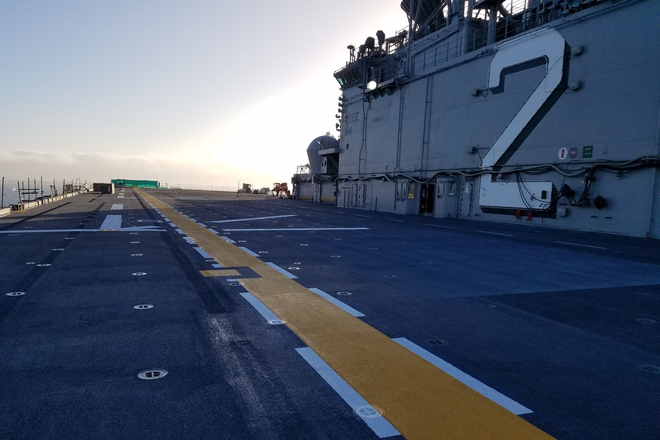
SSPC Standards Update
September 2019
NSRP SP&C Panel, September 10-12, 2019
Quonset Point, RI
Bob Cloutier, for
SSPC Technical Services Dept.

Slide 2
Topics
Ongoing Revision Projects 2019 Update
  SSPC-SP 11, Power Tool Cleaning to Bare Metal; and SSPC-SP 15, Commercial Grade Power Tool Cleaning
  SSPC-PA 17, Procedure for Determining Conformance to Steel Profile/Surface/Roughness/Peak Count Requirements
  Proposed revisions to SSPC/NACE Joint Dry Blast Cleaning Standards
  QP 2 Standard Revision (QP 1 revision is complete)

Slide 3
Topics (cont’d.)
New Projects
  SSPC-SP 17 Standard for Thorough Blast Cleaning of Non-Ferrous Metals (SSPC Board has approved)
  Possible technology update to non-profiling surface preparation techniques (plasma blast, laser ablation, possibly dry ice) that do not generate secondary waste stream
Notes:
Board of Governors has approved Thorough Blast Cleaning of

Slide 4
2019 Revisions – SP 11 and 15
No significant change in cleanliness requirements
Proposed table for selection of tool types for various uses, e.g.
  Rust removal
  Removal of single coating layer
  Removal of all coating layers
  Creation of anchor profile
  Feathering edges

Slide 5
Proposed Revisions SP 11 and 15
Addition of a tool selection table is proposed
Table will describe various existing conditions and the appropriate tools to use for best results on each condition
Proposal for new cleanliness standard needs more “grassroots support” from users and contractors to be developed as a separate standard

Slide 6
Power Tool Selection Table
Still a “work in progress”
Types of tools (still in discussion) include
  Grinding wheels
  Coated abrasive discs/belts/flaps
  Nonwoven abrasive flap
  Nonmetallic brush
  Metallic brush
  Rotary flapper
  Cutter bundle
  Bristle impact
  Needle gun

Slide 7
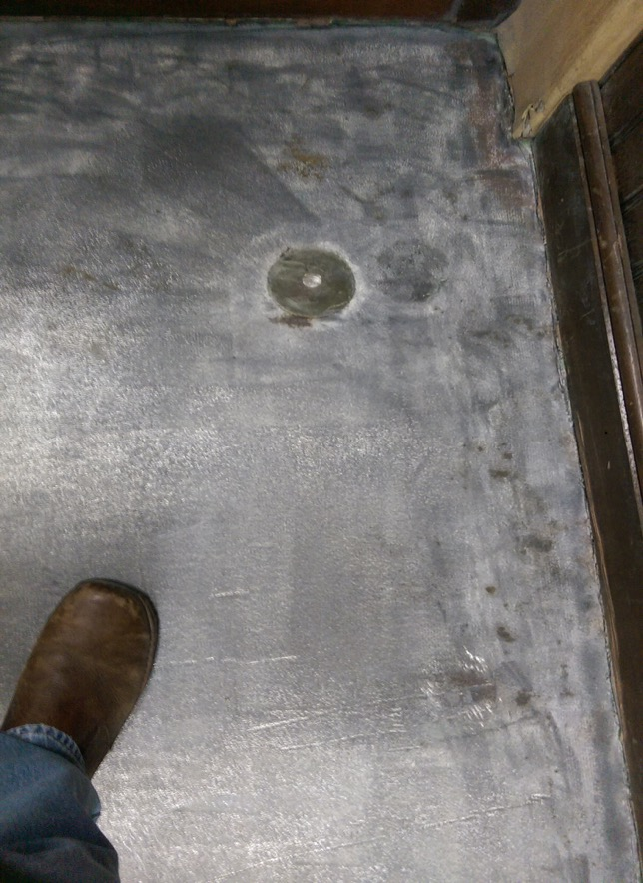
SP 11 on Ship Deck

Slide 8
Revision PA 17
(Compliance to Profile Requirements)
New appendix that describes techniques for measuring profile on severely pitted substrates
  Take readings on non-pitted area of substrate if available
  Create companion coupon of non-pitted steel to evaluate profile created by the abrasive
Definitions are being revised to reflect revisions in ASTM D4417 - waiting for publication of revised D4417 before continuing work
ASTM had to reballot D4417 due to internal issue with previous ballots. ASTM ballot due September 9. So PA 17 revision is still “on hold.”

Slide 9
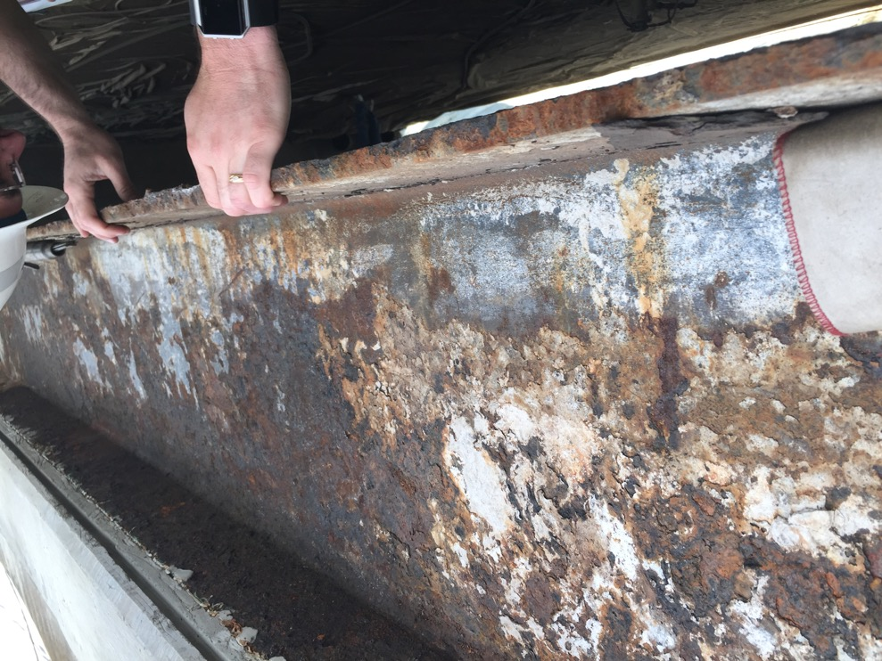
Heavily Pitted Steel

Slide 10
2019 Revision of SSPC-PA 2
Revision issued January 2019
Added nonmandatory appendix describing use of scanning probe technology to acquire readings

Slide 11
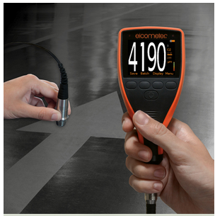
Scanning Probe

Slide 12
PA 2 Appendix 10 Highlights
Scanning Batch Measurement – mean of no fewer than 12 and up to 24 DFT readings w/o lifting probe from coated surface
  Readings taken within 645 m² (~100 in²) segment of coated area
Scanning Area Measurement – sample mean of 5 scanning batch measurements obtained over each 10 m² (~100 ft²)

Slide 13
Large box represents 100 ft² area (scanning area)
Smaller boxes represent 100 in² areas (scanning batch)

Slide 14
Revisions to Joint Dry Blast Standards
SSPC and NACE Committees voting on “template” language revisions that affect all five dry blast standards
SSPC-SP 10/NACE No. 2 has been chosen to provide the “template”
Most changes proposed to reflect parallel language in joint WAB standards issued in 2018

Slide 15
Revisions to Dry Blast Standards (cont’d.)
Propose to add
  Info on removal of pack, stratified, rust scale as in 2018 revisions of SP 2 and SP 3 (include instructions for methods and extent of removal in project spec)
  Nonmandatory commentary sections on nonvisible contaminants, definition of staining, example of specification statement
No plan to change the existing cleanliness definitions
First draft ballot to SSPC and NACE completed (there was one negative), joint SSPC-NACE task group is reviewing comments.

Slide 16
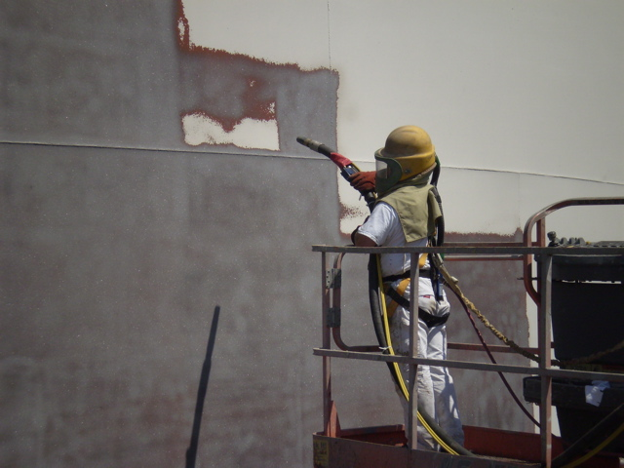

Slide 17
SSPC-SP 17, Thorough Blast Cleaning of Non-Ferrous Metals
Cleaning of previously coated non-ferrous alloys (copper, aluminum), stainless steel for subsequent coating application
Organization similar to dry blast cleaning standards for steel
Non-mandatory appendices contain supplementary info on selection of abrasives, blast pressures, chemical cleaning, profile, etc.
Should be available on SSPC Marketplace by October 1.

Slide 18
Possible Non-Profiling SP
Technology Update
Include use of laser ablation, plasma blasting, and dry ice blasting
Conference call held September 5 to draft proposal
After all interested parties approve proposal (concept) it is sent to Standards Review Committee
If SRC approves proposal, SSPC will canvass for consensus review body and task group will work on preliminary draft

Slide 19
QP 1 2019 Revision
Revised standard issued January 7, 2019
PCCP Advisory Committee is working on revising Audit Checklist to reflect revisions
No audits to the 2019 requirements are planned until 2020
Clarifications to subcontracting requirements and requirements for EH&S manager training and education are the principal changes

Slide 20
QP 2 Revision
Board of Governors ballot for publication approval due September 15
Revisions to Audit Checklist will start after standard is approved and require approval by PCCP Advisory Committee

Slide 21
Questions?
THANK YOU!

