Slide 1


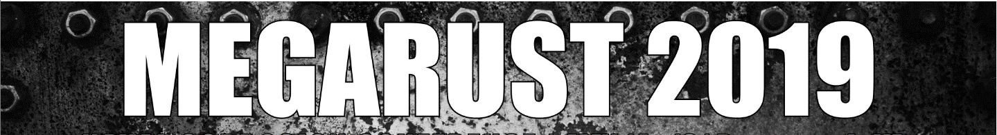

Analysis of Underwater Hull Qualified and Alternative Tie Coats
Jacy Easterday, Code 6137, Jimmy Tagert, Code 6138, Ivan Stanke, Code 6138, James Martin, Code 6138, Tim Wise, Excet
DISTRIBUTION STATEMENT A. Approved for public release.

Slide 2
Introduction:
Current Process
009-32
Section 3.1.19: Second coat of primer must be tacky when applying the ablative antifouling (AF) topcoat
Section 3.6.3: Defines tacky as the cured state of a coating where a fingertip is gently pressed into the surface (without twisting) and no residue is present on the fingertip, only a slight impression is left behind on the surface
Tacky Req. Pros:
  Promotes good intercoat adhesion
  Eliminates additional surface preparation (i.e. scuff sanding)
Tacky Req. Cons:
  Improperly judging the tacky requirement leads to premature failures
  Limited QA on tacky primer layer
  Puts constraints on dry dock operations
Alternative Process
Fully Cured Pros:
  Allows ablative AF to be applied to the alternative primer beyond the tacky requirement without a decrease in intercoat adhesion
Fully Cured Cons:
  Chance of surface contamination when top coated with ablative AF beyond the tacky state of cure
Ablative AF Top Coat
Ablative AF Top Coat
MIL-PRF-23236 – Tacky
Alt. Primer – Fully Cured
MIL-PRF-23236 – Fully Cured
MIL-PRF-23236 – Fully Cured
Steel
Steel
Notes:
Stack up: For the current process and alt. process, the primer applied directly to steel should be MIL-PRF-23236 fully cured to ensure the AF paint system has good resistance to cathodic disbondment.
Objective: Determine if manufacturers that have qualified antifouling (AF) paint systems produce epoxy “tie coats” with an extended overcoat window (up to 3 days).
Current process: The current Navy process is for a coating applicator to apply the first coat of primer direct to steel and allow it to fully cure. A second coat of primer is applied and allowed to cure to thumb tacky then the first coat of AF is applied. It is important for the second coat of primer to be thumb tacky to promote adhesion between the second coat of primer and first coat of AF.
Current process issues:
Improperly judging thumb tacky leads to premature failure of AF
Very limited QA on second coat of thumb tacky primer
Puts constraints on dry dock operations

Slide 3
Sample Fabrication
Qualified coating systems (controls) were spray applied to steel panels in accordance with requirements in Standard Item 009-32 and the NAVSEA Reviewed ASTM F718 data sheets
Alternative primers were spray applied in accordance with requirements appearing on commercial data sheets
Manufacturer matched ablative AF top coats were applied over the primers at tacky and Days 1, 2, 3, 4, 7, 15, and 30 with no additional surface preparation of the primer
Test Matrix
Property Test
  Glass Transition (Tg): Primers and system (primer + AF top coat) on Days 1, 2, 3, 4, 7, 15, and 30 using Modulated Differential Scanning Calorimetry (MDSC)
  % Solvent Loss: Primers only on Days 1, 3, 7, 15, and 30
  Hardness
Mechanical Test
  Pressure Washer Test
  Dry Dolly and Peel Adhesion Test
**For this presentation only tacky through day 3 is being presented**
Notes:
Analytical testing allowed us to monitor the coatings curing process
Mechanical and other testing monitored the coatings performance, we were interested to see if the performance declined as you increased the overcoat window.

Slide 4
Test panel matrix:
Test | Substrate | Size | Panel Preparation
Dry Time | Leneta Card | 8.5”x11” | None
Hardness | Q-Panel | 3”x6” | Solvent Clean
% Solvent Loss | Release Film | 8.5”x11” | None
Tg | Release Film | 8.5”x11” | None
Adhesion | Steel | 2”x12” | Grit Blast
Pressure Washer Test** | Steel | 2”x12” | Grit Blast
**Substrate used for adhesion testing was also used for pressure washer testing**
Notes:
Analytical testing allowed us to monitor the coatings curing process
Mechanical and other testing monitored the coatings performance, we were interested to see if the performance declined as you increased the overcoat window.

Slide 5
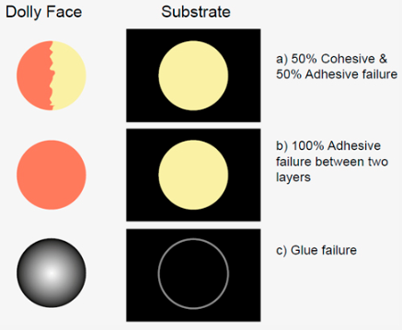
Pull-Off (Dolly) Adhesion Set Up and Analysis :
Test Set Up
Test Analysis
ASTM D4541
A = Substrate
B = 1st Primer Layer (MIL-PRF-23236)
C = Tie Coat: Qualified Primer (MIL-PRF-23236) or Alternative Primer
D = Ablative AF Top Coat
Y = Glue
Z = Dolly (Tab)
https://www.elcometer.com/en/coating-inspection/adhesion-testers/pull-off-adhesion-testing/elcometer-510-automatic-pull-off-adhesion-gauge.html
Notes:
Yellow = control primer
Blues – alternative primers
Overall: Cure rates were very comparable, no extreme differences were seen that would raise a concern.

Slide 6
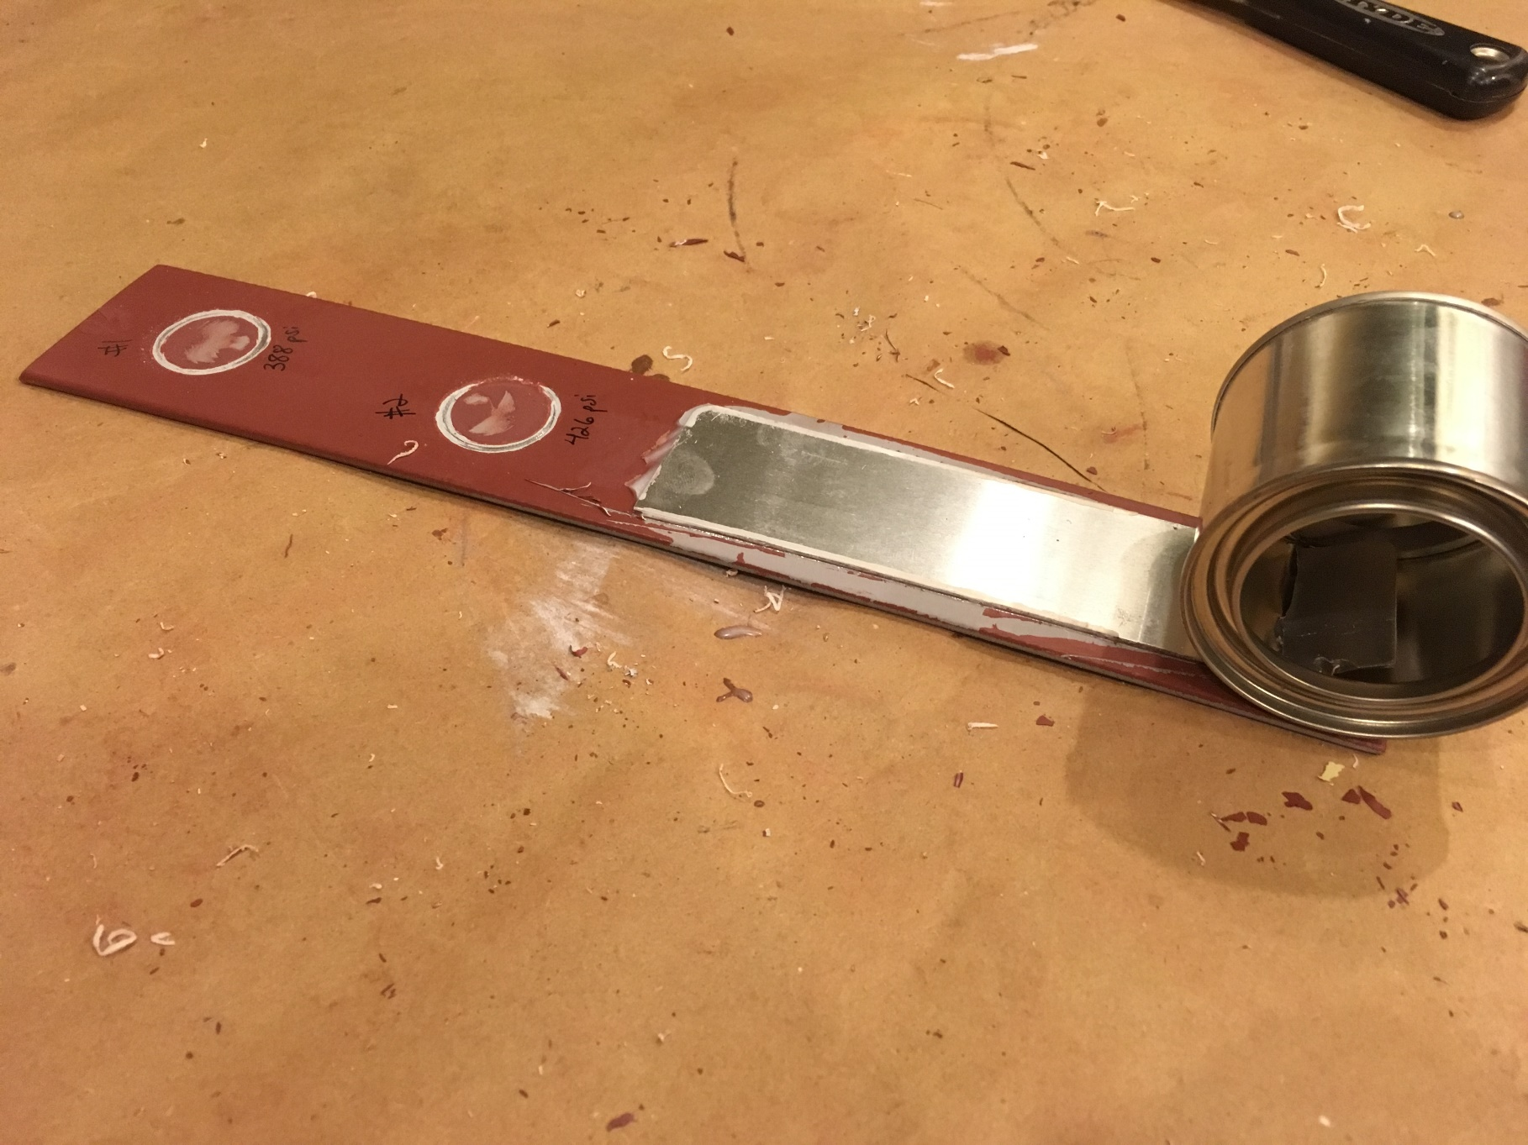
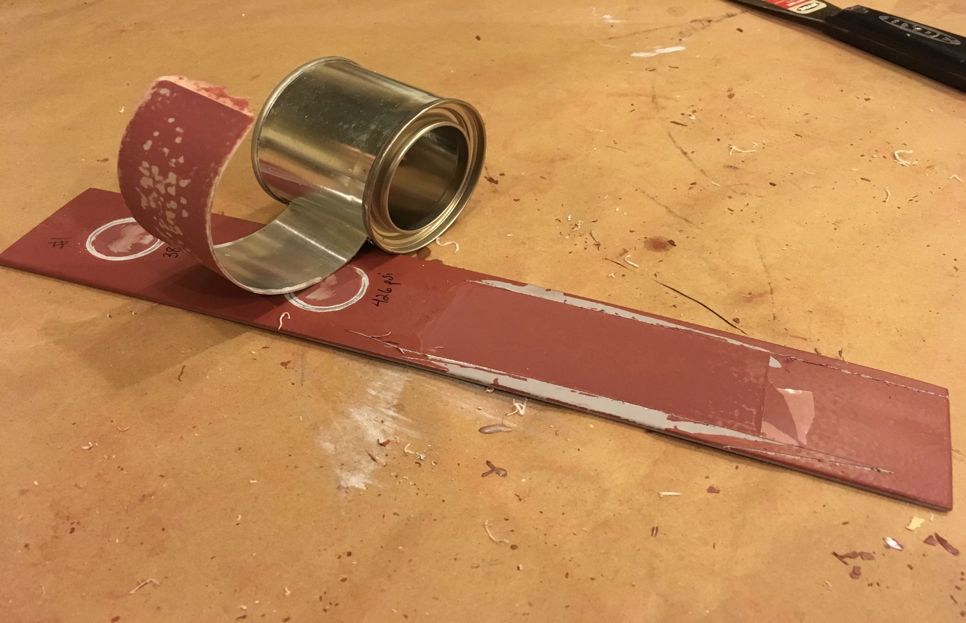
Peel Adhesion Set Up and Analysis:
Test Set Up
Test Analysis
Ablative AF is found on both the peel tab and substrate after testing
Qualitative evaluation, similar results to pull-off adhesion testing where cohesive and adhesive failure is monitored.
Notes:
Yellow = control primer
Blues – alternative primers
Overall: Cure rates were very comparable, no extreme differences were seen that would raise a concern.

Slide 7
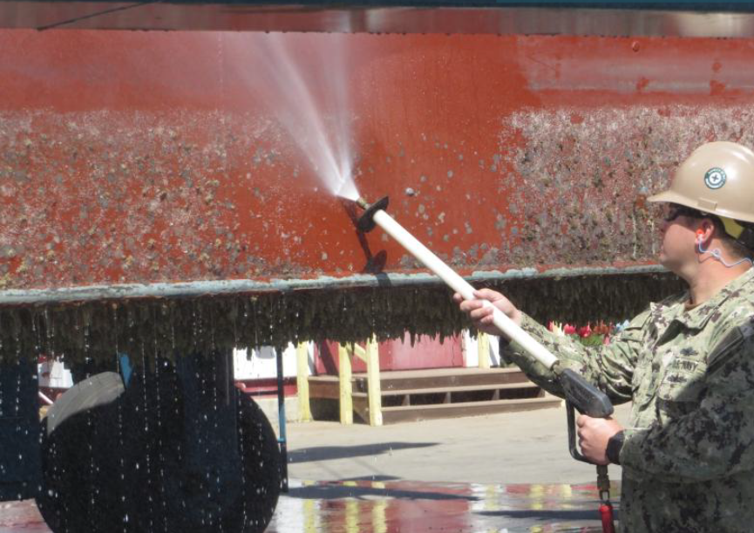
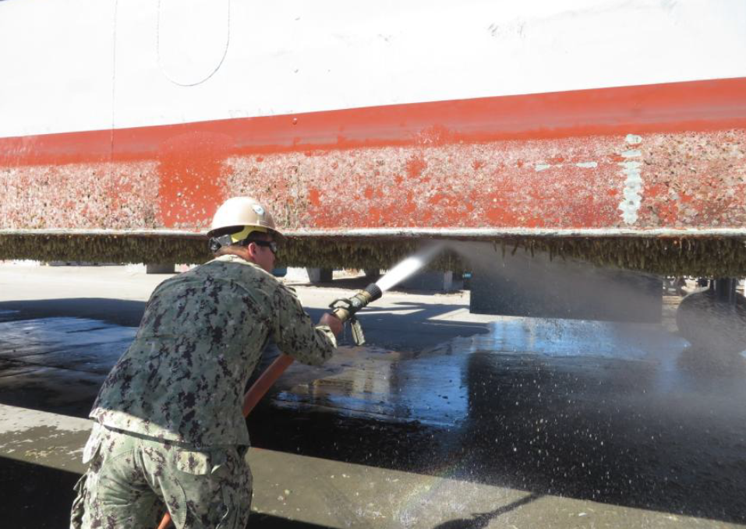
Cleaning Method: Pressure Washing:
Notes:
Cleaning Methods:
Soft Scrubbing
Hard Scraping
Pressure Washing
Want to remove fouling without removing the AF paint from the primer or the entire system from the substrate.

Slide 8
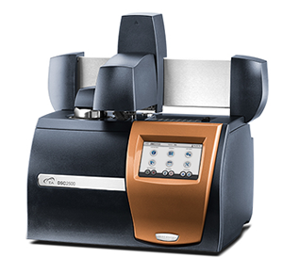
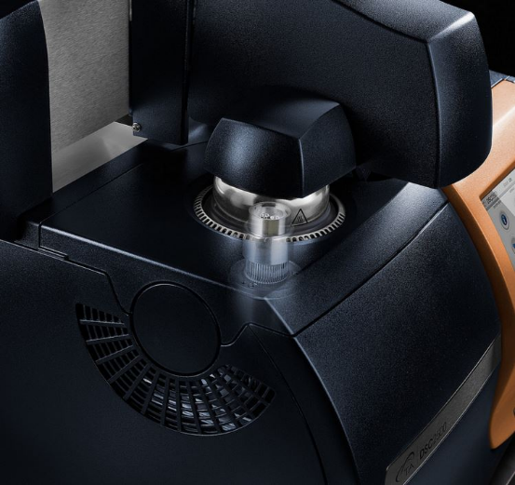
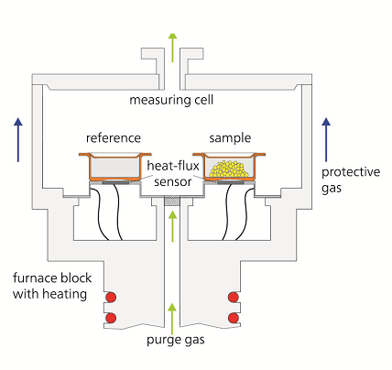
Modulated Differential Scanning Calorimetry (MDSC):
Primers only and Primer + Ablative AF samples were spray applied to release films and cured at ambient lab conditions
Sample collection involved hole punching the samples and placing them in the DSC aluminum pans and capped with an aluminum lid
https://www.tainstruments.com/dsc-2500/
https://www.netzsch-thermal-analysis.com/us/products-solutions/differential-scanning-calorimetry/dsc-214-polyma/
https://www.tainstruments.com/dsc-2500/
Notes:
MDSC
Characterization of transitions involving a change in heat capacity (Tg)
Monitors heat flow that does and does not respond to a changing heating rate
In general, only heat capacity and melting respond to the changing heating rate
Heat capacity is a measure of molecular motion. Heat capacity increases as molecular motion increases.
Vibration – occurs below and above Tg
Rotation – polymer backbone and sidechains (in and above Tg)
Translation – entire polymer molecule (above Tg)

Slide 9

























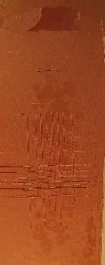
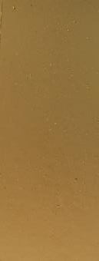
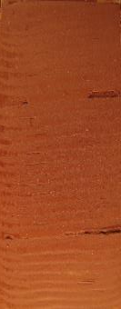


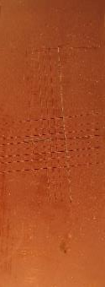
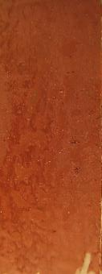
Adhesion Between Primers and Antifouling Topcoat:
Tacky
Day 1
Control
Tacky
Day 1
Alternative
Day 2
Day 3
Day 2
Day 3
Pull-Off (Dolly) Adhesion
Peel Adhesion
Notes:
More intercoat adhesion failure beyond day 1 for all coats
Less intercoat adhesion failure beyond day 1 for the alternative primers

Slide 10
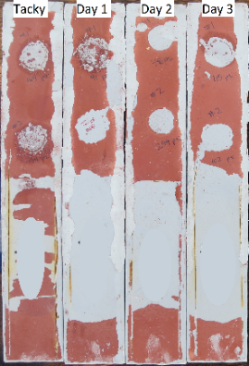
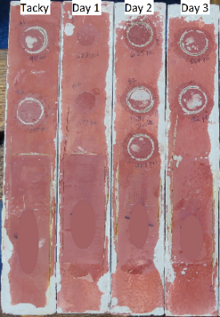
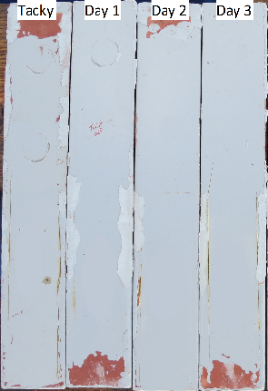
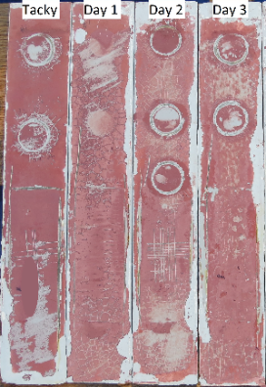
Pressure Washer Test:
System (AF Top Coat 1 with Primer):
Control Primer
Alternative Primer
Before
4000 psi freshwater
15˚ fan tip
3 inch distance
30 seconds cleaning time
After
Notes:
Control 1 – performed better when over coated at tacky and day 1
Alternative primer 1.1 did extremely well for all 4 days of over coating
Alternative primer 1.2 did not perform well, but the best results were observed when over coated at tacky

Slide 11
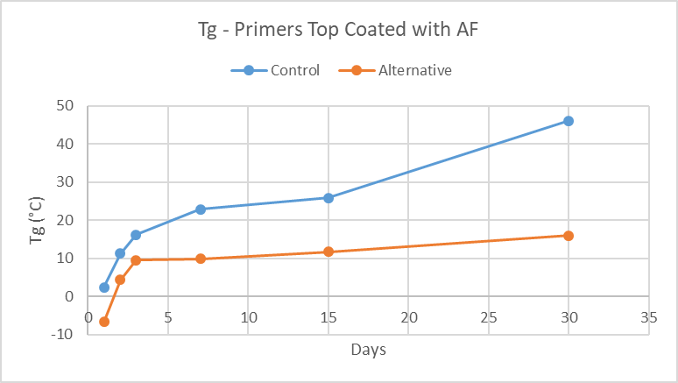
Monitor curing process of primers after top coat application:
Notes:
MDSC
All three primer’s cure behavior were similar
After top coating the AF, the primers had a drop in Tg
Control Primer 1 and Alt. Primer 1.2 recovered
Alt. Primer 1.1 never recovered
AF Coating (1K) – solvent evaporation
% Solvent Loss
Control Primer 1 and Alt. Primer 1.2 had similar % solvent loss
Alt. Primer 1.1 had higher percent solvent loss,
this supported that the Alt. Primer 1.1 top coated system had a
low Tg as a result of solvent entrapment

Slide 12
Conclusion:
Primers were applied to test panels and allowed to cure for different time intervals before an AF top coat was applied
Tg and hardness measurements were made at the same time intervals to gain an understanding of cross-link density and solvent resistance of the primers during curing
  These tests provided an indication if solvent in the AF top coat is able to diffuse into the primer creating a bond between the two systems
  The Tg of the alternative primer had a larger decrease when exposed to solvent in AF top coat
    This could be related to good adhesion properties
Considering results of all testing:
  Alternative primers had the best results in adhesion tests with a preferred cohesive failure mode of AF top coat
Alternative primers tested can extend the overcoat window for MIL-PRF-24647, Type II AF paint for several days
  Length of overcoat window needs to be balanced against surface contamination risk
PRIMERS WITH A LOW Tg YIELDS POOR SOLVENT RESISTANCE WHICH INCREASES THE OVERCOAT WINDOW

Slide 13
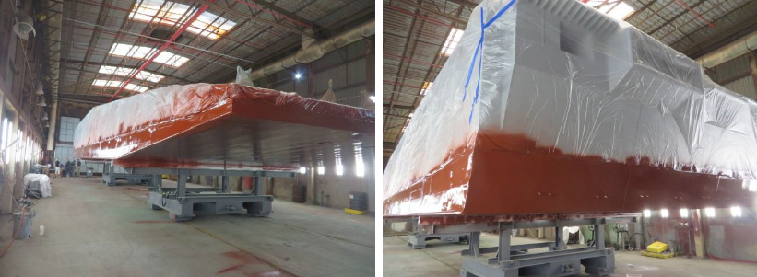
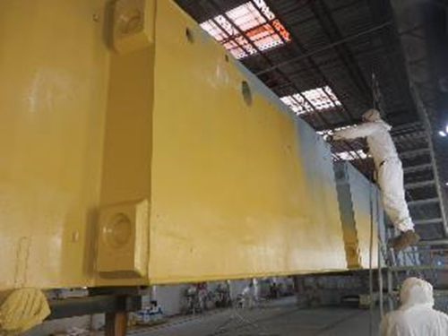
Next Steps:
PCoE Funded Demonstration: Amphibious Construction Battalion One (ACB-1) on the underwater hull of a barge (ECD June 2019)
NSRP Shipyard Demonstration: Underwater hull of shipyard asset, or large test plates
For both demos, primer will cure for 3 days before applying AF top coat.
Qualify alternative primers to MIL-PRF-24647 as part of a system
  1st coat: MIL-PRF-23236 anti-corrosive primer (cathodic protection)
  2nd coat: NEW MIL-PRF-24647 primer (tie coat)
  3rd coat: MIL-PRF-24647 antifouling paint system
Update ASTM F-718 with new primer/tie coat requirements
ACB-1 Demo – Completed July 2019

Slide 14
Test and Evaluation of Primers with Extended AF Overcoat Window
Test Panel Preparation

Slide 15
Panel Preparation Guidelines
Panel size: 4’ X 8’ X ¼” cold rolled steel
One (1) panel for each of the four tie coat primers being tested
Three to four MIL-PRF-24647 coating systems with tie coat primers will be tested
The host facility (shipyard) will advise for a way to secure the panels in the water that will minimize movement and / or damage during the submersion cycles
Each panel will be coated with test primers and AF on both sides
Following the first prime coat, all edges and any holes or other attachments installed by the shipyard for securing purposes will receive a stripe coat (of the first coat material) of contrasting color
Each panel will receive one of the tie coat primers on both sides
After 72 hours cure cycle for each tie coat, the manufacturers corresponding AF will be applied, using the diagram provided for guidance
Follow full credible cure, the panels will be submerged in salt or brackish tidal water and secured at the shipyard
Two follow-up inspections will require the shipyard to remove the panels from the water, low pressure wash (100-150 PSI), let the panels dry overnight, destructive adhesion test, LPWC at 3500 PSI, and re-submerge / secure.

Slide 16
Panel Diagram
8’
Primer, Tie Coat, one coat AF
Primer, Tie Coat.
Two Coats AF
Primer, Tie Coat,
Three Coats AF
4’
Side 1
Side 2

