Slide 1
Shore Power Connector Tester
D’Angelo Technologies (D5T)
819 Factory Rd. A
Beavercreek, OH 45434
Matt Boubin
D’Angelo Technologies
(513) 706-5783
matthew@dangelotechnologies.com
Jeff Callen
Penn State Electro-Optics Center
(724) 295-7000 x7141
jnc13@arl.psu.edu
NSRP ETP July 24, 2019
Atlanta, GA
A: Approved for public release: distribution unlimited

Slide 2
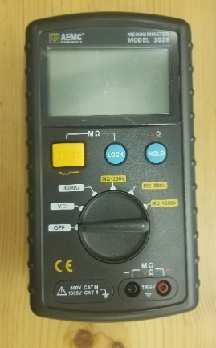
Project Overview
A Dec. 2014 NSWCCD-SSES report notes a significant number of 450V 400A surface ship shore power connection plug and receptacle failures.
These connectors are subject to corrosion at the connection pins themselves. Corrosion leads to high impedance contact and subsequent heating of the pins and eventual failure.
The connectors are tested before connection to shore power with a Megohmmeter (“Megger”) to verify that there are no accidental low impedance paths between the phases or to ground.
In Feb. 2018, a pin failure in a 450V shore power connector on the USS Fitzgerald (DDG-62) led to an Arc Flash Event in which the connector exploded.
Due to similar issues in the fleet, a new Maintenance Requirement Card (MRC) has been issued that requires Megger testing from each pin in the receptacle to every other pin and also to ground, rather than just a single phase to phase and phase to ground tests.
(a)
Fig. 1 (a) Results of an arc flash event at 450 V Shore Power Connector on DDG62 (b) MegOhm Meter currently used to measure isolation between connector pins.
A: Approved for public release: distribution unlimited
(b)
Distribution Statement A: Approved for public release: distribution unlimited

Slide 3
Project Overview
The number of permutations for the new tests results in a significant increase in the time and effort to perform these tests and also increases the opportunity for human error.
  Phase A (7 pins) to (Phase B (7) and to Phase C (7)) is 7 X 14 = 98 tests
  Phase B (7) to Phase C (7) is 7 X 7 = 49 tests
  All Phases (21 pins) to ground = 21 tests
  Total tests per receptacle = 168 X 12 receptacles per ship = 2016 tests
Fig. 2: 450 V Shore Power Connector
The Project
Investigate the suitability of COTS equipment first and determine if such equipment can be adapted to this application.
Should it prove suitable, develop any required modifications, including a connector to mate the equipment to the ship connectors, and program the equipment for the appropriate tests.
If there is a fundamental issue with the equipment, the project will develop a design concept for switching the Megger measurement device between all the test permutations and offloading or recording the test data.
If sufficient funds remain at this point, a prototype proof of concept device will be constructed.
The goal is to develop a portable tester that can be plugged into the shore power connector and run the required tests at a single command or button push.
Distribution Statement A: Approved for public release: distribution unlimited

Slide 4



Project Team
The Penn State Electro-Optics Center – project administration, requirements and test plans, evaluations.
  POC – Jeff Callen
D’Angelo Technologies, LLC – programming and testing COTS equipment, recommending modifications.
  POC – Matt Boubin
Huntington Ingalls Pascagoula Shipbuilding – Shipyard representative – arranging final demo
  POC – Jason Farmer
Gulf Coast SUPSHIPs – government stakeholder – first identified the issue.
  POC – Clay Smith
Project Technical Representative – Walt Skalniak, Panduit Corporation.
  POC – Walt Skalniak
Distribution Statement A: Approved for public release: distribution unlimited

Slide 5
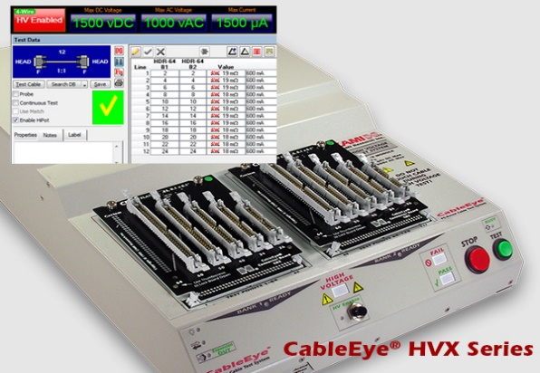
Project Approach
Define firm requirements and test conditions for performing the required tests.
A candidate COTS device has been identified that is potentially suitable.
  It is the CableEye HVX High Voltage Cable Tester from CAMI Research (Acton, MA).
  Nominally it tests a cable from end to end, but appears to be configurable to make the required measurements.
  Portable table top device with interface to a laptop computer. Generates and records a full report in 2-3 minutes.
  In-house at D’Angelo Technologies, LLC and available for tests.
Perform laboratory tests on the COTS device, including developing of programming to perform the required test. Simulate low and high impedance connections via resistors.
Fig. 3 CableEye HVX High Voltage Cable Tester
CAMI Research, Acton, MA.
Distribution Statement A: Approved for public release: distribution unlimited

Slide 6
Project Approach (cont.)
Mate an appropriate cable and connector to the tester for testing with a shipboard connector.
  Investigate whether it is more economical to buy the mating connector or fabricate it. HII Pascagoula has the capability to fabricate the connector, if necessary.
Discuss with the shipyard to determine if a realistic test can be made aboard ship or in another test facility to verify the prototype tester performance in actual tests and whether a detectable failure can be simulated.
Perform this test and collect data if schedule and availability can be worked out.
Should the COTS equipment not prove suitable, the project will be re-evaluated under the guidance of the stakeholders to develop a design for a tester and possible proof-of-concept prototype. The extent of this prototype will be determined by available remaining schedule and funds.
Identify the path forward for implementation.
Distribution Statement A: Approved for public release: distribution unlimited

Slide 7
Deliverables
Deliverable | Team Member(s) | Due Date
Quarterly Reports | PSU, D’Angelo | 10/31/19, 1/31/20, 4/30/20
Laboratory Demonstration | D’Angelo, PSU, Other IPT as available | 12/5/19
Practical Demonstration | HII Pascagoula, PSU, D’Angelo, SUPSHIPSGC | 4/22/20
Final Report with Recommendations | PSU, D’Angelo, HII Pascagoula, SUPSHIPSGC | 7/31/20
Distribution Statement A: Approved for public release: distribution unlimited

Slide 8
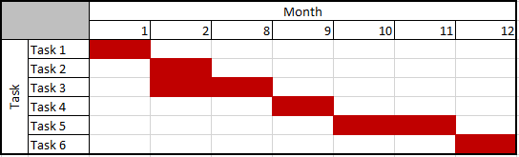
Project Task Workflow
Task 1- Review Project Requirements along with Penn State and Gulf Coast SUPSHIPS to develop a requirements document
Task 2 - Assess COTS applicability to requirements
Task 3 - Program COTS equipment for laboratory tests and test against requirements
Task 4- Host a simulation demonstration D’Angelo Technologies, LLC facility demonstrating the lab tests for Penn State, IPT members and invited participants.
Task 5 - Support a field demonstration at a shipyard of equipment with actual connector.
Task 6- Contribute to Quarterly and Final Reports as necessary.
Distribution Statement A: Approved for public release: distribution unlimited

Slide 9
Project Benefits
The former test procedure required 6 tests (phase to phase and phase to ground), manually performed on 12 connector or 72 tests. The new requirement changes this to 2016 tests, or a x28 increase in labor effort and time. An automated tester can check each connector in about 2 minutes or roughly one half hour for all the tests, a significant savings in labor.
Once the tester is completed, acquisition costs are fixed.
Another strong benefit is the reduction in potential for human error.
  Each of these tests is repetitive and the connector pins are identical in appearance.
  The sheer number of identical tests increases the likelihood of a mistake being made.
  Manual recording of data is also prone to error.
  An automated tester that performs all the combinations of tests and records the data eliminates these sources of error.
The recording of impedance measurements of the same connector over time can yield information on whether corrosion is starting to affect the integrity of the pins. This allows replacement of pins before they fail or show external signs of degradation.
Exact cost estimates for the tester acquisition will be determined by how the design develops during the course of the project. The benefits are extendible to all ships using this type of connector, or to other connector types by substituting the mating connector on the tester.
Distribution Statement A: Approved for public release: distribution unlimited

Slide 10
Questions?

