Slide 1
Build Your Future
NSRP JOINT PANEL MEETING – WELDING TECHNOLOGY AND WORKFORCE DEVELOPMENT
AUGUST 13, 2019
AUDREY KENNEDY, PROGRAM MANAGER
NATIONAL MARITIME EDUCATION COUNCIL and PROJECT LEAD
Shipbuilding and Ship Repair Works!

Slide 2
Agenda
About NMEC
Why the BYF Project is Needed
Goals
Deliverables
Schedule
Progress to Date
BYF Collaboration Team

Slide 3
ABOUT NMEC
Established in 2012
Member-based, industry-driven trade association
Working with NCCER to develop a national workforce development system

Slide 4
Challenges addressed
Aging workforce
Calls for a 355-ship Navy
Competition among industry sectors
Outdated public perceptions
89% - manufacturing sector growth stagnant
66% - attributed perceptions to a lack of jobs
70% - would not recommend a career in manufacturing to their kids

Slide 5
GOAL 1
Investigate best practices and replicate/pilot successful models
Recruiting best practice survey/toolkit
Branded image enhancement & career awareness platform
Social media/communication strategy
Ambassador program/toolkit
PROJECT
GOALS
Notes:
Louisiana Community and Technical College System reported that yearly program completions increased 145% since BYF Louisiana launched in 2011. BYF – Indiana reported a 3.9% increase in CTE secondary programs and 1008 high schools requesting customized resources.

Slide 6
GOAL 2
Investigate, develop and promote regional career pathways
PROJECT
GOALS
Notes:
Louisiana Community and Technical College System reported that yearly program completions increased 145% since BYF Louisiana launched in 2011. BYF – Indiana reported a 3.9% increase in CTE secondary programs and 1008 high schools requesting customized resources.

Slide 7
GOAL 3
Evaluate project effectiveness among students/student influencers and participating shipyards
Increasing numbers of first-time site visitors/subscribers
Increasing numbers of likes and followers on the social media platforms
Increased number of job-related inquiries
Increased awareness regarding career opportunities and improved perceptions among students/ student influencers
PROJECT
GOALS
Notes:
Louisiana Community and Technical College System reported that yearly program completions increased 145% since BYF Louisiana launched in 2011. BYF – Indiana reported a 3.9% increase in CTE secondary programs and 1008 high schools requesting customized resources.

Slide 8
Deliverables
Recruiting Best Practice Toolkit
Branded, Career Awareness Initiative
Shipyard profiles with links
Training center listing
Downloadable resources
Videos targeting veterans and women
Formal Ambassador Program/Toolkit
Regional Career Pathways
Notes:
Ambassador Toolkit-a guide to assist employers in identifying and developing craft professionals to conduct outreach activities at local high schools and community colleges and inspire the next generation’s workforce at the local level.

Slide 9
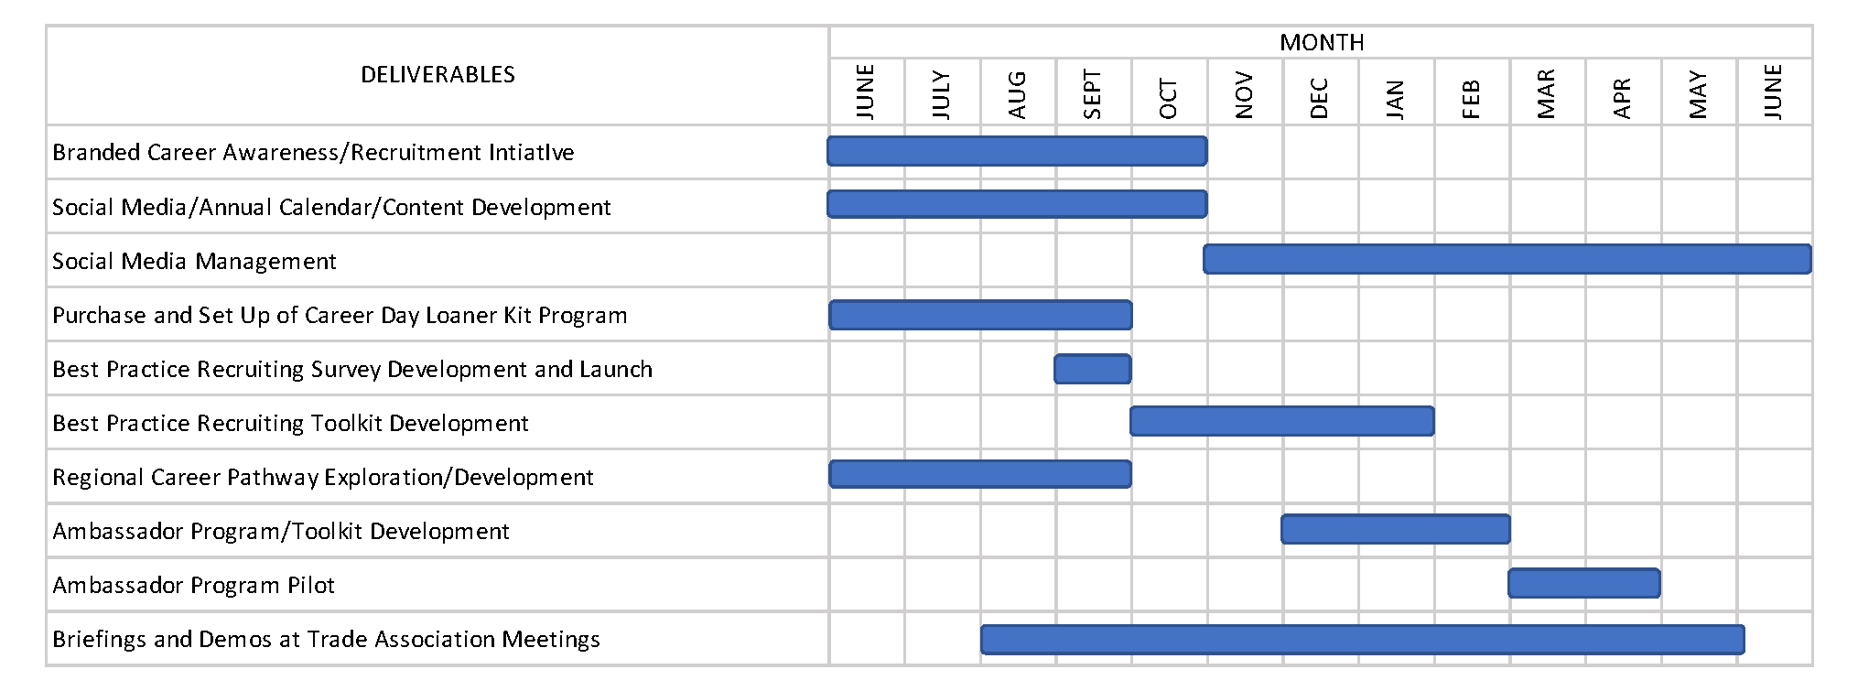
PROJECT SCHEDULE

Slide 10
Established BYF Collaboration Team
Completed Activities
BYF Website URL and Tagline Selected
Social Media Handles Reserved
Crafts Identified
Trading Card Language Finalized
Training Center Profile Form
Activities In Progress
Social Media Calendar
Image Collection
Recruiting Best Practices Survey Draft
Proclamation for State Recognition of Careers in Shipbuilding and Repair Week Draft
National Career Pathway
CTE Directors, Counselors, and Career Coaches Database
progress

Slide 11
Input into content development for website/ collaterals
Contributing photos and/or raw footage of shipyard workers/ environments
Survey development related to recruiting best practices
Input into regional career path development
BYF Collaboration team . . .
Join us!
Notes:
These activities will not require travel and will be handled via email and occasional online meetings.
These activities will not require travel and will be handled via email and occasional online meetings.

Slide 12
Collaboration
team
Austal
Bath Iron Works
Bollinger Shipyards
Continental Maritime
Electric Boat
Ingalls Shipbuilding
Newport News Shipbuilding
Seaspan Shipyards
Aerotek
American Welding Society
Northeast Wisconsin Technical College
Mentoring Solutions
NCCER
Skagit Valley College (a Marine Manufacturing & Technology Center of Excellence
TransPorts
Notes:
Includes members of NMEC and the NSRP Workforce Panel

Slide 13
QUESTIONS?

Slide 14
Get in Touch
Audrey Kennedy
Phone
205.504.9330
Email
audrey.kennedy@thetjcgroup.com
Notes:
Fill in your company contact information. If you have an apprenticeship program, include ways to get involved.
Thank the audience for their attention and ask if there are any questions.

