Slide 1
Janice Bryant
Director, Tactical Innovation Implementation Lab (TIIL)
NAVSEA 043X

Slide 2
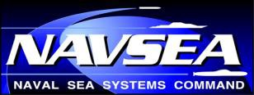




NAVAL SEA SYSTEMS COMMAND
THE FORCE BEHIND THE FLEET
1
Agile Navy Ship Sustainment
The Honorable Richard Spencer, Secretary of the Navy, 15JAN19, at the 2019 Surface Navy Symposium:
“We have set the foundation for restoring readiness and increasing lethality. However, while we are on the right direction, the RATE OF CHANGE must increase. We need to deliver the Navy the Nation needs. We cannot live by the old adage, “Business as Usual”, it will not work.”
ADM Bill Moran, Vice Chief of Navy Operations (VCNO), 15JAN19, at the 2019 Surface Navy Symposium:
“We (industry, NAVSEA, Fleet Planners, OPNAV) all have to be on the same page if we are going to answer the bell. On time and on budget is a two-way street and a partnership is the only way we are going to work this backlog down over time, improve reliability of systems, and truly establish configuration control.”
Janice Bryant
Director
Tactical Innovation Implementation Lab
janice.k.bryant@navy.mil , (360) 507-8745
Distribution Statement A: Approved for release. Distribution is unlimited

Slide 3

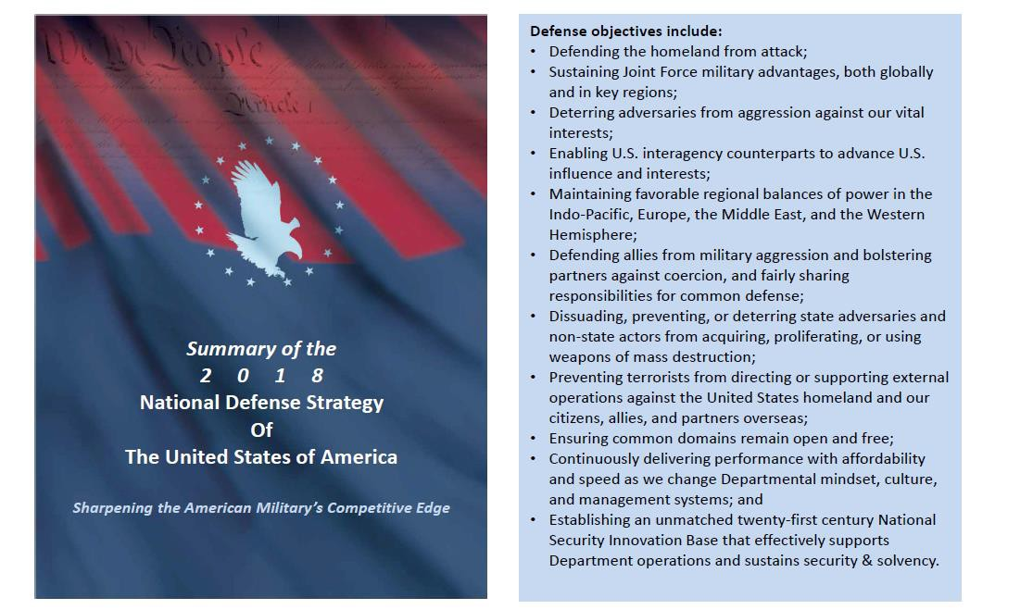
NAVAL SEA SYSTEMS COMMAND
THE FORCE BEHIND THE FLEET
Strategic Alignment

Slide 4
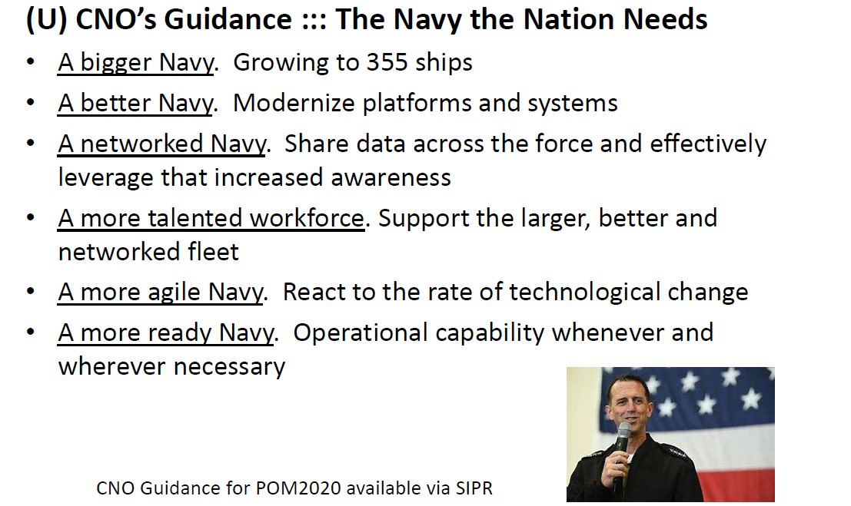
NAVAL SEA SYSTEMS COMMAND
THE FORCE BEHIND THE FLEET
CNO Priorities

Slide 5
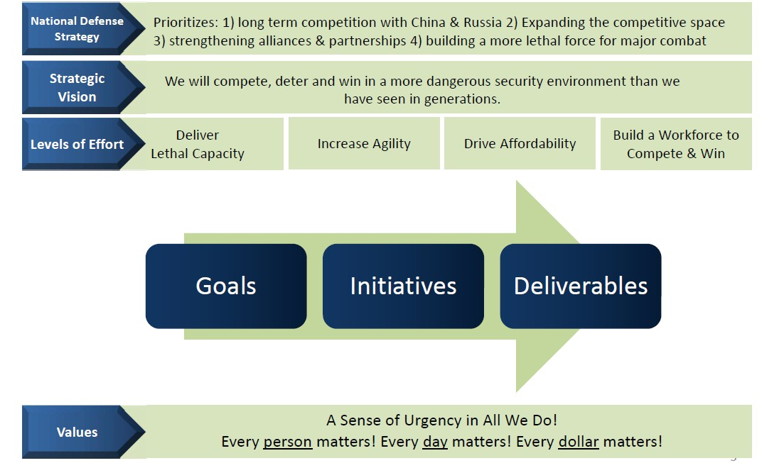
NAVAL SEA SYSTEMS COMMAND
THE FORCE BEHIND THE FLEET
ASN RDA Strategic Framework

Slide 6
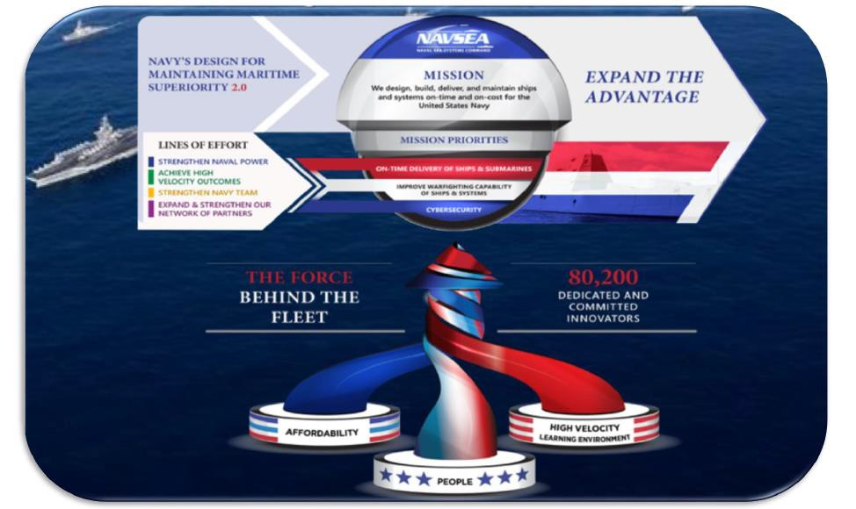
NAVAL SEA SYSTEMS COMMAND
THE FORCE BEHIND THE FLEET
NAVSEA Strategic Framework

Slide 7
NAVAL SEA SYSTEMS COMMAND
THE FORCE BEHIND THE FLEET
What’s the score?
In 2015, Beijing replaced the 1,300 ton Sanyuan bridge in 43 hours* Jay Bennett, “Here’s an overpass in Beijing being replaced in under two days”: Popular Mechanics 20 Nov 15
Vs.
Annual Budget Cycles
Phased Approaches
Study vs. Act
Research not directly tied to Operations
We must move at the speed of the need

Slide 8
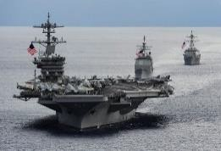
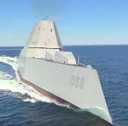
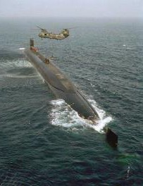
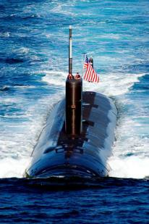
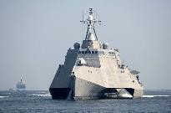
NAVAL SEA SYSTEMS COMMAND
THE FORCE BEHIND THE FLEET
NAVSEA Sustainment Framework
Strengthen Naval Power
→Achieve 355 ship Navy as close to 100% Ao
Support all ships in combat role - extended OPTEMPO, battle damages…
Transform maintenance for all platforms – NOW and continuously into the future
Achieve High Velocity Learning
→Historic levels of change required for work force and processes
Strengthen Navy Team
→Capabilities, agility and affordability must be achieved before the fight
“4 Ds” – Decentralize, Differentiate, Digitize and Develop
Reduce ownership costs – drive costs out of the backend
Expand & Strengthen Our Network of Partners
→Use connections with other DoD and federal partners
Recognize capabilities sought cut across DoD and beyond (e.g., NASA, DOE,
USCG)
Collaborate to develop/field multi-purposed and multi-service solutions
Lethality, agility, affordability, and workforce for today and tomorrow’s Navy

Slide 9
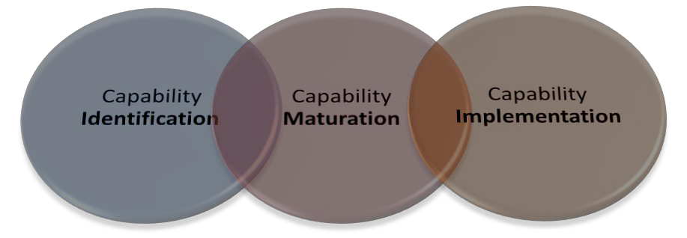
NAVAL SEA SYSTEMS COMMAND
THE FORCE BEHIND THE FLEET
NAVSEA 04X Approach:
FOCUS on rapid implementation of new capabilities across all shipyards systemically to meet current and future mission
Three Elements
  Capability Identification
  Capability Maturation
  Capability Implementation
Basis:
Seek synergy around “dual-use” solutions
Scalable for simple and complex solutions
CJCS 5123.01H
Draft DoDI 4151
DAU Technology Transition papers
Without it…
The long-term impact to mission is evident, but the detrimental impact to
staff is even more profound.

Slide 10
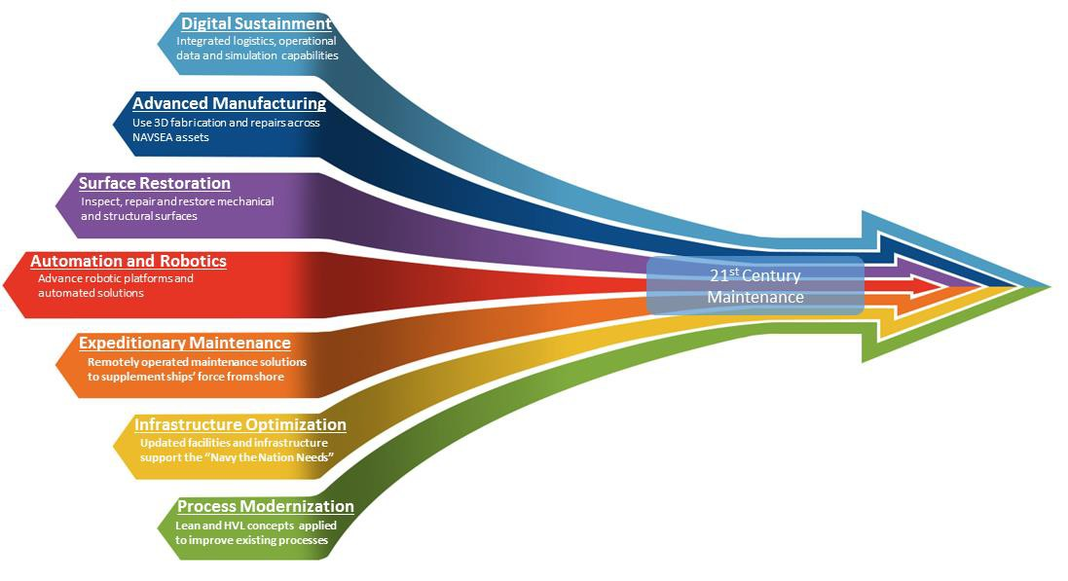

NAVAL SEA SYSTEMS COMMAND
THE FORCE BEHIND THE FLEET
Enhancing Ao Through Sustainment Technologies
Building an ongoing implementation portfolio of early, mid and long term projects
LINES OF EFFORT
STRENGTHEN NAVAL POWER ACHIEVE HIGH VELOCITY LEARNING STRENGTHEN NAVY TEAM
EXPAND & STRENGTHEN OUR
NEWTORK OF PARTNERS

Slide 11
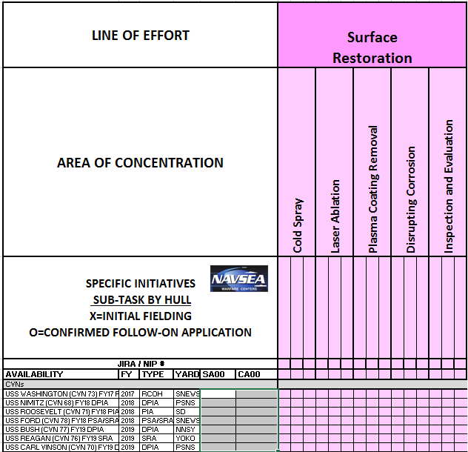
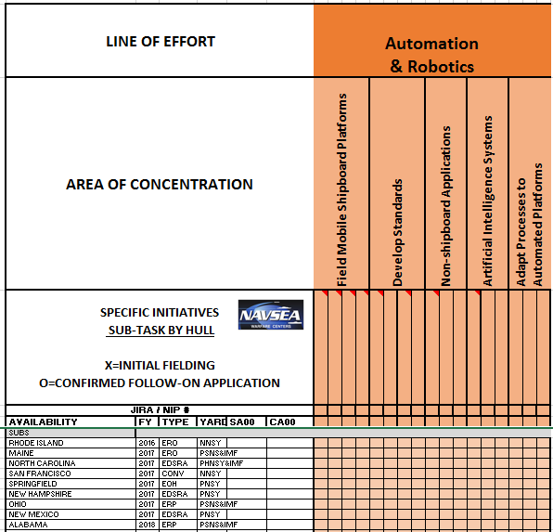
NAVAL SEA SYSTEMS COMMAND
THE FORCE BEHIND THE FLEET
Tied directly to ship repair work
10

Slide 12
NAVAL SEA SYSTEMS COMMAND
THE FORCE BEHIND THE FLEET
How are we achieving of rapid change?
Deploy what’s available now - Robotic Summit (3/2019)
Work within our family - Creation of Navy Integrated Priority List (IPL)
More Industry, Government and Academic partnerships
  TECH BRIDGES/Technology Parks
  Establish NSYs as Technology Transfer (T2) Laboratories
    Cooperative Research and Development Agreements (CRADA)
    Educational Partnership Agreements (EPA)
Different Contract Methods –
  Small Business Innovative Research (SBIR)
    ONR Accelerated Delivery and Acquisition of Prototype Technologies (ADAPT) Pilot Participant
  Other Transactional Authority (OTA)
    National Center of Manufacturing Sciences (NCMS)/CTMA
12

Slide 13
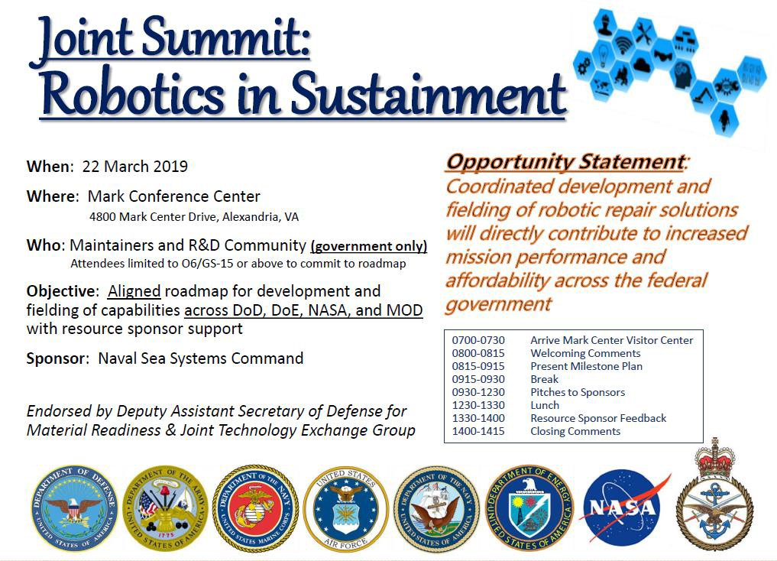
NAVAL SEA SYSTEMS COMMAND
THE FORCE BEHIND THE FLEET
13

