Slide 1
Evaluation of Plasma Beam Technology for Coating Removal
Chris Wowk, General Dynamics Electric Boat
March 14, 2019
NSRP Surface Prep and Coatings Panel Meeting
Charleston, SC

Slide 2




Working Team
General Dynamics Electric Boat (Project Lead)
  Chris Wowk, Glenn Mihok
Atmospheric Plasma Solutions (APS)
  Pete Yancey, Glenn Astolfi, Olga Asanov
Advanced Technology International
  Frances Pearce (Project Manager)
Bath Iron Works
  Robert Cloutier (PTR)

Slide 3
Project Objective and Goals
Objective
Develop a NAVSEA approved qualification plan for the use of atmospheric plasma technology to remove coatings from steel
Project Goals
Characterize impact of plasma on typical ferrous substrates – Complete
Determine necessary process controls/features/training necessary to prevent deleterious effects on substrate – Complete
Determine pathway to allow use of plasma coating removal in shipbuilding applications (method & scope of approval) – In Process
Transition project to Affordability Initiatives for business case development and implementation – In Process

Slide 4
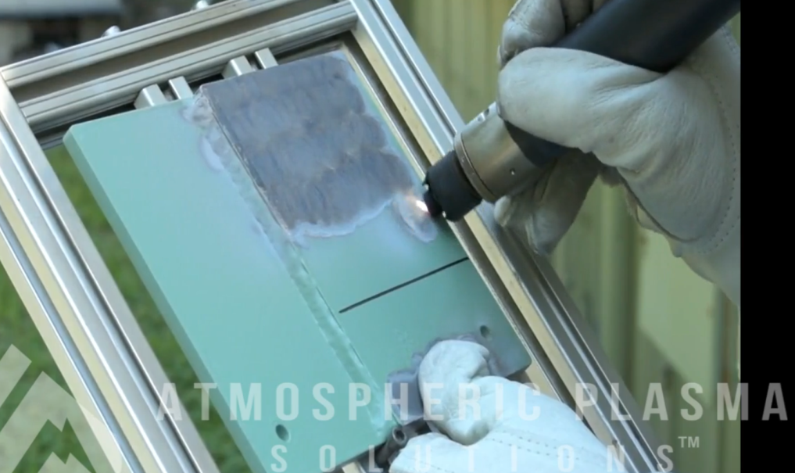
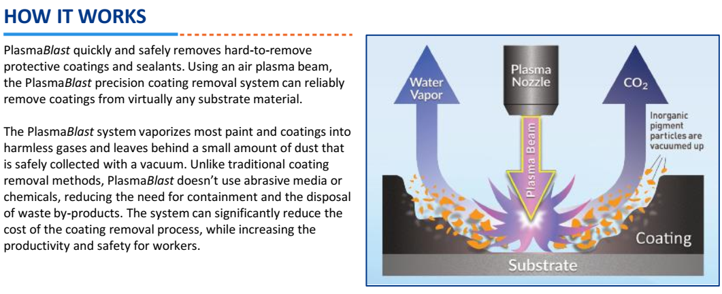
Technology Overview
PlasmaBlast system developed by APS
Atmospheric plasma breaks down organic coatings quickly and safely
Compact (person portable/hatchable), only requires compressed air and power
Leaves underlying surface profile
Improved accessibility over typical power tools
Little/no impact to typical shipbuilding steels characterized during project
  PlasmaBlast unit design improvements mitigate issues found

Slide 5
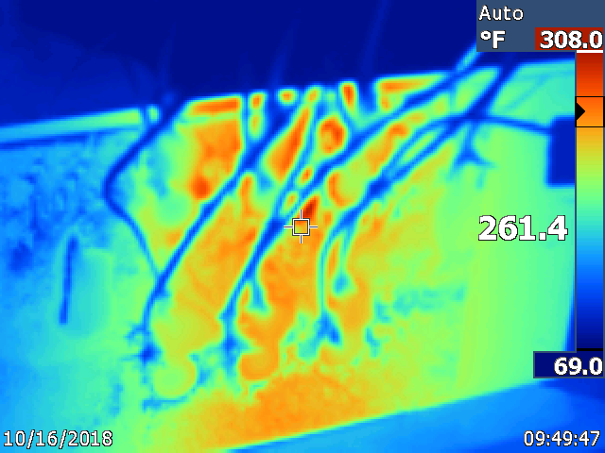
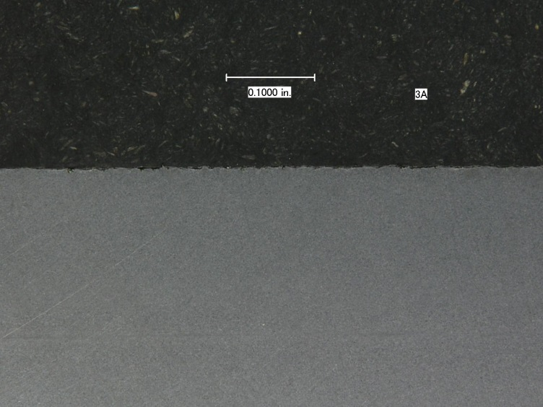
Testing Performed (GDEB)
Marine Coating Removal Capability
  Capable of removing MIL-DTL-24441 and MIL-PRF-23236 (Ultra High Solids and Powdercoat) coatings
  Significantly less dust/debris generated compared to typical power tool removal
Process Temperature Study (3/8” thick steel)
Metallurgical Evaluation (Weld and Base Metal)
  No visible impacts under normal use (“hold” locations under evaluation)
Backside | 380°F @ 1/8” Thickness | 308°F @ 3/8” Thickness
Frontside (Removal Area Adjacent) | Up to 300°F (2-3 seconds), below 250°F typical
“Hold” Test 4 x 10 Min Holds | 466°F @ 1/8” Thickness | 430°F @ 3/8” Thickness
“HOLD TESTING” FULLY BOUNDS PROCESS TEMPERATURES

Slide 6
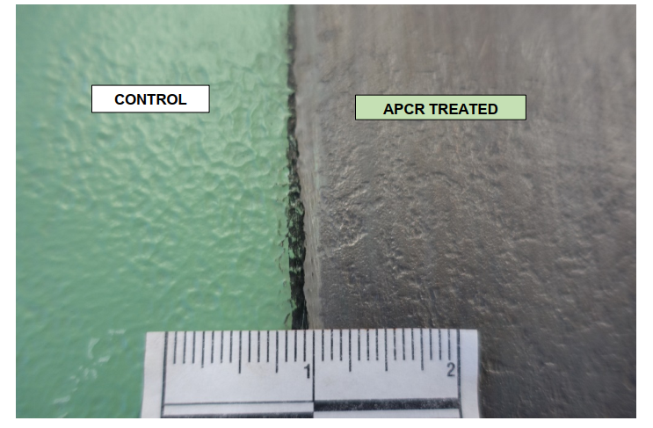
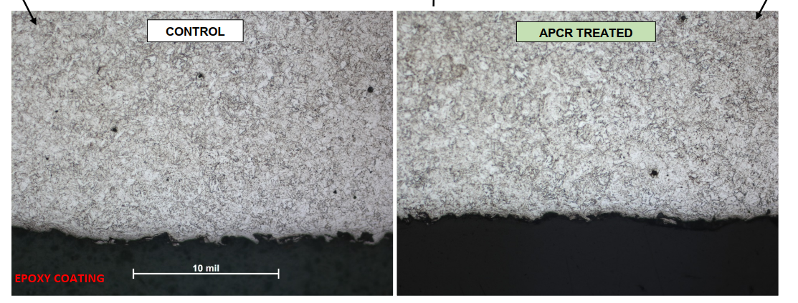
Testing Performed (APS)
Metallurgical Analysis (Weld and Base Metal)
  No significant differences compared to untreated controls
Mechanical Testing
  Hardness, Tensile Testing, Charpy Impact – No significant differences between treated and controls
Hydrogen Content
  Insignificant change to hydrogen content between treated and controls
AGREEMENT BETWEEN EB AND APS TESTING

Slide 7
Implementation Roadmap
All test data in review prior to NAVSEA evaluation
Process implementation roadmap – In Review
GDEB transitioning effort to affordability initiatives for full business case development and implementation
Roadmap will be available to NSRP community to guide PlasmaBlast implementation

Slide 8
Project Specific Deliverables
Quarterly Reports (3)
    May 18, 2018 - COMPLETE
    August 17, 2018 - COMPLETE
    December 18, 2018 - COMPLETE
Final Report
NAVSEA approved qualification plan (Under Review)

Slide 9
Thank You

