Slide 1
AWS D20 - Specification for Fabrication of Metal Components using Additive Manufacturing
Dennis Harwig and Bill Mohr, EWI

Slide 2
Agenda - D20, New 2019 Standard
Background
Outline
Powder-bed requirements
Directed Energy Deposition (DED) requirements
Navy relevance

Slide 3
Background
Metal additive manufacturing (AM) technology is rapidly maturing.
AM impact to the US Navy limited by the availability of standards and US Navy Technical Publications (Tech Pub).
New AWS standard provides framework for manufacturers and suppliers to implement AM
  Navy stakeholders engaged with D20 and developing new Technical Publications to support Navy AM implementation

Slide 4
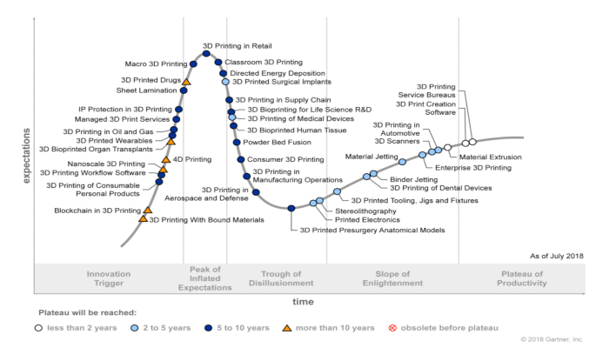
Hype Cycle by Gartner – 3D Printing

Slide 5
D20 Metal AM (Fusion) Processes
Process | Abbreviation
Laser Powder Bed Fusion | L-PBF
Electron Beam Powder Bed Fusion | EB-PBF
Laser Directed Energy Deposition | L-DED
Electron Beam Directed Energy Deposition | EB-DED
Plasma Arc Directed Energy Deposition | PA-DED
Gas Tungsten Arc Directed Energy Deposition | GTA-DED
Gas Metal Arc Directed Energy Deposition | GMA-DED

Slide 6
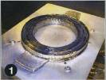
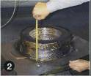

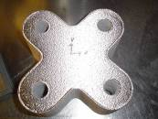
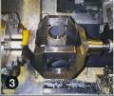

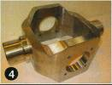
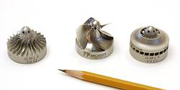

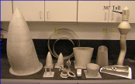
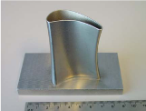

Deposition Rate vs Resolution
DED
Capability
Increased Deposition Rate
Decreased Resolution
Courtesy Boeing

Slide 7
D20 Clauses
Clause 1. General Requirements: Basic information on the scope and provisions of this standard.
Clause 2. Normative References: A listing of the documents that are required for the application of this standard.
Clause 3. Terms and Definitions: A list of technical terms and definitions of particular importance to this standard.
Clause 4. Design of Additively Manufactured Components: Requirements for the design of additively manufactured components.
Clause 5. Additive Manufacturing Machine and Procedure Qualification: Qualification requirements for additive manufacturing machines and procedures.
Clause 6. Additive Manufacturing Machine Operator Performance Qualification: Qualification requirements for the operators of additive manufacturing machines.
Clause 7. Fabrication: Requirements for fabricating additively manufactured components.
Clause 8. Inspection: "Requirements for the qualification of inspection personnel. Nondestructive and destructive examination requirements and acceptance criteria for qualification and production builds.

Slide 8
D20 Materials and Classifications
All metal materials can be used within D20, provided the Engineer can provide the particular requirements and acceptance criteria for that material.
Class A – Critical application. A component, whose failure would cause significant danger to personnel, loss of control, loss of a system, loss of a major component, or an operating penalty.
Class B – Semi-critical application. A component whose failure would reduce the overall strength of the equipment or system or preclude the intended functioning or use of equipment, but loss of the system or the endangerment of personnel would not occur.
Class C – Noncritical application. A component whose failure would not affect the operation of the system or endanger personnel.

Slide 9
Engineer shall define……
(1) Classification – Class A, B, or C (1.4.1)
(2) Component and design requirements (4.1)
(3) Essential process controls (4.1)
(4) Feedstock specification requirements (4.2)
(5) Material and component property data (4.2)
(6) Design of witness specimens (4.3)
(7) Product definition data set (4.4)
(8) Tensile specimen removal plan for pre-production test builds (5.3)
(9) Determination of acceptability of in-process correction (7.13)
(10) Method of dimensional examination (8.2.2)
(11) Approval of visual and dimensional examination plans (8.2.1 and 8.2.2)
(12) Surface inspection in any condition other than fully machined (8.2.3 and 8.2.4)
(13) Alternate method for examining builds that cannot be completely inspected by RT (8.2.5.2)
(14) Sampling plan for Class B builds (8.2.5.2 and 8.3.3.1)
(15) Location of tension test specimens within witness specimens (8.3.1.2)
(16) Chemical analysis test method (8.3.3)
(17) Acceptance criteria for tensile testing (8.4 and 8.4.3)
(18) Disposition of components not meeting the requirements of Table 8.3 or Table 8.4 (8.4.2)
(19) Acceptance criteria for metallographic testing (8.4.4)
(20) Acceptance criteria for chemical analysis (8.4.5)
(21) Acceptance criteria for density testing (8.4.6)
(22) All Engineer’s responsibilities listed in subsequent sections of this document
(23) All additional requirements, identified by the Engineer, that are not specifically addressed in this standard

Slide 11
Table 5.1 Inspection and Testing Requirements for Machine and Procedure Qualification
Test Method |  | Powder Bed Fusion |  |  | Directed Energy Deposition
 |  | Class A | Class B | Class C | Class A | Class B | Class C
Machine Qualification Standard Qualification Build(s) | Visual Examination | Yes | Yes | --- | Yes | Yes | ---
 | Dimensional Inspection | Yes | Yes | --- | Yes | Yes | ---
 | Radiographic Examination | Yes | Yes | --- | Yes | Yes | ---
 | Density Testing | Yes | Yes | --- | Yes | Yes | ---
 | Tension Tests | 54 | 54 | --- | 36 | 36 | ---
 | Metallographic Examination | Yes | Yes | --- | Yes | Yes | ---
Procedure Qualification Pre-Production Test Build(s) | Visual Examination | Yes | Yes | Yes | Yes | Yes | Yes
 | Dimensional Inspection | Yes | Yes | Yes | Yes | Yes | Yes
 | Penetrant Testing | Yes | Yes | --- | Yes | Yes | ---
 | Radiographic Examination | Yes | Yes | --- | Yes | Yes | ---
 | Density Testing | Yes | Yes | Yes | Yes | Yes | Yes
 | Tension Tests (Witness Specimens) | 3 | 1 | --- | --- | --- | ---
 | Tension Tests (Component) | 3 | 3 | --- | 3 | 3 | ---
 | Metallographic Examination | Yes | Yes | Yes | Yes | Yes | Yes
 | Chemical Analysis | Yes | Yes | --- | Yes | Yes | ---

Slide 12
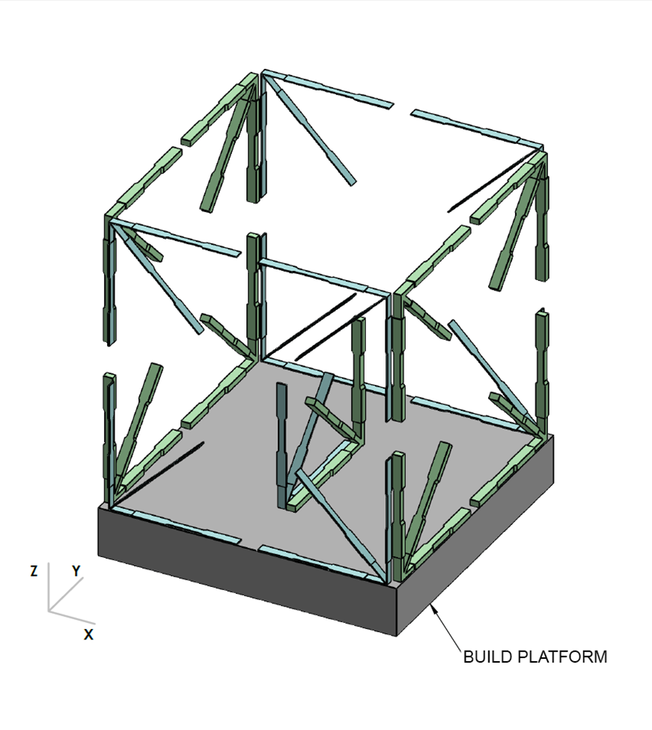
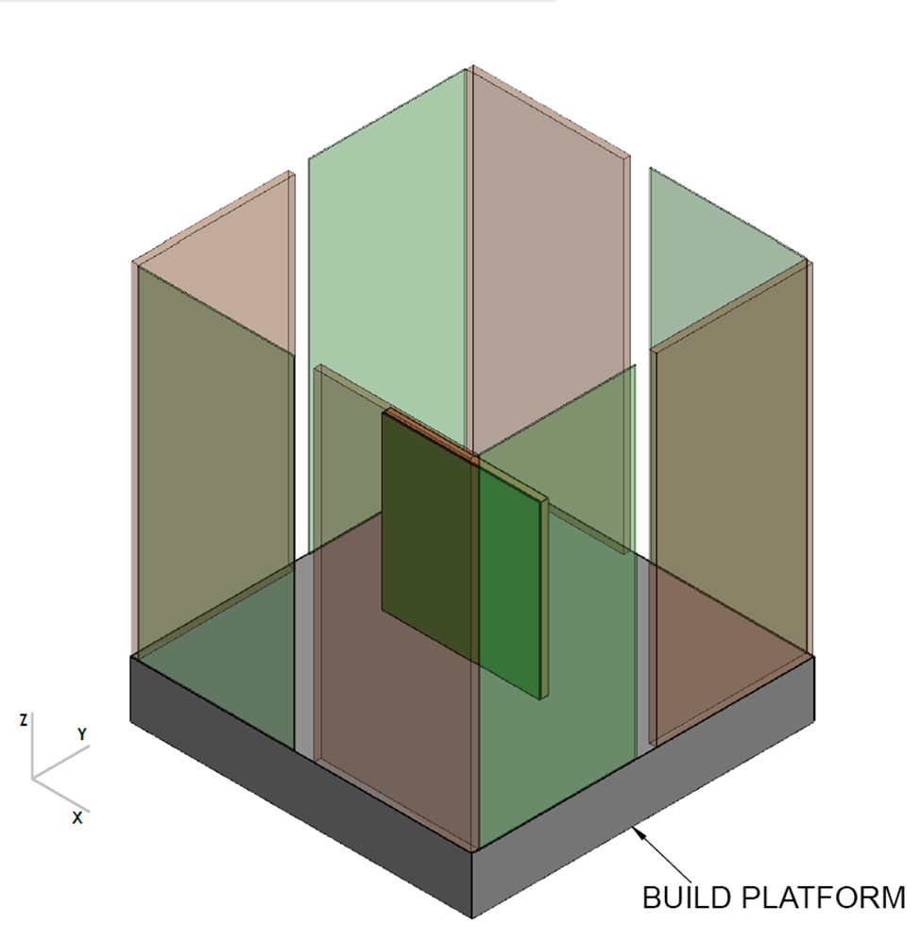
PBF Standard Qualification Build
54 Tensile Specimens + Additional Req?
Tension test specimens from each corner and the center of the build volume being qualified.
Half test specimens in each location shall represent a thin feature (maximum of 0.04 in [1 mm]).
Half of the standard qualification build tension specimens in each location shall represent a thick feature Use multiple builds to reduce the risk of a problem with a single build
Additional samples if qualifying integrated build plate

Slide 13
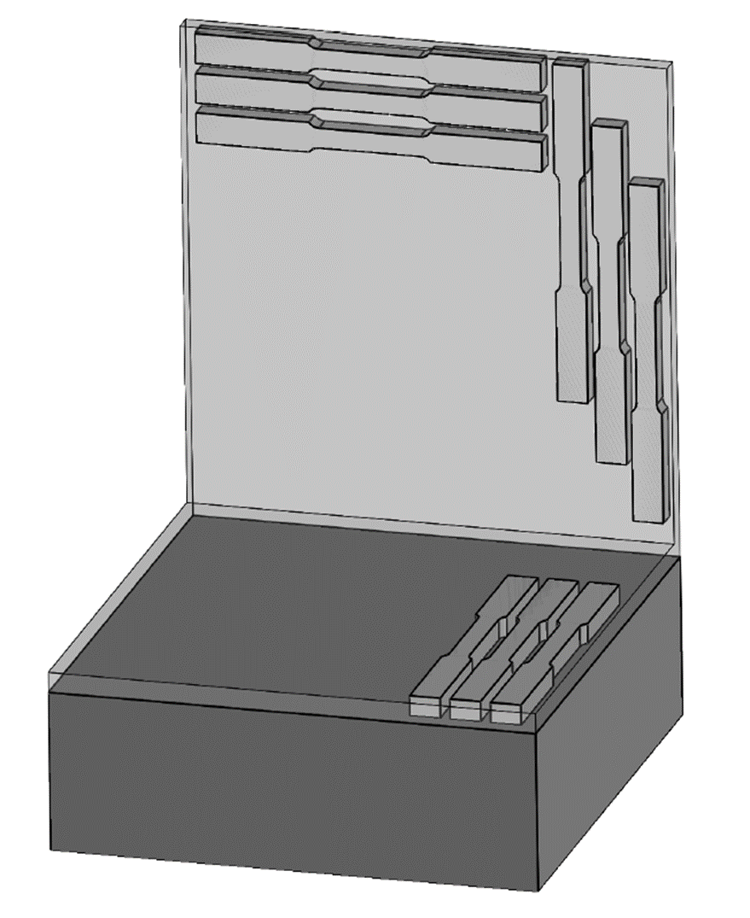
DED Standard Qualification Build
Can combine Machine & Procedure Qualifications
Vertical Plane Condition – less than three deposition passes wide, is five or more deposition layers thick, and extends for a length greater than 10 times the width of a single DED pass.
Horizontal Plane Condition – less than three deposition layers thick, is five or more deposition passes wide, and extends for a length greater than 10 times the width of a single deposition pass.
Dimensional Inspection Features – Material shall be built at each corner of the build platform (or at four, equally-spaced extremes at the edges of the build platform) that represents the smallest resolution feature(s) of components to be fabricated to an AMPS utilizing the AM machine to be qualified with this build.
Additional samples if qualifying integrated build plate

Slide 14
6.0 AM machine operator qualification
Determine the ability of AM machine operators to complete acceptable AM component builds using a given AM machine.
Clause establishes the minimum requirements for AM machine operator performance qualification.
Levels of Qualification (Class A, B, or C)
6.3 Requirements
  Training, including successful completion of written examinations
  Practical examinations
  Demonstration build

Slide 16
7.0 Fabrication
  7.2 Digital Control Plan. The Contractor shall create a digital control plan that provides a method for tracking the digital files necessary to fabricate an AM build.
  7.3 Additive Manufacturing System. A pre-production maintenance checklist shall be developed and used by the Contractor that includes the manufacturer’s guidelines for each piece of equipment in the AM system.
  7.3.1 Calibration Control Plan. The Contractor shall establish and maintain a calibration control plan to ensure that the AM system will be capable of producing AM components that meet the requirements of the AMPS and the acceptance criteria of Clause 8.

Slide 17
7.0 Fabrication Clauses cont.)
  7.4 Additive Manufacturing Feedstock and Build Platform
  7.5 Preheating and Interpass Temperature Control
  7.6 Additive Manufacturing Environment
  7.7 Additive Manufacturing Build
  7.8 Build Interruptions
  7.9 In-Process Adjustments and Modifications
  7.10 Powder Bed Fusion Witness Specimens
  7.11 Component Identification Requirements
  7.12 Acceptance Inspection
  7.13 In-Process Correction
  7.14 Post-AM Processing
  7.15 Record Requirements

Slide 19
Navy Relevance
  D20 allows for more predictable interactions between suppliers and customers for AM components
  Metal AM technology increases the industrial base for small runs of specialized parts
  Separate qualification approaches for PBF and DED.
    DED requirements are less rigorous and leverage the large body of welding standards for consumables, processes, fabrication and inspection
    Similar approach being developed by Navy stakeholders.
  New technical publications for AM technologies can fit into a wider spectrum of AM uses and standards

Slide 20
Questions?

