Slide 1
Elastic Pressure Loads on Stiffened Metallic Composite Stacks
Ship Design & Material Technologies Panel Meeting
Robert Lanoue – General Dynamics NASSCO

Slide 2
Presentation Overview
Description of Out of Plan Loading of Composite Material Stacks
Problem Description
Multiple loading examples
Fender Loads
Tug Push Loads
Ship Docking
Current Methods of Load Application
Real World Scenario

Slide 3
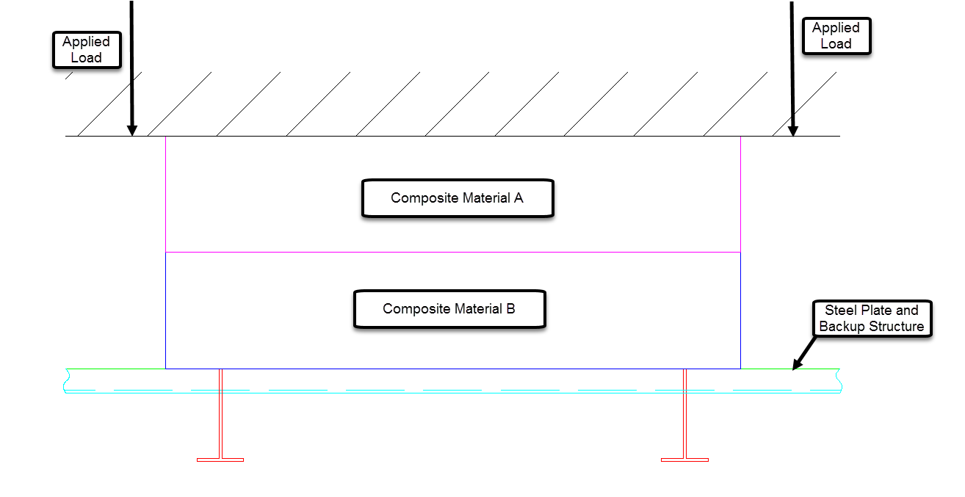
Composite Material Stacks Definition
Out of plane loading of composite material stacks refers to the application of a patch load on an isotropic (steel/aluminum) surface from a material other than steel
The steel surface of which the load is applied is a mix of unsupported plate and main supporting structure

Slide 4
Problem Description
Accurately capturing the reaction of the loads from the composite surface onto the isotropic surface.
Logically the back up structure would take most of the loads from the composite surface and the unsupported plate would take some load but a limited amount
Must make assumptions on deflection of both steel and composite material that could impact results of analysis
Due to inaccuracy of current methodology backup structure is normally very conservative and adds extra pieces that increase cost
Non technical example: Boxer is punched in the ribs, the ribs will break, the skin will deflect slightly but not take much of the load

Slide 5
Problem Description (cont)
Non Linear Effects of Composite Loading
Material Non-Linearity: Possible for Composite material to have non-linear stress/strain relationship, such as rubber
Geometric Non-Linearity: possible for deflection of one material such that small deflection theory no longer applies and lower forces could cause higher deflections
Boundary Non Linearity: As composites compress, the boundary conditions change as material properties of each composite could differ

Slide 6
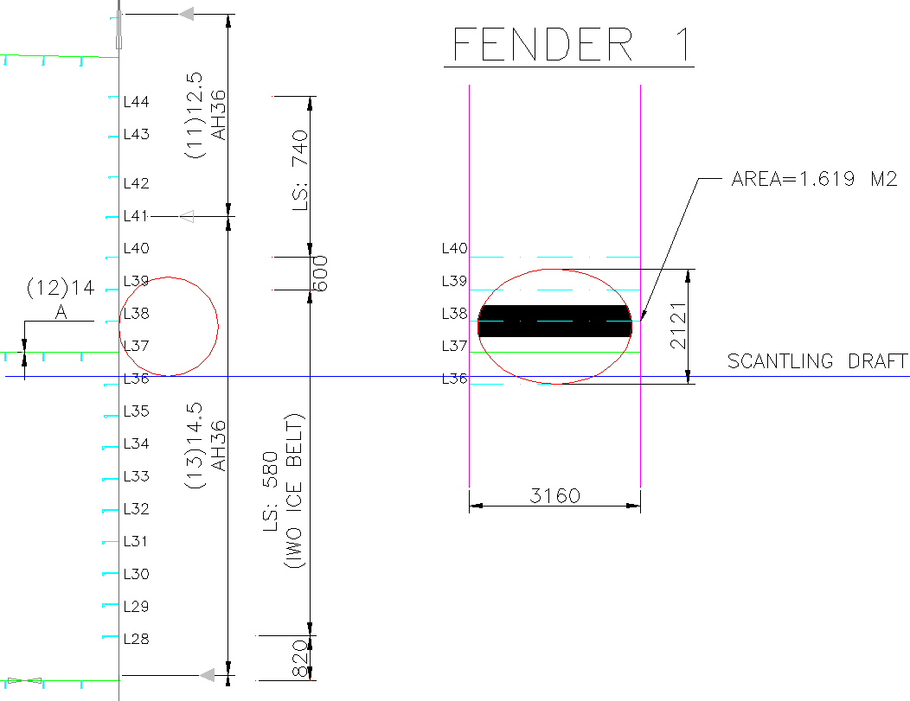
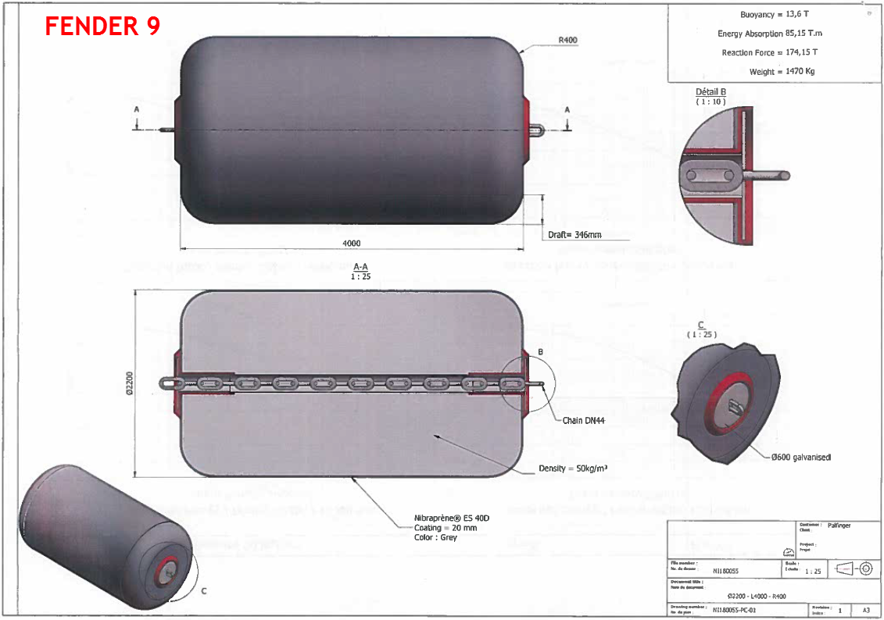
Common Examples in Shipbuilding
Fender Loads on the Side Shell

Slide 7
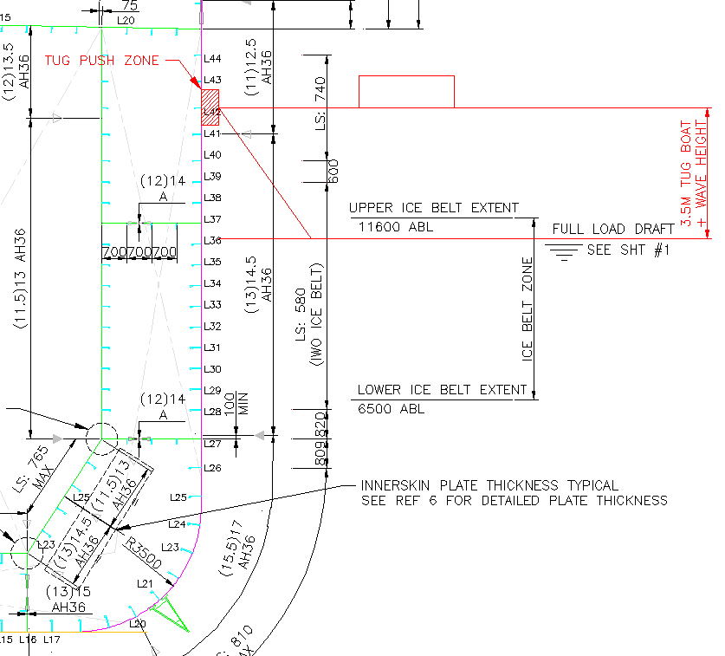
Common Examples in Shipbuilding (cont)
Tug Pushing on Side Shell

Slide 8
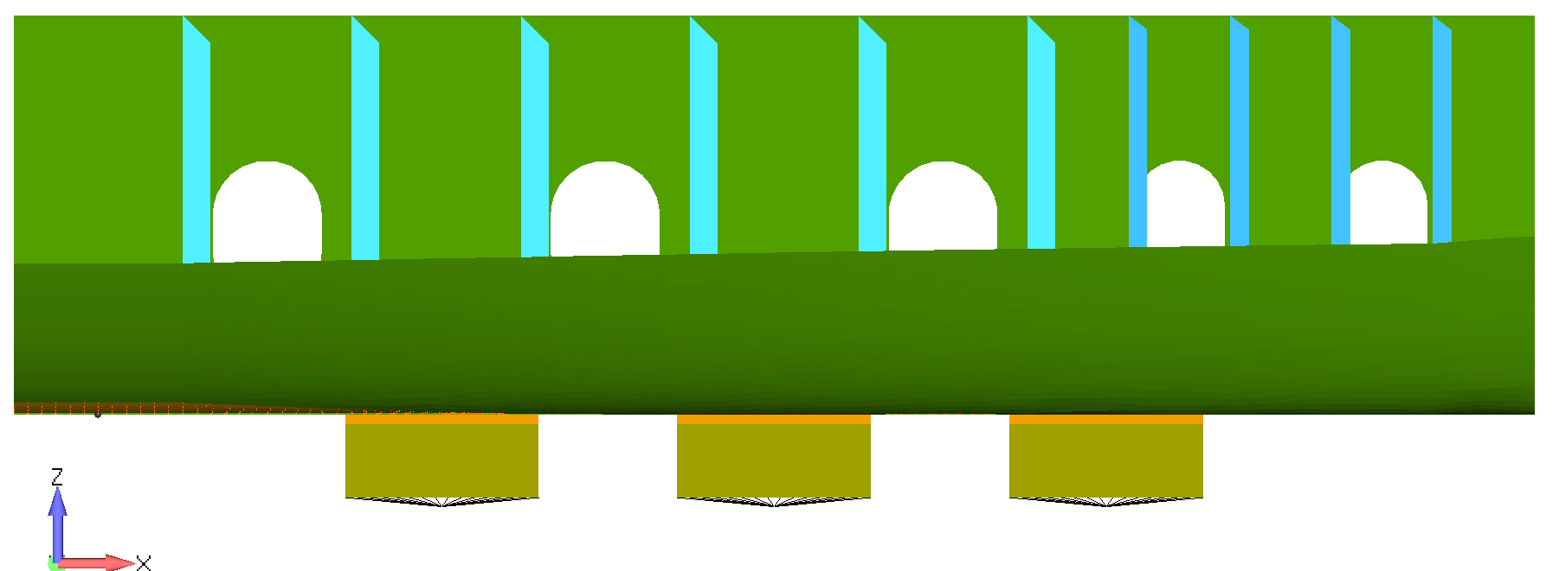
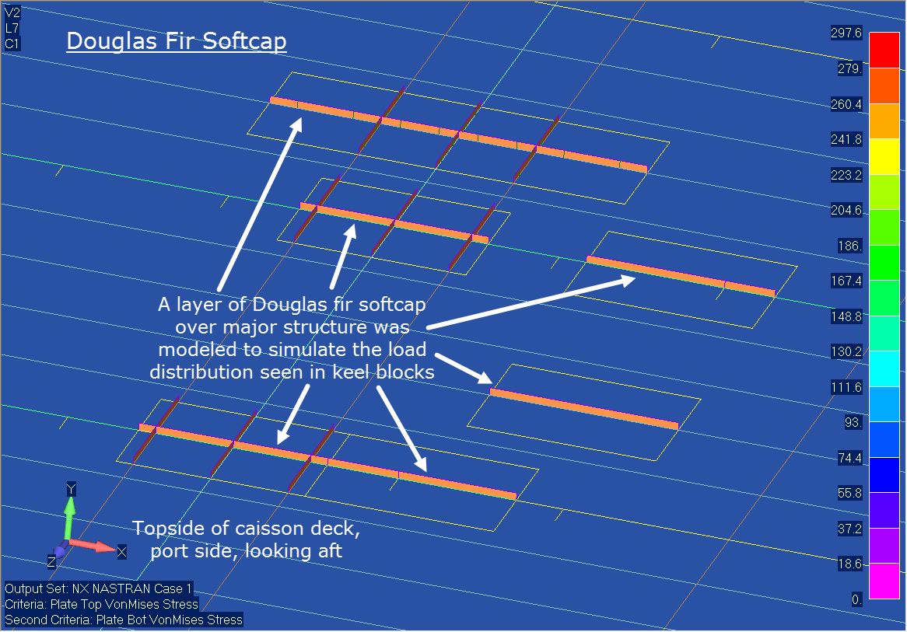
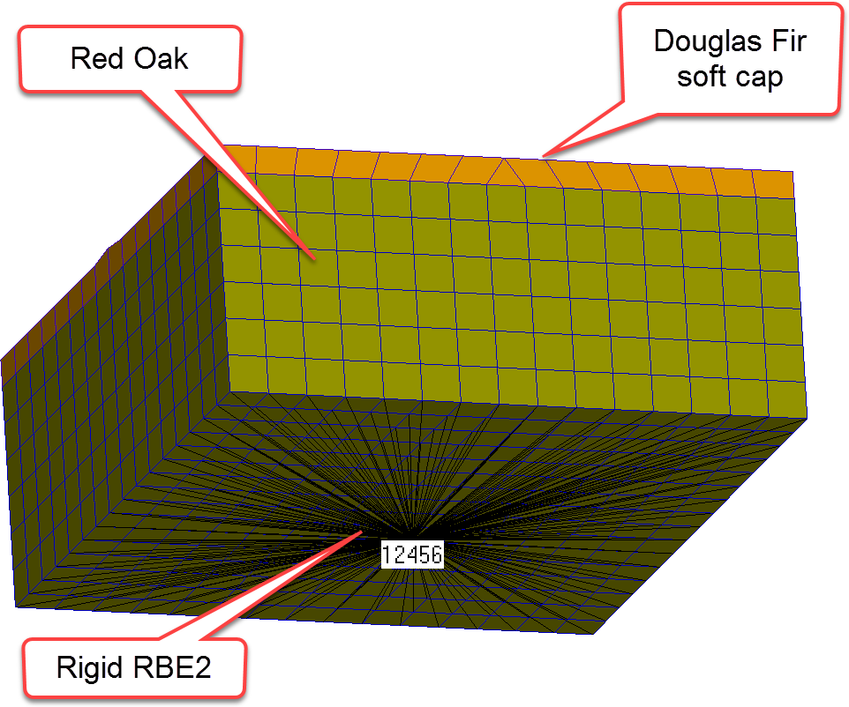
Common Examples in Shipbuilding (cont)
Docking Blocks on ship or dry dock

Slide 9
Methods of Load Application
Load Line on Structure
Assumptions
No loading of the plate
Backup structure will take full load
Leads to conservative results of analysis on backup structure

Slide 10
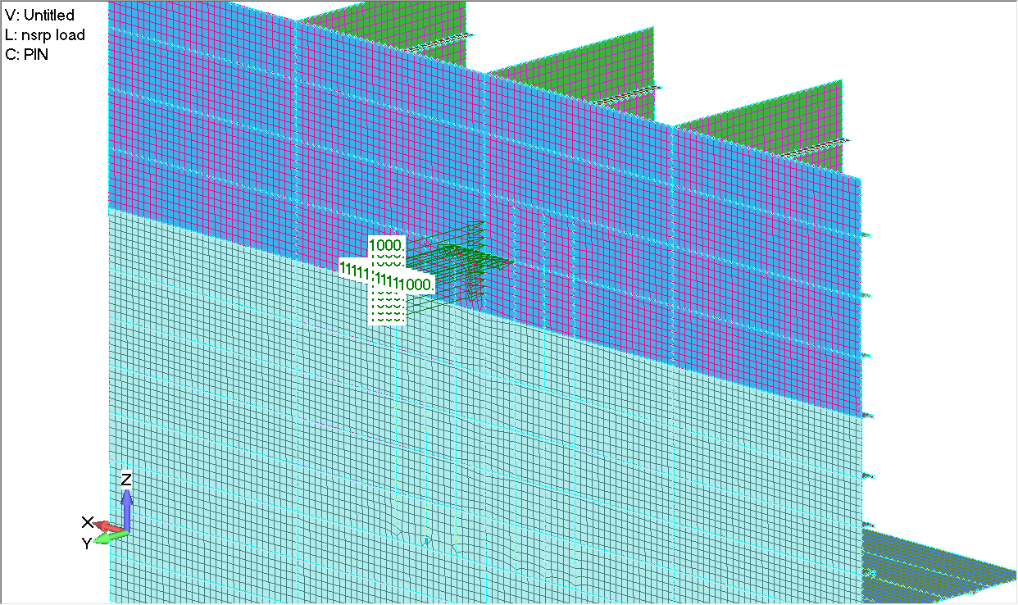
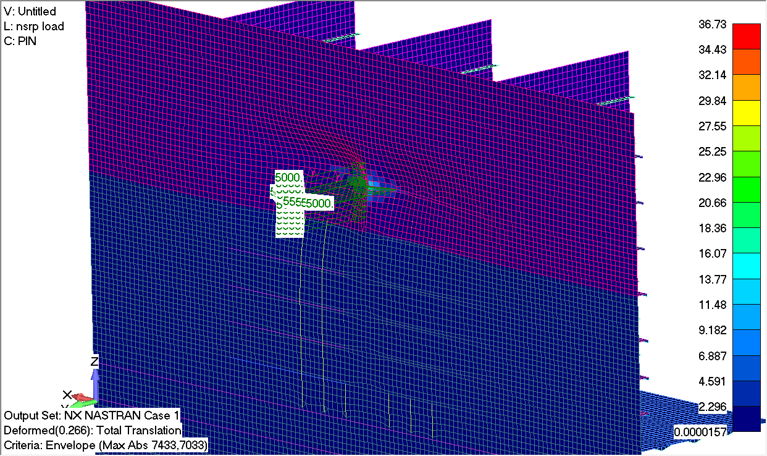
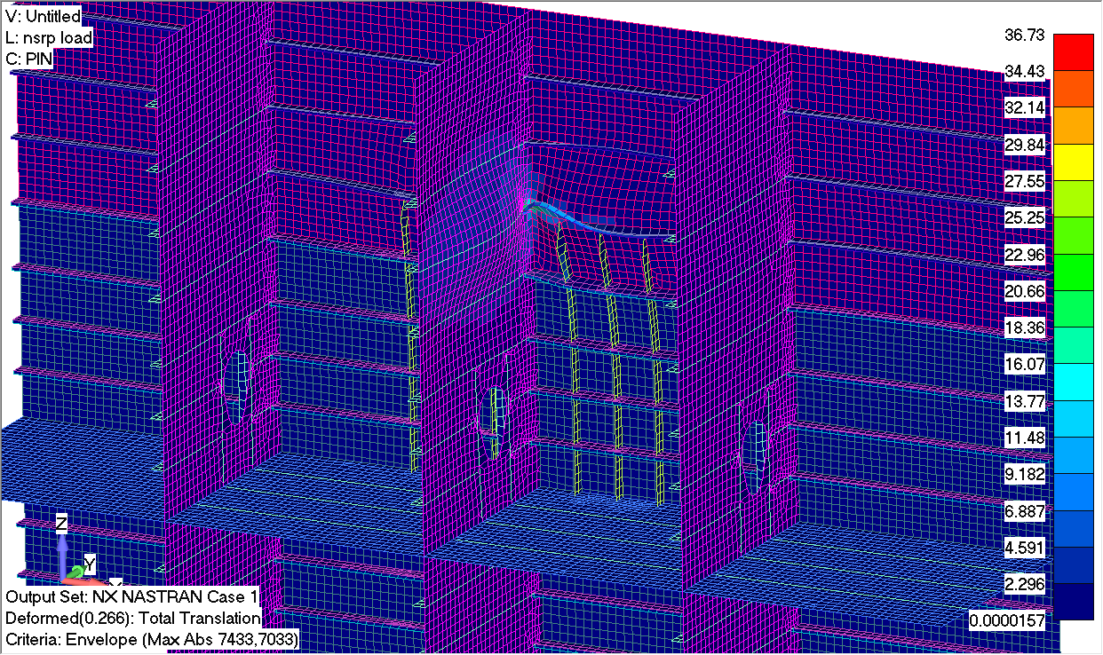
Methods of Load Application
Load Line on Structure

Slide 11
Methods of Load Application
Load Line on Structure
Benefits
Load fully transferred to main supporting structure
No hot spots on the surrounding plate
Drawbacks
Plate is not loaded

Slide 12
Methods of Load Application
Rigid Body Element (RBE2)
RBE2: connecter used to transmit load from one point to set of points. No individual deflection allowed on connections
Assumptions:
Area of applied load is fully rigid
Does not allow for individual deflection of plate and backup structure

Slide 13
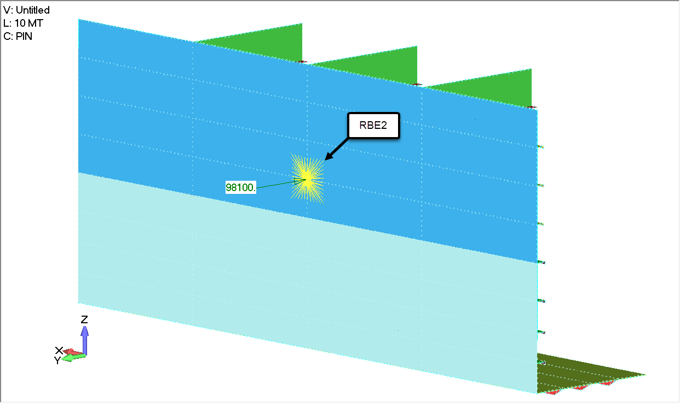
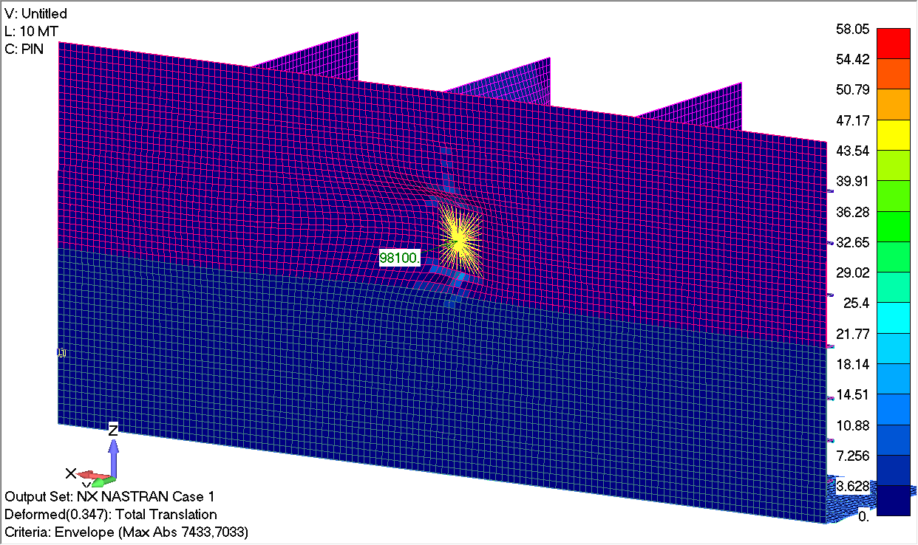
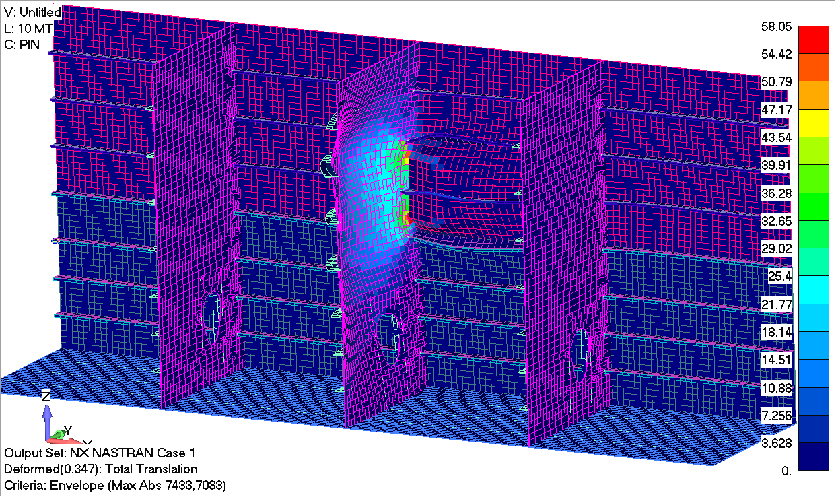
Methods of Load Application
Rigid Body Element (RBE2)

Slide 14
Methods of Load Application
Rigid Body Element (RBE2)
Benefits
Main supporting structure is highly loaded
Drawbacks
No individual deflection of connectors allowed so plate sees little to no load
Hotspots created around perimeter of loading patch
Assumes fully rigid load application, no changes for material non linearity or boundary non linearity

Slide 15
Methods of Load Application
Rigid Body Element (RBE3) and Pressure Loads
RBE3: connected used to transmit load from one point to set of points. Individual deflection allowed on connections
Pressure loads achieve same results as RBE3 loading applications just using a different tool
Assumptions
Area of applied load will be allowed to deflect based on area applied
Allows for individual deflection of plate and backup structure

Slide 16
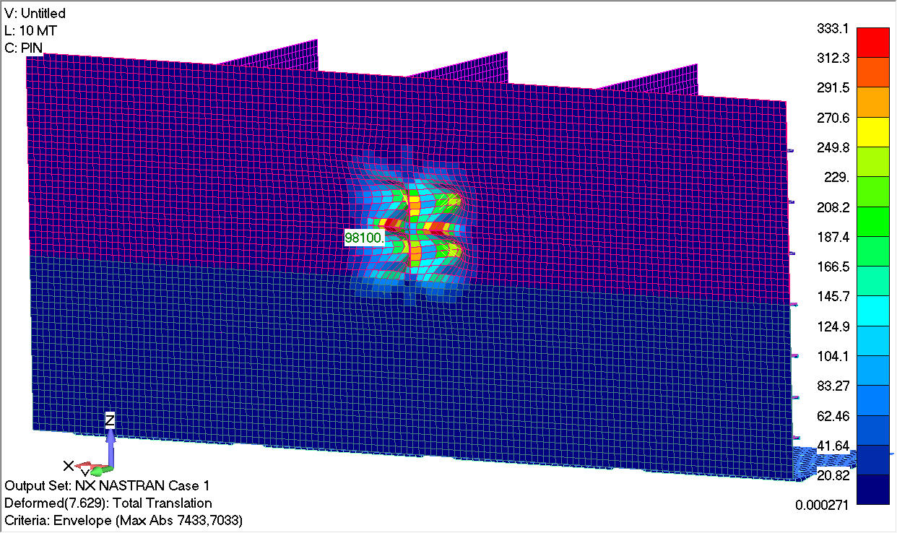
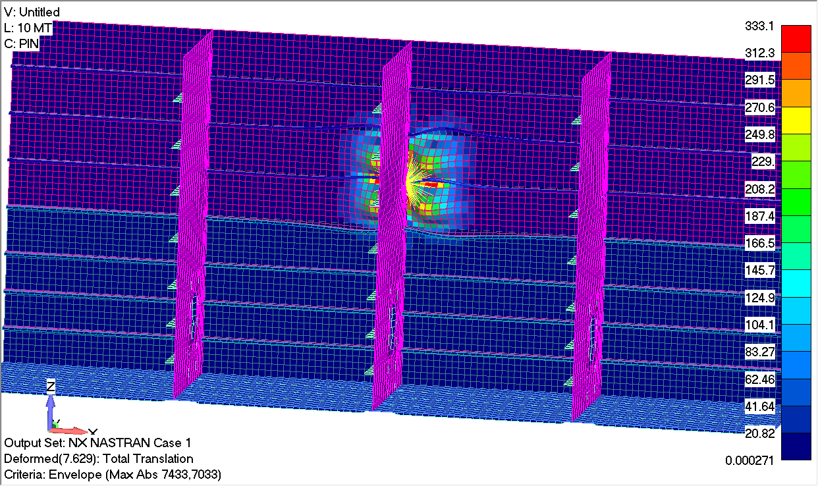
Methods of Load Application
Rigid Body Element (RBE3)

Slide 17
Methods of Load Application
Rigid Body Element (RBE3)
Benefits
Applies loading to the Plate and to the Main Supporting Structure
Drawbacks
No stiffness in connectors, load will flow to path of least resistance leading to increased plate loads
Girder and backup structure will not see enough of the loads
No non-linear effects taken into account of the composite material application. In the case of a fender, the non-linear elastic behavior is not accounted for

Slide 18
Possible Alternate Method of Application
Use of solid elements (for composite surface) and a connection surface to the steel/aluminum plate
This method has the benefit of being useful for non linear loading
Has the ability to provide orthotropic material properties to the composite materials
Has the ability to layer composite materials well
Requires large amount of computing power (not computationally efficient)

Slide 19
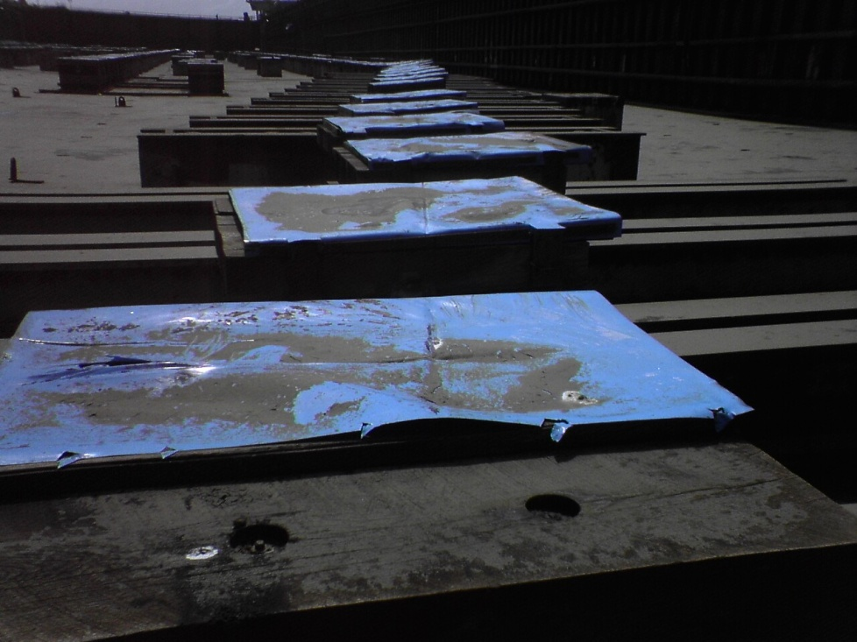
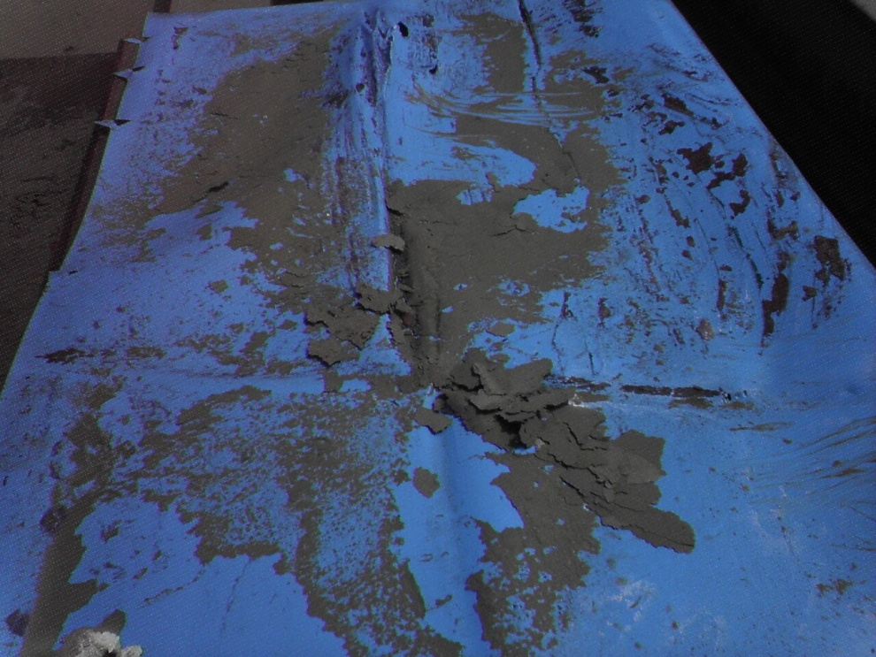
Plate Dishing Seen During Construction Cycle

Slide 20
Questions?
Contact: robert.lanoue@nassco.com

