Slide 1
Work Cell Development Ingalls Shipbuilding March 13, 2019
DCN# 43-5004-19
Sarah Hayes ManTech Project Manager
Prepared under ONR Contract N00014-14-D-0377 as part of the Navy ManTech Program
This material is based upon work supported by the Naval Shipbuilding Advanced Manufacturing Center of Excellence under Contract No. 2015-456-11

Slide 2
ManTech Team Members
ONR Program Office (Program Officer)
Paul Huang
Program Office (Designator)
Todd Hellman (PMS-400)
Contractor Organization
Ingalls Shipbuilding
Ambre Cauley (ManTech Manager)
Sarah Hayes (Project Manager), Reid Kennedy (Technical Lead), Michele Robb (Contract Specialist), & Nick Rosetti (Budget Analyst)
Center of Excellence
NSAM
Dale Orren (Deputy Director)
Tim Macon (Program Manager)
Richard Storch (Project Technical Representative)
Wade Hedges (Contract Manager)

Slide 3
Issue Description & Project Objective
Issue
The current process, tools, and equipment utilized to fabricate many repetitive parts require intensive manual processes. Currently, there are currently no readily available commercial off-the-shelf solutions to automate or semi automate these processes.
Project Objective
The project’s objective is to develop a manufacturing solution focused on improving process efficiency and tooling for production of repetitive tasks and labor intensive products.
Work Cell Approach
Advanced Tooling and Fixtures
Modifications to existing equipment and processes

Slide 4
Project Overview
Shop Process Baseline & Part Family Identification
Concept Development
Work Cell Prototype Development
Work Cell Pilot
Develop Final Report
Project Initiation
Completed Work
Planned Work

Slide 5
Shop Process Baseline & Part Family Identification
Integrated Product Division (IPD Shop)
Manhole Assemblies
Tank and Manufacturing Testing
Electrical Shop
Light Legs
Machine Shop
Field Bolts
Custom Bolts
Continual Process Evaluation
Continual Process Evaluation
Continual Process Evaluation
Notes:
These three areas were selected as they encounter more uniform, high volume parts than most shipyard process areas and likely have the highest potential for successful application of work cell and process development with resultant savings, efficiency and quality improvement.

Slide 6
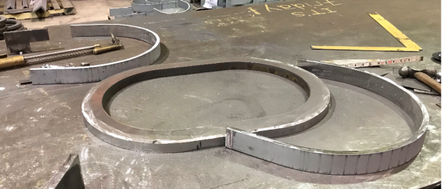
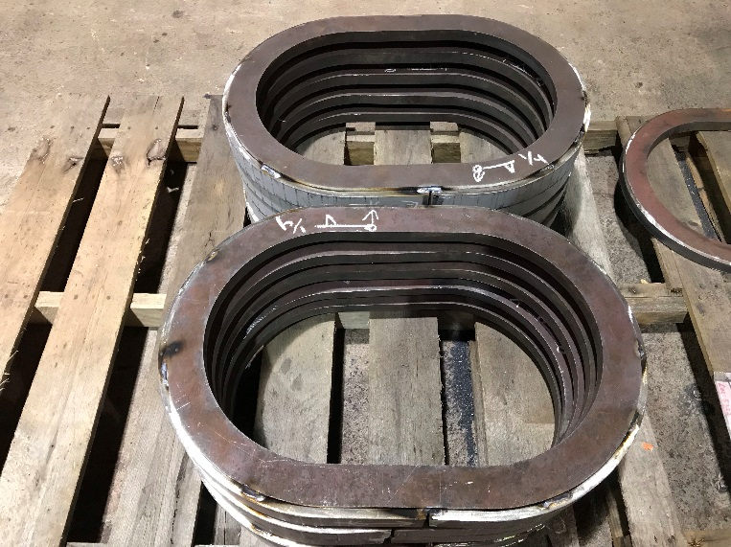
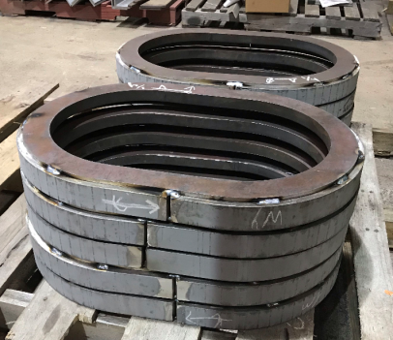
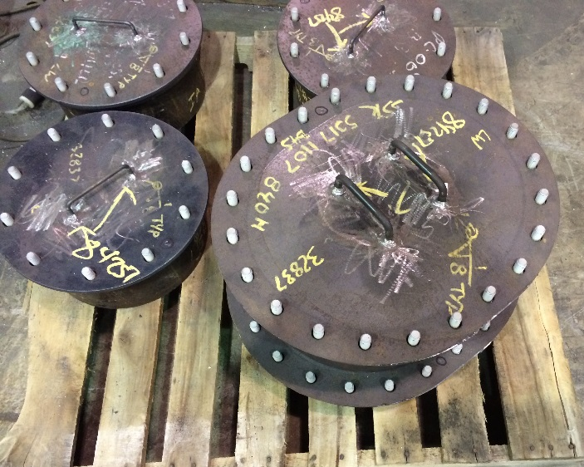
Integrated Product Division (IPD Shop)
Tank Manufacturing
Manhole Assemblies

Slide 7
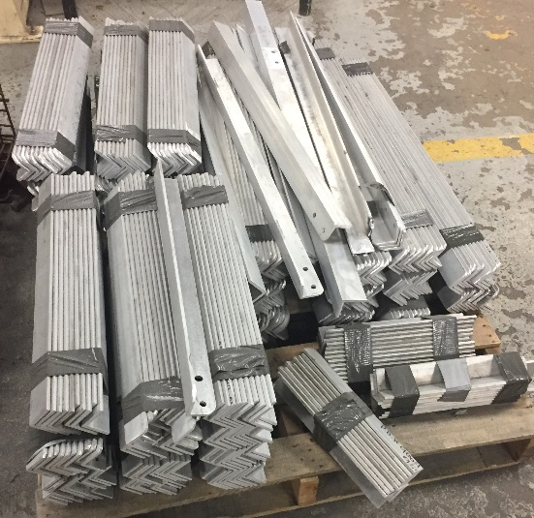
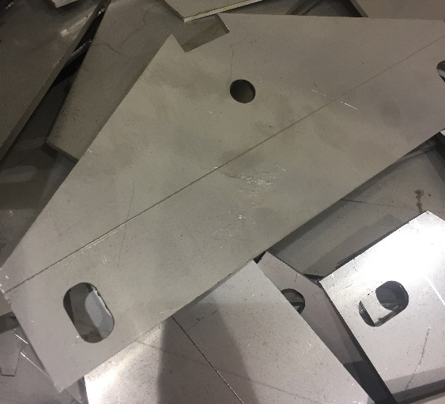
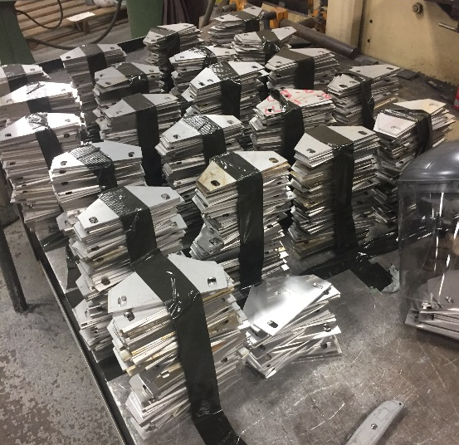
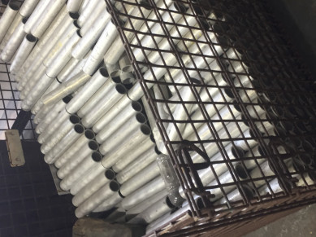
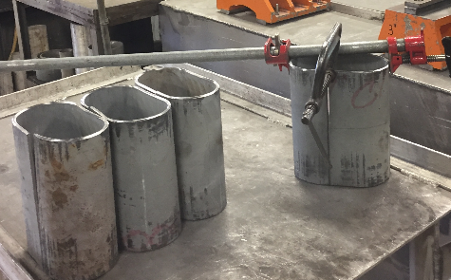
Electrical Shop
Light Legs & Light Feet
Pipe
Spools

Slide 8
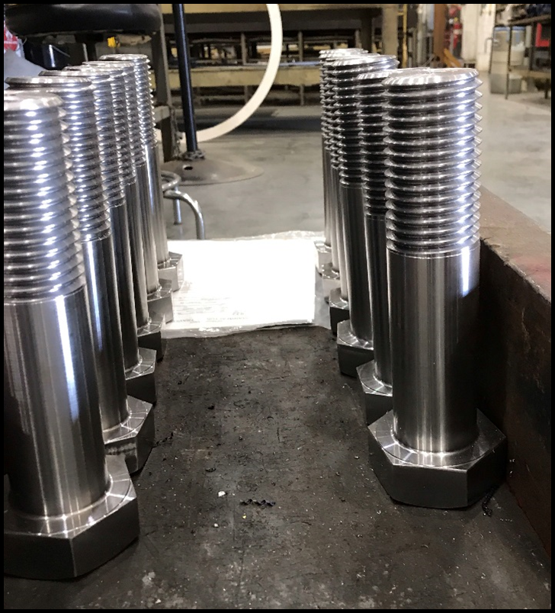
Machine Shop
Custom Bolts

Slide 9
Next Steps
Concept Development
Market Survey
Identify Work Cell Concepts
Work Cell Pilot
Pilot Test Plan
Final Reporting
Implementation Plan
Final Report
Work Cell Prototype Development
Candidate Downselect
Prototype Design
Test Plan Development
Prototype Testing
Prototype Modifications
Execute Pilot
Final Modifications
Final Business Case

Slide 10
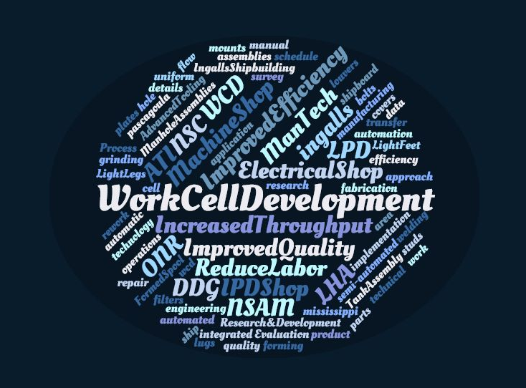
Benefits
Notes:
This project will provide the following benefits:
Reduced labor
Improved quality
Increased throughput by workflow planning
Improve efficiency resulting in schedule savings

