Slide 1
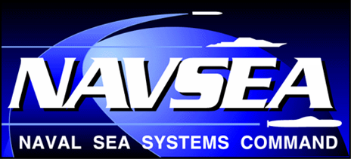
How can NAVSEA better meet fleet demands?
NSRP
Charleston, SC
March 2019
Howard Castle
SEA 05P2
(202) 781-5082
howard.castle@navy.mil
Distribution A: Approved for Public Release

Slide 2
Overview
Technical Warrant scope and pyramid
NAVSEA Strategic Business Plan
Colors issues affecting various products and specifications
NAVSEA Standard Item updates
Hurdles to adopting industry standards
Improvements needed with product application
Distribution A: Approved for Public Release

Slide 3
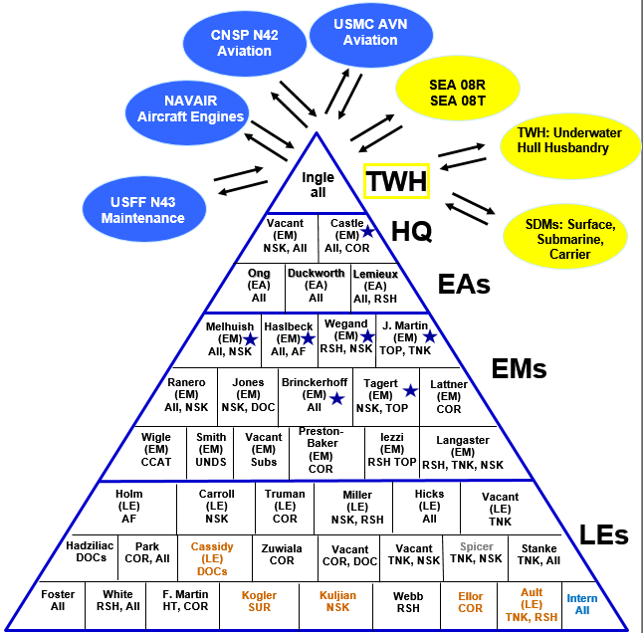
Technical Authority Pyramid - Coatings & Corrosion Control
Draft: Sep 2018
Code Product Related Specs
All All Technical Products, Managerial All
AF Antifouling Coating Systems MIL-PRF-24647
TNK Tank Coatings, Epoxy Primers MIL-PRF-23236
MIL-DTL-24441
PRM Primers, Single Component TT-P-645
TOP Topside, Alkyds & Polysiloxanes MIL-PRF-24635
INT Interior Coatings (SEA 08) MIL-DTL-24607
MIL-PRF-24596
MIL-DTL-15090
MIL-DTL-1115
HT High Temp Coatings, Metallic TT-P-28
PWD Powder, Interior, Cosmetic MIL-PRF-24712
NSK Nonskid MIL-PRF-24667
MIL-PRF-32577
DCK Deck Coverings MIL-D-3134
MIL-PRF-3135
MIL-PRF-24613
MIL-PRF-32171
MIL-PRF-32584
MIL-PRF-32170
SUR Abrasive blasting, surface prep MIL-A-22262
SEL Sealants & Preservatives MIL-PRF-16173
DOC Policy Documents NSTM 631, NSTM 634
NAVSEAINST 9630.1
S636-MAN, CCAMM
Standard Item 009-124
Standard Item 009-32
Standard Item 009-26
COR Corrosion/PCOE Policy/Design DODI 5000.67
RSH Research & Development To be determined
UNDS Regulations, Underwater hull TBD
Delegated signature authority
Navy Employee
Navy Developmental Employee
Contractor
Distribution A: Approved for Public Release

Slide 4
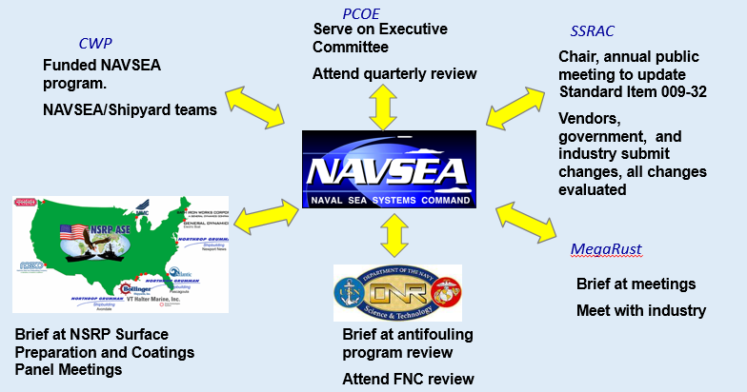
NAVSEA Strategic Business Plan
NAVSEA Strategic Business Plan 2018-2022, has three key mission priorities:
1) On-Time Delivery of Ships and Submarines
2) Culture of Affordability
3) Cybersecurity
NAVSEA addresses these items through continual, ongoing interactions with shipbuilding and ship repair community:
4
Distribution A: Approved for Public Release

Slide 5
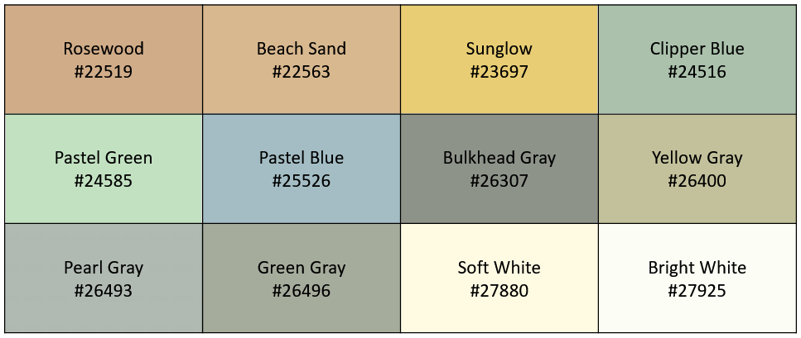
Interior topcoat colors
Eleven colors have been defined or included in the MIL-DTL-24607 and MIL-PRF-24596 interior alkyd specs.
Fleet customers have requested to use “Bright White” instead of “Soft White” for interior spaces for appearance and cleanability.
Recognizing habitability requirements, can any of these be eliminated?
Distribution A: Approved for Public Release

Slide 6
Color flake percentage in cosmetic polymeric decking
Products seeking qualification are tested, including fire/smoke performance, with notional 20% color flake coverage.
Fleet customers have requested authorization to apply 100% or “full flake” coverage.
Suppliers of color flake decking routinely support full flake installations.
PCOE project analysis supports low risk of expanding to full flake with supporting fire/smoke tests.
NAVSEA working with Fleet to define process and support installations with oversight.
Image source: www.originalcolorchips.com
Distribution A: Approved for Public Release

Slide 7
TT-P-645 interior primer color
Originally, TT-P-645 Formula 84 primer used zinc chromate and then zinc molybdate as the corrosion inhibitor. Both versions were mostly yellow.
With TT-P-645C, the inhibitor was changed to calcium borosilicate and the paint is now green.
One ship builder requested formula be tinted yellow to differentiate from F150 and to make topcoating with lighter colors easier
By removing blue pigment from TT-P-645C, a yellow equivalent could be obtained.
Is there a ship builder demand signal? A new formula could be added if needed.
Proposed color
Distribution A: Approved for Public Release

Slide 8
Pending updates to Standard Item 009-32
Modified feathering requirement for tanks, voids, machinery spaces, and bilges
Decreased number of conductivity/chloride readings
Included SSPC/NACE wet abrasive blasting standards WAB-2/L and WAB-2/M on applicable tables/lines
3.1.7 Excluding potable water and reserve feedwater tanks on submarines and aircraft carriers, and freshwater drain collecting tanks on aircraft carriers, feathering is not required in tanks, voids, machinery spaces, or bilges. For other areas including underwater hull, accomplish feathering of well-adhered paint remaining after cleaning for all surface preparation methods by creating a 1 to 2 inch transition area around areas of exposed substrate. Feathering is explained in more detail in 3.6.4.
3.6.4 Feathering is used to smoothly transition an intact tightly adhered paint system. Feathering is used primarily for aesthetic or cosmetic reasons.
3.11.5 Accomplish the requirements of 3.10.6 for conductivity/ chloride measurements with one reading to be taken for every 200 square feet for the first 1,000 square feet and one reading for every additional 1,000 square feet or less.
Table 1, Line 1, Column A: NEAR WHITE METAL BLAST, NACE 2/SSPC-SP 10 - OR - WATERJETTING TO NACE/SSPC-SP WJ-2/M - OR - SSPC-SP 10/M (WAB)/NACE WAB-2/M
Distribution A: Approved for Public Release

Slide 9
Planned specification updates
MIL-PRF-24635 updates to pigment package for gray topcoats for total solar reflectance
MIL-PRF-24667 undergoing significant rewrite:
Types based on installation method (rolled vs. sprayed) and environment (standard vs. extended durability & surface vs. submerged)
Composition driven by aggregate used (hardness, density)
Removal of Type XI peel and stick nonskid to MIL-PRF-XX642 solid decking specification (long pole)
MIL-PRF-16173 expansion of class definitions (temporary vs. persistent, hard vs. soft, solvent- vs. steam-removable, etc.)
TT-C-492 update to define types (VOC-based), classes (thermal conductivity), and grade (condensation limit)
Distribution A: Approved for Public Release

Slide 10
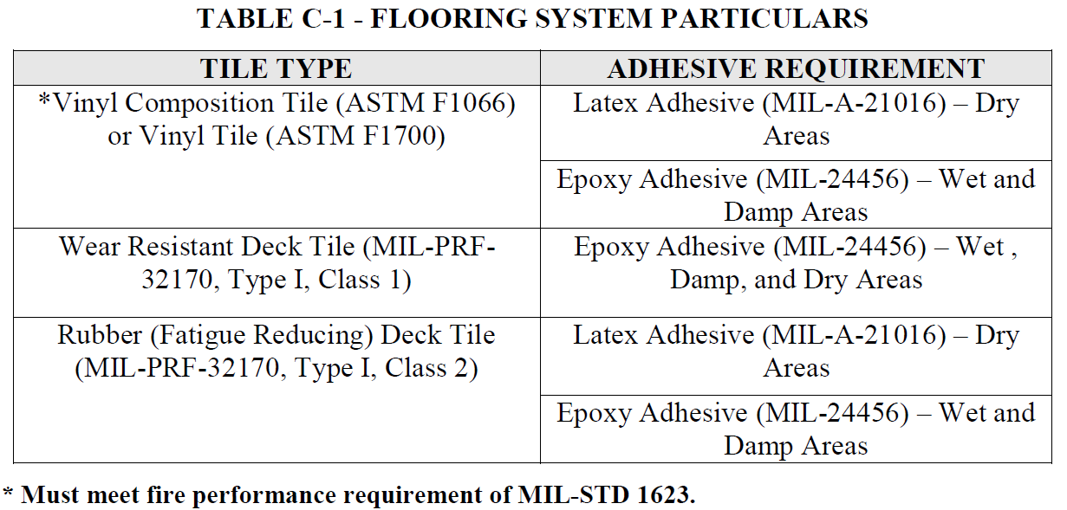
Move to industry standards
Every specification managed by the Navy has a real associated cost
Industry standards can be useful but may not be specific enough for the Navy (e.g., fire/smoke, off-gas, etc.)
Can the Navy utilize commercial vessel standards but still only “qualify” the products that meet our needs?
Coast Guard section 634 for “fire-retardant deck tile systems” cites a mix of industry standards, MIL specs, and specific tests.
Distribution A: Approved for Public Release

Slide 11
What risk is NAVSEA accepting with industry standards?
There are instances of invoking industry standards for processes…
SSPC-PA 2 for DFT measurements
NACE SP0178 for minimum weld preparation before coating
SSPC/NACE for surface preparation
But relatively few for materials…
Inorganic Zinc Silicate Coatings are invoked in 009-32 for CVN Catapult Water Brake Tanks and certain new construction ship specifications in chain lockers.
NAVSEA requires SSPC Paint 20, Type I-C (inorganic, self-curing vehicles).
Standard invokes ASTM D520 for lead level in dust purity. Only D520 Type III is permitted.
SSPC-AB 1 for abrasive media could theoretically be used instead of MIL-A-22262 but SSPC-AB 1 is silent on radioactivity tests.
Distribution A: Approved for Public Release

Slide 12
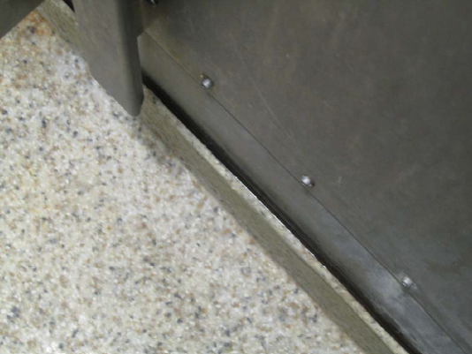
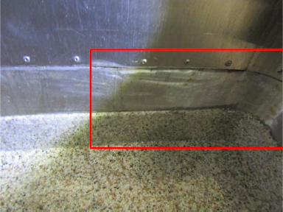
Need for more detailed manufacturer guidance
Product data sheets may not cover Navy materials and applications, which leads to need for F718 data sheets
While stainless steel may not need surface preparation or painting for corrosion-control purposes, decking cove base installed over stainless steel may pull away from substrate without epoxy layer.
Evidence of surface preparation and primer leading to well-adherent cove base.
Distribution A: Approved for Public Release

Slide 13
Conclusion
NAVSEA exists to support the fleet
NAVSEA has to balance “wants” vs. “needs” due to associated costs
Adopting industry standards is a good idea… until something goes wrong
NAVSEA leadership wants to be more responsive – requires commitment to change old ways of behavior
NAVSEA relies on industry partners to identify the right improvement opportunities
Distribution A: Approved for Public Release

