Slide 1
NSRP Workforce Development Panel –
Navy Program Manager Thoughts
Mr. Erik Oller, SEA 06N
14 March 2019
Distribution A: Approved for Public Release

Slide 2
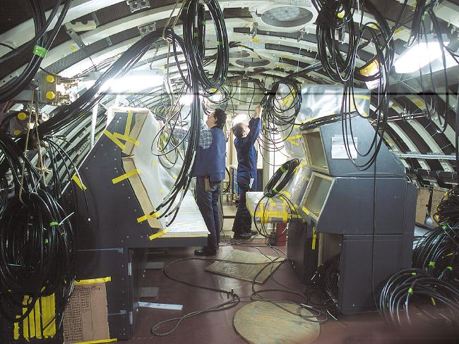
Mission Alignment
NSRP Mission:
Manage and focus national shipbuilding and ship repair research & development funding on technologies and processes that will:
Reduce the total ownership cost of ships for the U.S. Navy, other national security customers and the commercial sector
Develop and leverage best commercial and naval practices to improve the efficiency of the U.S. shipbuilding and ship repair industry
Provide a collaborative framework to improve shipbuilding-related technical and business processes
Workforce Development Panel Scope:
Reduce the cost of shipbuilding through effective projects centered on training and development, human resources, change management and technology transfer.
Panel Focus Areas
Workforce of the Future
Collaboration with other NSRP panels and other organizations
Future Goals
Increase understanding and partnerships (MEEP; Academia; Associations) to keep educational feeder tubes sending workers to private and public shipyards.
Example: “Maritime Workforce Development Initiative” is advancing the capabilities of 2-year community and technical colleges to assist the Government and industry in securing the talent pipeline for domestic maritime industry jobs
Distribution A: Approved for Public Release
Notes:
Proposed Presenter: Spaulding
RA Project 2015-473
The Computer Aided Robotics – Welding (CAR-W) project focused on automating the time-intensive process of robot programming for welding, to enable cost-effective utilization of robotic automation for one-off and high-mix/low-volume production in the defense and commercial shipbuilding industries.
The project team approached this challenge by developing enhancements to three core technology platforms that enabled simple, rapid programming of robots for highly complex welded assemblies. These enhancements included:
- Generation of robot-class 3D model and welding specification exports from the ShipConstructor CAD platform
- Development of automated robot path planning and collision avoidance software including support for large robot systems with many axes of freedom
- Development of robot-class weld procedure database to enable automatic weld process selection and welding program generation

Slide 3
Manufacturing Engineering Education Program (MEEP)
Established by NDAA FY 2017
10 U.S.C. § 2196
Authorizes DoD to support industry-relevant, manufacturing-focused, engineering training at U.S. institutions of higher education, industry, nonprofit institutions, and consortia
Administered by ONR
Purpose: Establish new or enhance existing programs to better position current and next-generation manufacturing workforce to produce military systems and components to assure DoD technological superiority
Eligibility: All responsible sources from industry, not-for-profit institutions, institutions of higher education, or a consortia of such institutions or industry
Distribution A: Approved for Public Release

Slide 4
NAVSEA NSRP Program Office
NSRP Program Executive
Government
Contractor
NSRP Program Manager
NSRP Program Engineer
BFM
Senior Program Analyst
Navy Reps are designated for and participate with all Panel activities
Surface Preparation and Coatings
Environmental
Ship Weapons System Integration
NSWCPD Lead/Electrical
NSWCCD Lead
Risk Management
Workforce Development
Business Technologies
Ship Design and Material Technologies
Welding
Matt Sinfield
Planning, Production Processes and Facilities
The NAVSEA NSRP Program Office is here to help.
Distribution A: Approved for Public Release

Slide 5
Contact Information
Mr. Erik Oller, NAVSEA 06N,
(202) 781-4342 or
Erik.oller1@navy.mil
Distribution A: Approved for Public Release

