Slide 1
Fe-Ni Steel Welding Consumable Development for High-Strength, Low Service Temperature Applications
NSRP Welding Technology Panel Meeting
Charleston, SC
14 March 2019
Matthew F. Sinfield¹, Jeffrey D. Farren¹, Daniel H. Bechetti¹,
John DuPont², Erin Barrick², and Patrick C. Ray³
¹Naval Surface Warfare Center, Carderock Division, West Bethesda, MD, USA
²Lehigh University, Bethlehem, PA, USA
³Carpenter Technology Corporation, Reading, PA, USA

Slide 2
Introduction
Achieving both high-strength and toughness in steel weld metal (> 102 ksi) is extremely challenging over a range of welding conditions, cooling rates, and service temperatures
High nickel “ferritic” steel welding consumables (between 3-12 wt.% Ni) have been investigated by researchers since the 1960’s as a way to achieve both high strength and good toughness [1] for low service temperature applications
    Nickel alloy additions in low carbon-steels can strengthen and decrease toughness ductile-to-brittle transition temperature (DBTT), but may also negatively influence upper-shelf energy [2-3]
[1] Linnert, G. E., Welding Metallurgy of Carbon and Alloy Steels, American Welding Society (New York, 1967), pp. 567-570.
[2] Saunders, G. G., “Effect of Major Alloying Elements on the Toughness of High Strength Weld Metal,” The Welding Institute, Technical Report M/86/75, July. 1975.
[3] Alloying: Understanding the Basics, edited by Davis, J.R, ASM International, Materials Park, Ohio, April 2005.

Slide 3
Objective
Although a vast majority of the previous work in this area has been quite promising [1-2] [4-12], a robust, commercially available high-strength, good toughness welding electrode does not exist in today’s market that meets many commercial and military requirements
Objective is to develop a cooling rate insensitive solid wire welding consumable for high-strength steels that meet or exceed the following design requirements:
  Yield Strength > 102 ksi;
  Charpy V-notch Toughness > 60 ft-lbs at 0°F and > 45 ft-lbs at -60°F
[1] Linnert, G. E., Welding Metallurgy of Carbon and Alloy Steels, American Welding Society (New York, 1967), pp. 567-570.
[2] Saunders, G. G., “Effect of Major Alloying Elements on the Toughness of High Strength Weld Metal,” The Welding Institute, Technical Report M/86/75, July. 1975.
[4] Keehan, E. et al, “New Developments with C-Mn-Ni High-Strength Steel Weld Metals, Part A – Microstructure,” Welding Journal, Vol. #, No. # (2006), pp. 200-s – 210-s.
[5] Lord, M., “Effect of interpass temperature on properties of high-strength weld metals,” Svetsaren, No. 1-2 (1999), pp. 53-58.
[6] Stout, R. D. et al, “Effects of Impurities on Properties of High-Strength Steel Weld Metal,” Welding Journal, Vol. 49, No. 11 (1970), pp. 521-s – 530s.
[7] Lyttle, J. E. et al, “Some Metallurgical Characteristics of Tough, High Strength Welds,” Welding Journal, Vol. 48, No. 11 (1969), pp. 493-s – 498-s.
[8] Krantz, B. M., “Factors Affecting the Strength of Multipass Low-Alloy Steel Weld Metal,” Welding Journal, Vol. 50, No. 6 (1971), pp. 235-s – 241s.
[9] Deloach J. J., “Current Welding Consumable Research in The US Navy,” Proc 12th International Conf on Offshore Mechanics and Arctic Engineering, Glasgow, Scotland, June. 1993, pp. 75-82.
[10] Kang, B. Y., “Effect of Mn and Ni on the Variation of the Microstructure and Mechanical Properties of Low-carbon Weld Metals, “ISIJ International, Vol. 40, No. 12 (2000), pp. 1237-1245.
[11] Keehan, E. et al, “New Developments with C-Mn-Ni High-Strength Steel Weld Metals, Part B – Mechanical Properties,” Welding Journal, Vol. #, No. # (2006), pp. 218-s – 224-s.
[12] Fairchild, D. P., “Girth Welding Development for X120 Linepipe,” Proc13th International Offshore and Polar Engineering Conf, Honolulu, HI, May. 2003, pp. 26-35.

Slide 4
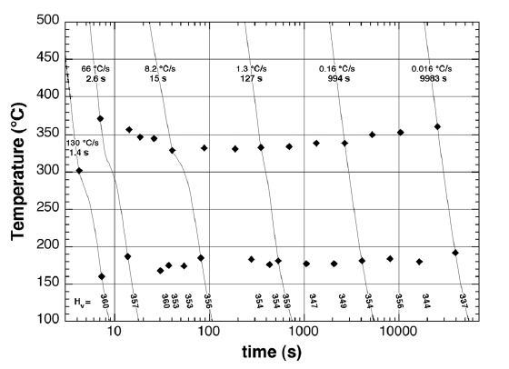
Background
Researchers at the Naval Surface Warfare Center, Carderock Division (NSWCCD) have been developing a low-carbon high-strength, high toughness steel plate based on an Fe-10Ni metallurgical system, as a possible alternative to HY-130 steels [13-14]
Early investigation revealed a continuous cooling transformation (CCT) curve (on the right) of a typical Fe-10Ni steel plate composition exhibited a stable transformation behavior [15]
An ideal welding consumable for Naval structures should have utility in thin and thick sections and out-of-position welding (i.e., cooling rate insensitive)
The stable on-cooling weld metal transformation observed in the Fe-10Ni steel provides an intriguing starting point for development
[13] Zhang, X. J., et al, “Development of Low-Carbon, 10% Ni, High-Strength, and High Toughness Steel,” NSWCCD-61-TR-2006/09, Naval Surface Warfare Center Carderock Division, West Bethesda, MD, USA, 2006.
[14] Zhang, X. J., “Microhardness characterisation in developing high strength, high toughness and superior ballistic resistance low carbon Ni steel,” Material Science and Technology, Volume 28, 2012 – Issue 7, pages 818-822.
[15] Fonda, R.W. and Spanos, G., ”Effects of Colling Rate on Transformations in Fe-9 Pct Ni Steel, Metallurgical and Materials Transactions A, Volume 45A, December 2014, pp. 5982 - 5989.

Slide 5
Approach
Partnering with Carpenter Technology Corporation [16], a feasibility study was established to design, manufacture, and test a series of high-strength steel solid wire welding electrode formulations based on a nominal Fe-10Ni plate compositional system
Typical Fe-10Ni Steel Chemistry
A typical Fe-10Ni formulation was used as an entry point for the study (table)
  Notable absence of characteristic deoxidizing elements used in welding consumables (e.g., Si and Mn)
  Carbon content is slightly high for Naval high strength steel welding consumables (e.g., 0.07 wt.% max C for MIL-100S, MIL-120S [17]; 0.12 wt% max for MIL-140S [18])
Element | Wt%
C | 0.125
Ni | 10.0
Mo | 1.00
V | 0.15
Ti | 0.05 max
Nb | 0.05 max
S | 0.005 max
P | 0.002 max
Fe | Rem
[16] Navy Cooperative Research and Development Agreement, Welding Consumable Development, NCRADA - NSWCCA - 15 - 213 dated 25 May 2016.
[17] NAVSEA Technical Publication T9074-BC-GIB-010/0200, Filler Materials for Critical Applications: Requirements for Flux-Cored Welding Electrodes, Bare Welding electrodes and Fluxes, and Covered Welding Electrodes for Low-Alloy Steel Applications
[18] MIL-E-24355(SH) Electrodes, Welding, Bare, Solid, Nickel-Manganese-Chromium-Molybdenum Alloy Steel For Producing HY-130 Weldments for As-Welded Applications

Slide 6
Electrode Design
To establish feasibility, a baseline Fe-10Ni steel electrode composition was manufactured
Element | Nominal Fe-10Ni Plate | Target | Actual
C | 0.12 | 0.090 - 0.110 | 0.088
Mn | - | 0.50 - 0.70 | 0.54
Si | - | 0.30 - 0.50 | 0.40
P | < 0.002 | 0.002 | < 0.004
S | < 0.005 | 0.0005 | 0.0009
Cr | - | - | 0.0027
Ni | 10.00 | 9.50 - 10.50 | 10.40
Mo | 1.05 | 1.00 - 1.10 | 1.02
V | 0.15 | 0.10 - 0.20 | 0.14
Ti | 0.015 | 0.01 - 0.02 | 0.018
Al | - | - | 0.009
Cu | - | - | 0.0079
Nb | < 0.05 | < 0.05 | < 0.002
H | - | - | 0.00029
O | - | - | 0.0065
N | < 0.005 | - | 0.0006
B | - | - | < 0.0005
Zr | - | - | 0.004
Mn and Si were added to promote weld pool deoxidation for gas metal arc welding (GMAW)
Carbon range was slightly decreased to enhance weld metal toughness and weldability

Slide 7
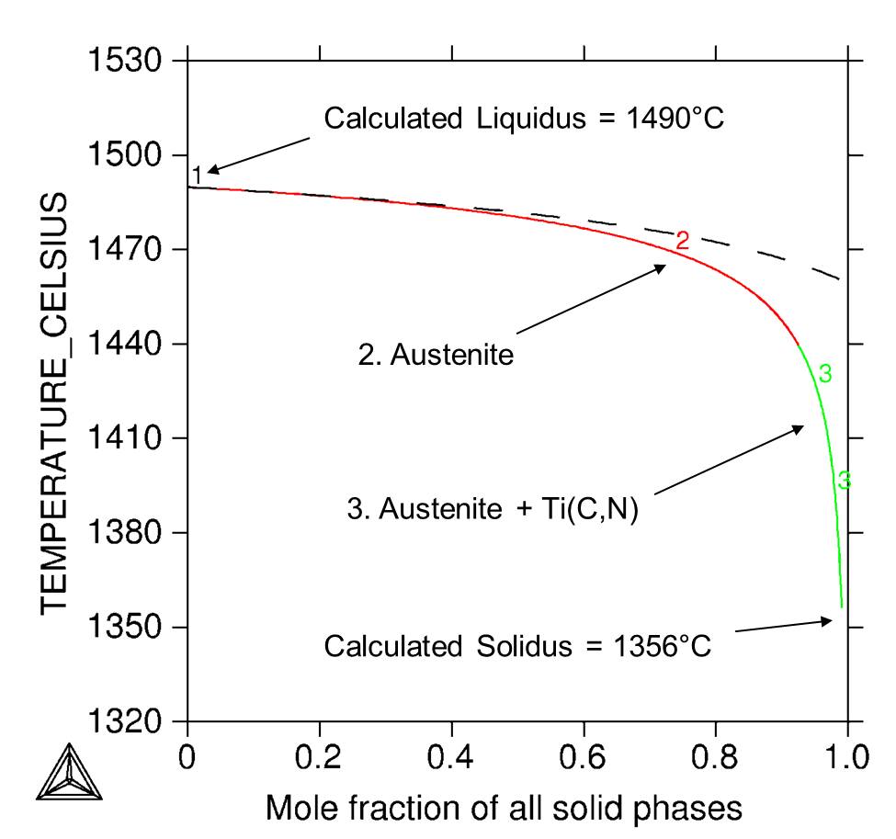
Solidification and Transformation
Scheil Solidification Simulation*
Weld Metal Continuous Cooling Transformation
t_{8/5} = 64 s
HI = 100 kJ/in.
P/I = 300°F, 1-in.
t_{8/5} = 16s
HI = 31 kJ/in.
P/I = 100°F, 1-in.
* With C and N back diffusion
CCT curve produced by NRL
Fe-10Ni weld metal solidifies as primary austenite (Type A Solidification) remaining austenitic to approximately 350°C
Calculated solidification temperature range of 134°C
Weld metal on-cooling transformation behavior from austenite is similar to that reported for Fe-9Ni-0.11C steel plate [15], over range of weld metal cooling rates.
[15] Fonda, R.W. and Spanos, G., ”Effects of Colling Rate on Transformations in Fe-9 Pct Ni Steel, Metallurgical and Materials Transactions A, Volume 45A, December 2014, pp. 5982 - 5989.

Slide 8
Welding Parameters and Destructive Test Results
Test Assembly Welding Parameters
Weld ID | Welding Process | Shielding Gas | Preheat/Interpass Temperature (°F) | Voltage (V) | Current (Amps) | Travel Speed (IPM) | Heat Input (kJ/in.)
10-10 | ME-GMAW-S | M2 – Ar, 2% O₂ | 250 - 275 | 28 | 240 | 9.7 | 40
11-01 | ME-GTAW | 100% Ar | 250 - 275 | 10 | 230 | 3 | 46
Flat position
Gas metal arc welding - spray
0.045” wire diameter
HY-130 base plate
Wide root gap to minimize base plate dilution
All Weld Metal Tensile Test Results, per AWS B4.0
Both GMAW and GTAW weld metals demonstrated good strength and ductility
GMAW weld metal did not meet Cv design
GTAW weld metal Cv values were excellent
Weld ID | Process | YS (0.2%) (ksi) | UTS (ksi) | Percent Elongation
10-10 | ME-GMAW-S | 140 | 162 | 19
11-01 | ME-GTAW | 156 | 183 | 21
Design | * | > 102 ksi | * | *
All Weld Metal Tensile Test Results, per AWS B4.0
Weld ID | Process | Avg. Cv at 0°F (ft-lbs) | Avg. Cv at -60°F (ft-lbs)
10-10 | ME-GMAW-S | 35 | 32
11-01 | ME-GTAW | 153 | 148
Design | * | 60 | 45

Slide 9
Weld Metal Chemistries
Element | Electrode | Baseline Weld Metal
 | Actual | 10-10 GMAW | 11-01 GTAW
C | 0.088 | 0.070 | 0.075
Mn | 0.54 | 0.540 | 0.570
Si | 0.40 | 0.34 | 0.40
P | < 0.004 | 0.002 | 0.004
S | 0.0009 / | 0.001 | 0.001
Cr | 0.0027 | 0.033 | 0.052
Ni | 10.40 | 9.95 | 10.10
Mo | 1.02 | 1.08 | 1.01
V | 0.14 | 0.14 | 0.15
Ti | 0.018 | 0.014 | 0.009
Al | 0.009 | 0.007 | 0.011
Cu | 0.0079 | 0.022 | 0.014
Nb | < 0.002 | < 0.002 | 0.006
H | 0.00029 | 0.00005 | DNR
O | 0.0065 | 0.026 | 0.005
N | 0.0006 | 0.0012 | DNR
B | < 0.0005 | < 0.0005 | 0.0008
Zr | 0.004 | < 0.002 | 0.003
Both GMAW and GTAW weld metals showed a slight decrease in C and increase in Cr and Cu
  C loss likely attributed in part to disassociation of the O₂ molecules in the arc and re-association with C elements in the molten weld pool to make CO and CO₂ gases
  Cr and Cu additions likely due to HY-130 base plate dilution
Slight Si decrease in the GMAW weld due to deoxidation
GTAW weld metal showed very low weld metal oxygen
GMAW weld metal oxygen slightly high, relative for the process
DNR = Did not report

Slide 10
Reformulated Weld Metal Chemistries
Element | Baseline Weld Metal |  | Reformulated Weld Metal
 | 10-10 GMAW | 11-01 GTAW | MS17-01 | MS17-02 | MS17-03 | MS17-04 | MS17-05 | MS17-06
C | 0.070 | 0.075 | 0.024 | 0.028 | 0.011 | 0.023 | 0.007 | 0.015
Mn | 0.540 | 0.570 | 0.61 | 0.63 | 0.66 | 0.62 | 0.62 | 0.61
Si | 0.34 | 0.40 | 0.44 | 0.41 | 0.42 | 0.40 | 0.40 | 0.40
P | 0.002 | 0.004 | 0.012 | 0.012 | 0.011 | 0.011 | 0.012 | 0.009
S | 0.001 | 0.001 | 0.003 | 0.003 | 0.003 | 0.002 | 0.003 | 0.002
Cr | 0.033 | 0.052 | 0.03 | 0.02 | 0.02 | 0.03 | 0.02 | 0.04
Ni | 9.95 | 10.10 | 9.42 | 9.44 | 9.46 | 9.55 | 9.53 | 9.30
Mo | 1.08 | 1.01 | 0.57 | 0.59 | 0.57 | 0.59 | 0.58 | 0.58
V | 0.14 | 0.15 | 0.16 | 0.16 | 0.16 | 0.16 | 0.16 | 0.15
Ti | 0.014 | 0.009 | 0.01 | 0.02 | 0.02 | 0.01 | 0.01 | 0.01
Al | 0.007 | 0.011 | 0.008 | 0.008 | 0.020 | 0.008 | 0.007 | 0.008
Cu | 0.022 | 0.014 | 0.01 | 0.01 | 0.01 | <0.01 | <0.001 | 0.01
Nb | < 0.002 | 0.006 | 0.01 | 0.01 | 0.01 | 0.01 | 0.01 | 0.01
H | 0.00005 | DNR | DNR | DNR | DNR | DNR | DNR | DNR
O | 0.026 | 0.005 | 0.03 | 0.03 | 0.02 | 0.03 | 0.03 | 0.03
N | 0.0012 | DNR | 0.006 | 0.014 | 0.014 | 0.014 | 0.014 | 0.015
B | < 0.0005 | 0.0008 | <0.001 | <0.001 | <0.001 | <0.001 | <0.001 | <0.001
Zr | < 0.002 | 0.003 | 0.004 | 0.004 | 0.004 | 0.004 | 0.004 | 0.004
DNR = Did not report
Reformulated chemistries targeted lower C, Cr, and Ni contents in an attempt to increase GMAW impact toughness

Slide 11
Destructive Test Results - Reformulations
Weld ID | Welding Process | Shielding Gas | Preheat/Interpass Temperature (°F) | Voltage (V) | Current (Amps) | Travel Speed (IPM) | Heat Input (kJ/in.)
10-10 | ME-GMAW-S | M2 – Ar, 2% O₂ | 250 - 275 | 28 | 240 | 9.7 | 40
11-01 | ME-GTAW | 100% Ar | 250 - 275 | 10 | 230 | 3 | 46
MS17-01 | ME-GMAW-S | M2 – Ar, 2% O₂ | 250 - 300 | 25.2 | 279.1 | 11 | 38.4
MS17-02 | ME-GMAW-S | M2 – Ar, 2% O₂ | 250 - 300 | 25.2 | 275.1 | 11 | 37.9
MS17-03 | ME-GMAW-S | M2 – Ar, 2% O₂ | 250 - 300 | 25.2 | 276.3 | 11 | 38.0
MS17-04 | ME-GMAW-S | M2 – Ar, 2% O₂ | 250 - 300 | 25.3 | 271 | 11 | 37.3
MS17-05 | ME-GMAW-S | M2 – Ar, 2% O₂ | 250 - 300 | 25.2 | 268 | 11 | 37.8
MS17-06 | ME-GMAW-S | M2 – Ar, 2% O₂ | 250 - 300 | 25.3 | 272.3 | 11 | 37.5
Nominally the same heat input achieved between the 10-10 GMAW and the 2017 GMAW welds
Weld ID | Process | YS (0.2%) (ksi) | UTS (ksi) | % Elongation | CVN @ -60°F (ft-lbs) | CVN @ 0°F (ft-lbs)
10-10 | ME-GMAW-S | 140 | 162 | 19 | 32 | 35
11-01 | ME-GTAW | 156 | 183 | 21 | 148 | 153
MS17-01 | ME-GMAW-S | 135.8 | 146.9 | 17 | 34 | 41
MS17-02 | ME-GMAW-S | 134.5 | 144.3 | 17 | 48 | 53
MS17-03 | ME-GMAW-S | 128.3 | 136.2 | 17.5 | 43.7 | 46
MS17-04 | ME-GMAW-S | 133.7 | 144.9 | 17.0 | 53.3 | 55.3
MS17-05 | ME-GMAW-S | 123.2 | 133 | 19.5 | 63.3 | 62.7
MS17-06 | ME-GMAW-S | 124.7 | 132.7 | 18.5 | 58.7 | 63.3
Design | * | > 102 | * | * | 45 | 60
The reduced C, Ni, and Cr contents did produce a resultant increase in elongation and impact toughness

Slide 12
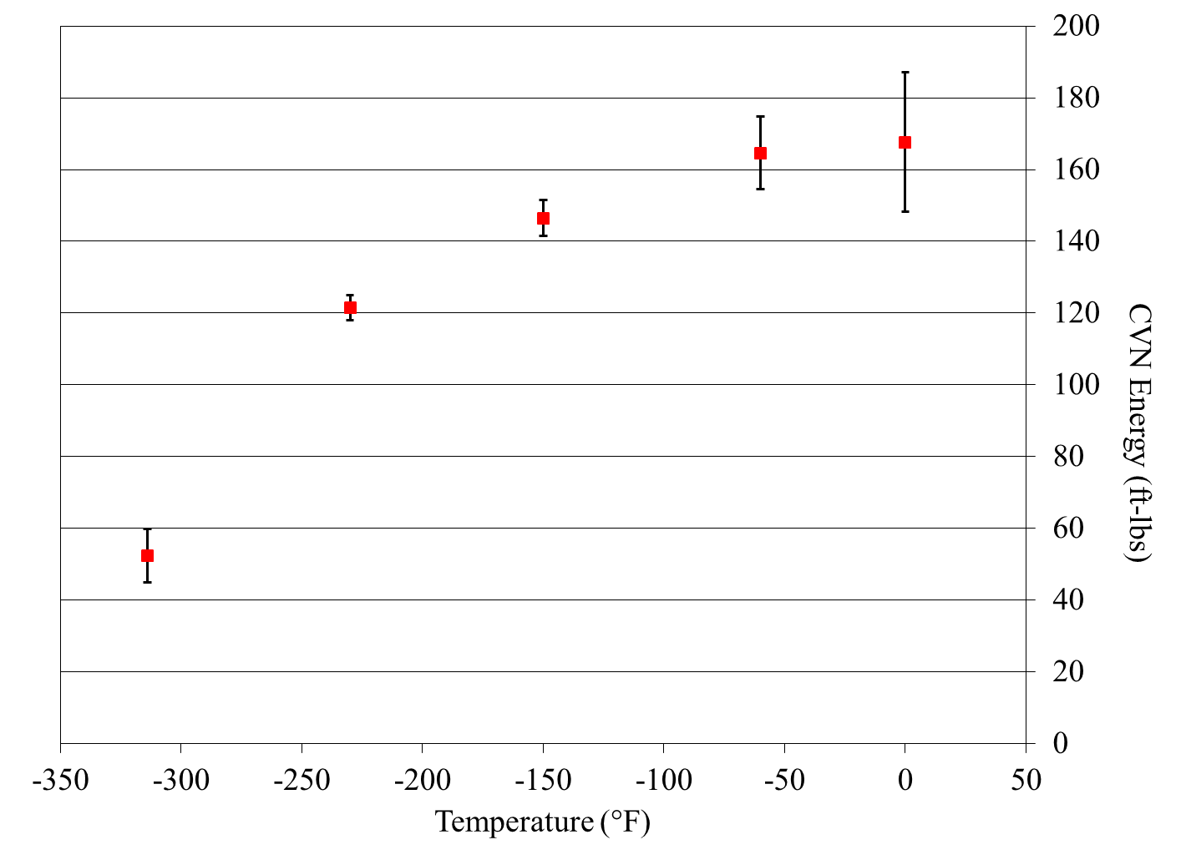
Fe-10Ni GTAW Cv Fractography
GTAW weld 11-01 was rewelded (weld ID 12-01) under the same conditions to investigate DBTT behavior
As illustrated below, the Fe-10Ni GTAW weld metal exhibits high fracture toughness across a wide range of temperatures with primarily ductile failure down to -320°F
No sharp ductile to brittle transition
-60°F
100% shear
0°F
100% shear
-150°F
100% shear
-230°F
99% shear
10 μm
-320°F
70% shear

Slide 13
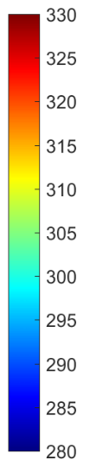
MS17-05 Microhardness Trace
The weld was etched to reveal the weld beads, which were then superimposed on the microhardness map

Slide 14
MS17-05 Microstructural Characterization
Last Pass
Last Pass

Slide 15
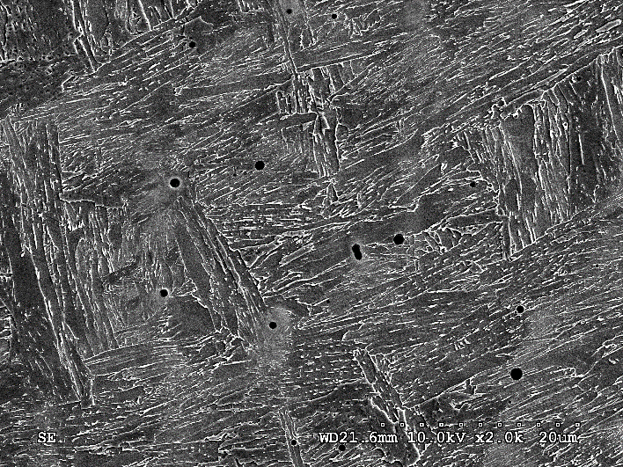
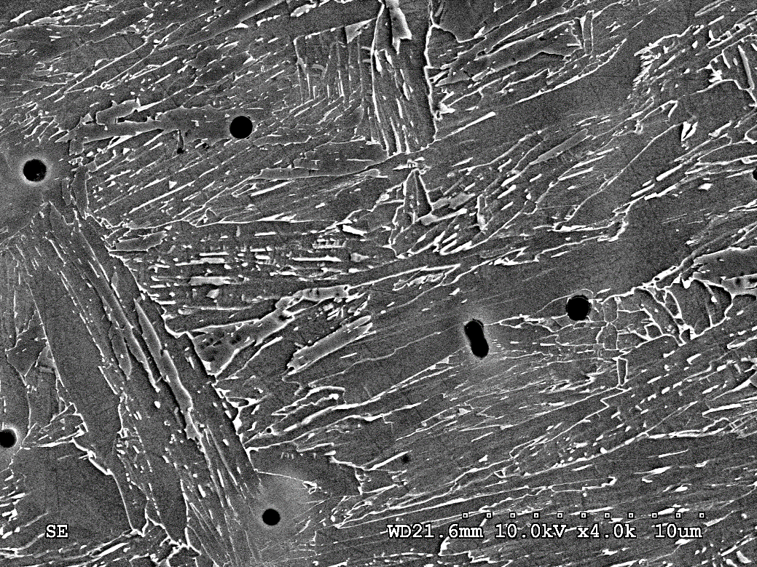
MS17-05 Microstructural Characterization
2nd to Last Pass
2nd-to-Last Pass

Slide 16
Summary and Conclusions
Mechanical properties of both Fe-10Ni steel GMAW and GTAW weld deposits are promising and justify further investigation
  GTA weld Cv values exceed design and were exceptional, and may be suitable for a variety of low service temperature applications where high-strength is necessary
  GMA welds showed significant improvement and several met target mechanical properties following the most recent reformulation which reduced C, Ni, and Cr
    MS17-05 and MS17-06 were most promising
    Initial results have culminated in US patent application [20]
Office of Naval Research (ONR) has funded Lehigh University to investigate and characterize the unique microstructure evolution occurring in the Fe-10Ni steel fusion zone, in collaboration with NSWCCD and NRL
[20] Sinfield, M.F., et al., “High Strength Welding Consumable Based On A 10% Nickel Steel Metallurgical System,” Application No. 62/241,468, USPTO Provisional Patent Application, Filed 14 October 2015

Slide 17
Questions
Acknowledgements
***This work was partially funded by Carderock Division under the Naval Innovative Science and Engineering (NISE) NDAA Section 219 program, managed by the NSWC Carderock Division Director of Research

