Slide 1
Cost Model Based Network Design
March 29, 2018
Charleston, South Carolina
DISTRIBUTION STATEMENT A: Approved for public release.

Slide 2



Acknowledgement
The cost model was developed under the National Shipbuilding Research Program (NSRP) Panel Project Number 2016-426
“Paradigm for Optical Networks”
www.nsrp.org

Slide 3
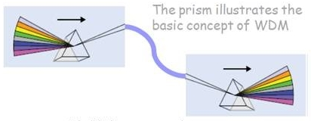
MOTIVATION FOR USE OF WDM LAN-
Reduces weight, space, and complexity
Reduces EMI susceptibility
Flexible Infrastructure (FI) modular deployment
Technology follows mature commercial applications
Large capacity physical layer to accommodate all traffic

Slide 4
WHAT WE’VE LEARNED-
WDM LAN ARCHITECTURES-
Reduce number of physical connections
Physical versus functional topologies
Re-arrangeable backbone implementation
MILITARY AND AEROSPACE-
Highly variable traffic between static nodes
The environment dictates allowable components
Can use evolving data center technologies
Constant increase in bandwidth demand

Slide 5
BASIS FOR THE WDM LAN
ISO / open systems view:
Access / Adaptation Elements change with application or mission

Slide 6
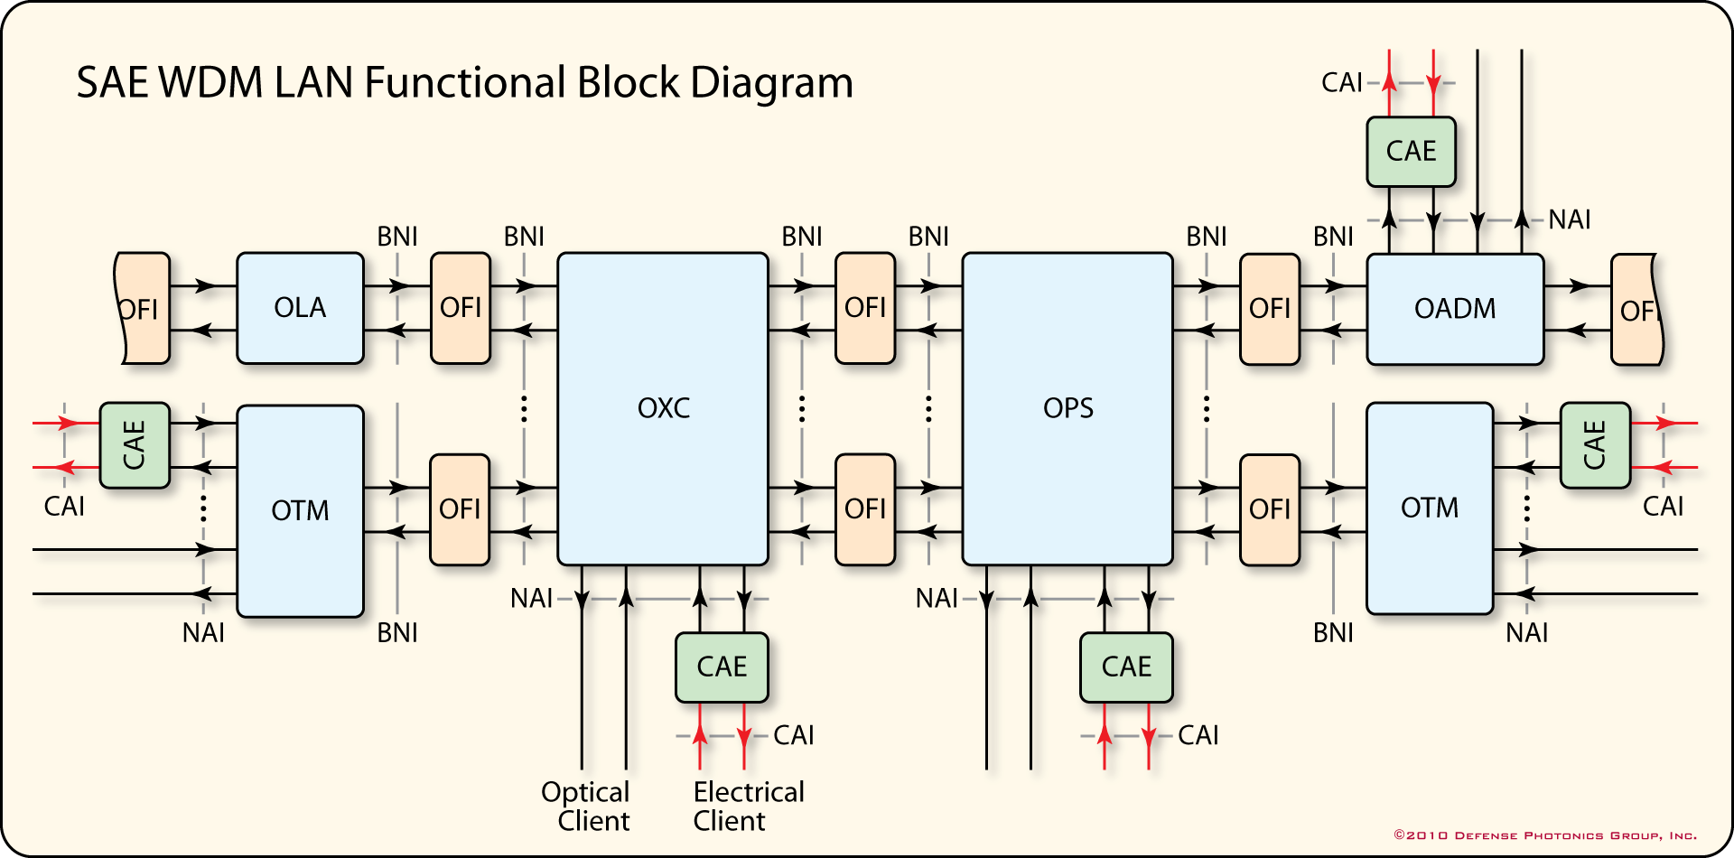
PRACTICAL WDM LAN
BACKBONE NETWORK ELEMENTS
OTM- Optical Terminal Multiplexer
OXC- Optical Cross Connect
OPS- Optical Power Splitter
OLA- Optical Line Amplifier
OADM- Optical Add-Drop Multiplexer

Slide 7
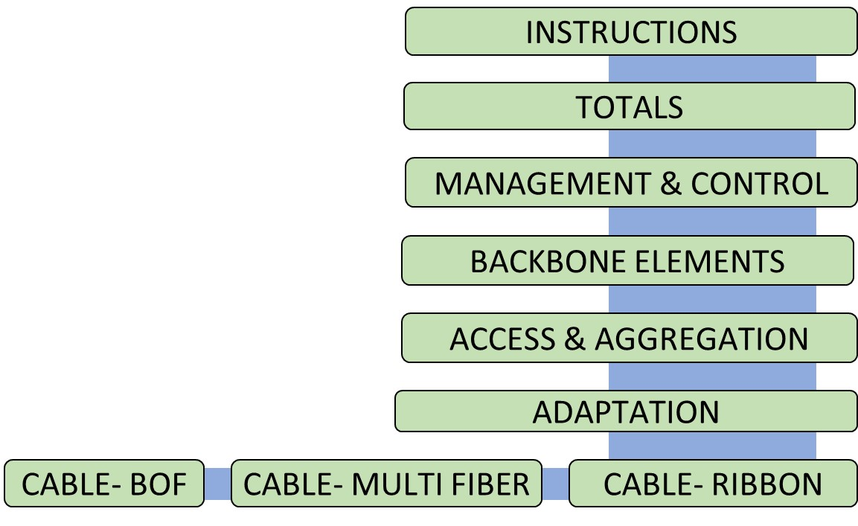
COST MODEL DESIGN
Follows WDM LAN architecture
Open spreadsheet with instructions
COSTS: Acquisition / Maintenance / Upgrade
LABOR: Engineering / Install / Test / Maintenance / Upgrade
TOTALS: All levels all categories switchable

Slide 8
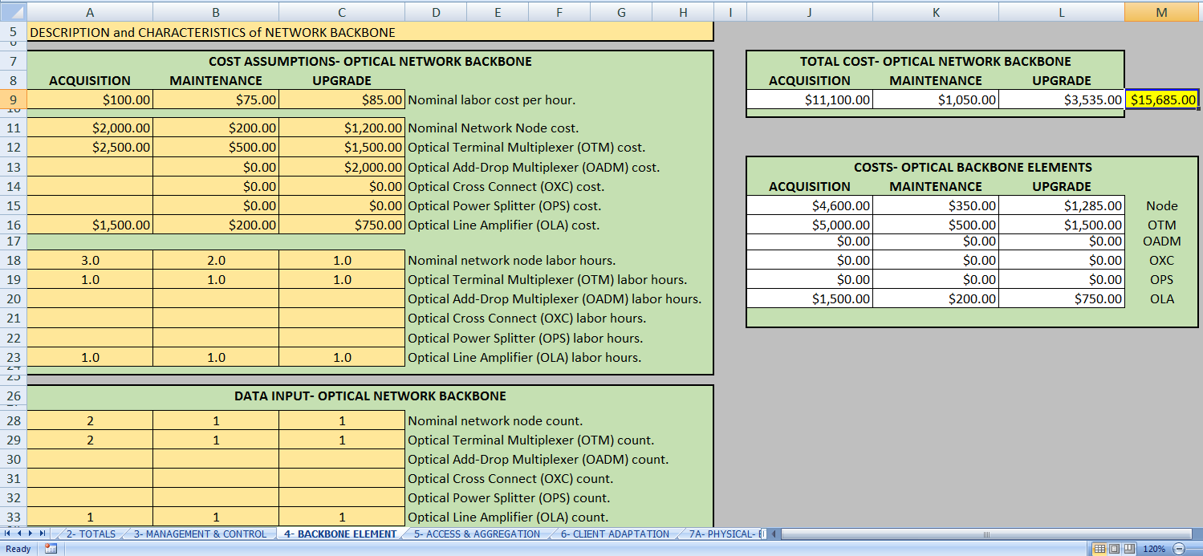
COST MODEL

Slide 9
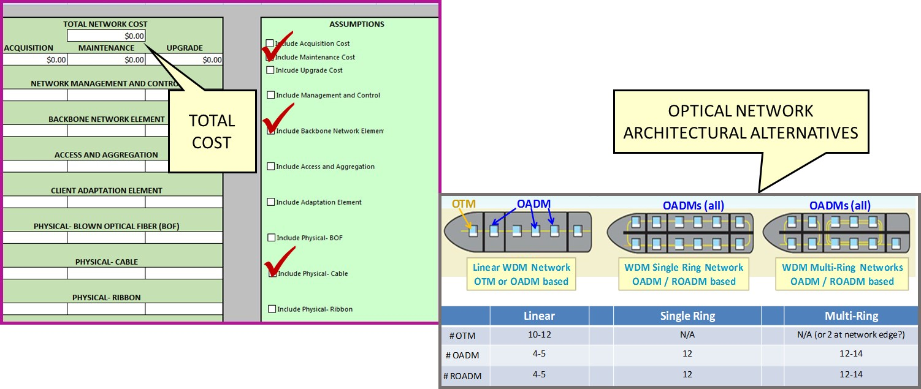
COST MODEL COMPARISON OF ALTERNATIVES
From: Mazurowski, Habiby- AVFOP 2018

Slide 10
THIS PROJECT WILL-
Task 1: Identify architectures, applications, and associated interface protocols and required adaptation (Ingalls Shipbuilding, Penn State ARL, and Vencore Labs).
Task 2: Construct cost model for selected variants (Penn State ARL and Vencore Labs).
Task 3: Develop simple WDM testbed using existing facilities (Vencore Labs and Penn State ARL).
Task 4: Optimize interconnect methods considering single mode fiber and fusion splicing technologies (Ingalls Shipbuilding, Penn State ARL and Vencore Labs).

Slide 11
DELIVERABLES-
Technical Report- includes task results, cost model results for specified architectures, and a template for network analysis.
Quarterly Status Reports- three, six, and nine months.
Panel Meeting Presentations- quantity two.
Work Meetings- quantity two.

Slide 12
ISSUES-
The project team will need platform specific information (Task 1); however the subcontractor assigned to this task did not subcontract.
There may be an alternate vehicle that would be more suitable for participation of the original subcontractor.
Ingalls Shipbuilding has prepared an estimate for the cost of taking on this task. The project would remain within its original budget.

Slide 13
NEXT STEPS-
Kickoff teleconference.
Solve platform information issue.
Schedule work meeting.

Slide 14

Thank you!

